Slide 1
Asteroids

Slide 2
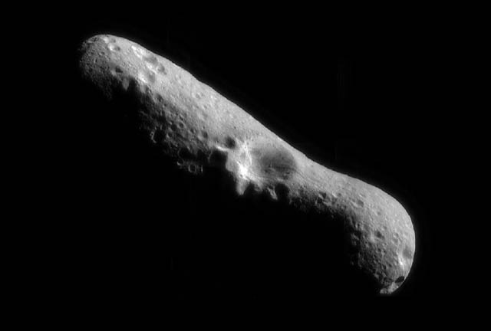
EROS-1893

Slide 3
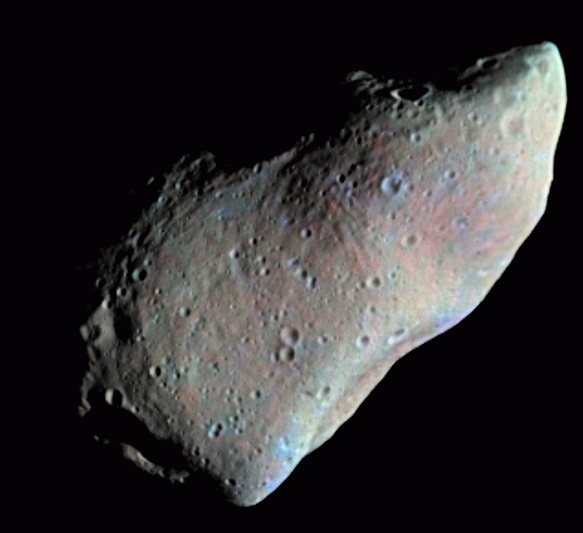
GASPRA -1916

Slide 4
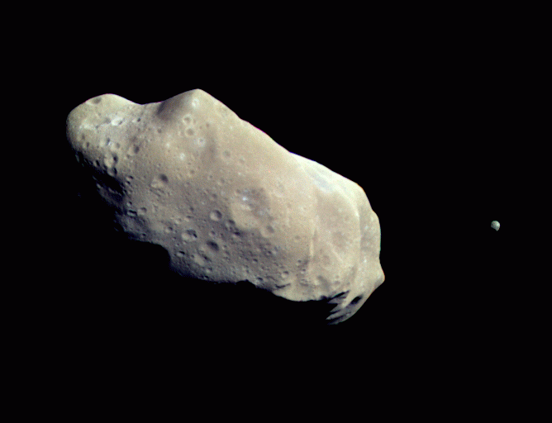
IDA - 1884
Note small satellite orbiting Ida. It is named Dactyl.

Slide 5
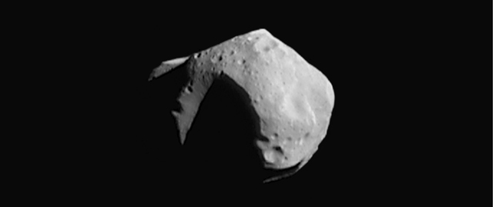
Mathilde - 1885

Slide 6
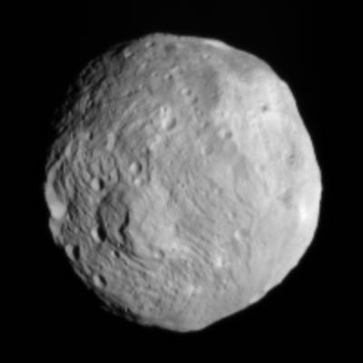
Vesta - 1807

Slide 7
Draw and name your own asteroid!

