Slide 1
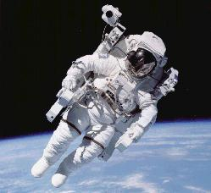
Accommodations for Manned Space Exploration

Slide 2
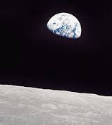
Conditions in Space
Very little matter
Some dust and gasses
Temperatures
very cold or very hot
Weightlessness
Microgravity negative effect on human body
Radiation
No protection from cosmic rays

Slide 3
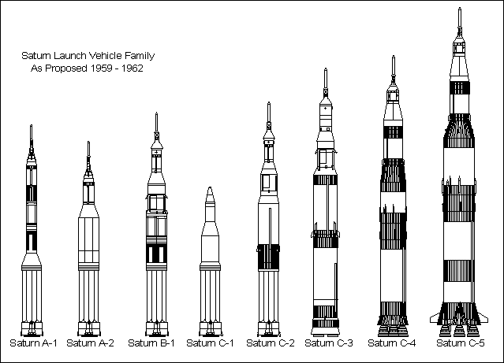
Space Craft
Need rockets to blast off from Earth
Mercury – 1 human
Gemini – 2 humans
Apollo – 3 humans
Space Shuttle
Engineered to accommodate astronaut’s needs
oxygen
earth-like temperatures
protection from cosmic rays

Slide 4
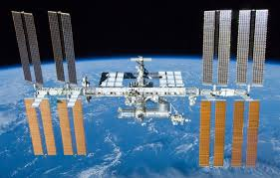
Space Stations
Skylab
Mir
International Space Station
Engineered to accommodate astronaut’s needs
oxygen
earth-like temperatures
protection from cosmic rays

Slide 5
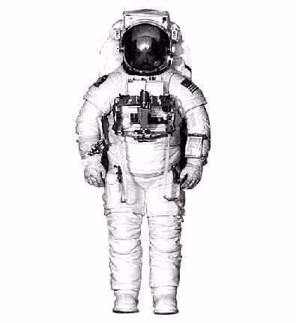
Space Suits
Different ones for different missions
Created to accommodate astronaut’s needs
oxygen
earth-like temperatures
protection from cosmic rays

