Slide 1
Using Satellite Imagery

Slide 2
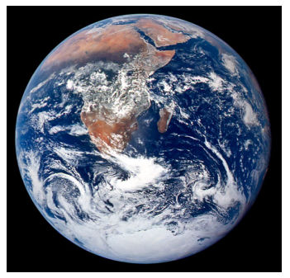
Blue Marble

Slide 3
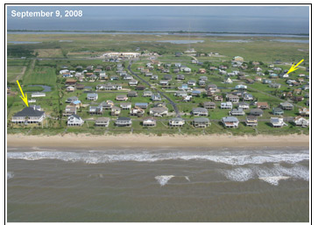
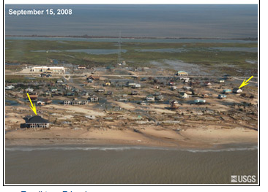
Galveston, TX photos from helicopter
Before Hurricane Ike
After Hurricane Ike

Slide 4
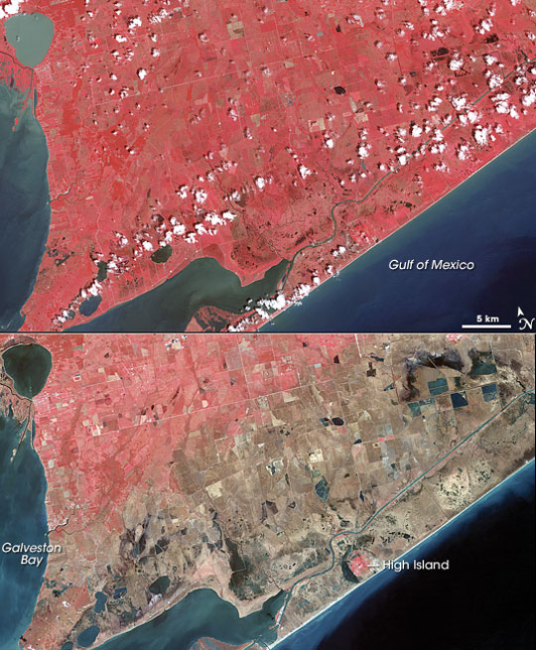
Galveston, TX from NASA’s Terra satellite
Taken 2 years before Hurricane Ike
Thermal (heat)images
Pink color is vegetation
Taken 2 weeks after Hurricane Ike
Pink color is vegetation
Brown color is vegetation
destroyed by salt water

