Slide 1
Different Types of Cells

Slide 2
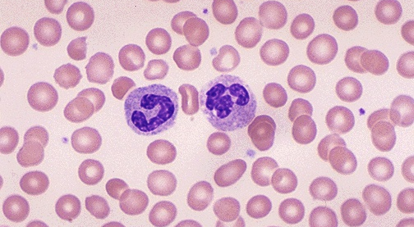
1. Blood Cells 100X
Red Blood Cells and White Blood Cells (stained)

Slide 3
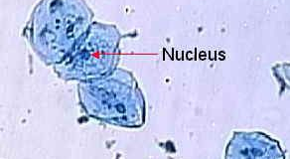
2. Cheek Cells 100X

Slide 4
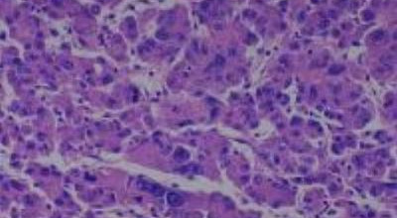
3. Human Liver Tissue 100X

Slide 5
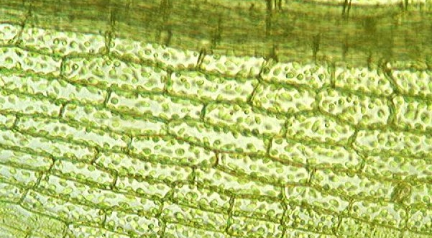
4. Leaf Cells 100X

Slide 6
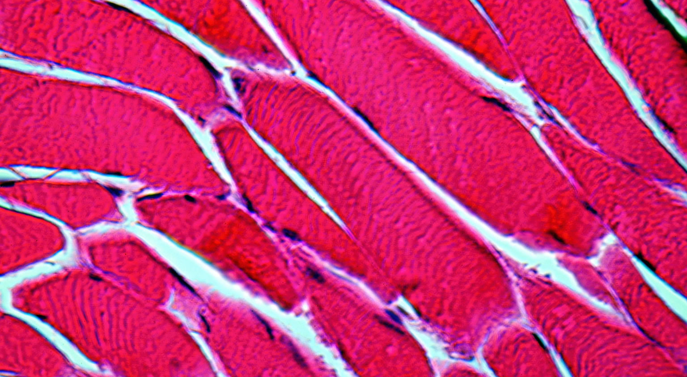
5. Muscle Cells 100X

Slide 7
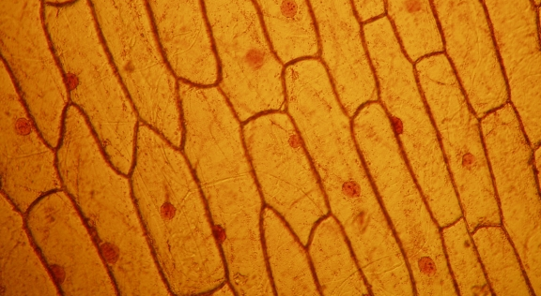
6. Onion Skin 100X
Stained with iodine

Slide 8
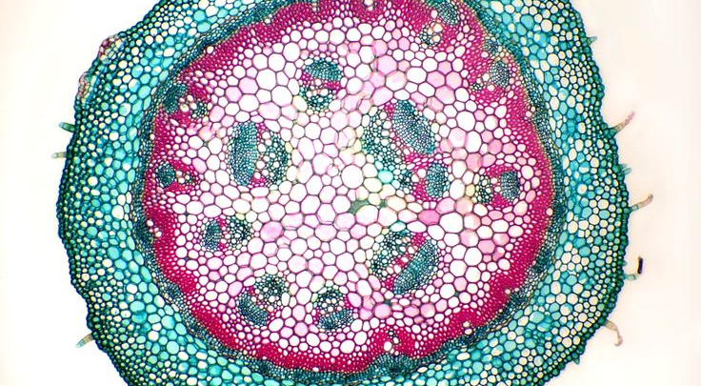
7. Plant Stem 100X
Cross section

Slide 9
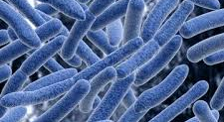
8. Bacterial Cells 10,000X

