Slide 1
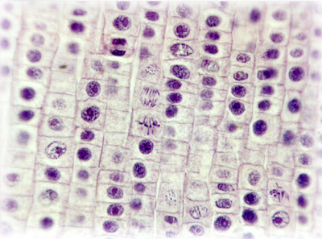
Cell Theory
6th grade Life Science Unit

Slide 2
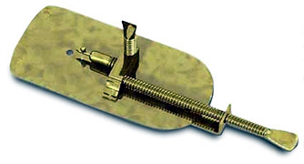
Leeuwenhoek’s Microscope
The microscope was invented sometime in the early 1600’s.
It was improved upon by Anton von Leeuwenhoek.
This is his microscope.

Slide 3
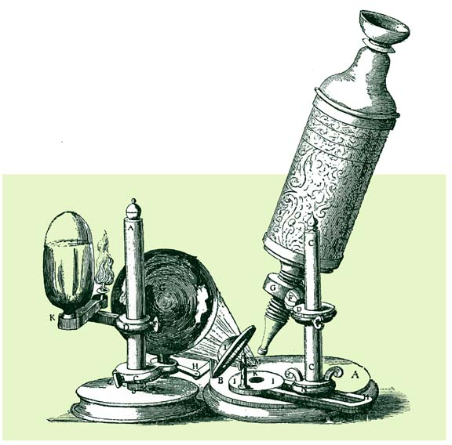
Robert Hooke’s microscope.
There was no electricity or batteries for light.
Hooke used a burning flame and a mirror to reflect the light to see the specimen under the microscope.

Slide 4
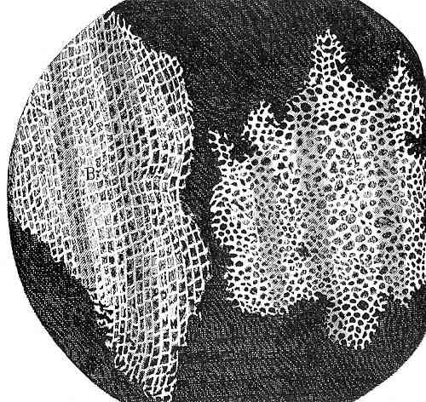
What Hooke saw!
This is from a tree called cork.
Hooke saw the rows of boxes that looked like the rooms in a monastery called cells.
Hooke published his drawings in a book and called the little rooms CELLS.
The name cell stuck!

Slide 5
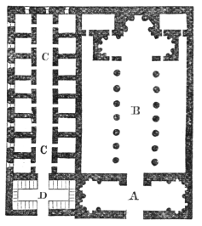
Monastery Cells
The area on the left side of the picture are cells that monks live in.
Notice the square cells are very much like the cork that Hooke saw under his microscope.

Slide 6
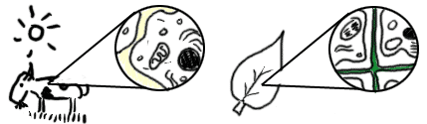
Cell Theory is born.
In 1839 two scientists named Theodor Schwann and Matthias Schleiden proposed that all living things are made up of cells.
This idea was a revolution in science.
No one has proved them wrong yet!

