Slide 1
3 Kingdoms

Slide 2
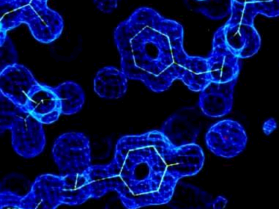
Methanogen 20000X
A type of Archaebacteria
They are unicellular and have no defined nucleus.

Slide 3
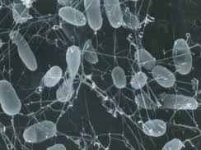
Thermophile 20000X
A type of Archaebacteria
They are unicellular and have no defined nucleus.

Slide 4
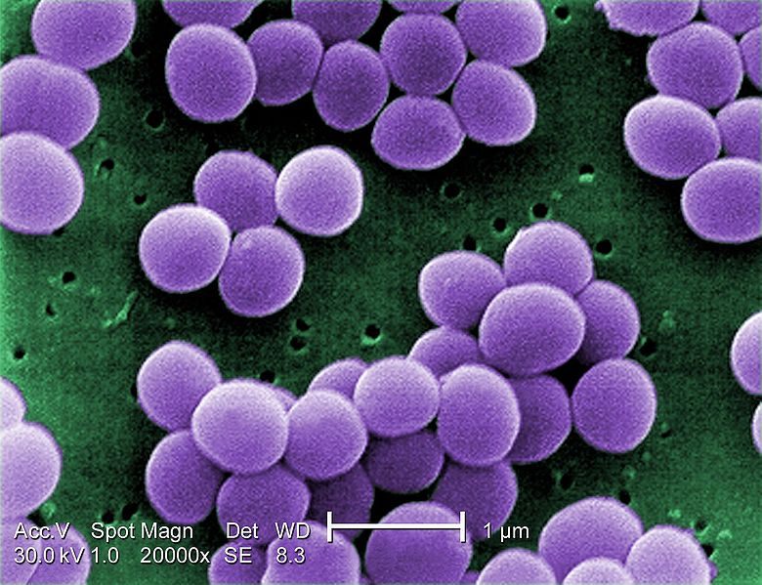
Staphylococcus 20000X
A type of Eubacteria
They are unicellular and have a nucleus.

Slide 5
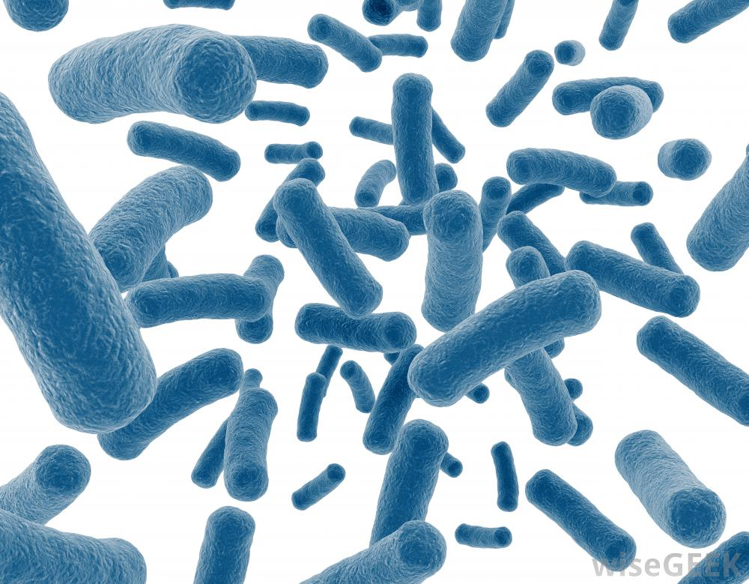
Bacilli 20000X
A type of Eubacteria
They are unicellular and have a nucleus.

Slide 6
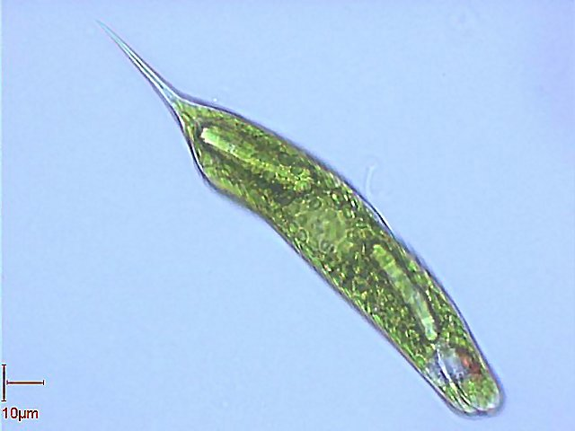
Euglena 1000X
A type of Protista
They are unicellular and have a nucleus.

Slide 7
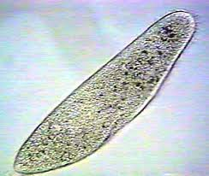
Paramecium 800X
A type of Protista
They are unicellular and have a nucleus.

