Slide 1
What Can We See Under a Microscope?

Slide 2
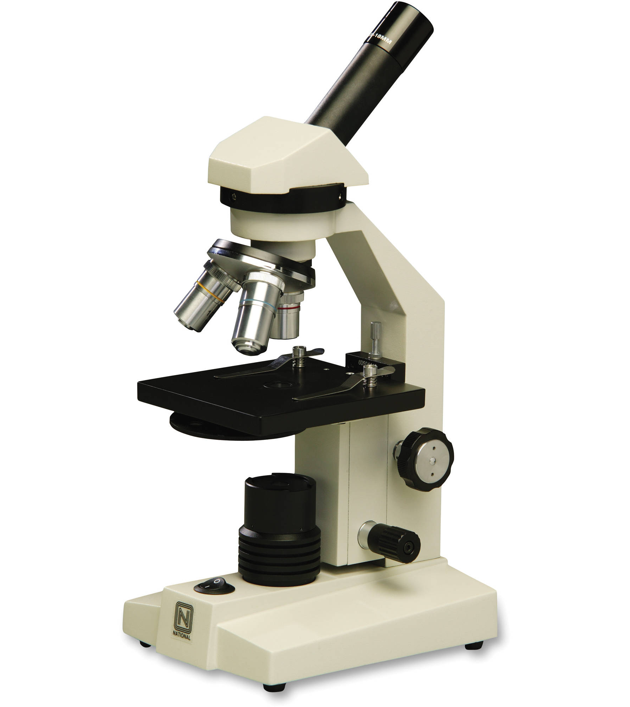
Microscope
The instrument we use to see tiny objects in the microscope.
A microscope uses lenses to enlarge objects so we can see them.

Slide 3
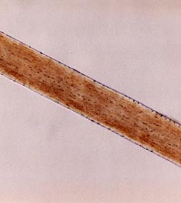
Lenses and Light
When light passes thorough a lens it will bend and will magnify objects.
This is human hair seen under a microscope.
The picture was taken using a camera through the microscope.

Slide 4
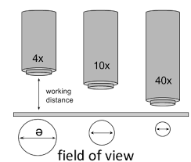
Magnification
Images under a microscope are captured at different magnifications.
The amount of magnification is written with a number and and X to mean “times.”
40x means an image is magnified 40 times.

Slide 5
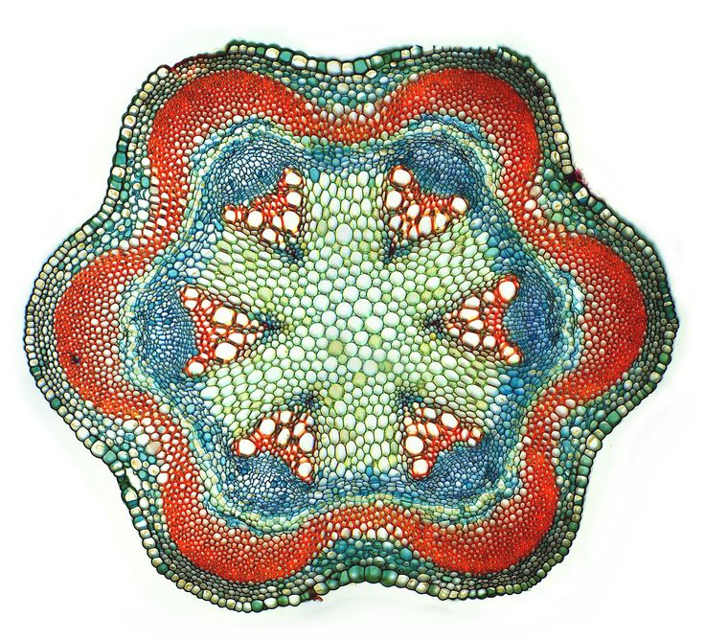
Plant Stem (cross section)
Many objects are not easy to see under the magnification of the microscope.
Scientists use dyes to stain objects so they may be seen easier.

Slide 6
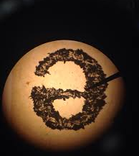
The letter e – 10x
This letter has been printed on a piece of paper.
When viewing images they will be upside down and backward.

Slide 7
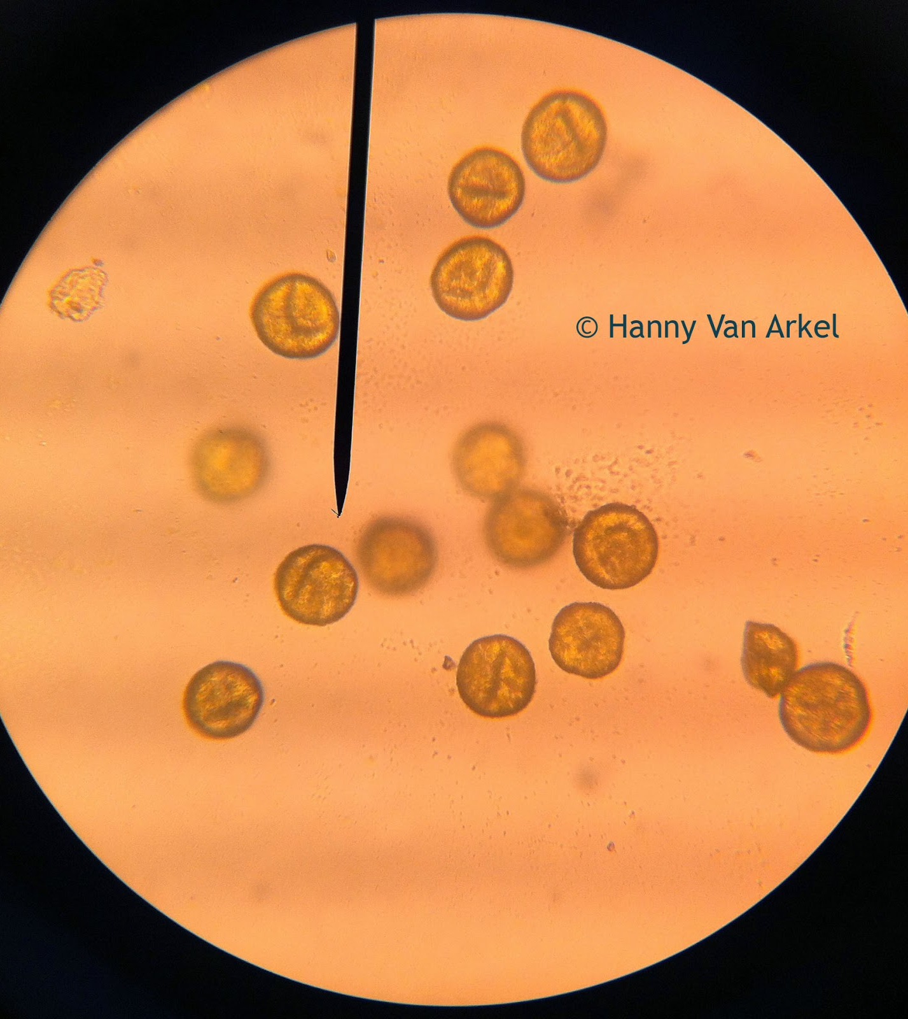
Pollen – 400x
These small circles are pollen from a flower.
This is what causes allergies when you breathe them in!

Slide 8
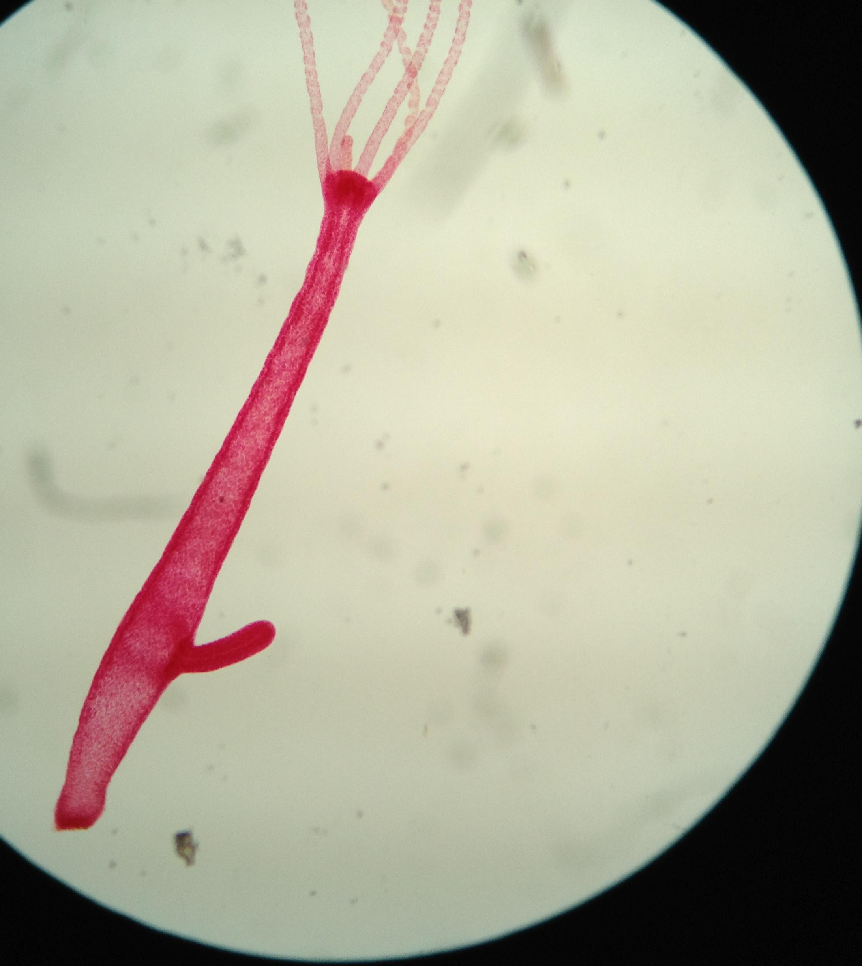
Hydra – 40x
The hydra is a freshwater animal.
It captures its food with its tentacles like a jellyfish.
The bump on the side is a new baby hydra.

Slide 9
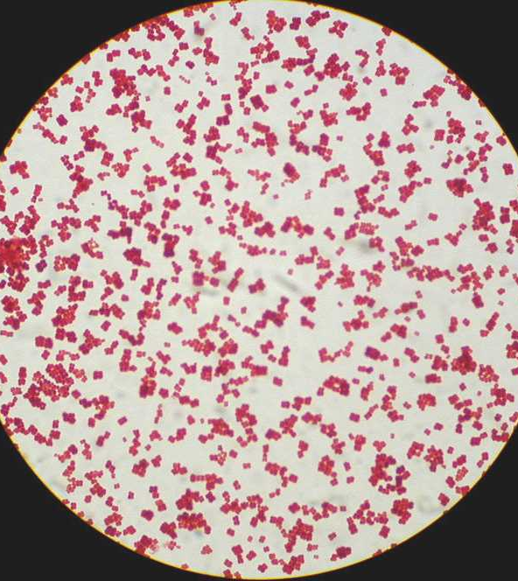
Bacteria – 1000x
This bacteria has been stained with a red dye so you can see it.
If you look closely the clumps are made of round cells.
This bacteria can cause strep throat.

Slide 10
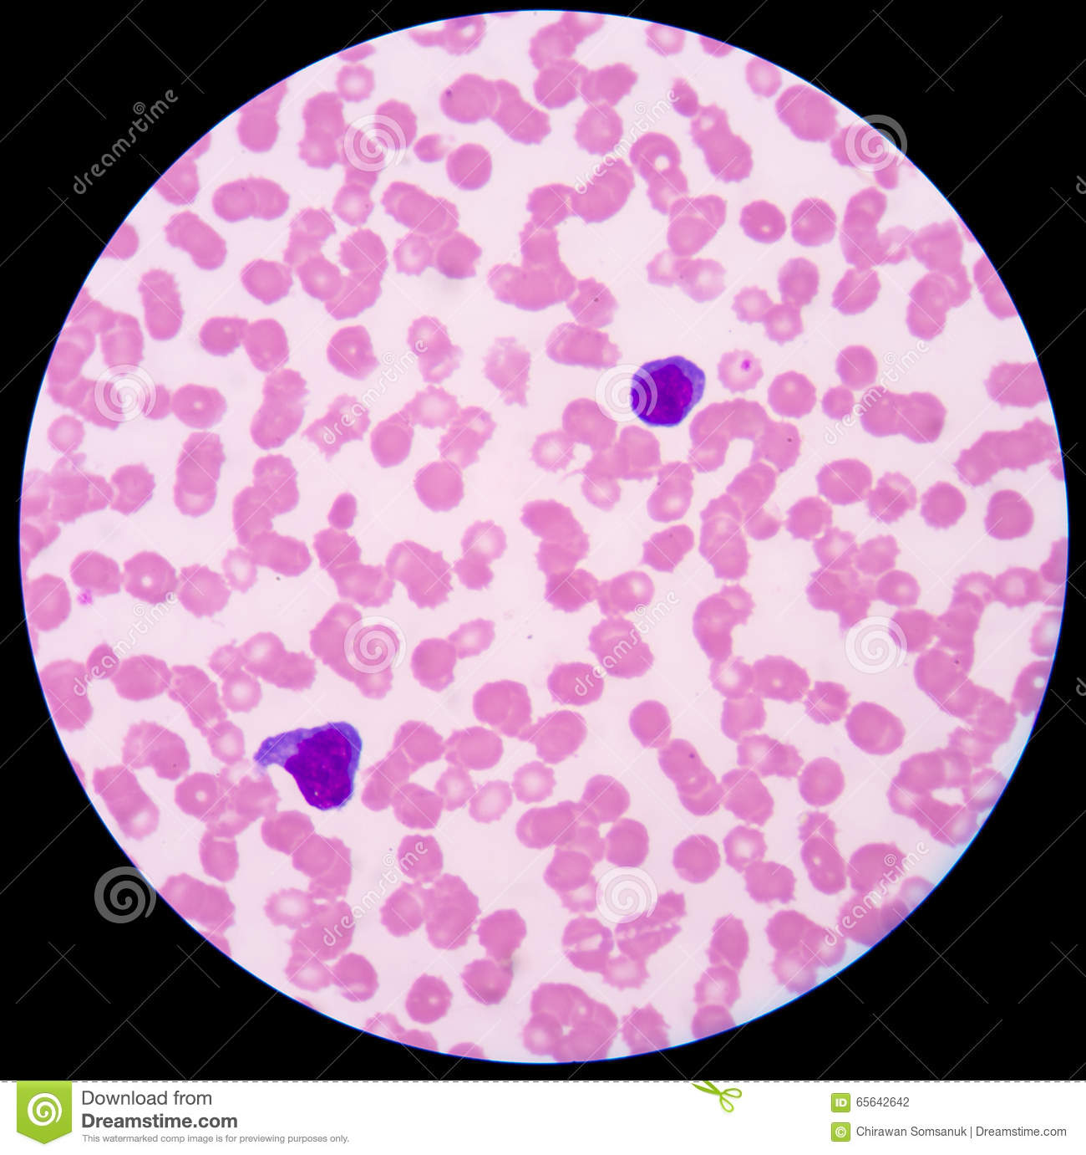
Blood Cells 40x
The pink cells are known as red blood cells.
The purple cells are known as white blood cells.
They have been stained with a purple dye.

Slide 11
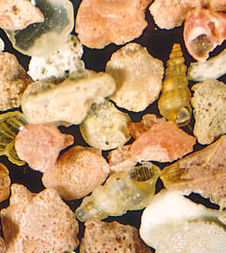
Sand and Shells – 100x
Mixed in with the sand are the shells of tiny sea creatures.
The sea creatures are called whelks.

Slide 12
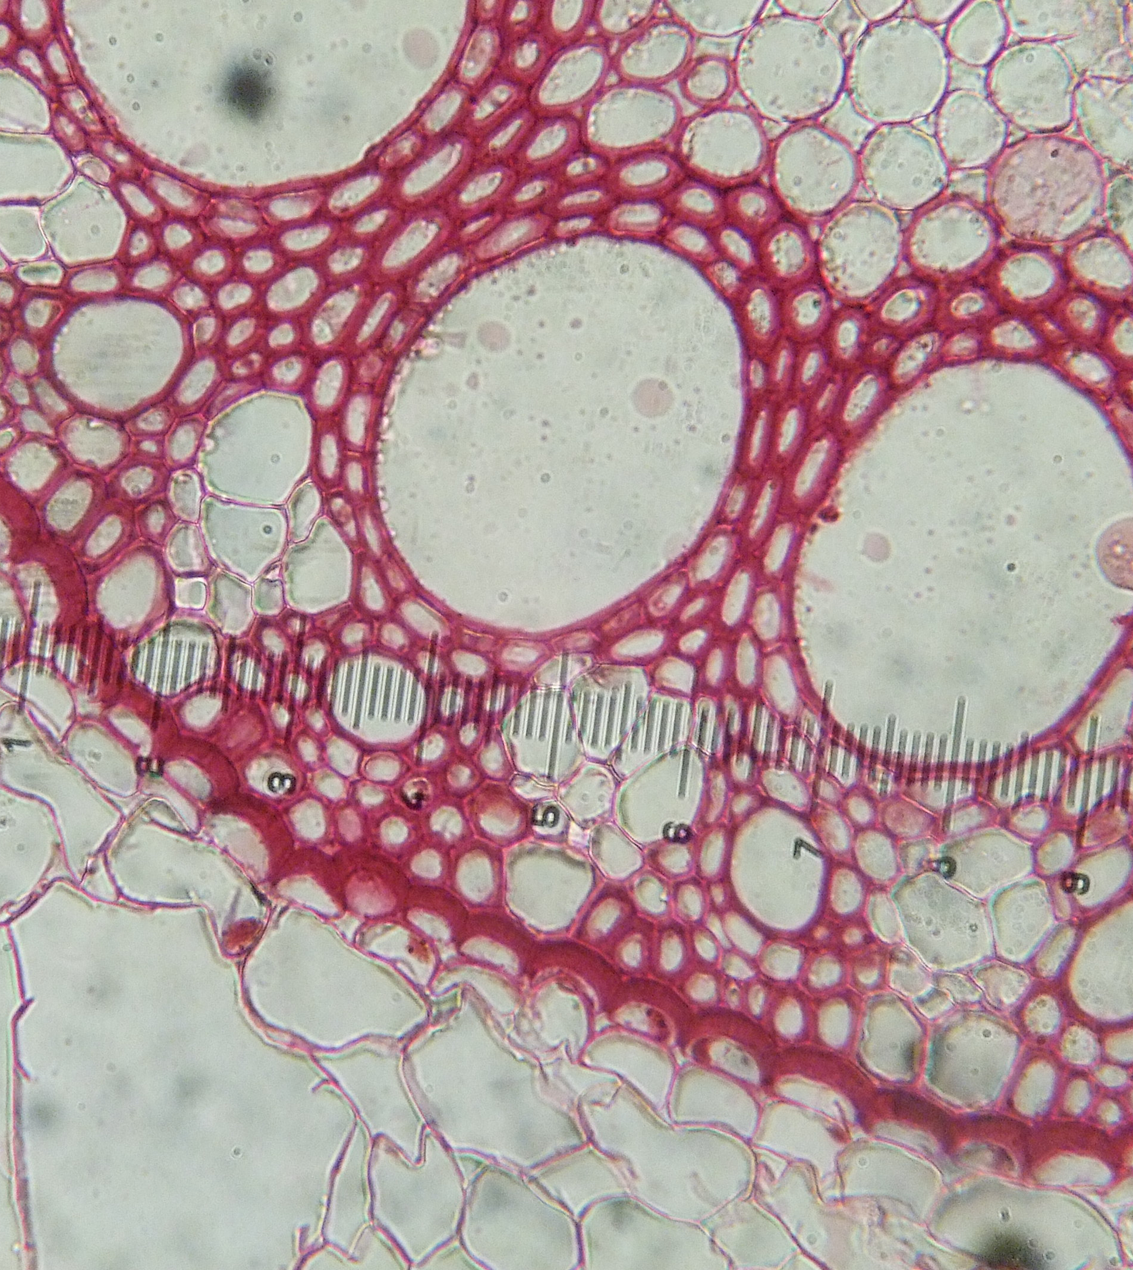
Cross Section- 100x
This is the stem of a corn plant.
The large holes allow water to move from the roots to the leaves.
It has been stained.

Slide 13
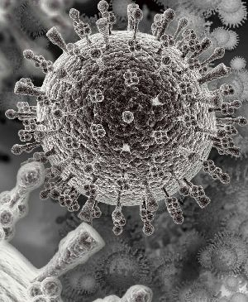
Virus – 500,000x
AIDS virus
Picture taken through a scanning electron microscope

