Slide 1
Did you really see that?
Typical Mistakes when making a Wet-mount slide

Slide 2
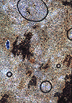
Air Bubbles
Usually circular
Always have a dark line around the outside
Always black and white – no color

Slide 3
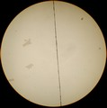
Edge of Cover Slip
Straight line
Dark

Slide 4
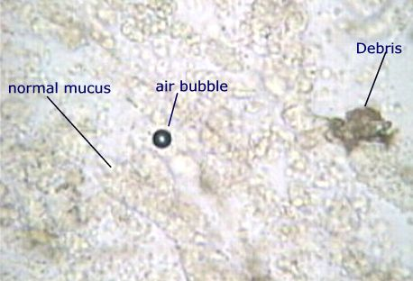
Trash or Debris
No color
Many shapes

Slide 5
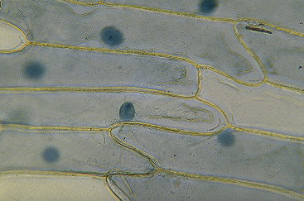
Cells (plant)
Has regular shape
Usually has color

