Slide 1
Asteroids

Slide 2
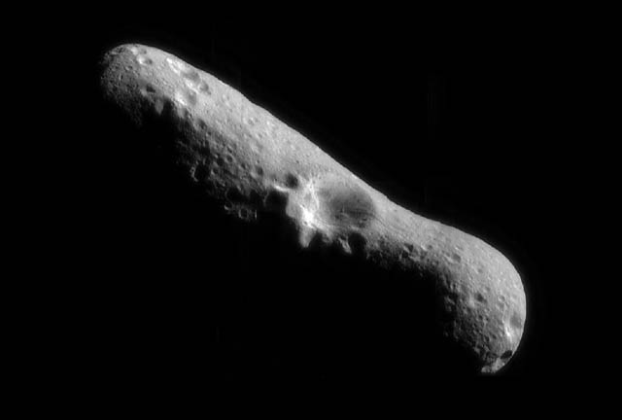
EROS-1893
Made of rock and metal

Slide 3
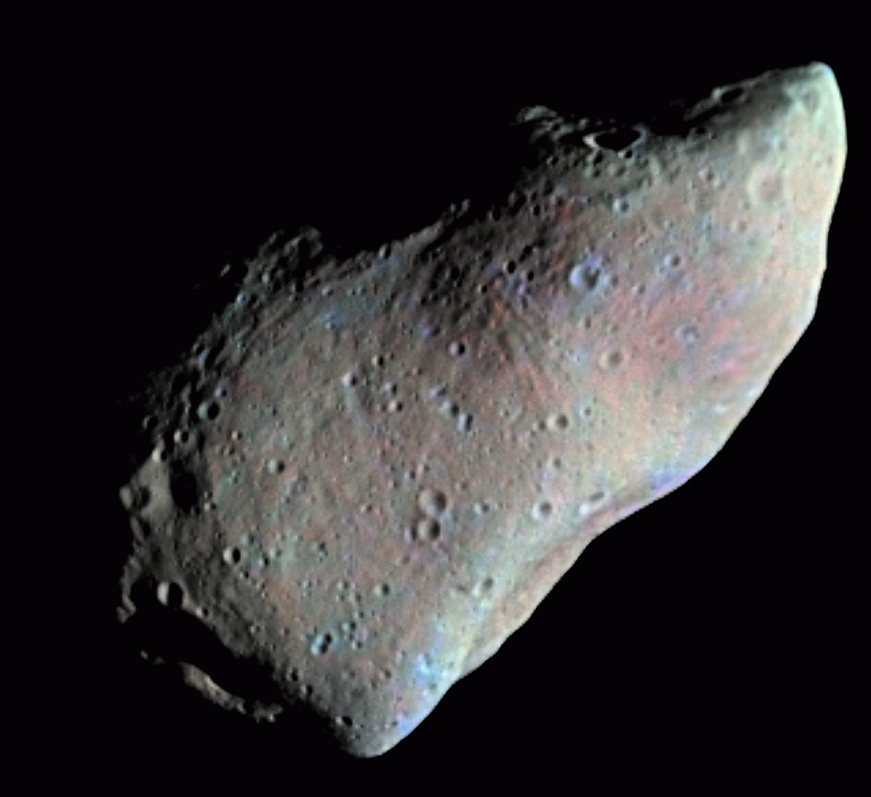
GASPRA -1916
Made of rock and metal

Slide 4
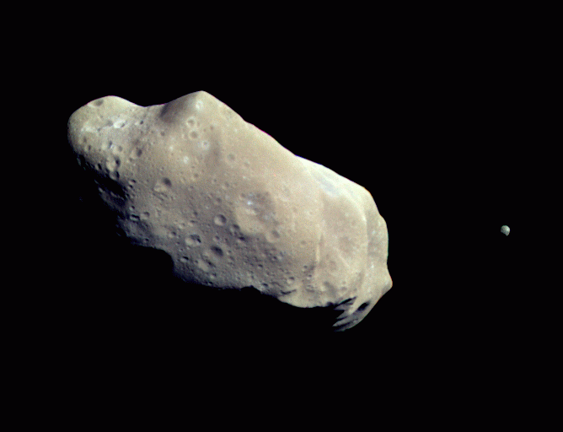
IDA - 1884
Note small satellite orbiting Ida. It is named Dactyl.
Made of rock and metal

Slide 5
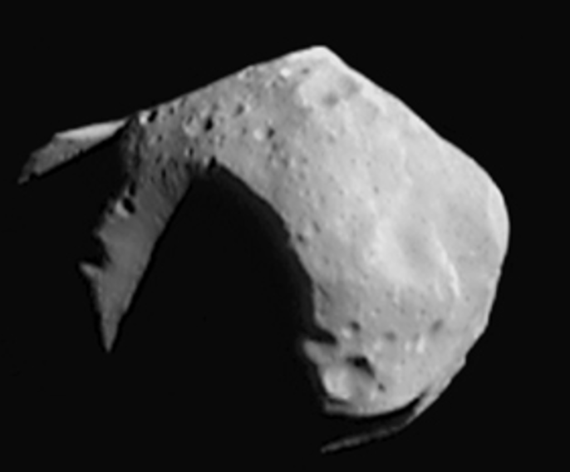
Mathilde - 1885
Made of rock

Slide 6
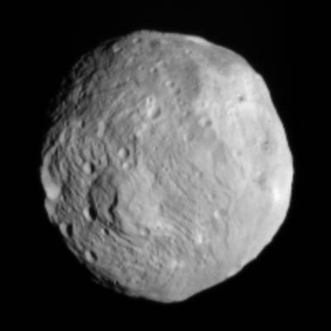
Vesta - 1807
Made of rock and metal

Slide 7
Draw and name your own asteroid!

