Slide 1
What Can We See Through a Microscope?

Slide 2
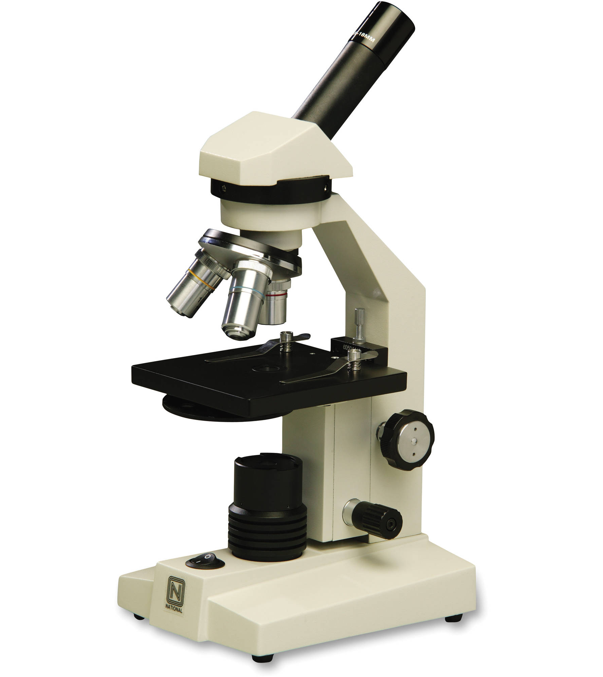
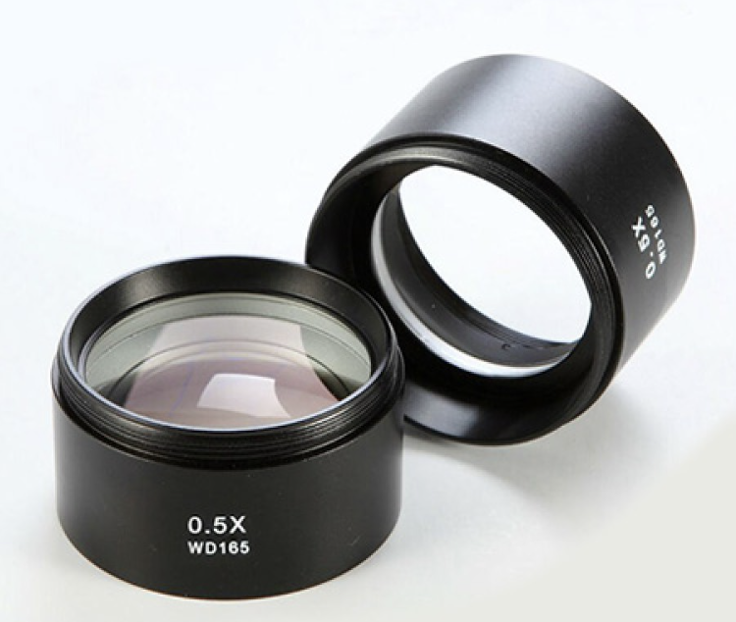
Microscope
The instrument we use to see tiny objects in the microscope.
A microscope uses lenses to enlarge objects so we can see them.

Slide 3
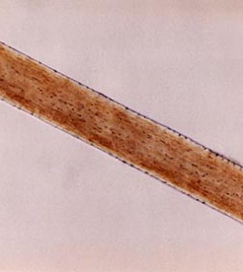
Lenses and Light
When light passes thorough a lens it will bend and will magnify objects.
This is human hair seen under a microscope.
The picture was taken using a camera through the microscope.

Slide 4
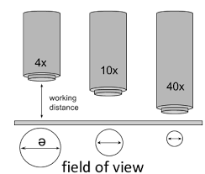
Magnification
Images under a microscope are captured at different magnifications.
The amount of magnification is written with a number and and x to mean “times.”
40x means an image is magnified 40 times.

Slide 5
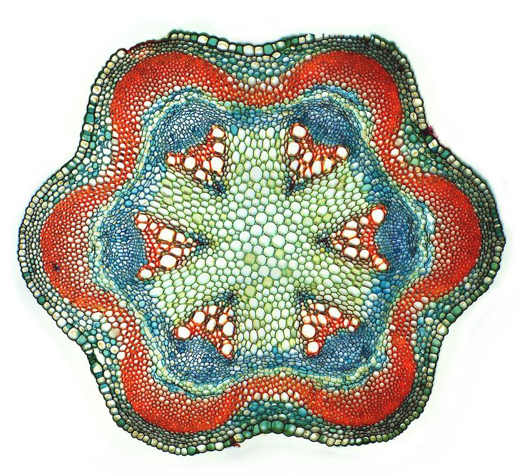
Plant Stem (cross section)
Many objects are not easy to see under the magnification of the microscope.
Scientists use dyes to stain objects so they may be seen easier.

Slide 6
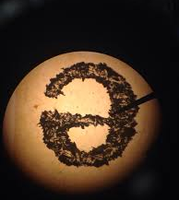
The letter e – 10x
This letter has been printed on a piece of paper.
When viewing images, they will be upside down and backward.

Slide 7
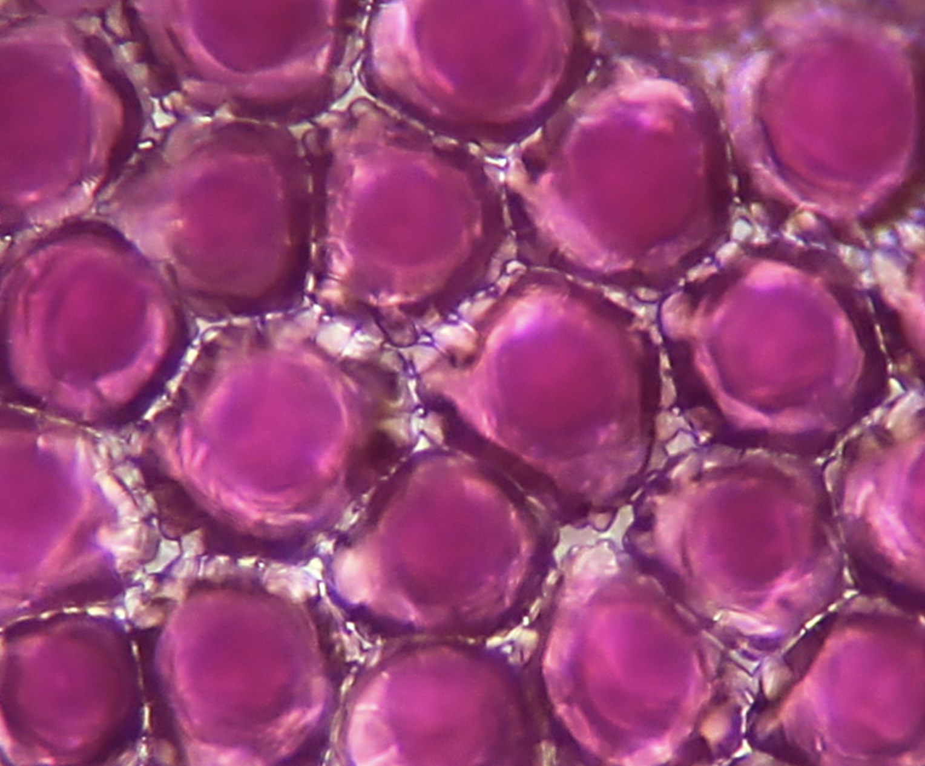
Flower Petal – 20x
Slide 1
The are the cells from a geranium flower.
Each cell has a wall around it.

Slide 8
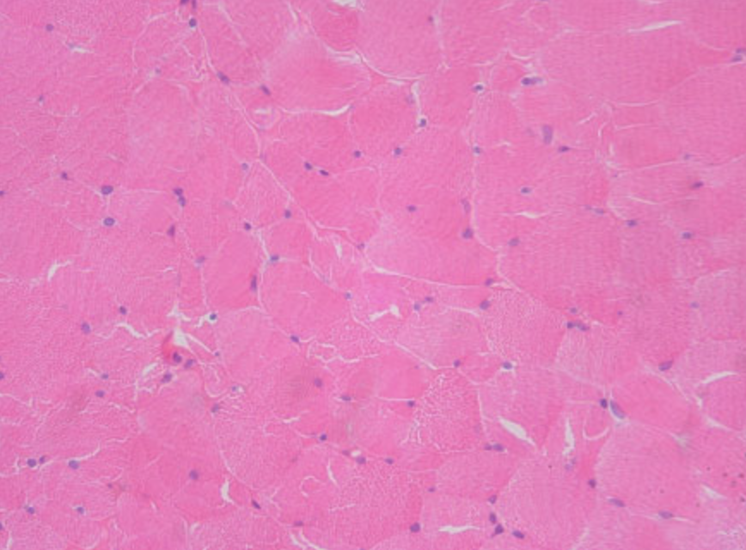
Skeletal Muscle – 400x
Slide 2
This is muscle that is found in arms and legs.
The little purple dots are the nucleus of each cell.
These cells do not have a wall around them.

Slide 9
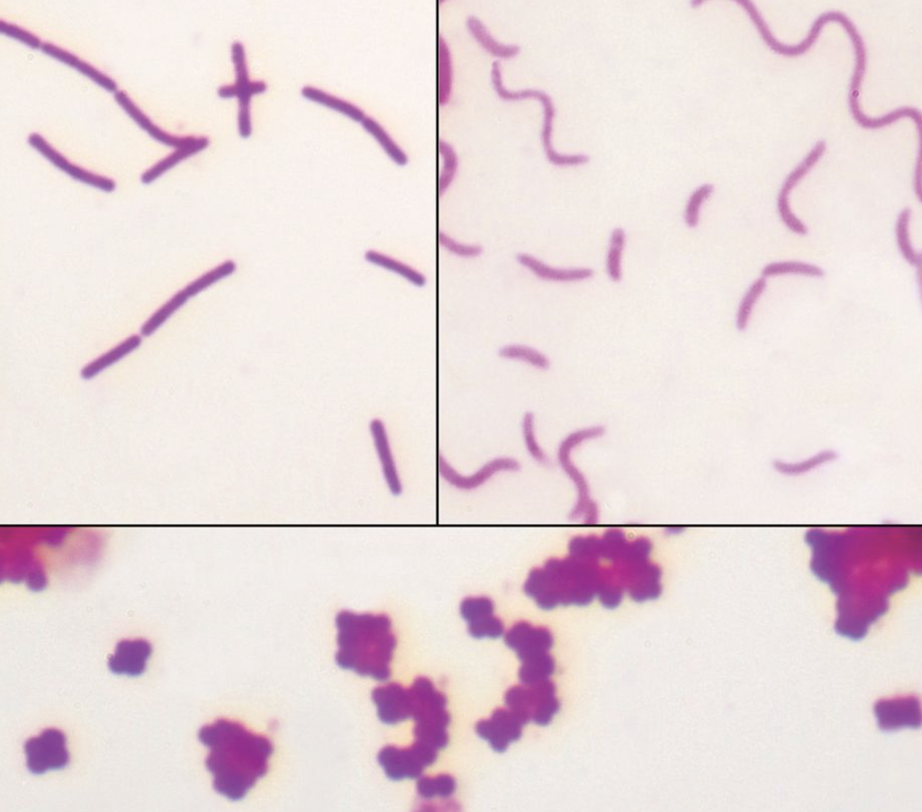
Bacteria – 1000x
Slide 3
This bacteria has been stained with a red dye so you can see it.
There are three different shapes.
One is rod shaped, another is a spiral shaped, and the last one is round shaped.

Slide 10
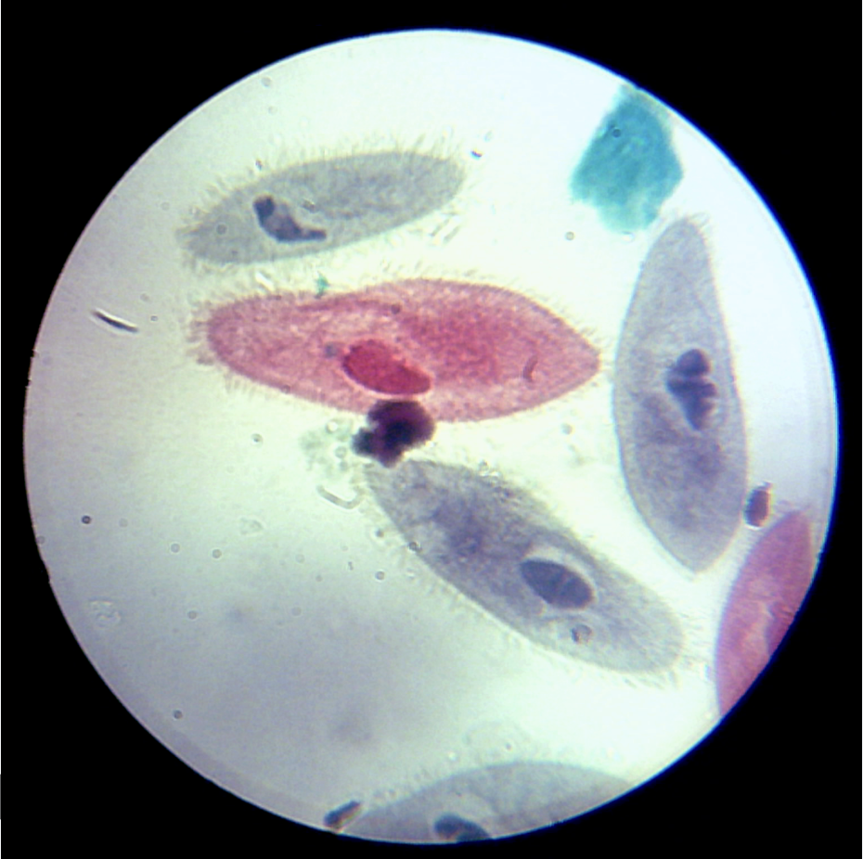
Paramecia– 100x
Slide 4
These cells are small organisms that live in pond water.
They move around using small hairs called cilia.

Slide 11
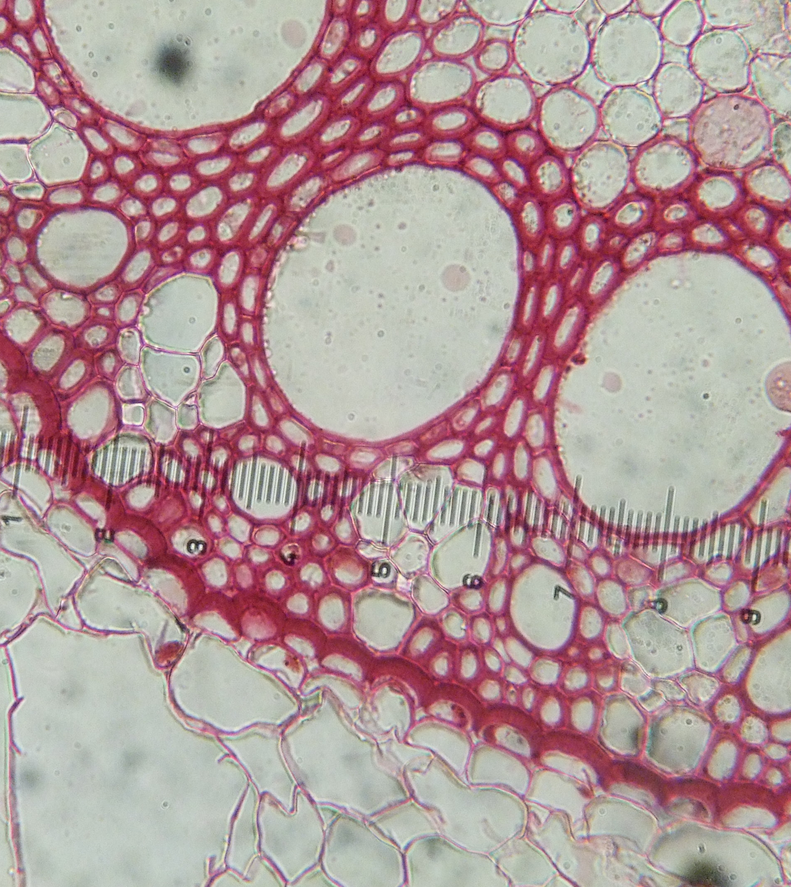
Corn Plant Cross Section- 100x
Slide 5
This is the stem of a corn plant.
The large holes allow water to move from the roots to the leaves.
It has been stained.

Slide 12
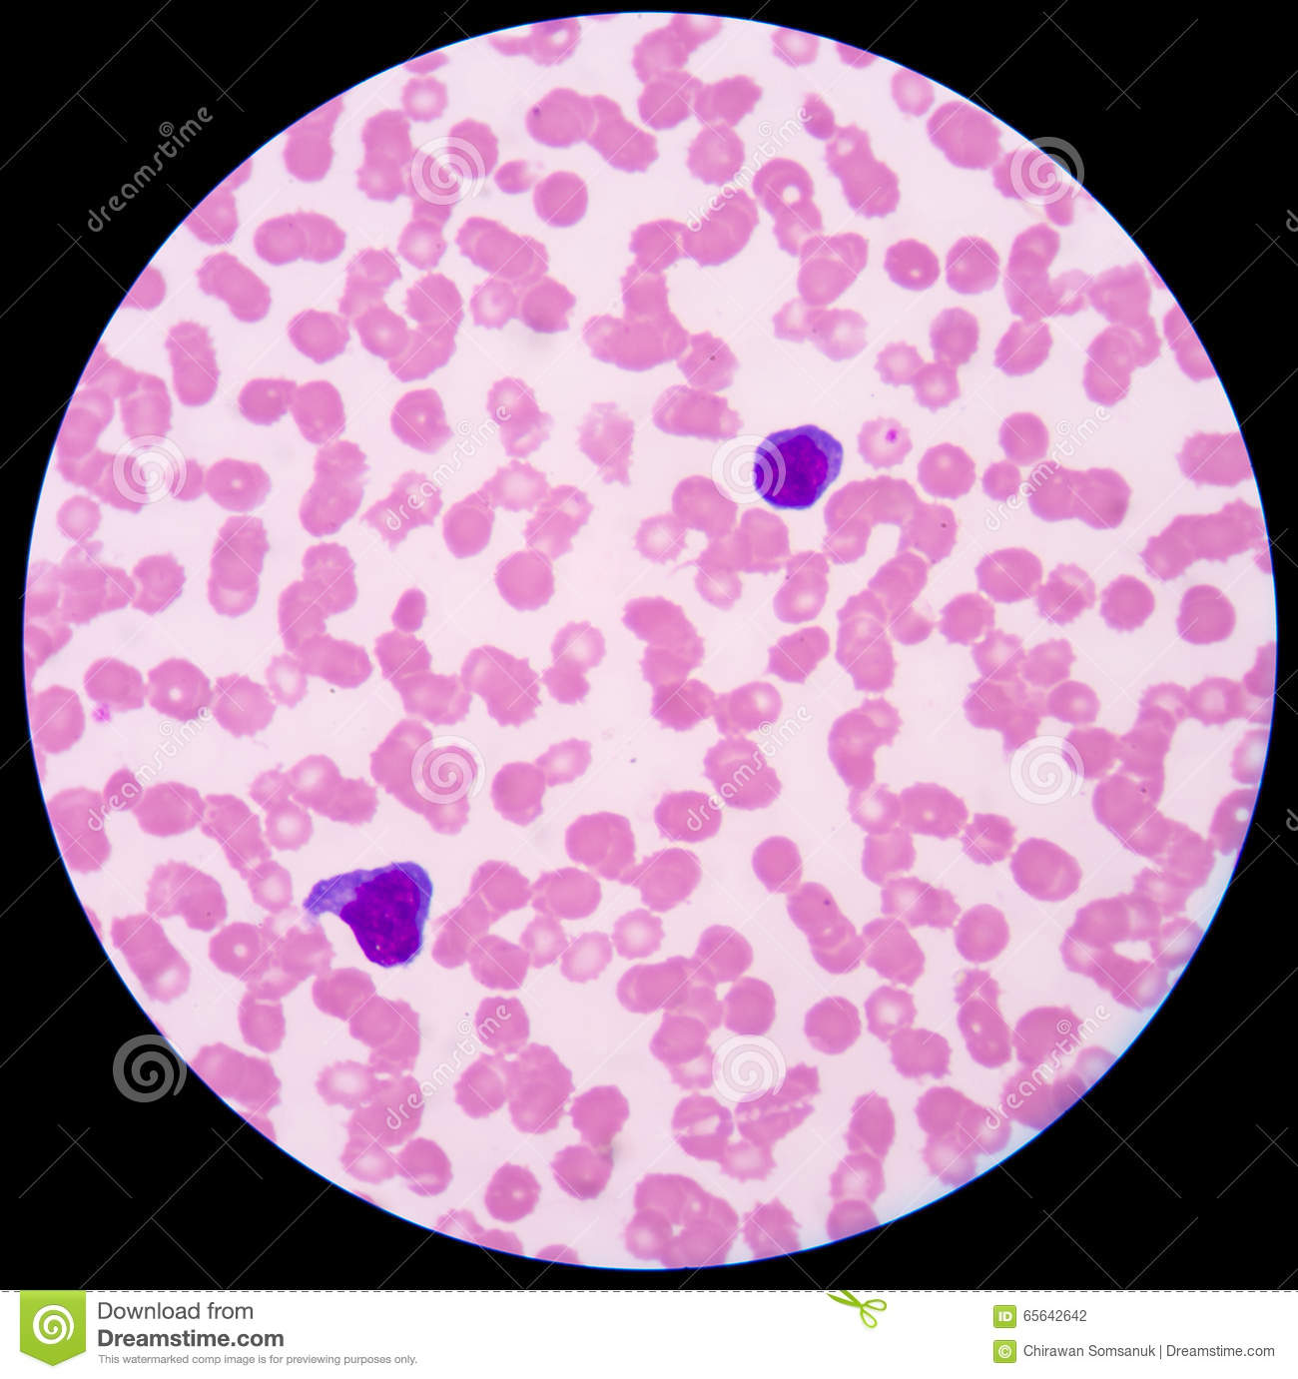
Blood Cells 40x
Slide 6
The pink cells are known as red blood cells.
The purple cells are known as white blood cells.
They have been stained with a purple dye.

