Slide 1
Manage Investments Like a Pro!
Returns and risks – history
Returns and risks – outlook
Asset allocation and the power of diversification
Market timing
The Case for Indexing – Theory and Evidence
Life cycle investing and target-date funds
Goals-driven investing (a.k.a., ALM, LDI)
Smart retirement strategies
(Other) Smart financial strategies

Slide 2
(Other) smart financial strategies

Slide 4

Knowledge is power.
Francis Bacon
Read “excellent” books – not “trash” books. Lessons for a lifetime.
Stocks for the Long Run, Jeremy Siegel
Irrational Exuberance, Robert Shiller
A Random Walk Down Wall Street, Burton Malkiel
Enough, John Bogle
Capital Ideas, Peter Bernstein
Attend college-level investment courses
Avoid cable financial news. “Financial Pornography” – Jack Bogle
“Skim” through daily/weekly business news

Slide 5
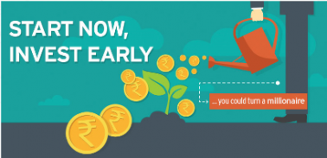
How to Become a Millionaire 101
$
$
$
$
$
$
$
$
Source: MoneyControl

Slide 6
“This above all: Saving is the Key to Wealth”
Source: The Bogleheads’ Guide to Investing, Larimore, Lindauer, LeBoeuf
Pay yourself first each month when you get a paycheck. Put at least 10% (including any employer match) of your gross income into your 401(k), 403(b), 457, IRA savings plan each month.
If a strain in your twenties – start with 1% and then increase by 1% each month. (“Reducing your spending is financially more efficient than earning more money.”)
Focus upon Roth accounts in your early years as your tax bracket will likely be on the low side
If you are a higher earner target a 15% contribution (your Social Security checks will replace a “relatively” smaller share of your retirement income.)
If you want to early-retire, consider a 20% contribution
$
$
$
$
$
$
$

Slide 8

The miracle of compound interest: note how the line slope gets steeper and steeper as you get returns on prior years’ of interest.
Year Annual Annual
Amount Return 7%
A Single $5,000 Contribution Invested at 7% Return Grows To:
Total Investment: $5,000 Grows 15X

Slide 9
The Real Story of Jack and Jill
Jack invests a total of $5,000 pa starting at age 25 for 10 years ($50,000) Jill invests $5,000 pa starting at age 35 for 30 years ($150,000)…but never catches up to Jack!
START SAVING AND INVESTING EARLY!
Different Start Dates. Jack and Jill’s Portfolios
$563 K
$505 K
7% Annual Return
Jack
Jill
Age
Jack invests 10 years.
Jill invests 30 years

Slide 10
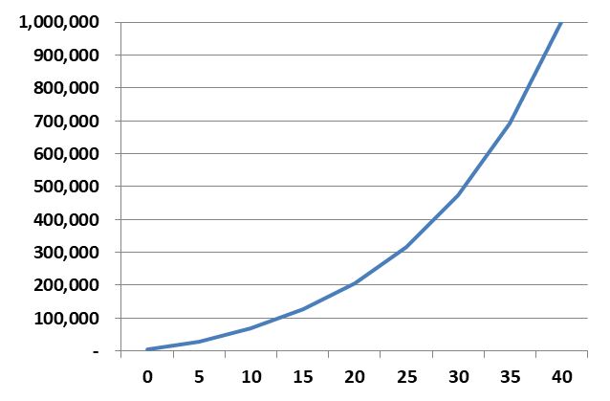
The miracle of compound interest: What if Jack had invested $5,000 every year until he hit age 65 (40 years of investing)?
Year Annual Annual
Amount Return 7%
Annual $5,000 Contributions Invested at 7% Return Grows To:
0 | 5,000 | 5,000
5 | 5,000 | 28,845
10 | 5,000 | 69,211
15 | 5,000 | 125,826
20 | 5,000 | 205,231
25 | 5,000 | 316,600
30 | 5,000 | 472,802
35 | 5,000 | 691,883
40 | 5,000 | 999,155
Total Investment: $200,000 Grows 5X
BINGO!

Slide 11
The miracle of compound interest: An annual $5,000 contribution at 7% for 40 years results in serious money at retirement.
Year Annual Annual
Amount Return 7%
Annual $5,000 Contributions Invested at 7% Return Grows To:
0 | 5,000 | 5,000
5 | 5,000 | 28,845
10 | 5,000 | 69,211
15 | 5,000 | 125,826
20 | 5,000 | 205,231
25 | 5,000 | 316,600
30 | 5,000 | 472,802
35 | 5,000 | 691,883
40 | 5,000 | 999,155
Total Investment: $200,000 Grows 5X
BINGO!
Nice! But remember, a $3.99 Big Mac will cost $8.81 in 40 years assuming 2% inflation.

Slide 12
The miracle of compound interest: An annual $5,000 contribution (increased by $500 each year) at 7% for 40 years results in serious money at retirement.
Year Annual Annual
Amount Return 7%
Annual $5,000 Contributions Invested at 7% Return Grows To:
Total Investment: $615,000 Grows 3.5X
REAL BINGO!
Nice! But remember, a $3.99 Big Mac will cost $8.81 in 40 years assuming 2% inflation.

Slide 13
If you can’t save, you can’t invest.
Save smart without skimping.

Slide 14
How do you save without skimping?!

Slide 15
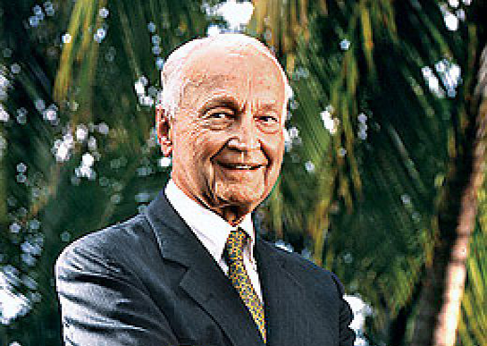
For all long-term investors, there is only one objective – maximum total real return after taxes.
Sir John Templeton

Slide 16
Nonretirement (taxable) accounts are a fine place to invest in equity index funds and municipal bonds
Buy and hold index equity funds throw off very little capital gains – particularly broad “total” equity funds.
  ETFs tend to be more tax efficient than traditional index “mutual” funds – especially sector and specialty funds
They can grow for decades while throwing off virtually no (taxable) capital gains.
When you finally do pay taxes it is at the lower capital gains tax rate – top rate of 20% - rather than the ordinary income tax rate - up to 37% - that you pay when you withdraw money from a traditional tax-deferred account. A HUGE TAX RATE DIFFERENCE! (plus state and local taxes)
Municipal bond income can be free of federal, state, and city income taxes

Slide 17
Are investment costs hurting your “net” returns?
Plug those leaks!

Slide 18
Over the long term, fees can significantly reduce the size of your portfolio
Time Horizon
Annual Fee Rate
 | 0.10% | 0.25% | 0.50% | 1.00% | 2.00% | 3.00%
10 years | -0.9 | -2.3 | -4.6 | -9.0 | -17.2 | -24.8
20 years | -1.9 | -4.6 | -8.9 | -17.1 | -31.4 | -43.4
30 years | -2.8 | -6.8 | -13.1 | -24.5 | -43.2 | -57.4
40 years | -3.7 | -8.9 | -17.1 | -31.3 | -53.0 | -67.9
% Effect on Your Portfolio
Note: assumes 7% annual return

Slide 19
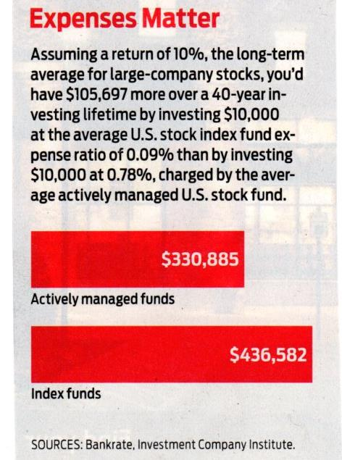
Expenses matter!
Assuming a return of 10%, the long-term average for large-company stocks, you’d have $105,697 more over a 40-year investing lifetime by investing $10,000 at the average expense ratio of 0.09% than by investing $10,000 at 0.78%, charged by the average actively managed U.S. stock fund.
“With returns it’s the magic of compounding, with expenses, it’s the tyranny of compounding.”
Jack Bogle
Source: Kipplinger ‘s Personal Finance, April, 2019

Slide 20
Total Wealth Asset Allocation
No portfolio is an island.
Your financial assets should be considered in the context of all of your effective “assets” and expected future “liabilities”:
Do you own your home – or do you rent? If you own, have you paid off your mortgage?
Do you have any other significant debts?
Is your Social Security benefit small or large relative to your future income needs?
Do you have a pension?
Do you have an annuity?
Do you expect to inherit a significant sum of money?
What is your “funded status?”
Do you have strong legacy desires?
Manage your financial asset portfolio around your effective other “assets” and expected future “liabilities.”

Slide 21

Asset allocation gets lots of attention.
What is asset location?

Slide 22
Beyond Alpha and Beta – Now, Gamma*
*The “extra” return an investor experiences based on optimal financial planning decisions
Potential Enhancements to Every $100 of net Retirement Income
Total Wealth Asset Allocation $6.00
Dynamic Withdrawal Strategy $9.00
Annuity Allocation $4.00
Asset Location and Withdrawal Sourcing
“To Roth with love…” $8.00 Liability (Goal) - Relative Optimization $2.00
Extra Retirement Income Per $100 $29.00
* Morningstar Retirement Insights, Spring 2013, David Blanchett and Paul Kaplan, “Alpha, Beta, and Now…Gamma,” 2012

Slide 23
Pick your investment provider (mutual fund company, brokerage house, bank) with care

Slide 24


Slide 25
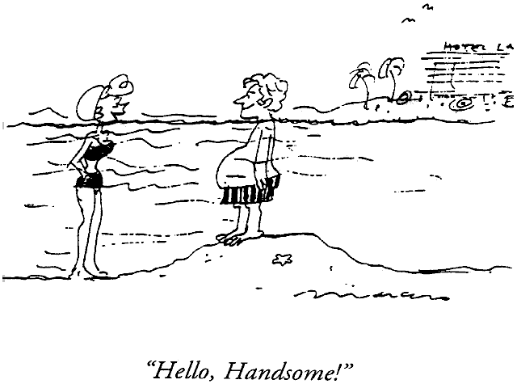

Slide 26

Vanguard your assets
Minimize your costs
Maximize your “net” returns
“Make the money sweat.” Voltaire

Slide 27
Vanguard has focused upon minimizing investors’ costs throughout its existence. Active management actually has a decent chance of success.
Average Expense Ratios
The Active Expense Ratio Advantage

Slide 28

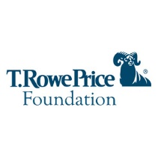



Major investment management providers
Vanguard is the only “not-for-profit” mutual fund group.
  A coop-like structure in which you are the company owner
  “At-cost” services
  The low-cost index-fund powerhouse
  Low-cost active management as well
There are also a host of other solid “for-profit” investment groups including T. Rowe Price, Fidelity, Blackrock (iShare ETFs), Schwab, etc.

Slide 29
The case for Vanguarding your assets
Philosophical congruity
A mutual, or coop-like structure. in which you are a company owner. After expenses, all Vanguard fund returns go to the fund stockholders.
The low-cost index-fund powerhouse
The low-cost active management fund powerhouse
Multiple share classes. Investor class. Admiral class (even lower expense ratios)
Access to more than 500 Vanguard and other broad ETFs with no commissions
Broad other fund families mutual fund window with low cost access to “institutional” class shares. For example, Doubleline Total Return Fund IRA expense ratio at $5,000 level of 0.47% versus regular 0.72%.
Easy access to free full CFP financial plan at the $500,000 Voyager level and $1,000,000 Flagship level (along with one-off CFP access, 25 free commission trades and $2 thereafter). These levels can also be attained through “family” relationships.

Slide 30


