Slide 1
Manage Investments Like a Pro!
Returns and risks – history
Returns and risks – outlook
Asset allocation and the power of diversification
Market timing
Passive (index) vs. active investing
Life cycle investing and target-date funds
Goals-driven investing (a.k.a., ALM, LDI)
Smart retirement strategies
Smart financial strategies

Slide 2
Asset Allocation and the Power of Diversification
Improving your return per unit of risk (Sharpe Ratios)!

Slide 3
Through thoughtful diversification, we seek to design a portfolio which is less volatile than its component parts and which also delivers a superior compound annual (geometric) return.
$1 Grows To:
Time

Slide 4
Through thoughtful diversification, we seek to design a portfolio which is less volatile than its component parts and which also delivers a superior compound annual (geometric) return.
Portfolio
$1 Grows To:
Asset A
Time

Slide 5
Through thoughtful diversification, we seek to design a portfolio which is less volatile than its component parts and which also delivers a superior compound annual (geometric) return.
$1 Grows To:
Asset A
Asset B
Time

Slide 6
Through thoughtful diversification, we seek to design a portfolio which is less volatile than its component parts and which also delivers a superior compound annual (geometric) return.
Assumes periodic rebalancing
Portfolio
$1 Grows To:
Asset B
Asset A
Time

Slide 7
Can diversification really increase returns?

Slide 8
.

Slide 9
.

Slide 10
Now imagine a portfolio made up of a constant 50/50 split between Asset A and Asset B

Slide 11
BINGO!

Slide 12
di ver si fi ers
“A group of asset classes that zigs and zags a different times.”

Slide 13
Avoid the lure of individual stocks.
Taylor Larimore

Slide 14
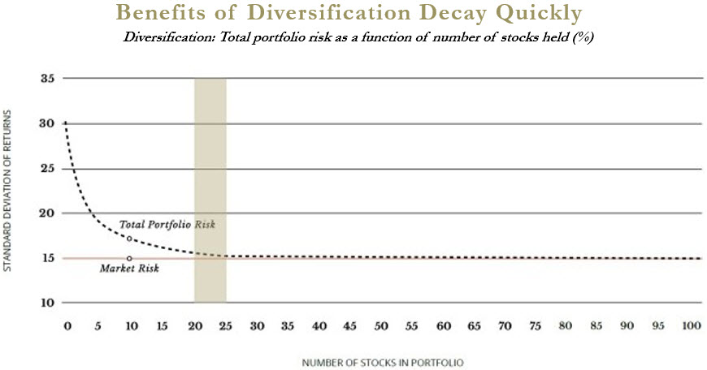
How many stocks should you own?
Total Portfolio Risk as a Function of Number of Stocks Held

Slide 15
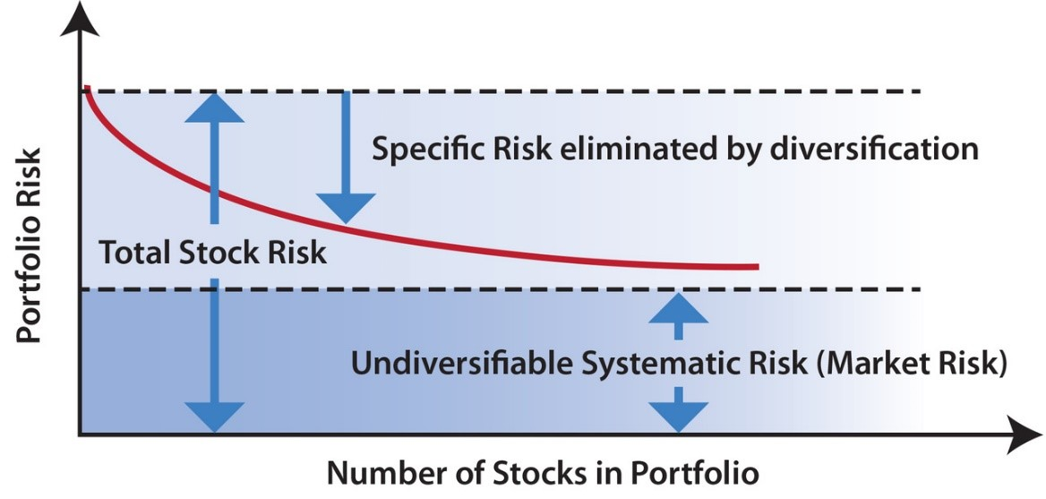
How many stocks should you own?
Total Portfolio Risk as a Function of Number of Stocks Held

Slide 16
Minimize your allocation to your company’s stock in a 401(k)! Single company risk - AND - your career. Think Enron. Think GE. Think…

Slide 17
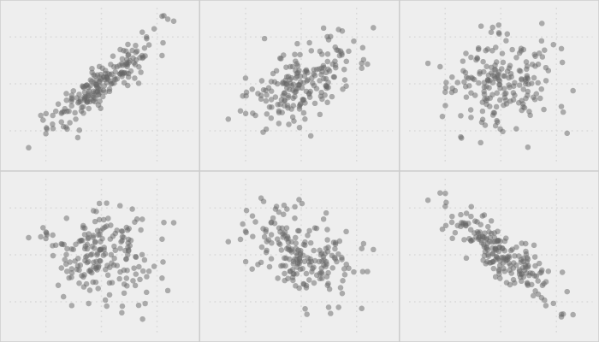
To what extent does one asset move in line (“covary”) with another?
Correlation statistics measure this and run from -1 to +1. The lower the score the better the diversification.
Statistics!
+0.75
+0.25
0.00
Asset A
Asset B
0.00
-0.25
-0.75

Slide 18
Diversification works! Stock and bond returns have not been both negative once in the same year since 1970.
Year | Stocks | Bonds |  | Year | Stocks | Bonds
70 | 3.9 | 16.9 |  | 89 | 31.7 | 13.3
71 | 14.3 | 8.7 |  | 90 | -3.1 | 9.7
72 | 19.0 | 5.2 |  | 91 | 30.5 | 15.5
73 | -14.7 | 4.6 |  | 92 | 7.6 | 7.2
74 | -26.5 | 5.7 |  | 93 | 10.1 | 11.2
75 | 37.2 | 7.8 |  | 94 | 1.3 | -5.1
76 | 23.9 | 12.9 |  | 95 | 37.6 | 16.8
77 | -7.2 | 1.4 |  | 96 | 23.0 | 2.1
78 | 6.6 | 3.5 |  | 97 | 33.4 | 8.4
79 | 18.6 | 4.1 |  | 98 | 28.6 | 10.2
80 | 32.5 | 3.9 |  | 99 | 21.0 | -1.8
81 | 4.9 | 9.5 |  | 00 | -9.1 | 12.6
82 | 21.6 | 29.1 |  | 01 | -11.9 | 7.6
83 | 22.6 | 7.4 |  | 02 | -22.1 | 12.9
84 | 6.3 | 14.0 |  | 03 | 26.7 | 2.4
85 | 31.7 | 20.3 |  | 04 | 10.9 | 2.3
86 | 18.7 | 15.1 |  | 05 | 4.9 | 1.4
87 | 5.3 | 2.9 |  | 06 | 15.8 | 3.1
88 | 16.6 | 6.1 |  | 07 | 5.5 | 10.1
08 | -37.0 | 13.1 |  | 13 | 32.4 | -3.9
09 | 26.5 | -2.4 |  | 14 | 13.7 | 3.0
10 | 15.1 | 7.1 |  | 15 | 1.4 | 1.8
11 | 2.1 | 8.8 |  | 16 | 12.0 | 1.9
12 | 16.0 | 1.7 |  | 17 | 21.8 | 1.6

Slide 19
Diversification works! The annual correlation between stocks and bonds has been practically zero. (0.024)
Annual Stock Return %
Annual Bond Return %

Slide 20
Diversification works! The annual correlation between stocks and bonds is practically zero. (0.024)
Annual Bond Returns Vs. Annual Stock Returns, 1970-2017
Annual Stock Return %
!
Annual Bond Return %

Slide 21
Bonds* have been great diversifiers in stock bear markets
*
* US Treasury bonds

Slide 23
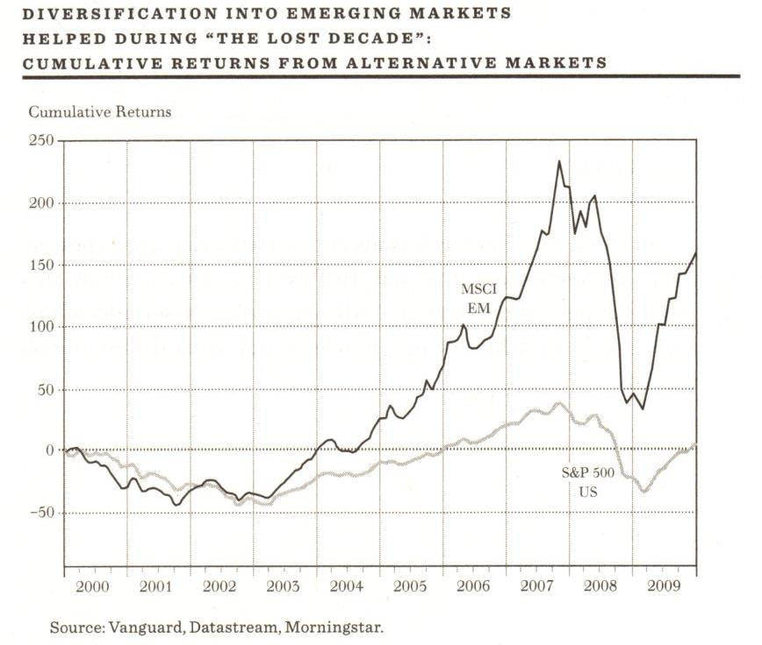
Even if developed international and emerging market stocks seem to move similarly to US stocks over the short term, their longer returns can be quite different
Diversification into Emerging Markets During “The Lost Decade”
Cumulative Returns

Slide 24
A correlation matrix shows the degree to which asset classes are correlated with each other and is useful for designing an optimal portfolio

Slide 26
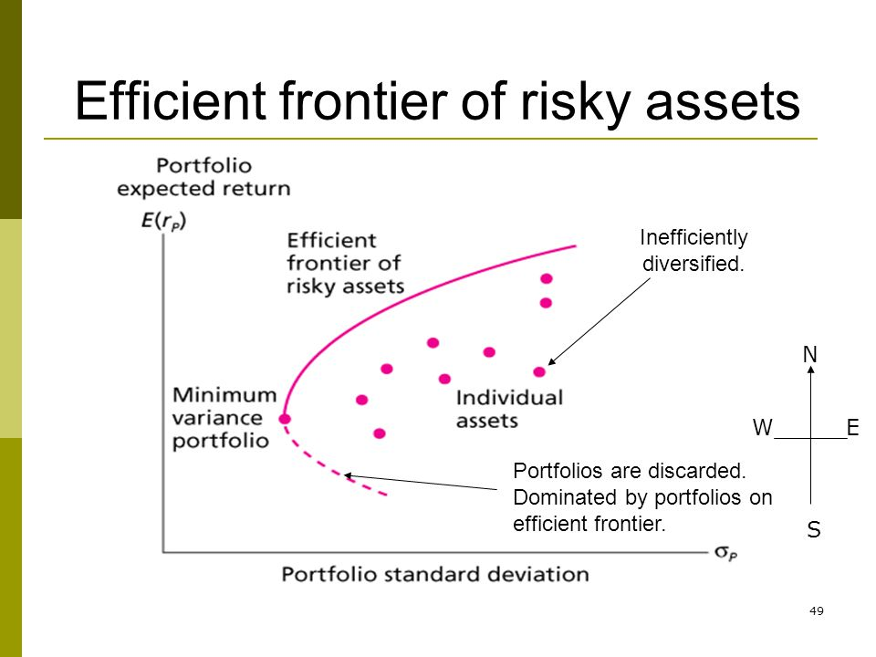
The “Efficient Frontier” represents different combinations of asset classes with the highest expected return per unit of risk
(Risk)

Slide 27
During the past several decades, “modern” investors have sought to push the frontier in a northwest direction by adding additional asset classes to their portfolios
(Risk)

Slide 28
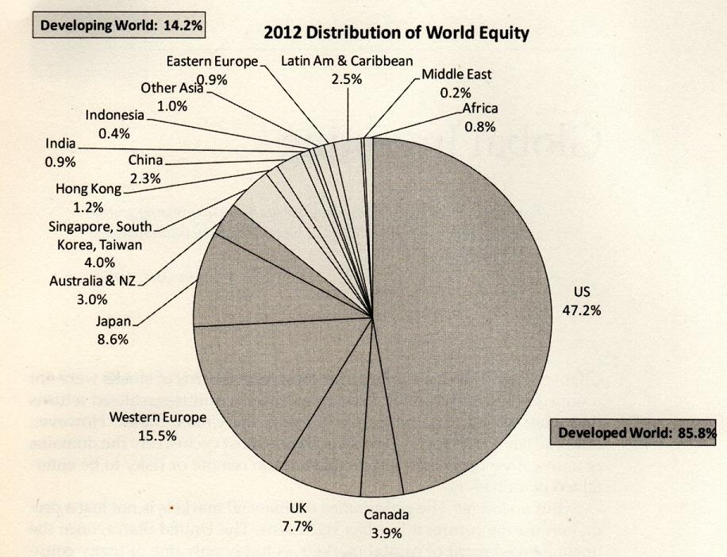
Developed international and emerging markets stocks have been particularly important new diversifiers
Distribution of World Equity by Market Capitalization
Source: Stocks for the Long Run, Jeremy Siegel

Slide 29
What are examples of “new” asset classes?
International developed stocks (70s and 80s)
Gold bullion (70s)
High yield bonds (80s)
Emerging markets stocks (90s)
Treasury Inflation Protected Bonds (TIPS) (90s)
Real estate investment trusts (90s)
Emerging markets $ bonds (00s)
Commodity futures (00s)
Emerging markets local currency bonds (10s)
Bank loans (10s)
Catasphophe (CAT) bonds (10s)
Agricultural land (10s)

Slide 30
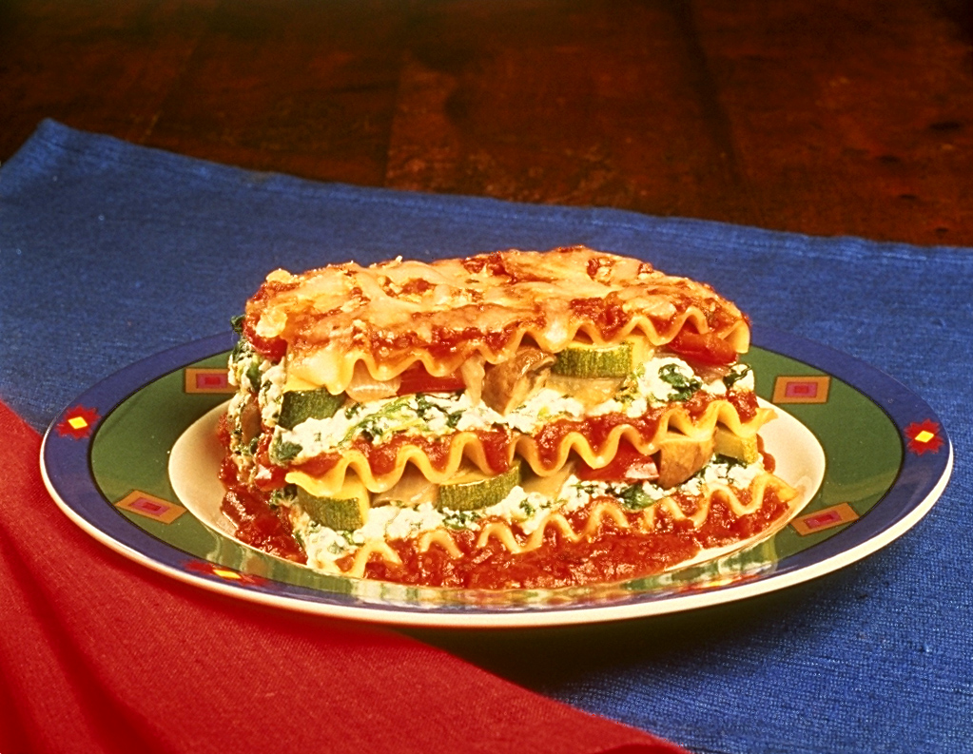
Diversification is the only free lunch!
The whole is greater than the sum of the parts

Slide 31
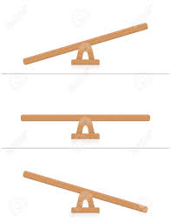
Rebalancing
Over time a portfolio that starts out with a strategic allocation of 50% stocks, 50% bonds will naturally get out of balance as either stocks or bonds outperforms.
In order to maintain the portfolio’s strategic risk/return profile it becomes important to restore the targeted stock/bond mix. That will mean selling the asset that has performed the best and buying the one that has underperformed.
Calendar-based strategies
Range-based strategies

