Slide 1
Manage Investments Like a Pro!
Returns and risks – history
Returns and risks – outlook
Asset allocation and the power of diversification
Market timing
The Case for Indexing – Theory and Evidence
Life cycle investing and target-date funds
Goals-driven investing (a.k.a., ALM, LDI)
Smart retirement strategies
Smart financial strategies

Slide 2
Goals-driven investing (a.k.a., ALM, LDI)

Slide 3
Optimize your asset allocation to your “inflation-sensitive liabilities”
Year 1 in Retirement
Year 15 in Retirement
Year 30 in Retirement
Chart “assumes” approximately 2.4% inflation “each” year
-$75K
-$100K
-$125K
-$150K
Each year in retirement you will typically need to come up with an increasing and variable amount of money to maintain your life style. What will happen to inflation during your retirement?!

Slide 4
One of the biggest risks in retirement is unexpected swings in inflation
Year-Over-Year Inflation Rate %
Even a 1% increase in long term inflation can reduce a 30-year retirement plan by 9 years!
Current:
2.8%
*

Slide 5

One of the biggest risks in retirement is inflation
Purchasing Power of an Initial $100,000 Traditional Annuity

Slide 6
Now, let’s take a an even longer look at inflation (and deflation)!
Year-Over-Year Inflation Rate %

Slide 7

Staying Ahead of Inflation
Source: Plan Sponsor Magazine, October-November 2018, Art by Zohar Lazar

Slide 8

Treasury Inflation Protected Securities (TIPS) can be very useful to protect against unexpected inflation

Slide 9
Goals Driven Investing in retirement includes large allocations to TIPS and cash
Asset/Liability Management For Retirees
Source: Alpha, Beta, and Now…Gamma, David Blanchett, CFA, CFP, Paul Kaplan PhD., CFA

Slide 10
Goals Driven Investing in retirement includes large allocations to TIPS and cash
Asset/Liability Management For Retirees
Vanguard’s retirement income fund
has 17% in TIPS and T. Rowe Price’s
similar fund has 16% in TIPS
Very few investors buy similar
allocations to TIPS when they
asset allocate on their own
Source: Alpha, Beta, and Now…Gamma, David Blanchett, CFA, CFP, Paul Kaplan PhD., CFA

Slide 11
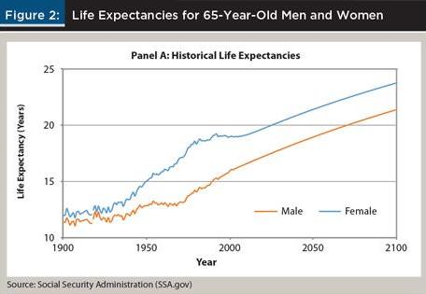
Besides inflation, another uncertainty is how long will you live? Women have an especially big challenge.
Life Expectancies of 65-Year-Old Men and Women

Slide 12
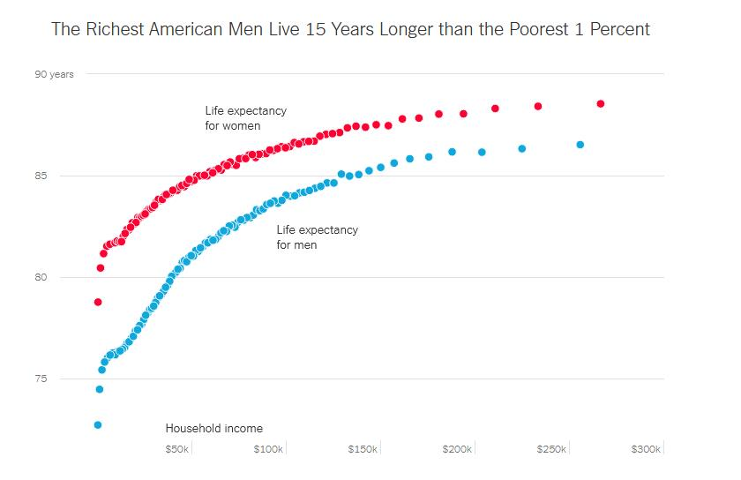
The richest American men live 15 years longer than the poorest 1%
Life Expectancies Based Upon Income Levels
The Society of Actuaries shows people living 4 to 5 years longer than the Social Security life table
(People who buy annuities live longer.)
Source: New York Times, April 11, 2016

Slide 13
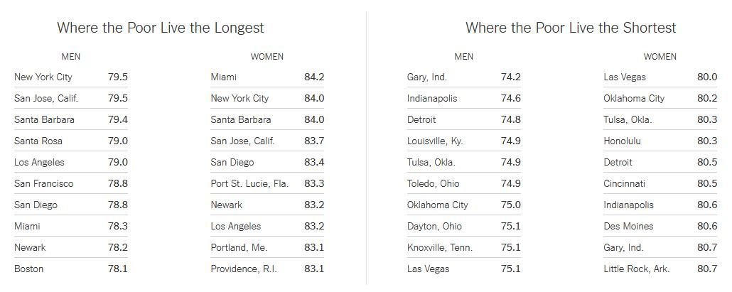
Even your city can influence your life expectancy
Life Expectancies Based Geography
Source: New York Times, April 11, 2016

