Slide 1
Manage Investments Like a Pro!
Returns and risks – history
Returns and risks – outlook
Asset allocation and the power of diversification
Market timing
The Case for Indexing – Theory and Evidence
Life cycle investing and target-date funds
Goals-driven investing (a.k.a., ALM, LDI)
Smart retirement strategies
Smart financial strategies

Slide 2
K.I.S.S.
Life cycle investing and target-date funds
Asset allocation in action
“Give me a lever long enough…, and I could move the earth itself.”
- Archimedes

Slide 3
In the investment world that lever is asset allocation

Slide 4
The value of future earnings and Social Security can be thought of as an asset with TIPS-like characteristics. It should be balanced with a significant exposure to stocks early on.
Human Capital: Present Value of Future Earnings and Social Security Payments
Thousands
Source: The Vanguard Group. Staring salary of $25 K. Social Security replacement of 32% of lifetime average salary.

Slide 5
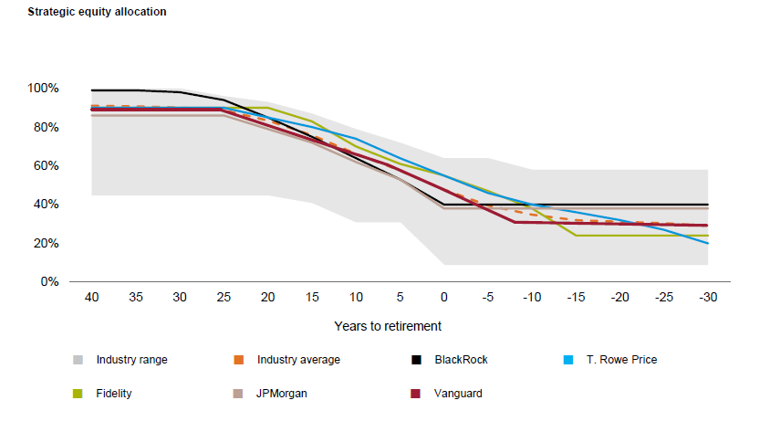
That is exactly what takes place with Target-date funds
Glide Path Comparisons – Strategic Equity Allocation
Source: Vanguard Target Retirement Funds and Trusts, March 31, 2018

Slide 6
That is exactly what takes place with Target-date funds
Glide Path Comparisons – Strategic Equity Allocation
Low Human Capital * – TIPS-Like
High Financial Capital
High Human Capital * – TIPS-Like
Low Financial Capital
* Life expectancy; built up by EDUCATION, work and life experiences
Source: Vanguard Target Retirement Funds and Trusts, March 31, 2018

Slide 7
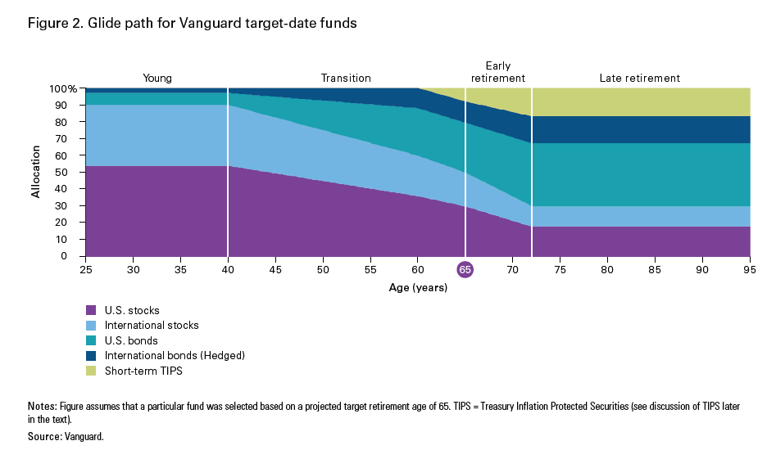
Target-date funds gradually change shareholders’ asset allocation as they move through their life cycle.
They start aggressive (risky) and then gradually become conservative (low risk)
Glide Path for Vanguard Target-Date Funds
17% Max
90% Stock
50% Stock
30% Stock
International stocks are 40% of total stocks.
International bonds are 30% of total traditional bonds.

Slide 8
Target-date funds gradually change shareholders’ asset allocation as they move through their life cycle.
They start aggressive (risky) and then gradually become conservative (low risk)
Glide Path for Vanguard Target-Date Funds
17% Max

Slide 9
Target-date funds gradually change shareholders’ asset allocation as they move through their life cycle.
They start aggressive (risky) and then gradually become conservative (low risk)
Glide Path for Vanguard Target-Date Funds
17% Max
90% Stock
50% Stock
30% Stock
International stocks are 40% of total stocks.
International bonds are 30% of total traditional bonds.

Slide 10
Sub-asset Allocation Comparison of Different Target-date Funds
Various target-date funds’ asset allocations are fairly similar

Slide 11

It is natural for diversified funds to get “out of balance” as one asset class does particularly well or poorly relative to the other ones.
A 50% stock/ 50% bond portfolio can become a 60% stock / 40% bond portfolio in a stock bull market.
Target-date funds automatically REBALANCE each month to the targeted asset allocation.
In short, they sell high and buy low.
One less thing that the investor doesn’t have to worry about.
Source: Chicago Tribune, Terry Savage

Slide 12
But is it safe to put all of your investments in one single fund?!
Shouldn’t you diversify with many funds?
Source: Vanguard Target Retirement Funds and Trusts, March 31, 2018

Slide 13
But is it safe to put all of your investments in one single fund?!
Shouldn’t you diversify with many funds?
Vanguard’s target date funds hold more than 28,000 securities
They account for 89% of all available global investments
Source: Vanguard Target Retirement Funds and Trusts, March 31, 2018

Slide 15
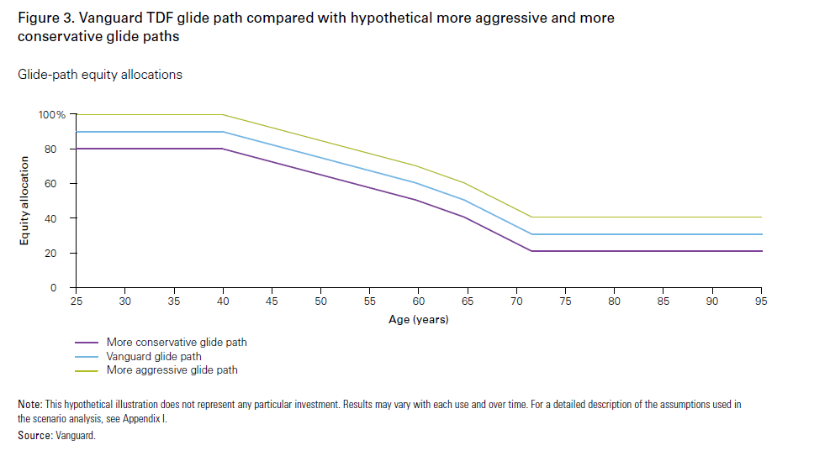
Simulations of different glide paths results in different median “expected outcomes – and “expected worst-case” results
Vanguard Modeled Different Glide Paths and Their Different Outcomes

Slide 16
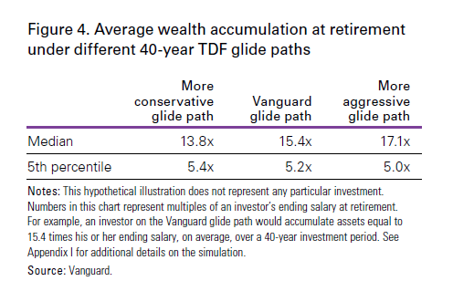
Simulations of different glide paths results in different median “expected outcomes – and “expected worst-case” results
Average Wealth Accumulation at Retirement Under Different 40-Year TDF Glide Paths

Slide 17
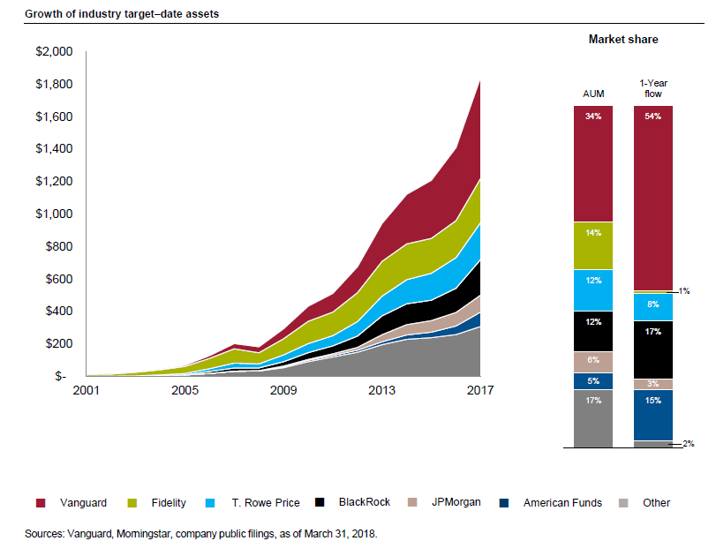
Investors – particularly millennials – love target-date funds. They account for about 50% of all money flowing into 401(k)s
Growth of Industry Target-Date Assets
Vanguard

Slide 18
Most of the growth in target-date fund assets has been from passive (index) programs
Total Target Date Program Assets of Managers Surveyed
Source: Mercer

Slide 19
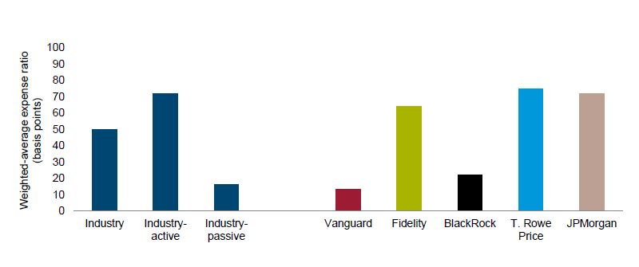
Target-date expense ratios are strongly driven by the active/passive decision
Target-Date Weighted Expense Ratios
Source: Vanguard Target Retirement Funds and Trusts, March 31, 2018

Slide 20

An alternative to target-date funds is target-risk funds. At Vanguard these come in four flavors:
Life Strategy Funds: (indexed)
Income (20% stocks, 80% bonds)
Conservative Growth (40% stocks, 60% bonds)
Moderate Growth (60% stocks, 40% bonds)
Growth (80% stocks, 20% bonds)
These weights are fixed and do not vary over time.
Vanguard and others also offer classic actively managed “balanced” funds. Such funds are typically 60% stocks and 40% bonds – with that ratio fluctuating based upon the manager’s market views.

