Slide 1
Manage Investments Like a Pro!
Returns and risks – history
Returns and risks – outlook
Asset allocation and the power of diversification
Market timing
Passive (index) vs. active investing
Life cycle investing and target-date funds
Goals-driven investing (a.k.a., ALM, LDI)
Smart retirement strategies
Smart financial strategies

Slide 2

Market-timing

Slide 3
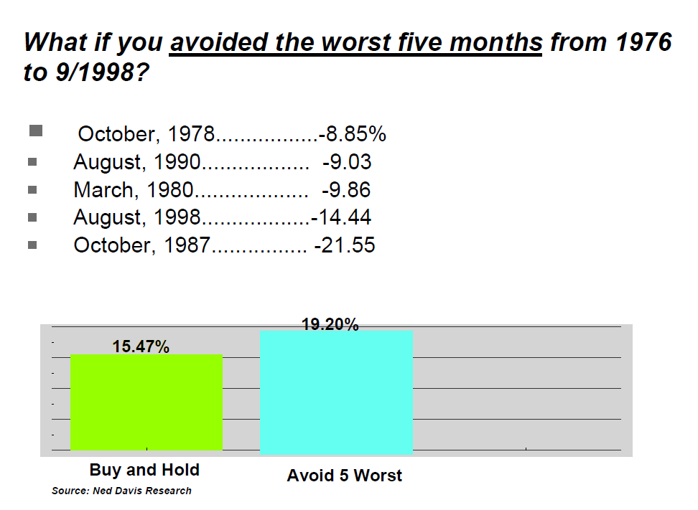

Slide 4
If only I could get out of the markets during the worst performing months!
Arithmetic Scale
$1 Grows To:
$1 Grows To:
1926-2008
Miss 10 Worst Months
$22,549
Buy and Hold
$2,353
$256
Miss 10 Best Months

Slide 5
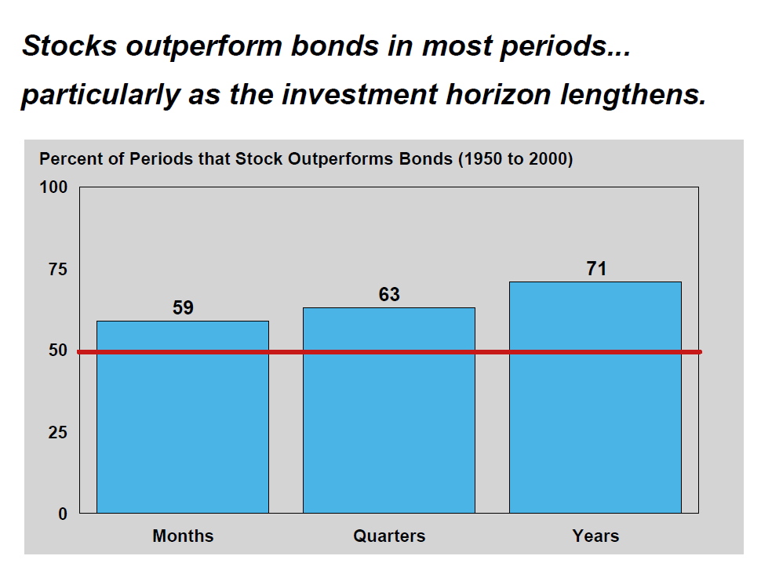

Slide 6
If only I could get out of the market before the big bear markets!
Name | Top | Bottom | Recovery | Months from Top to Recovery | Decline from Top to Bottom
Great Depression | 29-Aug | Jun-32 | Jan-45 | 185 | -83.41%
Mid 40’s | Jun-46 | Nov-46 | Oct-49 | 41 | -21.76%
Early 70’s | Nov-68 | Jun-70 | Mar-71 | 28 | -29.23%
Mid 70’s | Dec-72 | Sep-74 | Jun-76 | 42 | -42.62%
Late 70’s | Dec-76 | Feb-78 | Jul-78 | 19 | -14.12%
Early 80’s | Mar-81 | Jun-82 | Oct-82 | 19 | -15.33%
Crash of 1987 | Aug-87 | Nov-87 | May-89 | 21 | -29.53%
Tech Crash | Aug-00 | 2-Sep | 6-Oct | 74 | -44.73%
2008 Crisis | 7-Oct | 9-Feb | 12-Mar | 53 | -50.95%
Source: Bob French, CFA, Director of Investment Analysis, Retirement Researcher

Slide 8
But what if I got out a bit too early…
Name | Enter 1 Month Early | Enter 2 Months Early | Enter 3 Months Early
Great Depression | -0.22% | -22.13% | -37.68%
Mid 40’s | -0.27% | -0.87% | -10.75%
Early 70’s | -4.82% | -10.03% | -18.03%
Mid 70’s | -11.70% | -19.01% | -25.16%
Late 70’s | -1.61% | -7.47% | -7.03%
Early 80’s | -2.15% | -3.85% | -6.62%
Crash of 1987 | -8.19% | -27.95% | -29.53%
Tech Crash | -10.87% | -10.28% | -17.28%
2008 Crisis | -10.65% | -18.18% | -17.31%
Average | -5.61% | -13.31% | -18.82%
Still some real losses
Source: Bob French, CFA, Director of Investment Analysis, Retirement Researcher

Slide 9
But what if I got back in a bit too late…
Name | Enter 1 Month Late | Enter 2 Months Late | Enter 3 Months Late
Great Depression | 38.15% | 91.60% | 84.97%
Mid 40’s | 4.57% | 7.24% | 6.41%
Early 70’s | 7.52% | 12.99% | 16.91%
Mid 70’s | 16.57% | 11.35% | 9.38%
Late 70’s | 2.76% | 11.70% | 13.22%
Early 80’s | 12.67% | 13.91% | 26.74%
Crash of 1987 | 7.38% | 11.97% | 17.23%
Tech Crash | 8.80% | 15.21% | 8.44%
2008 Crisis | 8.76% | 19.17% | 25.83%
Average | 11.91% | 21.68% | 23.24%
Some real missed opportunities
Source: Bob French, CFA, Director of Investment Analysis, Retirement Researcher

Slide 10
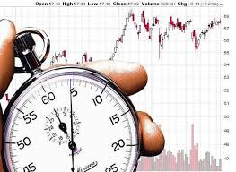
Being too far ahead of your time is indistinguishable from being wrong. Howard Marks

Slide 12
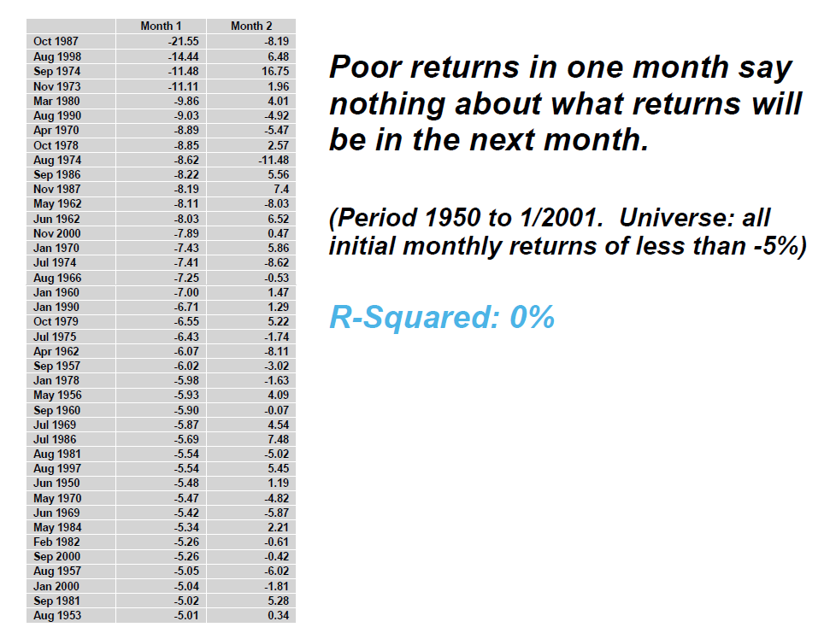

Slide 13
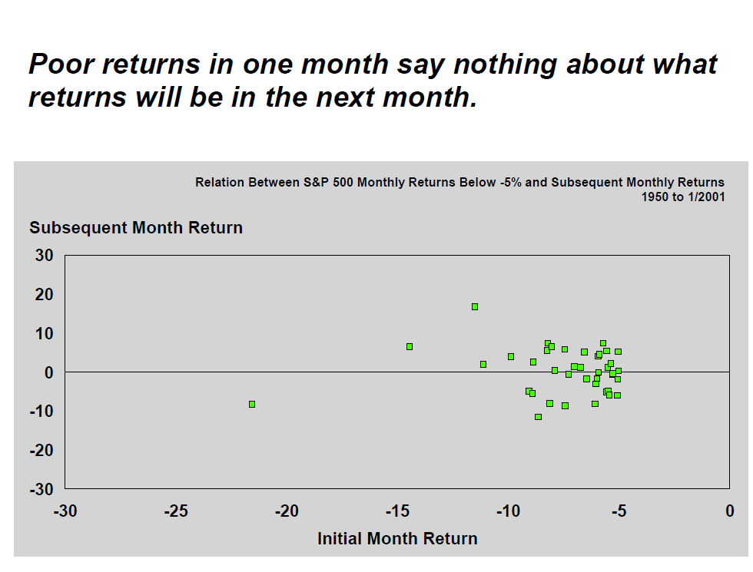

Slide 14
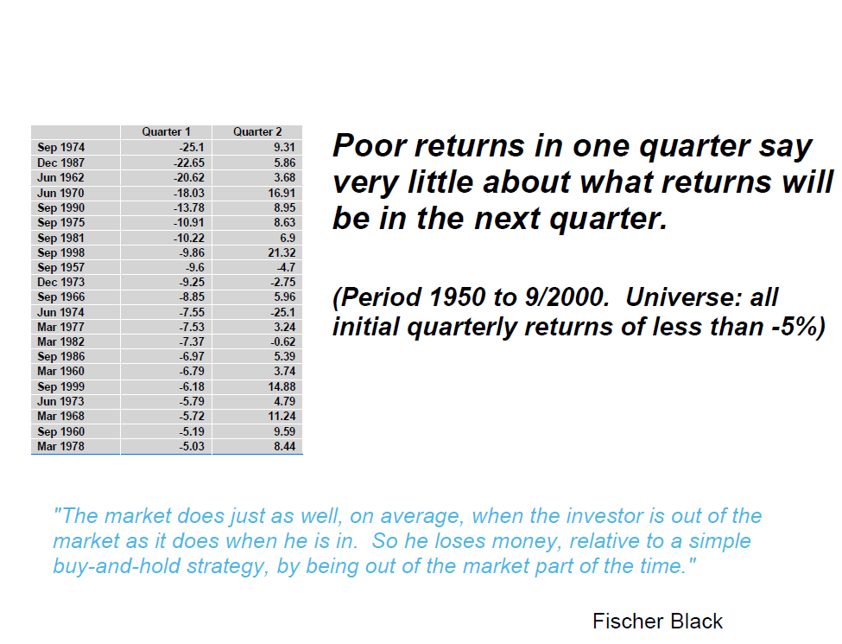

Slide 15
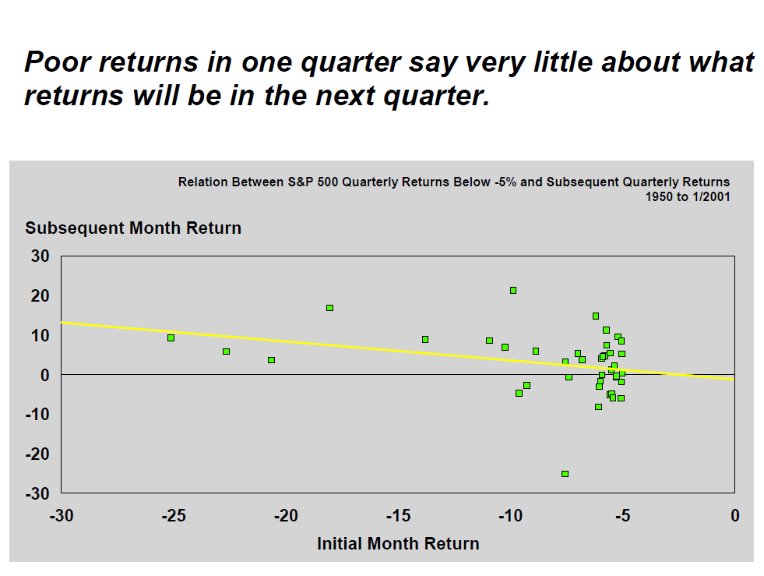

Slide 17
Source: Wilshire Compass

Slide 18
How have professional market-timers fared?
 | Bull Market | Bear Market | Bull Market | Bear Market | Bull Market
Date Range | 1/1/1997 - 8/31/2000 | 9/1/2000 - 2/28/2003 | 3/1/2003 - 10/31/2007 | 11/1/2007 - 2/28/2009 | 3/1/2009 - 12/31/2012
Benchmark Returns | 14.0% | -8.2% | 14.0% | -26.8% | 15.8%
Number of Flexible-Allocation Funds | 144 | 193 | 228 | 467 | 409
Number of Flexible-Allocation Funds That Outperformed Benchmark | 48 | 117 | 83 | 204 | 170
Percentage of Flexible-Allocation Funds That Outperformed Benchmark | 33% | 61% | 36% | 44% | 42%
Annual Performance of Median Fund Relative to Benchmark Return | -2.1% | 2.7% | -1.3% | -2.4% | -0.6%
Number That Outperformed Benchmark in Consecutive Periods | 18 of 48 | 47 of 117 | 26 of 83 | 32 of 204 | -

Slide 19

“My favorite holding period is forever.”
Warren Buffett

Slide 20
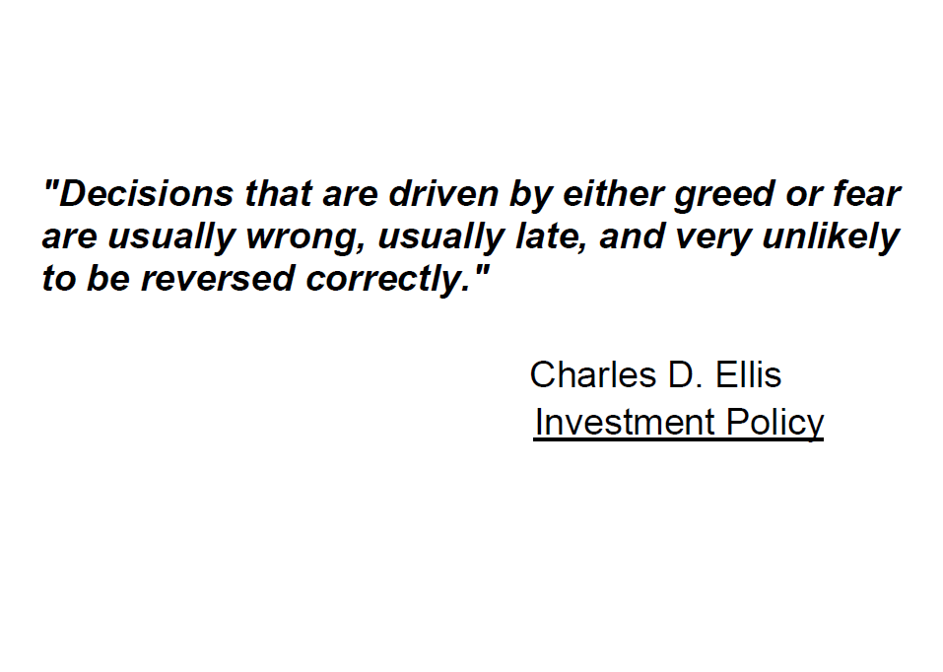

Slide 21
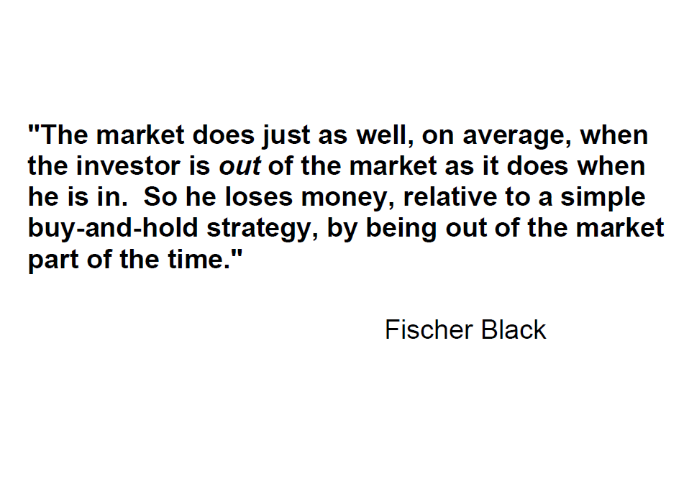

Slide 22

“The market timer’s Hall of Fame is an empty room.”
Jane Bryant Quinn

Slide 23

Slow and steady wins the race

