Slide 1
Manage Investments Like a Pro!
Returns and risk – history
Returns and risk – outlook
Asset allocation and the power of diversification
Market timing
Passive (index) vs. active investing
Life cycle investing and target-date funds
Goals-driven investing (a.k.a., ALM, LDI)
Smart retirement strategies
Smart financial strategies

Slide 4
Returns and risk - history

Slide 5
Stocks have provided the highest long term returns
Annualized – 1926 to 2017
Real: 7.1% *
Inflation: 2.9%
1926-1975 Duff & Phelps Long Term Corporate Bonds, 1976 to 2017 Bloomberg Barclays US Aggregate Bonds
* (1.102/1.029) -1

Slide 6
Geometric Scale: $1 grows to…
$1 Grows To – Dec 1926 to Dec 2017
Stocks
$7,353
Bonds
$136
T-bills
$21
$2.20
$0.79
1926-1975 Duff & Phelps Long Term Corporate Bonds, 1976 to 2017 Bloomberg Barclays US Aggregate Bonds

Slide 7
Geometric Scale: $1 grows to…
Small-Cap Stocks
$36,929
$1 Grows To – Dec 1926 to Dec 2017
Stocks
$7,353
Bonds
$136
T-bills
$21
$2.20
$0.79
1926-1975 Duff & Phelps Long Term Corporate Bonds, 1976 to 2017 Bloomberg Barclays US Aggregate Bonds

Slide 8
Small-Cap Stocks
$36,929
Arithmetic Scale: $1 grows to…
$1 Grows To – Dec 1926 to Dec 2017
Stocks
$7,353
Bonds
$136
T-bills
$21
1926-1975 Duff & Phelps Long Term Corporate Bonds, 1976 to 2017 Bloomberg Barclays US Aggregate Bonds

Slide 9
Arithmetic Scale: $1 grows to…
$1 Grows To – Dec 1926 to Dec 2017
Stocks
$7,353
($535 real)
Bonds
$136
T-bills
$21
($2 real)
1926-1975 Duff & Phelps Long Term Corporate Bonds, 1976 to 2017 Bloomberg Barclays US Aggregate Bonds

Slide 11
Source: Wilshire Compass

Slide 13
Source: Wilshire Compass

Slide 14
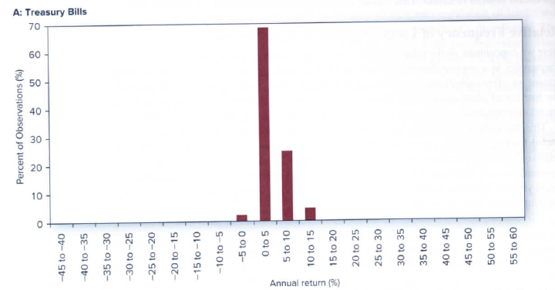
Treasury bill returns are tightly distributed around the median
Introducing the histogram!
Treasury Bills Histogram (1927-2015)
Source: Investments, Eleventh Edition, Bodie, Kane, Marcus, Page 125

Slide 15
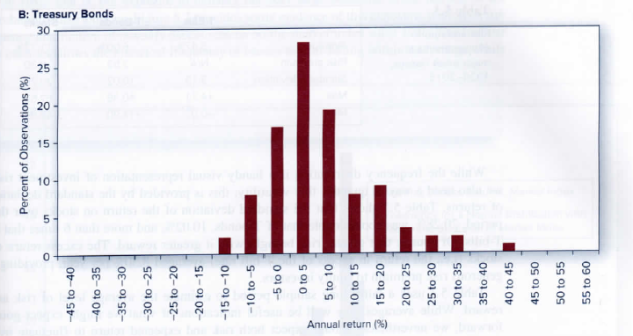
Treasury bond returns less tightly distributed around the median
Treasury Bonds Histogram (1927-2015)
Source: Investments, Eleventh Edition, Bodie, Kane, Marcus, Page 125

Slide 16
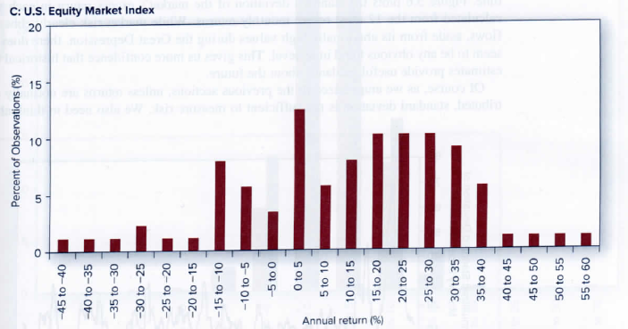
US stock returns very broadly distributed around the median
S&P US Stocks Histogram (1927-2015)
Source: Investments, Eleventh Edition, Bodie, Kane, Marcus, Page 125

Slide 17
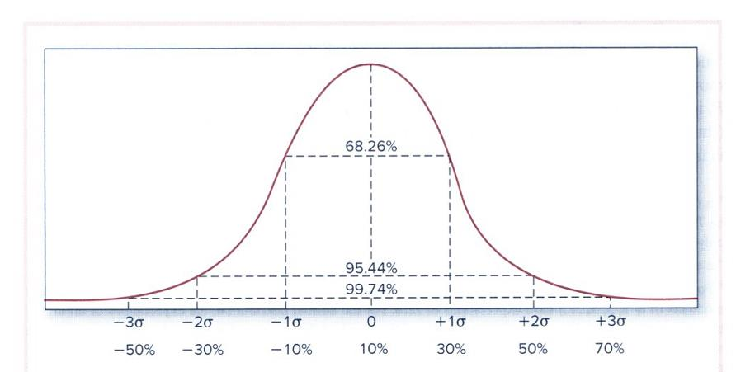
We typically measure asset class risk in terms of volatility – standard deviation – how far annual returns are typically (~68% of time) away from their long term average
Statistics!
The Normal Distribution With Mean 10% and Standard Deviation 20%
Source: Investments, Eleventh Edition, Bodie, Kane, Marcus, Page 135

Slide 18
Stocks can be very risky. And you can lose money in bonds also.
Year | T-Bills | Bonds | Stocks
1990 | 8.4 | 8.9 | -3.2
1991 | 6.4 | 16.0 | 30.5
1992 | 3.9 | 7.4 | 7.7
1993 | 3.2 | 9.8 | 10.0
1994 | 4.3 | -2.9 | 1.3
1995 | 6.0 | 18.5 | 37.5
1996 | 5.3 | 3.6 | 23.1
1997 | 5.3 | 9.7 | 33.2
1998 | 5.2 | 8.7 | 28.7
1999 | 4.8 | -0.8 | 21.0
2000 | 6.2 | 11.6 | -9.1
2001 | 4.4 | 8.4 | -11.9
2002 | 1.8 | 10.3 | -22.1
2003 | 1.2 | 4.1 | 28.7
2004 | 1.3 | 4.3 | 10.9
2005 | 3.1 | 2.4 | 4.9
2006 | 4.8 | 4.3 | 15.8
2007 | 5.0 | 7.0 | 5.5
2008 | 2.0 | 5.2 | -37.0
2009 | 0.2 | 5.9 | 26.4
2010 | 0.1 | 6.5 | 15.1
2011 | 0.1 | 7.8 | 2.1
2012 | 0.1 | 4.2 | 16.1
2013 | 0.1 | -2.0 | 32.4
2014 | 0.0 | 6.0 | 13.7
2015 | 0.0 | 0.6 | 1.4
2016 | 0.2 | 2.7 | 12.0
2017 | 0.8 | 3.5 | 21.8
Three consecutive loosing years!
How much of a gain is required to erase a 37% decline?
57.8%
S&P 500, Bloomberg Barclays US Aggregate

Slide 19
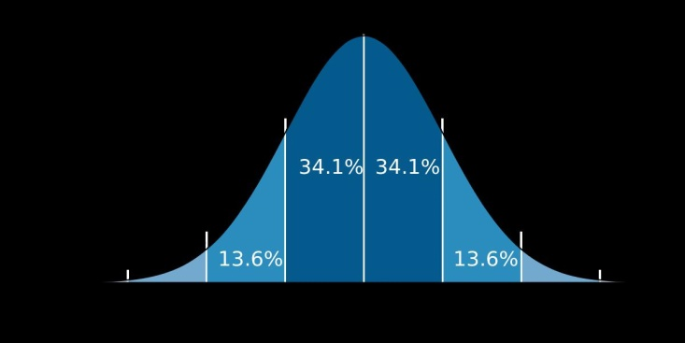
We typically measure asset class risk in terms of volatility – standard deviation – how far annual returns are typically (~68% of time) away from their long term average
Year | T-Bills | Bonds | Stocks
1990 | 8.4 | 8.9 | -3.2
1991 | 6.4 | 16.0 | 30.5
1992 | 3.9 | 7.4 | 7.7
1993 | 3.2 | 9.8 | 10.0
1994 | 4.3 | -2.9 | 1.3
1995 | 6.0 | 18.5 | 37.5
1996 | 5.3 | 3.6 | 23.1
1997 | 5.3 | 9.7 | 33.2
1998 | 5.2 | 8.7 | 28.7
1999 | 4.8 | -0.8 | 21.0
2000 | 6.2 | 11.6 | -9.1
2001 | 4.4 | 8.4 | -11.9
2002 | 1.8 | 10.3 | -22.1
2003 | 1.2 | 4.1 | 28.7
2004 | 1.3 | 4.3 | 10.9
2005 | 3.1 | 2.4 | 4.9
2006 | 4.8 | 4.3 | 15.8
2007 | 5.0 | 7.0 | 5.5
2008 | 2.0 | 5.2 | -37.0
2009 | 0.2 | 5.9 | 26.4
2010 | 0.1 | 6.5 | 15.1
2011 | 0.1 | 7.8 | 2.1
2012 | 0.1 | 4.2 | 16.1
2013 | 0.1 | -2.0 | 32.4
2014 | 0.0 | 6.0 | 13.7
2015 | 0.0 | 0.6 | 1.4
2016 | 0.2 | 2.7 | 12.0
2017 | 0.8 | 3.5 | 21.8
57.8%
S&P 500, Bloomberg Barclays US Aggregate
2.5 | 4.8 | 17.4

Slide 20
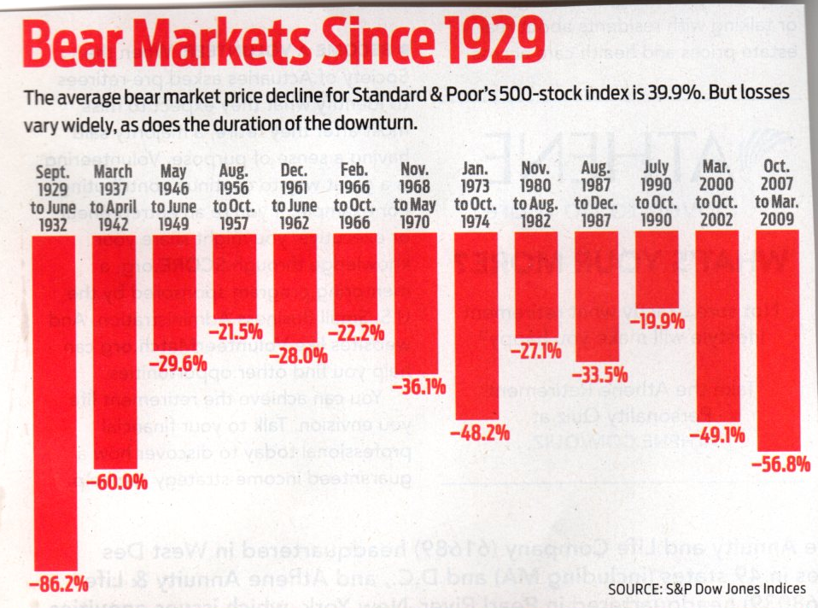
The average bear market (at least -20%) for the S&P 500 index is 39.9%. Losses vary widely, as does the duration of the downturn.
Bear Markets Since 1929
Source: Kiplinger’s Personal Finance, 11/2018

Slide 21

Financial disaster is quickly forgotten. There can be few fields of human endeavor in which history counts for so little as in the world of finance.
John Kenneth Galbraith

Slide 22
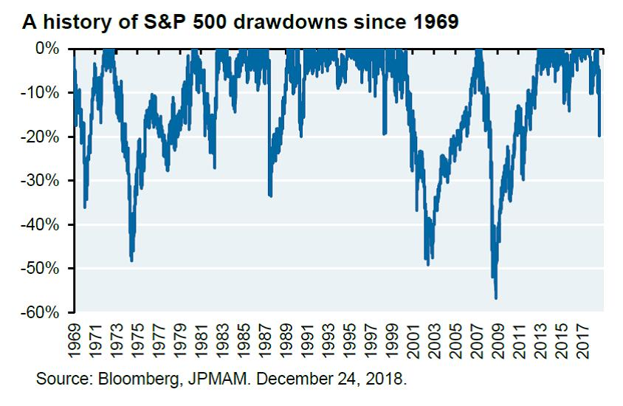
Another measure of risk is “drawdowns” which show declines from market tops to bottoms – and how long it took to recover
A History of S&P 500 Drawdowns Since 1969
= Years to Breakeven

Slide 23
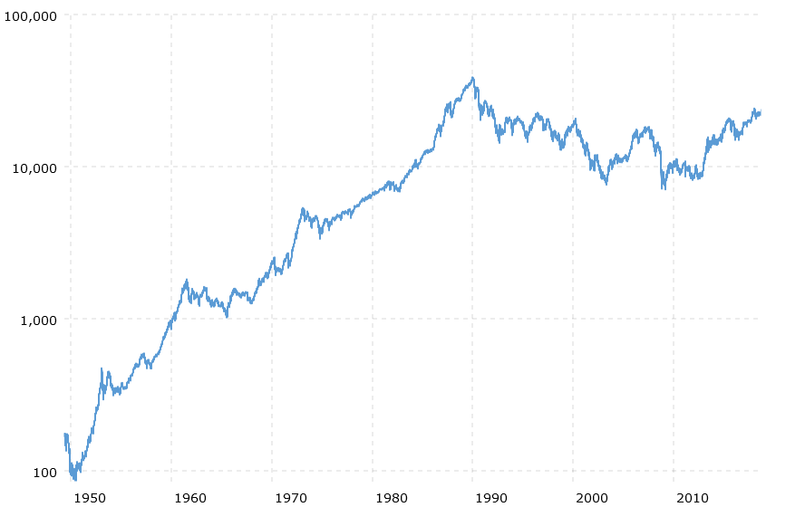
Stocks can be very risky – even for long term investors
Nikkei 225 (Japanese Stock Index)
12/29/89
38,915.87
9/28/18
24,120.04
NB: Ratio Scale!
-38% over 29 years
7699
12/29/89
The largest stock market in the world!

Slide 24
Stocks can be very risky – even for long term investors
Nikkei 225 (Japanese Stock Index)
12/29/89
38,915.87
9/28/18
24,120.04
NB: Ratio Scale!
-38% over 29 years
7699
Sad is the Japanese investor who failed to diversify outside of Japan!
12/29/89
The largest stock market in the world!

Slide 28
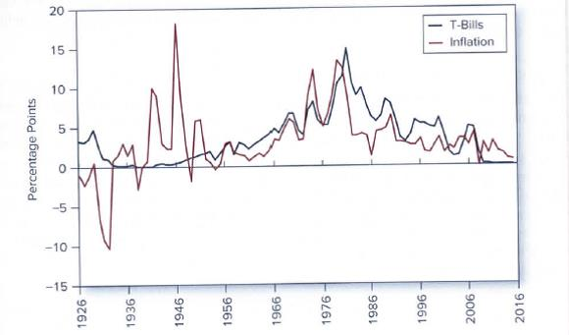
Even T-bills (unlike TIPS) have their risks in terms of purchasing power
Annualized – 1926 to 2017
Source: Investments, Eleventh Edition, Bodie, Kane, Marcus, Page 125

Slide 29
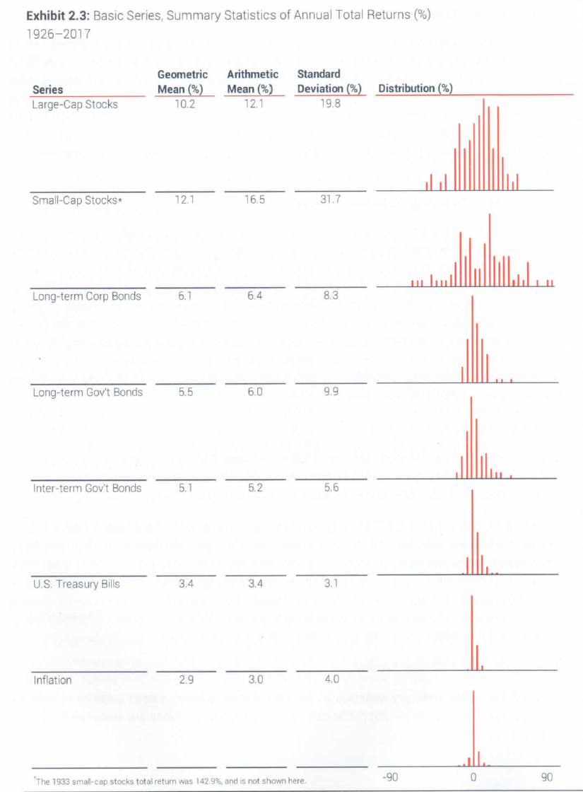
Risk and Return Summary of Key Asset Classes (1926-2017)
Series | Geometric Mean (%) | Arithmetic Mean (%) | Standard Deviation (%) | Distribution (%)
Large-Cap Stocks | 10.2 | 12.1 | 19.8
Small-Cap Stocks | 12.1 | 16.5 | 31.7
Long-term Corp Bonds | 6.1 | 6.4 | 8.3
Long-term Gov't Bonds | 5.5 | 6.0 | 9.9
Inter-term Gov't Bonds | 5.1 | 5.2 | 5.6
U.S. Treasury Bills | 3.4 | 3.4 | 3.1
Inflation | 2.9 | 3.0 | 4.0
+142.9
Over the long term,
higher risk --->
higher return
Source: 2018 SBBI Yearbook, Roger G. Ibbotson
-90% 0% +90%

Slide 30
Risk and Return Summary of Key Asset Classes (1926-2017)
Modified* Sharpe Ratios
Series | Geometric Mean (%) | Arithmetic Mean (%) | Standard Deviation (%) | Distribution (%)
Large-Cap Stocks | 10.2 | 12.1 | 19.8
Small-Cap Stocks | 12.1 | 16.5 | 31.7
Long-term Corp Bonds | 6.1 | 6.4 | 8.3
Long-term Gov't Bonds | 5.5 | 6.0 | 9.9
Inter-term Gov't Bonds | 5.1 | 5.2 | 5.6
U.S. Treasury Bills | 3.4 | 3.4 | 3.1
Inflation | 2.9 | 3.0 | 4.0
0.34
0.27
+142.9
Over the long term,
higher risk --->
higher return
0.33
0.21
0.30
* Geometric means are used rather than arithmetic means
Source: 2018 SBBI Yearbook, Roger G. Ibbotson
-90% 0% +90%

Slide 31
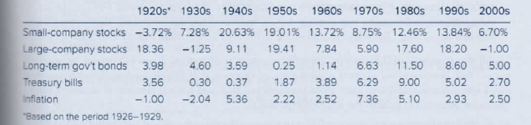
Even within an asset class (small and large-company stocks) returns can be quite different decade by decade
Annualized Asset Class Returns by Decade
Source: Investments, Eleventh Edition, Bodie, Kane, Marcus, Page 125

Slide 32
Dirty little secrets…small cap can underperform for very long periods of time and often has an inferior Sharpe ratio (risk/return efficiency)
Risk/Reward for Russell Indexes Since Inception in 1979 to 6/30/14
Russell 1000
Sharpe Ratio: 0.46
Russell 2000
Sharpe Ratio: 0.36
Annualized Return %
T-Bills
Annualized Risk %
Source: Raw data from Mutual of America Capital Management LLC

Slide 33
Don’t allocate between large and small – buy the total stock market! *
Anatomy of the Russell 3000
200 Companies
Russell Top 200 – A Subset of Russell 1000
(~69% of R1000)
~ S&P
500
Russell 1000
800 Companies
Russell Mid Cap – A Subset of Russell 1000
(~31% of R1000)
2000 Companies
Russell 2000
(~10% of R3000)
* Vanguard Total Stock Market Index Fund (VTSMX) or Vanguard Total Stock Market ETF (VTI)

Slide 34
Over the long term, higher risk ---> higher return
Annualized Returns and Risks – 1926 to 2017
Stocks
Return (Annualized)
Bonds
Money Market (T-Bills)
Risk (Standard Deviation)

Slide 35
Over the long term, higher risk ---> higher return
Annualized Returns and Risks – 1926 to 2017
Stocks
You would think…
Return (Annualized)
Bonds
Money Market (T-Bills)
Risk (Standard Deviation)

Slide 36
Over the long term, higher risk ---> higher return
Annualized Returns and Risks – 1926 to 2017
Stocks
The power of diversification! (Lesson #3)
Return (Annualized)
Bonds
Money Market (T-Bills)
Risk (Standard Deviation)

Slide 37
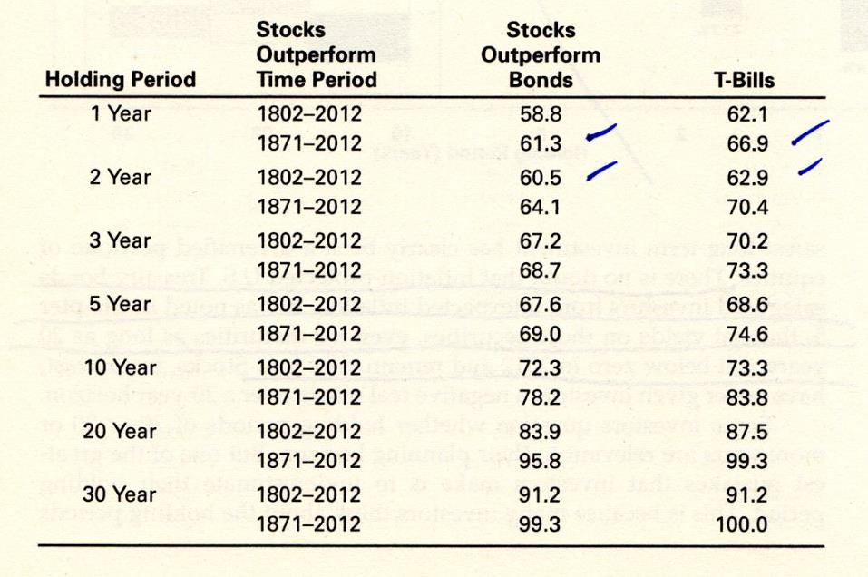
The probability of stocks outperforming bonds or T-bills increases with longer time horizons
% of Time Stocks Outperform Bonds and Bills over Various Holding Periods
Source: Stocks for the Long Run, Jeremy Seigel

Slide 38
Stocks for the Long Run. The volatility of asset class outcomes has narrowed as the investment horizon has increased. However, the decline has not been in line with what would be expected if annual returns were independent of each other (Random Walk).
Risk % for Average Real Return Over Various Holding Periods, 1802-2001
Stocks
Bonds
Cash
Source: Stocks for the Long Run, Jeremy Seigel
Holding Period (Years)

Slide 39
Stocks for the Long Run. The volatility of asset class outcomes has narrowed as the investment horizon has increased. However, the decline has not been in line with what would be expected if annual returns were independent of each other (Random Walk).
Risk % for Average Real Return Over Various Holding Periods, 1802-2001
Stocks
Bonds
Cash
?!
?!
Source: Stocks for the Long Run, Jeremy Seigel
Holding Period (Years)

Slide 40
Stocks, by contrast, have had a tendency to actually mean revert over longer time periods. Thus, their long term risk has declined more rapidly than with the square root of time.

Slide 41
The efficient frontier. Higher risk, higher return.
Risk-Return Trade-Offs for Various Holding Periods, 1802 through 2006
Stocks for the Long Run, Jeremy J. Siegel

Slide 42
Time diversification. The efficient frontier gets steeper as the investment horizon is increased…until it flips!
Risk-Return Trade-Offs for Various Holding Periods, 1802 through 2006
Stocks for the Long Run, Jeremy J. Siegel

Slide 43
Time diversification. The efficient frontier gets steeper as the investment horizon is increased…until it flips!
Risk-Return Trade-Offs for Various Holding Periods, 1802 through 2006
Stocks for the Long Run, Jeremy J. Siegel

Slide 44
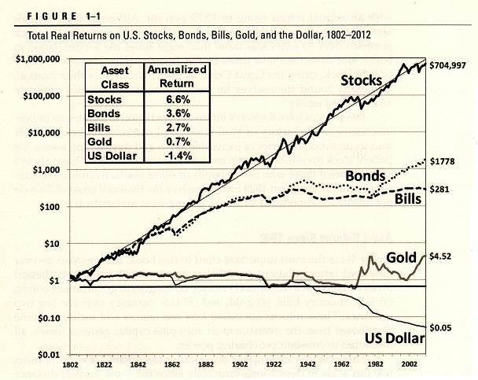
What about gold?
$1 “Real” Grows To:

Slide 45

No discussion about investment returns would be complete without at least a brief discussion of most people’s biggest single investment – their homes.
Actually, the largest asset class, by value, of all. Bigger than both stocks or bonds.

Slide 46
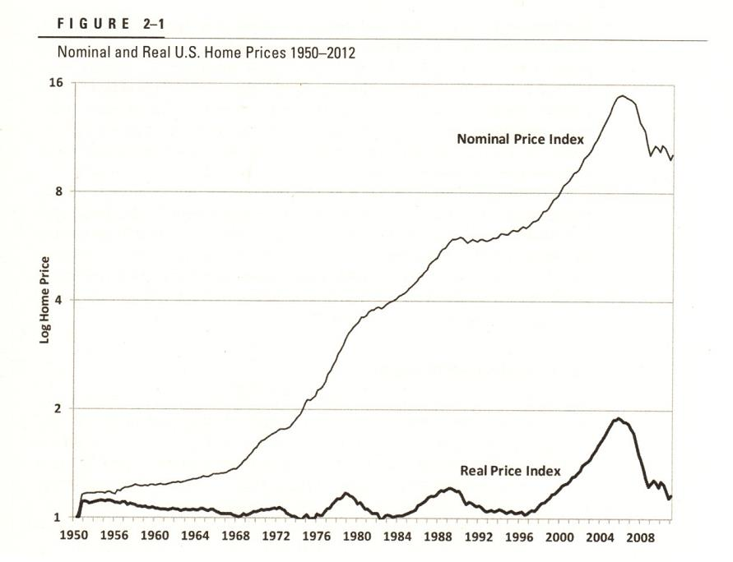
Homes have been great investments!
Homes have been great investments!
Nominal and Real US Home Prices 1950-2012
(Geometric
Scale)
Source: Stocks for the Long Run, Jeremy Siegel

Slide 47
Homes have been great investments! Or not?
Nominal and Real US Home Prices 1950-2012
(Geometric
Scale)
Source: Stocks for the Long Run, Jeremy Siegel

Slide 48
Homes have been great investments! Home prices have pretty much just kept pace with inflation over the long term. Think of your home as, first and foremost, a place to live and enjoy,… which also frees you from monthly rent (but not maintenance, taxes, and insurance).
Nominal and Real US Home Prices 1950-2012
(Geometric
Scale)
Source: Stocks for the Long Run, Jeremy Siegel

Slide 49
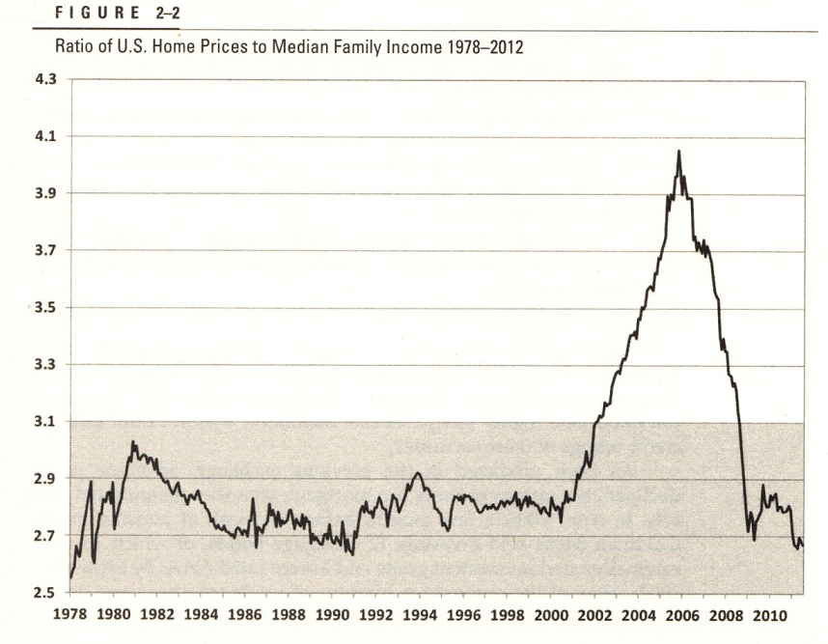
Home prices got unusually out of whack with family income in the early 2000s. Local real estate markets vary tremendously around the country in terms of affordability, though, with New York being extraordinarily expensive relative to average incomes.
Ratio of US Home Prices to Median Family Income 1978-2012
Source: Stocks for the Long Run, Jeremy Siegel

