Slide 1
Manage Investments Like a Pro!
Returns and risks – history
Returns and risks – outlook
Asset allocation and the power of diversification
Market timing
Passive (index) vs. active investing
Life cycle investing and target-date funds
Goals-driven investing (a.k.a., ALM, LDI)
Smart retirement strategies
Smart financial strategies

Slide 2
Returns and risks – outlook
Demographics
Financial Repression
Valuations and Returns
Expect the unexpected!

Slide 6
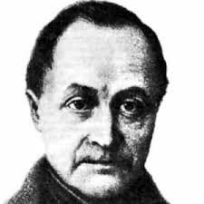
Demographics
“Demographics are destiny.”
Auguste Comte

Slide 7
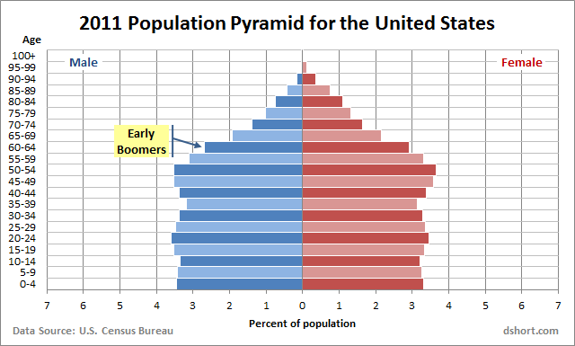
The U.S., and most of the developed world, are about to undergo a major demographic change which significantly shifts the economic landscape
2011 Population Pyramid for the United States
Echo
Boomers
Every day now, for the next 19 years, 10,000 US Baby Boomers will reach retirement age
Notes:
Boomers: 1946-1964, 18 years, 65+ from 13% last year to 18% in 2030,next 18 years. On white board.

Slide 8
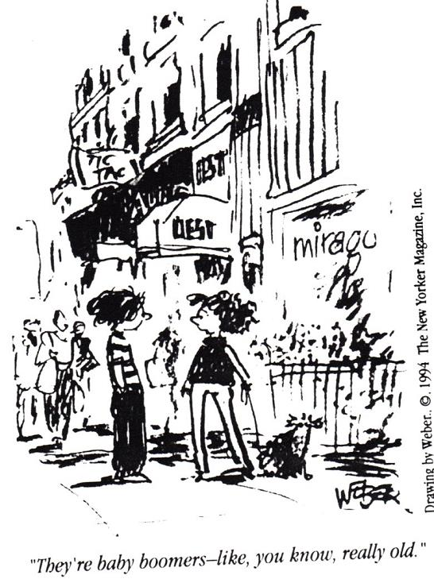

Slide 9
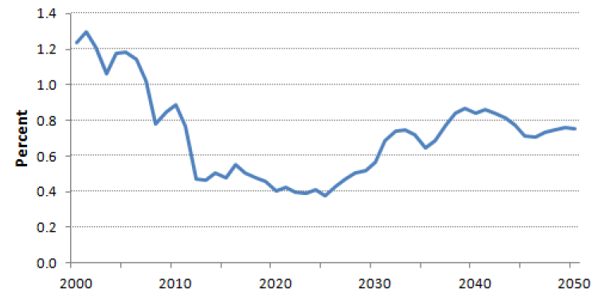
Demographics point to an extended period of slow US economic growth
Annual Rate of Change in Number of US Persons of Working Age
Sources: US Census Bureau, ISI Group

Slide 10
Economic Outlook
We have constantly kicked the can down the road – but now we’re down the road.
Mohamed El-Erian Paraphrase
A Roadmap for the Grey Age
Deutsche Bank

Slide 11

The entire developed world appears to be headed for a period of slow growth
Developed World Working Age Population Growth
Developed World 10 Year Average Growth Rate
Source: Bridgewater

Slide 12
While population growth stalls in the developed world it is expected to continue to swell in emerging markets
EM and DM Population in Billions
By 2099 EM will be 90% of total
US will be one of the only DM countries to grow: +150 M
Germany will contract by 12 M and Japan by 35 M
+53% +3 B
Billions
+8% +90 M
Notes:
The US population will expand by 150 M while Germany will contract by 12 M and Japan by 35 M.

Slide 13
And dependency ratios will climb throughout the developed world.
But another story in the emerging world.
Dependency Ratios*
Source: GMO, United Nations

Slide 14
There will also be many crosscurrents within the developed and emerging worlds
Dependency Ratios*
Source: GMO, United Nations

Slide 15
China’s productivity ratio peaks in about five years at a lofty level before starting a long decline. India has a very long climb from low levels ahead of it.
35-54 yr productivity ratios for different global regions
Source: Deutsche Bank, GFD, UN Population Division

Slide 16
Where do stock returns come from?
Dividend Income
Earnings Growth
Change in PE Ratios
The Three Building Blocks of Stock Returns

Slide 17
That simple formula has closely accounted for US stocks’ performance, decade-by-decade
The Three Components of Stock Returns
 | 1900s | 1910s | 1920s | 1930s | 1940s | 1950s | 1960s | 1970s | 1980s | 1990s | 2000s | 2010-2017
Initial Dividend Yield | 3.7 | 4.7 | 7.9 | 4.5 | 5.0 | 6.8 | 3.1 | 3.4 | 5.2 | 3.1 | 1.1 | 2.5
Earnings Growth Rate | 5.4 | 2.7 | 6.1 | -5.7 | 9.9 | 3.9 | 5.5 | 9.9 | 4.4 | 7.7 | 1.1 | 10.7
Change in PE Ratio | -0.2 | -3.7 | 3.0 | 0.4 | -6.3 | 9.4 | 1.0 | -7.6 | 7.8 | 7.0 | -3.4 | 2.8
Calculated Total | 9.0 | 4.3 | 17.0 | -0.8 | 8.6 | 20.1 | 9.6 | 5.7 | 17.4 | 17.9 | -1.2 | 16.0
Actual Total | 10.9 | 2.2 | 15.6 | -0.1 | 9.2 | 19.4 | 7.8 | 5.9 | 17.5 | 18.2 | -0.9 | 13.9

Slide 18
That simple formula has closely accounted for US stocks’ performance, decade-by-decade
The Components of Stock Returns
 | 1900s | 1910s | 1920s | 1930s | 1940s | 1950s | 1960s | 1970s | 1980s | 1990s | 2000s | 2010-2017 | Average
Initial Dividend Yield | 3.7 | 4.7 | 7.9 | 4.5 | 5.0 | 6.8 | 3.1 | 3.4 | 5.2 | 3.1 | 1.1 | 2.5 | 4.3
Earnings Growth Rate | 5.4 | 2.7 | 6.1 | -5.7 | 9.9 | 3.9 | 5.5 | 9.9 | 4.4 | 7.7 | 1.1 | 10.7 | 5.1
Change in PE Ratio | -0.2 | -3.7 | 3.0 | 0.4 | -6.3 | 9.4 | 1.0 | -7.6 | 7.8 | 7.0 | -3.4 | 2.8 | 0.9
Calculated Total | 9.0 | 4.3 | 17.0 | -0.8 | 8.6 | 20.1 | 9.6 | 5.7 | 17.4 | 17.9 | -1.2 | 16.0
Actual Total | 10.9 | 2.2 | 15.6 | -0.1 | 9.2 | 19.4 | 7.8 | 5.9 | 17.5 | 18.2 | -0.9 | 13.9 | 10.2

Slide 19
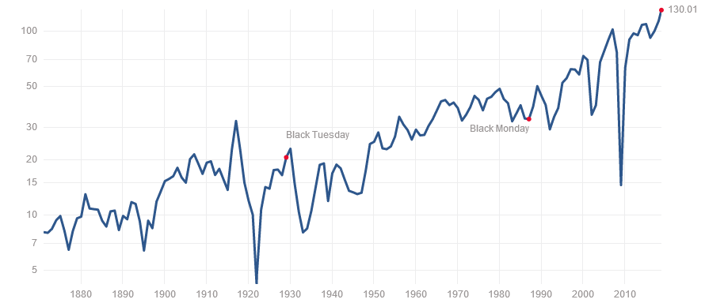
According to Professor Robert Shiller at Yale University, US stock “reported” earnings per shares grew at a 3.8% rate from 1874 to 2004 (and 1.7% inflation adjusted)
“Reported” GAAP S&P* Earnings Per Share
134.63
** https://en.wikipedia.org/wiki/Earnings_growth
(Robert Hiller, 1874-2004)
3.8% growth rate, 1.7% after inflation **
Dec 2018
Source: http://www.multpl.com/ * Data from Cowles Commission, 1871-1925, S&P 90, 1926-1956, S&P 500, 1957 - Present

Slide 20
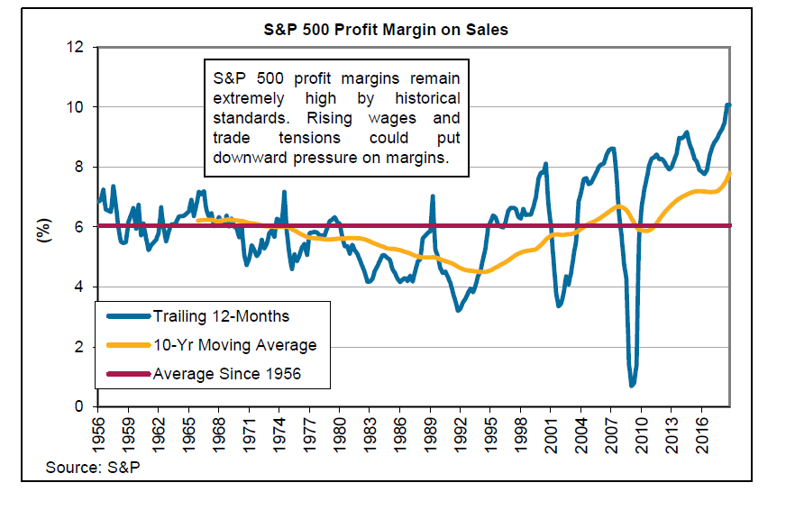
S&P 500 profit margins remain extremely high. Rising wages could and competition could put downward pressure on margins. Long history of reversion to the mean.
S&P 500 Profit Margin on Sales

Slide 21
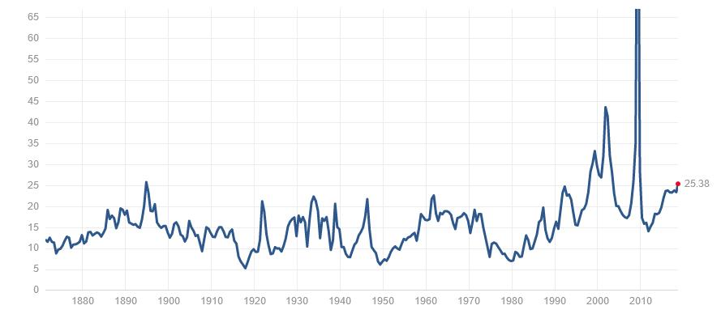
Price/Earnings ratios are very high by historic measures with plenty of room to revert to more “normal” levels
S&P* PE Ratio on Trailing Earnings
4/29/19: 22.2
Source: http://www.multpl.com/ * Data from Cowles Commission, 1871-1925, S&P 90, 1926-1956, S&P 500, 1957 - Present

Slide 22
Price/Earnings ratios are very high by historic measures with plenty of room to revert to more “normal” levels
S&P* PE Ratio on Trailing Earnings
4/29/19: 22.2
Median: 14.7
Source: http://www.multpl.com/ * Data from Cowles Commission, 1871-1925, S&P 90, 1926-1956, S&P 500, 1957 - Present

Slide 23

Most long term forecasters prefer to look at “cyclically-adjusted PE (CAPE)” rather than traditional PEs.
Such PEs are typically called Schiller PEs, named after Professor Robert Shiller, Nobel Prize Winner in Economics, at Yale University who popularized them.
Professor Shiller calculated the average earnings per share of the S&P 500 over the prior 10 years – and adjusted each of those earlier year’s earnings by the subsequent inflation. The objective was to get a better understanding of the earnings power of companies through booms and recessions.
Although a poor predictor of short and intermediate term returns, it has been a good long term (10+ year) predictor.

Slide 24
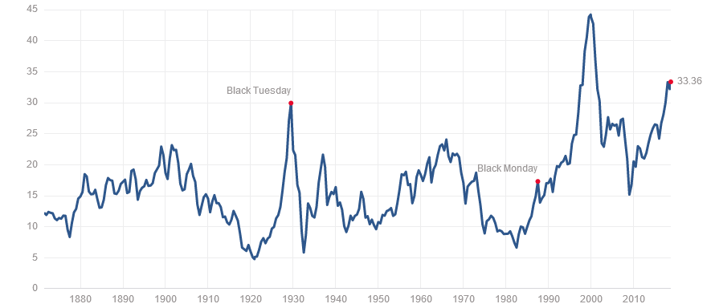
The Shiller PE climbed to an all-time record of almost 45 in 2000 before thereafter plunging. It is currently at a quite elevated level again.
Shiller PE Ratio (Price/10-Year Average Inflation-Adjusted Earnings)
4/29/19
31.0

Slide 25
The Shiller PE climbed to an all-time record of almost 45 in 2000 before thereafter plunging. It is currently at a quite elevated level again.
Shiller PE
4/29/19
31.0
Median: 15.7

Slide 26

When the sky seems bluest, returns are lowest.
And when things seem darkest, returns are highest.
William Bernstein
The Intelligent Asset Allocator

Slide 27
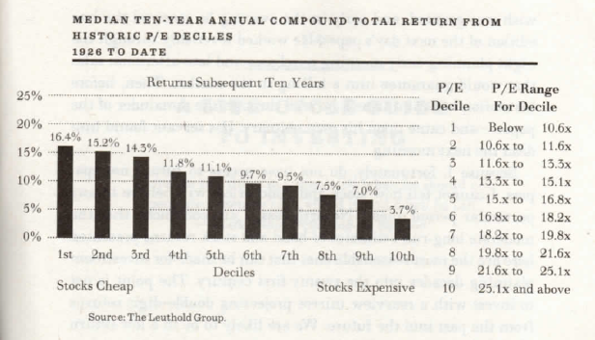
The Shiller PE climbed to an all-time record of almost 45 in 2000 before thereafter plunging. It is currently at a quite elevated level again.
Median 10-Year Annual Compound Total Return From Historic Shiller P/E Deciles Since 1926
Current:
3/30/19
30.5

Slide 28
Most professional forecasters believe the next 10 years performance will be muted due to low starting dividends yields, mean reverting high Shiller PEs, as well as more modest earnings growth as baby boomers retire and immigration slows
The Components of Stock Returns
 | 1900s | 1910s | 1920s | 1930s | 1940s | 1950s | 1960s | 1970s | 1980s | 1990s | 2000s | 2010-2017 | 10-15 Years
 |  |  |  |  |  |  |  |  |  |  |  |  | Expected
Initial Dividend Yield | 3.7 | 4.7 | 7.9 | 4.5 | 5.0 | 6.8 | 3.1 | 3.4 | 5.2 | 3.1 | 1.1 | 2.5 | 1.8
Earnings Growth Rate | 5.4 | 2.7 | 6.1 | -5.7 | 9.9 | 3.9 | 5.5 | 9.9 | 4.4 | 7.7 | 1.1 | 10.7 | 4.7
Change in PE Ratio | -0.2 | -3.7 | 3.0 | 0.4 | -6.3 | 9.4 | 1.0 | -7.6 | 7.8 | 7.0 | -3.4 | 2.8 | -1.0
Calculated Total | 9.0 | 4.3 | 17.0 | -0.8 | 8.6 | 20.1 | 9.6 | 5.7 | 17.4 | 17.9 | -1.2 | 16.0
Actual Total | 10.9 | 2.2 | 15.6 | -0.1 | 9.2 | 19.4 | 7.8 | 5.9 | 17.5 | 18.2 | -0.9 | 13.9 | 5.5

Slide 29
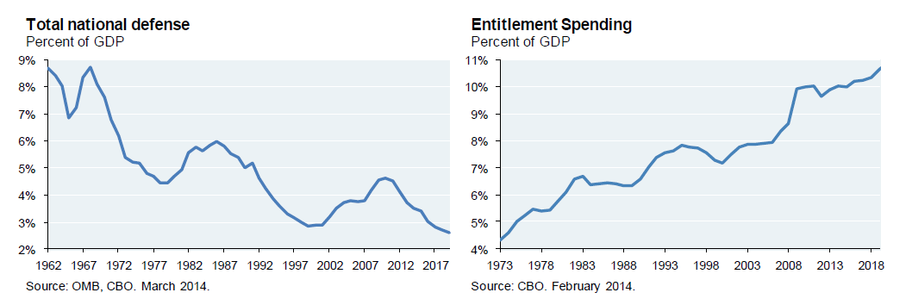
Recent increases in defense spending come at a time of climbing entitlement spending…and a massive tax cut.
Total National Defense (% of GDP)
Entitlement Spending (% of GDP)
Source: JP Morgan

Slide 30
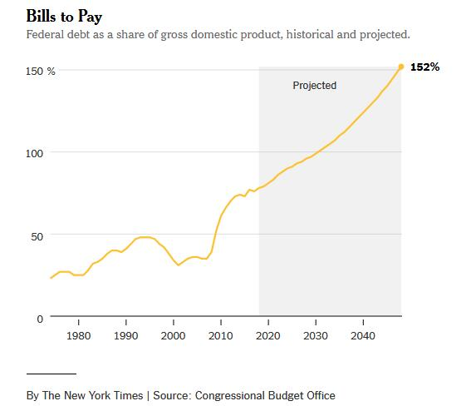
So the US government level of debt to GDP is expected to continue to rise to record levels
Federal Debt * to GDP Ratio
* Publicly held debt – does not include debt held in Social Security Trust Fund

Slide 31
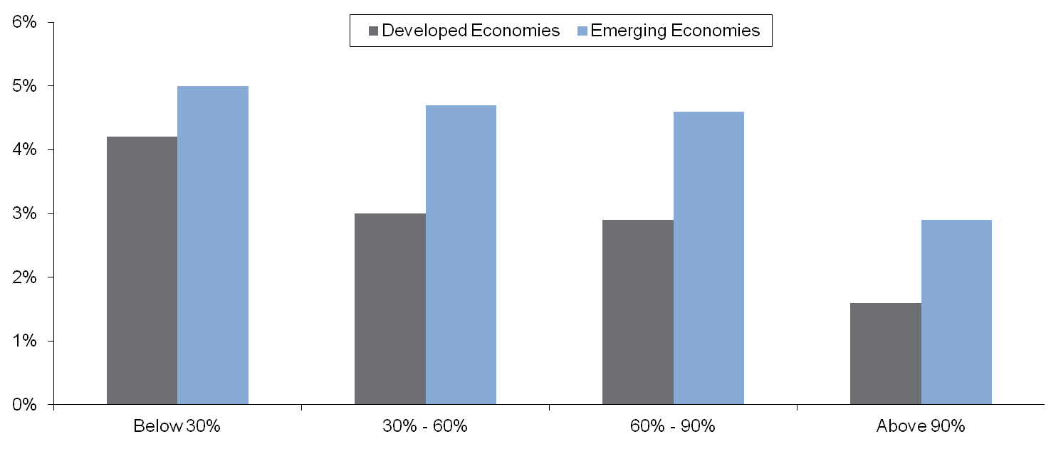
Economic growth tends to slow sharply when public debt levels exceed 90% of GDP
Real GDP Growth
Public debt/GDP ratio*
Source: “Growth in a Time of Debt” – Carmen M. Reinhart and Kenneth S. Rogoff, J.P. Morgan. *Based on median growth rates and debt levels between 1946-2009.

Slide 32
What about future returns from bonds?
Dutch 10-Year Yields U.S. 10-Year Yields
Lowest ever…in centuries
Hit an all time low…
Current: 0.34%
Current: 2.70%
Source: Deutsche Bank, GFD
Source: Deutsche Bank, Bloomberg

Slide 33
“Financial repression is occurring not just in the U.S. but in all developed countries with high debt levels. It is the hidden way governments pick the pockets of savers.”
Bill Gross
Barron’s
6/13/11

Slide 34
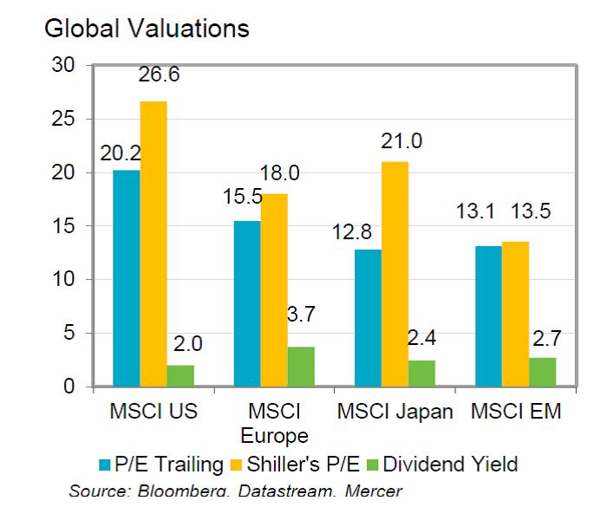
The good news, though, is that valuations outside the U.S. generally look more reasonable – particularly for emerging markets
Global Valuations – March 31, 2019

Slide 35
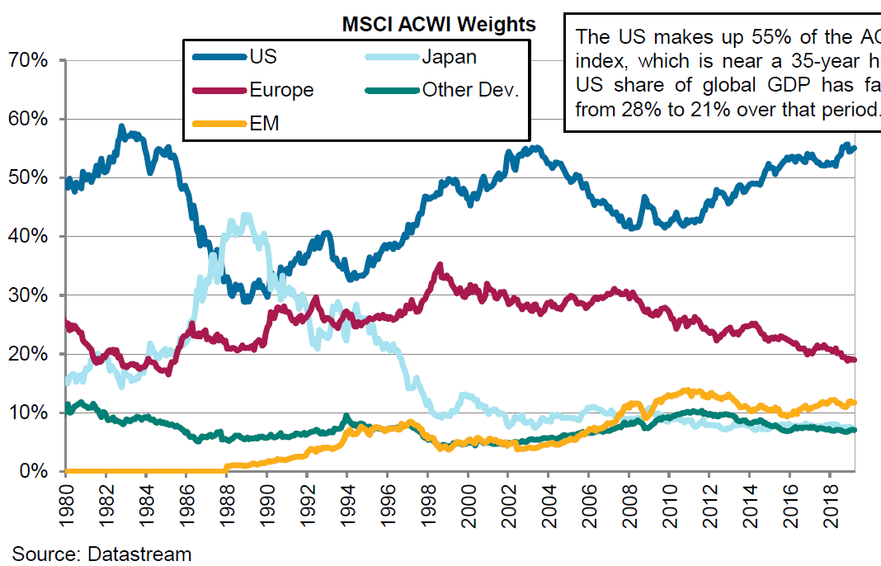
The US makes up 55% of the AC World Index, which is near a 35-year high. US share of global GDP has fallen from 28% to 21% over the period.
MSCI AC World Index Weights
(From Mercer)

Slide 36
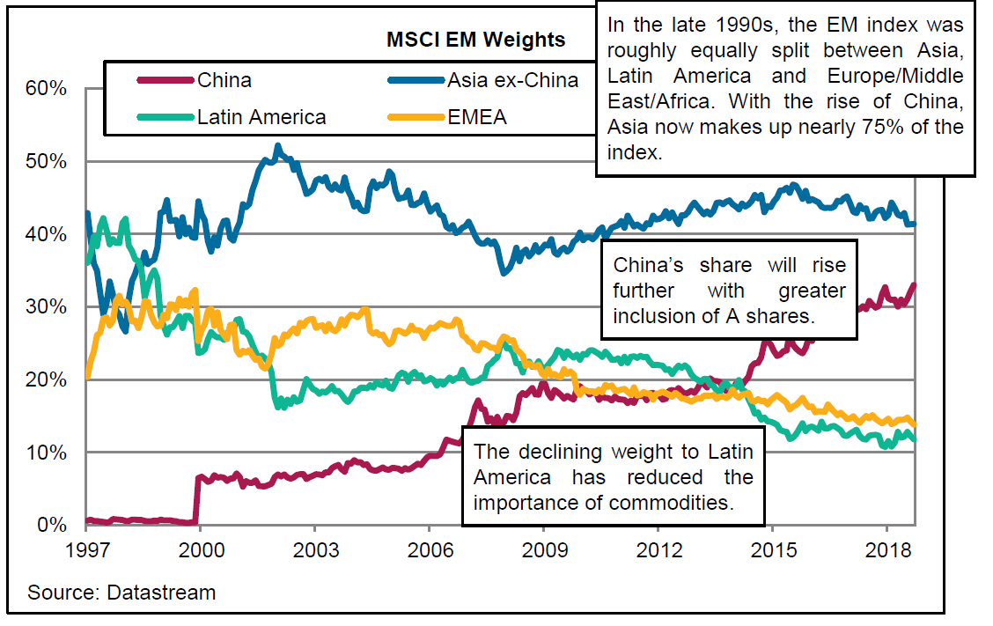

Slide 37
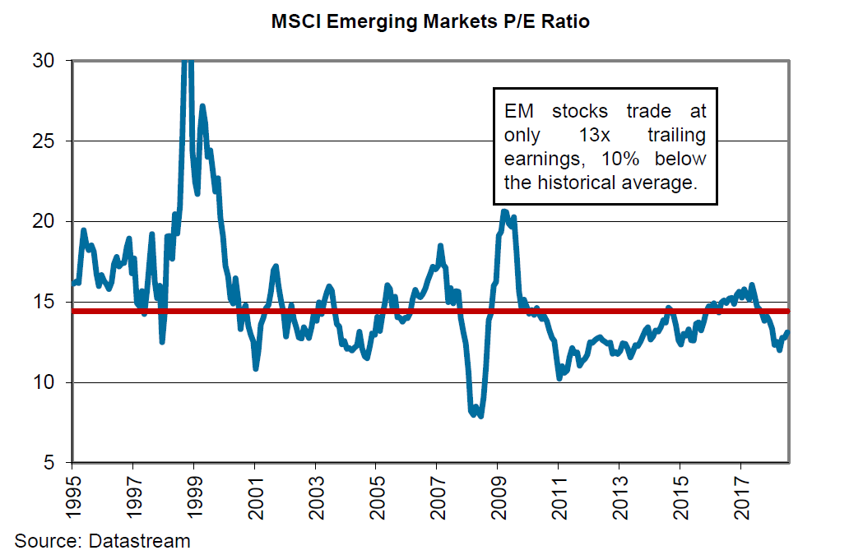

Slide 38
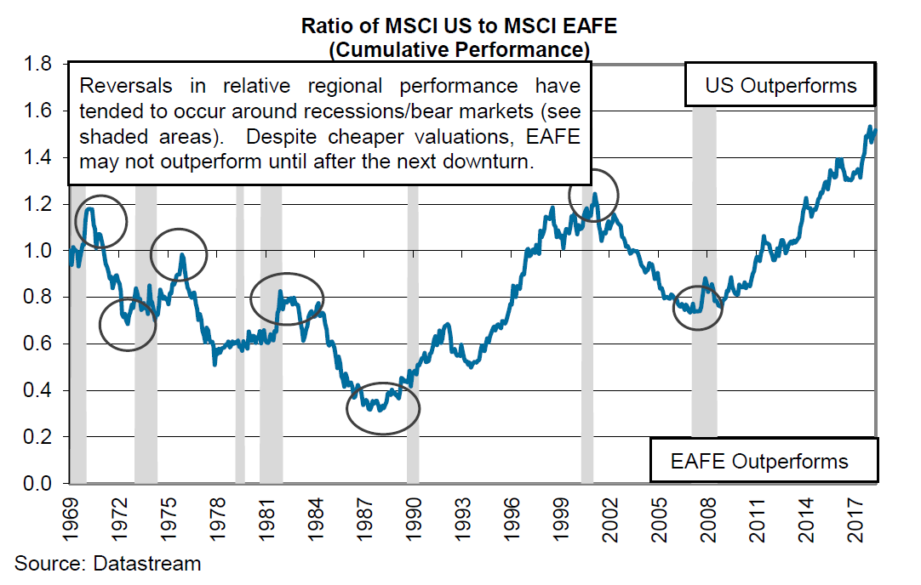
The US has outperformed international stocks since the Great Recession. Turns in this ratio have often occurred around past recessions.
Ratio of MSCI US to MSCI EAFE (cumulative performance)

Slide 39
JP Morgan’s long term expected asset class returns and risks (volatilities) are in line with most other professionals’ long term forecasts – muted.
JP Morgan 2018 Long Term (10-15 Years) Expected Returns and Risk (Volatility) | Compound Annual Return | Arithmetic Return | Standard Deviation
Inflation | 2.25 | 2.26 | 1.25
T-Bills | 2.00 | 2.00 | 0.50
TIPS | 2.75 | 2.90 | 3.50
US Aggregate Bonds | 3.25 | 3.32 | 5.50
US High Yield Bonds | 5.25 | 5.59 | 8.50
Emerging markets Sovereign $ Bonds | 5.25 | 5.70 | 9.75
Emerging Markets Local Currency Bonds | 6.25 | 6.94 | 12.25
US Muni Bonds (1-15 Yield Blend) | 2.50 | 2.55 | 3.25
US Large Cap | 5.50 | 6.41 | 14.00
US Med Cap | 5.75 | 6.93 | 16.00
US Small Cap | 5.75 | 7.35 | 18.75
Large Value | 5.75 | 6.75 | 14.75
Large Growth | 5.25 | 6.19 | 14.25
EAFE Hedged | 6.25 | 7.12 | 13.25
Eafe Un-Hedged | 6.25 | 7.61 | 17.25
EM Equity | 8.00 | 10.04 | 21.50
All Country World Equity | 6.00 | 7.10 | 15.50
Commodities 3.75 5.18 17.50
Gold 4.00 5.67 19.00

Slide 40

It may be tempting to hope that asset returns in the 21st century United States will continue to be as spectacular as in the last century, but John Bogle cautioned his readers in his 2009 book Enough, “Please, please, please: Don’t count on it.”

Slide 41
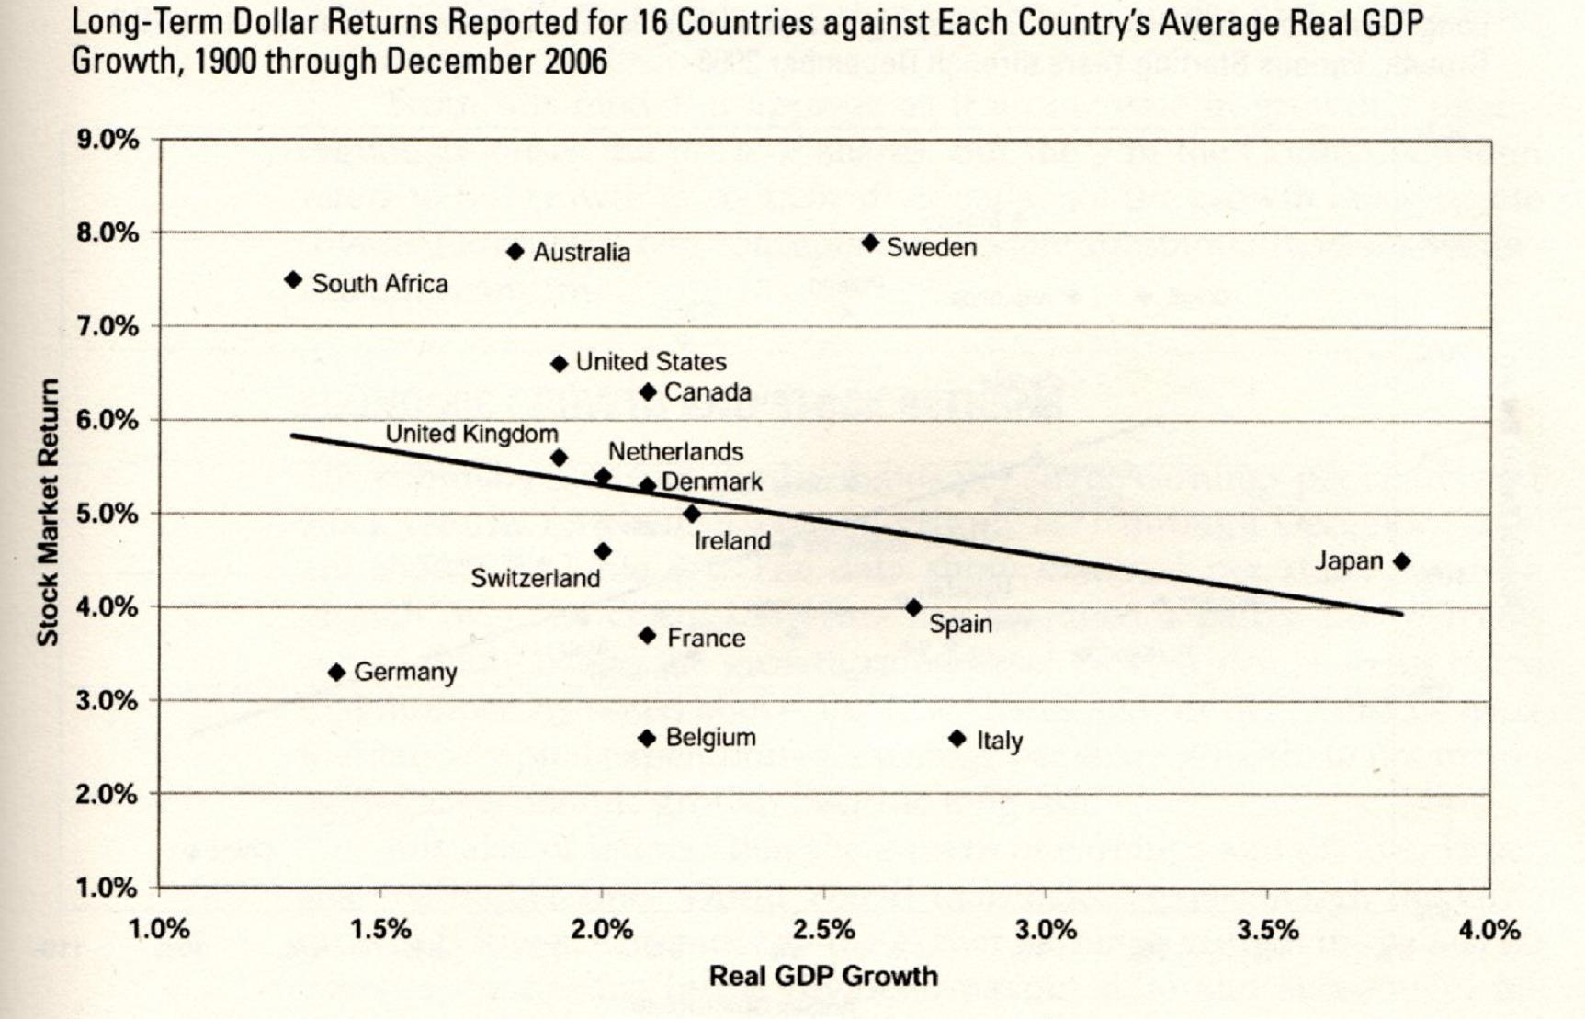
A final thought! There has been virtually no correlation between developed country long term GDP growth and their stock markets’ long term real annualized return
Long-Term Dollar Returns Reported for 16 Countries against Each Country’s Average Real GDP Growth, 1900 through December 2006
(Real)
(Per Capita)
Source: Siegel, Jeremy J., Stocks for the Long Run, Fourth Edition

Slide 42
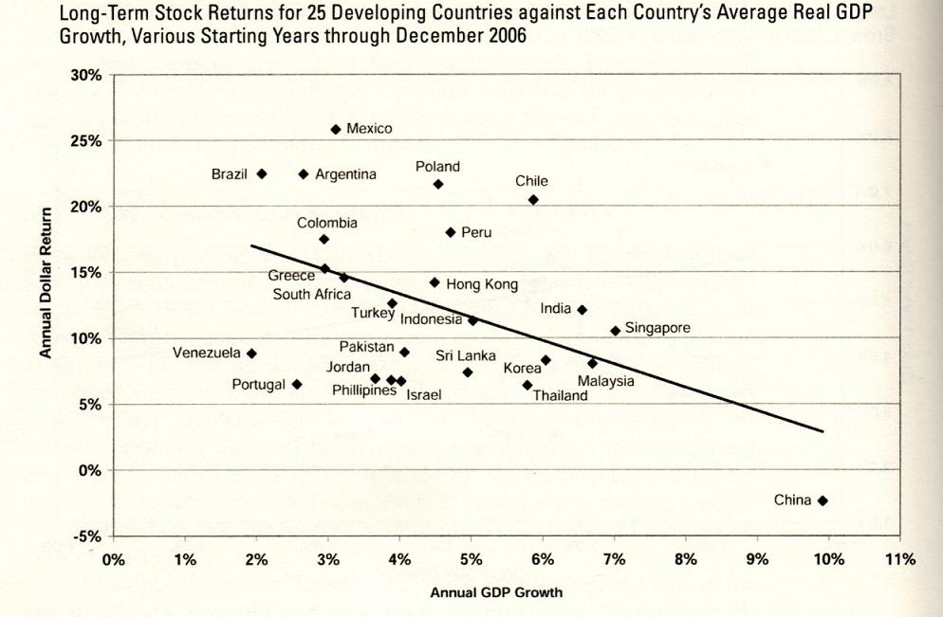
A final thought! There has been virtually no correlation between developed country long term GDP growth and their stock markets’ long term real annualized return
Long-Term Dollar Returns for 25 Countries against Each Country’s Average Real GDP Growth, Various Starting Years through December 2006
Source: Siegel, Jeremy J., Stocks for the Long Run, Fourth Edition

Slide 43
A final thought! There has been virtually no correlation between developed country long term GDP growth and their stock markets’ long term real annualized return
Long-Term Dollar Returns for 25 Countries against Each Country’s Average Real GDP Growth, Various Starting Years through December 2006
Valuations matter most
- as do how growth is financed
- as do dividends and buybacks
Source: Siegel, Jeremy J., Stocks for the Long Run, Fourth Edition

Slide 44


Slide 45


Slide 46


