Slide 1

Smart retirement strategies
Make your nest egg last a lifetime!

Slide 2
Due to mortality uncertainty, annuities, pensions, and Social Security have important roles to play in an optimal retirement portfolio. Covered in the next section – Retirement Strategies

Slide 5
Am I on track to have enough money for a comfortable retirement?
Age |  | Savings
30 |  | 1/2 X salary
35 |  | 1 X salary
40 |  | 2 X salary
45 |  | 4 X salary
50 |  | 6 X salary
55 |  | 8 X salary
60 |  | 10 X salary
65 |  | 12 X salary
(low income people will need less and high income people will need more do the relative importance of Social Security.)
Source: T. Rowe Price

Slide 6
How much do I need to save during my accumulation years?
9% if your compensation is < $50 K
12% or higher if your compensation is $50 K to $100 K
15% or higher if your compensation is > or = to $100 K
Source: The Vanguard Group

Slide 7
Higher income households need to be able to replace a larger share of their income on their own than lower income participants.
Source: Social Security web site

Slide 8
How much do I need to retire comfortably?
65%................………………..to…
Save a large portion of their annual earnings during their working careers
Don’t have a mortgage or any other debt in retirement
Are higher-income earners who don’t anticipate leading an expensive lifestyle in retirement
85%....of pre-retirement income...
Save little or none of their annual earnings before retirement
Still have a significant mortgage or growing rent to pay in retirement
Need nearly all current income to meet their current lifestyle
Have expensive hobbies that they have more time to pursue
Source: Personal Finance for Seniors for Dummies

Slide 9

Delay starting Social Security benefits
You will get 70% more annual income delaying the start of your benefits from age 62 to age 70.

Slide 10
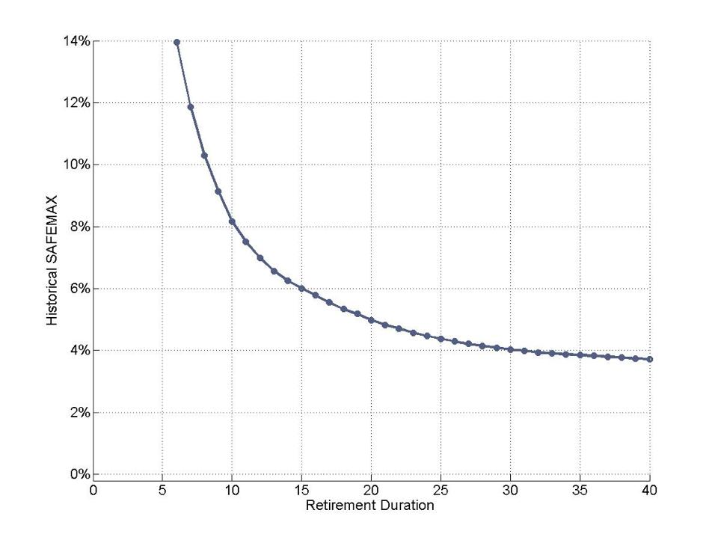
Up until recently conventional wisdom – based upon history – suggested 4% was a safe starting withdrawal rate for retirees
“Historical” Safe Maximum Withdrawal You Could Grow With Inflation
The strategy worked based upon stock allocations of 50% to 75%

Slide 11
Maximum Sustainable Withdrawal Rates
For Retirees 1900-1981
Asset Allocation: 50% Stocks & 50% Bills
The US has “historically” had the highest safe withdrawal rate – but country rankings do change through history

Slide 12
There are no guarantees when it comes to DC retirement success (not running out of money).
There are tradeoffs:
High sustained withdrawal rates = low probability of long term success
Low sustained withdrawal rates = high probability of long term success
What probability of retirement success do you want?
100%? 90%? 80%? 70%? 60%? 50%?
Are you willing to pay the price of high probabilities of success? (Low withdrawal rates)

Slide 13
Risk is a four-letter word in the retirement world

Slide 15
Imagine a 35-year investment horizon, a portfolio with an expected return of 7.5% and annual risk of 12.5%, (35-year risk of +/- 2.2%)
9.7%
5.3%

Slide 18
Big differences in retirement lifestyles!
We seek to minimize risk to avoid bad future outcomes
(while maximizing the “median” expected outcome)
$2,500,000 = $75,000 pa “real”
$1,250,000 = $37,500 pa “real”
$600,000 = $18,000 pa “real”

Slide 19
Big differences in retirement lifestyles!
We seek to minimize risk to avoid bad future outcomes
(while maximizing the “median” expected outcome)
$2,500,000 = $75,000 pa “real”
$1,250,000 = $37,500 pa “real”
$600,000 = $18,000 pa “real”

Slide 20

Or…

Slide 21


Slide 22
What is a safe starting withdrawal rate you can grow with inflation…today?

Slide 23
Current very low bond yields (and high PEs) call into question the traditional 4% withdrawal recommendation
Yields for U.S. Balanced Portfolios (50% stock/50% bond): 1926 to 2018
2/19/19 Yield: 2.4%
*

Slide 24
Long term interest rates have also been pushed down to unprecedented levels
Dutch 10-Year Yields U.S. 10-Year Yields
Lowest ever…in centuries
Hit an all time low…
Current: 0.3%
Current: 2.7%
Source: Deutsche Bank, GFD
Source: Deutsche Bank, Bloomberg

Slide 25
Bonds can disappoint for long periods of time.
Real 10-Year Treasury Return Series
1940
1980
Bonds: ~ -1% Real CAGR

Slide 26
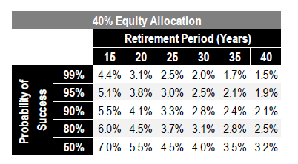
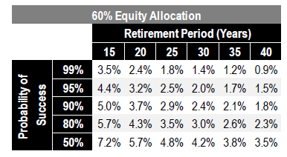
Based upon today’s high stock market valuations and low bond yields, most financial planners conclude a 3% starting withdrawal rate is appropriate for 30-year horizons
Uncertainty. The lower the withdrawal rate the higher the probability of success!
40% Equity Allocation
60% Equity Allocation
On “average” higher equity allocations help – but uncertainty increases
Source: Professor Wade Pfau, CFP

Slide 27
Based upon today’s high stock market valuations and low bond yields, most financial planners conclude a 3% starting withdrawal rate is appropriate for 30-year horizons
Uncertainty. The lower the withdrawal rate the higher the probability of success!
40% Equity Allocation – OK Withdrawal Rates
60% Equity Allocation – OK Withdrawal Rates
On “average” higher equity allocations help – but uncertainty increases
Nb: These projections assume 0% expense ratios on your investments. A 0.50% or 1.00% overall expense ratio – including a financial planner would make a big dent in these projections!
Source: Professor Wade Pfau, CFP

Slide 28
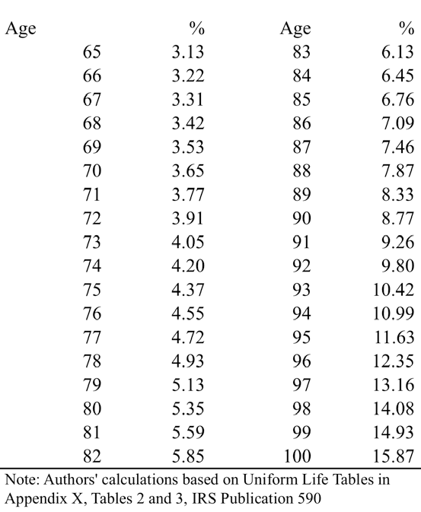
An alternative to the (historic) 4% withdrawal rule is to withdraw an age-related percent of your portfolio’s annual value
1/Years of Life Expectancy
Source: Wei Sun and Anthony Webb, Boston College
(RMD calculation pushed back to 65 by authors)

Slide 29
A “dynamic” withdrawal strategy typically allows retirees to withdraw more over their lifetimes – but with greater variability
With a dynamic withdrawal strategy withdrawals would be reduced during bear markets somewhat – in some cases just forego your inflation “raise” – and the opposite in bull markets
Many complex formulae!

Slide 30
Safe withdrawal rates versus optimal and variable withdrawal rates

Slide 31
Overall withdrawals can also typically be increased by including some income annuities into overall portfolio – a partial substitute for some of fixed income
Incorporating fixed and/or inflation-protected annuities into your overall portfolio may allow you to exceed the new 3% withdrawal standard.
A “deferred annuity” starting at age 85 is cheap to buy and can insure you against outliving your money.
“Outliving one’s savings is perhaps the greatest risk for retirees. For example, a study by Allianz Life noted that the greatest fear among retirees is not death (39%) but rather outliving one’s resources (61%). Annuities allow a retiree to hedge away this risk and can therefore improve the overall efficiency of a retiree’s portfolio.”
Alpha, Beta, and Now…Gamma, David Blanchett, CFA, CFP, Paul Kaplan PhD., CFA

Slide 32

It is better to have a permanent income than to be fascinating.
Oscar Wilde
Approximate 2019 Rates
Male 65 year old
Fixed annuity: 6.7%
Inflation-protected annuity: 4.7%
Female 65 year old
Fixed annuity: 6.4%
Inlation-protected annuity: 4.5%

Slide 33
Consider buying from a “bidding platform” like Hueler’s which can be accessed from Vanguard’s web site. Buy direct and save.

Slide 34
Different insurance companies can be more competitive at different times depending upon their own needs

Slide 35
And be sure to consider the creditworthiness of different insurance companies – although most are insured by state funds

Slide 36
How much does inflation protection cost?

Slide 38
Optimize your withdrawal strategy - maximize your net retirement income
Tap nonretirement account money first
  Tap your nonretirement accounts efficiently
Let tax-free accounts compound as long as possible.
  Then tap traditional tax-deferred
  Finally, tap Roth accounts
Use your money
  Too often, retirees who were good savers during their working years have great difficulty enjoying and using their money in retirement
Source: Personal Finance for Seniors for Dummies

Slide 39
Traditional tax-deferred accounts are a great place to “locate” fixed income
An excellent location for building in stability to your overall portfolio
A fine place to hold investment grade bonds
Also, a fine place to hold return-seeking high yield bonds

Slide 40
Tax-deferred accounts can grow more rapidly than taxable accounts.
However, taxes are only “deferred.”
And capital gains have been converted into ordinary income.
Tax-Deferred Accounts Vs. Taxable Accounts
7.00% pa
Assumptions: 7% gross return, 40% tax rate
4.20% pa
Year 1
Year 35

Slide 41
Tax-deferred accounts can grow more rapidly than taxable accounts.
However, taxes are only “deferred.”
And capital gains have been converted into ordinary income.
Tax-Deferred Accounts Vs. Taxable Accounts
7.00% pa
5.63% pa
Assumptions: 7% gross return, 40% tax rate
4.20% pa
*
Year 1
Year 35
(*If you withdrew money at the 10-year mark, your net annualized return would be 4.68%)

Slide 42
To Roth with love…
As the Boomers retire, soaring entitlement spending will put strong upward pressure on tax rates
Federal spending projections for Social Security, Medicare and Medicaid
Federal Spending Projections for SS, Medicare and Medicaid – as % of GDP
Share of GDP
First Boomer hits 65 in 2011
2018
2028
+4.0% in 10 years
Source: U.S. Congressional Budget Office December 2005 “The Long-Term Budget Outlook,” J.P. Morgan Securities Inc. Assumes Medicare and Medicaid growth continues to outstrip economic growth by 2.5% per year. Assumes nominal GDP growth of 4.1% and real GDP growth of 2.2%.

Slide 43
By global standards, the US tax burden is on the low side.
Although the rich will initially be targeted, the middle class will eventually also be impacted.

Slide 44
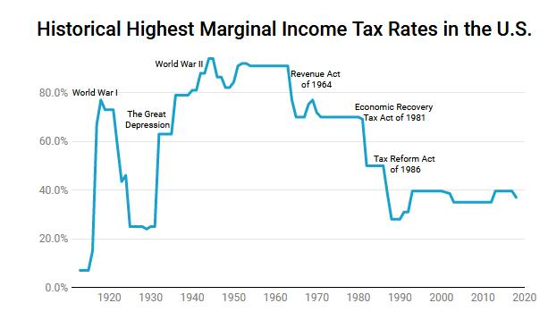
To Roth with love: Could we see such high marginal rates again?
Historical Highest Marginal Income Tax Rates in the U.S.
Source: Investopedia, The History of Taxes in the U.S., Tradiing Economics, multpx.com
40s: 5.6%, 50s: 4.3%, 60s: 4.4%, 20 years ending 2018: 2.1%

Slide 45
To Roth with love: Could we see such high marginal rates again?
Historical Highest Marginal Income Tax Rates in the U.S.
94%
92%
How was GDP growth in the 40s, 50s and 60s*?
How was GDP growth in 20 years ending 2018*?
Source: Investopedia, The History of Taxes in the U.S., Tradiing Economics, multpx.com
40s: 5.6%, 50s: 4.3%, 60s: 4.4%, 20 years ending 2018: 2.1%

Slide 46
Roth tax-deferred accounts are a great place to “locate” equities
Seek to grow your Roth accounts the fastest over time by focusing upon equities
An excellent place to hold emerging market equities as their dividends are typically not “qualified dividends” and are thus otherwise subject to ordinary income tax treatment. (EM equities also have little or no withholding tax at source.)
Also an excellent place to hold REITs as REIT income in a non-retirement account is taxed as “ordinary income.”
Can be a good place to hold gold bullion ETFs whose gains would otherwise be taxed at a “collectors” rate of 28%. Same goes for commodities funds.
An excellent place to hold high yield bond funds that throw off considerable income
Also a good place to hold actively managed funds that throw off lots of annual gains
A good opportunity for tax diversification
A Roth account also allows you to “effectively” defer a greater share of your income each year.
  You earn $100,000 pa. You can defer $18,500. (After age 50, you can defer $24,500.)
  In a Roth, that $19,000 would be the equivalent of $29,231 in a regular 401(k) ($19,000/.65…assuming a 35% tax bracket). And even more in higher tax brackets.
  You do not need to begin withdrawing from a Roth account when you hit 70.5.
  What a great account to inherit!

Slide 47
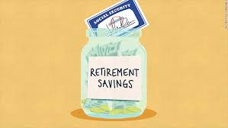
How do you hedge against the possibility of a very long life?
The importance of annuities – Social Security, pensions, private annuities, longevity annuities – which help offset longevity risk – as part of your Total Investment Portfolio

Slide 48
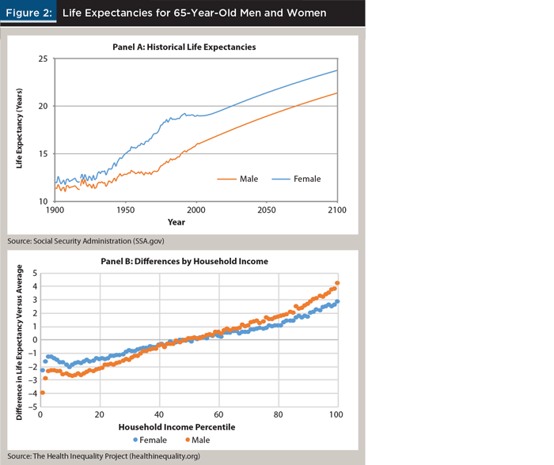
Life expectancy has increased as is expected to continue to increase. This makes Social Security benefits that much more valuable (and expensive to provide).
Life Expectancies of 65-Year-Old Men and Women

Slide 49
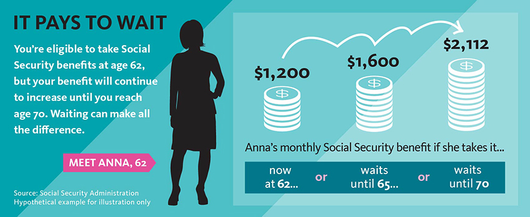
By deferring when you start taking Social Security you can effectively “buy” an inflation-protected annuity at very attractive rates much better than what you could get from a private insurance company

Slide 50
When should I begin my/our Social Security benefits?
Social Security benefits may be commenced at any time between age 62 and age 70
National Bureau of Economic Research, Working Paper, July, 2012
  Delaying is actuarially advantageous for a large subset of people
    particularly when real interest rates are 3.5% or below
    The gains are greatest for married couples relative to singles, for single women relative to single men, and for two-earner couples relative to one-iearner couples.
    Relative to claiming at age 62, all singles benefit from delaying the claim of Social Security benefits
      The average man, to age 69 and the average woman, to age 70
      The present value advantage for delay is significant for most, generally around 15%, but up to 24% for healthy women.
      If the real interest rate is 2.9%, the actuarial advantage largely disappears
  Its usefulness depends on the ability of households to overcome their natural, and fairly widespread, inclinations to claim Social Security retirement benefits at the same time they leave the labor force or at the earliest age they can, 62.
  Anomaly tends to favor the wealthy who can afford such strategies. And the wealthy live significantly longer than the average American.

Slide 51
When should I begin my/our Social Security benefits?
Social Security benefits may be commenced at any time between age 62 and age 70
National Bureau of Economic Research, Working Paper, July, 2012
  Delaying is actuarially advantageous for a large subset of people
    particularly when real interest rates are 3.5% or below
    The gains are greatest for married couples relative to singles, for single women relative to single men, and for two-earner couples relative to one-iearner couples.
    Relative to claiming at age 62, all singles benefit from delaying the claim of Social Security benefits
      The average man, to age 69 and the average woman, to age 70
      The present value advantage for delay is significant for most, generally around 15%, but up to 24% for healthy women.
      If the real interest rate is 2.9%, the actuarial advantage largely disappears
  Its usefulness depends on the ability of households to overcome their natural, and fairly widespread, inclinations to claim Social Security retirement benefits at the same time they leave the labor force or at the earliest age they can, 62.
  Anomaly tends to favor the wealthy who can afford such strategies. And the wealthy live significantly longer than the average American.

Slide 52
When should I begin my/our Social Security benefits?
Social Security benefits may be commenced at any time between age 62 and age 70
National Bureau of Economic Research, Working Paper, July, 2012
  Delaying is actuarially advantageous for a large subset of people
    particularly when real interest rates are 3.5% or below
    The gains are greatest for married couples relative to singles, for single women relative to single men, and for two-earner couples relative to one-earner couples.
    Relative to claiming at age 62, all singles benefit from delaying the claim of Social Security benefits
      The average man, to age 69 and the average woman, to age 70
      The present value advantage for delay is significant for most, generally around 15%, but up to 24% for healthy women.
      If the real interest rate is 2.9%, the actuarial advantage largely disappears
  Its usefulness depends on the ability of households to overcome their natural, and fairly widespread, inclinations to claim Social Security retirement benefits at the same time they leave the labor force or at the earliest age they can, 62.
  Anomaly tends to favor the wealthy who can afford such strategies. And the wealthy live significantly longer than the average American.

Slide 53

Buy a deferred income (“longevity”) annuity

Slide 54

To maximize lifetime income, consider using a portion of your fixed income portfolio to buy annuities – around 15% to 35% of your portfolio for a moderate investor with 40% in stocks
Buy an annuity
Given current low interest rates, consider an annuity ladder
Depending upon prevailing pricing, consider inflation-protected, or steadily increasing (1%, 2%, 3%) annuities
Annuity ladders

Slide 55
Deferred Income Annuities – An Example
Turns a lump sum into an annuity, after a period of deferment.
Assumes $100,000* investment by 60-year-old male, pays out for life beginning at age 80.
New York Life, Rating: A++
Lifetime Payout
Annual payout: $40,854
Lifetime Payout With 10-Years Certain
Annual Payout: $25,789
Lifetime Payout With Return of Principal to Heirs
Annual Payout: $30,238
Barron’s, May 27, 2013
* Actual published numbers are for $200,000 investments. Payouts in example are simply cut in half. Immediate “life only” annuity from Mass Mutual (A++) was $5,709.

Slide 56

Reverse Mortgages
Often retirees’ biggest asset in retirement is their home.
For those who need additional income, they can tap the equity in their homes through reverse mortgages.
Although there were historically many abuses in this arena, there are less today. But proceed carefully, regardless.

Slide 57
Optimize your assets to your liabilities
Follow the lead of a mature state pension (DB) plan as you approach retirement
Your liabilities are similar to those of a typical state DB plan – like being short a series of Treasury STRIPS which are sensitive to inflation
Short term TIPS may be the ideal fixed income asset as they closely track inflation with low volatility
  Longer term TIPS might be more attractive in the mix in a more typical real yield environment
Commodities (including gold), commodity equities (ETFs like VAW and VDE), and REITs may also provide some inflation protection
Although equities in general have a modestly “negative” correlation to inflation, their higher long term returns can help to offset high levels of inflation “over time”

