Slide 1
Manage Investments Like a Pro!
Returns and risks – history
Returns and risks – outlook
Asset allocation and the power of diversification
Market timing
The Case for Indexing – Theory and Evidence
Life cycle investing and target-date funds
Goals-driven investing (a.k.a., ALM, LDI)
Smart retirement strategies
Smart financial strategies

Slide 2
The Case for Index Funds
Theory and Evidence
Two basic types of mutual (and ETF) funds
Index funds seek to deliver the average return of the market (stock or bond)
Active funds seek to outperform the average return of the market

Slide 3
Theory:
A passive, or indexed, investment typically represents an entire asset class on a market capitalization-weighted basis. Due to its very low cost, it should deliver close to 100% of the asset class’s return.
Passive
Return
Risk

Slide 4
Theory:
Active management typically seeks to deliver more return than the total asset class at about the same risk level.
The Goal
Passive
Return
Risk

Slide 5
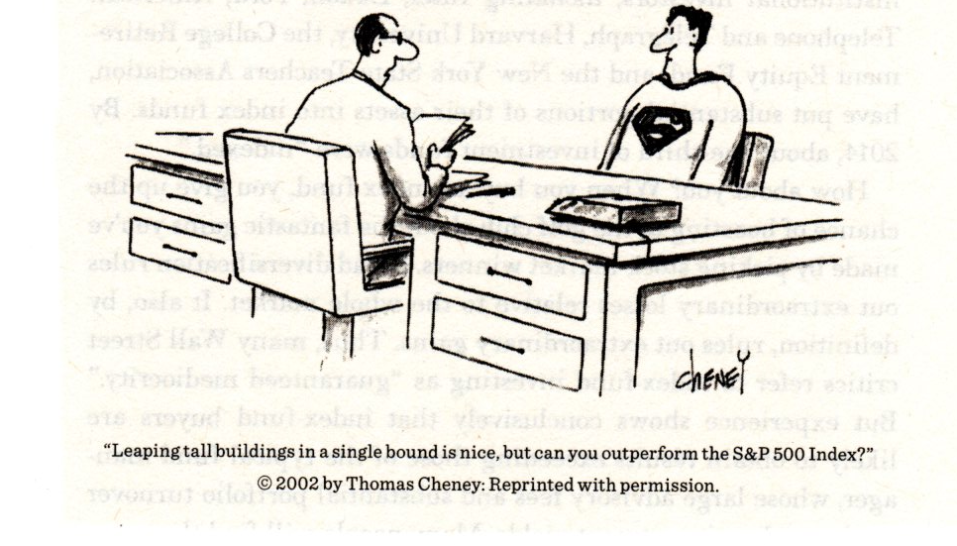
Source: A Random Walk Down Wall Street, Burton Malkiel

Slide 6
Theory:
In order for one active manager to outperform, another one must underperform. Given the higher management fees and transaction costs, the entire active universe must underperform.
The Goal
Passive
Return
Active “Universe”
Risk

Slide 7

Theory: Index Funds must outperform Active Funds over the long term
All managers comprise "The Market.“
Index managers match "The Market," less small fees and transaction costs.
If one active manager – or many – outperform the market, other active managers must underperform “The Market” by an equal amount.
Thus, Active managers, in aggregate, must also match "The Market" return less much higher fees and transaction costs.

Slide 8
How can institutional investors hope to outperform the market…when, in effect, they are the market?
Charles D. Ellis, 1975

Slide 9
Theory:
Indexing has a major cost advantage over active management
The Arithmetic of Active Management Index Active

Slide 10
Evidence:
Active U.S. equity mutual fund managers have underperformed, except during certain short periods of time.
Sources: Lipper Analytical Services, S&P, and Vanguard

Slide 11
Evidence:
Active U.S. equity mutual fund managers have underperformed, except during certain short periods of time.
Number of funds for each time period:
1-year: 2,245
5-year, 1,597
10-year, 801
20-year, 155
Sources: Lipper Analytical Services, S&P, and Vanguard

Slide 12
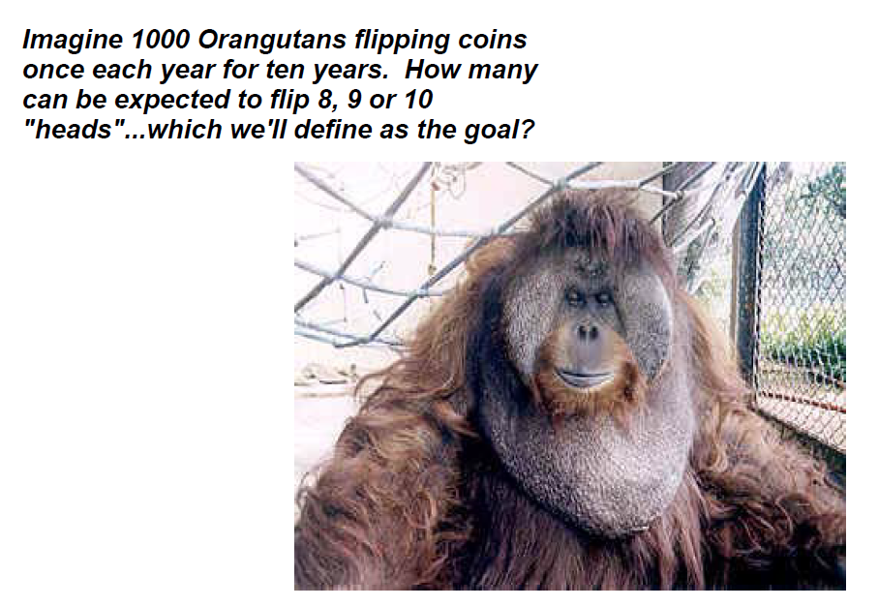

Slide 13
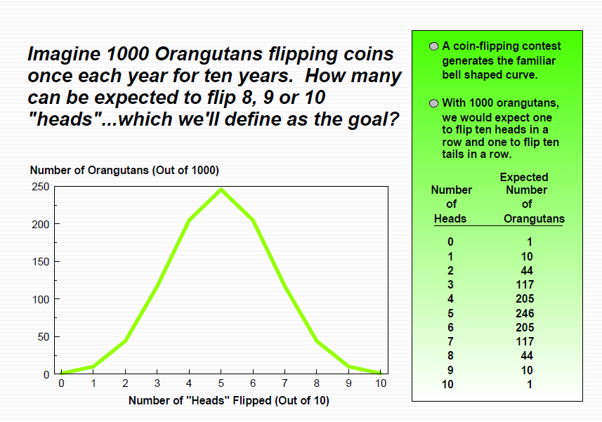

Slide 14
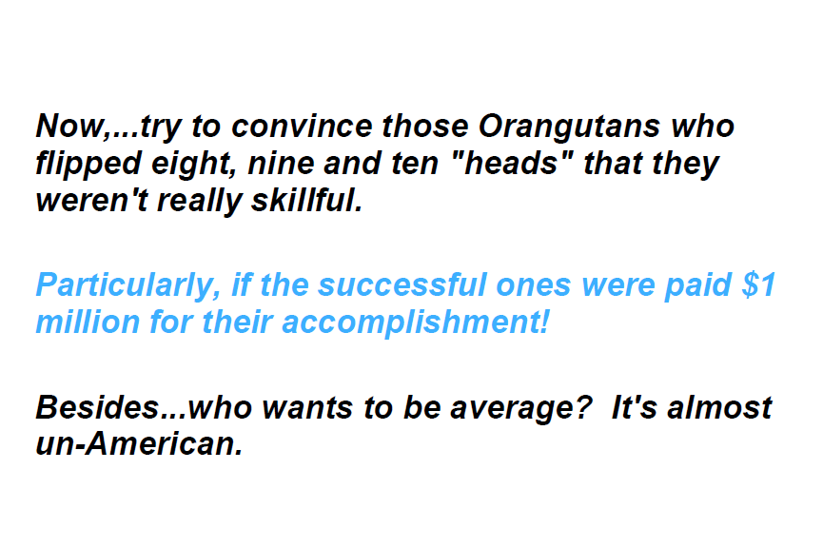

Slide 15
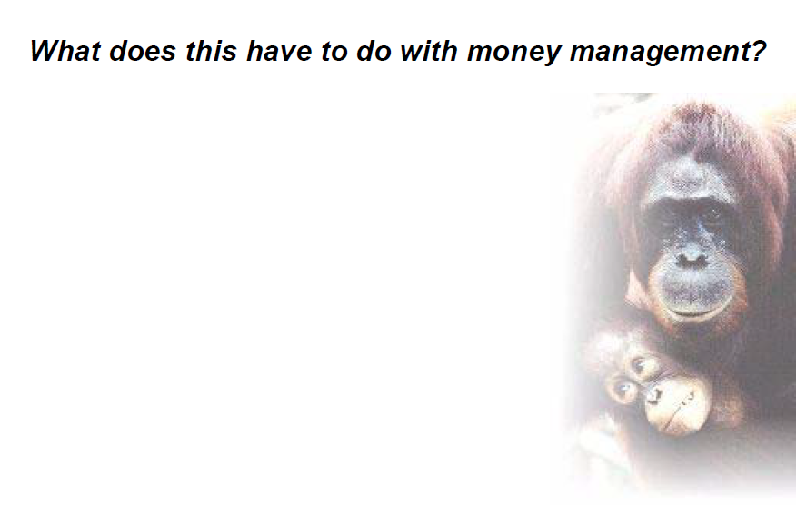

Slide 16
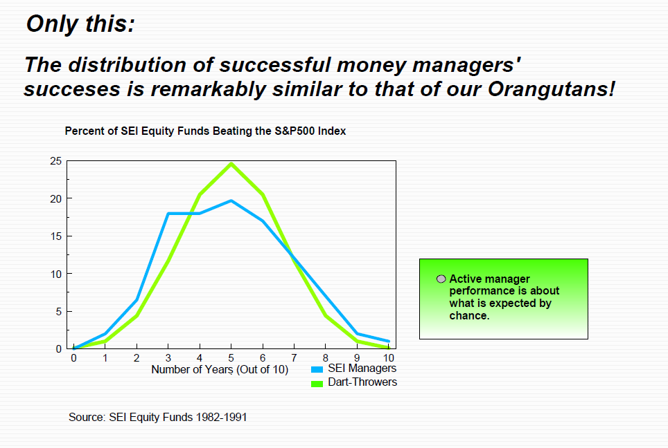

Slide 17
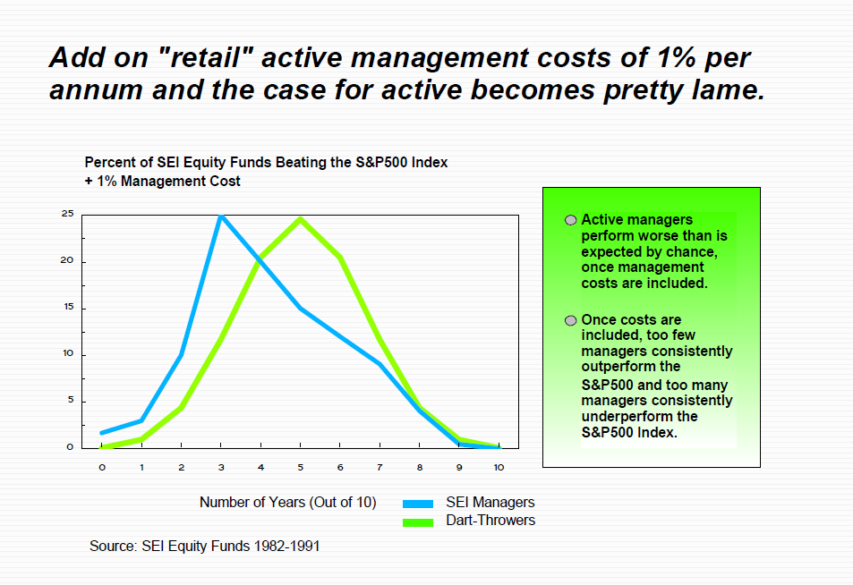
Evidence:

Slide 18
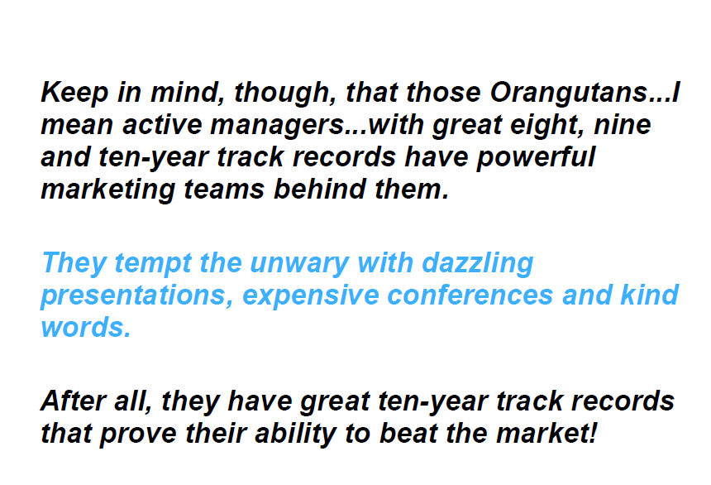

Slide 19
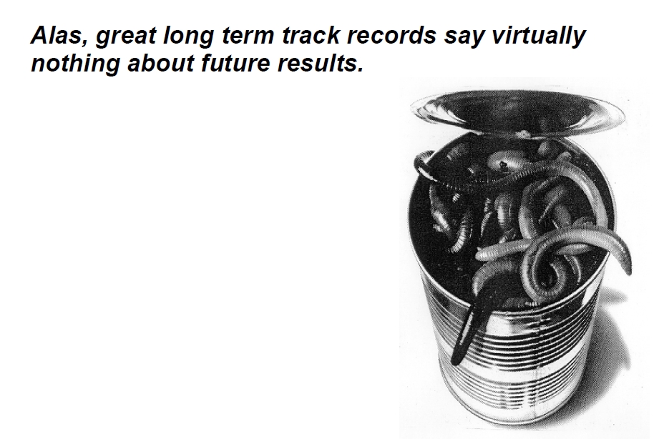

Slide 20
More Evidence:
86% of actively managed small-cap funds lagged the MSCI Small Cap 1750 Index over 10 years
0
Small-Cap Funds Versus MSCI US Small-Cap 1750 Index

Slide 21
More Evidence:
81% of actively managed emerging markets funds lagged the MSCI EM G Index over 10 years
0

Slide 22
By investing in index funds, you’re guaranteeing that you play the game at par every round…how many people are able to do that?
Professor Burton Malkiel

Slide 23
OK, but I only invest with mutual fund managers with great “long term” track records!

Slide 25
Evidence:
Buying top performing fund over past five years has not been a good strategy for the next five years
Top Five-Year Performers and Subsequent Performance

Slide 26
Evidence:
But we only select managers with great ten-year track records!
Rank of Top-20 Domestic Equity Funds and Their Rank in Subsequent Decade
Past performance is no guarantee of future performance. (In fact, past performance says virtually nothing about future performance.)

Slide 27
Evidence:
But the reality is even worse!
Survivorship Bias. Most mutual fund performance analysis significantly overstates performance as we only see the performance of the survivors.
Survivorship Bias

Slide 28
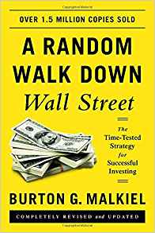
Evidence:
Princeton Professor Burton Malkiel studied survivorship bias inherent in long term mutual fund performance studies. He concluded that such studies overstate “actual” performance by an average of 1.5% per annum.
Source: Financial Planning, June, 2001

Slide 29
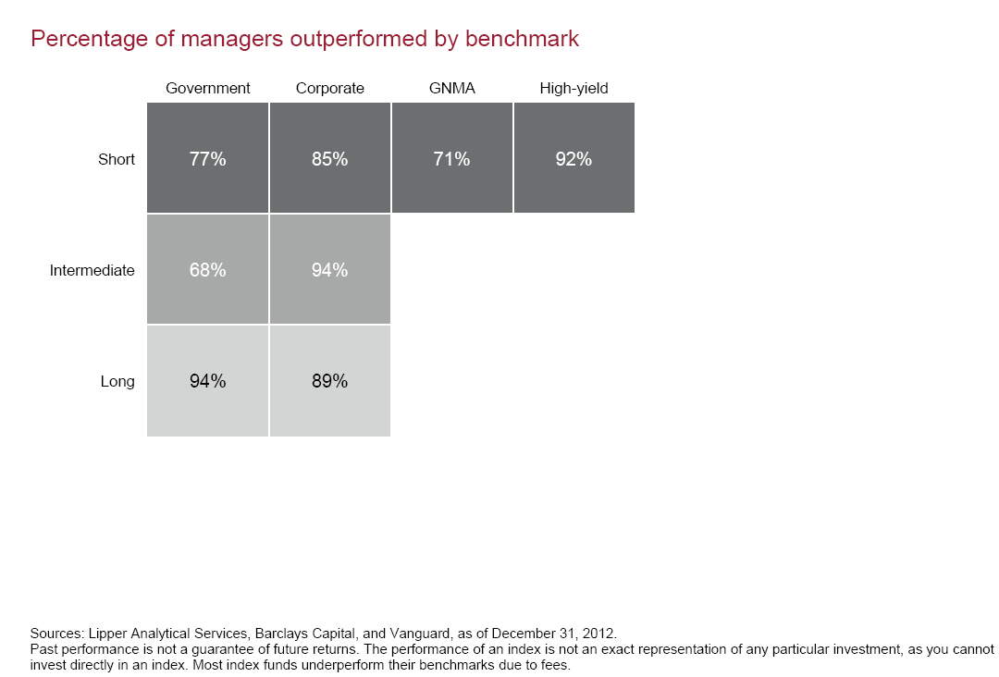
Evidence:
We see the same active underperformance in the bond arena
Percentage of Bond Managers That Outperformed Benchmark 10 Years Ending 2012
 | Government | Corporate | SNMA | High Yield
Short | 23% | 15% | 29% | 8%
Intermediate | 32% | 6%
Long | 6% | 11%

Slide 30
And past performance is actually not even any guarantee of past performance!
Magellan Fund
Excess Return %

Slide 31
And past performance is actually not even any guarantee of past performance!
Magellan Fund
Excess Return %
Assets Under Management $B
Time-weighted performance = Dollar-weighted (IRR) performance

Slide 32
The Game of Active Management in the Savings Plan World
Magellan has disappeared from virtually all savings plan investment lineups
It has been replaced by new funds with great track records…records that no savings plan investors have actually experienced
Bad records disappear. Great “records” appear. Bad records disappear. Great “records” appear.
Naïve investors feel happy – “what great choices I have!”

Slide 33
In addition to outperforming most active managers, index funds deliver very broad diversification (and lower risk)
For example,
Vanguard Total World Stock ETF tracks the performance of about 8000 stocks in over 47 countries
iShares Core U.S. Aggregate ETF tracks the performance of virtually the entire U.S. investment grade taxable bond market
SPDR S&P 500 ETF Trust tracks the performance of the 500 stocks in the S&P 500
Etc!
ER: 0.10%
ER: 0.05%
ER: 0.04%

Slide 34
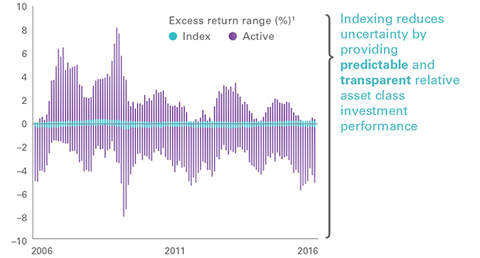
Another advantage of index funds is that they provide relative performance predictability
Excess Return Range (%)
Indexing reduces uncertainty by providing predictable and transparent relative asset class investment performance
Source: The Vanguard Group

Slide 35
And finally, indexing is a “tax-efficient” way of investing!
Unlike active management, index management is not making capital gains distributions – which result in annual tax liabilities
(Most relevant for taxable accounts…to the extent you want some active strategies…tax-deferred accounts are, in fact, good “locations.” “Asset location” is a whole other subject!)
Source: The Vanguard Group

Slide 36
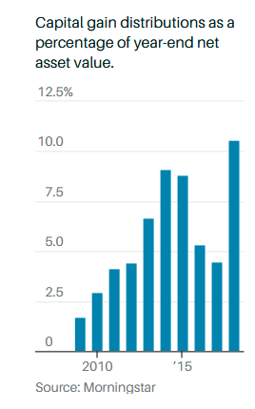

One of the problems with active mutual funds is that (taxable) investors have to pay capital gains taxes most years
Capital Gain Distributions as a Percentage of Year-end Net Asset Value
Source: Barron’s , February 4, 2019

Slide 37
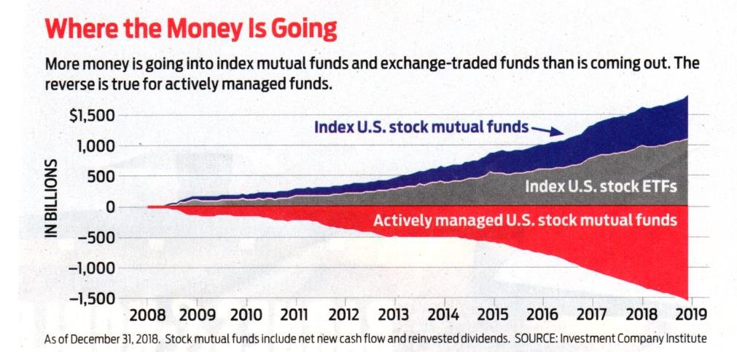
Low cost indexing is winning the battle for investors’ assets
Where the Money is Going
Source: Kiplinger’s Personal Finance, April 2019

Slide 38
“Beating the market” has been a short-lived victory
Predictability of Five-Year U.S. Equity Quintile Rankings

Slide 39
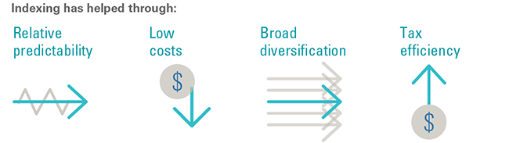
The benefits of indexing are clear
And indexing has helped millions of investors achieve their goals
Indexing Benefits
Source: The Vanguard Group

Slide 40
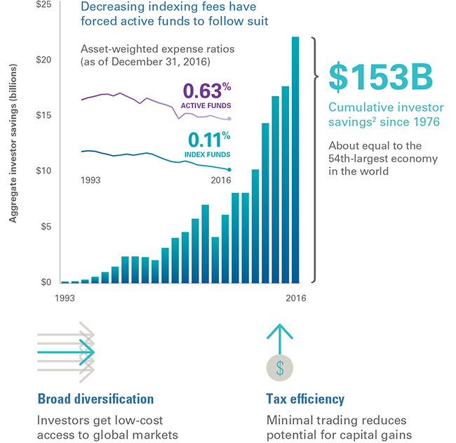
Indexing has helped investors keep more of their returns
Decreasing indexing fees have forced active funds to follow suit
Plus…
Source: The Vanguard Group

Slide 41
Major indexed asset classes can now be purchased through brokerage accounts using a variety of very low cost Exchange Traded Funds (ETFs)
Asset Class | Symbol | Expenses (bp) | Manager
Total US Stocks | VTI | 4 | Vanguard
Large Cap US Stocks (S&P 500) | SPY | 9 | SSGA
US Real Estate | VNQ | 12 | Vanguard
International Real Estate | VNQI | 14 | Vanguard
International Developed Stocks | VEU | 11 | Vanguard
International Emerging Markets Stocks | VWO | 14 | Vanguard
US Investment Grade Bonds | AGG | 5 | Barclays iShares
Treasury Inflation-Protected Bonds | SCHP | 5 | Schwab
Source: Morningstar

Slide 42
Conclusions
The capital markets are quite efficient and very tough to beat
Basic math suggests that passive management “in total” must outperform the active “universe” by more than 1% per annum on a “net” basis over the long term because of management fees and trading costs
Past great “past” active performance is not predictive – but costs are – in virtually all areas of the capital markets – large cap, small cap, international, emerging markets, and bonds
Index funds provide broad diversification and market returns at a very low cost
Index funds are also tax-efficient as they do not distribute capital gains each year
During the past decade, hundreds of billions of dollars have abandoned active funds and moved into low-cost index funds
Passive. Indexing. “Evidence-Based.”
Most investors would be best served by focusing upon getting their asset allocation right rather than trying to pick the next hot mutual fund. Other key focuses: Roth vs. Traditional. Asset location.

Slide 43
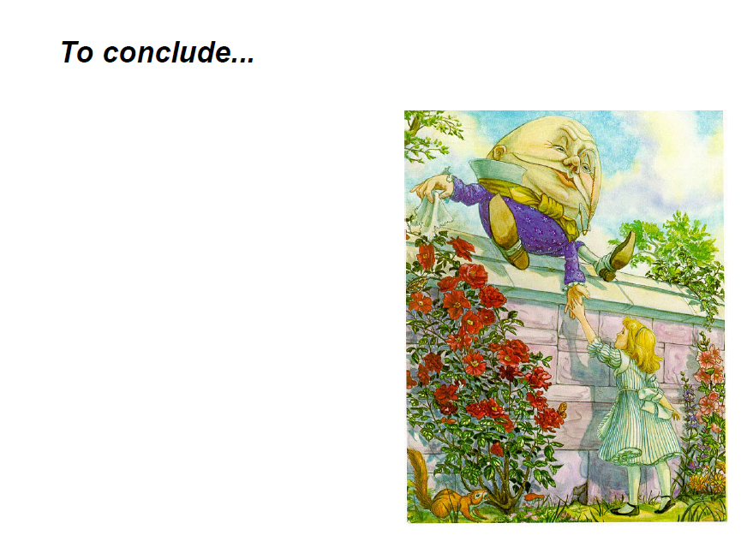

Slide 44
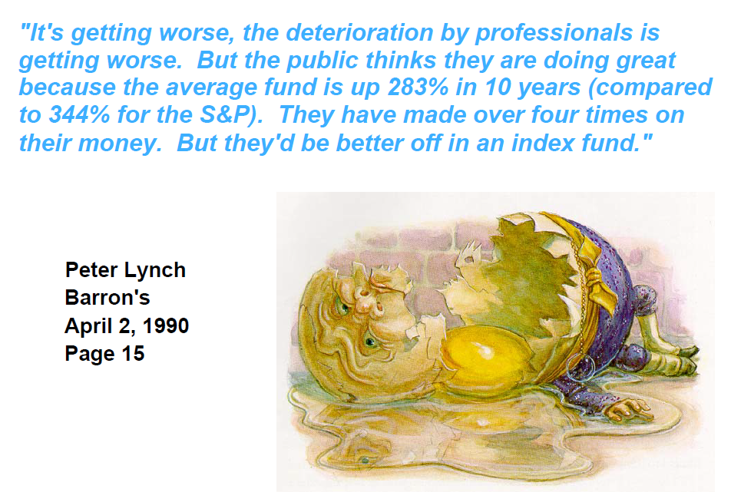

Slide 45
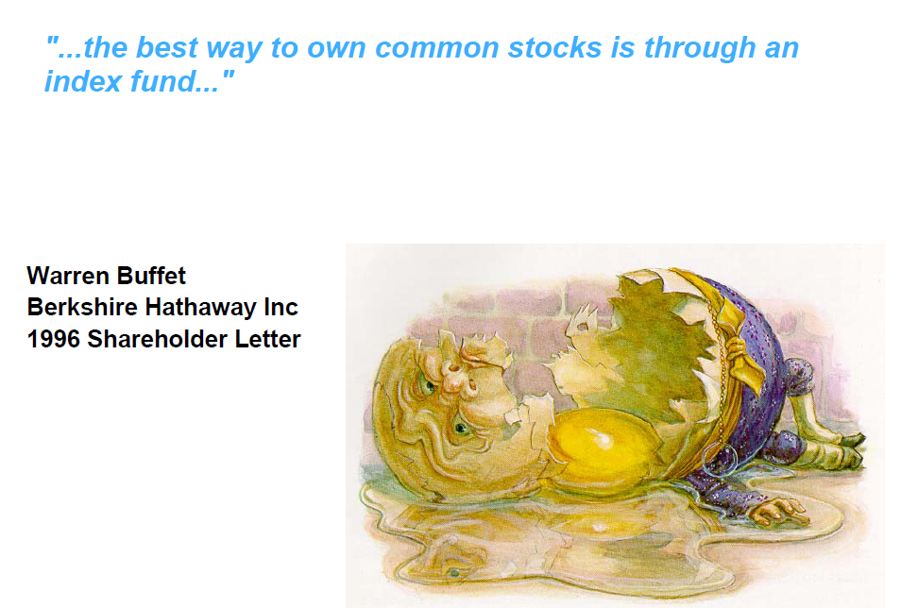

Slide 46

“Most investors would be better off in an index fund.”
Peter Lynch
Vice Chairman, Fidelity Management & Research Company

