Slide 1
Back-up

Slide 4
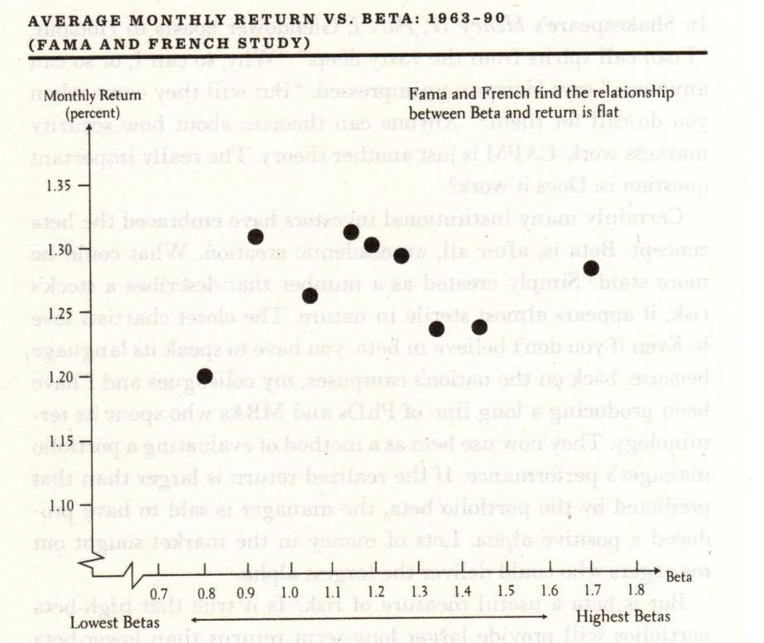
Fama and French found the relationship between beta and return has been flat – despite the CAPM theory
Average Monthly Return Vs. Beta: 1963-90
Source: Burton Malkiel, A Random Walk Down Wall Street, Citing Fama & French study

Slide 5
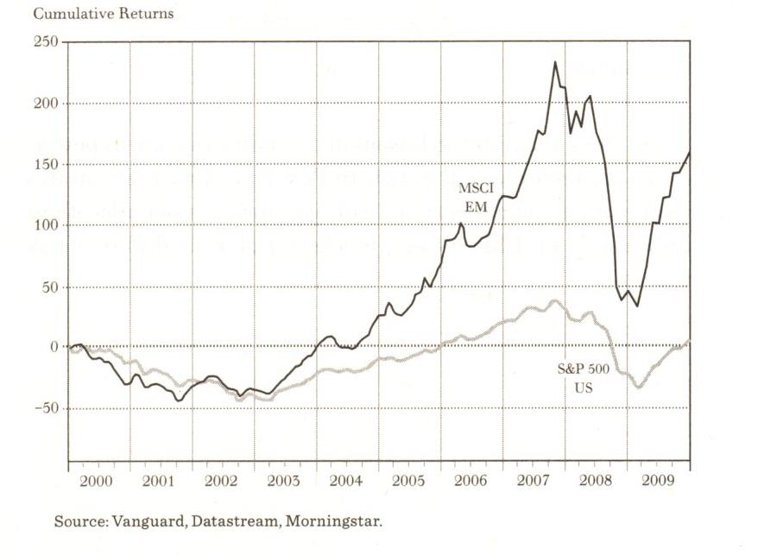
Short term diversification versus long term diversification
Cumulative Returns

Slide 6
Theory:
Before costs, relative investment performance is a zero-sum game.
Source: The Vanguard Group

Slide 7
Theory:
Before costs, relative investment performance is a zero-sum game.
Source: The Vanguard Group

Slide 8
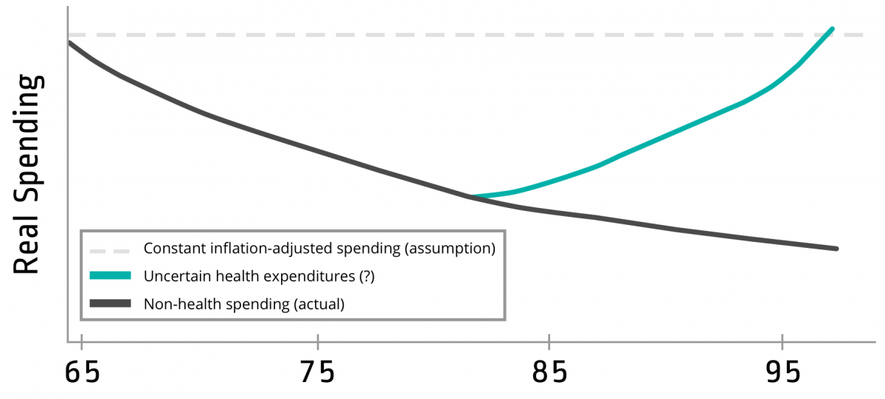
Understanding the Path of Real Retirement Spending
But will health care inflation be higher than the past?

Slide 9
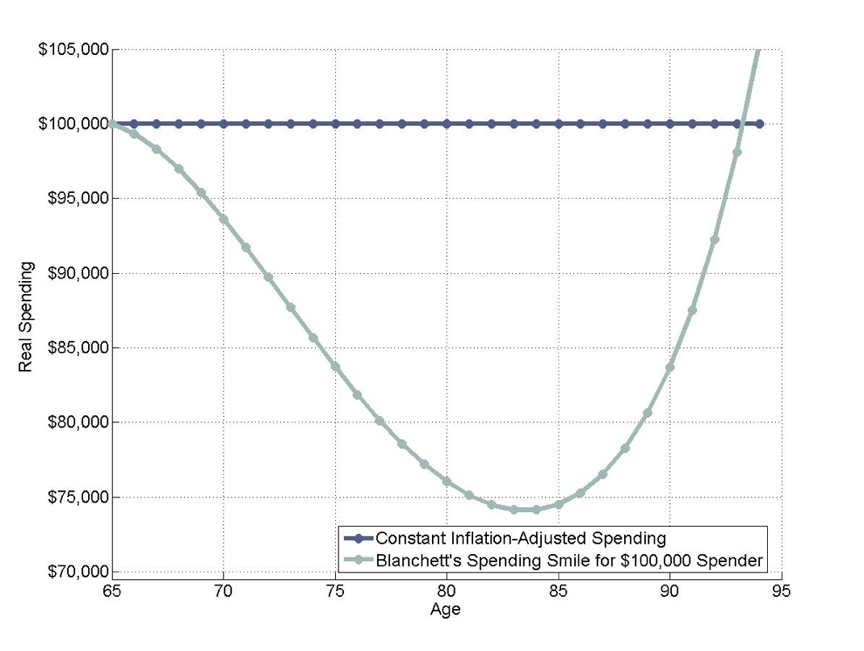
Estimated Path of Real Retirement Spending for a $100,000 Initial Budget at 65 vs. Constant Inflation-Adjusted Spending Strategy
Source: Data from Blanchett, Davidl 2014. “Exploring the Retirement Consumption Puzzle.” Journal of Financial Planning 27 (5): 34-42, per Wade Pfau

Slide 10
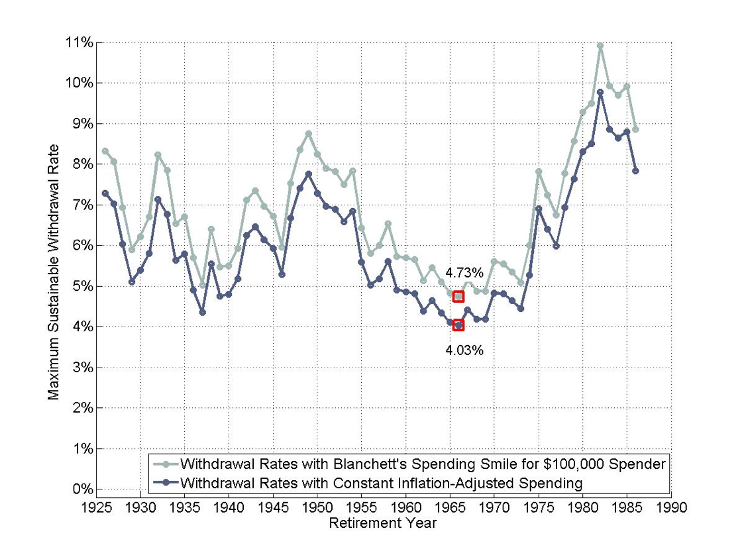
“With the spending smile, the initial spending rate can increase to account for subsequent spending declines.”
Wade Pfau, PhD
Two Views of Maximum Sustainable Withdrawal Rates
Spending smile would allow for 17% higher initial withdrawal amount…or to begin retirement with 15% less wealth. But health care inflation is higher than other inflation.
(30-Year Retirements with 50/50 Portfolios)
Source: Data from Blanchett, David 2014. “Exploring the Retirement Consumption Puzzle.” Journal of Financial Planning 27 (5): 34-42, per Wade Pfau

Slide 11
I helped put two children through Harvard – my broker’s children
Michael LeBoeuf

Slide 12
Highest Educational Attainment | Lifetime Earnings
Some high school, no diploma | $1,000,000
High school diploma or equivalent | $1,200,000
Some college, no degree | $1,500,000
Associate degree | $1,600,000
Bachelor's degree | $2,100,000
Master's degree | $2,500,000
Doctoral degree | $3,400,000
Professional degree | $4,400,000
Source: The Bogleheads’ Guide to Investing, Larimore, Lindauer, LeBoeuf, U>S> Census Bureau, “The Big Payoff; Educational Attainment and synthetic Estimates of Work-Life Earnings”

Slide 13
“Journalists have a constant need for something new to write about, and Wall Street is happy to oblige. The one thing a journalist knows is that if he or she focused on top-performing mutual funds, the journalist will always have something new to write about…These managers will always appear to have a convincing winning strategy.”
Source: The Bogleheads’ Guide to Investing, Larimore, Lindauer, LeBoeuf

Slide 14
No matter what happens, stick to your program. I’ve said “Stay-the-course’ a thousand times and I meant it every time. It is the most important single piece of investment wisdom I can give to you.
Jack Bogle

Slide 15
I never have the faintest idea what the stock market is going to do in the next six months, or the next year, or the next two.
Warren Buffett

Slide 16
The market timer’s Hall of Fame is an empty room.
Jane Bryant Quinn

Slide 18
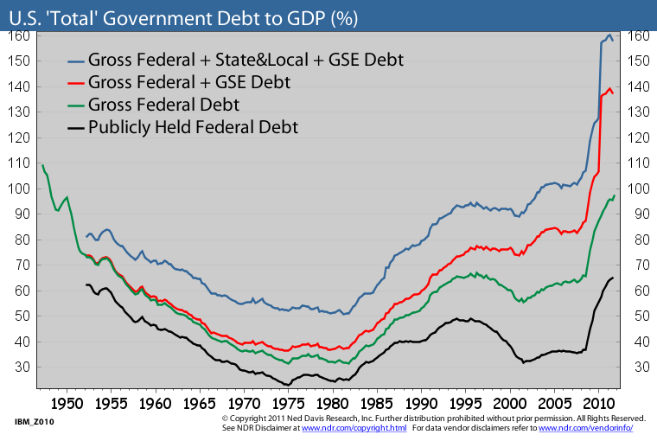
Layers and layers of government debt…
PV Entitlements: +350%
Source: Ned Davis Research
Notes:
The GAO projects that the present value of entitlement programs in excess of planned taxes over the next 75 years is $45.9 T. Source: National Taxpayers Union “It’s the entitlements, stupid.” James Carville.

Slide 19
The value of future earnings and Social Security can be thought of as an asset with TIPS-like characteristics. It should be balanced with a significant exposure to stocks.
Human Capital
Present value of future earnings and Social Security payments $ Thousands
Source: The Vanguard Group. Staring salary of $25 K. Social Security replacement of 32% of lifetime average salary.

Slide 20
In addition, investment volatility has historically declined sharply for long term investment horizons – particularly for stocks.

Slide 21
At a 20-year horizon all asset classes have had the same real risk. At a 30-year horizon the risk order has actually flipped with stocks the real low risk investment!
Higher return – lower risk. This reality bolsters the case for emphasizing stocks in the portfolios of those with at least 20 or 30 years to retirement.
Source: Stocks for the Long Run, Jeremy Siegel, Third Edition

Slide 22
Assets Listed by Tax Efficiency
High-yield bonds
International bonds
Taxable domestic bonds
Inflation-protected securities (TIPS)
Real Estate Investment Trusts (REIT)
Balanced funds
Stock-trading accounts
Small value stocks
Small cap stocks
Large value stocks
International stocks
Large growth stocks
Most stock index funds
Tax-managed funds
EE and I-bonds
Tax-exempt (muni) bonds
Least Tax Efficient
Most Tax Efficient
Source: The Bogleheads’ Guide to Investing, Larimore, Lindauer, LeBoeuf

Slide 23
The shortest route to top quartile performance is too be in the bottom quartile of expenses.
Jack Bogle
Source: The Bogleheads’ Guide to Investing, Larimore, Lindauer, LeBoeuf

Slide 24
Use tax-sheltered accounts

Slide 25
Asset allocation has accounted for 93.6% of the variability of pension fund returns historically
(Individual security selection, market timing, and costs, by contrast, did not account for much of the performance variability.
Furthermore, active management cost the funds are average 1.1% returns versus a passive alternative implementation.)
Gary Brinson, Randolph Hood, and Gilbert Beebower study of performance of 91 large pension funds during the 10-year period 1974 to 1983.
Source: The Bogleheads’ Guide to Investing, Larimore, Lindauer, LeBoeuf

Slide 26
Which of the following mutual fund performance predictors actually works?
Morningstar ratings
Past performance
Expenses
Turnover
Manager tenure
Net sales
Asset size
Alpha
Beta
Standard deviation
Sharpe ratio
Source: The Bogleheads’ Guide to Investing, Larimore, Lindauer, LeBoeuf, Per Financial Research Corporation

Slide 27
The Efficient Market Theory (EMT)

Slide 28
Modern Portfolio Theory

Slide 29
The Brinson, Hood, Beebower Study

Slide 30
Risk Tolerance

Slide 31
“…Remember, investing early in true alternative asset classes is, by definition, never easy, and once they do become securitized, liquid, and popular, all bets are off. In the digital age, any risky asset class you can buy with a keystroke can, and most likely, will bite you when things head south.”
Source: Skating Where the Puck Was, The Correlation Game in a Flat World, William J. Bernstein

Slide 32
Although short term stock correlations may be relatively high, longer term correlations are often much lower
Monthly Versus 5-Year Correlations of Fama/French LG and SV
Period, Intervals | Correlation
1927-2010, Monthly Periods | 0.77
1927-2006, 16 5-Year Periods | 0.65
1928-2007, 16 5-Year Periods | 0.62
1929-2008, 16 5-Year Periods | 0.43
1930-2009, 16 5-Year Periods | 0.22
1931-2010, 16 5-Year Periods | 0.25
Average for 5-Year Periods, 1927-2010 | 0.43
Source: The Bogleheads’ Guide to Investing, Larimore, Lindauer, LeBoeuf

Slide 33
“…, resign yourself to the fact that diversifying among risky assets provides scant shelter from bad days or bad years, but that it does help protect against bad decades and generations, which can be far more destructive to wealth.”
Source: The Bogleheads’ Guide to Investing, Larimore, Lindauer, LeBoeuf

Slide 34
A typical actively managed equity fund faces a lot of performance headwind due to its expenses
Average Equity Mutual Fund | Percent of Average Assets
Advisory Fees | 1.1%
Other operating expenses | 0.5
Total Expense Ratio | 1.6
Transaction costs | 0.7
Opportunity cost | 0.4
Sales Charges | 0.6
Total Annual Cost | 3.3
Source: The Bogleheads’ Guide to Investing, Larimore, Lindauer, LeBoeuf
Bogle Research Center

Slide 35
The Vanguard Total Stock Market Index Fund’s breakdown based on style and size mirrors that of the US stock market as a whole
Style
 | VALUE | CORE | GROWTH
LARGE | 21% | 31% | 19%
MEDIUM | 6% | 7% | 7%
SMALL | 3% | 3% | 3%
Size
Source: The Bogleheads’ Guide to Investing, Larimore, Lindauer, LeBoeuf
August, 2005

Slide 36
The principles that often work in most aspects of our lives often leave to failure in investing
If you don’t know how to do something…hire an expert.
You get what you pay for.
If there’s a crisis, take action!
The best predictor of future performance is past performance
Source: The Bogleheads’ Guide to Investing, Larimore, Lindauer, LeBoeuf

Slide 37
Average Equity Mutual Fund | Percent of Average Assets
Advisory Fees | 1.1%
Other operatiing expenses | 0.5
Total Expense Ratio | 1.6
Transaction costs | 0.7
Opportunity cost | 0.4
Sales Charges | 0.6
Total Annual Cost | 3.3

Slide 38
The Boglehead Investment Philosophy
Develop a workable plan.
Invest early and often.
Never bear too much or too little risk.
Diversify.
Never try to time the market.
Use index funds when possible.
Keep costs low.
Minimize taxes.
Invest with simplicity.
Stay the course.
Source: Taylor Larimore, The Bogleheads’ Guide to the Three-Fund Portfolio

Slide 39
“Just as the gambling industry wants people to think they can beat the casino, the investment industry wants investors to think they can beat the market.”
John Larimore, The Bogleheads’ Guide to the Three-Fund Portfolio

Slide 40
“Stay the course.
No matter what happens, stick to you program. I’ve said, ‘Stay the course’ a thousand times, and I meant it every time. It’s the most important single piece of investment wisdom I can give to you.”
Jack Bogle, Common Sense on Mutual Funds

Slide 41
“Avoid the lure of individual stocks.”
Taylor Larimore, The Bogleheads’ Guide to the Three-Fund Portfolio

Slide 42
“The shortest route to top quartile performance is to be in the bottom quartile of expenses.”
Jack Bogle

Slide 43
Index funds have low turnover – and hence, very low transaction costs (which are not included in expense ratio numbers).
Fund | Turnover | Category Average
Vanguard Total Stock Market | 4% | 59%
Vanguard Total International | 3% | 60%
Vanguard Total Bond Market | 61% | 232%

Slide 44
“Just as the gambling industry wants people to think they can beat the casino, the investment industry wants investors to think they can beat the market.”
Taylor Larimore, The Bogleheads’ Guide to the Tree-Fund Portfolio

Slide 45
“Let’s face it: Most investment companies are in business to make money from you, not for you. Every dollar you save in commissions and fee expenses goes right to your bottom line.”
Rick Ferri, CFA, (and former broker)

Slide 46

Sturgeon’s* Law:
“95 per cent of everything you hear or read is crap.”
*Theodore Sturgeon – science fiction writer

Slide 47
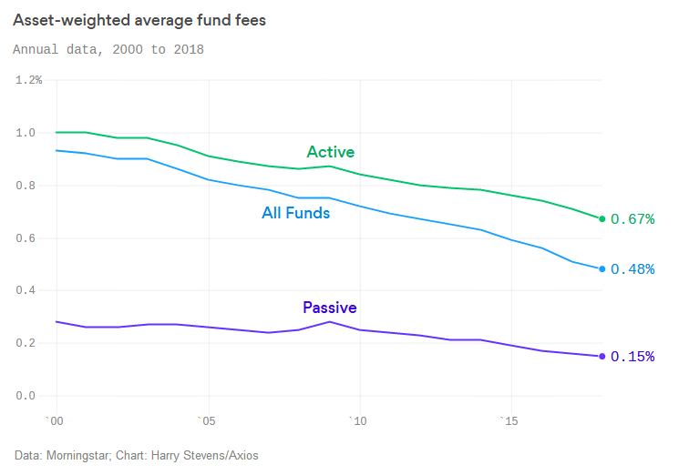
Investors are paying roughly half as much to own funds as they did in 2000
“The least expensive 20% of funds saw net inflows of $605 billion, with the remaining 80% of funds experiencing net outflows of $478 billion. “
Axios, May 2, 2019, Dan Rabouin

Slide 48


Slide 49
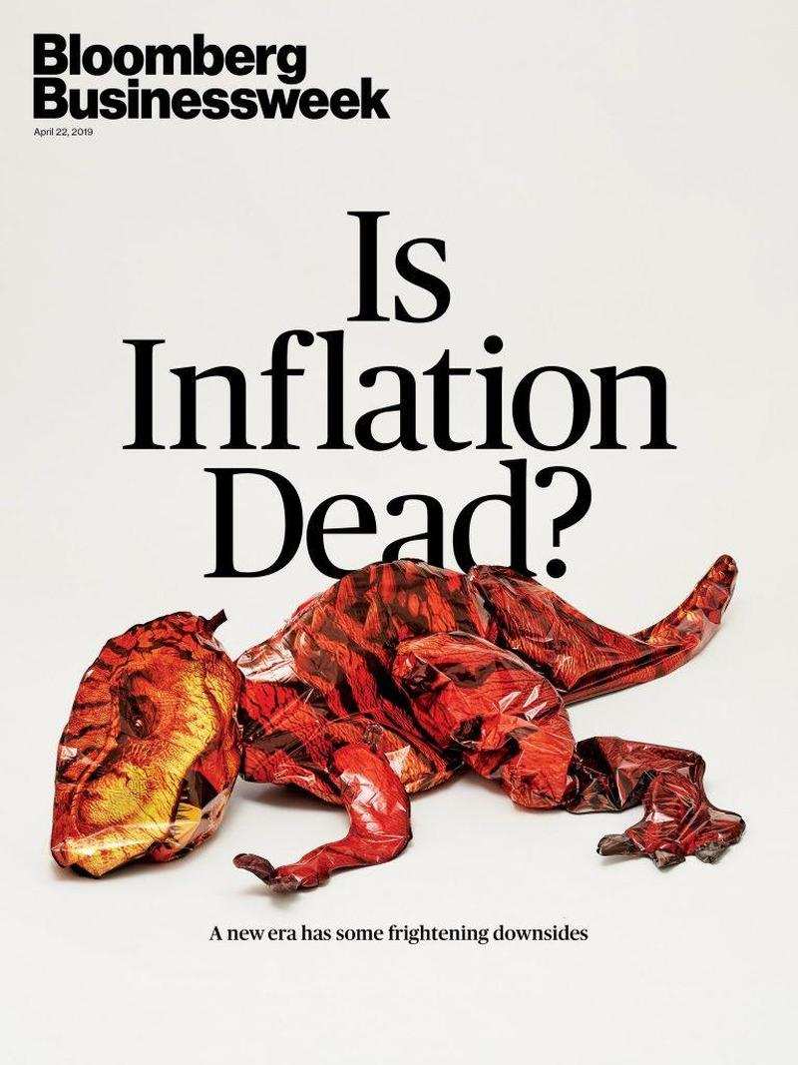

Slide 50
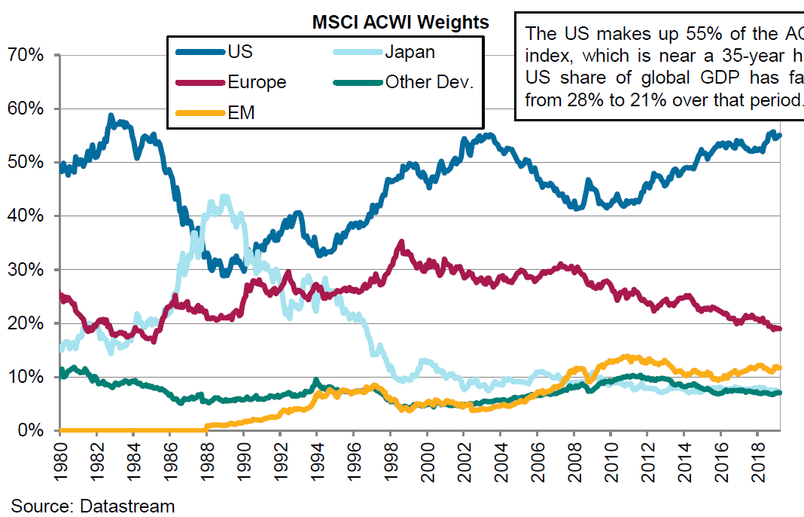
The US makes up 55% of the AC World Index, which is near a 35-year high. US share of global GDP has fallen from 28% to 21% over the period.
MSCI AC World Index Weights
(From Mercer)

Slide 53
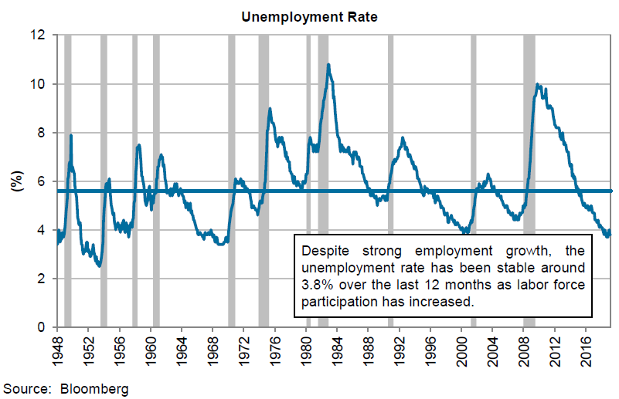

Slide 54
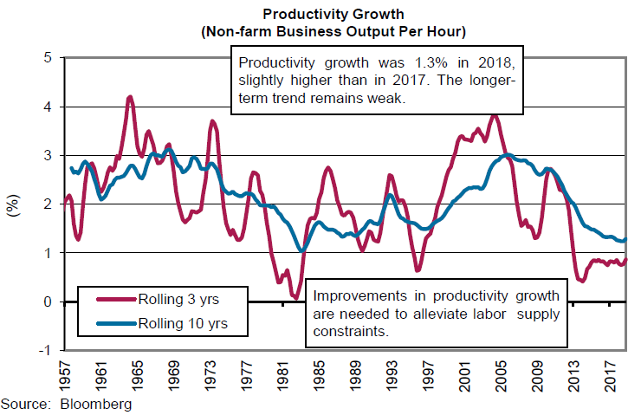

Slide 55
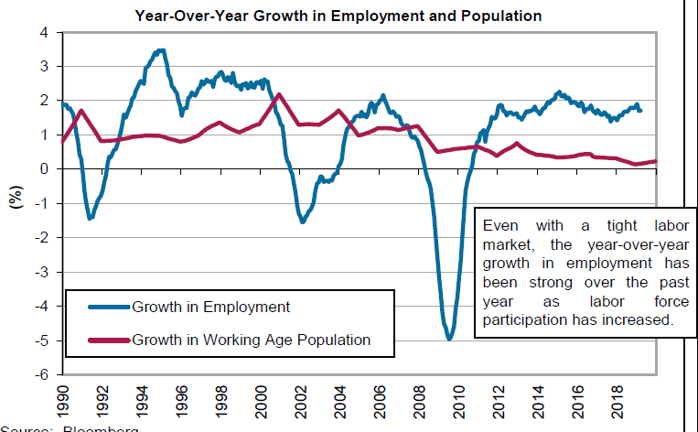

Slide 56
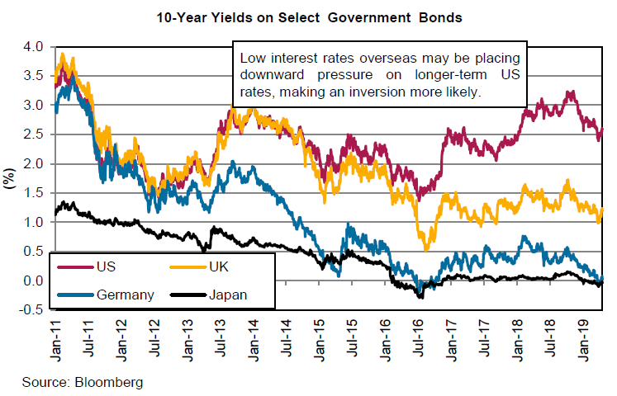

Slide 57
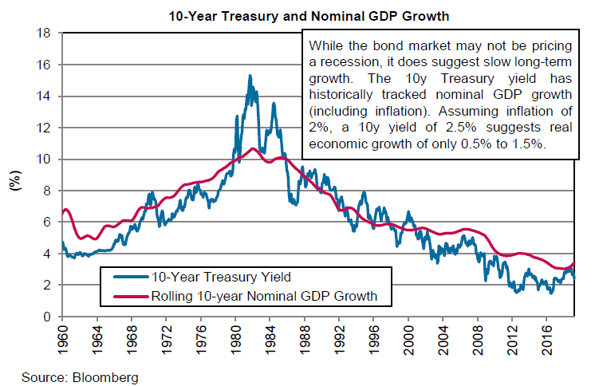

Slide 58
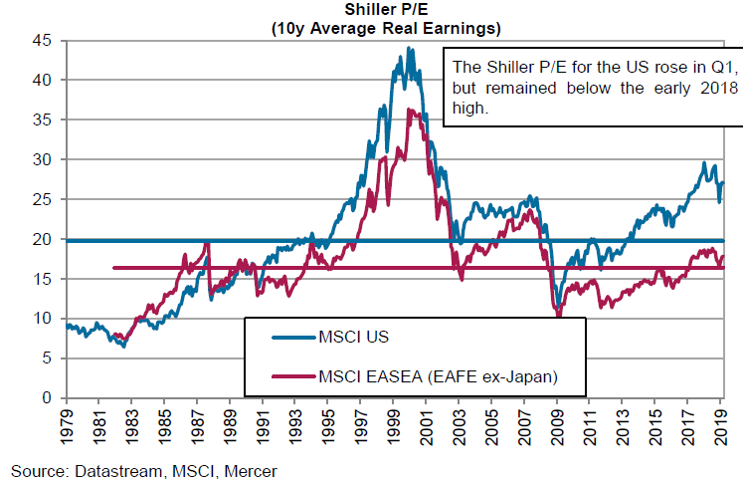

Slide 59
America’s Productivity Problem

Slide 60
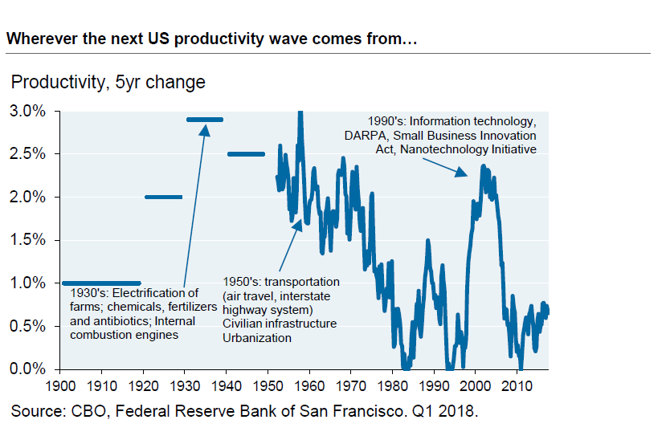

Slide 61
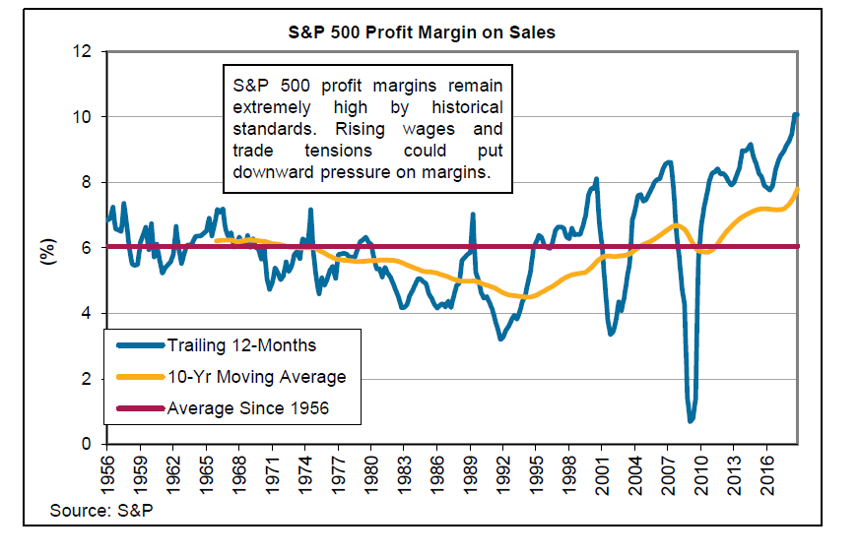

Slide 62
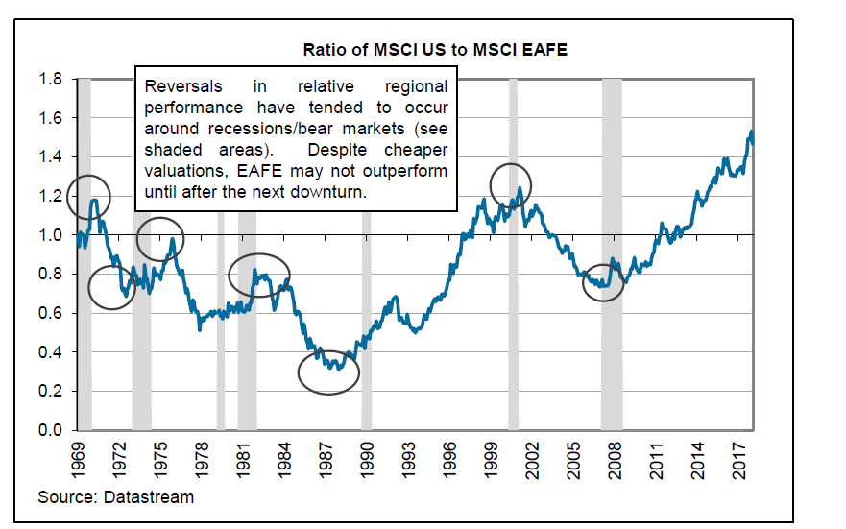

Slide 63


Slide 64
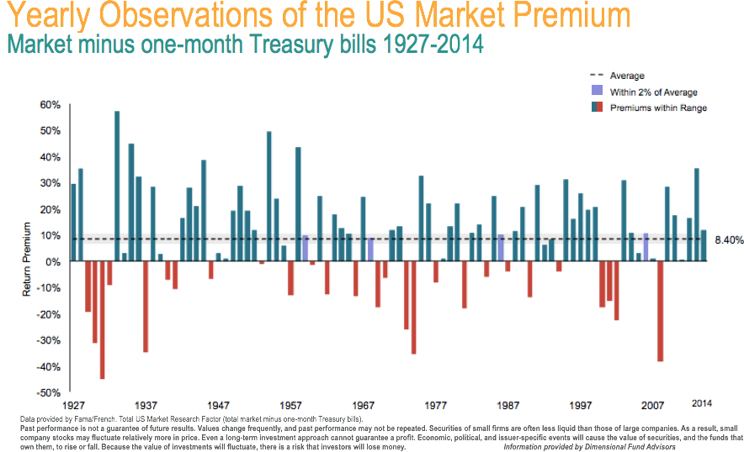
It is rare for investors to earn the equity risk premium in any given year. Risk is real – and investors have been paid for that risk – over the long term.

Slide 65
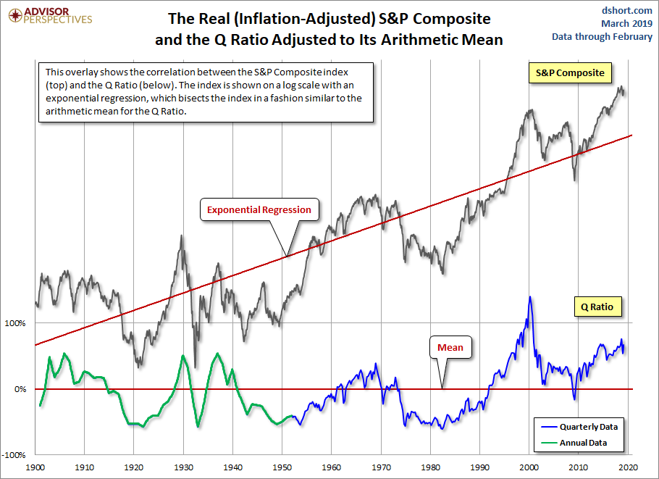

Slide 66
Keep investment costs low!
$1 Grows To:
Source: Wilshire Compass

Slide 67
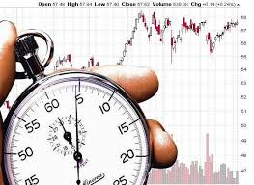
Being too far ahead of your time is indistinguishable from being wrong. Howard Marks

Slide 68
Mercer 12/31/19 long-term expected returns vs. equilibrium returns
Source: Mercer

Slide 69
Source: Mercer

Slide 70
Expect the unexpected!

Slide 71
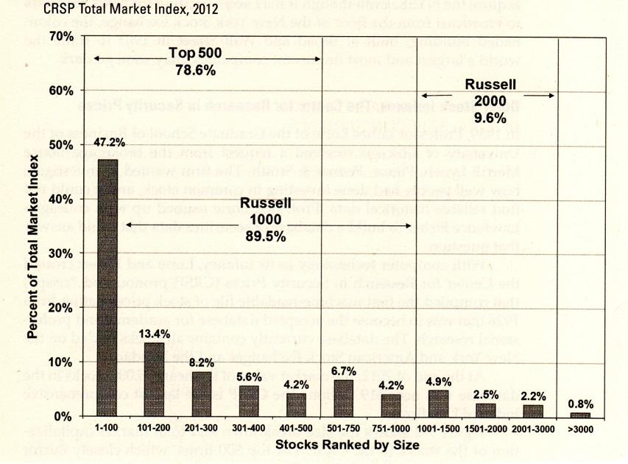
Large capitalization stocks dominate the total value of all US stocks
CRSP Total US Stock Market Index – By Capitalization - 2012
Source: Stocks for the Long Run, Jeremy

Slide 72
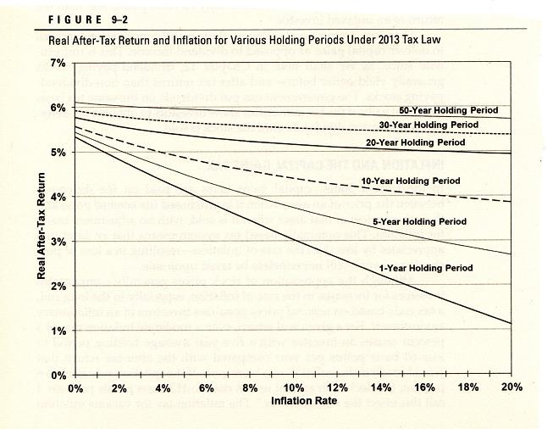

Long holding periods (low turnover) increases real after-tax returns – particularly during high inflation periods – due to tax-deferrals – and compounding
Buy and hold. Buy and hold. Buy and hold….
Real After-Tax and Inflation for Various Holding Periods Under 2013 Tax Law
Years of deferred taxes and return compounding increases real after-tax returns
Inflation increases taxes so reduces real after-tax returns
Source: Stocks for the Long Run, Jeremy Siegel Assumptions: Total real return of 7 percent (real appreciation of 5 percent, a dividend yield of 2 percent) and tax rates of 23.8 percent on capital gains and dividend income

Slide 73

“My favorite holding period is forever.”
Warren Buffett

Slide 74
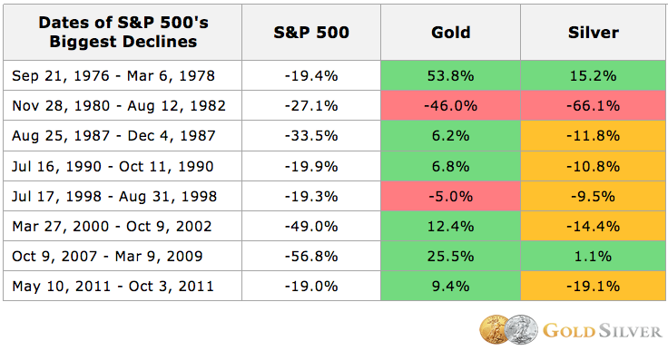
Gold, although certainly controversial, has often been a good diversifier to stocks during major declines
Major Stock Market Declines and Gold
Source: Gold Silver Council

Slide 75
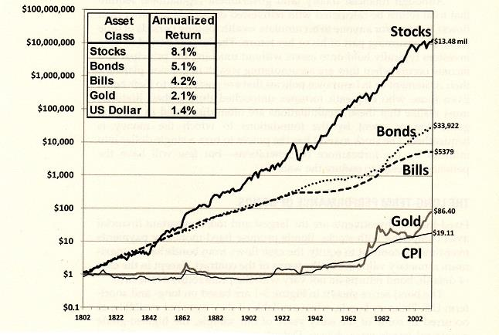
Gold has been a truly lousy investment over the very long term!
$1 Grows To:
Source: Stocks for the Long Run, Jeremy Siegel

Slide 76
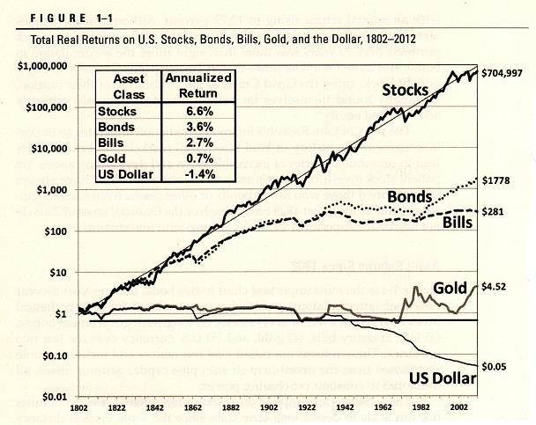
Gold has been a truly lousy investment over the very long term!
$1 Grows To:

Slide 77
The word crisis in Chinese is composed of two characters: the first, the symbol of danger,…the second, of opportunity.

Slide 78
Consider a family 401(k)
Get renters/ owners home insurance
Take care of your health
Enroll in industry training

Slide 79
Source: Wilshire Compass

Slide 80
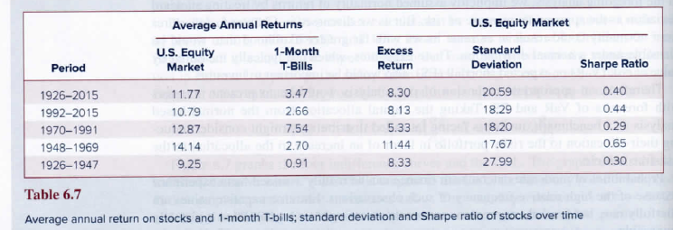
Sharpe Ratios have varied tremendously over various long periods of time
Returns, Risks, and Returns Per Unit of Risk (Sharpe Ratios)
Source: Investments, Eleventh Edition, Bodie, Kane, Marcus, Page 125

Slide 81
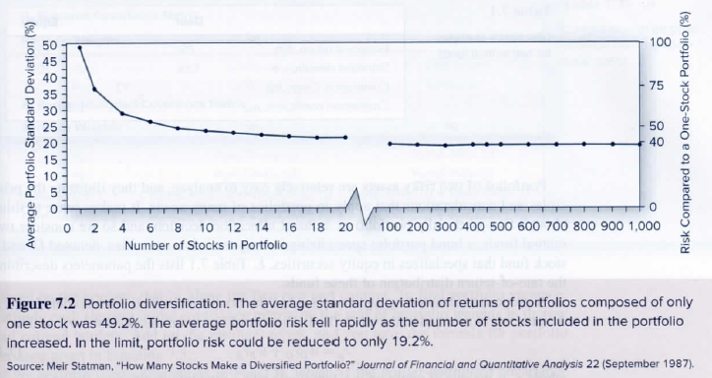
The average SD of returns of portfolios composed of only one stock was 49.2%.
The average portfolio risk fell rapidly as stocks were added. The limit to risk reduction was SD of 19.2%.
US Stock Risk Reduction Through Diversification
Source: Investments, Eleventh Edition, Bodie, Kane, Marcus, Page 125

Slide 82
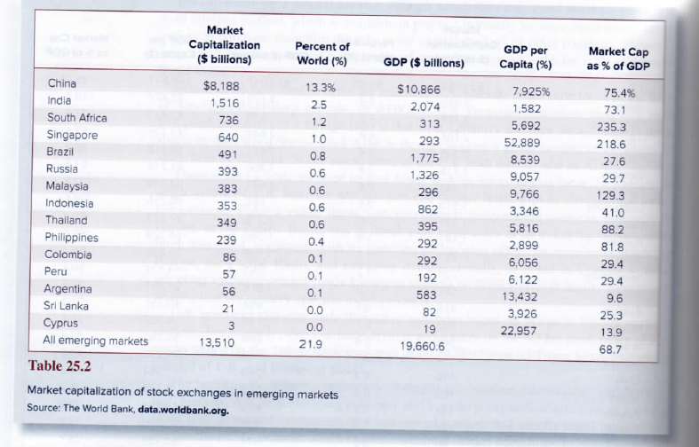
A world of opportunities
Emerging World Economies and Equity Markets
Source: Investments, Eleventh Edition, Bodie, Kane, Marcus, Page 125

Slide 83
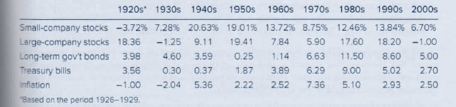
Even within and asset class (small and large-company stocks) returns can be quite different decade by decade
Annualized Asset Class Returns by Decade
Source: Investments, Eleventh Edition, Bodie, Kane, Marcus, Page 125

Slide 84
Gold

Slide 85
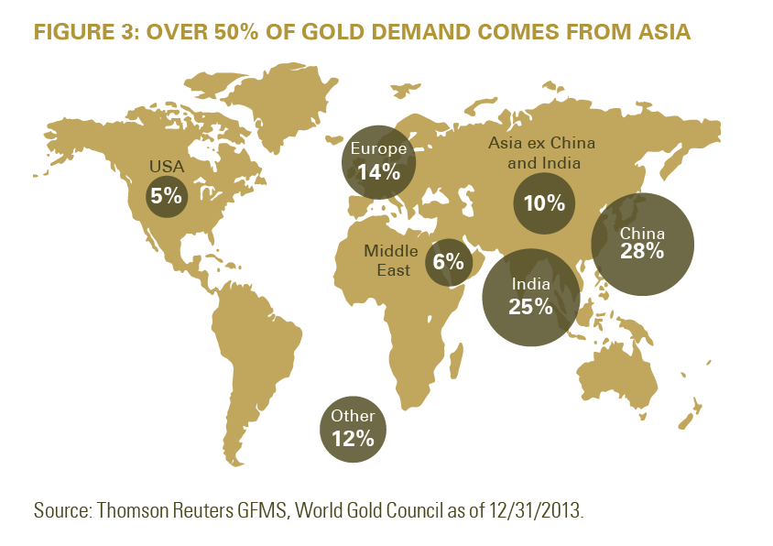
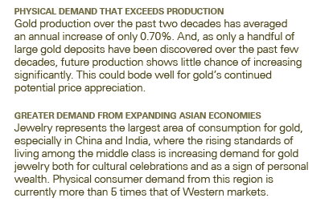

Slide 86
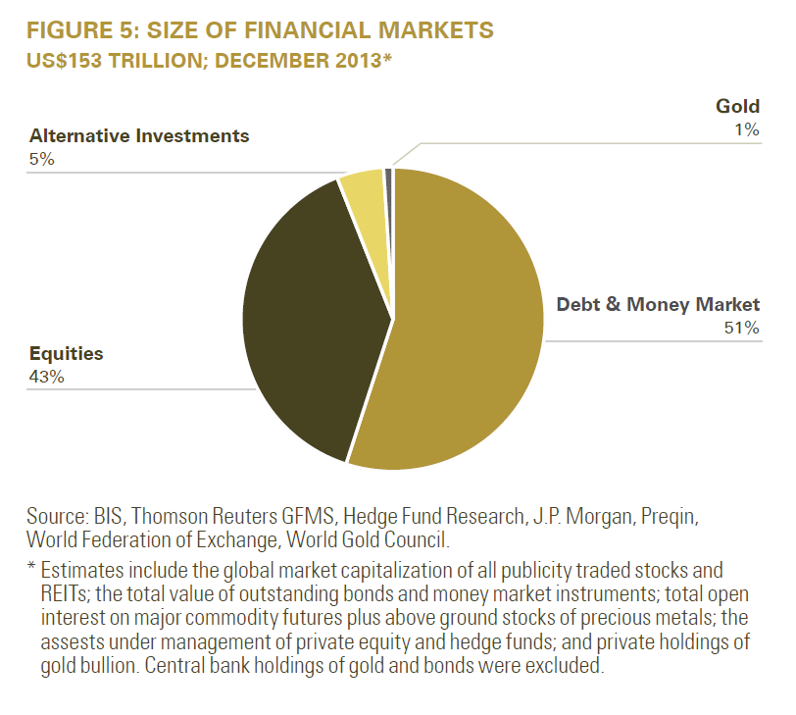

Slide 87
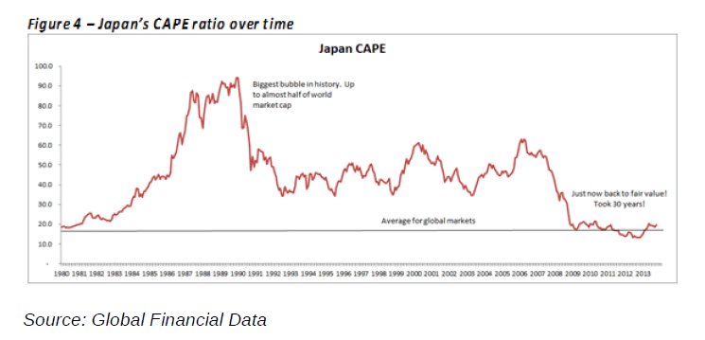

Slide 88
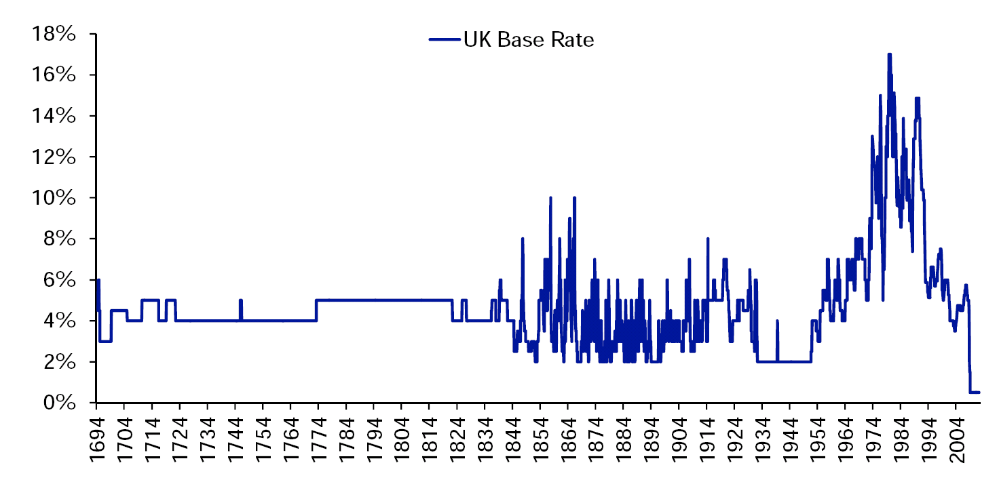
Developed countries have pursued unprecedented monetary policies to try to keep their economies afloat
UK Base Rate
Financial Repression =
CPI: 2.7%, ST Interest Rate: 0.75%
Lowest ever… in centuries
Source: Deutsche Bank, GFD
Source: Deutsche Bank
Notes:
0.5%. Lowest by 1.5%.

Slide 89
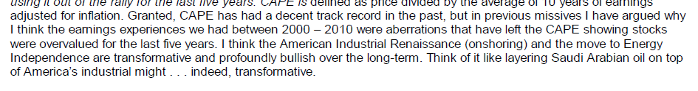

Slide 90
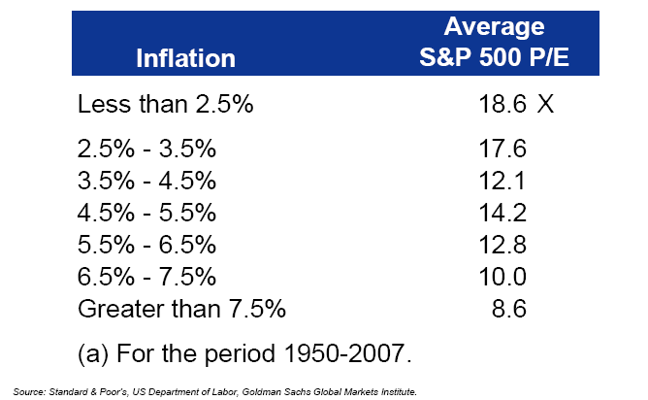
Stock PEs have generally been highest when inflation has been lowest.

Slide 91
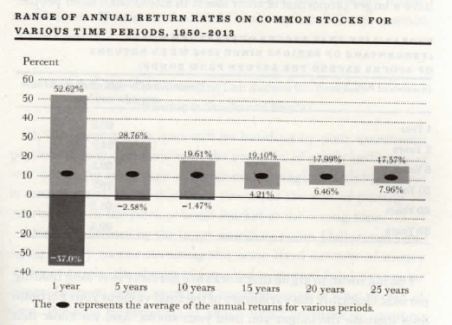

Slide 92
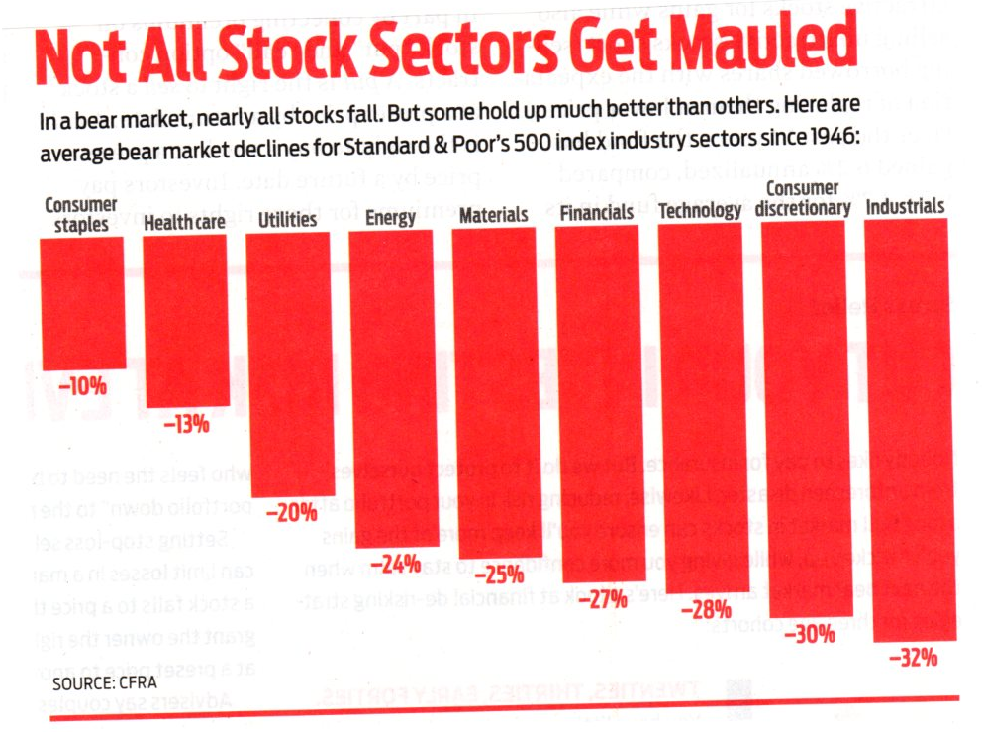
In a bear market, nearly all stocks fall. But some hold up much better than others. Here are average bear market declines for S&P 500 index industry sectors since 1946.
Not All Stock Sectors Get Mauled
Source: Kiplinger’s Personal Finance, 11/2018

Slide 93
Maximum Sustainable Withdrawal Rates
For Retirees 1900-1981
Asset Allocation: 50% Stocks & 50% Bills

Slide 94
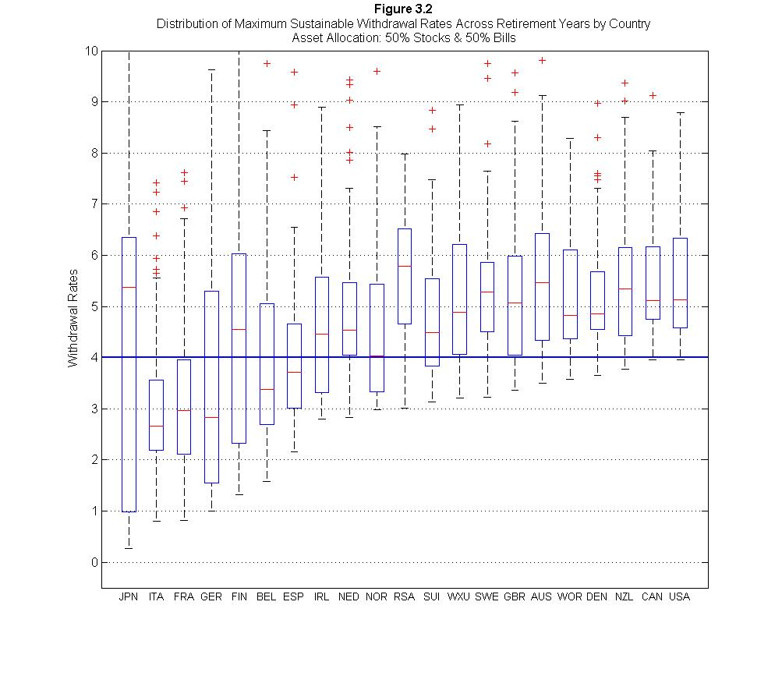

Slide 95
Keep in mind also that I am only looking at the 19 developed market countries in the dataset, with data going back to 1900. Travel back in time to 1900, though, and ask people to put together a list of 19 developed market countries for the 20thcentury, and you would probably find frequent mention of countries like Argentina, Russia, and China, among others. As those countries never made the dataset, even the results I describe here include survivorship bias.

Slide 96
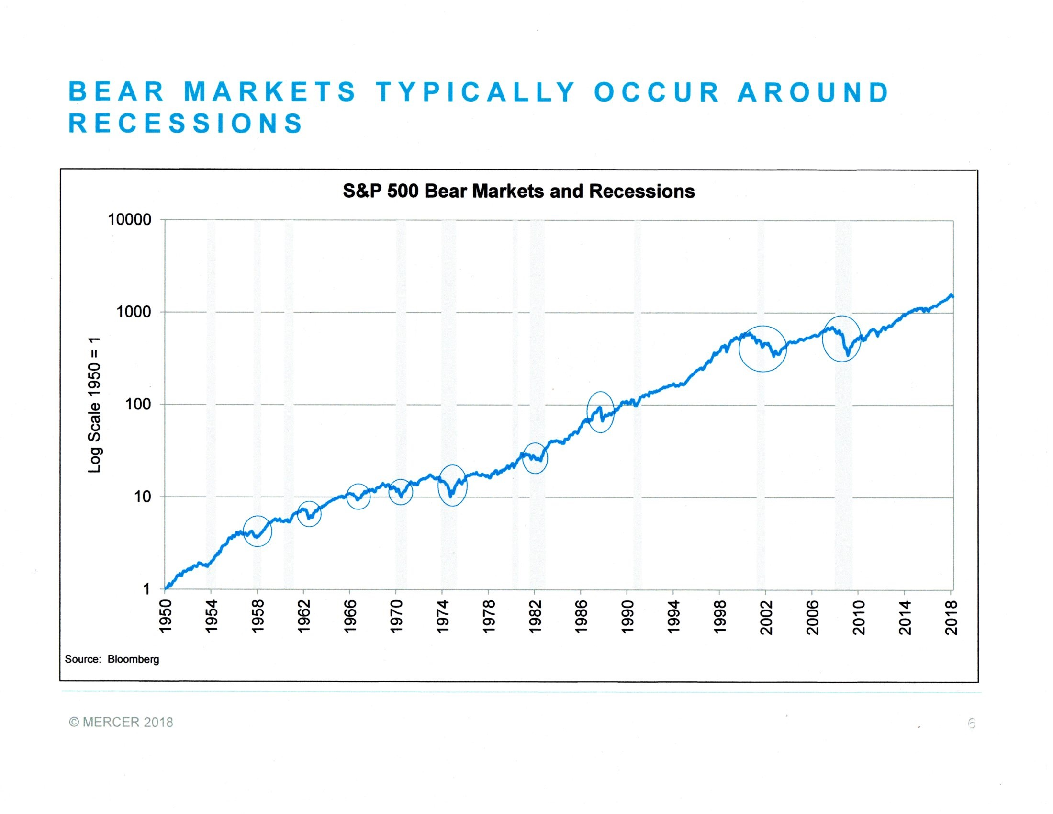

Slide 97

Getting safely down drawdown mountain

Slide 98
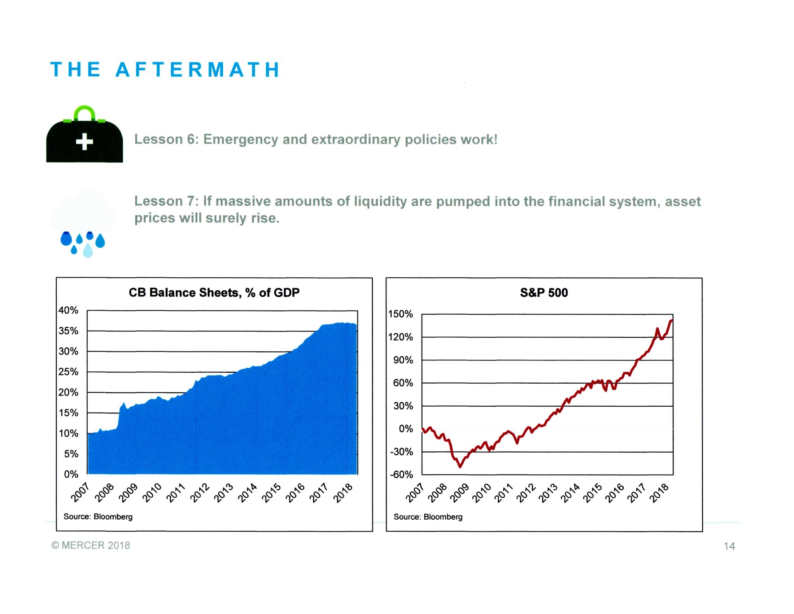

Slide 99
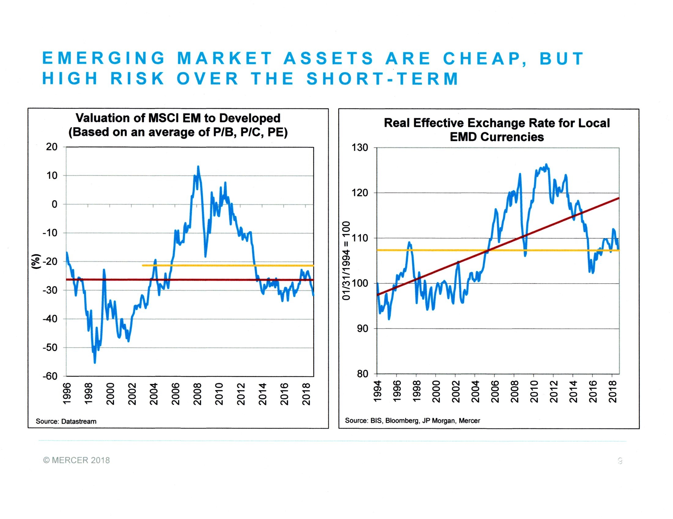

Slide 100
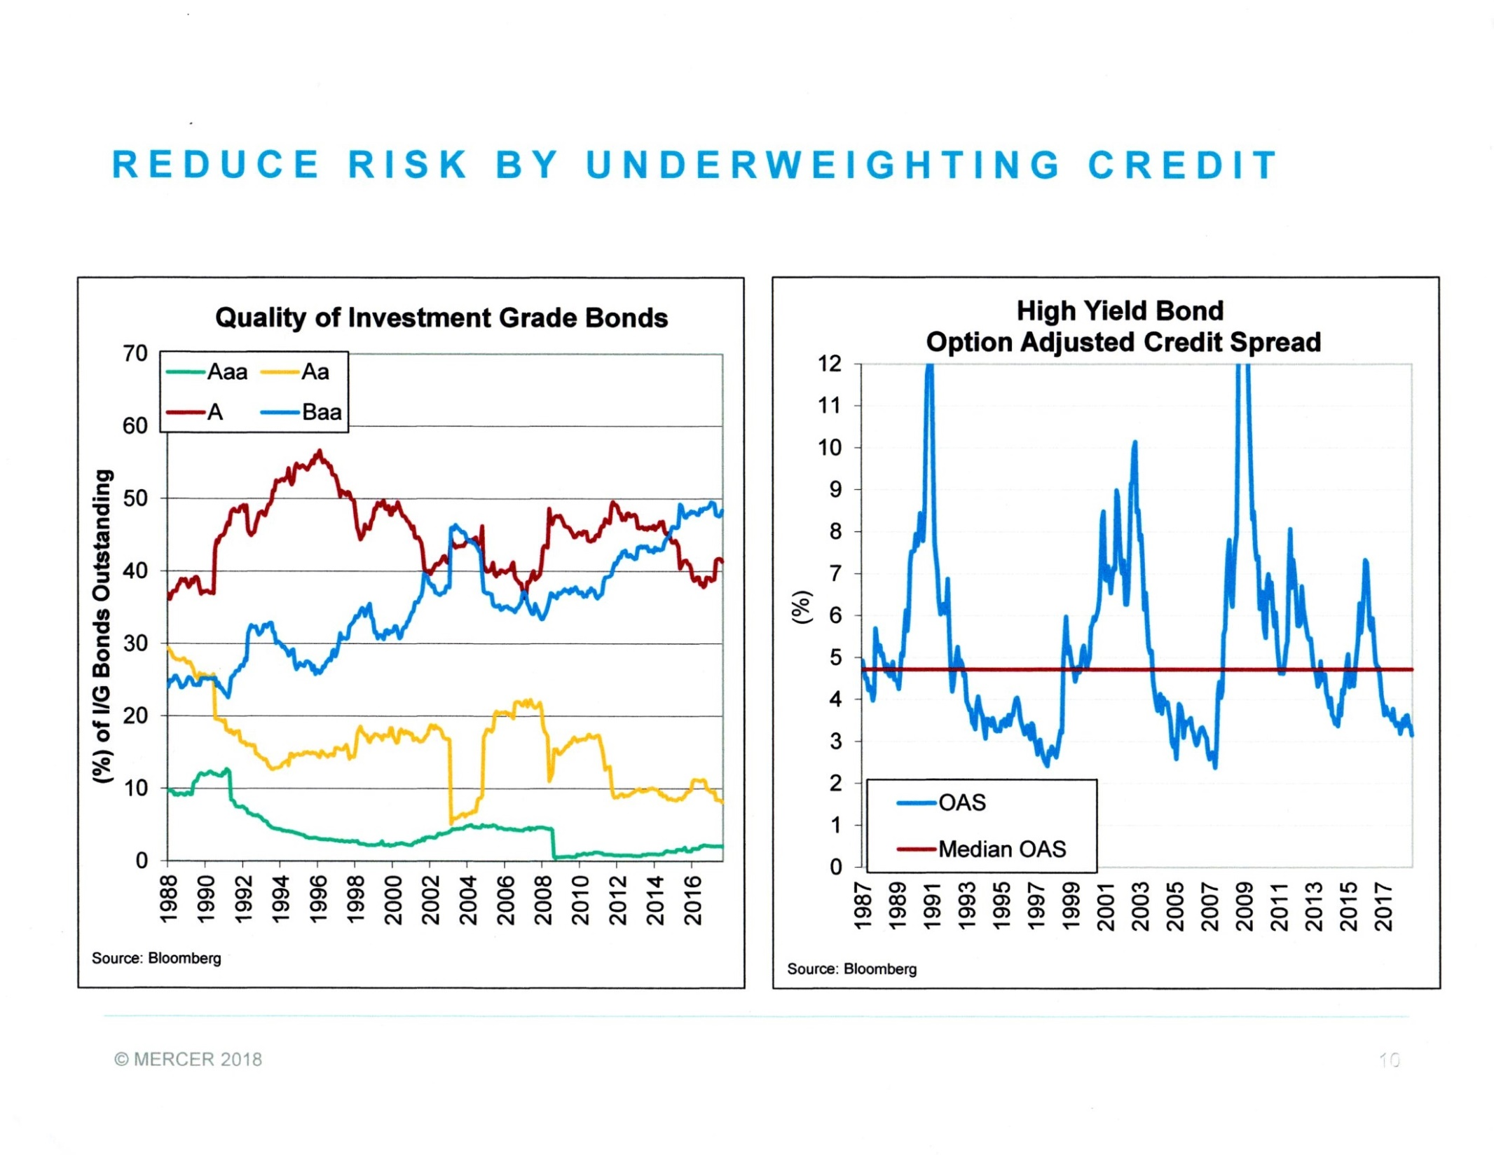
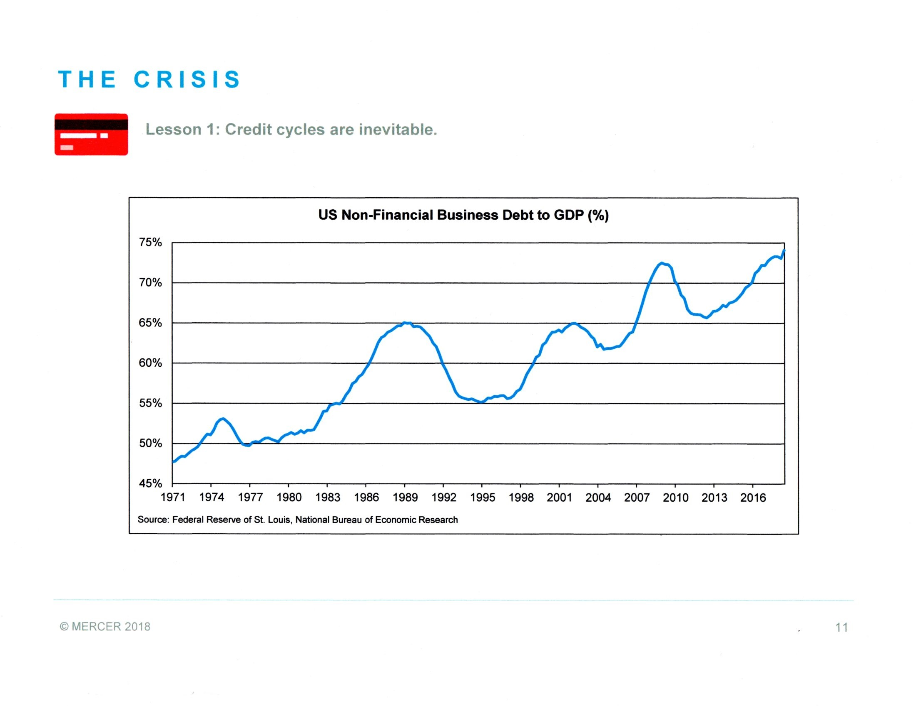

Slide 101
How long will a 65-year old person live?
Longevity Statistics for 65-Year Olds
 |  |  |  | At Least One Member of a Couple
 |  | Male | Female | One Male – One Female | Two Males | Two Females
 |  | Social Security 2013 Periodic Life Table
Probability of Living to Age: | 70 | 91% | 94% | 99% | 99% | 100%
 | 75 | 79% | 85% | 97% | 96% | 98%
 | 80 | 63% | 73% | 90% | 86% | 92%
 | 85 | 43% | 55% | 74% | 67% | 80%
 | 90 | 22% | 33% | 48% | 39% | 55%
 | 95 | 7% | 13% | 20% | 14% | 25%
 | 100 | 1% | 3% | 4% | 2% | 6%
Remaining Life Expectancy |  | 17.8 | 20.3 | 24.1 | 22.7 | 25.3
 |  | Society of Actuaries 2012 Individual Annuity Mortality with Projected Improvements for 65 Year Olds in 2016
Probability of Living to Age: | 70 | 95% | 96% | 100% | 100% | 100%
 | 75 | 89% | 91% | 99% | 99% | 99%
 | 80 | 80% | 84% | 97% | 96% | 97%
 | 85 | 66% | 71% | 90% | 88% | 92%
 | 90 | 45% | 52% | 74% | 70% | 77%
 | 95 | 22% | 29% | 45% | 39% | 50%
 | 100 | 6% | 10% | 16% | 12% | 20%
Remaining Life Expectancy |  | 22.6 | 24.3 | 28.6 | 27.7 | 29.4
What matters is longevity at 65, not at birth
So, how long should your planning horizon be?

Slide 102
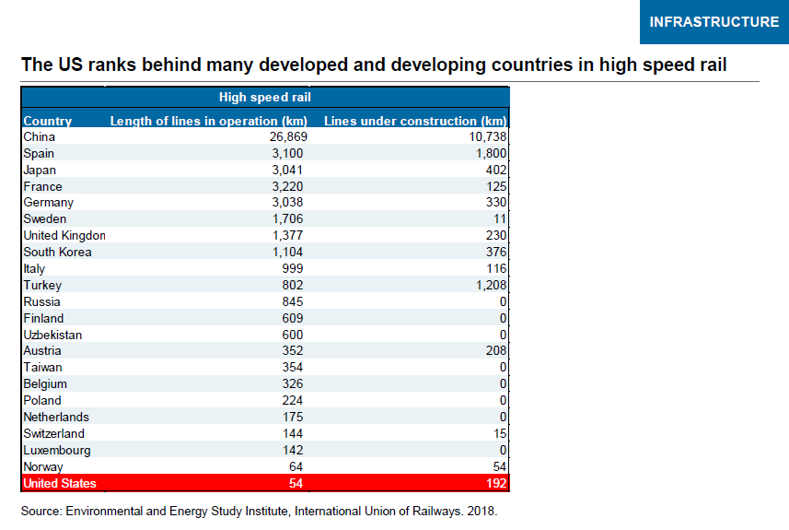

Slide 103
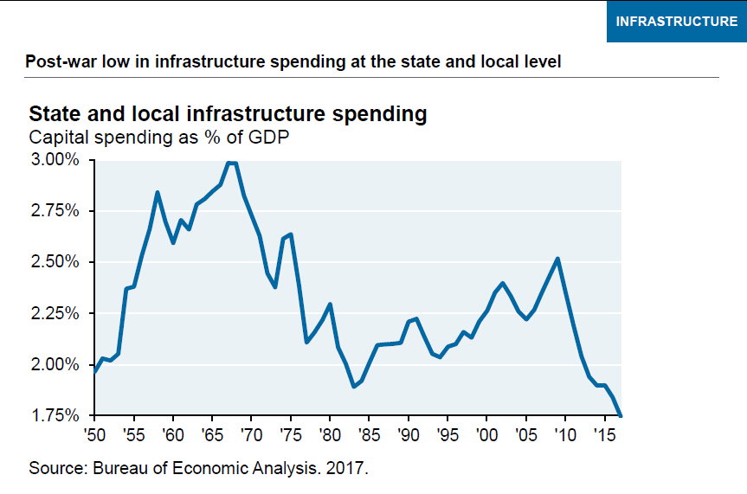

Slide 104
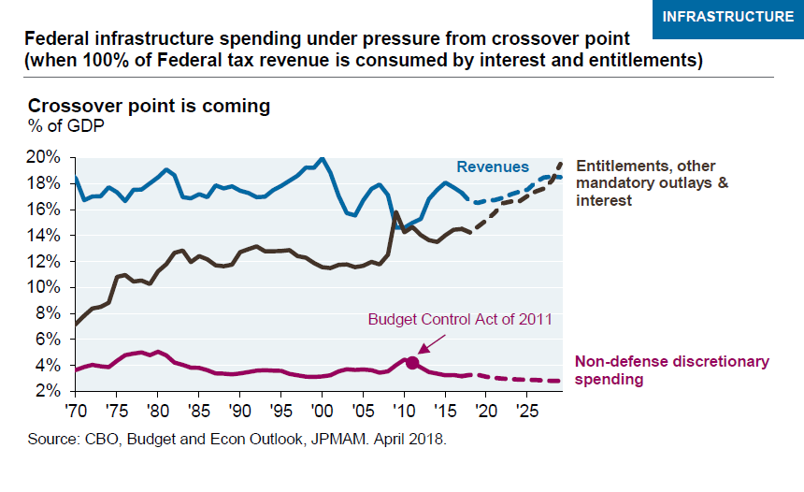

Slide 105
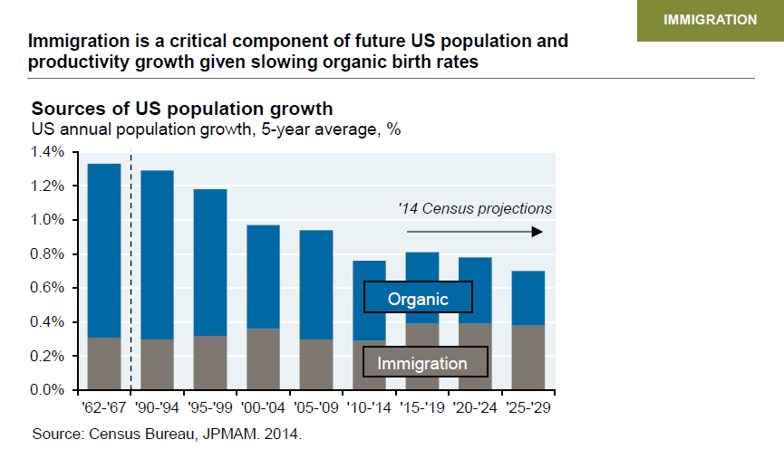

Slide 106
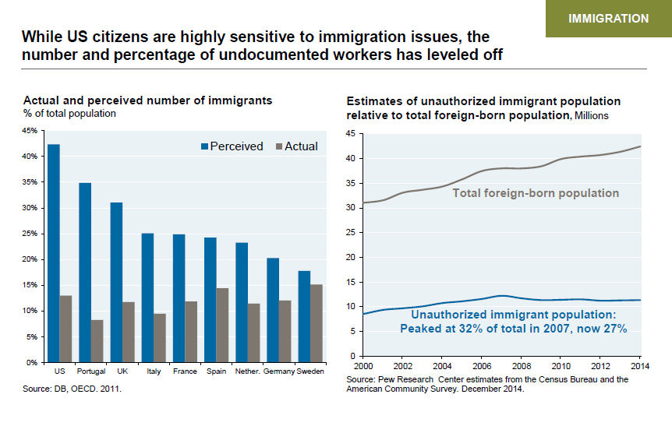

Slide 107


Slide 108


Slide 109


Slide 110


Slide 111


Slide 112


Slide 113


Slide 114


Slide 115


Slide 116


Slide 117


Slide 118


Slide 119


Slide 120


Slide 121


Slide 122


Slide 123


Slide 124
Index funds are now winning strongly in the race for assets
Long-Term Cumulative Cash Flows for U.S. Equity Funds

Slide 125

Portfolio Beta-Blockers
Source: JP Morgan

Slide 126


Slide 127


Slide 128


Slide 129


Slide 130


Slide 133
Do such diversifying asset classes actually exist?

Slide 140
By investing in index funds, you’re guaranteeing that you play the game at par every round…how many people are able to do that?
Professor Burton Malkiel

Slide 143
Source: Wilshire Compass

Slide 144
Source: Wilshire Compass

Slide 145
Source: Wilshire Compass

Slide 146
Major indexed asset classes can now be purchased through brokerage accounts using a variety of very low cost Exchange Traded Funds (ETFs)
Asset Class | Symbol | Expenses (bp) | Manager
Total US Stocks | VTI | 4 | Vanguard
Large Cap US Stocks (S&P 500) | SPY | 9 | SSGA
US Real Estate | VNQ | 12 | Vanguard
International Real Estate | VNQI | 14 | Vanguard
International Developed Stocks | VEU | 11 | Vanguard
International Emerging Markets Stocks | VWO | 14 | Vanguard
US Investment Grade Bonds | AGG | 5 | Barclays iShares
Treasury Inflation-Protected Bonds | SCHP | 5 | Schwab
Source: Morningstar

Slide 147
Which are better – growth stocks or value stocks?

Slide 148
Perhaps surprisingly, value has outperformed growth over time – albeit with greater risk
F-F Growth and Value Series Summary Statistics of Annual Returns (%), 1928-2017
 |  | Geometric Mean | Arithmetic Mean | Standard Deviation
F-F Large Growth |  | 9.2 | 11.1 | 19.8
F-F Large Value |  | 11.3 | 14.8 | 27.1
F-F Small Growth |  | 9.4 | 13.9 | 32.4
F-F Small Value |  | 13.9 | 18.5 | 32.1
Large Value
Large Growth
Source: 2018 SBBI Yearbook, Duff & Phelps
Small Value
Small Growth

Slide 152

Save early and reap the benefits of compound interest – let your savings do the heavy lifting
Imagine you start saving at age 25 and dutifully put away $10,000 a year. But at age 40, you need to stop saving for some reason.
Your friend starts saving at age 35 and saves the same $10,000 a year for the next 30 years, until you both retire.
At that point, all else equal, you'll have more money than your friend, despite having put away only half as much.
A Tale of Two Friends’ Savings Histories *
* Assumes 6% annualized returns
Source: Vanguard

Slide 153
Create your own smart equity glide path
Risk Capacity
Risk Preference
“Give me a lever long enough…, and I could move the earth itself.”
- Archimedes

Slide 155
Long Term Expected Return: 7%
The longer you tax-defer the better

Slide 156
How does one construct an efficient frontier – historical and more importantly “prospective?”

Slide 157
Even though monthly correlations of risk assets have been high, their long term returns can be quite different. Fixed income has also been a good short term diversifier.

Slide 158


Slide 159

Different stock/bond allocations result in different risk/reward portfolios
Stock/Bond Efficient Frontier with +0.2 Correlation
Source: Essentials of Investments, Bodie, Kane, Marcus, Ninth Edition

Slide 160

Different stock/bond correlations result in very different risk/reward portfolios
Stock/Bond Efficient Frontier with Different Correlations
Source: Essentials of Investments, Bodie, Kane, Marcus, Ninth Edition

Slide 161

The optimal capital allocation line includes stocks, bonds, and cash. The point of tangency is the optimal risky portfolio.
Optimal Capital Allocation Line
Source: Essentials of Investments, Bodie, Kane, Marcus, Ninth Edition

Slide 162

Taxable accounts can benefit from step-up provision and tax-loss harvesting in bear markets
“Asset Location: A Generic Framework for Maximizing After-Tax Wealth” by Gobind Daryanani and Chris Cordaro in the January 2005 issue of the Journal of Financial Planning

Slide 163
Withdrawal Sequencing Strategy
Standard Distribution Order
Taxes are the driving factor in withdrawal sequencing. In order to maximize after-tax spending, you have to maximize the benefits of your tax-advantaged accounts.
Investment accounts fall into three main tax categories:
Taxable accounts – Your standard brokerage accounts. Funded with after-tax money. Taxes are paid on capital gains and any income that comes from the account.
Tax-deferred accounts – Accounts like your 401(k), 403(b), and traditional IRA. Funded with pre-tax money. Money is taxed upon withdrawal, generally at ordinary income tax rates.
Tax-exempt accounts – Accounts like your Roth 401(k) and Roth IRA. Funded with after-tax money. but you don’t owe any taxes when you take the money out.
Bob French, CFA

Slide 164

Vanguard 10-Year Return Expectation for 60/40 Portfolio
Source: Vanguard. Early 2019

