Slide 1

Opportunity Presentation

Slide 2

Vision
Creationism as a standard in education.
Mission
Unveiling truths of creationism and exposing flaws of evolution to inspire conversation in schools and throughout communities.

Slide 3
Debates / Publicity
Turning Point, Charlie Kirk
Churches / Private Schools
Creation Content - Science
Fundraising
Clubs / Associations
Courts & Government
Lobbying / Court Cases
Public
Flaws of Evolution Book / Pamphlet

Slide 4












Other Logo Examples

Slide 5
Legal Background
As of 2024
All 50 states include the teaching of evolution in public school science
Creationism is not taught in science classes
May be discussed in non-science classes such as philosophy or comparative religion
Some biology instructors present creationism or intelligent design as alternatives to evolutionary biology
Ongoing Issues
Although creationism cannot be mandated in science classes, some legal and political efforts persist to reintroduce creationist ideas indirectly through “academic freedom” or alternative curricula.
The courts have maintained that public schools cannot advance or endorse a particular religion.
In summary, the teaching of creationism as science in U.S. public schools is constitutionally prohibited. Evolution remains the cornerstone of biological
science education, while Creationism and intelligent design are treated as
matters of personal belief or religious study outside the official science
Curriculum.

Slide 6
Strategy Insights
Where creationism-aligned organizations are active
Creationist organizations are heavily invested in legislation, public messaging, and parallel curricula—but they leave major gaps in teacher support, community trust‑building, and transparent, non‑combative science communication.
Legislative Pressure
Academic freedom bills
Teach the controversy language
Weaken evolution standards
Local school-board mobilization
Public-Facing Campaigns
Framing evolution as controversial
Casting science as ideologically biased
Positioning creationism as suppressed truth.
Parallel Education Ecosystems
Homeschool curricula
Christian textbooks
Museums, conferences, media channels
Local Grassroots Mobilization
Church networks
Parent groups
Speakers at school=board meetings

Slide 7
Strategy Insights
Current Industry Organizations
Organization | Mission / Role | Latest Known Financials | Organization Size | Notes
Answers in Genesis (AiG) | Young-earth creationism; operates Creation Museum & Ark Encounter; produces curricula | Estimated annual revenue ~$80M–$100M | ~400–600 staff | One of the largest creationist orgs; active in curriculum debates
Institute for Creation Research (ICR) | Young-earth creationist research; publishes textbooks; runs ICR Discovery Center | IRS Form 990 revenue ~$7M–$10M | ~40–70 staff | Influential in K–12 textbook challenges
Creation Research Society (CRS) | Research society; funds small grants up to $5,000 each | Annual revenue <$1M | Small membership org | Publishes CRS Quarterly; minimal policy activity
Discovery Institute – Center for Science & Culture (CSC) | Intelligent Design advocacy; major actor in education policy | DI overall revenue ~$8M–$10M | ~40–60 staff + fellows | Key driver of "teach the controversy" strategy
Creation Ministries International (U.S. branch) | Young-earth creationism; produces curricula | U.S. branch revenue ~$2M–$3M | Small U.S. staff | Limited direct policy activity
Apologetics Press | Christian apologetics with creationist materials | Revenue ~$2M | ~20 staff | Produces children’s creationist science materials
Answers in Genesis–affiliated local groups | Local creationist clubs, museums, and ministries | Typically <$500k each | Volunteer-run | Listed in creation.com directory
Intelligent Design Network | Legal/policy advocacy for ID in schools | Minimal public financial data | Very small | Known for model legislation templates
Geoscience Research Institute (GRI) | Seventh-day Adventist creationist research | Funded internally by SDA Church | ~20 researchers | Influences SDA school curricula

Slide 8

Strategy Insights
Where they are not active – The gaps
Gap 1
No organization is offering non‑combative, pro‑family, pro‑clarity science communication
Science‑advocacy groups often respond:
• “Religion has no place here”
• “Creationism is ignorance”
• “Parents are misinformed”
Creationist groups frame the issue as:
• “Science vs. faith”
• “Schools vs. parents”
• “Truth vs. secularism”
Nobody is offering a calm, respectful, middle‑path message that:
• Honors belief
• Protects scientific integrity
• Reduces fear
• Builds trust
This is the exact niche Truth In Schools occupies.

Slide 9
Strategy Insights
Where they are not active – The gaps
Gap 2
No one is helping teachers navigate belief‑science tensions
No training handling religious objections
They fear backlash
Many quietly avoid teaching evolution at all
Creationist organizations offer teachers:
Pressure
Scrutiny
Alternative materials
Teachers are on the front lines, yet:
No training handling religious objections
They fear backlash
Many quietly avoid teaching evolution at all
Nobody offers teachers:
Scripts
Classroom language guides
Parent‑communication templates
“How to teach evolution without disrespecting belief” resources
This is a massive unmet need.

Slide 10
Strategy Insights
Where they are not active – The gaps
Gap 3
No group is building community trust around science standards
Creationist groups mobilize communities
Science groups mobilize experts.
Nobody is mobilizing communities for clarity and trust:
Opportunities:
Community listening sessions
“Science & Belief: What’s the difference?” workshops
Faith‑friendly science nights
Materials for pastors who support science education (there are many)
This is a vacuum waiting to be filled.

Slide 11
Strategy Insights
Where they are not active – The gaps
Gap 4
No organization is producing simple, visually compelling materials for school‑board members
School‑board members are overwhelmed.
They receive:
Thick legal briefs
Angry emails
Ideological pamphlets
What they don’t receive (Opportunities):
One‑page explainers
Clear visuals
Calm, non‑political framing
“Here’s what belongs in science class and why” materials
Posters and explainers fill this gap beautifully.

Slide 12
Strategy Insights
Where they are not active – The gaps
Gap 5
No one is addressing the racial and cultural dimensions of creationism support
Research shows:
Black and Latino communities show higher support for creationism than white communities, but for different reasons National Law....
Creationist organizations rarely tailor messaging to these communities
Science organizations rarely engage them at all
Opportunities:
Culturally aware, respectful science‑education messaging
Partnerships with community leaders
Materials that speak to dignity, identity, and belonging—not just facts
This is a major strategic opening.

Slide 13
Strategy Insights
Where they are not active – The gaps
Gap 6
No group is offering a “Belief‑Safe Science Classroom” framework
Parents fear:
Indoctrination
Disrespect
Hidden agendas
Creationist groups exploit this fear. Science groups ignore it.
Opportunity: Create a Belief‑Safe Science Classroom Standard, including:
Transparency commitments
Clear boundaries
Respectful language guidelines
Parent‑communication templates
“What your child will learn—and what they won’t” sheets
This would be groundbreaking!

Slide 14
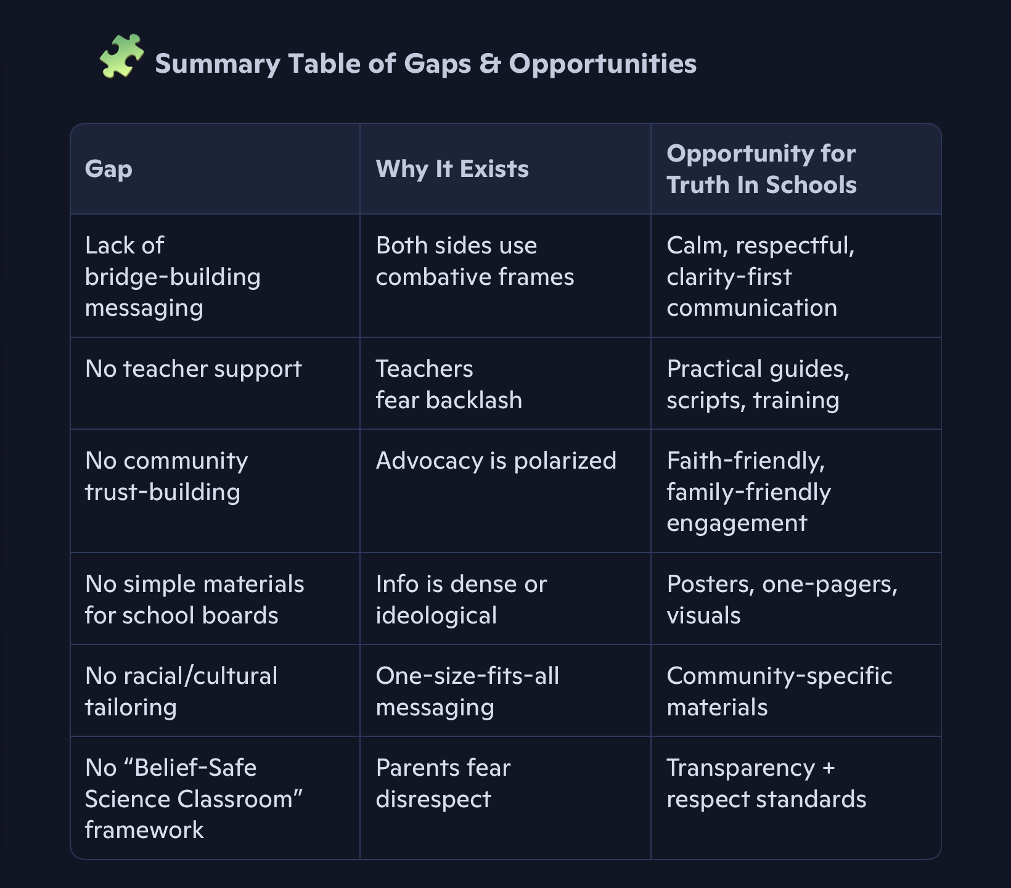
Strategy Insights
Where they are not active – The gaps

Slide 15
Strategy Insights
Where Truth In Schools fills the gaps
Where Truth In Schools Can Lead The Field
TIS is uniquely positioned to fill the trust gap, not the ideology gap.
The TIS tone, visuals, and messaging should align with the unmet needs:
Respect
Clarity
Transparency
Calm authority
Bridge‑building
This is the lane nobody else is occupying—and it’s the lane with the highest potential impact.

Slide 16
Conception to Implementation
First Steps
Next Steps
Formally Organize Non-Profit
Legal identity, location, and banking
Define Focus Areas
Primary and secondary
Determine Resource Needs
Operational and Staffing
Identify Investment Requirements
Outline Timelines and Milestones
Development and initial activities
Fundraising
Post-investment activities
Create Brand Identity
Logo, Vision, Mission, etc.
Establish marketing
Website and social media
Ambassadors and affiliates
Publications and public resources
Engage Advertising
Begin a weekly podcast
Outreach to target schools, groups and associations
Begin Fundraising
Begin attending local events
Identify government opportunities
Requests to present

Slide 17
Director Role
Standard NP Director Core Responsibilities
Strategic leadership: Develop and execute the organization’s mission, long‑term goals, and annual plans.
Board collaboration: Serve as the primary liaison to the Board of Directors; prepare reports, attend meetings, and support governance.
Fundraising & development: Lead donor relations, grant writing, sponsorships, and fundraising campaigns.
Financial oversight: Manage budgets, ensure compliance, oversee audits, and maintain financial sustainability.
Program management: Oversee program design, implementation, evaluation, and impact measurement.
Staff leadership: Hire, supervise, and develop staff; cultivate a positive, mission‑aligned culture.
Community & public relations: Act as spokesperson; build partnerships with stakeholders, agencies, and community leaders.
Compliance & risk management: Ensure adherence to nonprofit regulations, reporting requirements, and ethical standards.

Slide 18

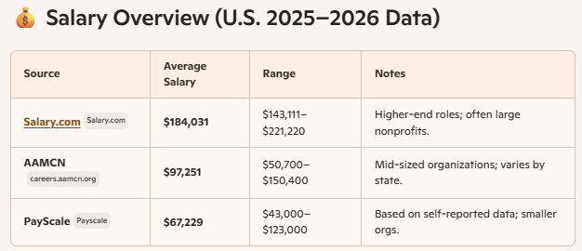
Director Role
Standard NP Director Compensation
Timothy’s most recent compensation was $122,000
Salary Expectations in Virginia (your region)
Virginia typically falls in the $80K–$120K range for Executive Directors of mid‑sized nonprofits, according to national comparisons and regional cost-of-living data (AAMCN lists VA at ~$99K average

