Slide 1
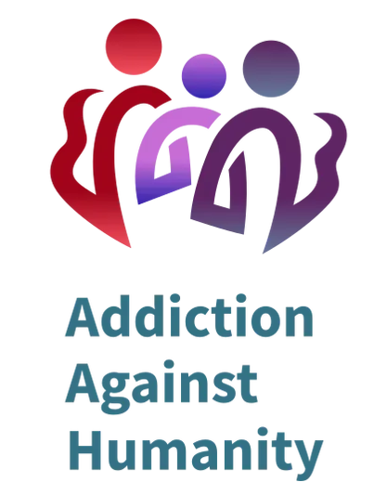
Addiction Against Humanity presentation Investor Pitch Deck. January 2022
Addiction Against Humanity – Proprietary and Confidential

Slide 2
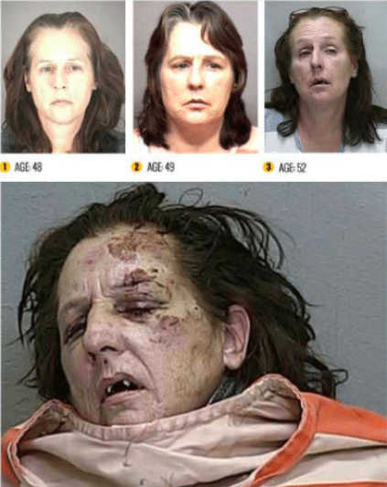
Overdose Deaths Are At Their Highest Ever In History.
Age 48 Age 49 Age 52
Addiction deaths are ipsum a met, and rapidly increasing commodo ligula ardless of race or social status. Usage starting earlier, youngest reported being u .
URGENT!
Addiction Against Humanity – Proprietary and Confidential

Slide 3
ADDICTED AMERICA
841,000 Overdose Deaths in USA
30% Increase In Overdoses Since Covid
93,000 in 2020, Highest Ever Recorded
14.2% Seriously Consider Suicide
16,066 Treatment Centers Across America
Addiction Is Over 6% Of US Disease Burden
Worldwide Only 2%
$249B Total Cost To The US Since 2007
YEAR 2017:
More Substance Abuse Deaths Worldwide Than
ALL CANCER DEATHS C O M B I N E D !
Source: https://ourworldindata.org/drug-use#disease-burden-from-substance-use-disorders https://www.cdc.gov/drugoverdose/deaths/prescription/maps.html#:~:text=In%202019%2C%20an%20average%20of,totaling%20more%20than%2014%2C000%20deaths.&text=While%20prescription%20opioids%20were%20involved,rates%20from%202018%20to%202019.
Addiction Against Humanity – Proprietary and Confidential

Slide 4
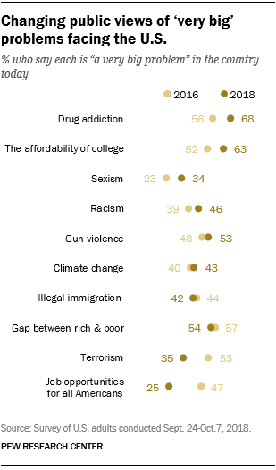
PUBLIC OPINION.
7 years
Drug addiction is the leading cause of concern for most Americans, and the numbers are increasing!
*STATISTICAL VARIATIONS:
Drug Addiction is in the
Top 19 of the Top 10 lists!
Addiction Against Humanity – Proprietary and Confidential

Slide 5
WHAT WE WILL DISCUSS TODAY:
6 Years
Except, Nobody’s Talking About It!
Drug addiction truths.
How it affects individuals, families, and our economy.
Solutions that work.

Slide 6
WHAT IS ADDICTION AGAINST HUMANITY? Addiction Against Humanity is a fun, dynamic icebreaker that brings laughter, educational awareness and entertainment to the #1 non-health related killer in our country today, the opioid crisis and drug addiction. Our unique board game uses raucous, adult humor that engages players and gets them talking, really talking. Players transcend the voluntary entertainment value and directly experience the cold hard truths about addiction in a friendly environment.
Addiction Against Humanity – Proprietary and Confidential

Slide 7
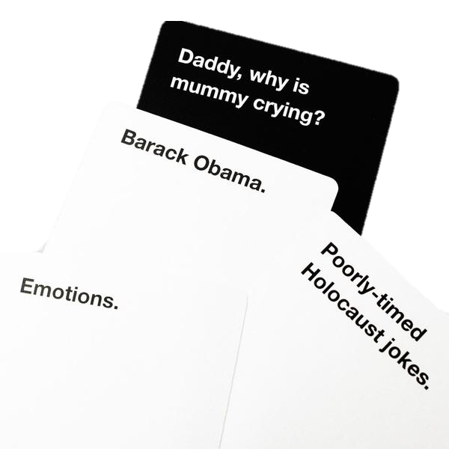
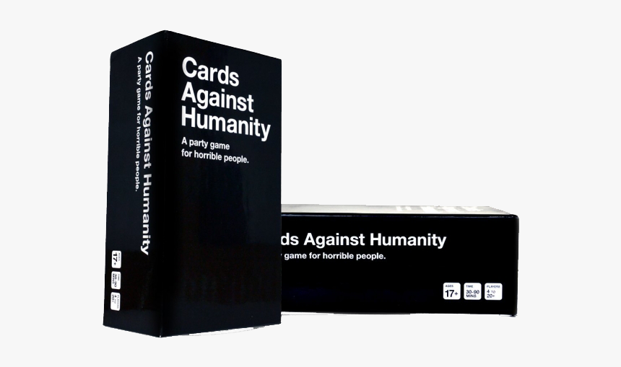
THE STATS
Cards Against Humanity sold 500,000 units the first 2 years on Amazon alone
Current valuation is $500M
* Only $4,000 initially raised on Kickstarter
Raucous Humor Sells!
Addiction Against Humanity – Proprietary and Confidential

Slide 8
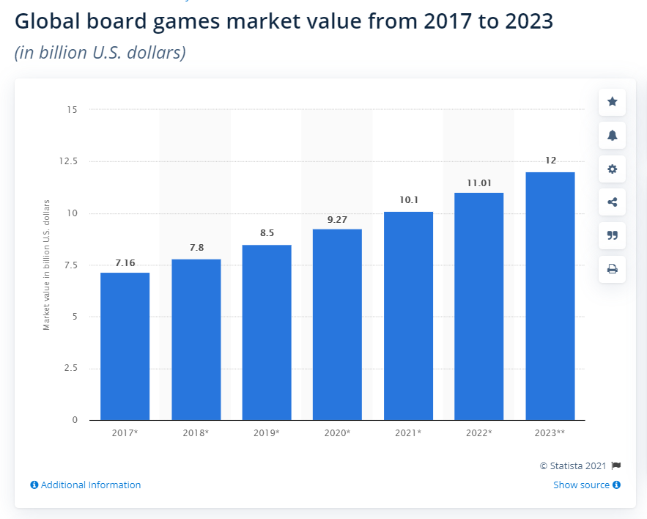
THE STATS
Projected Global Sales
$7.2B in 2017 to
Over $12B in 2023
*Industry expects a 9-13% CAGR
* COVID & lifestyle changes have increased gameplay.
Addiction Against Humanity – Proprietary and Confidential

Slide 9
THE STATS
Playing Habits
57% Own 1 - 25 Board Games (545 Surveyed)
10.9% Own 100+
41% Buy 5 - 10 Games/Expansions Annually
35% Buy 4 or fewer
53% Play
With Friends
18% Play
With Strangers
Addiction Against Humanity – Proprietary and Confidential
Source: PrintNinja, Board Game Industry Statistics 2019

Slide 10
REVENUE STREAMS.
1.) Consumer Direct -
$45 Retail Price
2.) Partner Wholesale -
$30 Wholesale Price
3.) Expansions & Custom Pieces -
$20 Expansion Packs
$35 Custom Game Board
$15 Custom Game Pieces
Addiction Against Humanity – Proprietary and Confidential

Slide 11
GETTING THE WORD OUT.
Social Media.-
Word-of-mouth is one of the top ways board games sell. We will leverage Groups, Brand Champions, and numerous social media strategies.
Online Ads.-
Provocative and non-politically correct ads across a variety of platforms, browsers, and media channels.
Partner Marketing.-
Cross-marketing and cobranding with strategic partners that are aligned within the addiction and treatment communities.
Addiction Against Humanity – Proprietary and Confidential

Slide 12
A.A.H. ROADMAP
1
3
5
7
A.A.H. Founded
Funding & Partnerships
Branding & Marketing
Launch Game!
Company Founded in September 2021 by Michael Roach and Timothy Baker
Begin full marketing campaign and launch game in the US, with some worldwide exposure.
We explore potential strategic partners and secure private and crowdfunded investments.
With the guidance of a marketing agency the brand will be defined, and marketing strategies established strategically.
Q3 2021
Q1 2022
Q2 2022
Q3 2022
Feb 2022
Mar/Apr 2022
May 2022
2023
MVP Created
UI/UX Testing
Game Produced
Regional Games
Our MVP was designed and created through a collaborative effort with recovered addicts.
User feedback collected through in-person play and the online gaming community.
Initial full production game produced and ready for distribution.
Begin production of games built and based on various cities worldwide.
2
4
6
8
Addiction Against Humanity – Proprietary and Confidential

Slide 13
Pro Forma | 2021 - 2024
Launch
Q3 2022
Advertising Sales Revenue Potential Was Not Included
Total 3-Year Revenue:
$22,769,285
Numbers Based Upon:
40% of CAH Sales (Initial 2 years sold 500K units)
10% of Airbnb/VRBO (7.6M locations)
25% of Treatment Centers (16,066 locations)
EBITDA of 49%
Addiction Against Humanity – Proprietary and Confidential
Notes:
INVEST
In terms of our business model, currently we are live-testing and later this year we will launch our management system with the 2 most industry-proven features, fundraising and polling.
This example shows even having less that a 1% penetration what we can do with only 4 candidates per election, 1 republican, 1 democrat,1 independent, and 1 Grassroots, right?

Slide 14
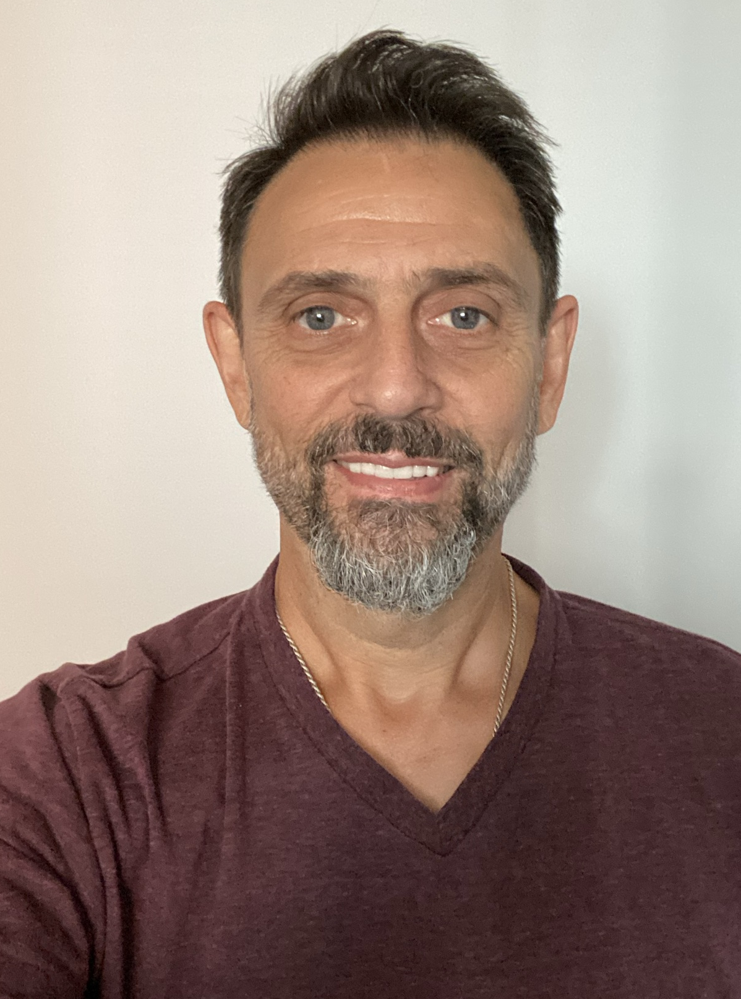
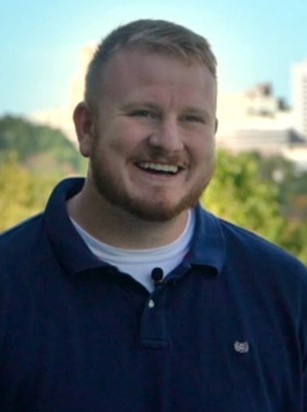
ABOUT US.
Michael Roach, Founder
CEO of Apex Construction Solutions & Virginia State Delegate Candidate.
Timothy Baker, Co-Founder
Serial entrepreneur who recently launched America’s Ticket & GOGO Band, and a Lighthouse Labs Alumni.
Addiction Against Humanity – Proprietary and Confidential

Slide 15
INVESTMENT DETAILS
We are currently exploring strategic partnerships and open to potential equity investments.
* Contact Timothy Baker or Michael Roach for details
timothy@aahumanity.com or (804) 836-6385
michael@aahumanity.com or (804) 690-1057
Addiction Against Humanity – Proprietary and Confidential

Slide 16
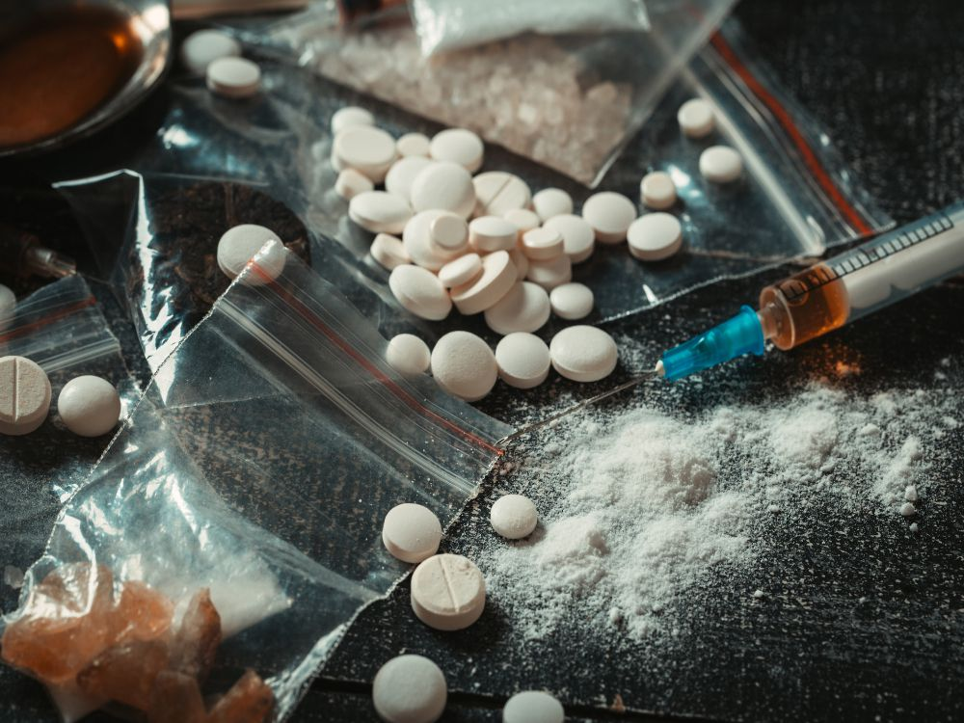
THANK YOU! ADDICTION AGAINST HUMANITY Bringing Awareness To Addiction, With laughter.
Addiction Against Humanity – Proprietary and Confidential

