Slide 1
Investor Presentation
March 2017

Slide 2
300+ million worldwide
suffer from Pediatric Enuresis
Families spend more than
$4.2B annually in the USA
Notes:
2

Slide 3
GOGO BAND Opportunity
GOGO BAND is the first biometric wearable solution to cure bedwetting in children, clinically known as Pediatric Enuresis (PE)
PE is the #1chronic health condition in children that affects 300+ million worldwide, 8.5 million in the USA
In the USA families spend $4.2 Billion annually for treatment
Technical innovation in this market has been stagnant for the last 30+ years and current treatments are ineffective
Our patent pending solution is a game changer that enables us to rapidly capture market share
Notes:
Pull-ups ~ $2+ Billion
Drugs ~ $300 to $350 Million
Product ~ $200 to $300 Million
Adult enuresis (AE) affects over 2-4% individuals annually

Slide 4
Investor Opportunity
GOGO BAND’s data-centric platform is disruptive and enables us to rapidly enter other healthcare markets
Biometric wearables for healthcare will be $50+ billion market by 2022
Companies are acquiring wearable startups to compliment and expand their market reach
Our proprietary IP and significant profits will make us an attractive acquisition target
We are raising $700K at $3 million pre-money valuation to enable launch in Q3 2017
Notes:
4

Slide 5
Corporate Highlights
Member of the Virginia Biotech Research Park
Accepted into Lighthouse Labs Accelerator – a GAN “Top 25” Global Accelerator – completed in November 2016
Named one of the “Top 6” Biotech Start-ups for 2016 by the Governor of Virginia
Awarded the Capital One “2016 Small Business of The Year”
First Start-up accepted into VCU Da Vinci Capstone Program and Brand Center Work-out Program
Notes:
5

Slide 6
Wearable Market Consolidation
Transaction Value vs. Company Age
$500
Acquisition revenue multiples range 8-12 on average, 1 to 5 years after founding
$400
$300
Transaction Value
(S Millions)
$200
$100
$0
0
2
4
6
8
10
Company Age When Acquired
(Years Since Founded)
Notes:
6

Slide 7
Potential Acquisition Partners
Biometric
Wearables
Fitbit
Jawbone
Fossil
Misfit
Under Armour
Nestlé Group
Kimberly Clark
Johnson & Johnson
Proctor & Gamble
Mattel
Novartis
Boston Scientific
Medtronic
Covidien
Pediatric
Focus
Medical
Devices
Apple
Google
Microsoft
Samsung
Siemens
Big Tech
Notes:
7

Slide 8
Future Vision
Opportunity | Market Opportunity
Potty Training | 16+ million children Pre-school & daycare centers
Geriatric Incontinence | 20+ million adults Nursing homes, hospitals & caregivers
Life-Threatening Anaphylactic Shock | 10 – 15 million children & adults Primary care physicians & allergists
Chronic Migraine Syndromes | 3 – 5 million adults Neurologists & general practitioners
Spinal Cord Injuries | Incontinence related issues Assists with catheterization timing
Stroke and Anxiety Attacks | Identify stroke risk with HRV/BP changes Biofeedback to help lower BP
Notes:
8

Slide 9
The Solution

Slide 10
Wearables Market Segmentation
Infant Biometrics
(Ages 0 – 2)
Children Biometrics
(Ages 2 – 18)
Adult Biometrics (Ages 19+)
Sproutling
Mimo
Misfit
Fitbit
Jawbone
Apple
Fossil
Under Armour
Core Focus
Pediatric
Enuresis
Core Focus
Infant Monitoring
Core Focus
Fitness
Tracking
Notes:
10

Slide 11
Size of Market
USA Children Population
(5 – 18 years old)
Enuretic Children Population¹
(5 – 18 years old)
Nighttime
& Daytime
1,200,000
Total Market
51,000,000
Enuretic Children
8,500,000
Nighttime
4,500,000
Initial Launch
Daytime
1,800,000
Physical
1,000,000
8.5M children suffer from Pediatric Enuresis
with 1,000,000 new cases diagnosed every year
¹Evaluation and Treatment of Enuresis, K. Ramakrish, MD AFP V78.4 August 15, 2008
Notes:
International market
Grossly underserved
Niche market
17% is TAM
15% physiological
75% night

Slide 12
The Devastating Impacts
Major Depression
Only blindness or death of parent is more traumatic to a child
Suicide
Low Self-Esteem
Psychological & Physical
Parental Abuse & Neglect
Bullied & Ostracized
Social Isolation
Severe Medication Side Effects
Kidney & Urinary Tract Infections
Family
& Social
Personality Disorders
Poor School Performance
Decreased Lifetime Earnings
Financial Drain on Family
Notes:
Increased psychological disorders as young as 7 years old
Early intervention is essential

Slide 13
Physiology of Enuresis
Central
Nervous System
Autonomic Nervous System
Bladder full signal not recognized
Increased heart rate, blood pressure & perspiration
Bladder
Maturation delay in neurological “brain to bladder” pathway
Notes:
13

Slide 14
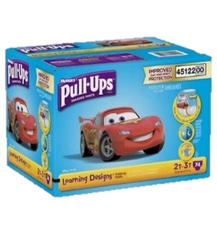
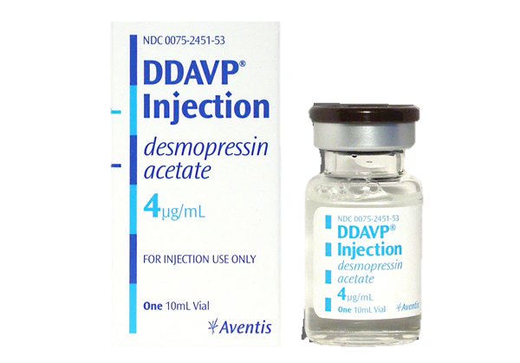
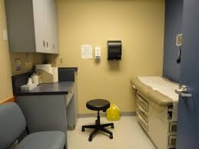
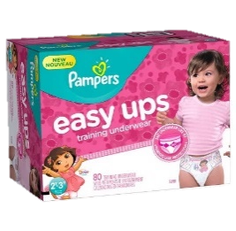
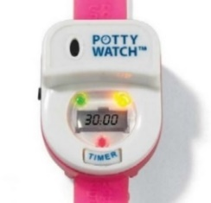
Current Treatment Options
Drugs
$100 - $300
per month
Diapers
$40 - 60
per month
Alarms
$25 - $2400
per device
Clinics
$2000-$5000
six months
Only masks the problem
Only 25%
effective
Cost
Prohibitive
Notes:
14

Slide 15
Competition
24-Hour
Daytime
Nighttime
Features | GOGO BAND $299.95 | Potty Time $19.99 | WobL $39.95 | vibraLITE $59.95 | Potty Monkey $29.99 | Roger $139.95 | Malem (Pad) $169.95
Out-of-Box Ready
Kid-Friendly Design
Multi Sensory Alarms
Waterproof (3M+)
Personalized Alarms
Bluetooth and Internet
Biometric Tracking (IPAS)
Parental Tracking
Nighttime Urine Sensor
These product features are unique differentiators that are covered in GOGO BAND filed IP
Full Feature
Partial Feature

Slide 16
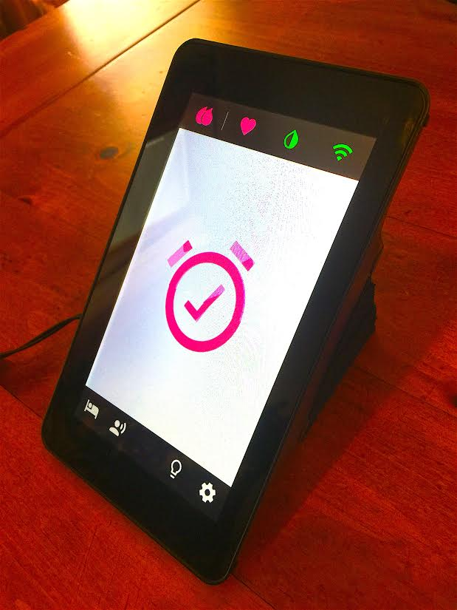
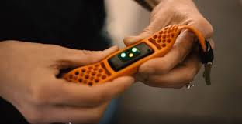
GOGOBAND Biometric Solution
Gateway
Biometric Band
Big Data
Predictive Engine
Bluetooth
WiFi
Parent App
WiFi/Cell
Notes:
16

Slide 17
The Power of Biometrics
Heart rate
IPAS
Respiration
Intelligent Predictive Alarming System
(Machine Learning)
Temperature
Movement
Big Data Engine
Blood Pressure
Continuous biometric data capture
IPAS big data engine intelligently predicts urination event
Machine learning continuously improves predictive accuracy
Significant value of biometric data for other healthcare applications
Notes:
No shelf life / expiration date.
Future analysis by the medical community of HRV will have future diagnostic value

Slide 18
The GOGO BAND Impact
60%
Lower Relapse Rate
Deeper Conditioning
8%
50%
Virtual
Coach Impact
7%
40%
Higher Adoption Rate
6%
Cure Rate (% of Users)
30%
8%
54%
GOGO BAND is expected to double
the efficacy of existing enuretic alarms
20%
25%
10%
0%
Current
Enuresis Alarms
Repeating the cycle of prediction, identification and notification will condition
a child’s brain to finally recognize the “lost” bladder full signal within a 1-6 month period.
Notes:
18

Slide 19
Market Strategy – Focus Groups
Based on independent third party focus group
insights from parents of children with PE
Brand
Strong belief in the GOGO BAND mission to help children
Seeing a child’s accomplishment has greatest impact
Messaging
Parents perplexed as to the root causes of PE
Astounded at the prevalence of the problem in children
Channels
Pediatricians are the “go-to” adviser for parents
Consumers wary of fortune seeking pricing policies
GOGO BAND is perceived as innovative and “different”
Parent’s stress level is high and cannot be underrated
Parent’s will follow doctor’s advice with little hesitation
Opportunity to be the knowledge expert in the market
Notes:
29 sec
Our go-to-market strategy is multi-channeled and targeted to moms.
The most important being our online and direct selling efforts and leveraging pediatricians and urologists who are key influencers in a parent’s search for treatment options.
We expect a 70% unit margin at an average system price of $250 and our system is covered by most FSA and HSA insurance plans.

Slide 20
Market Strategy – Focus Groups
Brand Building
Showcase the GOGO BAND mission to enable kids to achieve personal success
Messaging
Keep the message simple and not overcomplicated with the detailed “science” behind PE
Channels
Pediatricians are the gateway into the market – credibility
Maintain reasonable pricing so as not perceived to capitalize on the “pain” felt by children
Stay close to and echo what the parents believe are the root causes of PE
Connect on the innovation and technology of the solution
Online and social used for research treatment options and connecting
Ignite a “knowledge” movement by producing an online content factory
Notes:
29 sec
Our go-to-market strategy is multi-channeled and targeted to moms.
The most important being our online and direct selling efforts and leveraging pediatricians and urologists who are key influencers in a parent’s search for treatment options.
We expect a 70% unit margin at an average system price of $250 and our system is covered by most FSA and HSA insurance plans.

Slide 21
Market Strategy - Pricing
Launch
Retail (Avg.) $300
Cost $115
Profit $185
Margin 62%
2019
Retail (Avg.) $300
Cost $ 78
Profit $222
Margin 73%
Online
&
Direct
(100K daily searches)
Medical Sites
Social Networks
SEO
Direct Mail
Pediatricians
&
Urologists
Direct Sales
Conferences
White Papers
Journals
Qualifies for Flexible Spending and Health Savings Accounts
Notes:
29 sec
Our go-to-market strategy is multi-channeled and targeted to moms.
The most important being our online and direct selling efforts and leveraging pediatricians and urologists who are key influencers in a parent’s search for treatment options.
We expect a 70% unit margin at an average system price of $250 and our system is covered by most FSA and HSA insurance plans.

Slide 22
GOGO BAND Roadmap
$500K+ Lighthouse Labs & Partner Donations
$100K+ Seed Funding
International Expansion
$700K
Investment
Potty
Training
700+ Child Nights
Validates Biometric Model
Product Launch
GOGO BAND Founded
Provisional
Patent Filed
Geriatric
Enuresis
Cash Flow Positive
Feb 2016
Mar 2016
July 2016
Nov 2016
Dec 2016
Mar
2017
Aug
2017
Aug 2018
June 2019
June 2020
June 2021
We Are Here
Notes:
22

Slide 23
Donated Efforts from Partnerships
Ghent University Belgium Clinical Trials
$150K
Capital One Data Science Team
$250K
VCU Da Vinci and Brand Centers
$25K
$510,000
Corporate and
Academic Partnership
Donations
Capital One Focus Group and Brand Team
$50K
Lighthouse Labs VA Biotech Research Park
$25K
Altria Packaging Design
$10K
Notes:
23

Slide 24
Investment Overview
Use of Proceeds
Legal $25K
R&D $120K
Marketing $180K
G&A $75K
Salaries $116K
Inventory $184K
TOTAL $700K
Raising $700K at
$3 million pre-money valuation to enable launch in Q3 2017
Notes:
24

Slide 25
Intellectual Property
Activity | Status | Future Actions
Brand Logo Design | Complete | Develop sub-brands
USPTO Copyright | Complete | File with USPTO for sub-brands
Website URLs | Complete | Build website & drive traffic
USPTO Trademark | Complete | Application filed with USPTO
“Urination, Prediction and Monitoring” | Provisional Patent Filed 7/22/2016 | Predictive alarms using personalized biometrics & big data analytics engine
Additional 10+ Families of Inventions Under Review | Funding Dependent | Provisionals to be filed as more technical and market information becomes available
Notes:
25

Slide 26
The Management Team
Jon Coble
Co-Founder & CEO
Respond.com
Capital One
Spiegel – Eddie Bauer
Mercer Management Consulting
Timothy Baker
Co-Founder, President & CMO
US Navy Medical Corps
Regeneris Medical
Bosley Medical Group
Assurant Healthcare
Dr. Israel Franco
Chief Science Officer
Board Certified Pediatric Urologist
Yale Children’s Continence Center
International Children’s Continence Society Board
Mike Kohonoski
Chief Operating Officer
Privaris
Respond.com
Authentica Security Technologies
The Guild Corporation
Steven Zyglowicz
Chief Technology Officer
ABB-Ventyx
Respond.com
Decision Science
E-Systems
Board of Advisors
Gary LeClair
LeClair Ryan
(Legal & Corporate)
Carroll Hurst
Keiter Stephens
(Financial)
Lonnie Green
Board Certified Urologist
(Medical)
Notes:
26

Slide 27
Improving Children’s Lives
…And Their Families
Jon Coble ~ jon@mygogoband.com
Timothy Baker ~ timothy@mygogoband.com
Notes:
20 sec
In closing, I not only believe this is a wonderful business opportunity, but that giving these children back their childhood is a noble endeavor.
Thank you very much.
27

Slide 28
Product Launch Strategy
Detailed Design & Prototype
Test
Manufacturing
Test
LAUNCH
GOGO BAND V1
GOGO Urine Sensor
Detailed Design & Prototype
Test
Manufacturing
Test
GOGO Gateway
Hardware
Detailed Design & Prototype
Test
Manufacturing
Test
GOGO Gateway
Software
Design & Development
System Test
Development
Test
IPAS Software
Design & Development
System Test
Development
Test
Website & App
App Development
System Test
Website Design
Test
Dec
Jan
Feb
Mar
Apr
May
June
July
Aug

Slide 29
Investor Opportunity
The biometric wearables market is exploding and is forecast to grow from $17 billion to $72 billion by 2020
Wearable technologies are transforming the personal healthcare industry
Consolidation is underway for biometric wearable startups to compliment and expand the market reach of their acquirers
Our strategy is to build a rapidly growing, high margin company that is an attractive target for acquisition by other leading biomedical and technology firms
We are raising $700K to $1.5M to support product development and enable us to launch in Q3 2017
Notes:
Pull-ups ~ $2+ Billion
Drugs ~ $300 to $350 Million
Product ~ $200 to $300 Million
Adult enuresis (AE) affects over 2-4% individuals annually

