Slide 1
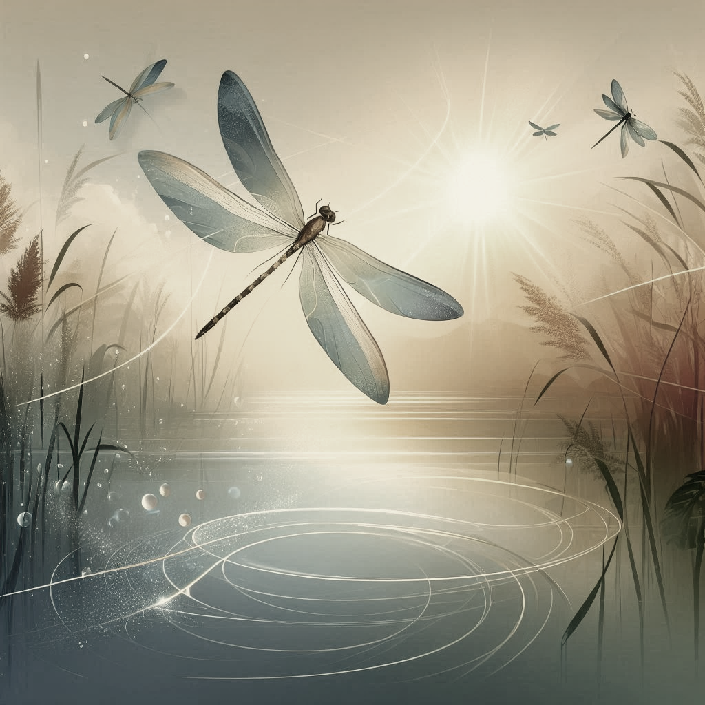
  The Parables of
  Lucian and Nyx
  Production and Investment Presentation
  Presented by: Timothy Baker
  October 2025

Slide 2
Table of Contents
  Mission
  Parable
  Opportunity
  Appendix
    Production Use Cases
    Page-by-Page
    Production prompts

Slide 3
Mission Statement
Through a series of adventures with Lucian and Nyx, the mission is
Communities and families regaining trust by broadening understanding, tolerance, and respect for one another by embracing the power of S.I.N. to build amazing relationships with open conversations, growing the Kingdom of God.

Slide 4

Intention Statement
Communication worldwide has experienced a breakdown at historic levels.
Our ability to trust in political, religious, and educational leaders has been shattered.
  Spilling over into our local communities, even impacting our friends and families.
Once cherished relationships and conversations are tainted by a fear of what is said.
Leaving people feeling disconnected and alone!
The Parables of Lucian and Nyx: Wings of Hope is written with the intent of
Bridging the communication gap by rebuilding trust in one another and breaking down walls and defenses, we have all been forced to erect.
Reminding readers with each interaction Lucian and Nyx experience, how vital people and communication is for everyone to thrive and grow, individually and together.
Exploring relationships and communications through the experiences of Lucian and Nyx, guiding readers to a better understanding and appreciation of others by engaging in S.I.N. – Sharing, Inspiring, and Navigating.

Slide 5

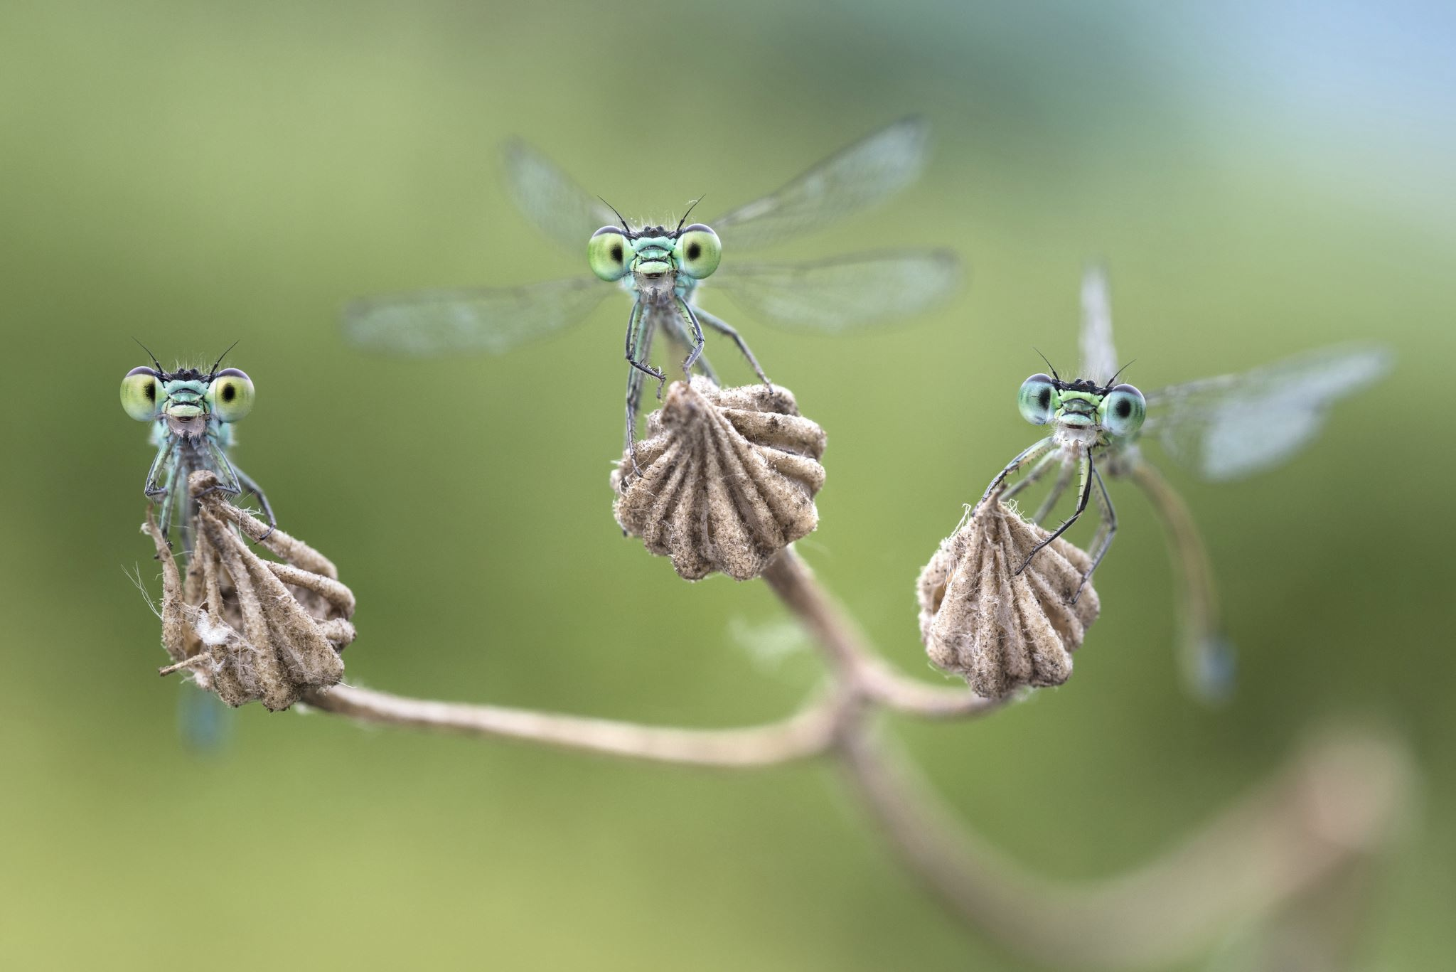
The Parables of Lucian and Nyx: Wings of Choice
By Timothy Baker
A Story of Sharing , Inspiration, and Navigation

Slide 6
Table of Contents
  The Parable
  Prologue
  Chapter 1: Brothers of the Mud
  Chapter 2: The Transformation
  Chapter 3: Sharing
  Chapter 4: Inspiring
  Chapter 5: Navigating
  Chapter 6: The Trial of the Bird
  Chapter 7: The Turning Point
  Chapter 8: The Redemption
  Chapter 9: Two Legacies
  Epilogue: The Moral For Humans

Slide 7
Prologue
The sun rose over the still waters, casting golden ripples that danced like promises yet to be fulfilled. From the bottom of the pond, the world above feels both distant and luminous. In the faint sway of reeds and drifting particles that catch the light like tiny sparks, two dragonfly siblings dart amongst the reeds—Lucian, the elder brother, his wings shimmering with calm, thoughtful wisdom, and Nyx, the younger, full of restless energy and wonder, always questioning.
Lucian often reminded his brother of the guiding principle their mother had whispered before her wings faded into the heavens: You S.I.N. better together — Share. Inspire. Navigate. “Remember,” he said, “these are not just words, but ways of living.”

Slide 8
Chapter 1 - Brothers of the Mud
In the shadowed pond, Lucian and Nyx grew together as nymphs. Their world was one of mud, reeds, and hunger. They stalked tadpoles and mosquito larvae with ambush strikes, their jaws snapping with ruthless efficiency. Yet even in those depths, Lucian often paused, gazing upward at the shimmering surface. “Surely,” he whispered, “there is more than mud and shadow. Perhaps above there is light, and in that light, meaning.”
Nyx scoffed. “Why dream of what you cannot see? The pond gives us everything. Here, we are kings. Take what you can, while you can.” His words carried the tone of one who feared change, though he cloaked it in arrogance.
Already, in their younger years their conversations strained. Lucian longed to speak of hope, but Nyx dismissed him. Their silence mirrored a truth that would echo later: when communities lose the ability to speak openly, even brothers grow distant.

Slide 9
Chapter 1 - Takeaways
Scripture Echo:
“The light shines in the darkness, and the darkness has not overcome it.” (John 1:5)
Lesson:
Some hearts hunger for light, others for possession. Humans too must choose whether to live only for survival or to seek higher purpose.

Slide 10
Chapter 2 - The Transformation
One dawn, Lucian felt a stirring. He climbed a reed, his body trembling. His skin split, and he emerged winged, radiant, and light. He clung to the reed until his wings hardened, then launched into the air. For the first time, he saw the pond from above, the meadow stretching beyond. He felt reborn.
Nyx followed days later. His wings were strong, his body swift, but his heart unchanged. He shed his skin, but not his pride. Where Lucian saw a gift, Nyx saw a weapon.
When Lucian tried to share his joy, Nyx cut him off. “Enough of your talk. Let us hunt.” Lucian sighed, realizing that even with wings, Nyx’s ears were closed. Their inability to speak openly mirrored the silence growing in their community, where even a greeting was met with suspicion.

Slide 11
Chapter 2 - Takeaways
Scripture Echo:
“You were taught… to put off your old self… and to put on the new self, created to be like God in true righteousness and holiness.” (Ephesians 4:22–24)
Lesson:
Transformation is not only outward but inward. Humans may change circumstances, wealth, or status, but true growth requires shedding pride, fear, and selfishness.

Slide 12
Chapter 3 - Sharing
Dragonflies are hunters of the air, catching prey mid‑flight with astonishing precision. Lucian mastered this art, but he did not keep it to himself. He taught the young how to hover like a helicopter, how to track mosquitoes with their enormous compound eyes, and how to clasp prey with their spiny legs. His lessons spread like ripples, strengthening all who listened.
Nyx mocked him. “Why waste time teaching? Let the weak fall. Survival is for the fastest.” Yet when storms came, Lucian’s students endured, while others faltered. Nyx’s laughter rang hollow.
But Lucian also noticed something troubling: the young hesitated to ask questions. They feared being mocked, not only by Nyx but by others who had grown cynical. Even among dragonflies, communication was breaking down. Lucian reminded them gently, “We must share not only food but words. For words can build or destroy.”

Slide 13
Chapter 3 - Takeaways
Scripture Echo:
“Do not let any unwholesome talk come out of your mouths, but only what is helpful for building others up.” (Ephesians 4:29)
Lesson:
Pride blinds us to danger. Humility keeps us watchful. As Scripture says, “Pride goes before destruction, and a haughty spirit before a fall.”

Slide 14
Chapter 4 - Inspiring
Dragonflies are territorial, often patrolling the same stretch of reeds. Lucian, however, turned his patrols into performances. He looped, spiraled, and glided, his joy lifting the hearts of those who watched. Even the butterfly said, “Your flight gives courage to the timid.” The young dragonflies, once hesitant, lifted their wings with new confidence.
Nyx scoffed. “Beauty is useless. Flight is for dominance.” Yet he could not ignore what he saw: Lucian’s joy became contagious. The timid grew bold, the weary found hope.
Still, Lucian noticed that many were afraid to speak of what inspired them. They feared ridicule, feared being cast out for their differences. “We must learn to celebrate one another’s gifts,” Lucian said. “Even if we do not agree, we can still honor what uplifts.”

Slide 15
Chapter 4 - Takeaways
Scripture Echo:
“Therefore encourage one another and build each other up.” (1 Thessalonians 5:11)
Lesson:
Beauty and joy are gifts meant to inspire others, not to glorify ourselves. Humans, too, are called to let their light shine, not hide it.

Slide 16
Chapter 5 - Navigating
When storms raged, Lucian guided the young to shelter. He showed them how to angle their wings against the wind, how to fly low and steady until the danger passed. Together, they survived.
Nyx tried to save himself alone. The wind battered him, nearly drowned him. He realized too late that Lucian’s way saved many, while his way saved no one—not even himself.
Afterward, Lucian gathered the young. “We must learn to navigate not only storms of wind, but storms of words. Fear and judgment scatter us. But if we listen, if we speak with grace, we can endure together.” The young nodded, though some still hesitated to speak.

Slide 17
Chapter 5 - Takeaways
Scripture Echo:
“Let your conversation be always full of grace, seasoned with salt, so that you may know how to answer everyone.” (Colossians 4:6)
Lesson:
Courage is not reckless display but sacrifice for others. Humans, like Lucian, are called to lay down pride and protect the vulnerable.

Slide 18
Chapter 6 - The Trial of the Bird
One afternoon, the great Bird descended, casting a shadow over the pond. Its talons gleamed, its eyes sharp. Lucian darted upward, weaving through the air, luring it away from the young. His courage was not reckless, but sacrificial.
Nyx, eager to prove himself, tried to outfly the predator. He boasted of his speed, but pride nearly killed him. The Bird’s talons scarred his wing, leaving him trembling. For the first time, Nyx feared—not death, but the emptiness of a wasted life.
Later, when Lucian tried to speak of the lesson, Nyx snapped, “Do not preach to me.” Lucian answered softly, “I do not preach. I share. You may not agree, but we must still speak. Silence will only divide us further.”

Slide 19
Chapter 6 - Takeaways
Scripture Echo:
“The tongue has the power of life and death.” (Proverbs 18:21)
Lesson:
In life’s storms, selfishness scatters, but navigation with integrity preserves. Humans, too, must guide one another through trials.

Slide 20
Chapter 7 - The Turning Point
In the days that followed, Nyx asked Lucian, “Why do you waste your short life on others?” Lucian answered, “Wings are not given only for ourselves. They are given so we may lift others.”
Nyx mocked him still, but the words haunted him. At night, when the pond was still, he replayed them in his mind. What if Lucian was right? What if wings were not for conquest, but for service?
He began to notice how even greetings were rare among the dragonflies. Fear of judgment silenced them. Nyx wondered: had his own mocking made others afraid to speak? For the first time, he felt the weight of his words.

Slide 21
Chapter 7 - Takeaways
Scripture Echo:
“Everyone should be quick to listen, slow to speak, and slow to become angry.” (James 1:19)
Lesson:
Redemption is always possible. Mistakes do not define us—our choices after them do. As Christ taught, the lost sheep is welcomed when it returns.

Slide 22
Chapter 8 - The Redemption
One storm, Lucian was weary. The young scattered, and he could not guide them all. Then Nyx appeared, darting into the wind. He caught the lost, guided them home, and shielded them with his scarred wing.
The old whisper returned: Save yourself. But Nyx remembered Lucian’s words. He chose differently. He saved others, not just himself. And in that moment, he felt lighter than he ever had. His scars became his testimony, his deeds his redemption.
Afterward, Nyx spoke to the young. “I once mocked. I once silenced. But I have learned: even when we disagree, we must speak. We must listen. We must share, inspire, and navigate together.”

Slide 23
Chapter 8 - Takeaways
Scripture Echo:
“Bear one another’s burdens, and so fulfill the law of Christ.” (Galatians 6:2)
Lesson:
Life is not measured by its length but by the light it leaves in others.

Slide 24
Chapter 9 - Two Legacies
As Lucian’s wings grew thin with age, he perched on a reed, watching humans by the pond. Children laughed, adults quarreled, lovers reconciled. He saw in them the same choices he and Nyx had faced: to hoard or to share, to mock or to inspire, to scatter or to navigate together.
Nyx, once the shadow, now guided the young. His scars no longer shamed him; they became his story, his gift. The pond remembered two dragonflies: Lucian, the Golden Teacher, and Nyx, the Shadow Redeemed.

Slide 25
Chapter 9 - Takeaways
Scripture Echo:
“If it is possible, as far as it depends on you, live at peace with everyone.” (Romans 12:18)
Lesson:
Communities falter when fear silences them, when even a greeting feels dangerous. But through S.I.N. —Sharing, Inspiring, Navigating — but having difficult conversations, even without full agreement, understanding and respect can be rebuilt.

Slide 26
Epilogue - The Moral for Humans
Lesson:
Through the lives of Lucian and Nyx, we see the path of S.I.N.—Sharing, Inspiring, Navigating:
Sharing: Lucian gave his wisdom freely, multiplying strength. Humans too are called to share gifts, as the early church shared bread and possessions.
Inspiring: Lucian’s flight lifted others. Humans are called to be salt and light, inspiring hope and courage
Navigating: Lucian guided others through storms. Humans are called to shepherd one another, bearing each other’s burdens.
And Nyx shows us this: even those who stray can return. Redemption is always possible. Scars can become stories, and stories can become guidance for others.
Final Reflection
Like dragonflies, humans live in fleeting time. But whether months or decades, the measure of life is not its span, but its service. To share, to inspire, to navigate—that is to live with integrity, to shine with light, and to leave a legacy that endures.

Slide 27
  Production Use Cases

Slide 28
Production Use Cases
Belief and imagination unveils unlimited applications.
Amazing growth and learning moments
for families, in classrooms, and churches.
Workplace & Community programs
with a sensitive, yet inspiring core offering.
Short Story Publication
Multi-Series Development Series
Group and Independent Studies
Classroom and Social Education
Workplace Educational Initiatives
Uplifting Team Building
Community and Social Experiences
Animated Series/Movies
Captures attention & creates excitement.
Dynamic all-audience vision.
  Younger readers by igniting curiosity and understanding,
  Engaging Adult readers seeking enjoyment, adventure, or maybe even a little direction with life.
  Countless production and marketing opportunities.
  Delivering across virtually any platform.

Slide 29
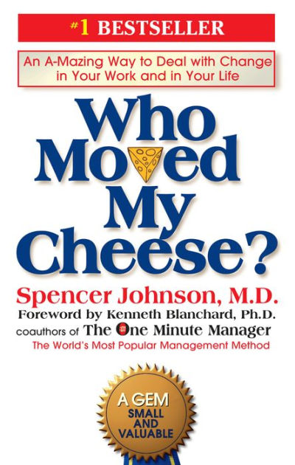

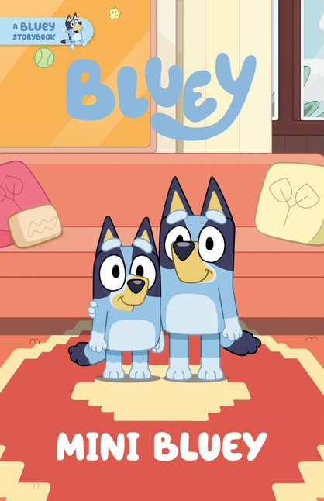
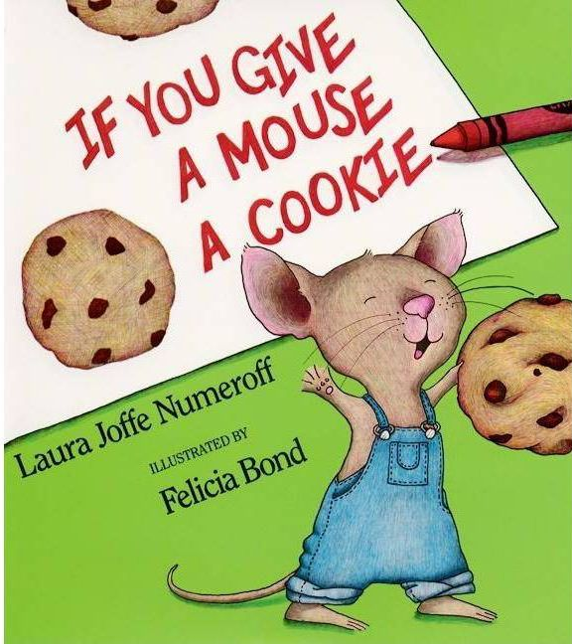


Production Potential
30M copies
28M copies
$2B in revenue
Not Publicly Available
16 million copies
68-book series

Slide 30
Production and Investment Opportunity
The Parables of Lucian and Nyx belongs in every home, classroom, church, and business around the world, engaging people and communities through the power of S.I.N..
We are making this happen by building a relationship that will,
    Establish mentorship and guidance with development.
    Secure necessary funding through the initial production, marketing, and distribution, to exponential revenue growth.
    Capitalize on peripheral opportunities and additional volumes.
To explore these opportunities: Contact Timothy Baker, Writer and Founder
Mobile: 804-836-6385 Email: Timothy@thefaithfulsinners.com

Slide 31
Thank You.
- Lucian and Nyx (and Timothy Baker)

Slide 32
  Appendix
  Page-by Page Layout

Slide 33
Page-by Page - Prologue
Page-by-Page Layout
Page 1: Opening spread
Visual: Golden sunrise over a glassy pond; ripples as gold threads. Soft particles glint like sparks. Subtle silhouettes of reeds.
Text placement: Title at top-left; subtitle beneath; opening paragraph in a slim column on right; pull-quote of “You S.I.N. better together — Share. Inspire. Navigate.” centered at bottom.
Design accents: Waterline motif; faint cross-light flare in the sun; dove-shaped glint blended into bokeh.
Page 2: Character vignette
Visual: Close-ups of Lucian (warm gold-blue wings) and Nyx (cool indigo wings) among reeds; twin panels.
Text placement: Short character intros at bottom of each panel; mother’s whispered principle as a ribbon text across center.
Design accents: S.I.N. monogram watermark; gentle gradient from dawn gold to pond teal.
Storyboard Outline
Scene 1: Dawn over still waters
Imagery: Macro ripples, golden light shafts, drifting motes.
Camera: Slow dolly across water surface; soft focus transition to reeds.
Tone: Reverent, luminous, expectant.
Narration cue: “The sun rose over the still waters…”
Scene 2: Siblings introduced
Imagery: Twin close-ups—Lucian’s warm shimmer; Nyx’s restless intensity.
Camera: Push-in to wings; cross-dissolve between faces.
Tone: Tender contrast; familial bond.
Narration cue: Mother’s whisper of S.I.N.
Full Narration Script
Narration notes
Voice: Calm, steady baritone or compassionate, never sentimental.
Tempo guidance: Slow in Prologue; brisk inaction; pause before moral lines; allow 1–2seconds of silence after key revelations (e.g.,“He felt reborn,” “He chose differently”).
Scene transitions: Soft crossfades for reflection; cuts for conflict; hold on light motifs for grace moments (0.5–1s).
Scene 1 (Dawn over still waters | slow, luminous):
“The sun rose over the still waters, casting golden ripples that danced like promises yet to be fulfilled.”
Scene 2 (Siblings introduced | warm, intimate):
“Beneath the reeds, two siblings—Lucian, shimmering with calm wisdom, and Nyx, bright with restless wonder—darted through the light.”
“Their mother’s whisper lingered: You S.I.N. better together—Share. Inspire. Navigate.”

Slide 34
Page-by Page - Chapter 1 - Brothers of the Mud
Page-by-Page Layout
Page 3: The depths
Visual: Dark, muddy pond floor; nymph forms hunting; tadpole silhouettes; tension.
Text placement: Left column narrative; right margin Scripture Echo (John 1:5).
Design accents: Mud-grain texture; faint upward light beam.
Page 4: Lucian’s longing
Visual: Lucian’s nymph form looking up; surface shimmer above like a distant heaven.
Text placement: Short paragraph, then “Lesson” callout card bottom-right.
Design accents: Thin vertical line connecting mud to light; subtle halo over the shimmer.
Storyboard Outline
Scene 3: Mud-world hunting
Imagery: Nymph predation; jaws snapping; tadpole silhouettes.
Camera: Low-angle tracking; quick cuts for ambush.
Tone: Raw survival; tension.
Narration cue: Life in shadowed pond.
Scene 4: Lucian gazes upward
Imagery: Upward glimmer at surface; hopeful eyes.
Camera: Tilt from mud to light; linger on shimmer.
Tone: Yearning; contemplative.
Narration cue: “Surely, there is more than mud…”
Scene 5: Nyx scoffs
Imagery: Nyx asserting dominance; ripples disturbed.
Camera: Snap zoom; cutaway to silent distance between brothers.
Tone: Defensive pride; growing silence.
Narration cue: Community silence foreshadowed.
Full Narration Script
Scene 3 (Mud-world hunting | brisk, raw):
“In shadowed mud they grew as nymphs—ambushers, jaws swift, hunger constant.”
Scene 4 (Lucian’s gaze upward | contemplative):
“Lucian paused, eyes lifted to the glimmering surface. ‘Surely, there is more than mud. Above, perhaps, meaning.’”
Scene 5 (Nyx scoffs | sharp, guarded):
“Nyx scoffed: ‘Take what you can, while you can. Here, we are kings.’”
“Even brothers grow distant when honest words are lost.”

Slide 35
Page-by Page - Chapter 2 - The Transformation
Page-by-Page Layout
Page 5: Emergence
Visual: Lucian climbing reed; exuvia splitting; wing unfurling; macro detail of veins.
Text placement: Full-width header “The Transformation”; narrative across two columns.
Design accents: Wing-vein linework overlay; gold foil for “reborn.”
Page 6: Two hearts
Visual: Split-page: Lucian’s grateful first flight vs Nyx’s predatory gaze.
Text placement: Dialogue snippets; Scripture Echo (Eph. 4:22–24) in a bordered card.
Design accents: Dual-color theme (gold vs indigo); mirrored compositions.
Storyboard Outline
Scene 6: Lucian’s emergence
Imagery: Exuvia split; wings unfurl; veins fill.
Camera: Macro time-lapse; gentle crane up the reed.
Tone: Awe; rebirth.
Narration cue: “He felt reborn.”
Scene 7: Nyx’s flight, unchanged heart
Imagery: Powerful takeoff; predatory gaze.
Camera: Fast whip-pan; harder cuts.
Tone: Strength without softness; pride.
Narration cue: “He shed his skin, but not his pride.”
Scene 8: Joy dismissed
Imagery: Lucian attempting to share; Nyx interrupts.
Camera: Two-shot; Nyx moves through frame, blocking light.
Tone: Friction; guarded community.
Narration cue: “Even a greeting met with suspicion.”
Full Narration Script
Scene 6 (Lucian emerges | awe, reverent):
“At dawn, a stirring. Lucian climbed a reed; his skin split; wings unfurled—light filled him. He felt reborn.”
Scene 7 (Nyx emerges unchanged | strong, tense):
“Days later, Nyx rose with power—but not with peace. He shed his skin, not his pride.”
Scene 8 (Joy dismissed | uneasy):
“When Lucian tried to share his joy, Nyx cut him off. Even greetings, now, felt suspect.”

Slide 36
Page-by Page - Chapter 3 - Sharing
Page-by-Page Layout
Page 7: Teaching flight
Visual: Lucian instructing young dragonflies; hover diagrams; compound eyes catching light.
Text placement: Steps as mini captions; main narrative in left column.
Design accents: Infographic-style mini icons for hover, track, clasp.
Page 8: Words as bridges
Visual: Young hesitant to speak; Lucian speaking gently; ripple rings connecting others.
Text placement: Scripture Echo (Eph. 4:29) in center; “Lesson” card bottom.
Design accents: Ripple motif linking speech bubbles.
Storyboard Outline
Scene 9: Lucian teaches
Imagery: Hover lessons; tracking drills; clasp technique.
Camera: Overhead diagrams; mid-shots of practice.
Tone: Patient; generous.
Narration cue: “He did not keep it to himself.”
Scene 10: Nyx mocks
Imagery: Nyx smirking; others flinch.
Camera: Insert of hesitant faces; ripple of silence.
Tone: Cynical; isolating.
Narration cue: Fear of asking questions grows.
Scene 11: Words build or destroy
Imagery: Bridges forming from ripples; speech bubbles turning into paths.
Camera: Slow pull back revealing collective.
Tone: Gentle exhortation.
Full Narration Script
Scene 9 (Lucian teaches | patient, generous):
“Lucian taught the young—hover steady, track with wide eyes, clasp with care. Strength shared multiplies.”
Scene 10 (Nyx mocks | cold, distancing):
“‘Let the weak fall,’ Nyx said. But storms tested all.”
Scene 11 (Words as bridges | gentle exhortation):
“The young hesitated to ask; fear of mockery silenced curiosity. ‘Share food and words,’ Lucian urged. ‘Words can build—or destroy.’”

Slide 37
Page-by Page - Chapter 4 - Inspiring
Page-by-Page Layout
Page 9: Joy in flight
Visual: Lucian looping and spiraling across reeds; butterfly watching with awe.
Text placement: Narrative center column; quote “Your flight gives courage…” italic callout.
Design accents: Motion trails; sunburst lines behind Lucian.
Page 10: Courage awakened
Visual: Young dragonflies lift off; timid becoming bold.
Text placement: Scripture Echo (1 Thess. 5:11); short reflection paragraphs.
Design accents: Light rays; gentle confetti sparkle.
Storyboard Outline
Scene 12: Joy-flight performance
Imagery: Spirals and loops against sun; butterfly witness.
Camera: Wide sweeping arcs; lens flares.
Tone: Jubilant; uplifting.
Narration cue: Courage spreads through beauty.
Scene 13: Timid take wing
Imagery: Young rise, tentative becoming steady.
Camera: Crossfades from low to high angles.
Tone: Encouraging; warm.
Narration cue: “Joy became contagious.”
Scene 14: Honor diverse gifts
Imagery: Montage of varied flights and talents.
Camera: Collage-style sequence.
Tone: Celebratory; inclusive.
Narration cue: “Celebrate one another’s gifts.”
Full Narration Script
Scene 12 (Joy-flight | bright, jubilant):
“Lucian turned patrols into art—loops, spirals, glides. A butterfly whispered, ‘Your flight gives courage.’”
Scene 13 (Timid rise | tender, hopeful):
“Joy proved contagious. Timid wings found air; weary hearts found light.”
Scene 14 (Honor gifts | inclusive, warm):
“‘Celebrate each gift,’ Lucian said. ‘Even without agreement, honor what uplifts.’”

Slide 38
Page-by Page - Chapter 5 - Navigating
Page-by-Page Layout
Page 11: Stormcraft
Visual: Dark skies; Lucian guiding low and steady; wings angled against wind.
Text placement: Practical navigation tips as side notes; main narrative left.
Design accents: Wind-line graphics; shelter silhouette.
Page 12: After the storm
Visual: Nyx, isolated in the wind; later, regrouping with the young.
Text placement: Scripture Echo (Col. 4:6); “Lesson” card.
Design accents: Contrast: turbulent indigo to calm teal-green.
Storyboard Outline
Scene 15: Storm guidance
Imagery: Wind-lashed reeds; low steady formation.
Camera: Tracking shot close to waterline; stabilizing motion.
Tone: Calm within chaos.
Narration cue: “Angle wings; fly low and steady.”
Scene 16: Nyx alone in the gale
Imagery: Buffeted; near-drowning; disorientation.
Camera: Handheld shake; abrupt cuts.
Tone: Vulnerable; stark.
Narration cue: “His way saved no one.”
Scene 17: Storms of words
Imagery: Whispered judgments as gusts; listening as shelter.
Camera: Sound design swells; visual wind-subtitles.
Tone: Reflective; instructive.
Narration cue: Speak with grace.
Full Narration Script
Scene 15 (Storm guidance | steady, instructional):
“When winds rose, Lucian guided low and true. Angle wings; fly steady; endure together.”
Scene 16 (Nyx alone | stark, sobering):
“Nyx fought alone; the storm broke him. His way saved no one—not even himself.”
Scene 17 (Storms of words | reflective):
“Not only wind scatters—judgment does, too. Listen with grace. Speak with care.”

Slide 39
Page-by Page - Chapter 6 - The Trial of the Bird
Page-by-Page Layout
Page 13: The descent
Visual: Predator bird shadow eclipsing pond; talon glint; Lucian weaving upward.
Text placement: Centered short lines for tension; narrative right column.
Design accents: High-contrast chiaroscuro; dramatic vignette.
Page 14: Scar and mercy
Visual: Nyx’s wing clawed; trembling; Lucian’s soft gaze.
Text placement: Scripture Echo (Prov. 18:21); dialogue exchange in small caption boxes.
Design accents: Thin red scratch lines; soft glow around Lucian.
Storyboard Outline
Scene 18: Shadow falls
Imagery: Bird silhouette; talon glint; pond darkens.
Camera: Top-down swoop; dramatic drop.
Tone: Urgent; dangerous.
Narration cue: “The great Bird descended.”
Scene 19: Lucian lures away
Imagery: Daring weave; sacrificial diversion.
Camera: Tight tracking; near-misses.
Tone: Brave; selfless.
Narration cue: Courage as sacrifice.
Scene 20: Nyx wounded
Imagery: Scar on wing; trembling stillness.
Camera: Freeze on injury; slow fade to quiet.
Tone: Sobering; introspective.
Narration cue: Fear of a wasted life.
Full Narration Script
Scene 18 (Shadow descends | urgent, taut):
“A great Bird fell upon the pond. Talons gleamed; eyes cut sharp.”
Scene 19 (Lucian lures away | brave, sacrificial):
“Lucian wove upward, drawing danger from the young. Courage chose sacrifice.”
Scene 20 (Nyx wounded | quiet, shaken):
“Nyx boasted of speed—then fell to silence. A scar marked his wing; fear marked his heart.”

Slide 40
Page-by Page - Chapter 7 - The Turning Point
Page-by-Page Layout
Page 15: The question
Visual: Night pond stillness; Nyx looking at stars reflected on water.
Text placement: Nyx’s question and Lucian’s reply centered; narrative below.
Design accents: Star-reflection motif forming a cross-like star.
Page 16: Weight of words
Visual: Dragonflies avoiding greetings; Nyx remembering his mockery.
Text placement: Scripture Echo (James 1:19) side card; “Lesson” callout.
Design accents: Broken speech bubbles slowly mending.
Storyboard Outline
Scene 21: Question at night
Imagery: Moonlit pond; star reflections; Nyx pondering.
Camera: Gentle orbit around Nyx; soft focus.
Tone: Penitent; searching.
Narration cue: “Wings are given to lift others.”
Scene 22: Weight of mockery
Imagery: Greetings avoided; social distance visualized.
Camera: Wide shots of separation; slow zoom on Nyx’s realization.
Tone: Honest; remorseful.
Narration cue: Words carry weight.
Full Narration Script
Scene 21 (Night question | penitent, low):
“‘Why spend your short life on others?’ Nyx asked.”
“Lucian answered, ‘Wings are given to lift others.’”
Scene 22 (Weight of words | honest, contemplative):
“Nyx saw greetings grow rare. Had his mockery built walls? His words suddenly felt heavy.”

Slide 41
Page-by Page - Chapter 8 - The Redemption
Page-by-Page Layout
Page 17: The rescue
Visual: Storm returns; Nyx shielding young with scarred wing; Lucian exhausted.
Text placement: Action-focused short paragraphs; bold “He chose differently.”
Design accents: Scar highlighted as a silver thread.
Page 18: Testimony
Visual: Nyx speaking to young; circle of attentive faces.
Text placement: Scripture Echo (Gal. 6:2); key lines in large type; “Lesson” card.
Design accents: Warm gradient; linked circles motif.
Storyboard Outline
Scene 23: Return to storm
Imagery: Nyx dives into wind; shields the young.
Camera: Dynamic pursuit; stabilizing frames around rescued.
Tone: Resolute; redemptive.
Narration cue: “He chose differently.”
Scene 24: Scars as testimony
Imagery: Scar catching light like silver thread.
Camera: Macro glow; soft music rise.
Tone: Hopeful; humble.
Narration cue: “His scars became his testimony.”
Scene 25: Speaking together
Imagery: Circle of dragonflies; attentive listening; nods.
Camera: Round-table pan; warm color grade.
Tone: Communal; restorative.
Narration cue: Share, inspire, navigate together.
Full Narration Script
Scene 23 (Return to storm | resolute, strong):
“Another storm. Lucian faltered; the young scattered. Nyx dove into the gale and gathered them home.”
Scene 24 (Scars as testimony | hopeful, warm):
“The old whisper—save yourself—rose. Nyx chose differently. His scar became a silver thread of mercy.”
Scene 25 (Speak together | communal, gentle):
“‘I once mocked,’ Nyx said. ‘Now I listen. We will share, inspire, navigate—together.’”

Slide 42
Page-by Page - Chapter 9 - Two Legacies
Page-by-Page Layout
Page 19: Watching humans
Visual: Humans by pond—children laughing, adults in debate, lovers reconciling; observed from reed perch.
Text placement: Narrative across bottom; reflective tone.
Design accents: Soft focus human scenes; reed silhouette framing.
Page 20: Names remembered
Visual: Portraits: “Lucian, the Golden Teacher” and “Nyx, the Shadow Redeemed.”
Text placement: S.I.N. summary lines; call to courageous conversations.
Design accents: Dual medallions; gold and indigo color seals.
Storyboard Outline
Scene 26: Humans at the pond
Imagery: Children laughing; adults debating; lovers reconciling.
Camera: Vignettes; observational lens from reed perch.
Tone: Universal; reflective.
Narration cue: Mirrors of choice.
Scene 27: Names and call
Imagery: Lucian gold; Nyx indigo; titles appear.
Camera: Hero frames; overlay of S.I.N. triad icons.
Tone: Honor; clarity.
Narration cue: Rebuild understanding through courageous conversation.
Full Narration Script
Scene 26 (Humans by the pond | universal, reflective):
“From a reed, Lucian watched children laugh, adults quarrel, lovers reconcile. Their choices mirrored his own.”
Scene 27 (Names and call | clear, honoring):
“The pond remembered: Lucian, the Golden Teacher; Nyx, the Shadow Redeemed. Communities heal when courage outspeaks fear.”

Slide 43
Page-by Page - Epilogue - The Moral for Humans
Page-by-Page Layout
Page 21: S.I.N. for humans
Visual: Triptych panels—Sharing, Inspiring, Navigating—with simple iconography (bread/shared hands; lantern; compass).
Text placement: Short expositions; redemption callout.
Design accents: Minimalist line art; clean white space.
Page 22: Final reflection
Visual: Dragonfly silhouette at dusk; light path over water fading into stars.
Text placement: Final Reflection centered; quiet closing line.
Design accents: Subtle page footer “2”; soft dusk palette.
Storyboard Outline
Scene 28: S.I.N. triptych
Imagery: Sharing (hands and bread), Inspiring (lantern), Navigating (compass in wind).
Camera: Clean transitions; minimalist motion.
Tone: Practical; invitational.
Narration cue: Lessons expressed simply.
Scene 29: Final dusk
Imagery: Dragonfly silhouette at dusk; starlit path on water.
Camera: Slow pull back; fade to quiet light.
Tone: Peaceful; resolved.
Narration cue: “The measure of life is its service.”
Full Narration Script
Scene 28 (S.I.N. triptych | practical, direct):
“Sharing multiplies strength. Inspiring lights the way. Navigating bears burdens through storms.”
“Redemption is always possible: scars become stories; stories become guidance.”
Scene 29 (Final dusk | peaceful, conclusive):
“Like dragonflies, our time is brief. Yet the measure of life is its service—to share, to inspire, to navigate—and to leave a light that endures.”

Slide 44
  Appendix
  Production Prompt

Slide 45
Production Prompt
Used with an AI video engine
Global style and pacing
Style: Painterly naturalism with macro insect detail; warm gold and teal palette; indigo for pride and storm. Subtle faith symbolism through light, not explicit iconography.
Aspect ratio: 2.00:1 cinematic; safe margins for captions.
Frame rate: 24 fps; occasional time-lapse for transformation scenes.
Music: Strings and woodwinds; light percussion during storms; hush and solo piano for introspection.
Sound design: Gentle water ambience; wind gusts during storms; soft wing flutters; distant bird calls.
Pacing: Meditative in Prologue; brisk during hunts; solemn in trials; spacious in redemption.
Camera and movement cues
Prologue: Slow dolly and crane; macro inserts of ripples and reeds.
Transformation: Macro time-lapse with delicate crane up reed; vein-filling visual.
Teaching/Inspiring: Wide arcs and overheads; motion trails; butterfly reaction shots.
Storms: Handheld shake; low tracking at waterline; stabilizing shots when guided by Lucian/Nyx.
Trial of the Bird: High-contrast lighting; top-down predator swoops; tight tracking escape paths.
Turning/Redemption: Night orbit around Nyx; warm circular pan around the community.
Visual motifs
Light as guidance: Gold shafts and halos near moments of grace; star reflections in water.
Ripples as communication: Bridges forming from ripple rings; mending speech bubbles.
Scars as silver thread: Nyx’s scar glints gently in redemption scenes.
S.I.N. triad icons: Discreet overlays in Epilogue; match color coding (gold/indigo/teal).
Text and narration integration
On-screen titles: Chapter headers fade in with reed silhouettes.
Scripture Echo: Brief lower-third cards; soft parchment texture; vanish before major action.
Narration: Calm, steady voice; empathetic; tempo adapts to scene (details below).
Subtitles: Optional; high-contrast white text with subtle drop shadow.
Safety and clarity
Predation/bird trial: Keep non-graphic; imply impact with sound and visual cutaway. Focus on emotional lesson.
Children/humans: No faces in close detail; keep vignettes respectful and universal.

