Slide 1
Public Education
is More than Teaching Kids to Dial 911
Erika Lakey, ENP CMCP RPL
&
Yasmen Barnett, ENP CMCP

Slide 2
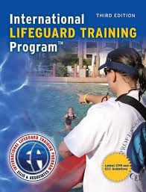
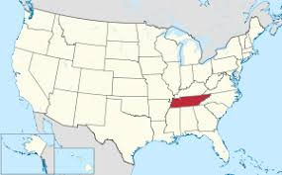
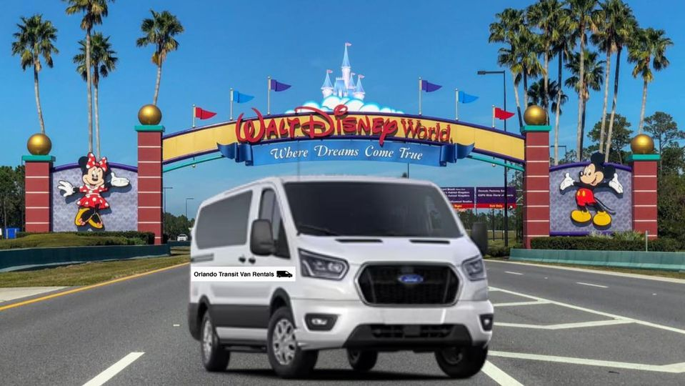
Erika Lakey, ENP CMCP RPL

Slide 3
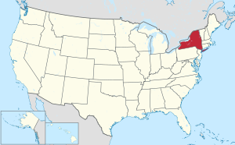
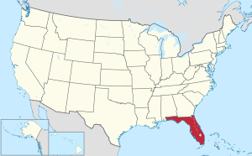
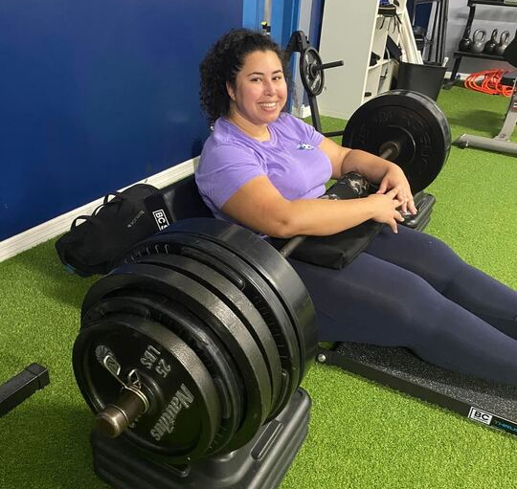
Yasmen Barnett, ENP CMCP

Slide 4
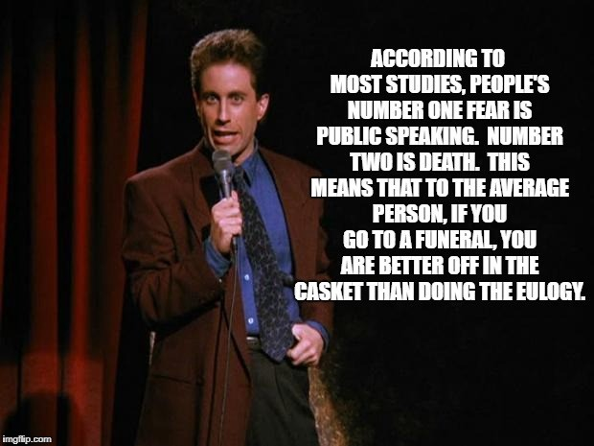

Slide 5
Everyone Should Know More on 911!
Exploring other approaches that go beyond teaching children how to dial 911
Know Your Audience
Educating Your Telecommunicators
Engage Your Community (Importance of Accurate Location Information)
Recruiting 911 Public Safety Telecommunicators
Reclassification Efforts in Local Government
Additional Resources

Slide 6
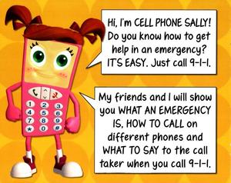
Why is Education on 9-1-1 Important?
Frontline Telecommunicators: Continue to educate your telecommunicators so they are aware of current/emerging technology, certifications, and resources to keep them up to date.
Community: Help community members understand when and how to use vital emergency resources during a crisis.
Hiring: Shining a positive light on 911 Telecommunicators helps in staffing centers and increasing morale!
Local Government: Reclassification Efforts provide knowledge to state legislators and others in local government who can continue to help us in

Slide 7
Know Your Audience!
Tailor to the specific audience
Age
Education level
Geographic area
Education Materials
Make it clear, concise, and memorable!
Include statistics, pictures and videos.
Prepare the public for when they need to call 911
Social media
Share information on various platforms and remain consistent to that audience
Engage the community with polls and questions
Celebrating 911 staff raises awareness of our profession and boosts morale

Slide 8
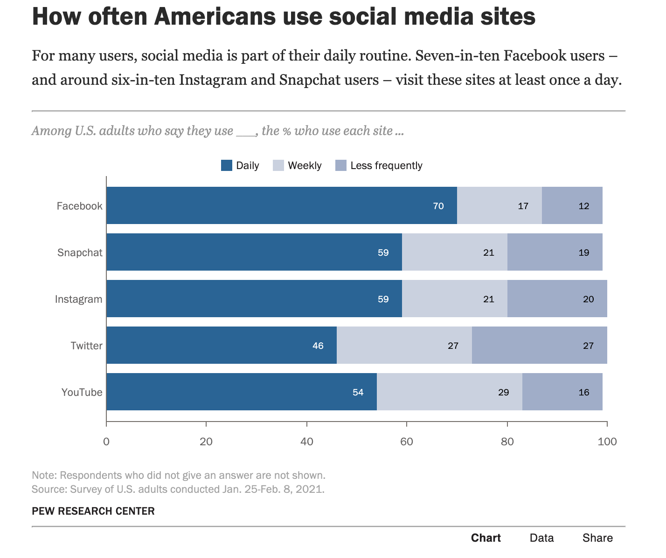

Slide 9
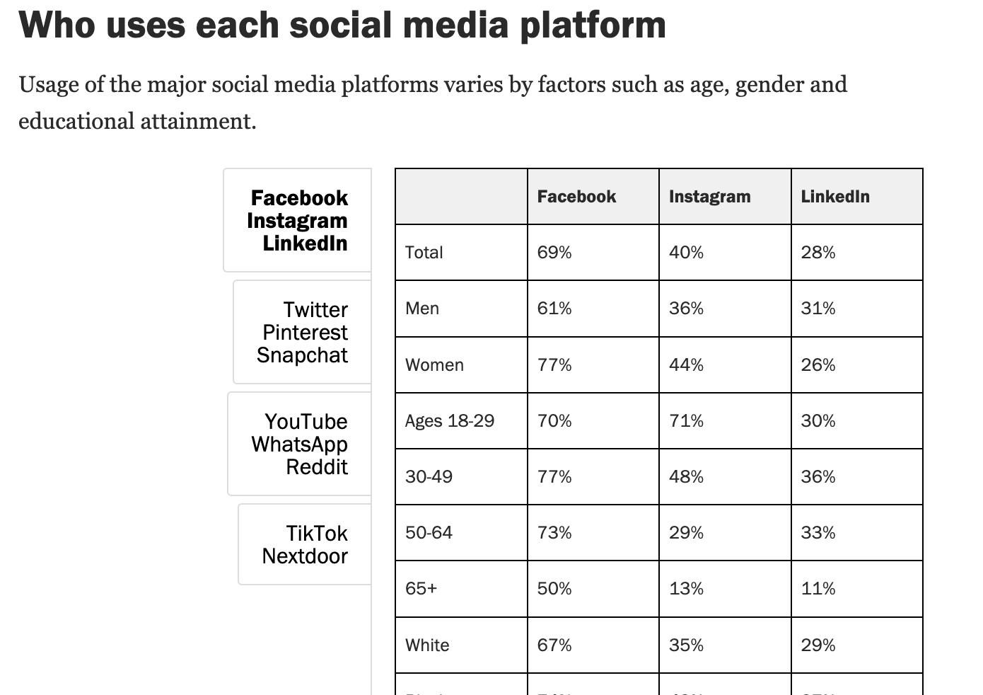
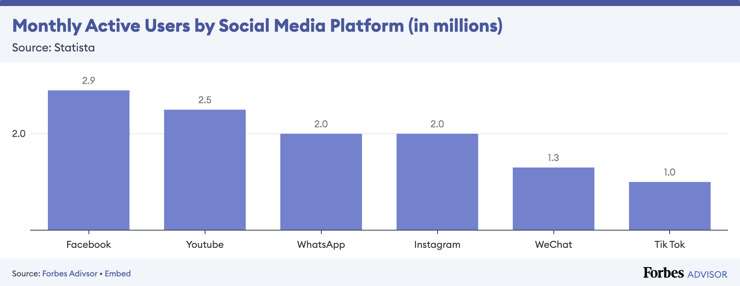

Slide 10
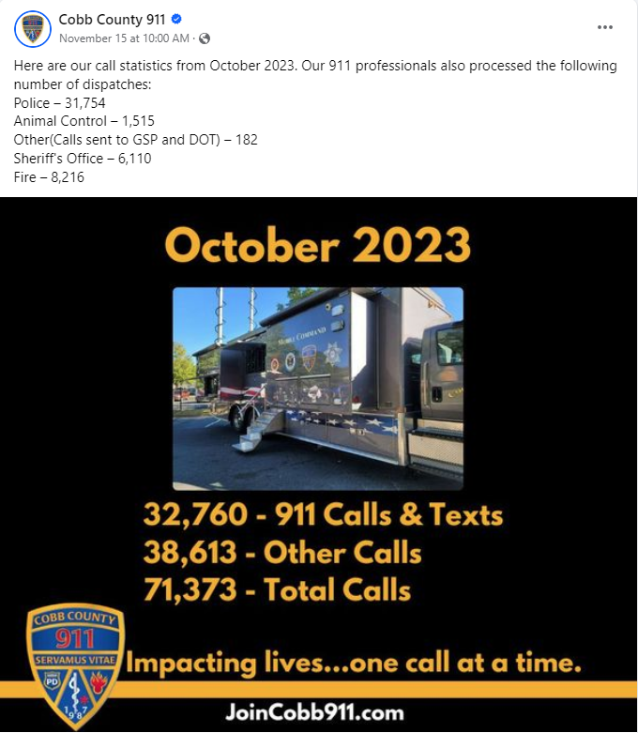
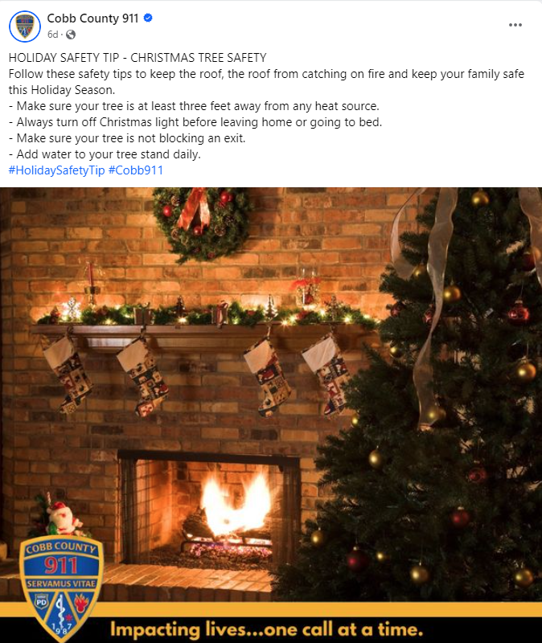
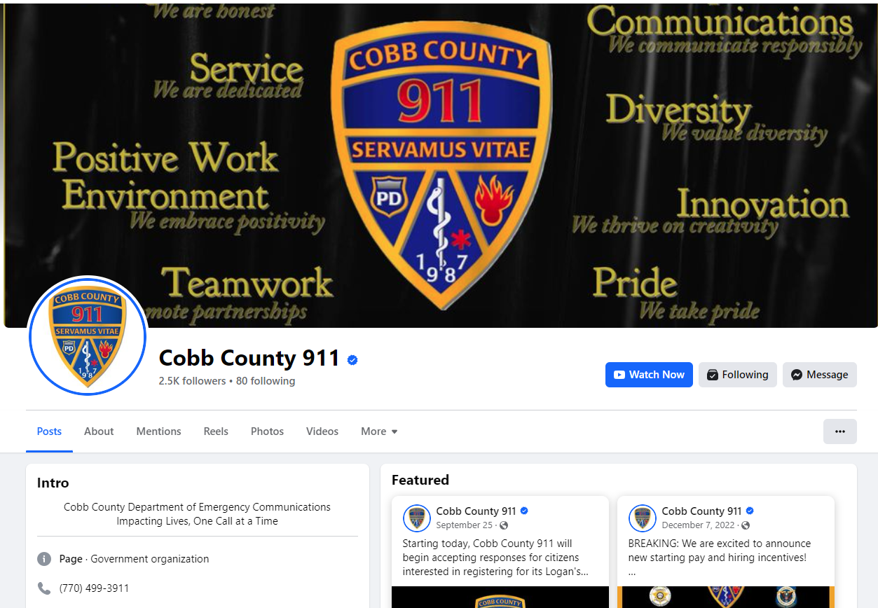
Inform the public of Call Statistics!
Provide Safety Tips to keep audiences engaged!

Slide 11
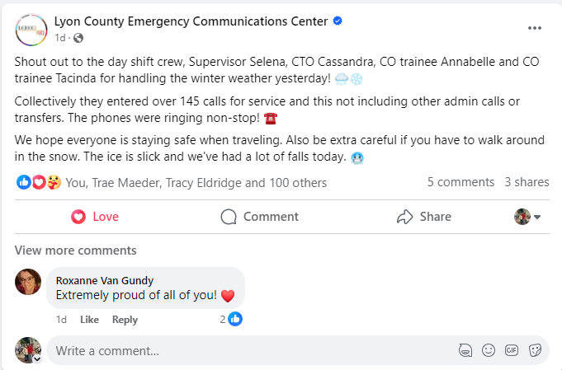
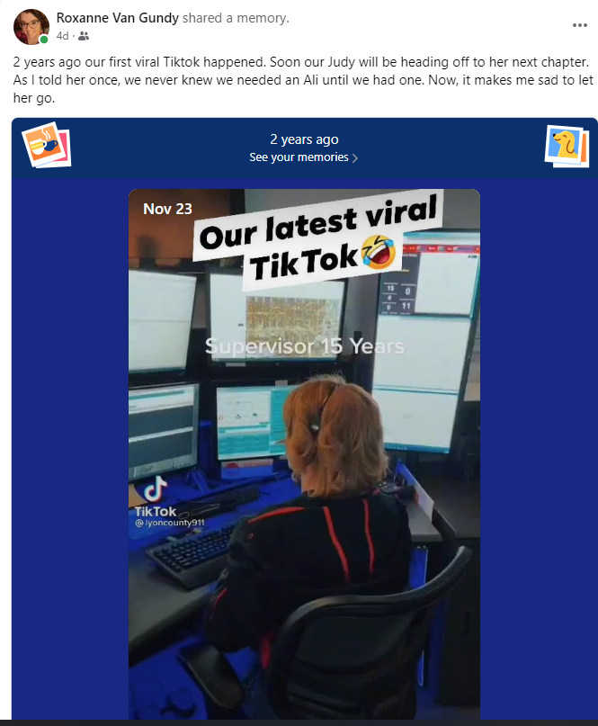
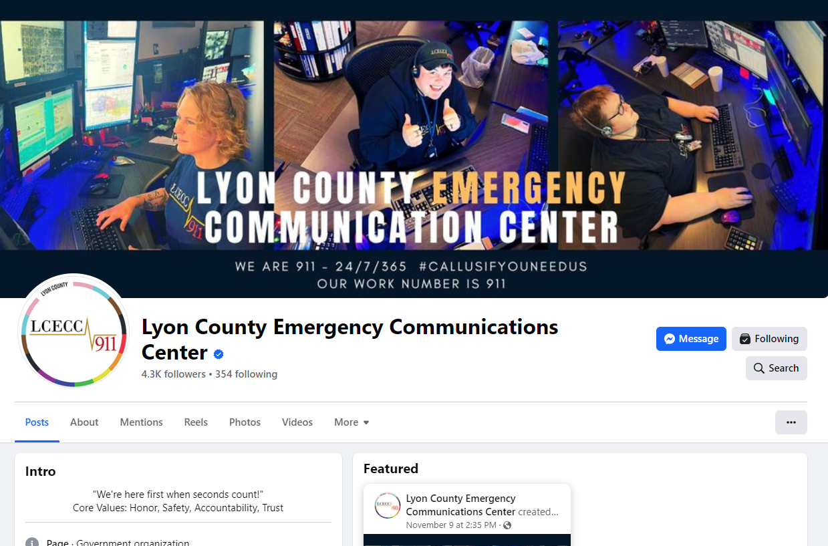
Create shout outs to your teams on social media!
Use all social media platforms to highlight the great work your employees do!

Slide 12
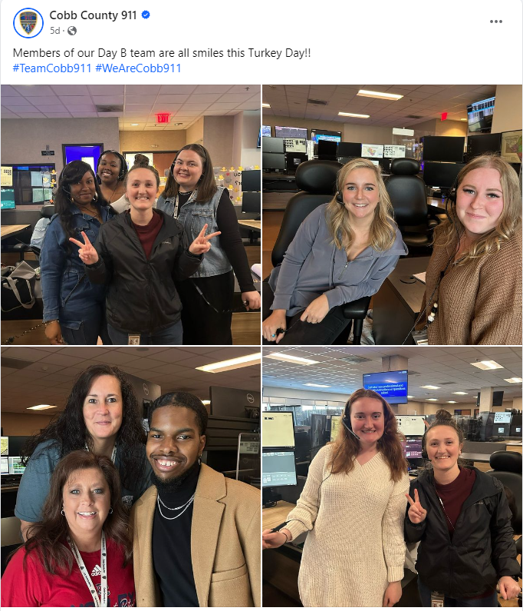
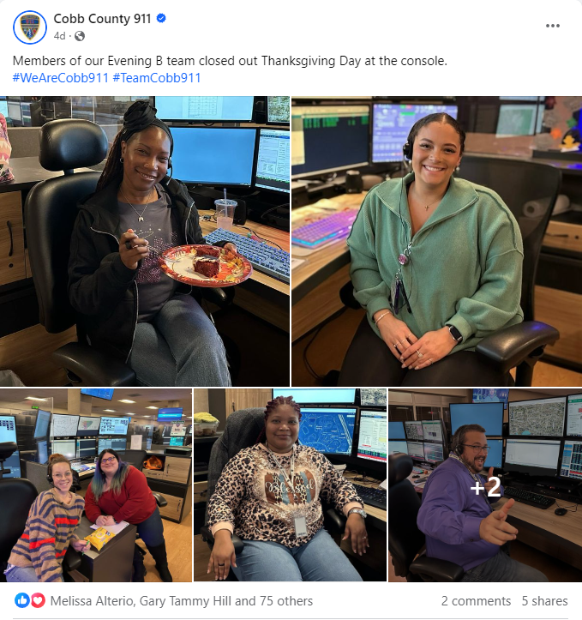

Slide 13
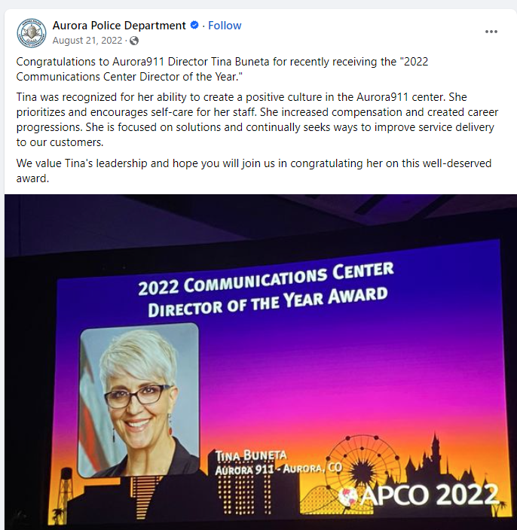
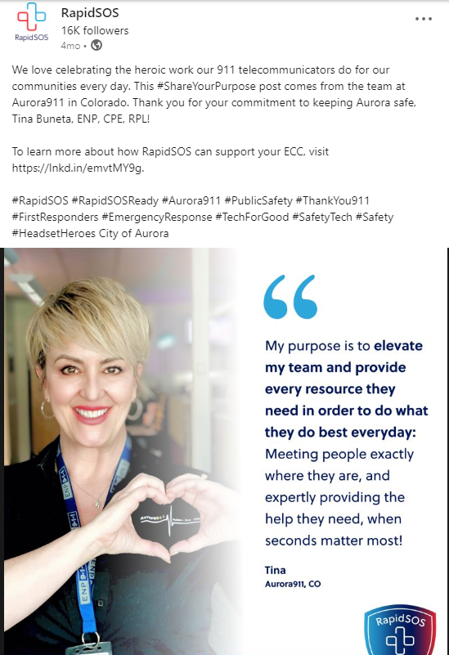

Slide 14
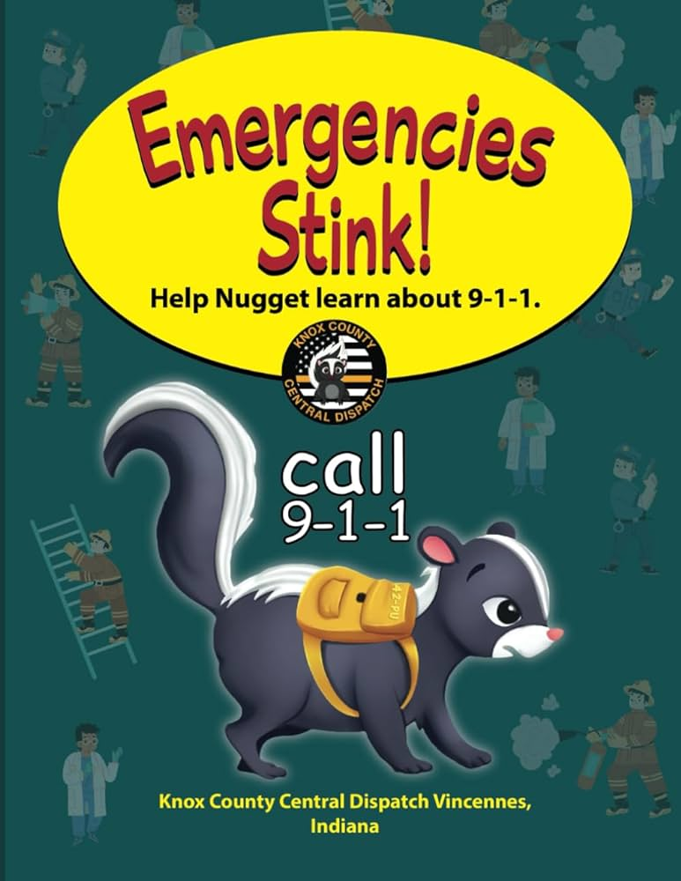
Be creative in highlighting the uniqueness of your centers. Don’t forget to shine some light on your center’s mascots!

Slide 15
911 Public Safety Telecommunicators
New hires
Provide the basics for solid foundation but DO NOT skip over the explanations on how things work!
Adult learners NEED the extra details so they can understand the WHY
Frontline
Include them at public education events so they can see the community they are serving
Invite them to help teach students (every grade level)
Provide Continuing education (i.e. inservice, training opportunities, conferences, certifications)
CTO’s and Supervisors
Most only teach from their point of reference; so expand their knowledge base!
Reiterate additional resources and CDE
Educated staff share knowledge and info, encouraging the success of others down the line (Don’t be a gatekeeper!)

Slide 16
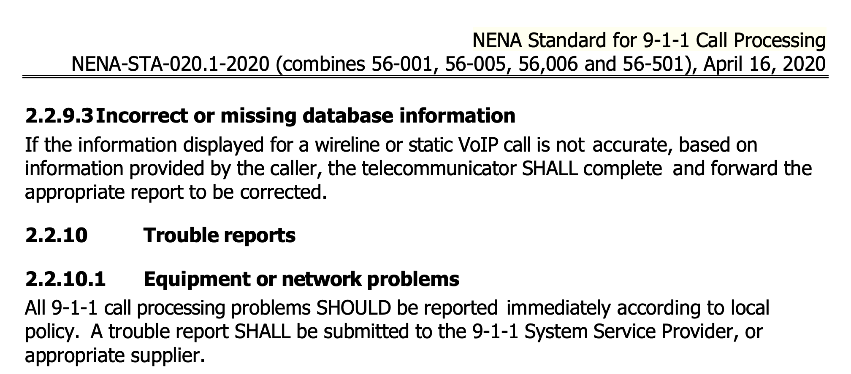
Discuss the Importance of Accurate Info

Slide 17
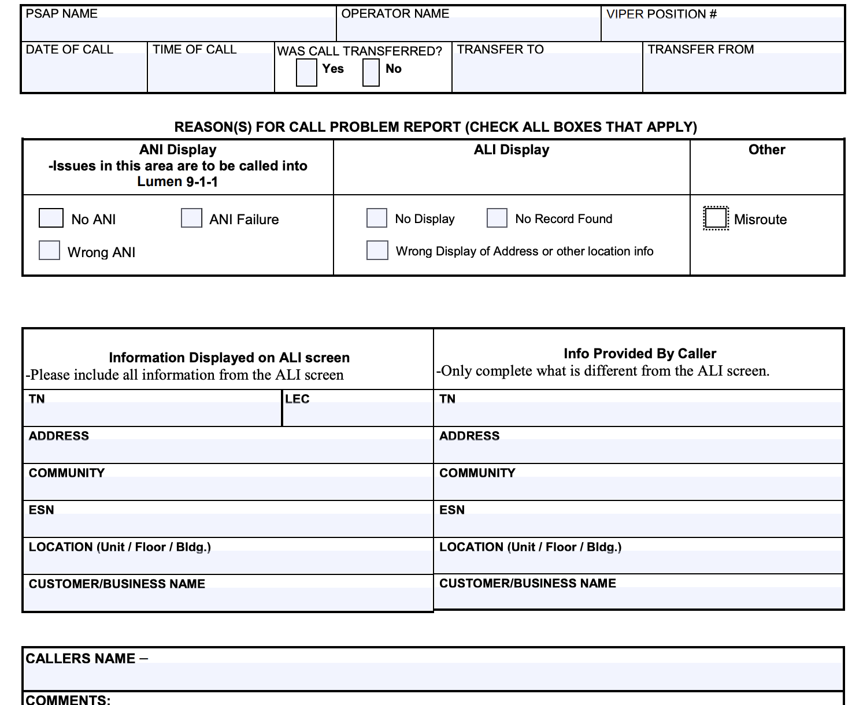
PSAP/ECC checklist monthly

