Slide 1
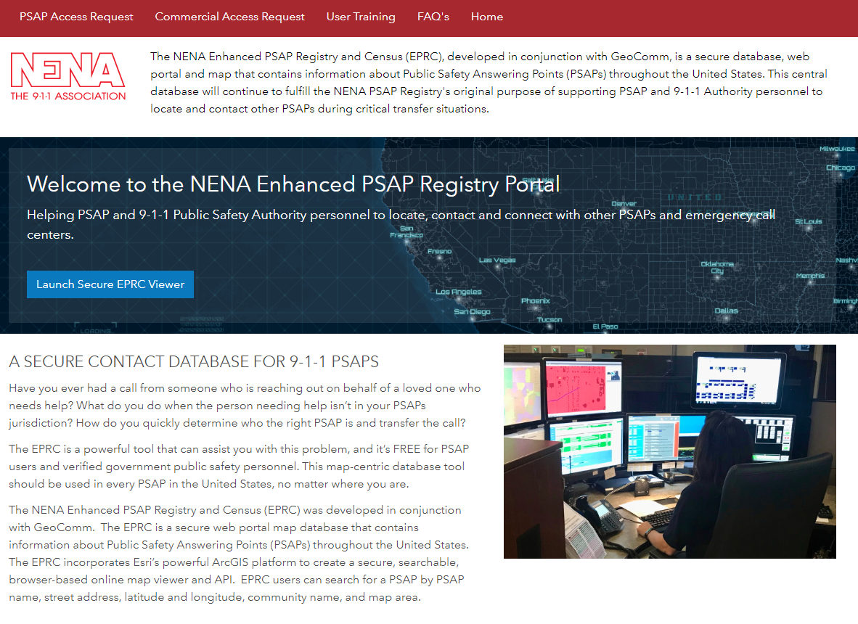
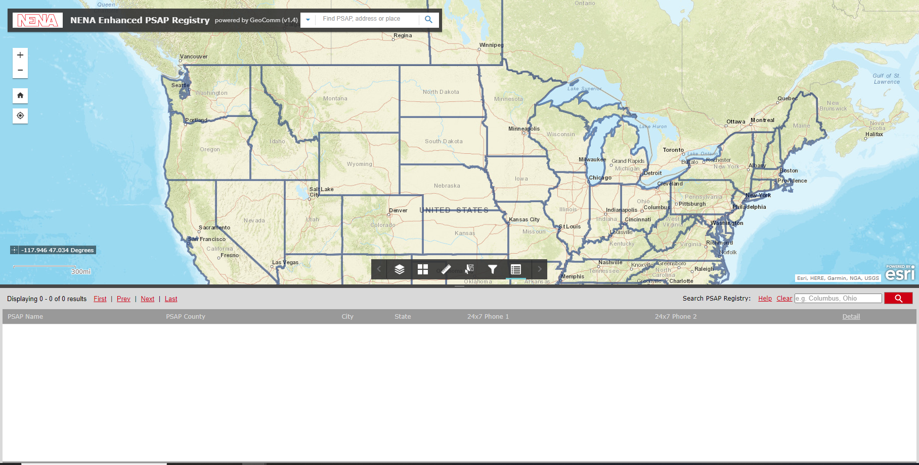
Additional Resources
NENA PSAP Registry

Slide 2
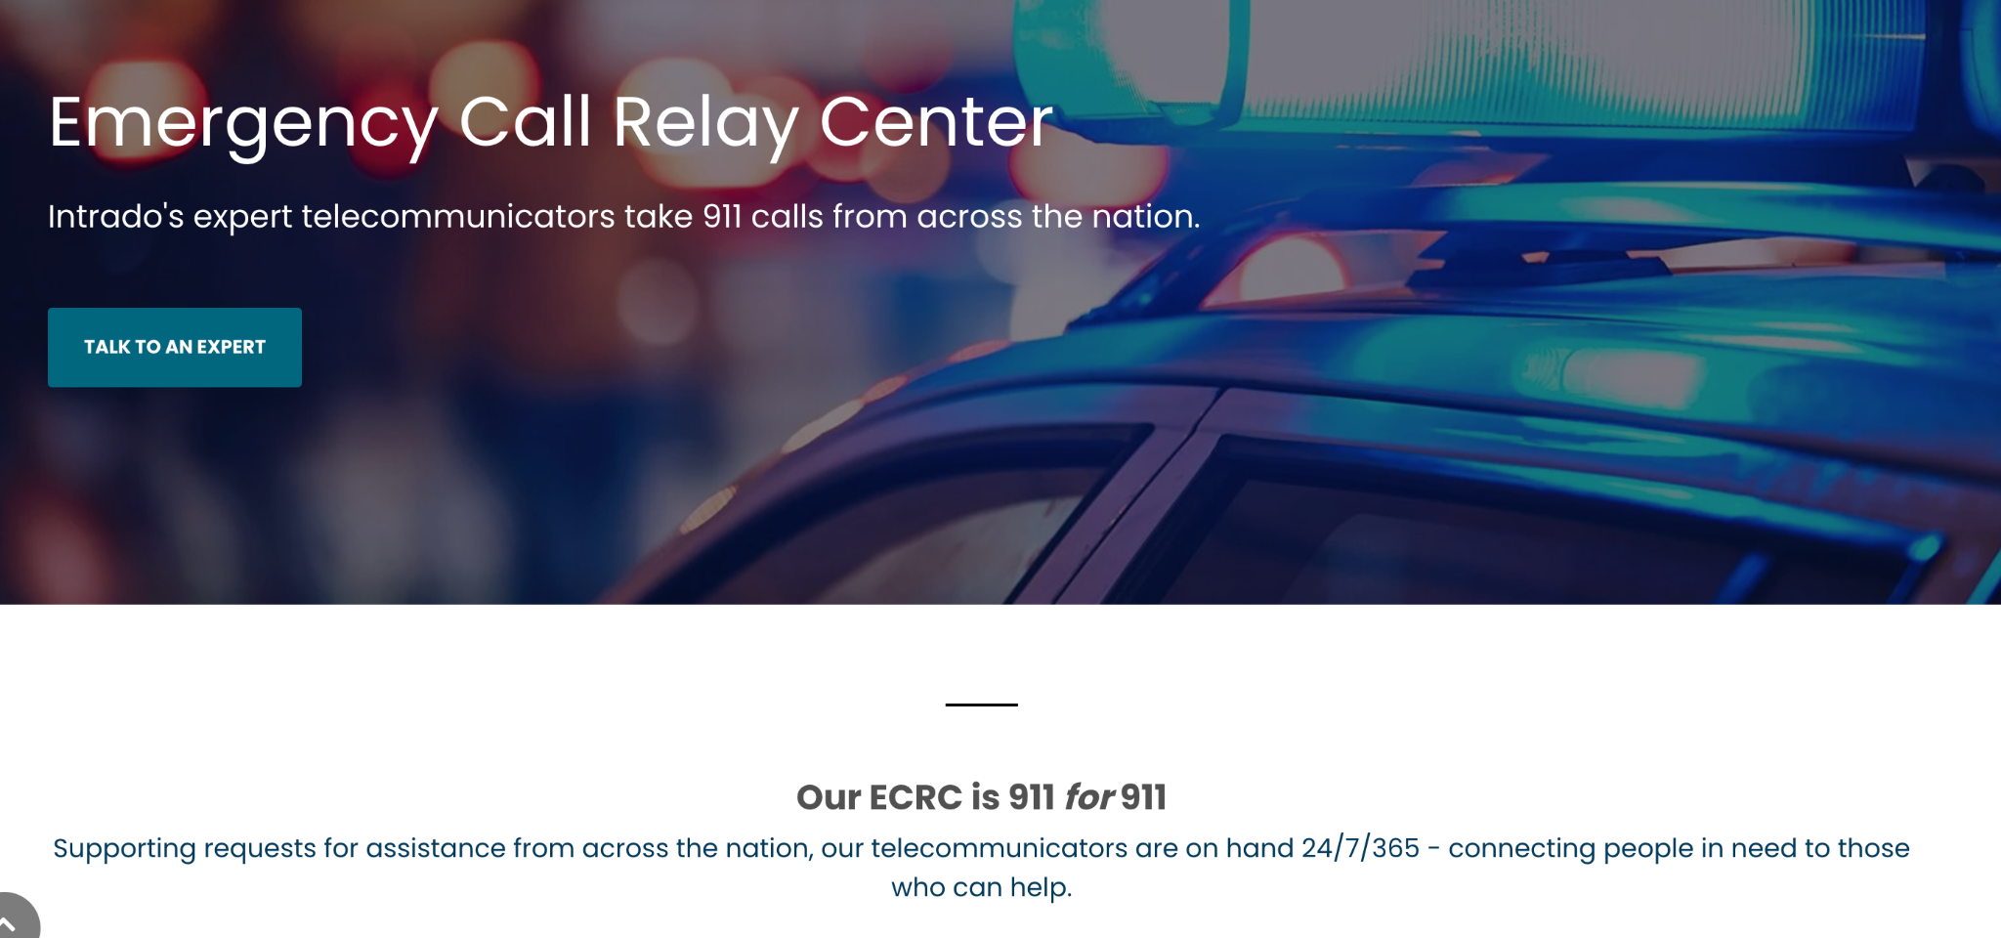
Northern911 and Intrado ECRC

Slide 3
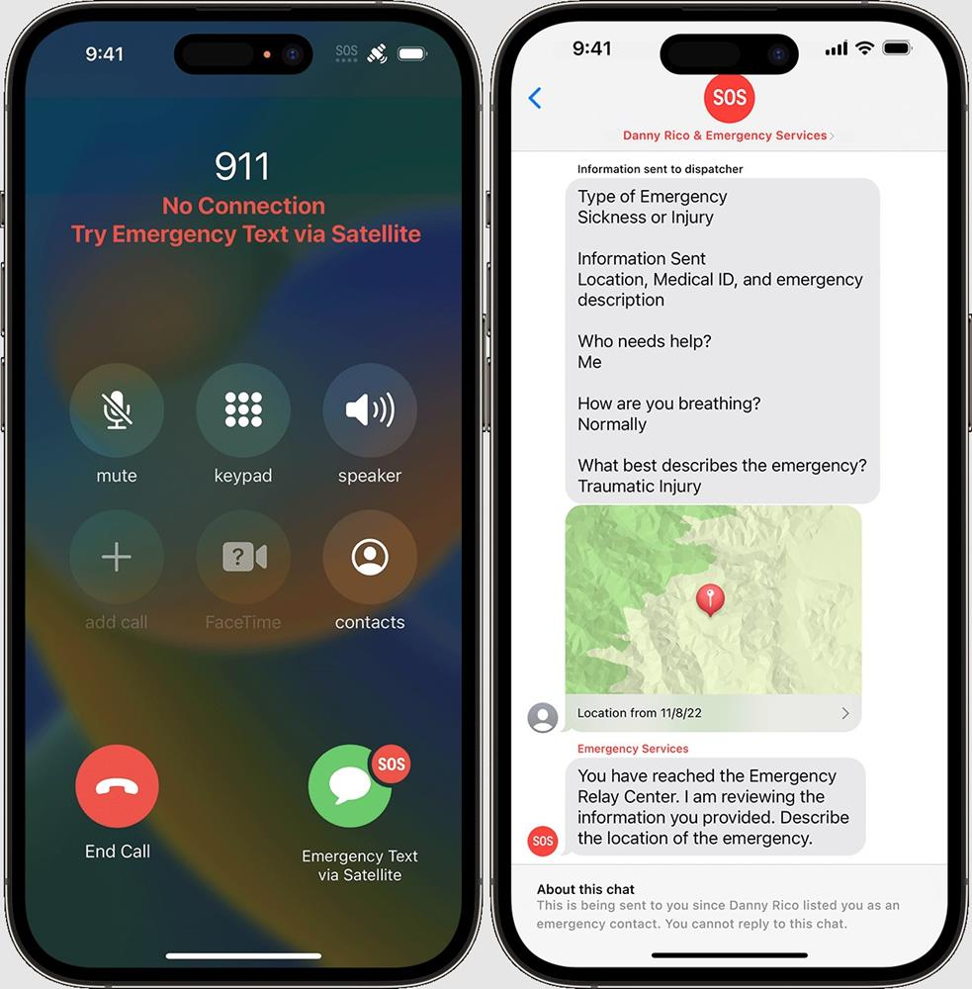
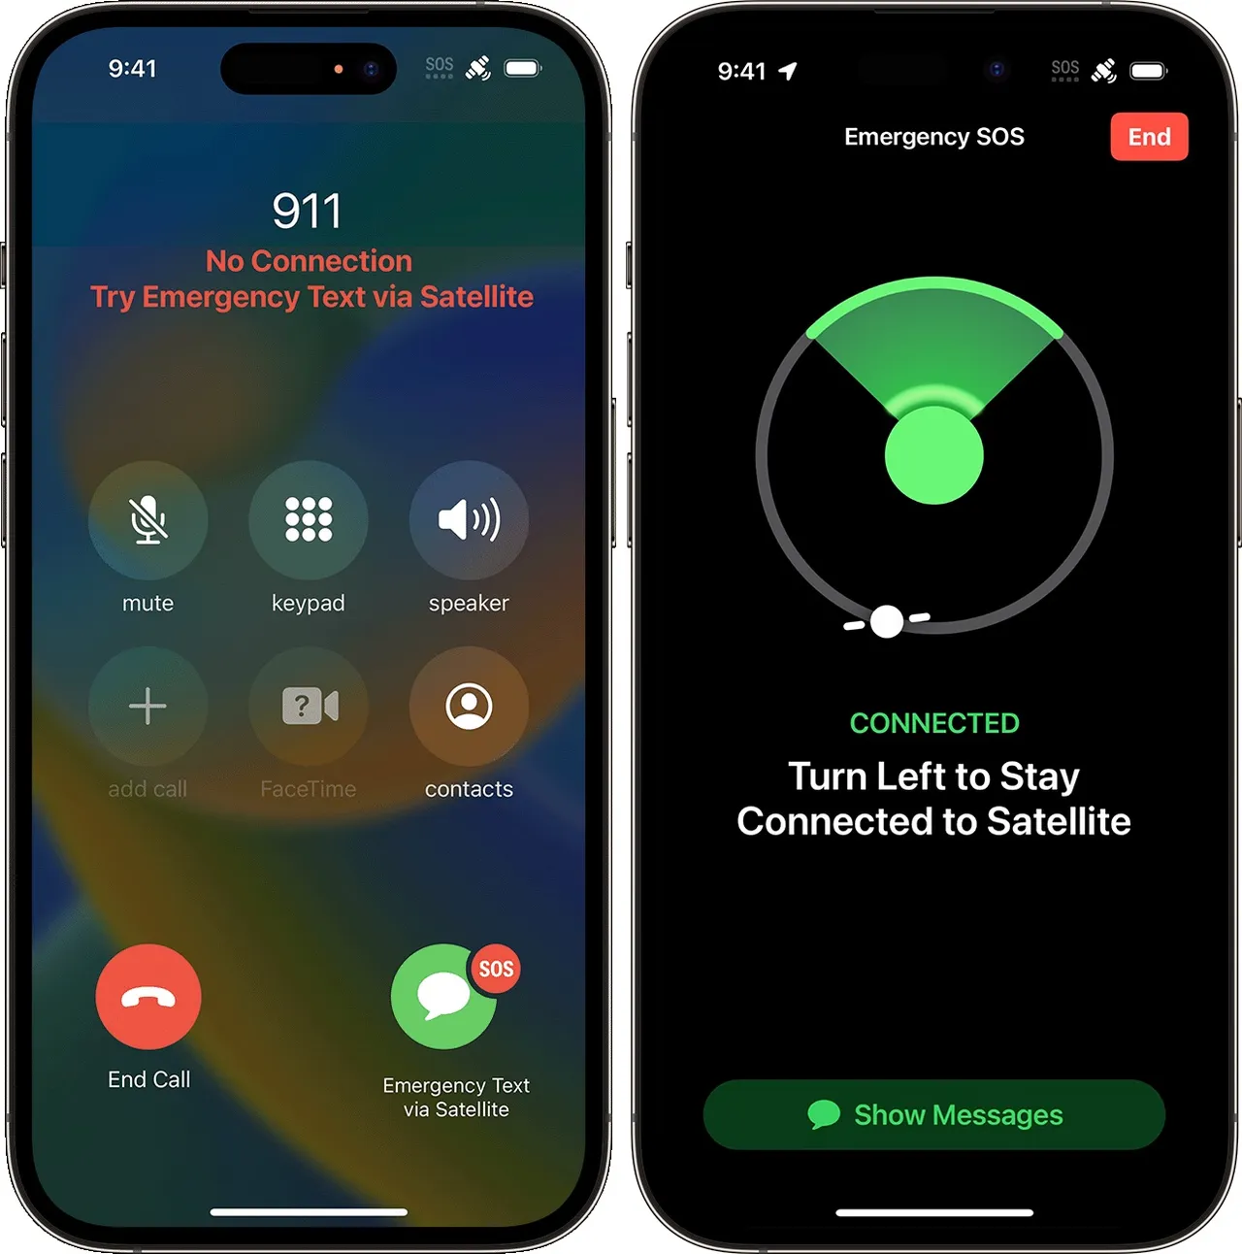
Apple, Inc

Slide 4
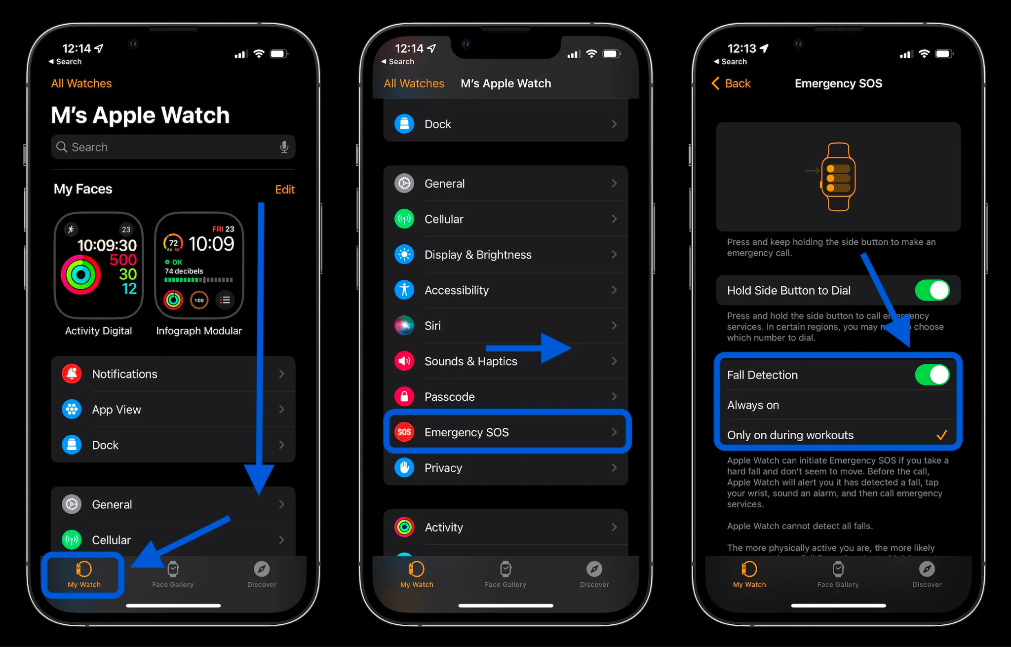
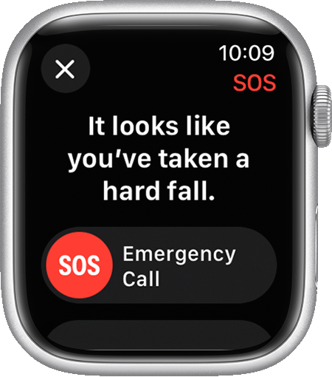
Apple, Inc

Slide 5
Discuss Certifications
Notes:
Erika / Yasmen

Slide 6
National Conferences
Notes:
Erika

Slide 7
Recruiting
There are several key strategies that agencies can use to attract the right candidates including:
Develop partnerships with local schools and universities to promote the profession to students.
Participate in career fairs, hosting information sessions, and offering internships or co-op programs.
Social Media for Public Education and Recruiting
As we talked about before, create promotional videos that showcase the work of 9-1-1 operators OR invite your local news channels to show the public what 9-1-1 operators do and your need for more employees.
Research other agencies in the area and stay competitive in pay!
Important to recruit civilians with a different approach
Technology focused career
Tuition reimbursement
Health insurance/benefits
Computer loan program
Gym onsite
Cell phone discount

Slide 8
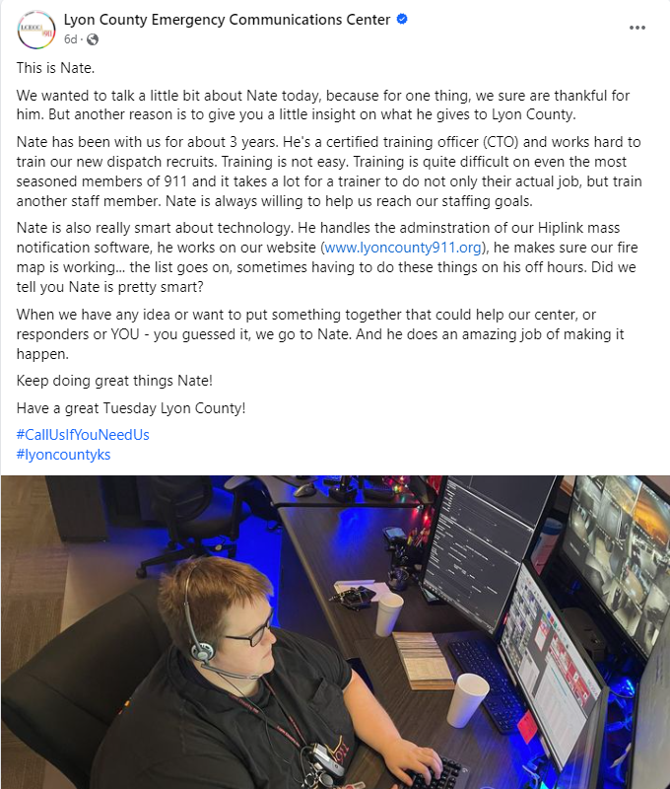
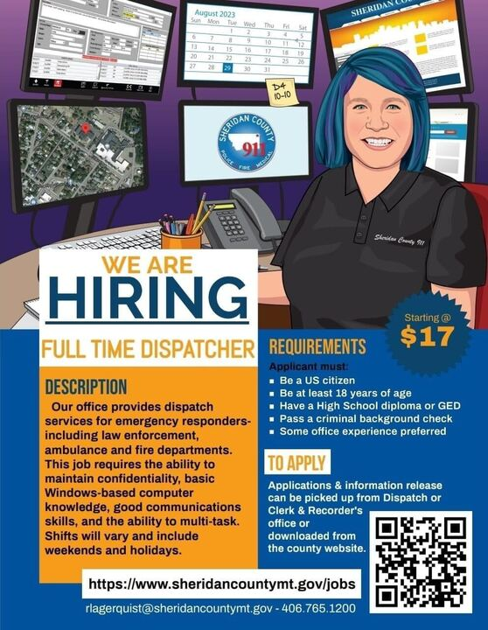
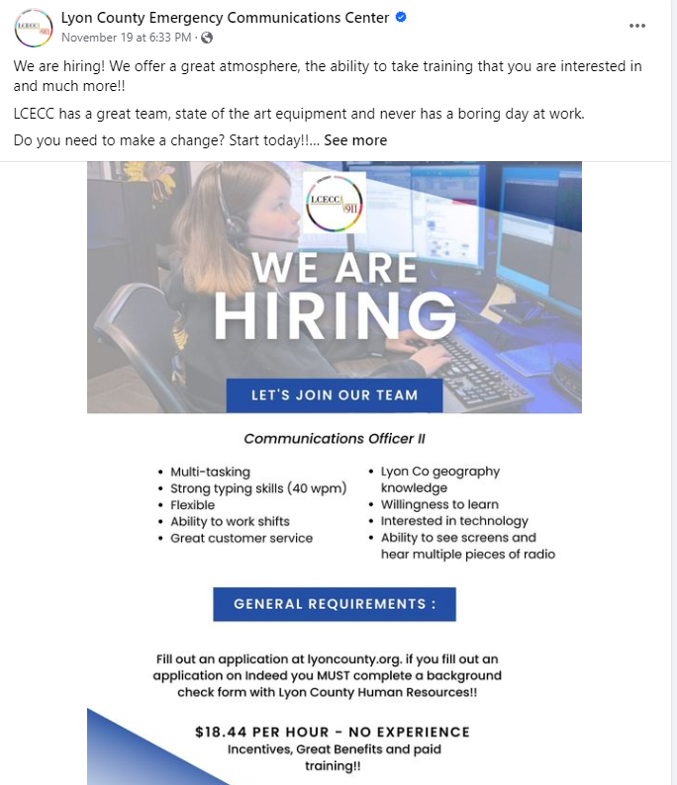
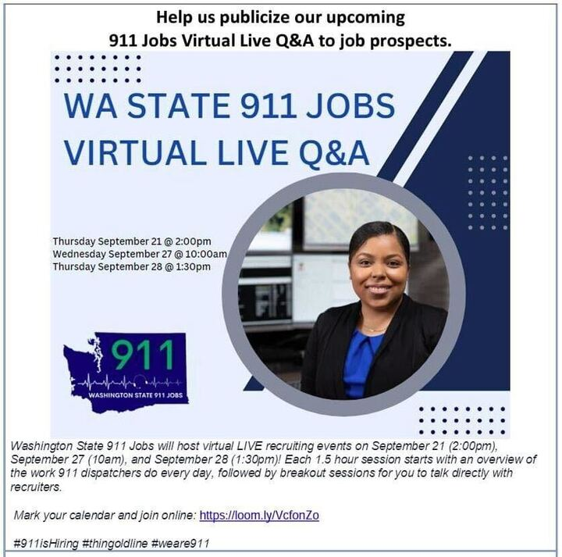
Social Media is Your Friend for Recruiting!

Slide 9
Engage the Local Community
Host Community Appreciation Days and have the community tour your center!
Host Career Fairs and Attend Local Ones
Attend career fairs where you will receive the best applicants but not be overshadowed by Law Enforcement applicants.
Have a 911 Booth at local community events like Public Safety Days, First Responders Night Out, Car Seat Events
Just Promote your center in the Community!
Write a small column in your local paper
Invite local news to events
Awards

Slide 10
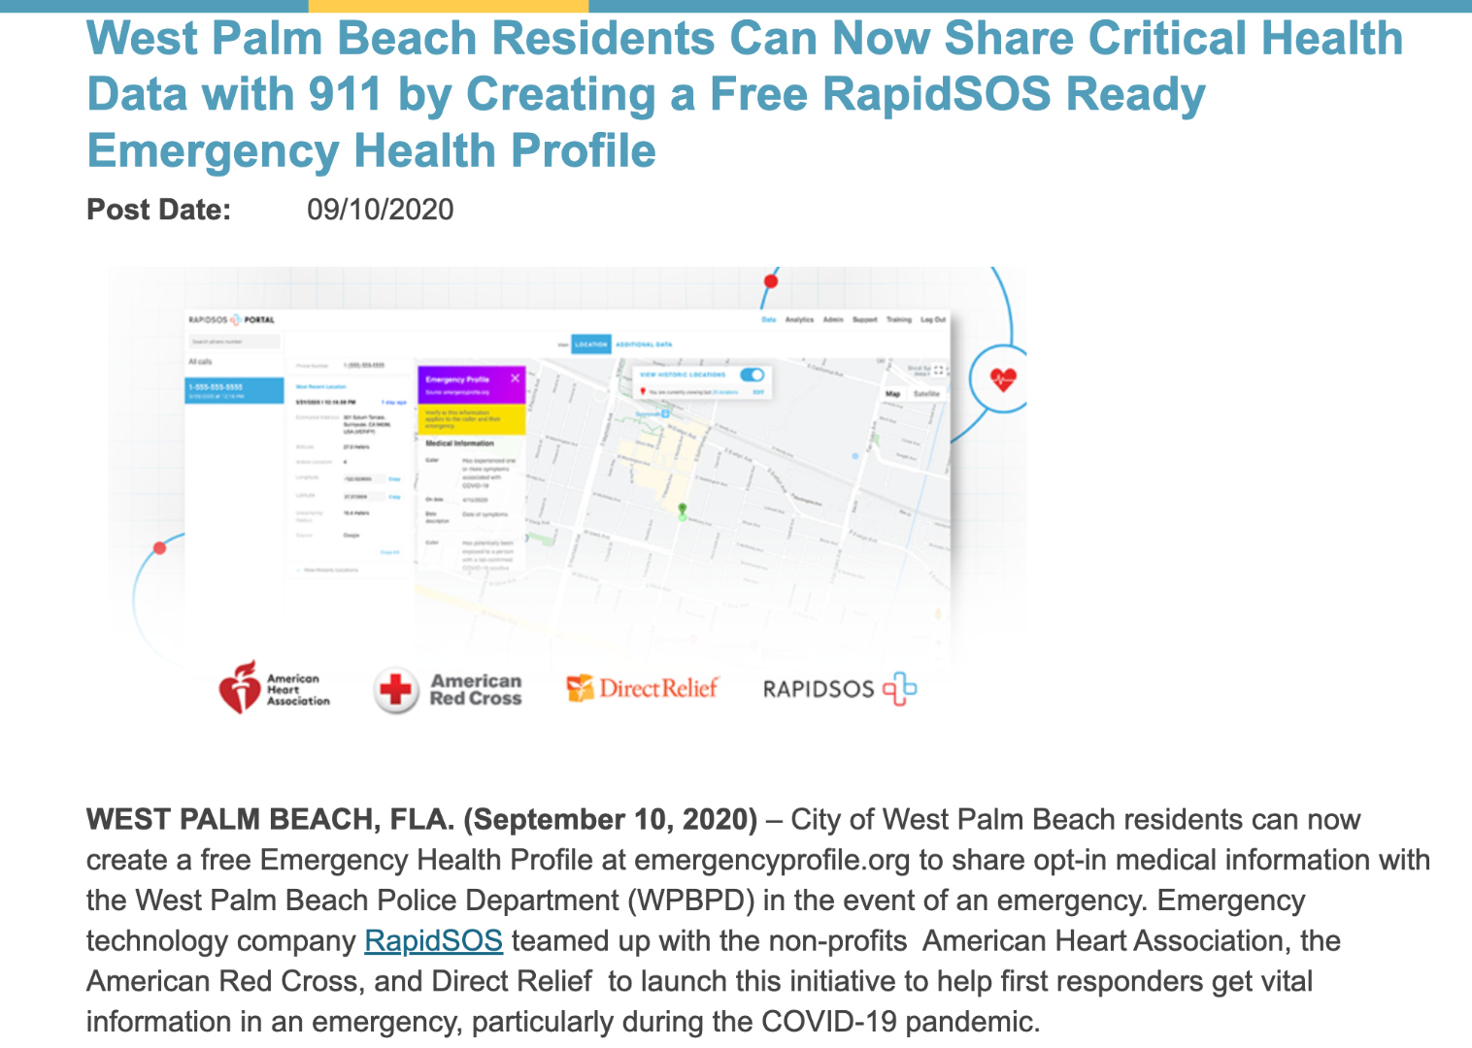
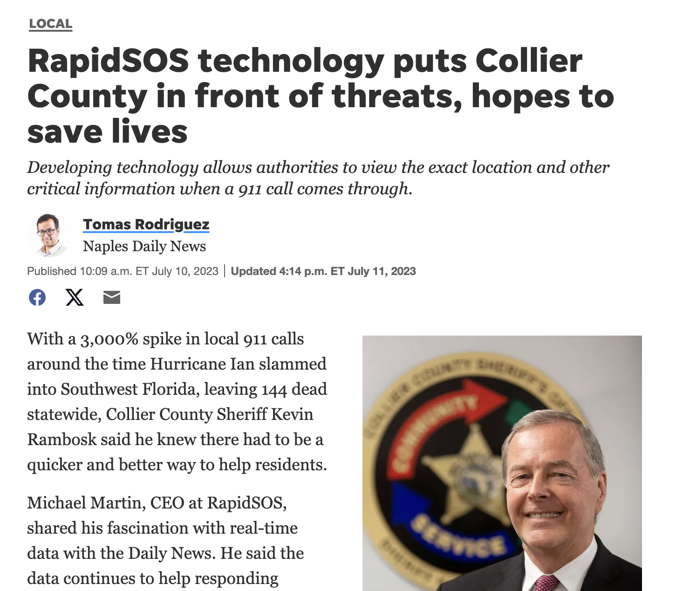
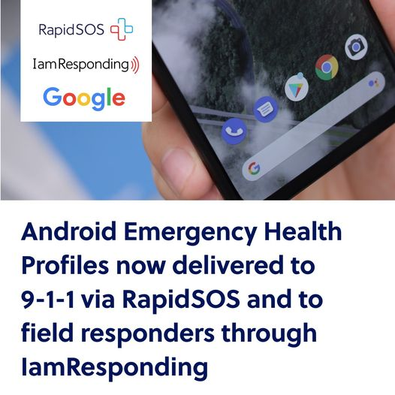
Discuss Technology with Your Community
Raise Awareness of Emerging Technology: Educate your community on how data provided assists telecommunicators in emergencies and gets informed field responders out to calls.

Slide 11
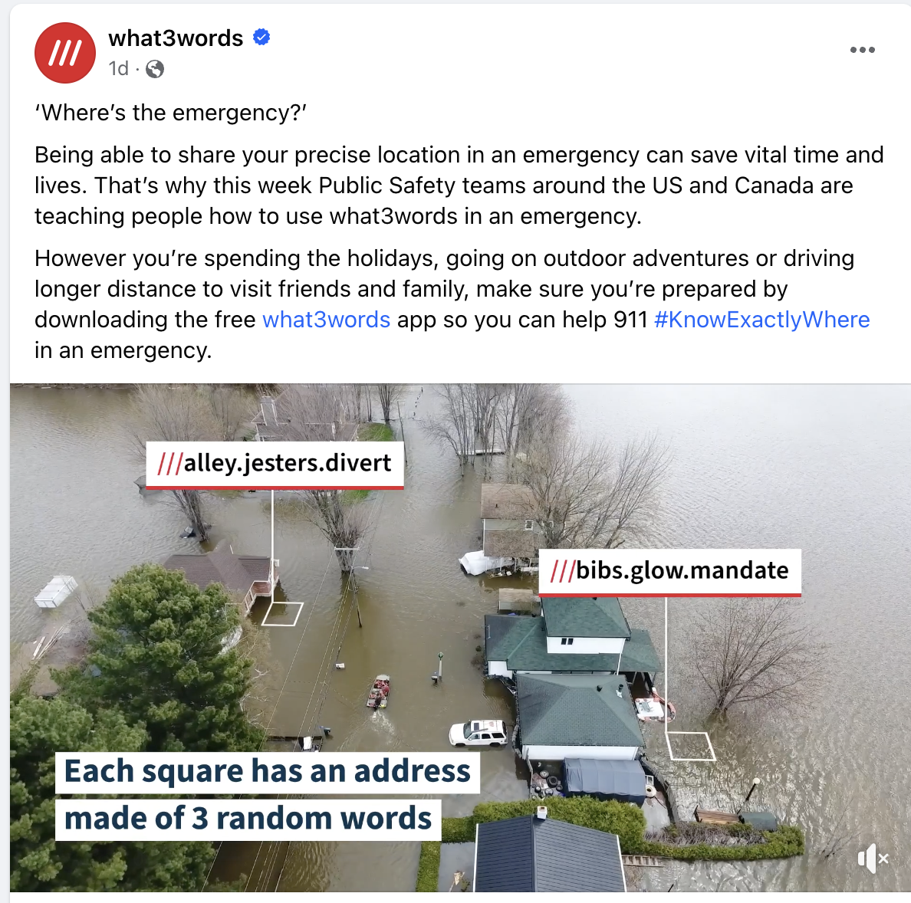
what3words

Slide 12
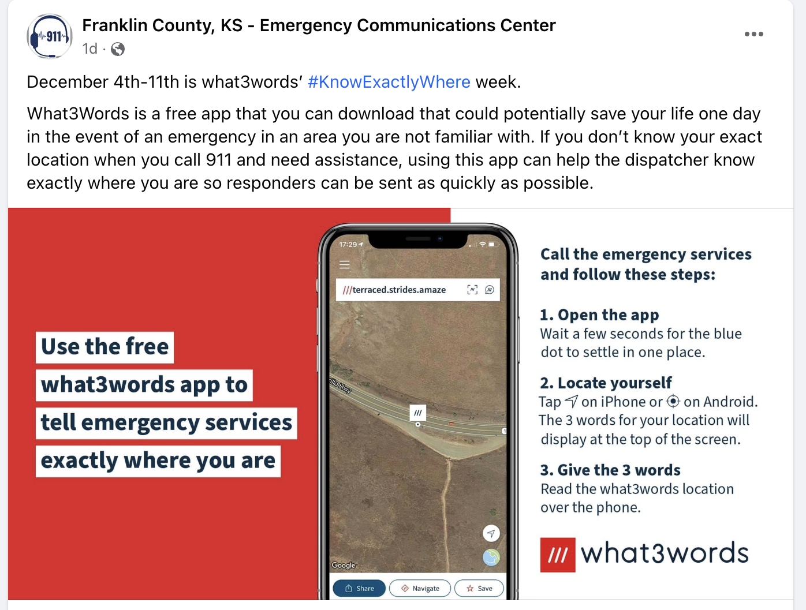
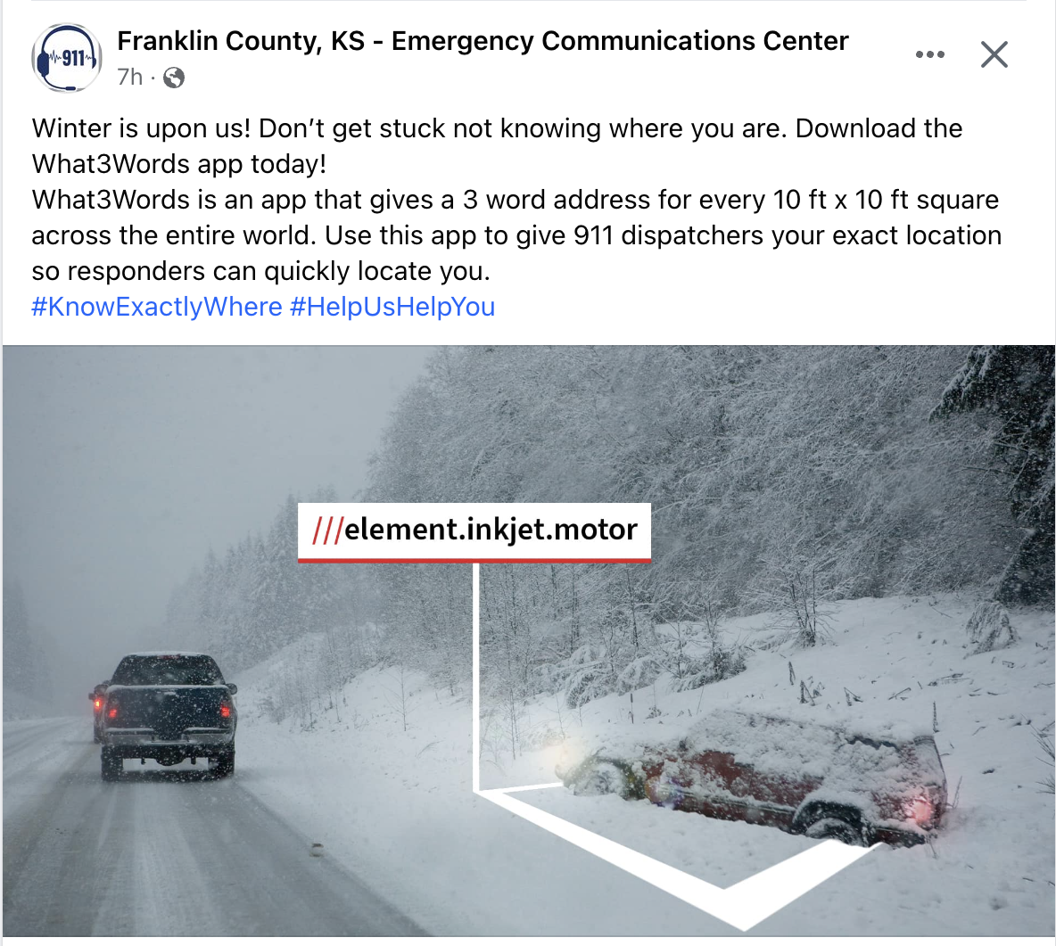

Slide 13
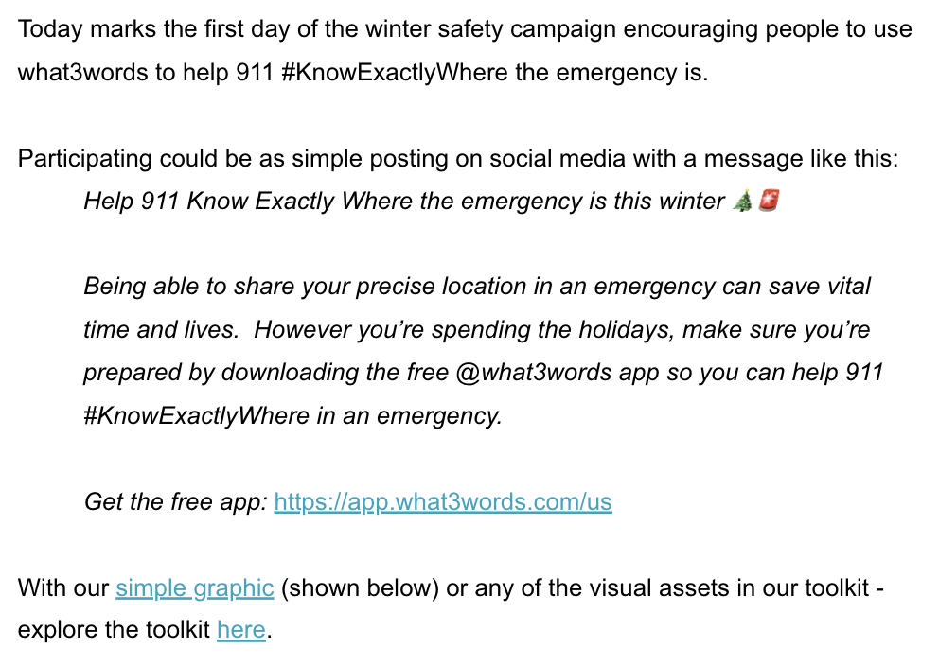
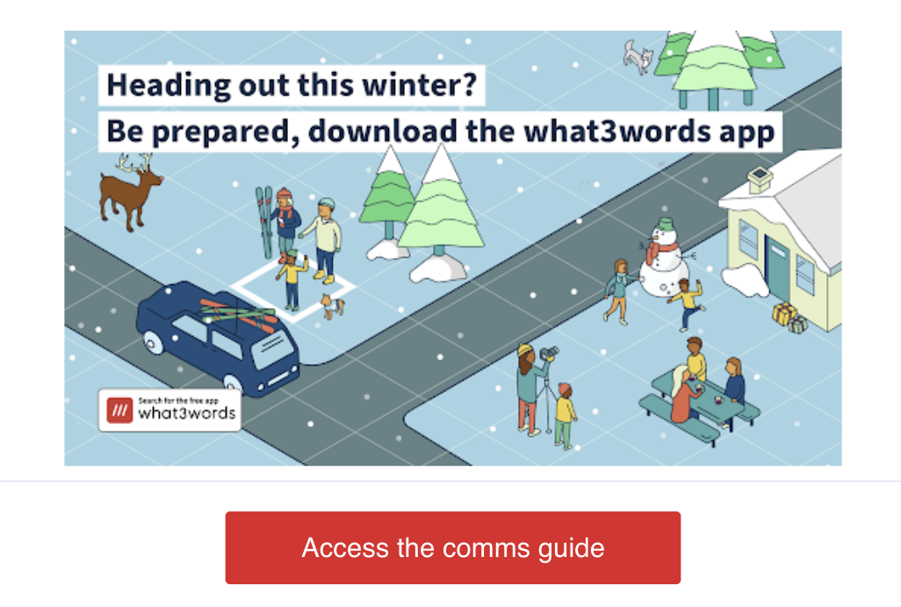
Educate your Field Units: Educate your units of the available technology as well that will help them in their everyday and communicate consistent information amongst disciplines!

Slide 14
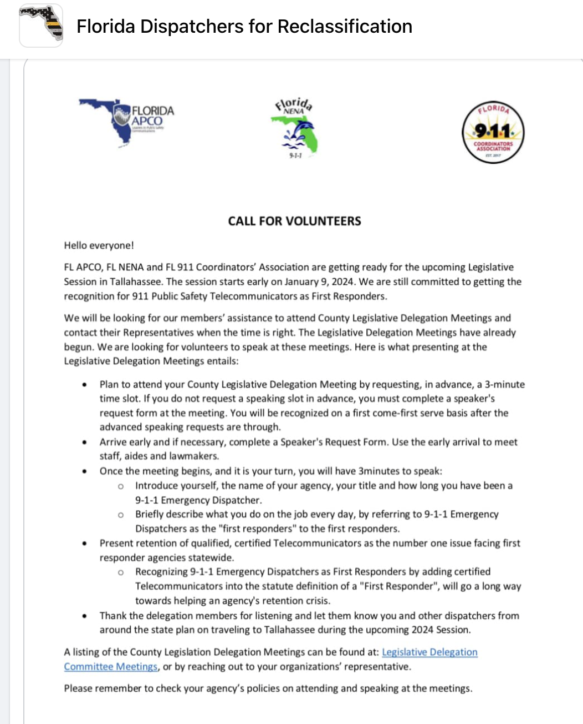
Reclassification Efforts in Local Government
NPSTW Proclamation
Encourage your local government/agency to proclaim telecommunicators as First Responders
Legislative Delegation Meetings
Speak up for your peers at these meetings
Senator Reach outs via email, phone and visits
This encourages further exposure of 911 telecommunicators, their job, their stressors, and brings new support!
Again, know your audience and who you’re representing!

Slide 15
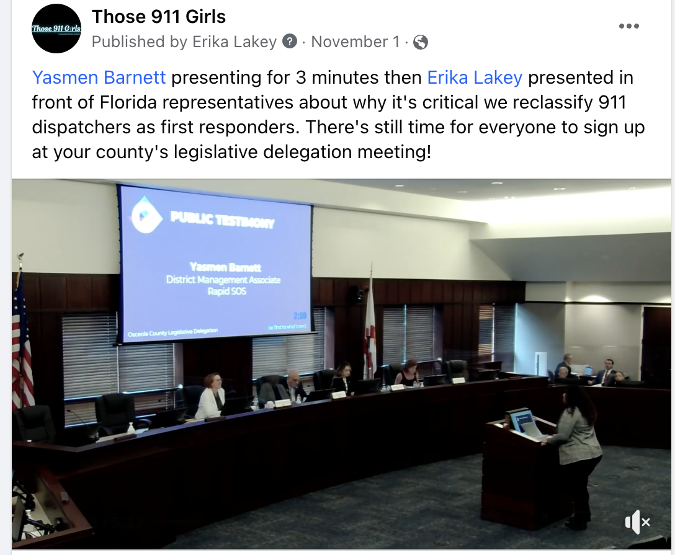
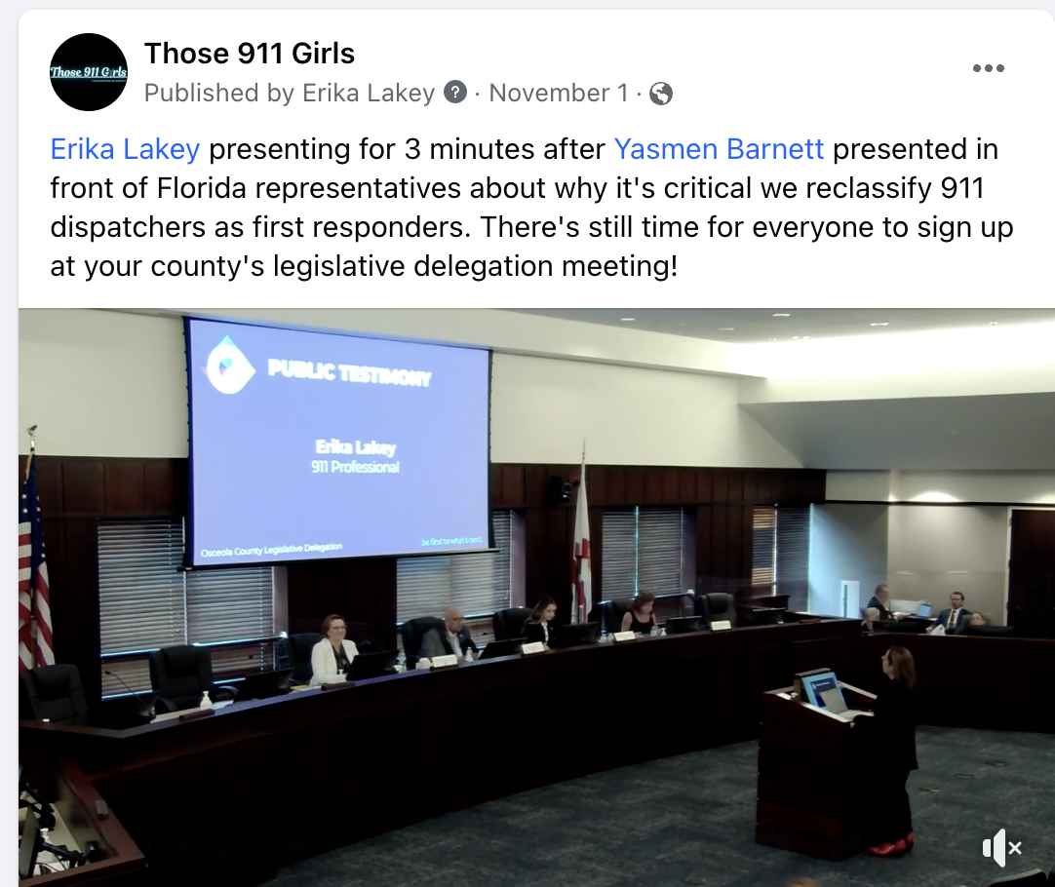
Reclassification Efforts in Local Government

Slide 16
Businesses
Kari’s Law and Ray Baum’s Act
Community Services and Crime Prevention
Safety checks / business surveys
Address location verification
Vehicle wrap
Chamber of Commerce
Central Florida Hotel and Lodging Association
Government buildings
Branch offices

Slide 17
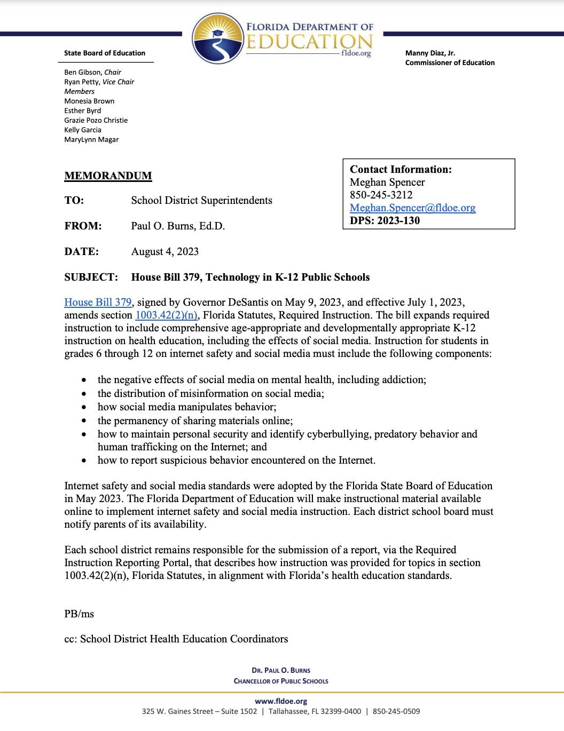
Schools
MLTS Compliance
CPR forms
PBX or VoIP
Florida HB 379
Social media ban
Limited or no cellphone use
Safety concern

Slide 18
It Doesn’t End Here!
People are resources too!
Networking is very important at every event
Get to know those in the industry, including vendors.
Find sites that will have resources all in one place

Slide 19
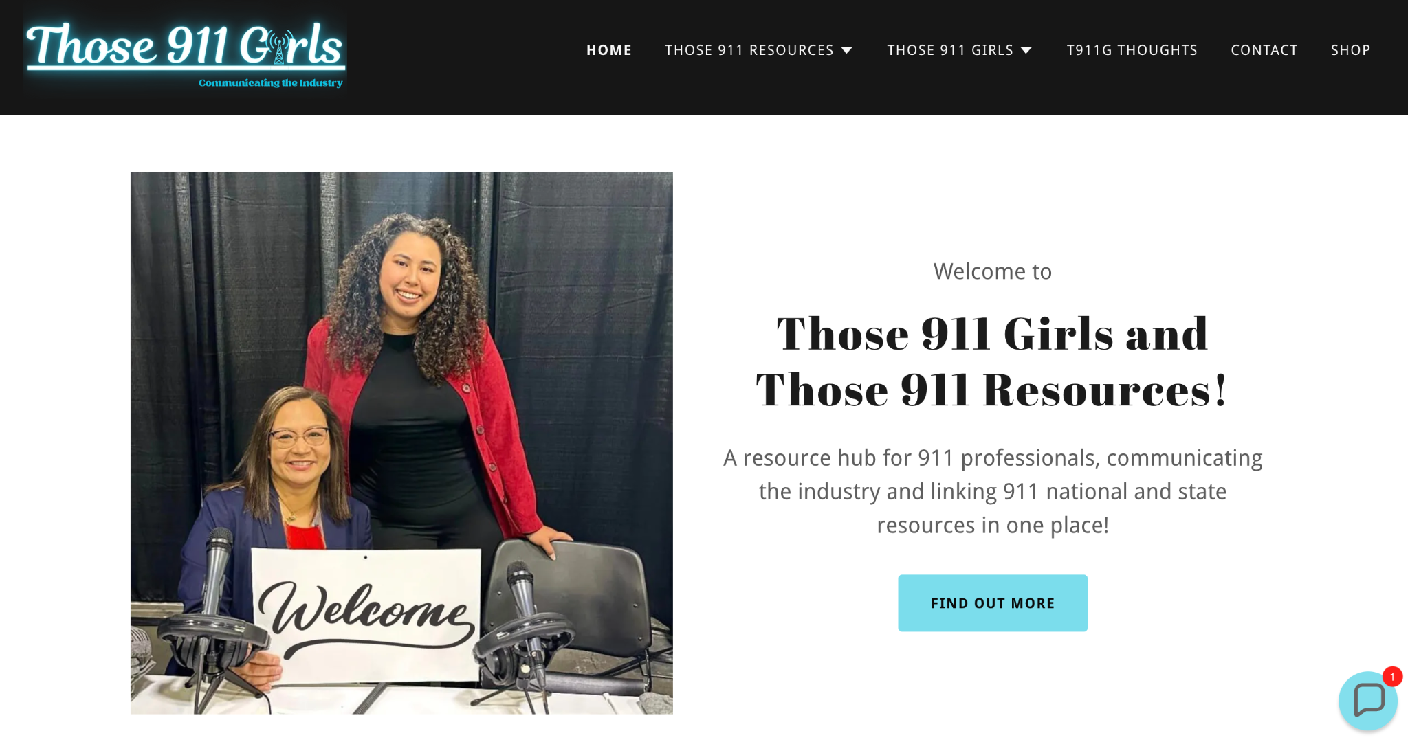

Slide 20
Thank you and please feel free to connect with us!
Notes:
Final Thoughts:

