Slide 1


The U.S. National Blueprint
for Transportation Decarbonization:
ACTIONS FOR THE RAIL SECTOR
+ Research to support electrification
Railroad Electrification Coalition
October 24th, 2024

Slide 2
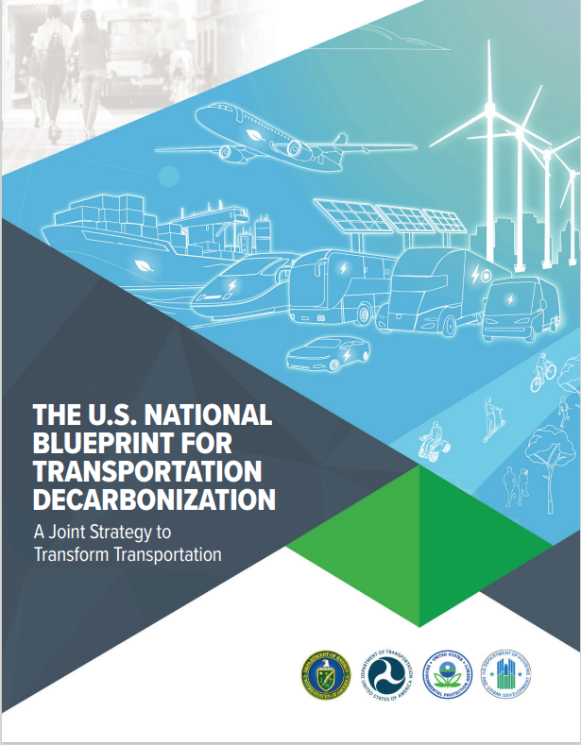

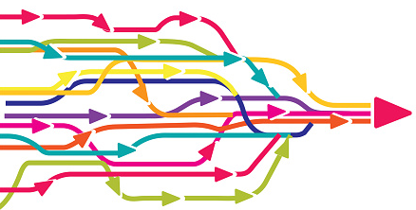

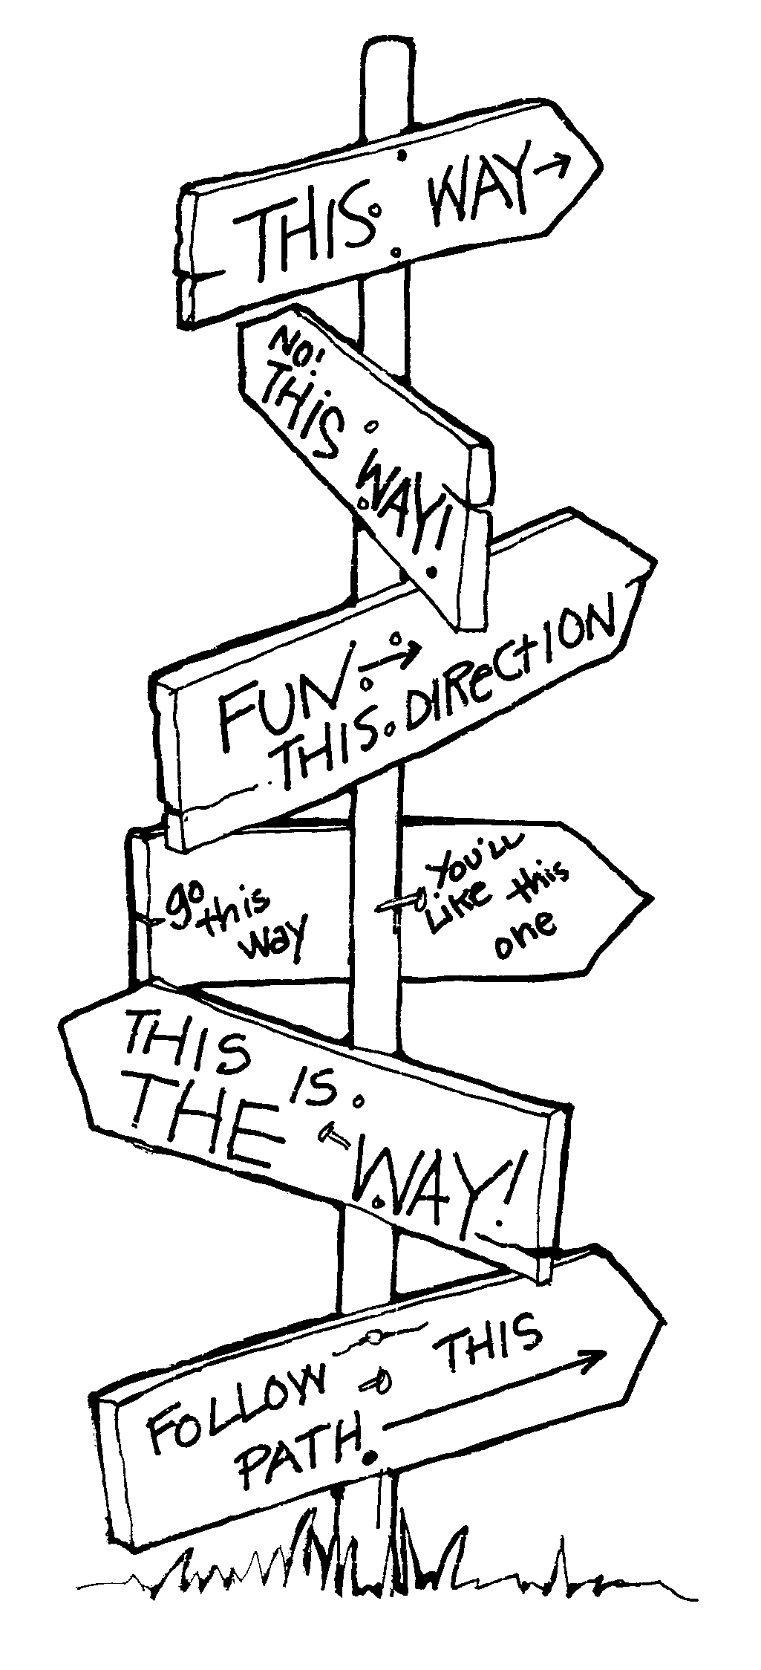
Connection to US Blueprint
Four agency MOU was signed 9/15/2022 established a historic, whole-of-government approach to transportation decarbonization.
The U.S. National Transportation Blueprint for Transportation Decarbonization (The Blueprint) a comprehensive, landmark interagency framework of strategies and actions to remove all emissions from the transportation sector by 2050 was released on 1/10/2023.
The Four Agencies committed to developing and releasing specific strategy action plans to align with the Blueprint. The Action Plans are proposed to be released this Fiscal Year.

Slide 3
Connection to US Blueprint
Modal Plans
(The Blueprint Clean Strategy)
Efficient plan
(November)
Convenient plan
(November)
Rail
(December)
Maritime
(November)
MHDV
(January)
Aviation*
(updated)
LDV
(TBD)
Off-Road
(TBD)
Pipelines
(TBD)
Plans: Build on the U.S. Decarbonization Blueprint; Each Identifies Strategies and includes Near Term Actions & Milestones.
Built on Engagement and Stakeholder Input: Labor, Equity (e.g. MFN), Industry (e.g. OEMs, Fleets such as Amazon, Fuel/Charging Providers), Trade Groups (e.g. ABS, BlueSky Maritime), and NGOs (e.g. RMI, TRB, Aspen Institute, T4A)
* The Aviation Plan is being covered by the 2021 Aviation Climate Action Plan, developed collaboratively with DOT, DOE, EPA and NASA and issued by FAA on 11/9/2021

Slide 4
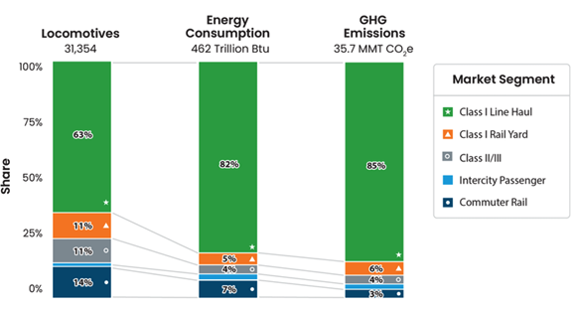
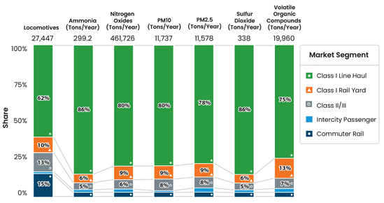
Rail sector emissions
Total 2022 rail sector emissions are estimated at 35.5 MMT CO₂e, or 2% of U.S. transportation GHG emissions
Air pollution from diesel locomotives contributed 10.6% of all NO_{x} emissions and 6% of PM_{2.5} emissions from mobile sources in the US in 2022.
Because the Inventory of U.S. Greenhouse Gas Emissions and Sinks does not break out rail emissions by subsector, we rely on the 2020 U.S. EPA National Emissions Inventory (NEI) to estimate the relative contribution from each rail subsector to overall rail GHG emissions. The NEI uses a bottom-up approach to estimate pollution from the different rail market segments, based on fuel consumption and estimated operating profiles. The NEI is updated every three years, so we use estimated emissions in 2020. The overall emissions from the rail sector were lower in 2022 than in 2019 due to the COVID-19 pandemic, but we rely on the NEI only for the distribution of emissions from different rail subsectors and not total emissions. Sources: https://www.epa.gov/system/files/documents/2023-01/2020_NEI_Rail_062722.pdf
And https://www.epa.gov/system/files/documents/2022-04/us-ghg-inventory-2022-main-text.pdf

Slide 5
Key Electrification Actions by 2030
Long-term catenary and discontinuous catenary electrification planning
Zero-emission rail yards (ZERY) transition
Expanded R&D through a Public-Private Research Partnership
Rail-to-Grid Integration (RGI)

Slide 6
Toward widespread rail electrification
Market Segment | Line-Haul | Short-Line and Regional Freight | Rail Yards | Intercity Passenger Rail | High-Speed Rail | Commuter Rail
Deploy near-term transitional technology | Dual-power diesel-electric locomotives that ensure interoperability throughout transition | Idle-reduction measures Tier 4 locomotives | Retrofits to diesel-battery hybrids Retrofits to battery switchers | Dual-power diesel-catenary trainsets (Amtrak Aero) | Initiate new full-electric HSR corridor (LA to Las Vegas in 2028, California HSR by 2033) | Discontinuous catenary technology on existing diesel-catenary systems
Lay the groundwork for long-term electrification | Catenary demonstrations Electrification planning in conjunction with long-term grid planning for widespread catenary deployment | Feasibility studies and planning for catenary on high-density routes that interchange with intermodal network | Zero-emission rail yard (ZERY) assessment and guidebook Discontinuous catenary demonstrations and deployment | Catenary electrification feasibility studies, especially for corridors already connected to catenary infrastructure |  | Feasibility studies for corridor electrification (full and disco cat depending on ROW constraints)

Slide 7
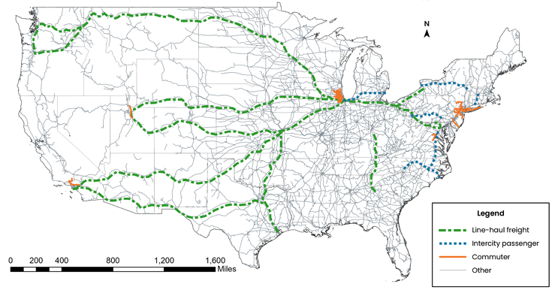
1. Electrification studies for high-potential routes
Initiate detailed feasibility studies for catenary and discontinuous catenary electrification for line-haul freight, intercity passenger, and commuter rail service on high-potential routes.
Develop a national electrification plan that identifies where catenary works, where discontinuous catenary works, and where other solutions may be required
Develop a national railroad workforce plan to ensure that a sufficient workforce is available for installation and maintenance of new catenary and other infrastructure out to 2050 and beyond

Slide 8
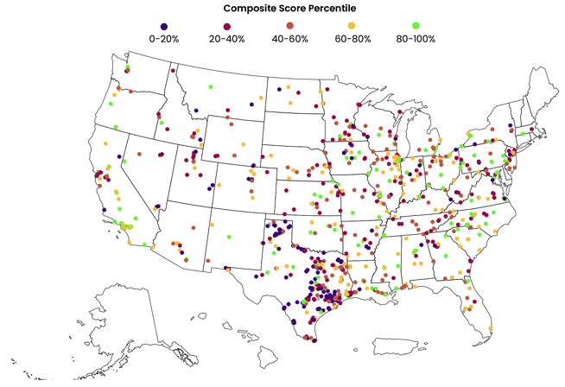
2 Zero-emission rail yards (ZERY)
Support deployment of zero-emission locomotives and idling-reduction measures in rail yard operations to improve public health.
Develop a framework for identifying suitable rail yards for full zero-emission transition in collaboration with industry, community partners and experts, and State and local officials
The cumulative score for each rail yard was generated from the following attributes of each rail yard: NO_{x} emissions, PM10 and PM2.5 emissions, number of other rail yards within 5 miles, population density, asthma rates, heart disease rates, proximity to schools, cumulative burden score from the DOE disadvantaged communities explorer,

Slide 9
3. US RAIL Partnership
Support development and deployment of battery electric and HFC locomotives for line-haul rail operations with the US Research for Advanced Infrastructure and Locomotion (RAIL) Partnership:
  Develop zero-emission locomotive and accompanying infrastructure deployment targets for the rail sector
  Address and reduce financial (catenary) and technical (battery electric and HFC locomotives) barriers to adoption
  Facilitate public-private partnerships for the research, development, testing and adoption of ZE propulsion technologies
  Facilitate OEMs, suppliers, utilities, labor, communities experiencing environmental justice concerns, and infrastructure companies to come together to develop plans to decarbonize routes and railyards

Slide 10
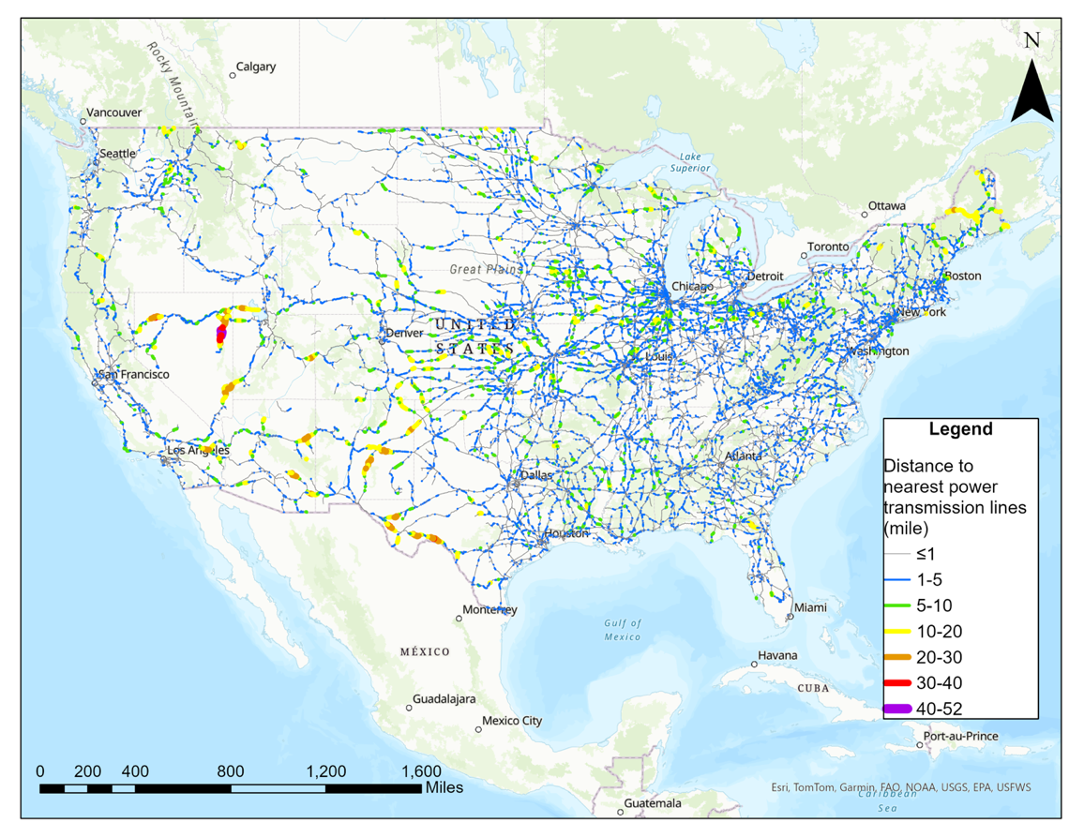
4 Rail-to-Grid Integration
Coordinate utilities, railroads, communities, and other stakeholders on rail electrification planning and grid decarbonization and reliability.
Host a series of rail electrification summits that bring together community stakeholder experts, railroads, workers, and utilities to identify challenges and solutions between transmission planning and rail electrification
Complete a national assessment to identify priority corridors for collocating transmission lines and rail right-of-way

Slide 11

Current Rail Electrification Research
Catenary feasibility for the Southern Transcon (ANL)
Technical (and economic-lite) assessment of catenary and discontinuous catenary for the Southern Transcon from Los Angeles to Chicago using BNSF data. Final results expected Nov 2024.
Industrial Locomotive Survey (NREL)
This project will work with large industrial companies to conduct a survey of industrial locomotives operating in the US. The team will reach out to all industrial locomotives that are identified but anticipates receipt of data for a sample of the full population. The sample data will be analyzed to estimate energy and GHG emissions for the full population. (FY25)
Barriers to and opportunities for mode shift from trucks to rail (ANL/NCSU)
This project will identify and understand the barriers that are preventing the shifting of cargo from trucks to rail and to provide strategies for overcoming these barriers to enable the shift with an estimate of what percentage of cargo traffic could be shifted from truck to rails if successful in overcoming these barriers. The project will consider a series of potential barriers include accessibility, service options, service quality, capacity limitations (both line and terminal), costs, equipment availability, interoperability, and regulation that prevent the shifting of cargo from truck to rail.

Slide 12
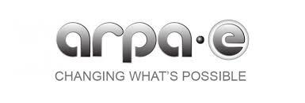
Current Rail Electrification Research
INTERMODAL
  This Topic seeks to develop the low-carbon intermodal freight transportation system of the future, with the goal of minimizing greenhouse gas emissions and maximizing freight resiliency. Project innovations developed will support the deployment of energy infrastructure and logistics for moving goods across maritime, rail, and road transportation through developing models that enable prioritization of low-carbon energy infrastructure deployment.
  7 projects funded
  https://arpa-e.energy.gov/technologies/exploratory-topics/intermodal-freight
Vision OPEN 2024: Intermodal energy super highways
  To fully realize the benefits of abundant, diverse sources of energy, an intermodal energy superhighway is envisioned as a nationwide network that resolves energy challenges associated with interconnection, intermittency, and access.
  https://arpa-e.energy.gov/technologies/programs/vision-open-2024
PROPEL 1K
  Funded through the Pioneering Railroad, Oceanic and Plane ELectrification with 1K energy storage systems (PROPEL-1K) program, projects will develop energy storage systems with “1K” technologies capable of achieving or exceeding 1000 Watt-hour per kilogram (Wh/kg) and 1000 Watt-hour per liter (Wh/L).
    12 projects funded
    https://arpa-e.energy.gov/technologies/programs/propel-1k

Slide 13
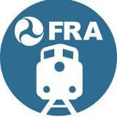
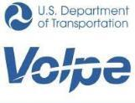
Current Rail Electrification Research
Zero-Emission Railyard (ZERY) Pilot Assessment
This project will create a framework for conducting and assessing a future ZERY Pilot. This report will include typical equipment found in railyards by railroad type/class (passenger, Class I, Class II/III), what factors should be considered when identifying a railyard to convert to zero emissions, and what metrics should be used to assess the success of the pilot.
End of 2024

Slide 14
DOE-funded rail models that support electrification analysis and planning
Model | Developer | Description | Electrification capabilities | More info
ALTRIOS | National Renewable Energy Lab | Simulates real-world, multi-train, multi-decade rail network operation in a single unified model, including the following energy-impacting aspects of rail operation | does not currently include catenary and disco cat, but they are seeking funding to expand | https://www.nrel.gov/transportation/altrios.html
A-STEP | North Carolina State University | Starts from energy pathways and economic forecasts and progresses through traffic assignment, energy intensity analysis, recharging facility assessment, and cost estimation to produce results that can help with decarbonization feasibility assessments | through work with ANL, now includes catenary and discontinuous catenary capabilities | https://itre.ncsu.edu/focus/rail/astep/
SCORE | Penn State | Online analysis framework that calculates the fuel consumption and emissions of consists over a route, to access the impact different locomotive technologies have across a rail network system with various freight requirements. Users can create consists with varying combinations of locomotives and freight cars to simulate energy and GHG emissions over routes. | does not currently include catenary and disco cat, but they are seeking funding to expand | https://www.scorelocomotives.org/
Autonomie Rail | Argonne National Lab |  | Catenary and discontinuous catenary | https://vms.taps.anl.gov/tools/autonomie/

Slide 15
Thank you!
Natalie Popovich
ndpopovich@lbl.gov

Slide 16
BACKUP SLIDES

Slide 17
Near-term strategy (now to 2035)
Market Segment | Line-Haul | Short-Line and Regional Freight | Rail Yards | Intercity Passenger Rail | High-Speed Rail | Commuter Rail
Deploy near-term transitional technology | Dual-mode diesel-electric locomotives Locomotive retrofits to use battery and hydrogen tenders Sustainable liquid fuels R&D on H2-ICE and criteria pollution reduction | Idle-reduction measures Tier 4 locomotives | Idle-reduction measures Hybrid battery-diesel electric locomotives Tier 4 locomotives | Hybrid battery-diesel electric locomotives Dual-power diesel-catenary trainsets Sustainable liquid fuels | Initiate at least 1 new full-electric HSR corridor | Discontinuous catenary technology on existing diesel-catenary systems
Lay the groundwork for long-term technology | Improve train energy efficiency, without compromising safety Catenary demonstrations Electrification planning in conjunction with long-term grid planning Research and demonstrations of battery and HFC locomotives | Battery locomotive deployment, especially retrofits Demonstration of HFC locomotives | Discontinuous catenary demonstrations and deployment Battery locomotives - especially retrofits - and supportive infrastructure | Expand intercity passenger rail to new communities Catenary electrification feasibility studies, especially for corridors already connected to catenary infrastructure |  | Feasibility studies for corridor electrification

Slide 18
3. Long-term strategy (2035 to 2050+)
Market Segment | Line-Haul | Short-Line and Regional Freight | Rail Yards | Intercity Passenger Rail | High-Speed Rail | Commuter Rail
Long-Term Technologies | Wide-scale catenary deployment Dual-power locomotives that will ensure interoperability with legacy equipment HFC locomotives for remote, low-density, long-distance routes, with access to clean hydrogen | Catenary on high-density routes that interchange with intermodal network Battery locomotives for operations with < 250+ miles daily range | Discontinuous catenary Battery locomotives and supportive infrastructure | Catenary for routes that operate on high-density freight corridors Dual-mode locomotives on routes that operate on low-density freight corridors | New dedicated, electrified high-speed rail service | Catenary on unconstrained ROW Discontinuous catenary on low-density routes
 | For all rail market segments, encourage the use of drop-in sustainable liquid fuels, when available, for hard-to-decarbonize portions of the network and legacy locomotives.

Slide 19
5. Key actions (non-electric)
Expanded access to intracity and intercity passenger rail
Freight rail system efficiency
Leveraging existing assets

Slide 20
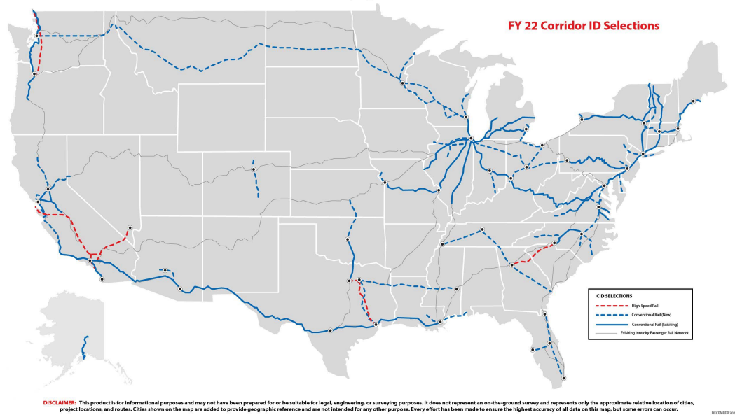
4.4 Expanded access to passenger rail
Expand access to intercity and intracity passenger rail service and initiate new high-speed rail service
Initiate new electrified high-speed and conventional intercity passenger rail service
By 2040, at least double intercity passenger rail ridership from 2019 baseline

Slide 21
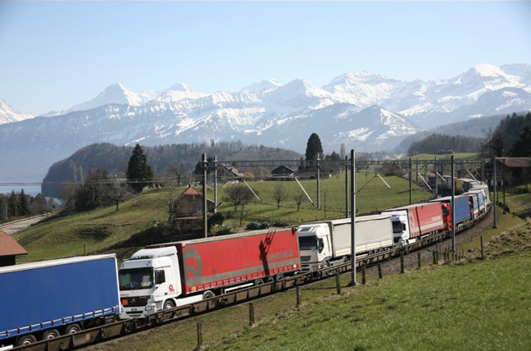
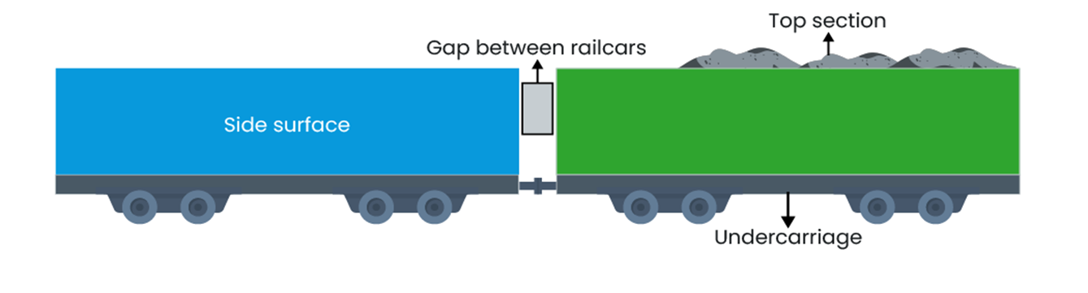
4.5 Freight rail efficiency
Expand affordable access to freight rail to accommodate projected increases in freight shipments and reduce overall energy requirements in the freight system
Complete a national assessment of potential mode shift from projected increase in truck and plane tonnage to rail
Support measures to improve freight train aerodynamics, without compromising safety
Roll-on/roll-off arrangement in Switzerland (Source: https://ralpin.com/en/medien)

Slide 22
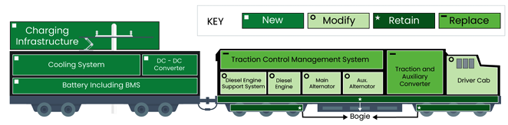
4.7 Transition technologies
Leverage existing assets by supporting transitional technologies to reduce near-term emissions.
Support demonstration of diesel-electric locomotive retrofits with battery tenders and dual-mode locomotives
Diesel-electric locomotive with a battery tender

Slide 23
5. Cross-cutting strategies
Equity and environmental justice
Workforce development
Tribal consultation and right-of-way justice

Slide 24
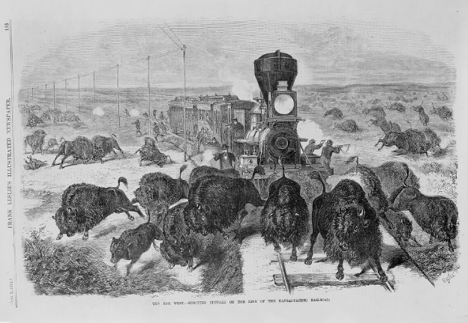
5.3 Tribal consultation and right-of-way justice
  Engage Tribal nations to identify potential sources of community benefits that could result from rail decarbonization
  Work in consultation with Tribal nations to identify locations to reroute rail lines, tracks, and/or other infrastructure to reinstate access to Tribal resources, when possible
  Explore pathways to waive cost-share requirements for rail improvement and decarbonization projects proposed by Tribal nations and communities with environmental concerns.
Source: Library of Congress (https://www.loc.gov/resource/cph.3c33890/)

Slide 25
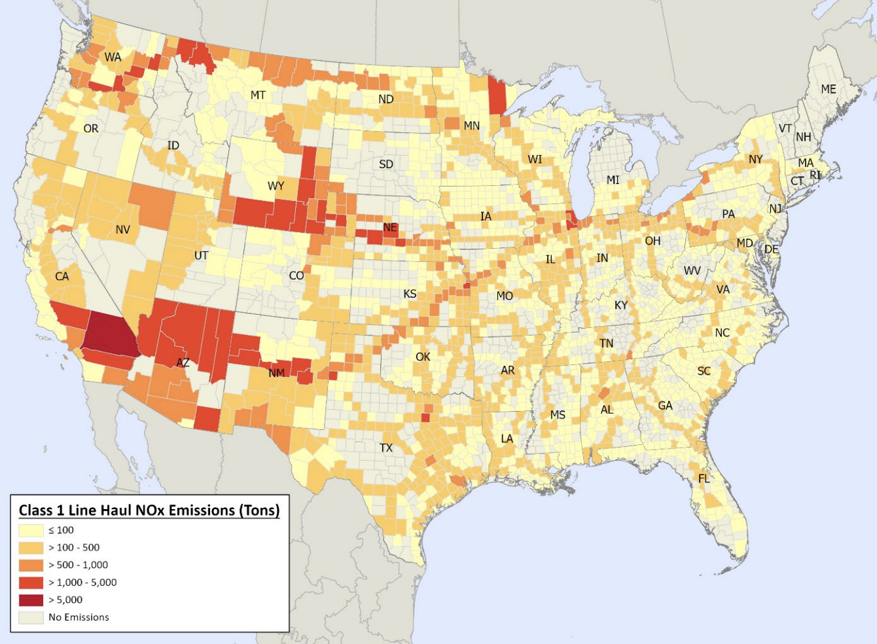
5.1 Environmental justice
  Collaborate in a meaningful and sustained way with communities and stakeholders on rail decarbonization planning, demonstrations, projects, and infrastructure expansion
  Ensure that at least 40% of overall benefits from rail decarbonization efforts flow to disadvantaged communities, in line with the national Justice40 initiative
Source: Eastern Research Group. 2022. 2020 National Emissions Inventory Locomotive Methodology. https://www.epa.gov/system/files/documents/2023-01/2020_NEI_Rail_062722.pdf

Slide 26
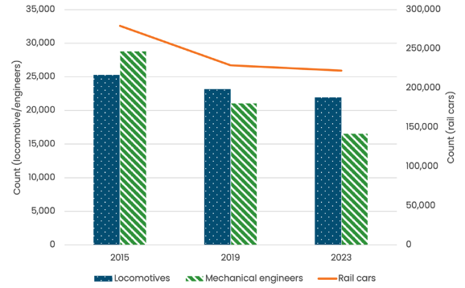
5.2 Workforce development
  Fund and support workforce development, training programs, and technical assistance for zero-emission technologies, especially in disadvantaged communities and with existing workers needing reskilling and retraining
  Build a domestic supply chain to retrofit, build, and maintain zero-emission locomotives.

