Slide 1
Infographics Campaign Assets
May 2020

Slide 2
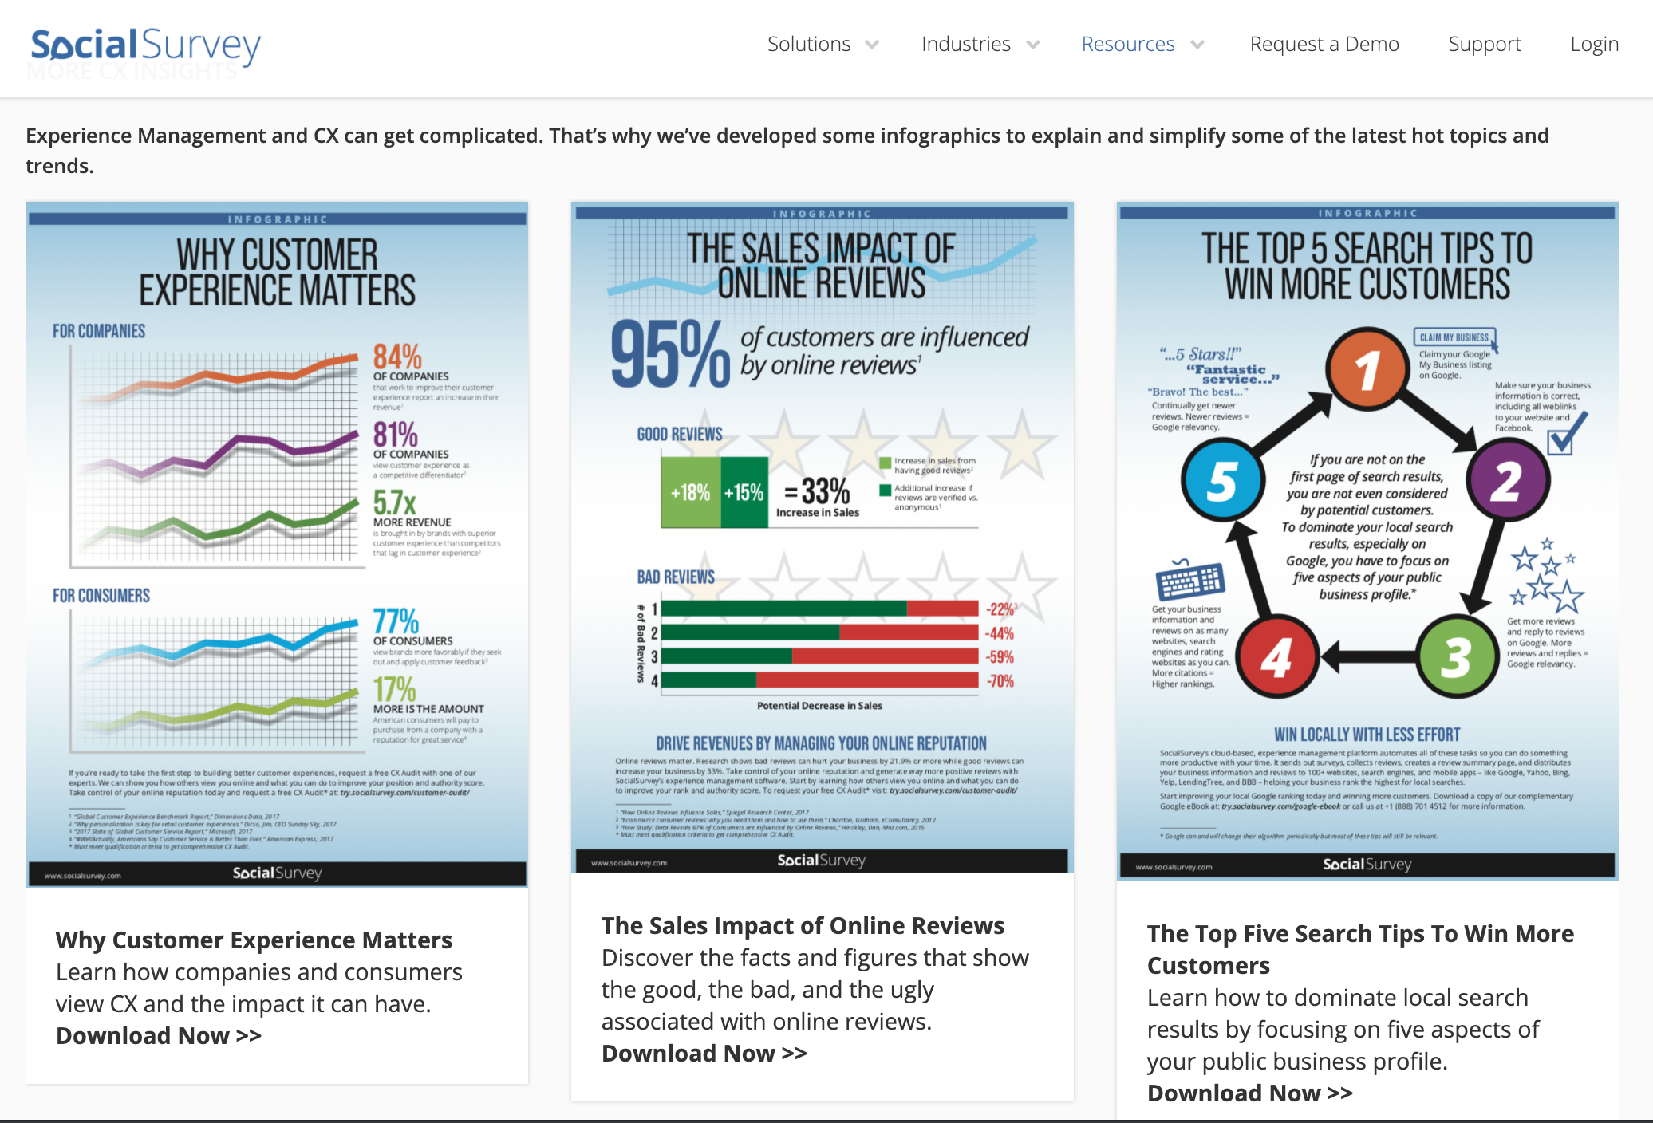
Infographic Campaigns

Slide 3


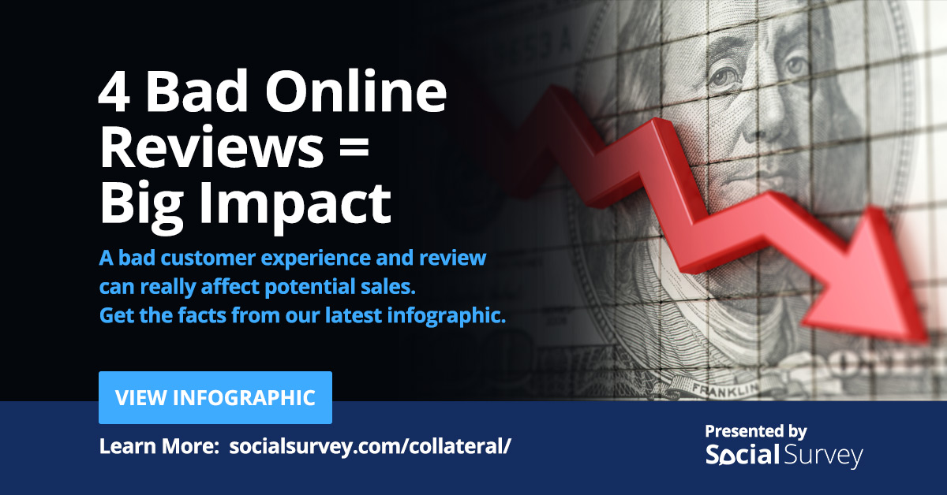

Social Campaigns:

Slide 4

Social Campaigns:

Slide 5




Social Campaigns:

Slide 6
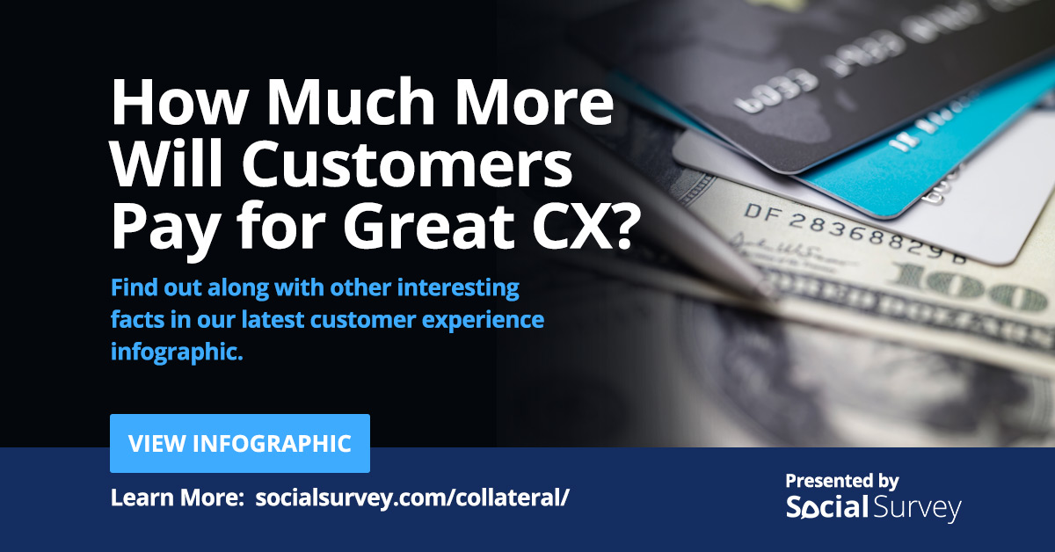
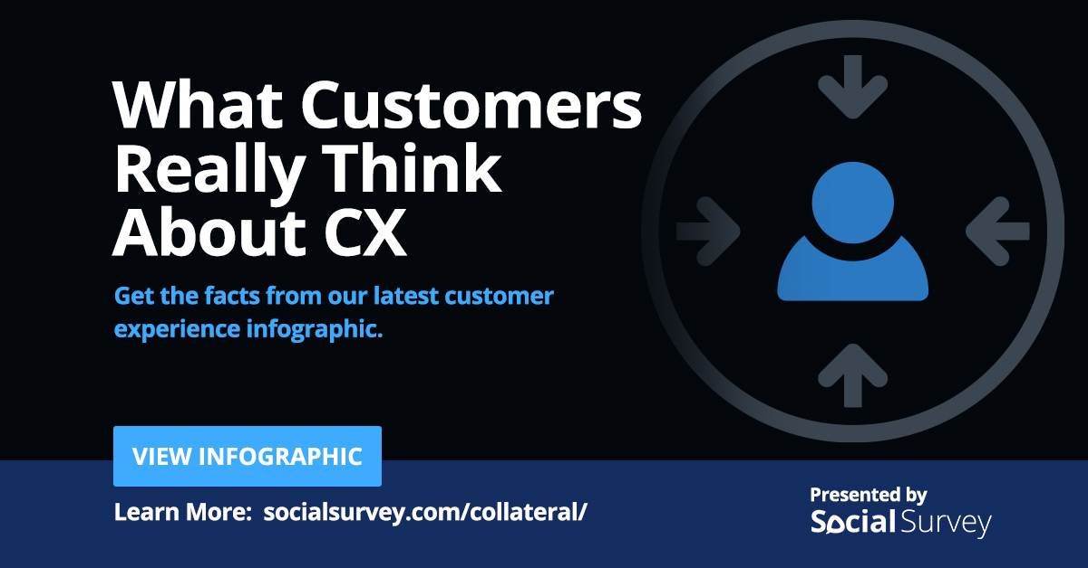


Social Campaigns:

Slide 7



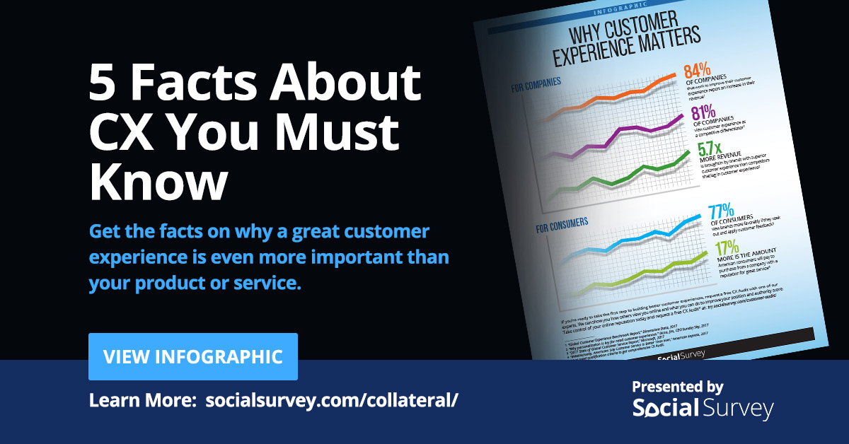
Social Campaigns:

Slide 8
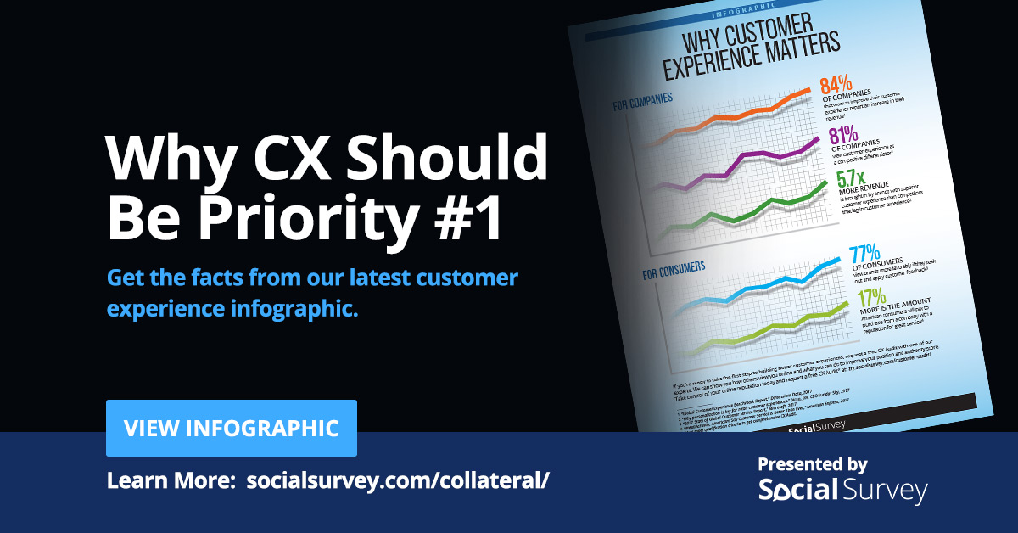
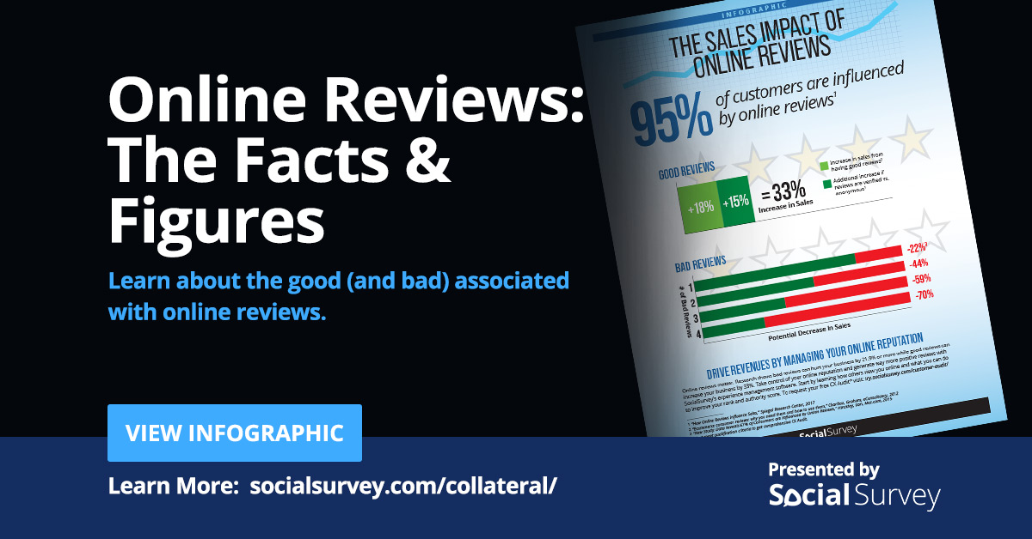
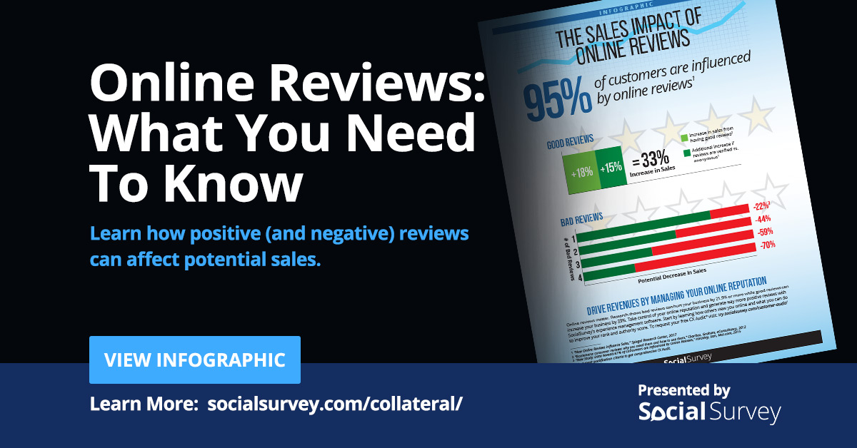
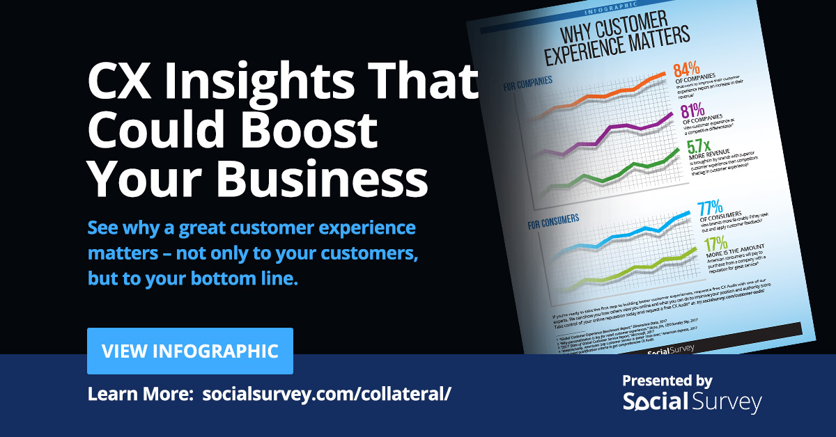
Social Campaigns:

Slide 9

Social Campaigns:

