Slide 1
NAF Case Study
May 2020

Slide 2
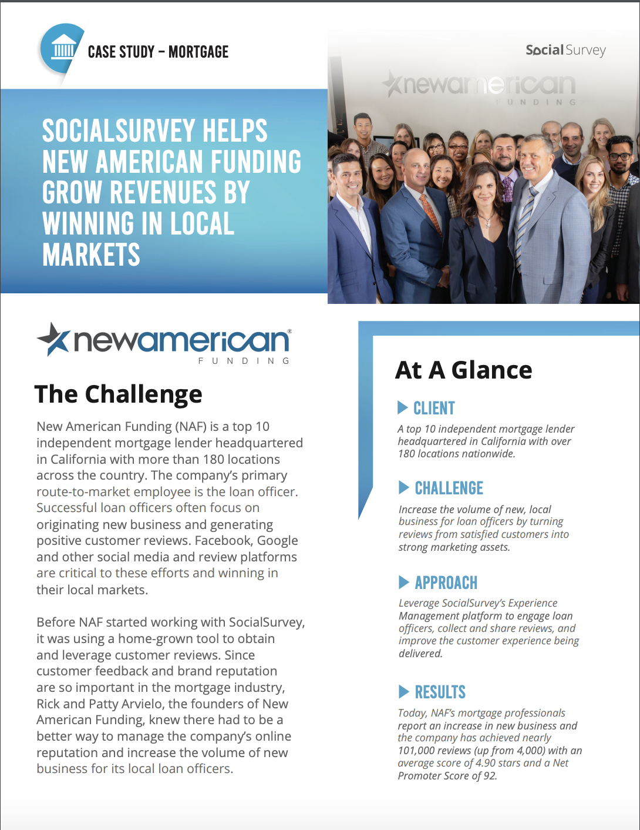
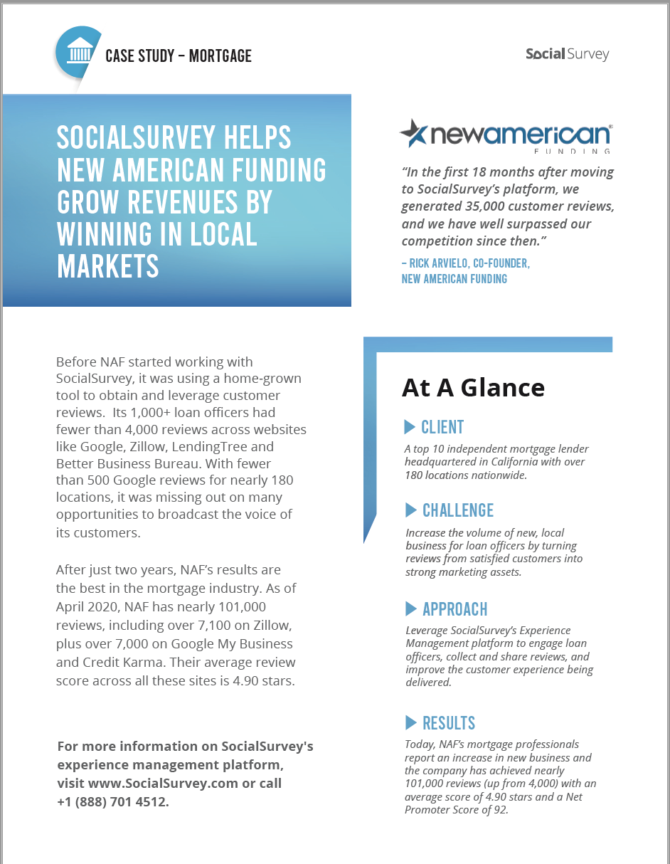
Case Study:
Four Pager and One Pager Versions

Slide 3
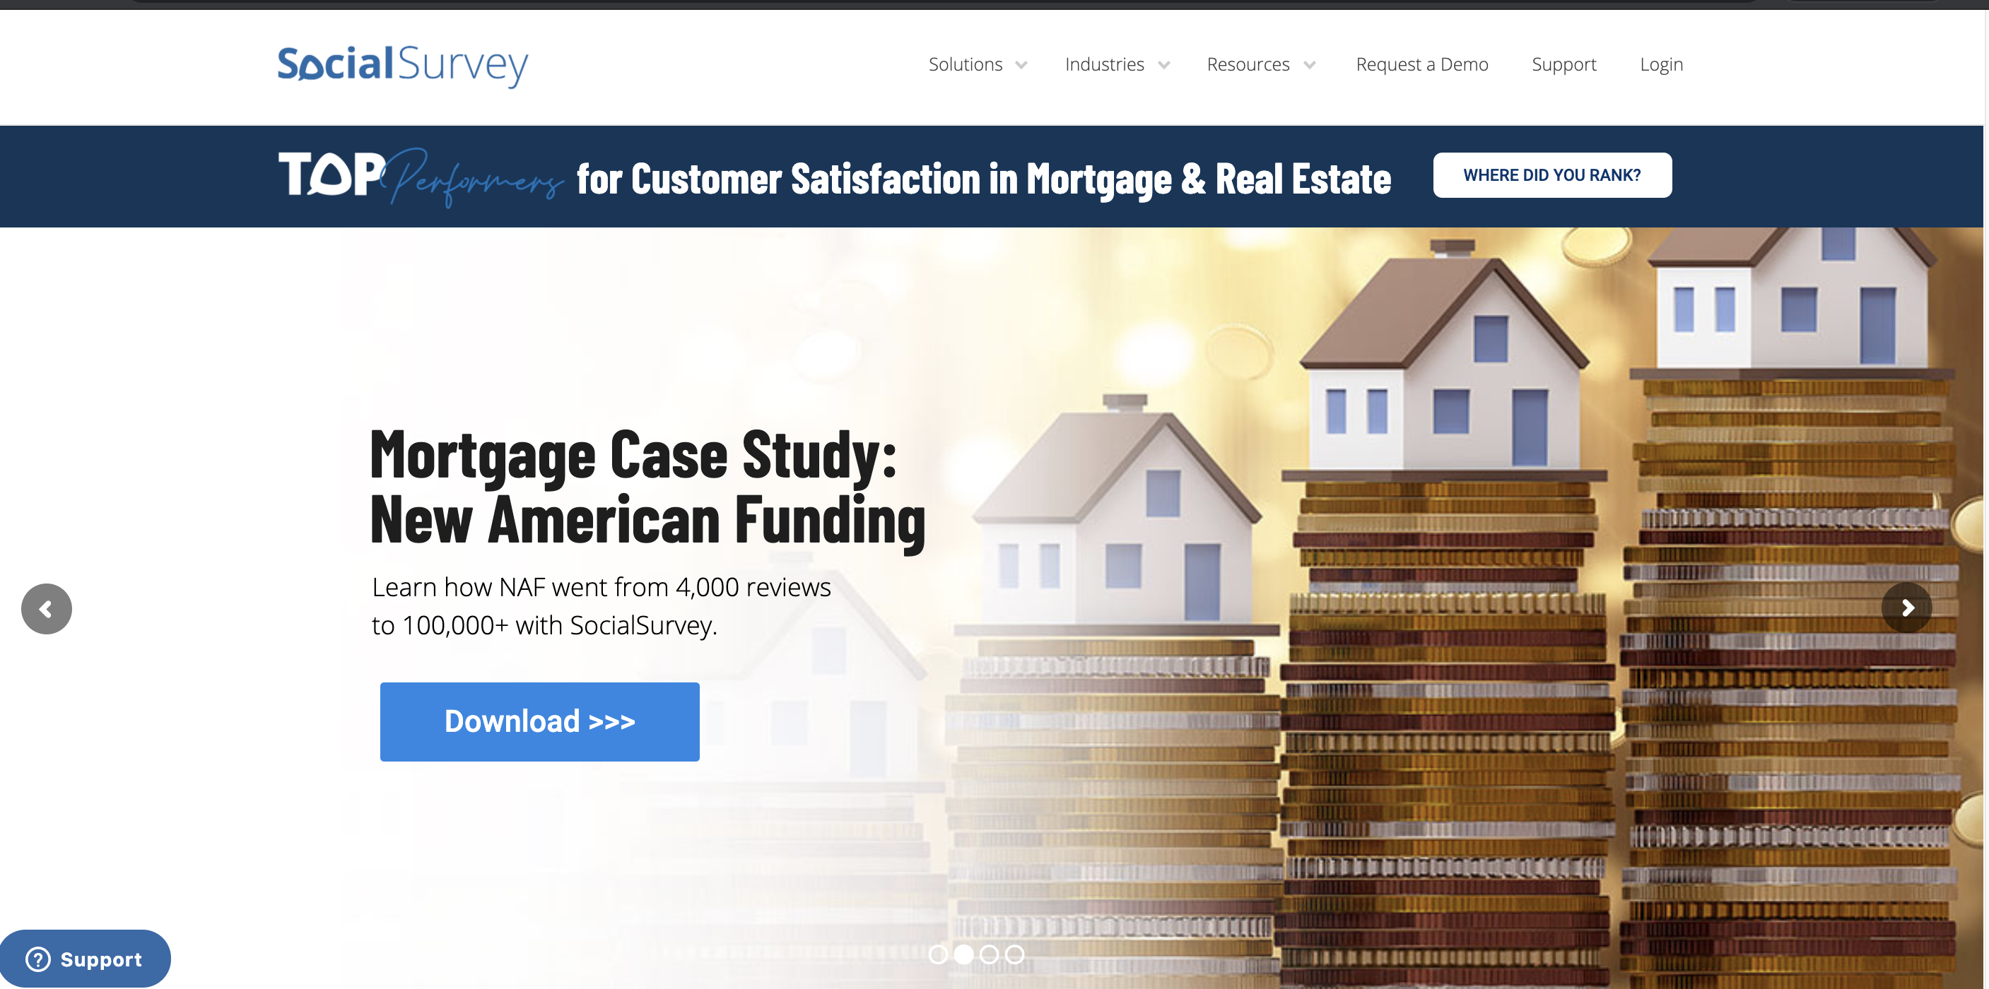
Website Banner:

Slide 4


Demand Generation:
Social Campaigns

Slide 5
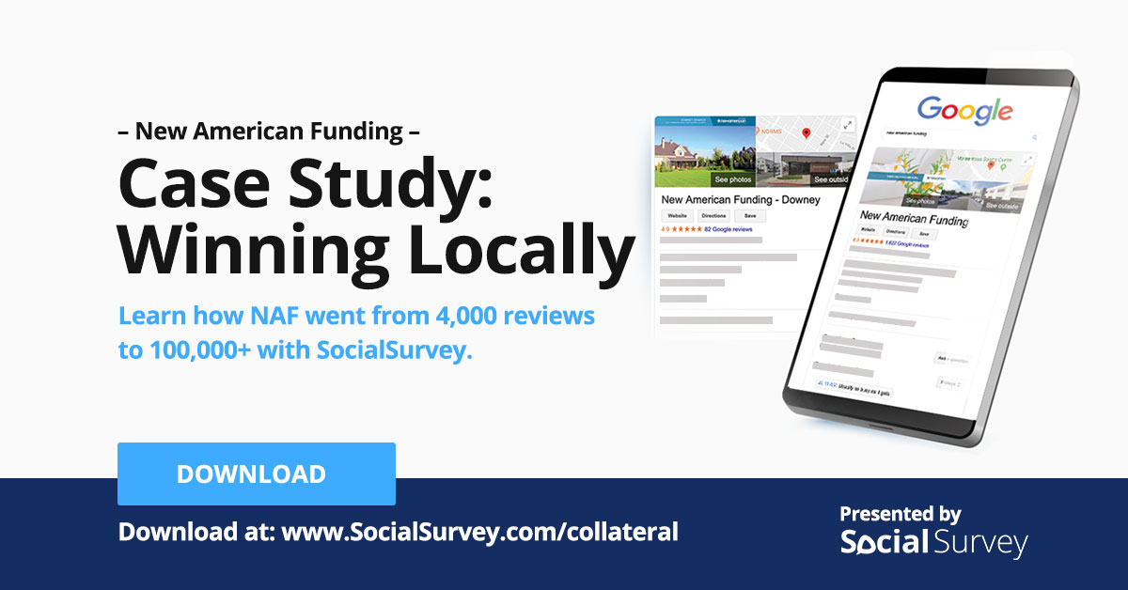


Demand Generation:
Social Campaigns

Slide 6
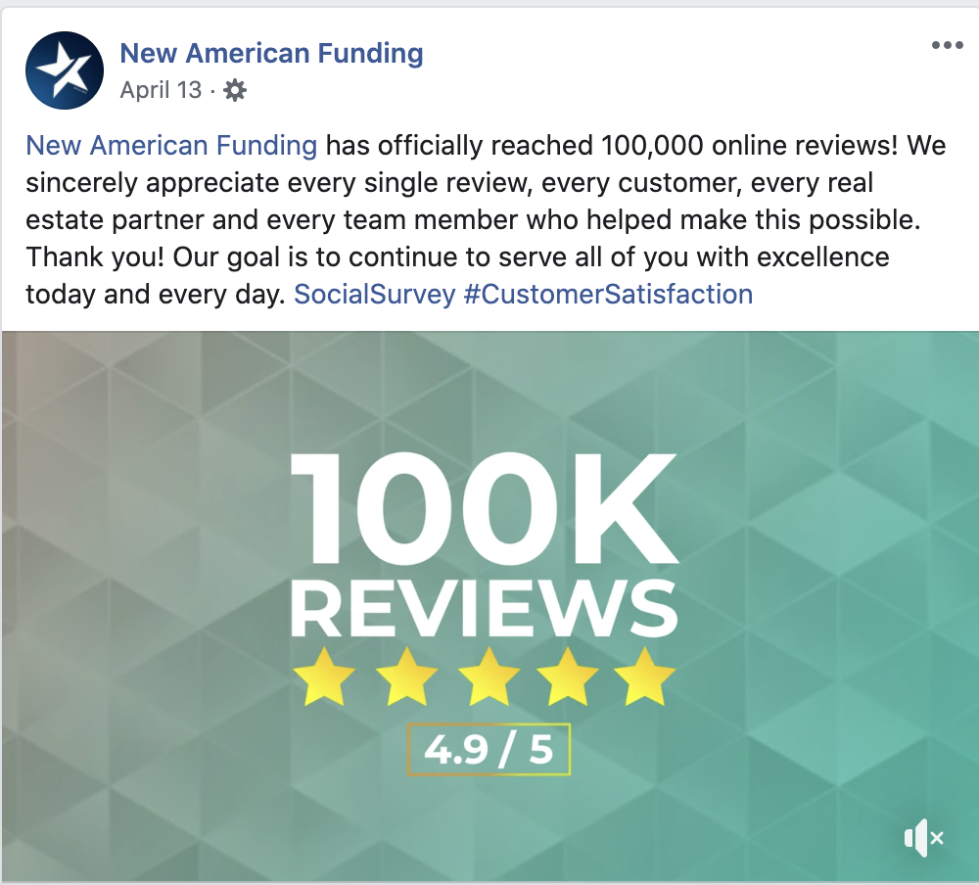
Demand Generation:
Social Campaigns

