Slide 1
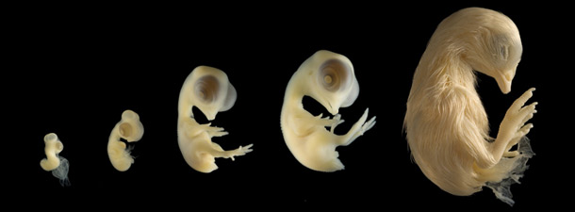
Plymouth County 4-H
Embryology in the classroom
Adapted from works by: By: Phillip J. Clauer, Senior Extension Associate
4-H Youth and Specialty Poultry , The Pennsylvania State University

Slide 2
Embryo
Development and Observation
This PDF PowerPoint should help you learn:
How the embryo develops
What the developing embryo looks like
What to observe at the various stages of
development

Slide 3
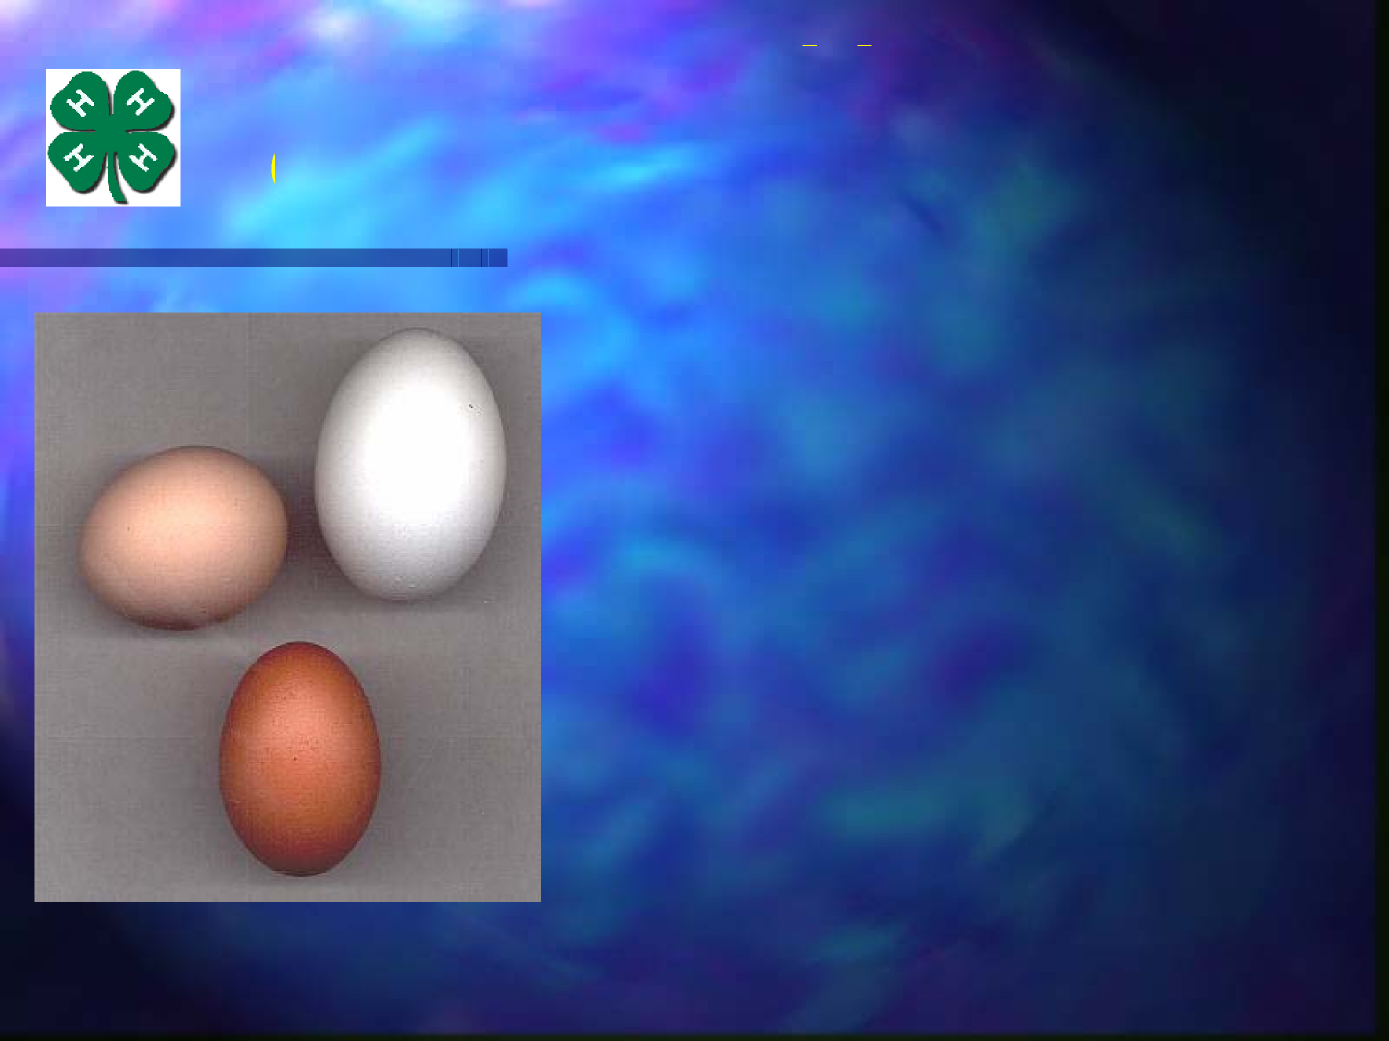
It Starts With
Quality Fertile Eggs
Proven Egg Source
Proper Collection and
Storage Techniques
– 45- 55 degrees F.
– 70 percent humidity
–7 days maximum
Other Factors
– Nutrition & age of birds
Consider Sampling Fertility
Chicken Eggs are best for
school projects

Slide 4
Fertile or Not Fertile?
Not Fertile
Solid white spot
Fertile
Darker outer circle

Slide 5
Function of Each
Embryonic Membrane
Yolk Sac
– Food
Amnion
– Protection
– Exercise
Chorion/Allantois
– Respiration
– Handles Waste
– Minerals from shell

Slide 6
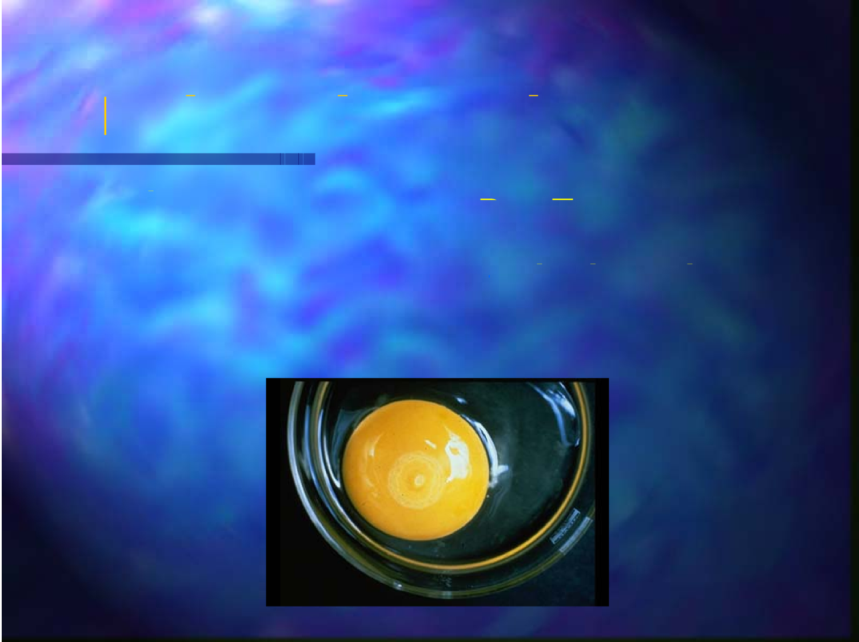
Embryonic Development
Day One
– Development of
Pellucida and Opaca
– Appearance of Blood
Island
Day Two
– Blood vessels
appear on yolk sac

Slide 7
3 Day Embryo
Heart Visible
Vertebrae Column -
Question Mark Shape
Amnion Complete
Brain and Head Visible

Slide 8
4 & 5 Day Embryo
Embryo is completely
separate from yolk sac
– Amnion clearly visible
Formation of reproductive organs
by 5th day - Sexual Division

Slide 9
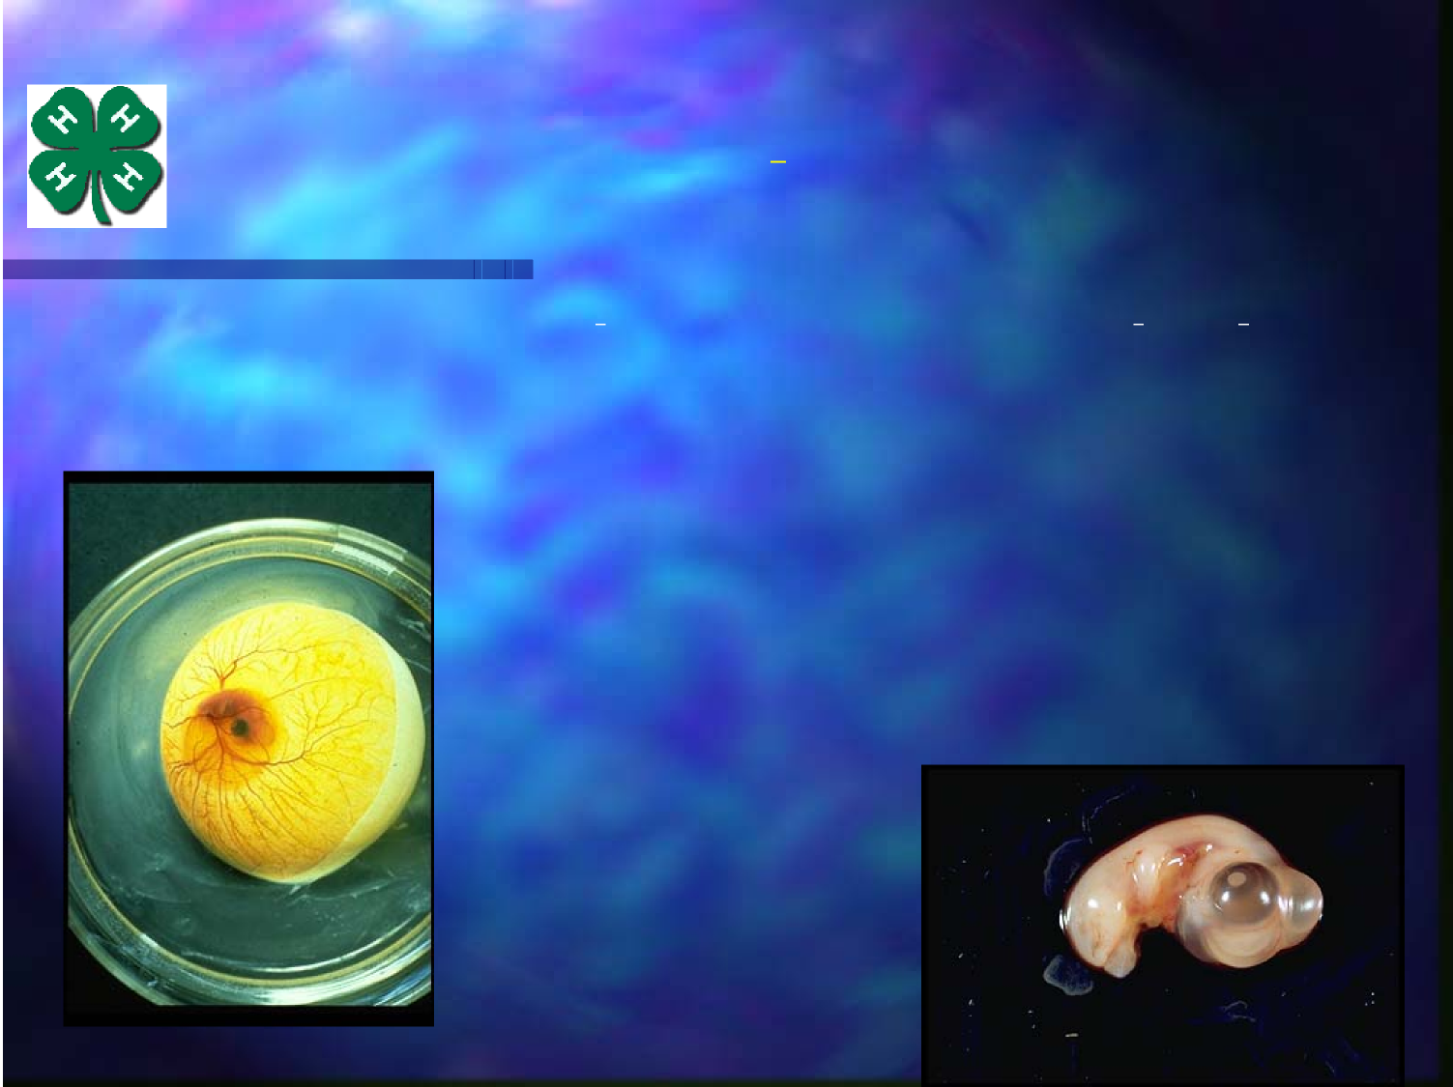
6 Day Embryo
Voluntary movement begins
Everything is present
– Organs
– Main division of limbs
– Beak and egg tooth starts

Slide 10
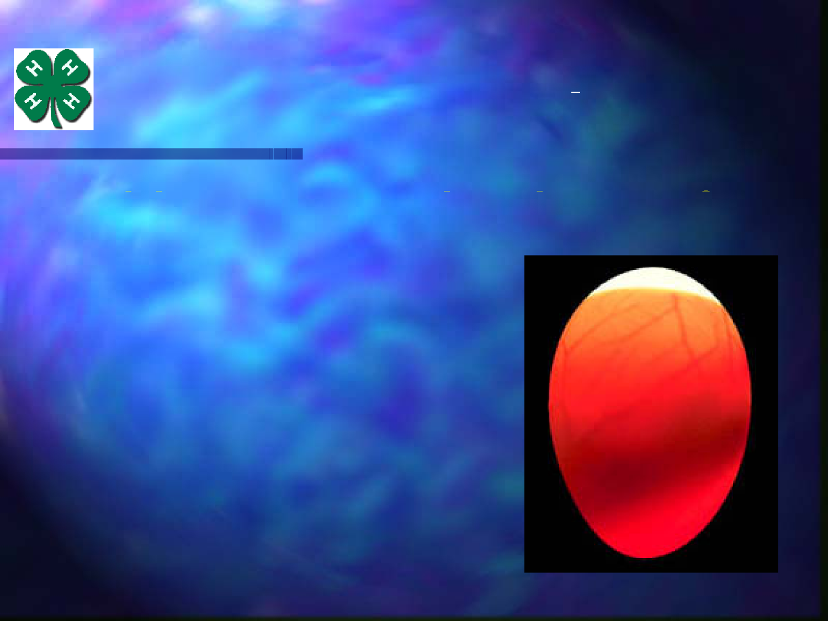
7 to 9 Day Embryo
Abdomen more prominent because of
viscera development
Feathers begin to form
Mouth opening appears
Embryo looks like a bird
by ninth day

Slide 11
10 to 13 Day Embryo
Beak and bones begin to harden
Skin pores visible
Digits completely
separated
Egg very full and
air cell is larger

Slide 12
13 to 17 Day Embryo
Scales, claws, and
feathers visible
Small intestine taken
into body
Begins to prepare for
hatching

Slide 13
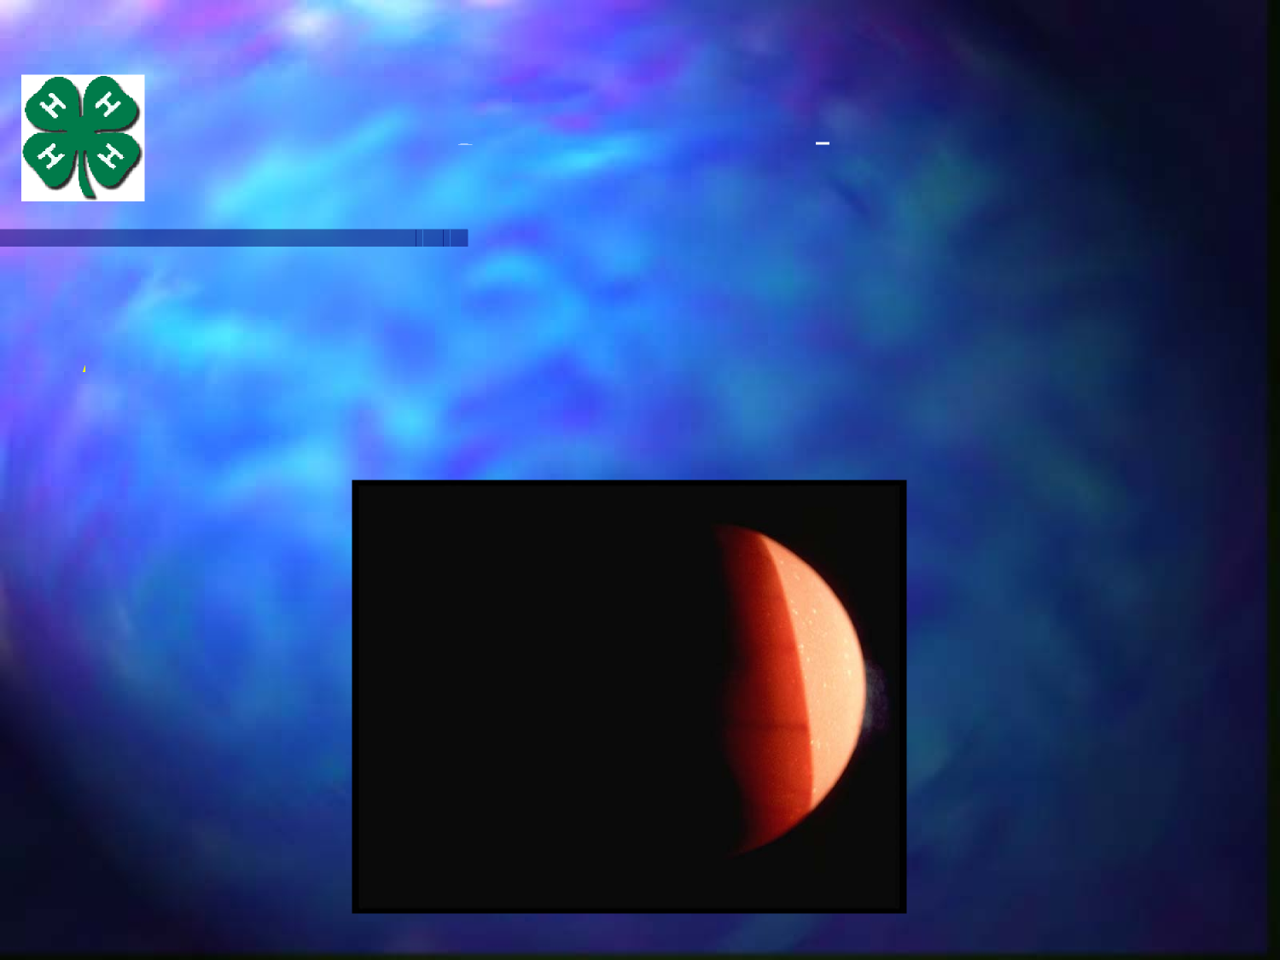
15 to 19 Day Embryo
After 15 days, it is very hard to observe
the embryo by candling

Slide 14
18 to 20 Day Embryo
Growth complete
Yolk sac is drawn
into body cavity
Embryo becomes a
chick when it
– Breaks the amnion
– Internal Pip (Into air cell)
– Starts breathing

Slide 15
19 to 20 Day Embryo
Can observe chick
inside air cell once
they pip through the
inner shell
membranes and
take first breath.

Slide 16
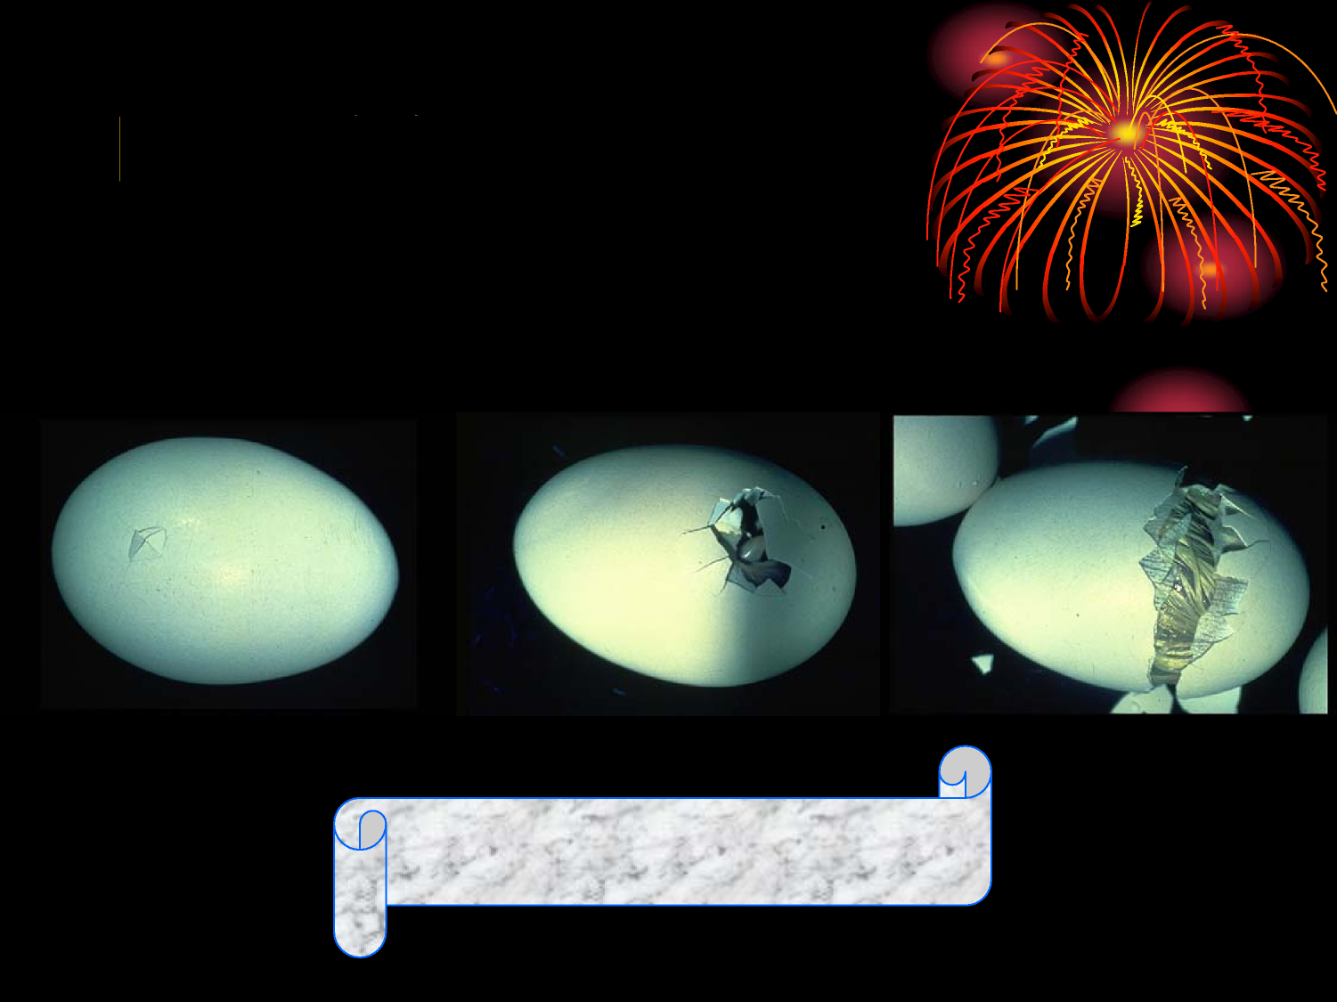
Day 20
1
2 3
Something Happens

Slide 17
21 Days
The Chick Hatches

Slide 18
Observe the Egg Tooth
It is only there for first 12 to 24 hours.

Slide 19
How to Sex Chicks
Sex-linked genes are used in some
strains of chickens to make sexing
easier.
– Feather Sexing
Female feathers longer
– Plumage Color
Males and females different colors
Vent Sexing is very difficult.

Slide 20
Feather Sexing

Slide 21
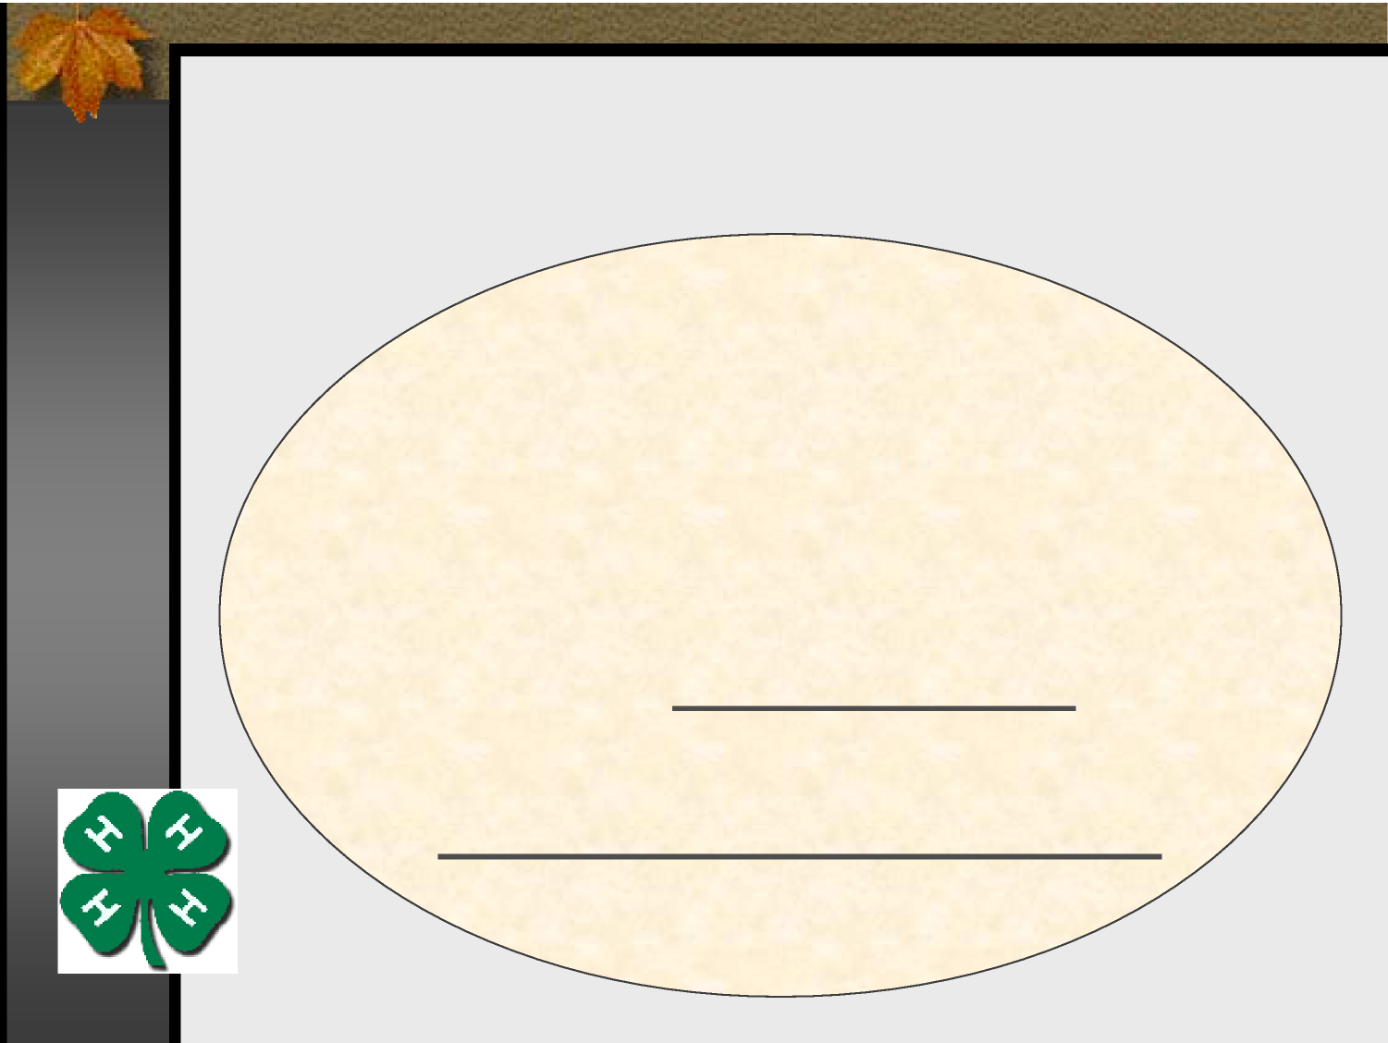
Contact Information:
Plymouth County 4-H
228 High Street
Hanson, Ma 02341
781-293-3541
mvollmer@umext.umass.edu
vschell@umass.edu
Plymouthcounty4h.org

