Slide 1

4-H
“Field of Dreams”
Presented by:
4-H Youth Task Force and Advisory Council

Slide 2


If you build it, they will come.”
-“Shoeless” Joe Jackson
Field of Dreams (1989)

Slide 3

You're going to need us

Slide 4
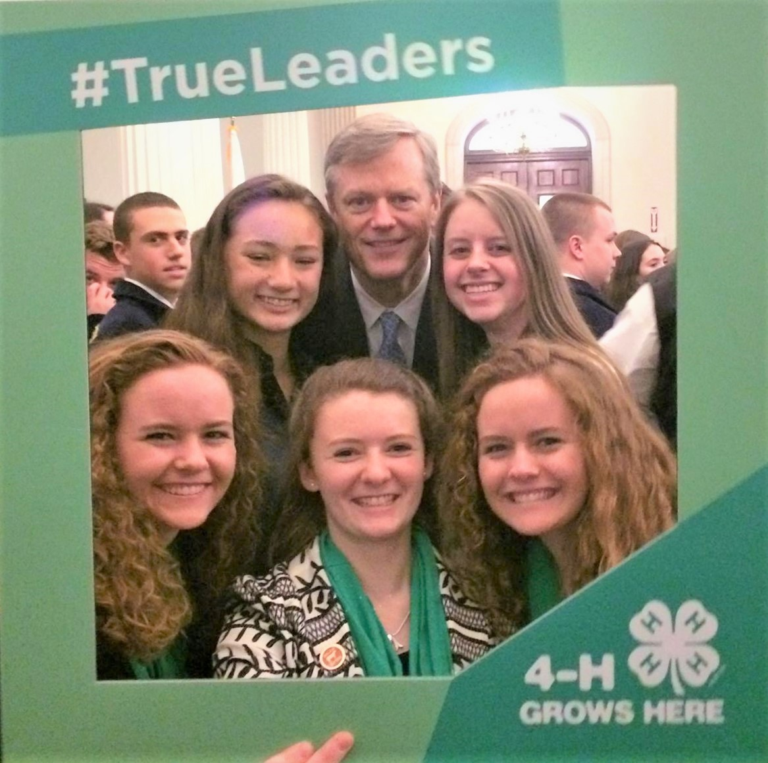


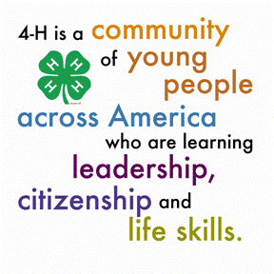
What is 4-H?
4-H is a volunteer-led organization that reaches boys and girls through small groups called clubs.
4-H members choose from over 40 projects in which to participate during the 4-H calendar year.
Most projects use hands-on learning experiences to teach subject matter and life-skills such as cooperation, leadership and decision-making skills that can be applied over and over for a lifetime.

Slide 5

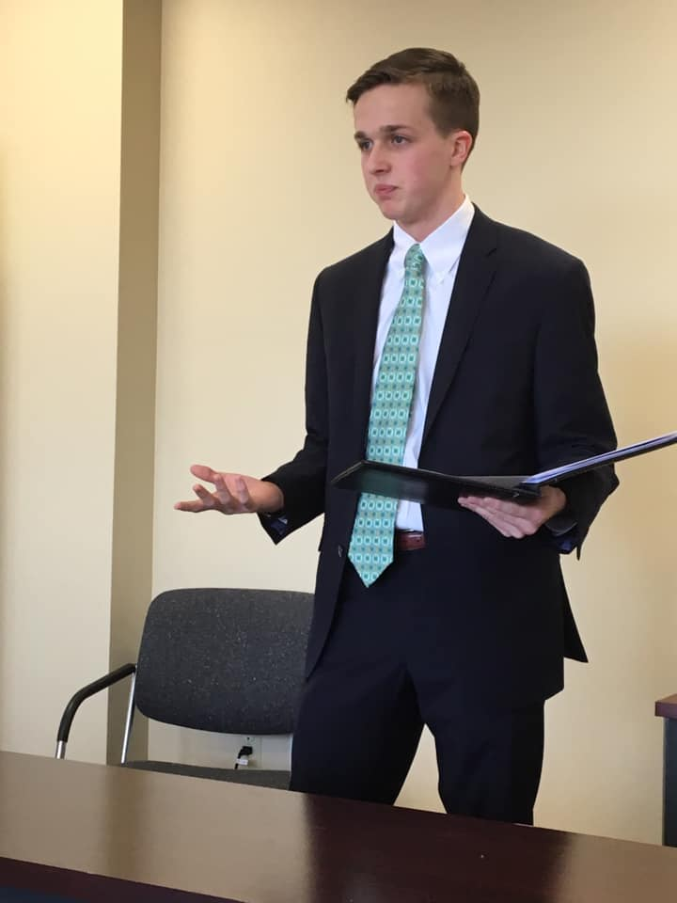
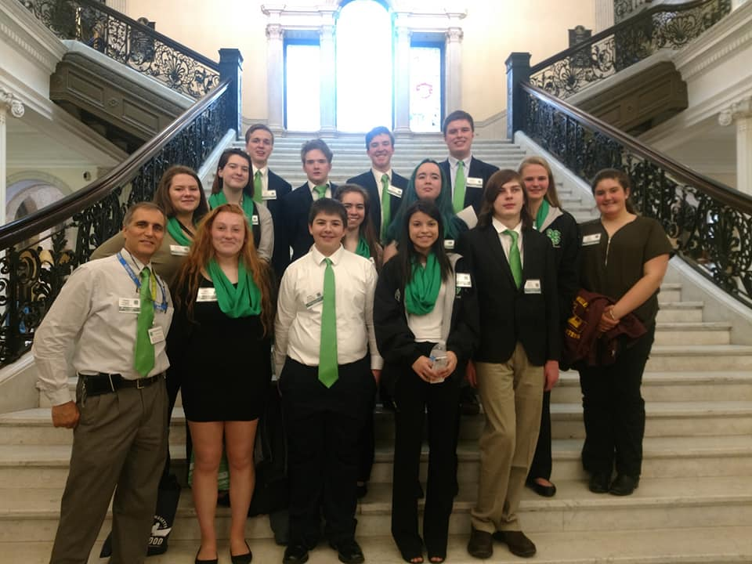
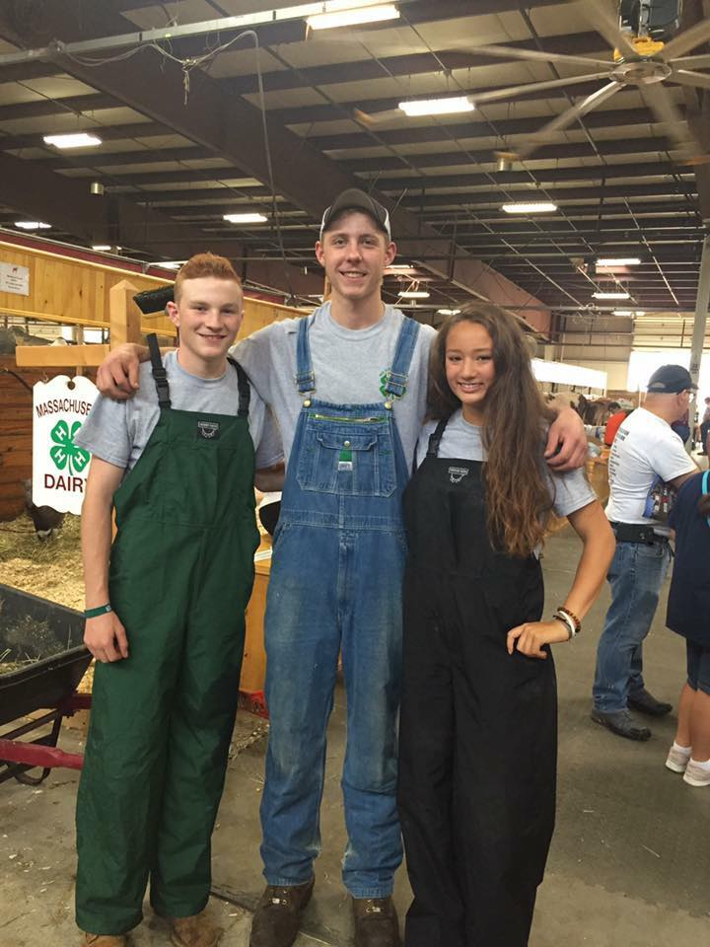
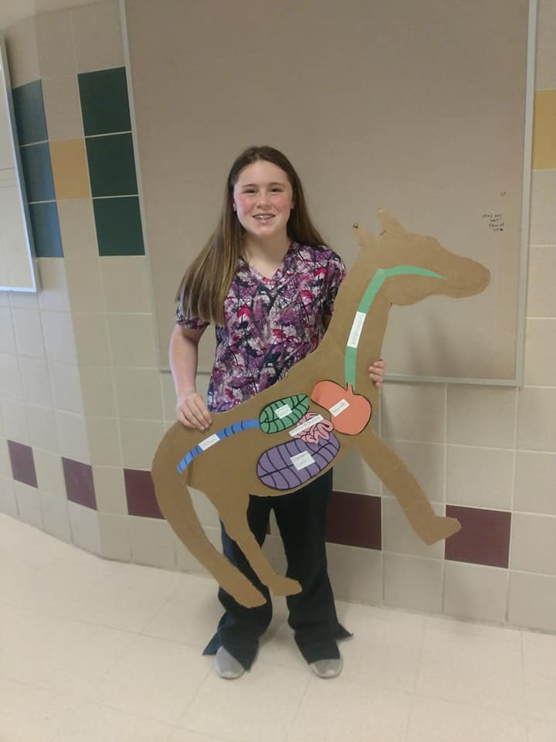
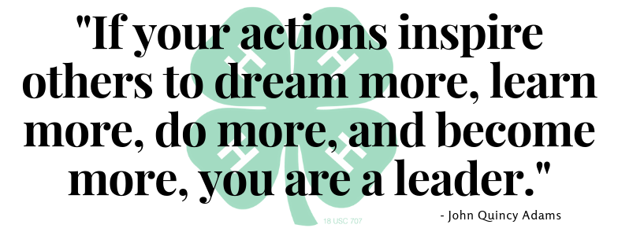
This is Plymouth County 4-H

Slide 6
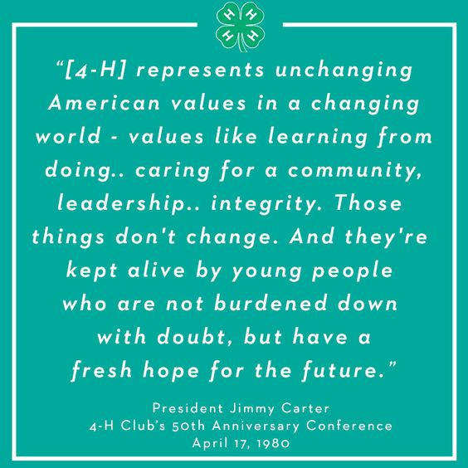
Benefits of the
4-H Program
4-H’ers are nearly 4 times more likely to make contributions to their communities.
4-H’ers are about 2 times more likely to be civically active.
Youth build life skills by leading hands-on projects in areas like science, health, agriculture and, civic engagement – helping them to grow confidence, independence, resilience, and compassion.
Adult mentors provide a positive environment where Youth learn by doing.

Slide 7

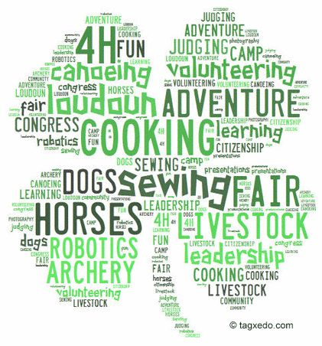
Benefits of the
4-H Program
Participation in 4-H helps youth develop a positive self image.
Youth have opportunities to take on leadership roles within the organization.
Youth have opportunities to gain new skills and knowledge
Youth work with adult mentors.
Youth have opportunities to “learn by doing”.
Youth learn Life skills that last a lifetime:
Public speaking
Record keeping
Citizenship
Community Service
Healthy lifestyle

Slide 8
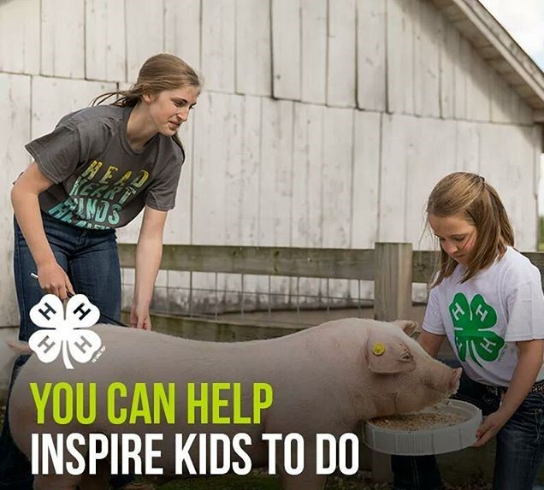

How 4-H can use 20 acres to Benefit the Community
A place to...
Promote youth education through practical hands on learning experiences outside the classroom.
Set an example for other community programs by showcasing an environmentally friendly model.
Keep our vibrant county active with activities and programs that link to array of topics.
Celebrate the rich history that our county has to offer.
Promote community engagement through volunteerism.

Slide 9
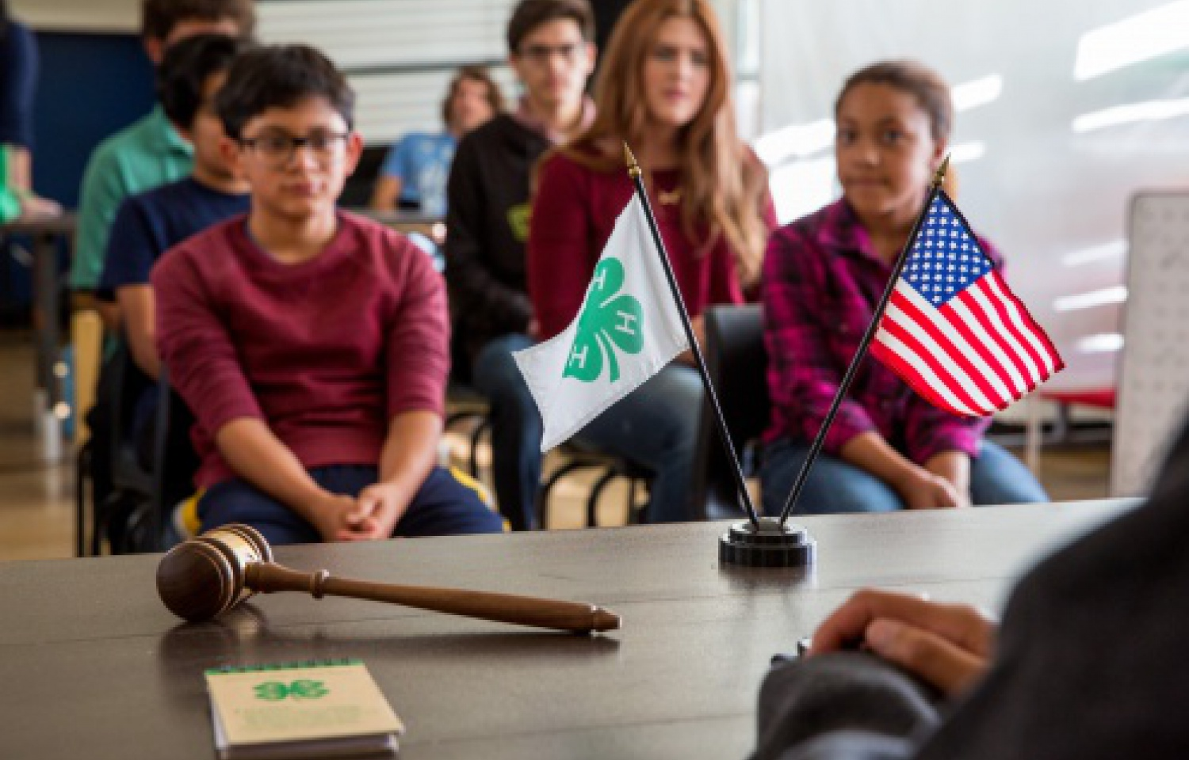
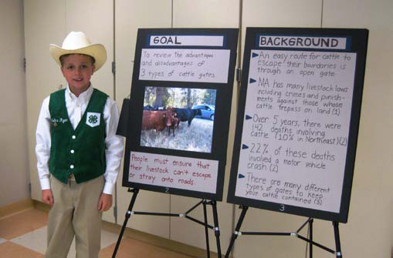
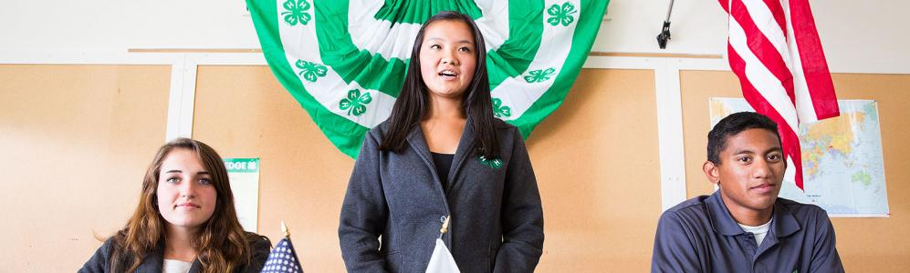
Why Plymouth County 4-H needs 20 acres
Plymouth County 4-H has no centralized meeting location.
Program space is becoming increasingly more difficult to obtain. Limiting the ablility to host programs.
With increased space and land we will be able to offer programs that create revenue.

Slide 10
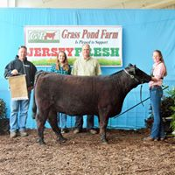

Why Plymouth County 4-H needs 20 acres (cont.)
Many 4-H'ers do not have direct exposure to agricultural operations/working farms.
Currently no designated property for year round use of livestock/animal exhibition rings.

Slide 11
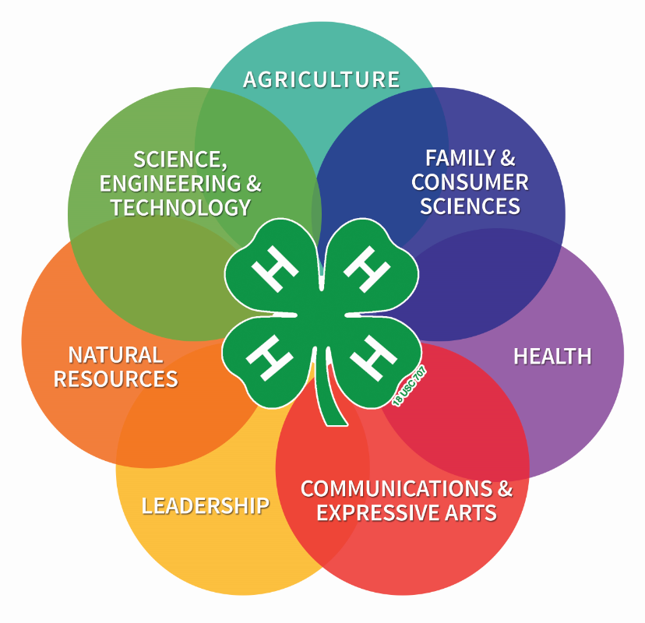
What will we do with 20 acres?
After multiple surveys and 4-H community outreach, many recommendations have been considered.
These ideas have been split up by the immediate needs and desires of the community.
Just some of the survey results
“In part, a working farm where 4-H clubs could volunteer to help care for crops and animals”
“Open space for nature walks”
“Educational programs – Farm to Table”
“Create more opportunities for kids to interact with animals, create a sustainable farm and enrich the community with the importance of ethical farming”

Slide 12
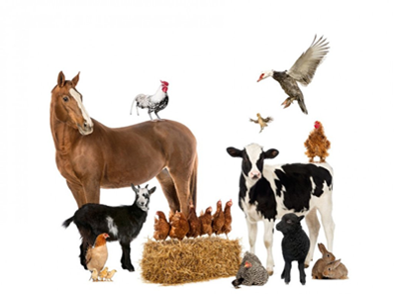
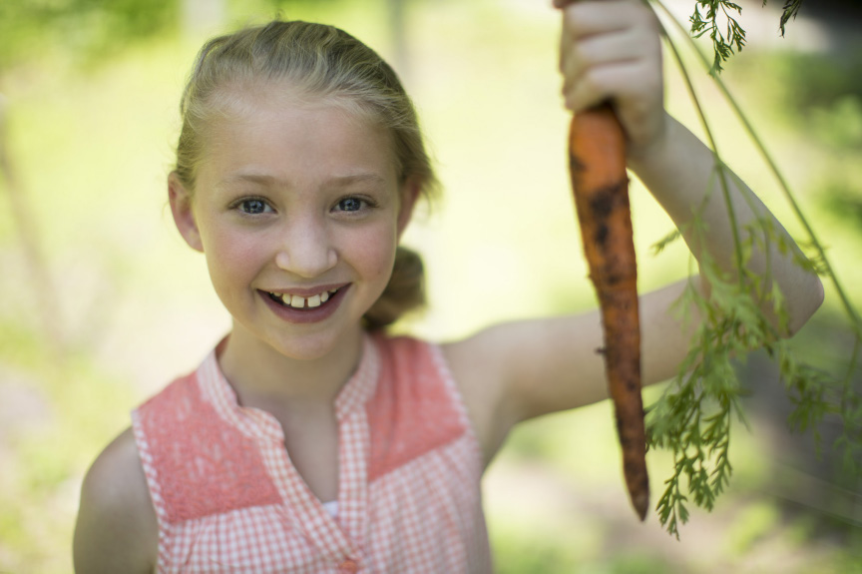
Year One
Most desired Ideas based on survey results
1. Meeting Space
4-H clubs and community
2. Show Space
4-H clubs and community
3. Gardening Space
4-H clubs and community

Slide 13
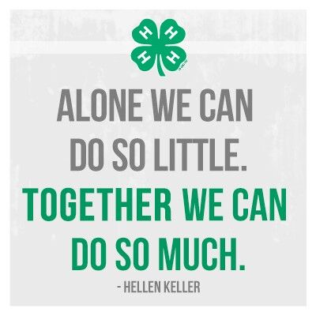
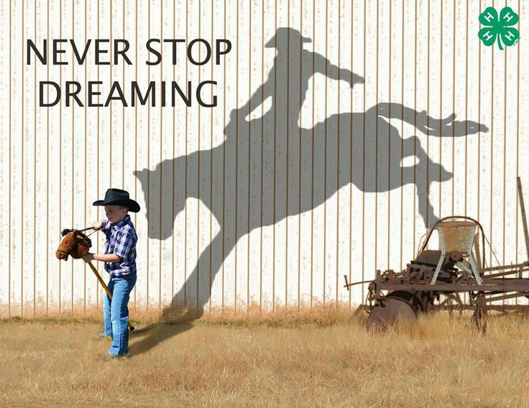
Year One
Immediate needs
1. Renovate
Existing building to include a kitchen, classroom space and offices
2. Repave Roadway
3. Run in sheds
  To offer field board (a source of revenue)

Slide 14
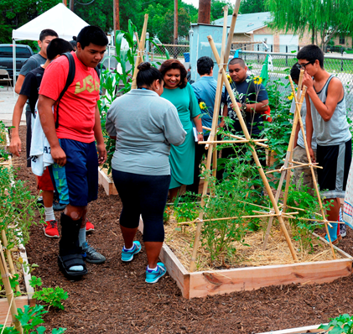
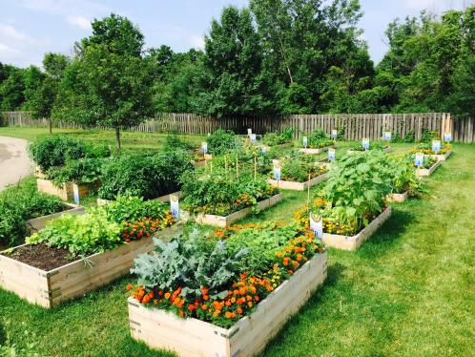

Year One
Immediate needs (Cont.)
4.Community Garden Raised beds
a. 4-H use
b. Community use (a source of revenue)
5.Display Garden

Slide 15

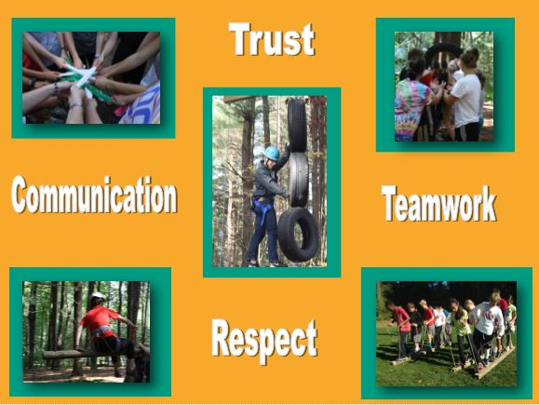
Year Three
Leadership Camp
Directed towards 4-H members and the community. Specifically At risk youth. (a source of revenue)

Slide 16
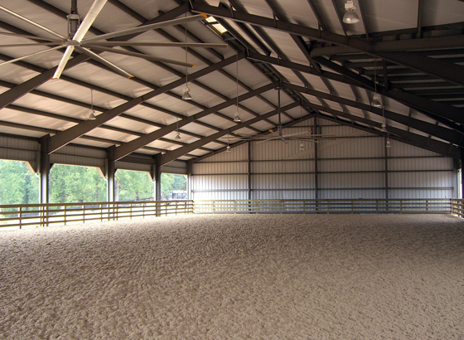


Year Four
1. Indoor Show Area
a. For 4-H club use
b. Host Animal Shows (a source of revenue)
  c. Community Use (a source of revenue)
2. Full time Horticulturist
  Implement a Master Gardener Program (a source of revenue)

Slide 17
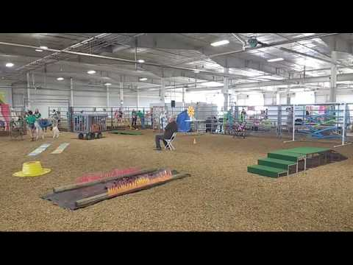
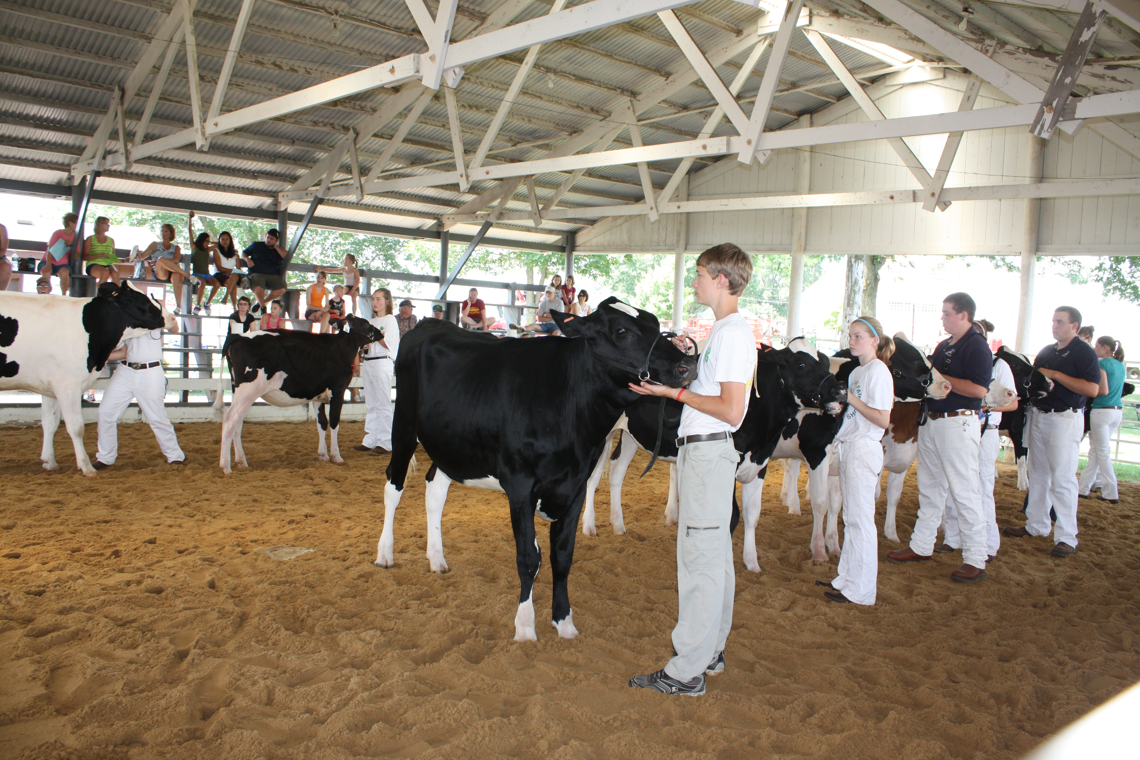
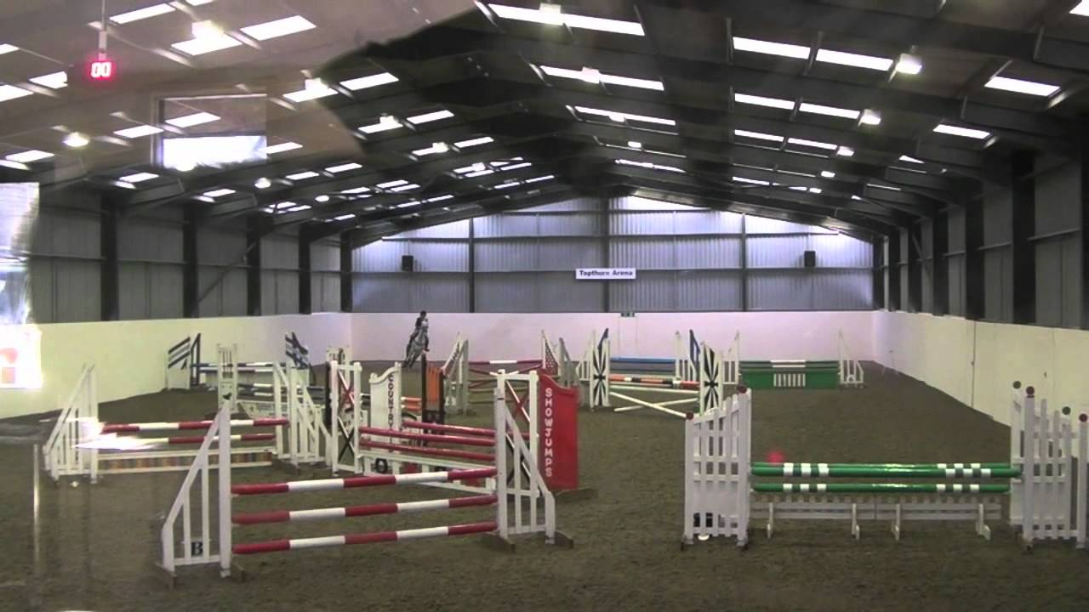
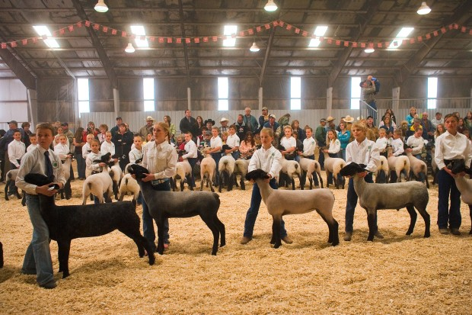
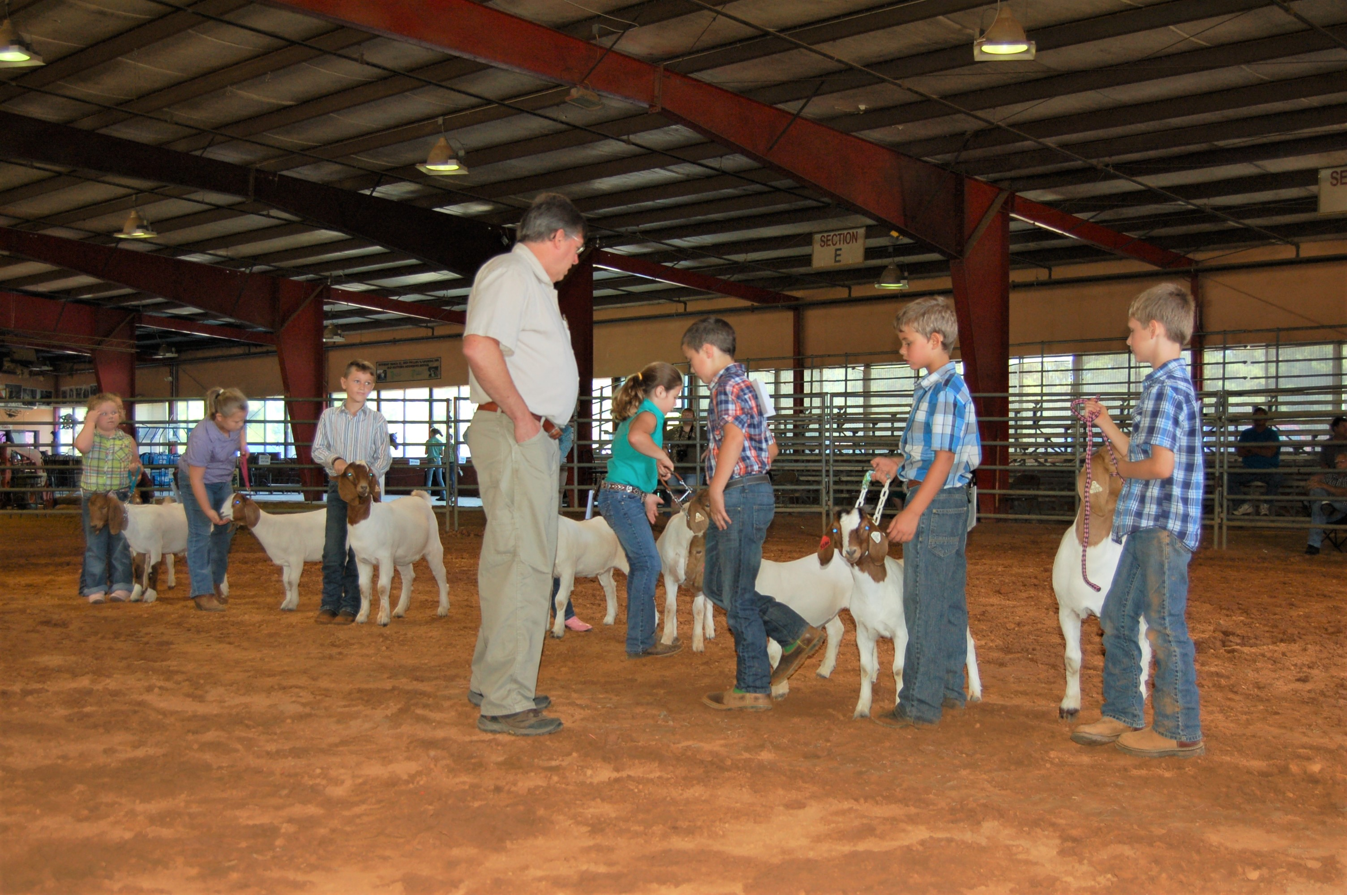

Examples of what we can do with an indoor arena.
Dog Agility Shows
Cow Shows
Sheep Shows
Goat Shows
Horse Shows

Slide 18

Year Five
Working boarding farm for horses/livestock
Machinery
Barns with stalls for horses
Cow barn

Slide 19
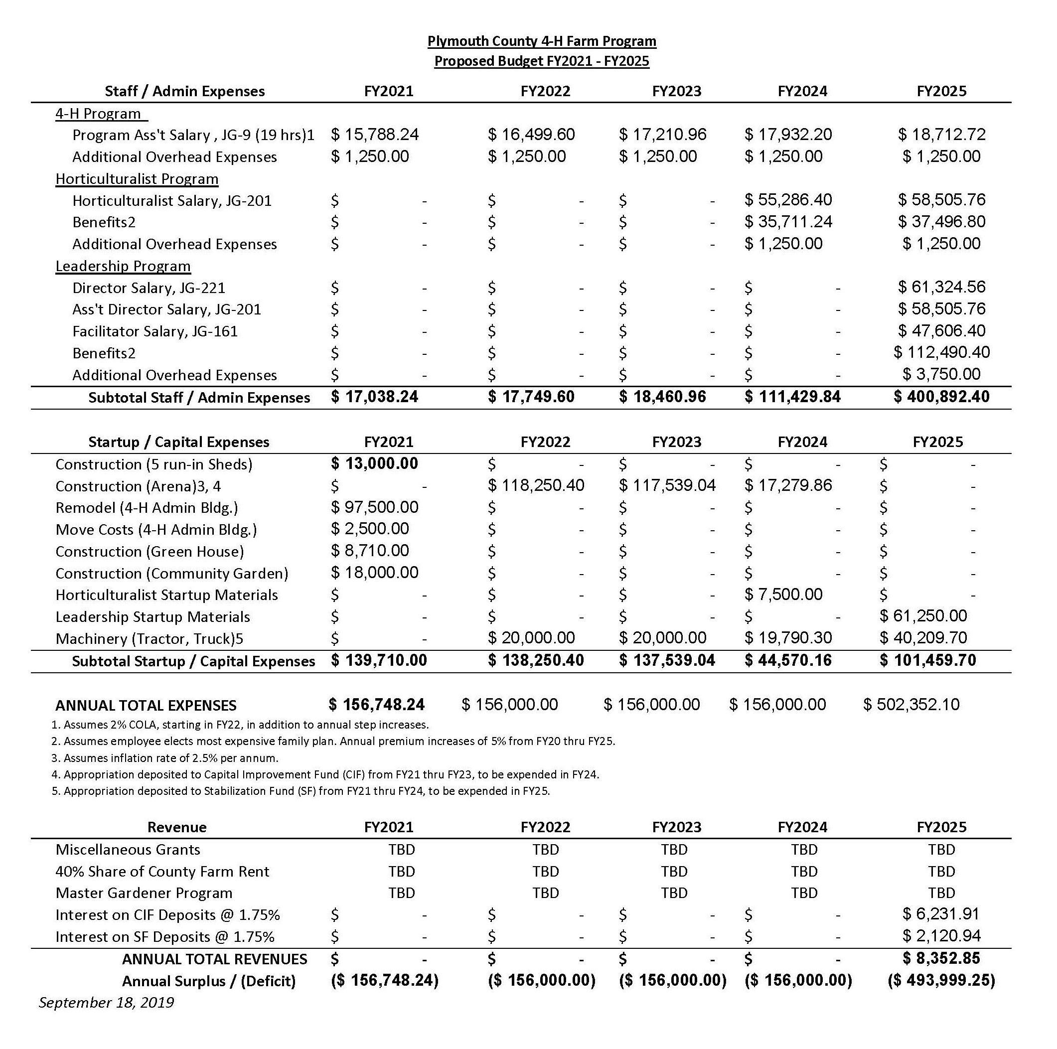
Plymouth County 4-H Farm
Proposed Budget
FY2021-FY2025

Slide 20
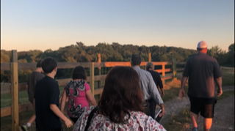
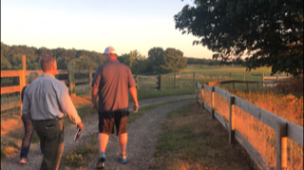
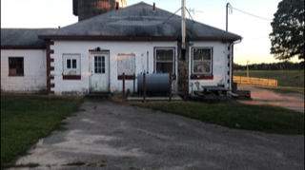
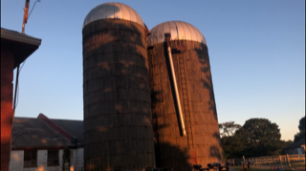
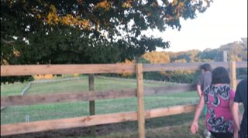
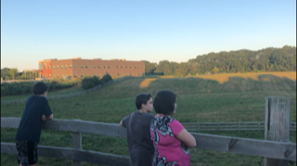
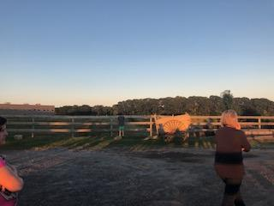
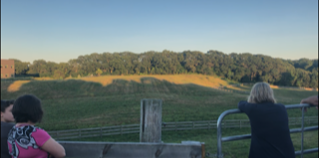
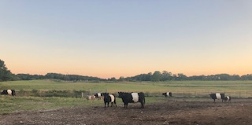

Slide 21


Thank you very much for listening!
Any Questions?

