Slide 1
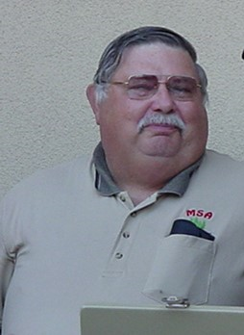
Lance Heide
July 24, 1947 - March 20, 2019

Slide 2
“Lance gave so much to so many in MSA”
“ Personally an awesome friend for over 30 years ”
“ His mentoring of our son ”

Slide 3
“ Lance was one of the corner stones of the MSA ”
“ Lance fighting executive board for decades ”
“ his unswerving dedication to Redwood Empire MSA ”
“ He was the Secretary / Treasure for as long as I can remember ”

Slide 4
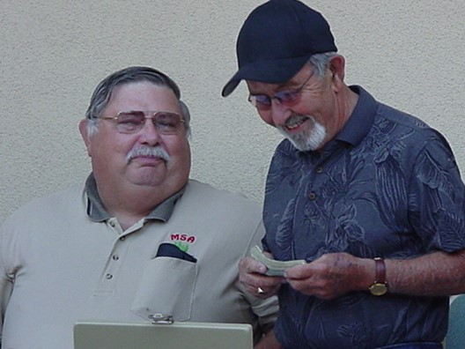
Lance and his dear friend Louis Ginocchio

Slide 5
“ He was always there to help with the Car Shows, Bar B Qs, all the training events, He was always there to help ”
“ Everyone enjoyed working with Lance ”
“ He will be missed ”

Slide 6
“ Lance's Dad was a member of the MSA ”
“ Lance was always a good pal to the ECA ”
“ dad was an engineer and Lance followed in his foot steps ”

Slide 7
“ Graduating from University of Nevada Reno ”
“ His dad was a founding Redwood Chapter member ”
“ Lance became a member while working for Napa County ”
“ Finally running the operation of the Napa County Silverado Trail maintenance yard for many years ”

Slide 8
“ Lance held every office in the Redwood Empire Chapter and was the secretary/treasurer for many many years ”
“ He served on the State (now) Executive MSA Board of Directors ”
“ He also held positions on the Engineer Society board ”
“ Lance was always the first to donate his time an effort for a good cause ”
“ Helping the ECA, MSA, or the Society of Engineers put on the many special events to raise money for a worthy cause ”

Slide 9
“ We know Lance help raise over $100,000 for scholarships and special projects for the MSA and ECA ”
“ The biggest was the Father's Day Show & Shine Car Show ”
“ Lance also loved the game of golf which can be very frustrating but the engineer in him would find a way for him to excel ”

Slide 10
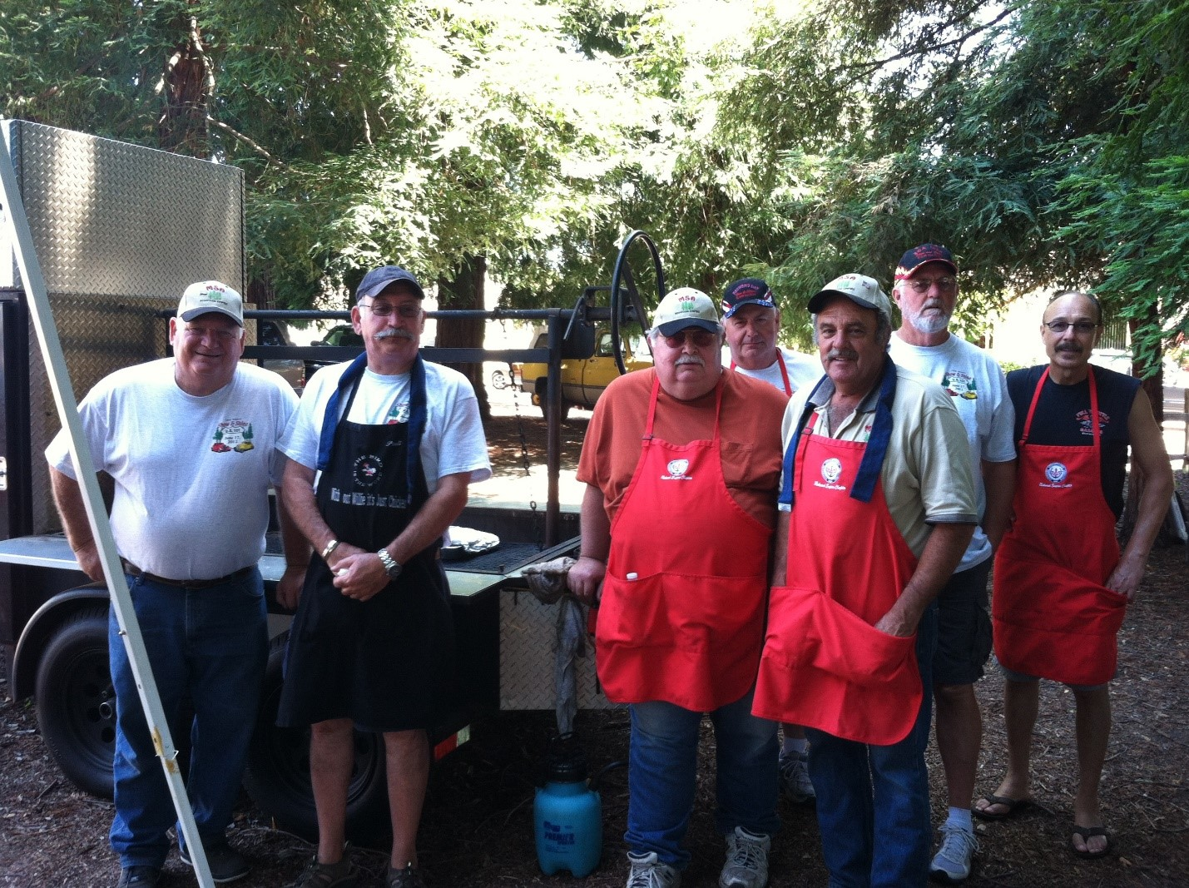

Slide 11
“ the go-to guy! ”

Slide 12
“ He is an indelible author of many words, while always in the background keeping us all grounded ”
“ He was a good man! ”
“ The Roadrunner"
“ He was always a gentleman ”
“ He was a constant Professional ”

Slide 13
“ I got to know Lance better through the MSA and realized how important the MSA was in keeping all the agencies informed, educated and most of all, built friendships ”
“ I value the friendships that were made ”
“ Lance was an integral part of the MSA and always made everyone feel welcome ”

Slide 14
“ Lance had a degree in Civil Engineering. Frank and I were always on Lance’s case about taking the PE, but he liked what he did and wanted to stay in the “field.”
“ Lance was a major force in agency n contractors breaking bread together ”
“ Lance was quite an individual that kept our MSA chapter together ”

Slide 15
the go-to guy!
He will be missed

