Slide 1
WELL BUBBLER
Compressed Air Well Level Sensor
And Pump Controller

Slide 2
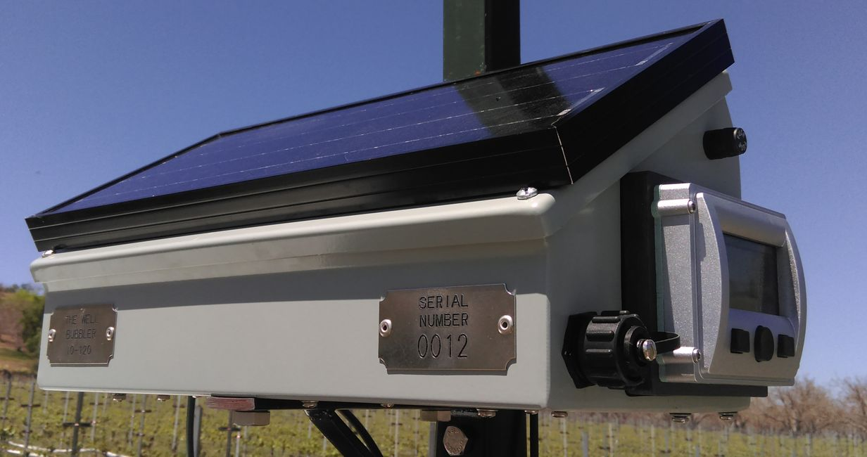
CONTENTS
How does it work?
FEATURES
OTHER SENSOR TYPES
SPECIFICATIONS
ACCESSORIES
CURRENT INSTALLATIONS
WHAT’S NEXT?

Slide 3
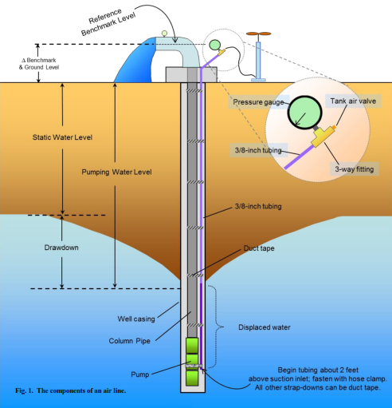
How Does It Work?
The Well Bubbler forces compressed air through a tube installed in the well to accurately measure the standing and pumping well levels - the same approach used by well drillers and pump installers.
The well level is automatically calculated from the length of the tube and the air pressure, and is shown on the display in feet.

Slide 4
FEATURES
SECURE data logger, free software - view well level history, flow rate & pressure
Built-in solar power - no wiring, assembly or AC power needed
LCD display - visible in bright sunlight, and at night
Relay output - stop the pump when level is low; 5A @ 480 VAC
Telemetry output - 4 to 20mA and 0 to 5Vdc
Use with pre-existing, 1/4" diameter air line
Immune to engine & electrical noise
Portable, Easily moved to measure & log multiple wells

Slide 5
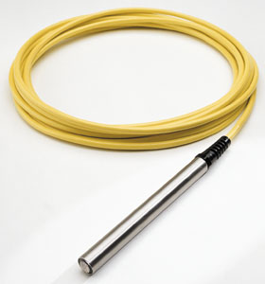
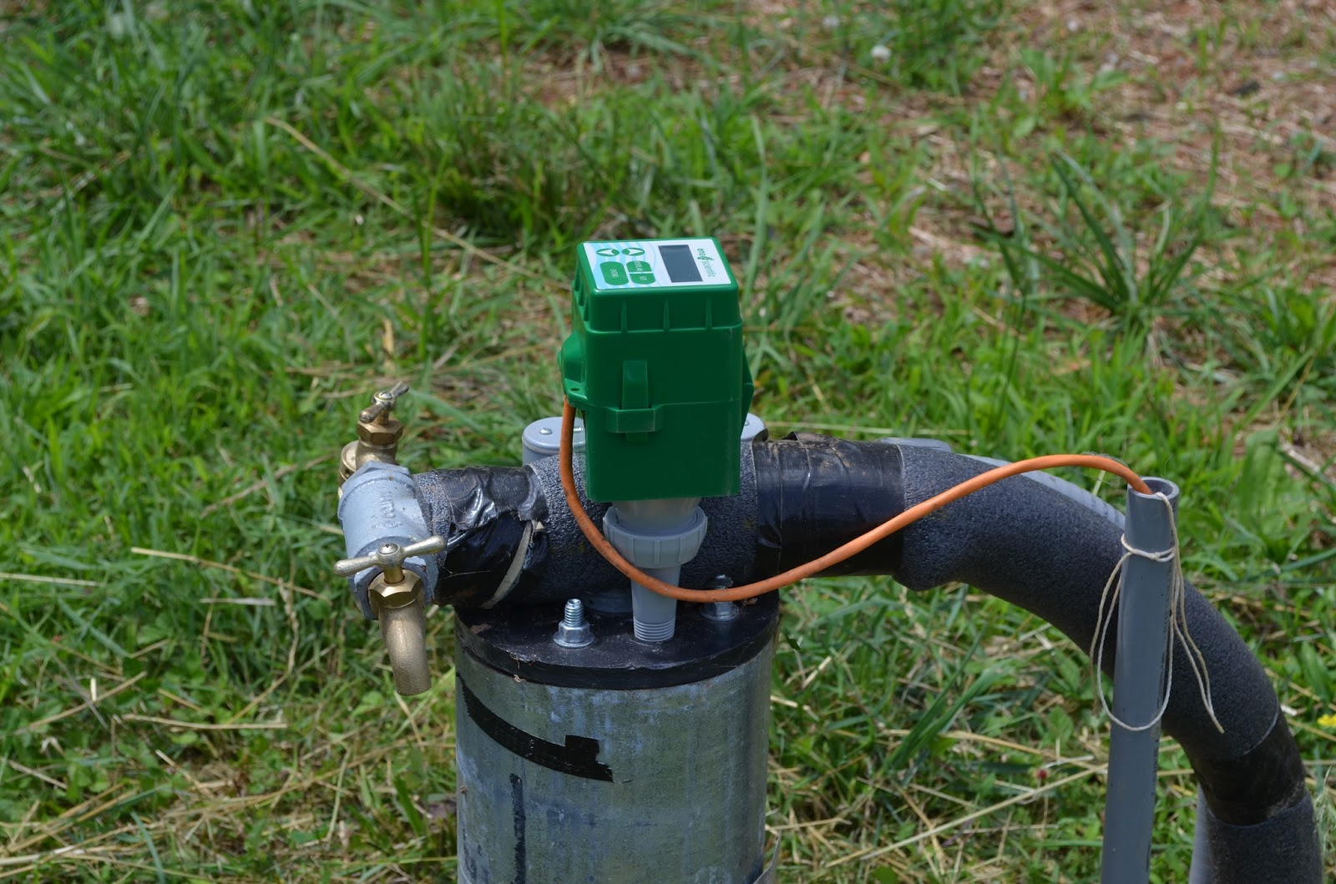
Other SENSOR types
Hydrostatic / pressure type
ACOUSTIC

Slide 6
Turbine pumps: oiler
LUBRICATION OIL DRIPS INTO WELL
COLLECTS ON TOP OF WATER, congeals
SENSOR HAS small HOLES TO Measure pressure
Sensor CLOGS with oil during installation
Bubbler tubing not affected by oil

Slide 7
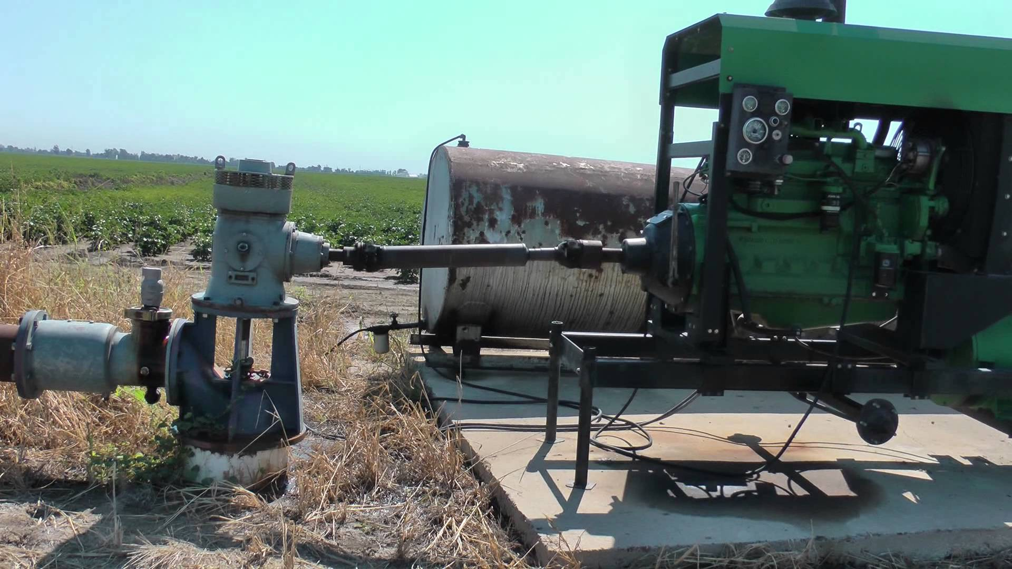
Turbine pumps: Engine noise, vibration
Engine-driven gear head
Severe Noise and vibration
Acoustic sensor accuracy affected
Bubbler mounted remotely
Bubbler not affected by noise

Slide 8
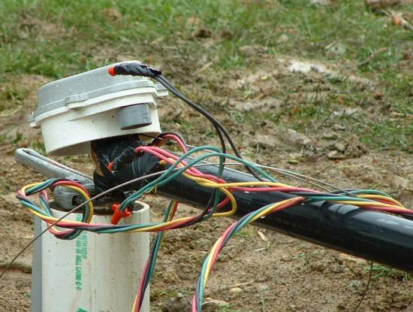
submersible pumps: motor wiring
Motor wiring taped to discharge pipe
Over time, wiring can come loose
Sensor wire becomes tangled
Sensor cannot be removed
Pump must be pulled to retrieve sensor
Bubbler tubing uses tear-away design

Slide 9
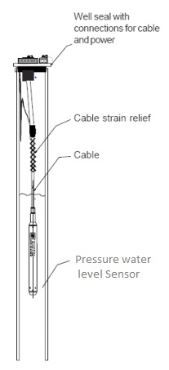
submersible pumps: vfd noise
VFD creates electrical noise
motor wiring is long
Sensor wire runs along motor wiring
Sensor picks up vfd electrical noise
pumping level cannot be measured
Bubbler air line immune to electrical noise

Slide 10
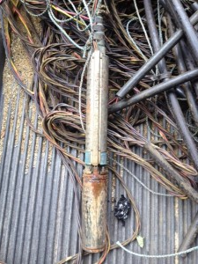
ALL pumps: ingestion
Pump set depth unknown
Sensor set too deep
Sensor and wire ingested by pump
Pump damaged
Bubbler uses plastic tubing

Slide 11
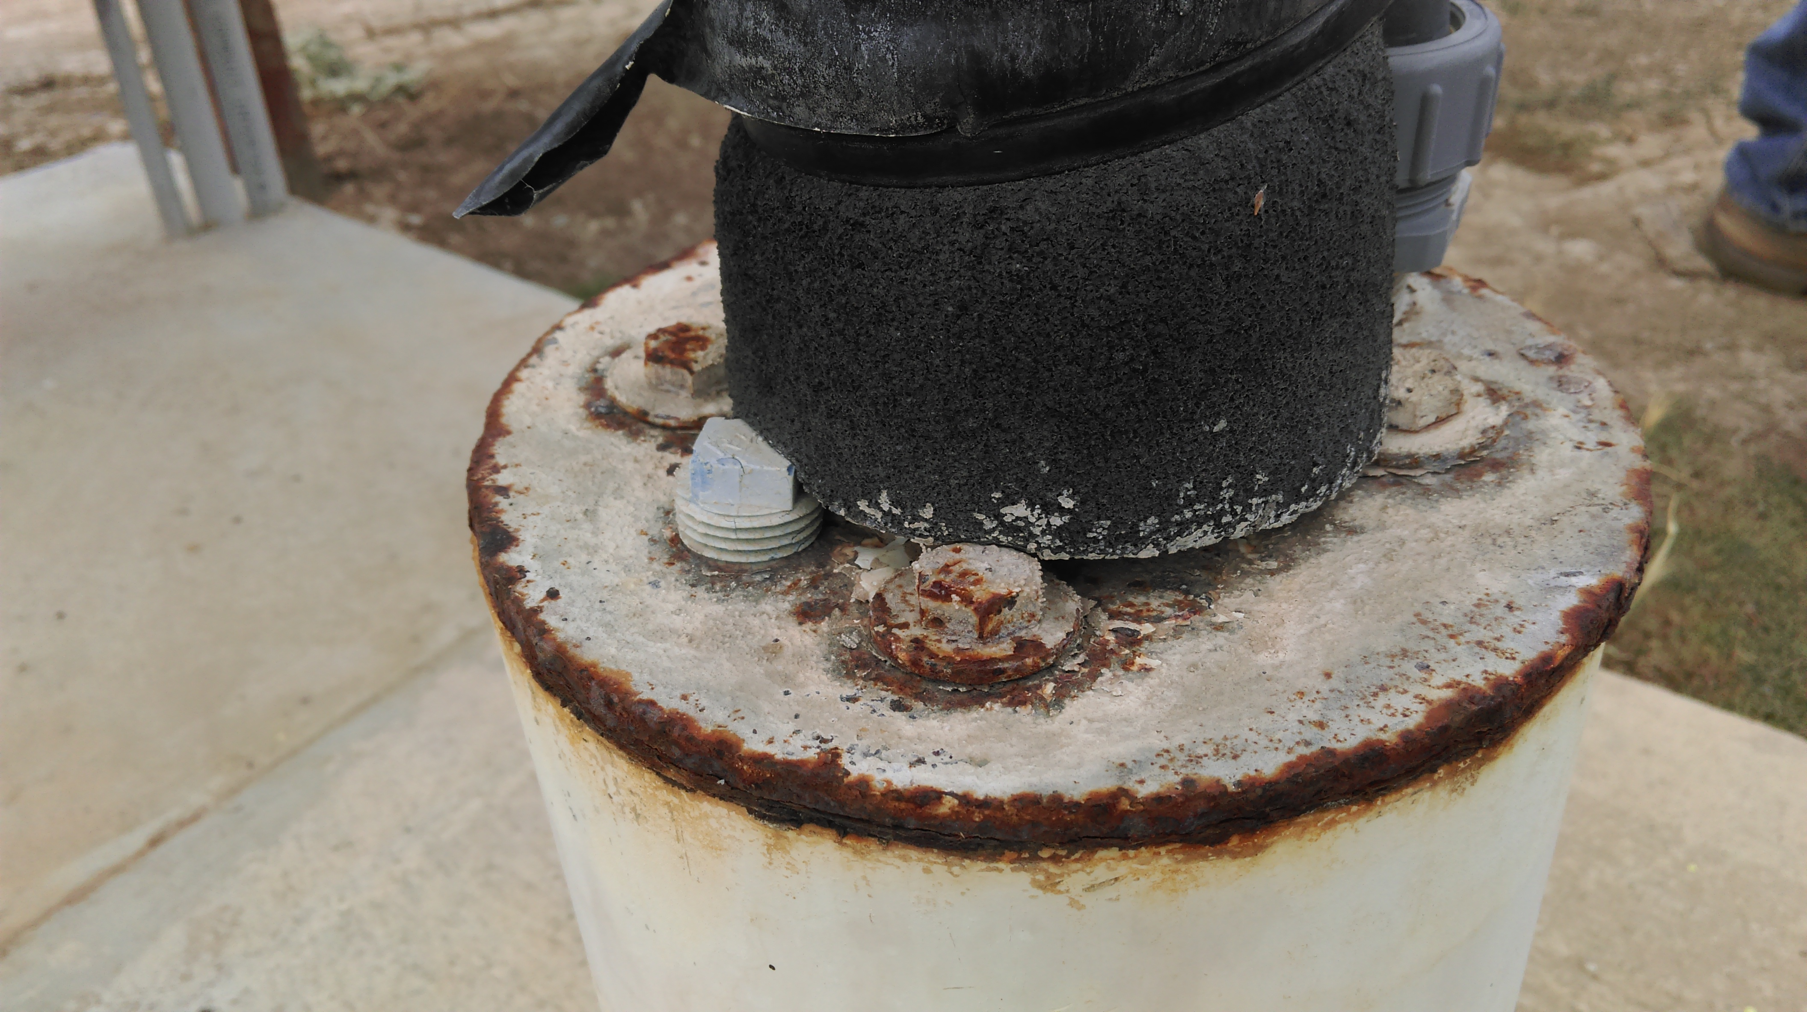
ALL PUMPS: Well cap access
Well cap has no access to casing
Existing ports obstructed
Existing ports too small for sensor body
Discharge piping in the way
Bubbler weight beads are 3/8 inch diameter
Bubbler tubing has ½ inch bend radius
air line already present

Slide 12
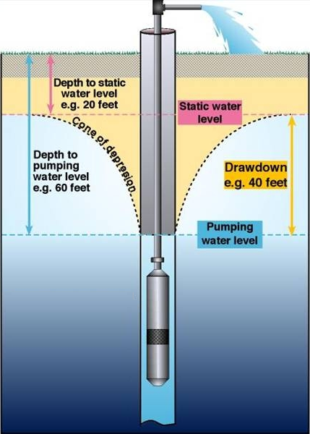
ALL PUMPS: splashing water
Water level falls during pumping
Well recharges through casing perforations
recharge water causes splashing & noise
Acoustic sensor inaccurate when pumping
Unable to measure pumping water level
Bubbler is not affected by splashing noise

Slide 13
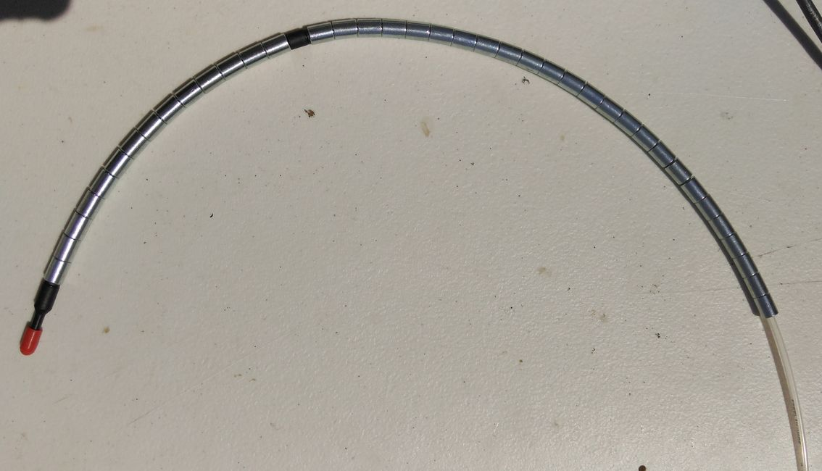
INSTALLING NEW AIR LINE
5/32” diameter
300 psi rating
½” bend radius
Up to 1000 ft rolls
3/8” soft metal “beads”
Tear-away design

