Slide 1
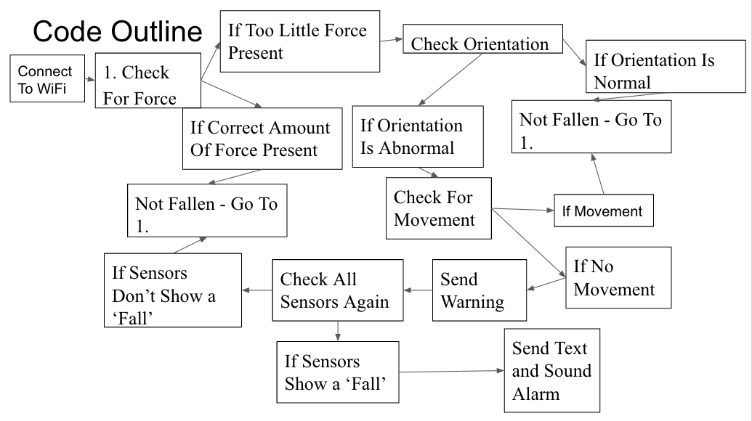
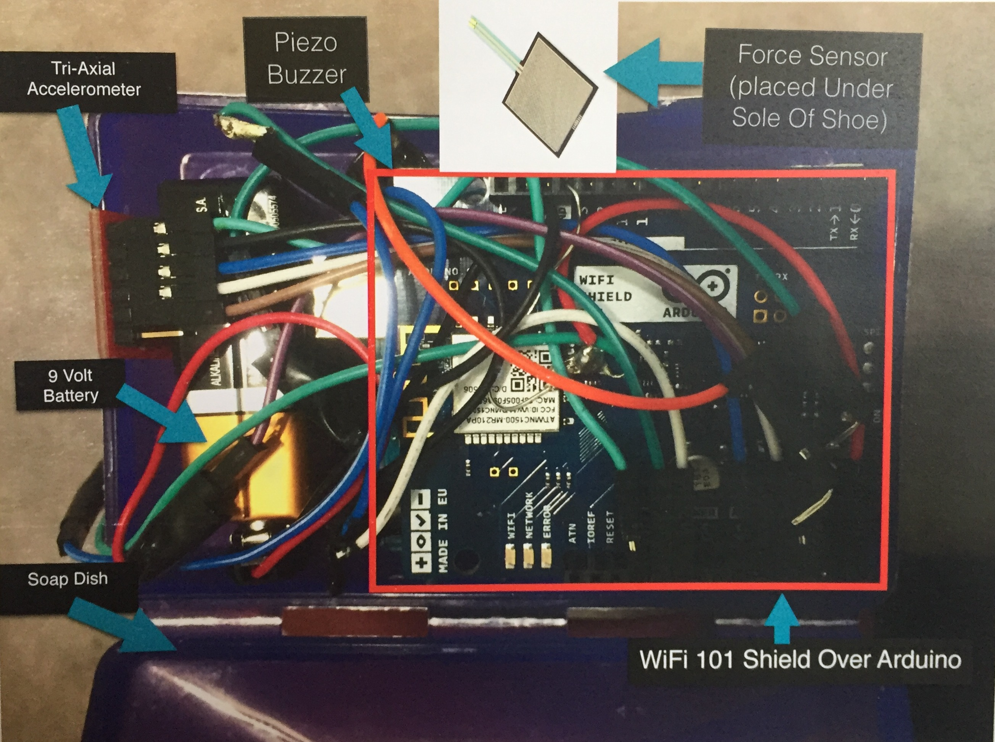
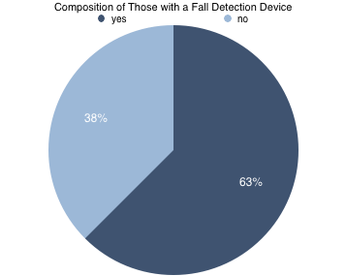
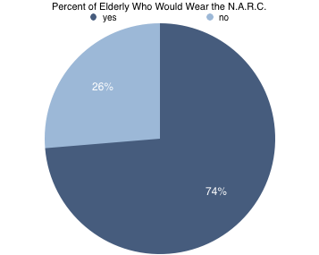
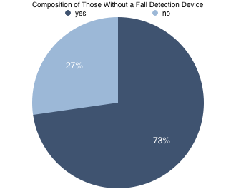
The Neo-sole Accelerometer-based Remote Communications (N.A.R.C.)
Fall Detection Device
Jake and Saurabh
OVERVIEW
PURPOSE
CONCLUSIONS
The purpose of this research is to design and build an in-shoe fall detection system, as well as test the market for demand. The first phase of the project involved learning the Arduino language and designing the hardware and software. The next phase was testing the shoe for accuracy using four types of falls (forward, backward, right and left) as well as false alarm tests during normal activities (sitting, standing, and walking). The final phase involved surveying the target audience: the elderly (of age 65 or older). Survey questions included gender, age, medical conditions, whether or not the participants own a fall-detection device, and if they are interested in the N.A.R.C. A total of 49 trials were completed. The device detects 97.5% of all falls, and is not prone to many false alarms, though it did show two false warnings while walking (in 45 minutes). 38 people completed surveys, 74% of those surveyed were interested in the shoe and would use the device. Additionally, 58% of those surveyed are not currently using any fall detection device. The shoe detected almost every fall, and thus needs little to no improvement of that aspect. The number of false alarms and warnings was also acceptably low. Additionally, 73% of those who are not currently using a fall detection device were willing to use the N.A.R.C. fall detection system, showing that the target audience wants the device.
Can shoes be used to detect falls and get help for elderly people and people at risk for falls? Are the elderly interested in such a device?
The 97.5% accuracy shows that the device truly works in all situations.
The survey results show that the target audience for the product is mostly (74%) interested in the device.
We also found that people without fall detection devices at the moment were more interested (73%) in our shoe than those with fall detection devices.
Low false alarm rate (0 per hour) shows device is not intrusive
HYPOTHESIS
A microcontroller based application can be used to make shoes that detect falls and send out a message to call for help. Elderly people are interested in a better fall detection device
SOURCES OF ERROR
Hardware breaks (resistors fail, solder breaks, battery dies, etc.)
Inconsistent falls, as they were not perfectly replicated each time (could prove the device’s ability even further as it more accurately reflects how people fall outside of scientific studies)
Only 20 surveys
Only four of the people surveyed were male
BACKGROUND
FUTURE STUDIES
According to the WHO, “Falls are the second leading cause of accidental or unintentional injury deaths worldwide¹”
With a quick medical response, a fallen patient can be saved compared to a slow medical response which raises the chance of mortality²
Other devices include a chest mounted gyroscope (Bourke et al.) and an accelerometer placed on the waist (Shan and Yuan)⁴
Customized printed circuit board
ESP Wifi chip
Implanted into the sole of the shoe
Code could be adjusted to turn the device on when it senses pressure, extending the battery life massively.
More complicated and accurate algorithms could be created to more efficiently and accurately detect falls.
RESULTS
Simulated Fall Detection Tests
MATERIALS
Fall type | Number of trials | Number detected | Accuracy
Forward | 20 | 18 | 90%
Backwards | 20 | 20 | 100%
Right | 20 | 20 | 100%
Left | 20 | 20 | 100%
Arduino Uno
Soap Dish
9 Volt Battery
Tri-Axial Accelerometer
Force Sensor
Piezo Buzzer
WiFi 101 Shield
OTHER DEVICES
False Alarm Tests
Life Alert-most popular device on the market. Does not actually detect falls, but rather is a communication device. Will not work on an unconscious user.
Great Call- A wearable lanyard which detects falls, but costs $40 a month, and is obtrusive/noticeable to both the user and observers
Guardian- detects falls, but only works in a specific range
Chest-mounted Gyroscope- is very accurate and detects falls, though is obtrusive to the user
Smartphone/watch ADL- an abundance of false alarms will be observed when using this device
METHODS
Daily Activity | Number of trials | Number of False Alarms | Number of Warnings
Sitting 15 Minutes | 3 | 0 | 0
Walking 15 Minutes | 3 | 0 | 0
Standing 15 Minutes | 3 | 0 | 2
Problem: Is there a better way to detect fall? Will the shoe work in detecting falls and calling for help?
Attend University of Pennsylvania ESE 11 labs to learn how to use Arduino software and hardware
Design software and hardware for the device
After the first prototype has been designed, use bench top tests to test the device. Put the shoe in 4 different positions (on either side, with the toe facing down, and with the toe facing up)
Collect data and adjust software or hardware to improve detection accuracy and false alarm rate
Repeat steps 4 and 5 until the device is at least 97% accurate and exhibits no false alarms
After a working prototype is produced, create a survey to collect data on whether or not the target audience (elderly) is interested in the product
After obtaining IRB approval, distribute the survey to elderly people. The survey should ask about age, sex, and whether or not participant uses a Fall Detection or Alerting device
After collecting data, organize it and make conclusions
Survey Results
REFERENCES
Number of People Surveyed | Number of People Who Already Have a Fall Detection Device | Number of People Who Want Our Device | Percent of People Who Want Our Device
38 | 16 | 26 -- Yes, 9 -- No, 3 -- Unsure | 68%
WHO. "Falls." World Health Organization. World Health Organization, Sept. 2016. Web. 20 Oct. 2016.
Casilari, Eduardo, Jimenez Oviedo, and Miguel A. "Automatic Fall Detection System Based on the Combined Use of a Smartphone and a Smartwatch." Ebsco Host. Plos One, 11 Nov. 2015. Web. 22 Sept. 2016. <Automatic Fall Detection System Based on the Combined Use of a Smartphone and a Smartwatch.>.
HealthinAging.org. "Aging & Health A to Z." Causes & Symptoms Falls Prevention Aging & Health A To Z Health in Aging. Health in Aging.org, Mar. 2012. Web. 20 Oct. 2016.
Hu, Xinyao, and Xingda Qu. "Pre-impact Fall Detection." Ebsco Host. Biomedical Engineering Online Journal, 2016. Web. 19 Sept. 2016.
Pappas, Stephanie. "Best Medical Alert Systems 2016: Top 3 Picks." Live Science. Livescience.com, 22 Sept. 2016. Web. 20 Oct. 2016.
n=16
n=38
n=22

