Slide 1
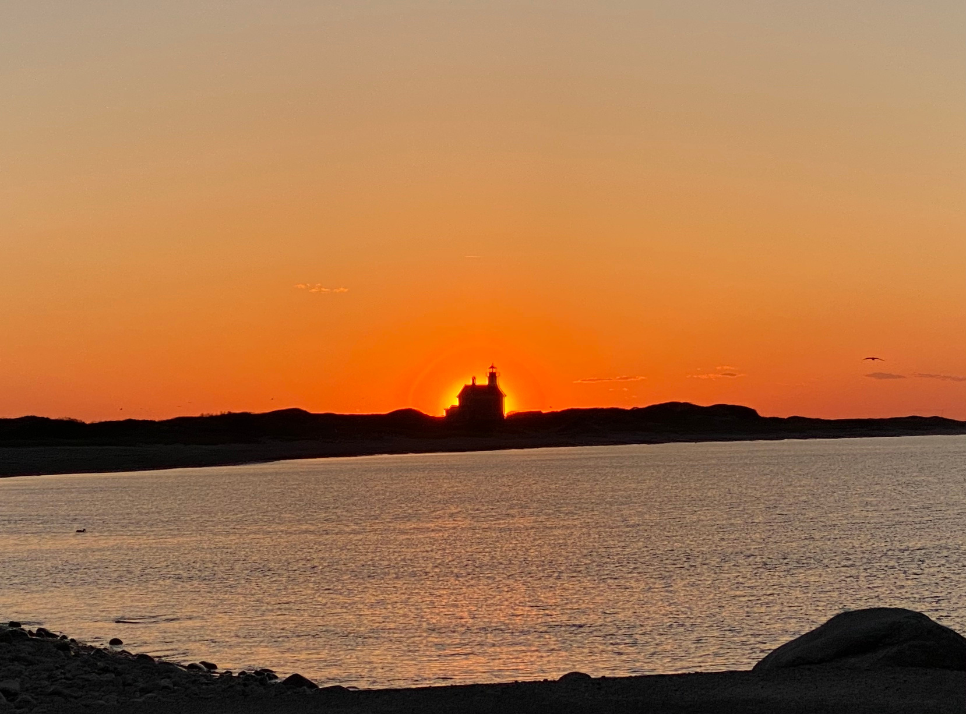
WEEKEND OF HOPE
A WATERFRONT CHARITY RETREAT
WHERE LUXURY MEETS PURPOSE
OCTOBER 1–3, 2027
CHAMPLIN'S MARINA & RESORT

Slide 2

WHY I FOUNDED THIS
It began with a phone call.
While working as a dockhand at Champlin’s Marina on Block Island, my mother FaceTimed me to tell me she had been diagnosed with breast cancer. In that moment, life changed for our family.
As we navigated her journey, I came to realize that the waterfront offered something invaluable—a place to reconnect, find peace, and simply enjoy time together despite life’s challenges.
Anchoring Hope Foundation was born from that experience. Our mission is to bring people together through extraordinary waterfront experiences that inspire generosity, support families affected by cancer, and create hope that lasts far beyond a single weekend.
KYLE SOUSA, FOUNDER

Slide 3
WHY ANCHORING HOPE IS UNIQUELY POSITIONED
Great organizations are built by people who understand the communities they serve.
Founder Kyle Sousa has spent more than a decade earning the trust of New England's waterfront community. Combined with a deeply personal mission inspired by his family's experience with breast cancer, these relationships provide the foundation for an organization unlike any other.
Anchoring Hope is uniquely positioned to unite the waterfront community with healthcare organizations, philanthropic leaders, and mission-driven businesses through extraordinary experiences that inspire generosity, build lasting relationships, and create meaningful impact.
More than a fundraising event, Anchoring Hope is building a community where people come together around a shared purpose—to create hope for families affected by cancer.
Anchoring Hope is built on authentic relationships, guided by purpose, and inspired by the belief that the waterfront has the power to bring people together to create lasting hope.

Slide 4

OUR MISSION
To inspire generosity by creating extraordinary waterfront experiences that advance cancer research, support patients and families, and strengthen coastal communities.
ANCHORED IN COMPASSION.

Slide 5
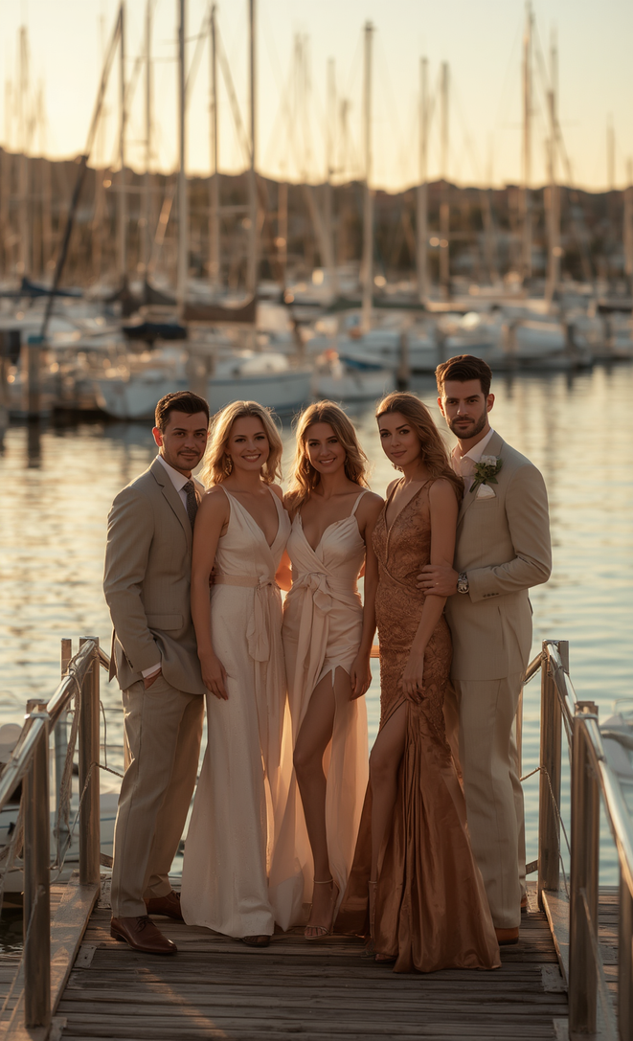
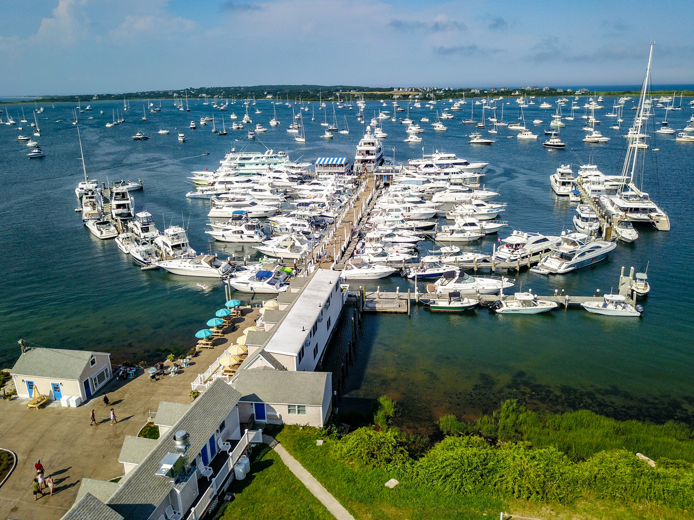
WHY WE'RE
DIFFERENT
A RETREAT UNLIKE ANY OTHER
A three-day destination retreat designed to create deeper relationships, lasting memories, and meaningful charitable impact.

Slide 6
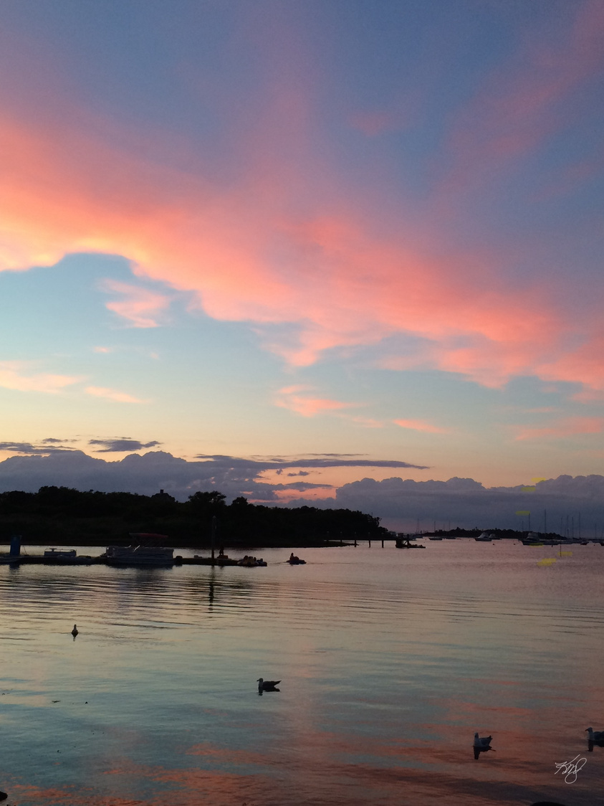
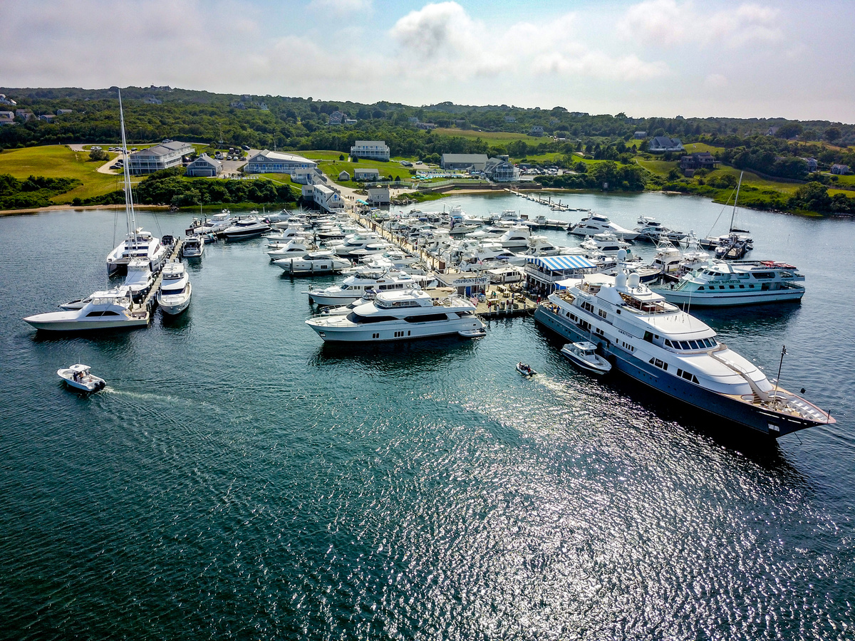
CHAMPLIN'S
MARINA &
RESORT
BLOCK ISLAND'S PREMIER
WATERFRONT VENUE
200 guests | 44 waterfront rooms | 1,000+ ft of marina dockage
Three-day destination retreat | Exclusive waterfront venue

Slide 7




OUR
IMPACT
Every dollar raised advances cancer research, funds patient assistance programs, and provides families with the support, transportation, and wellness care they need most.

Slide 8
OUR AUDIENCE
Who will your brand reach?
An intentionally curated audience where philanthropy, business, and coastal lifestyle converge.
An invitation-only audience of approximately 200 business leaders, philanthropists, waterfront executives, healthcare leaders, and community influencers.
The Northeast's Premier
Waterfront Charity Retreat

Slide 9
WHY BLOCK ISLAND
New England's premier boating destination
250,000+ annual visitors
Iconic East Coast yachting community
Destination experience — guests stay all weekend
No competing events
Creates deeper sponsor engagement
Champlin's Marina & Resort — waterfront venue
250K+
Annual visitors to
Block Island
The destination itself becomes part of the sponsorship experience.

Slide 10
IMPACT ALLOCATION
Every partnership helps fund research, provides transportation to treatment, offers emergency financial assistance, and creates moments of hope for families facing cancer.
40%
30%
20%
10%
Cancer
Research
Patient
Assistance
Transportation
& Lodging
Foundation
Operations
Transparency builds trust. Anchoring Hope Foundation will publish an annual impact report detailing funds raised, grant distributions, and measurable community outcomes.
Potential Impact of Every $100,000 Raised
Advance cancer research through strategic grant funding
• Provide 150–250 nights of lodging for patients and caregivers
• Fund 300–500 transportation services for medical treatment
• Award 50–100 emergency assistance grants to families in need
• Expand access to wellness and recovery programs
Illustrative examples. Actual impact will depend on funding priorities and nonprofit partners.

Slide 11
WHY BECOME A FOUNDING PARTNER?
You're Not Sponsoring an Event.
You're Helping Build a Legacy.
Every enduring institution begins with a small group of visionaries who believe in something before everyone else.
Anchoring Hope Foundation is creating more than a weekend fundraiser.
Our vision is to build New England’s premier waterfront charitable tradition.
As a Founding Partner, your organization becomes part of the story from the very beginning.
Together, we are creating:
• The Northeast's premier waterfront charity retreat
• An exclusive community where business leaders, philanthropists, and industry professionals build meaningful relationships
• A platform that inspires generosity through extraordinary waterfront experiences
• A lasting legacy that will support families affected by cancer for generations to come
WHY LEADING ORGANIZATIONS CHOOSE ANCHORING HOPE
Exceptional organizations deserve more than logo placement.
They deserve to be recognized for helping build something meaningful.
As a Founding Partner, your organization becomes synonymous with:
✓ Leadership
✓ Purpose
✓ Community
✓ Hospitality
✓ Innovation
✓ Long-Term Impact
This is not simply a sponsorship.
It is an opportunity to help shape one of New England's most distinctive philanthropic experiences while aligning your brand with a mission that inspires generosity, meaningful relationships, and lasting community impact.
WHY FOUNDING MATTERS
Founding Partners receive more than sponsorship recognition.
They receive permanent recognition as the organizations that helped establish Anchoring Hope Foundation.
As the foundation grows, your organization will forever be recognized as one of the leaders that believed in the mission from day one.
Legacy cannot be purchased later. It can only be earned at the beginning.

Slide 12
FOUNDING PARTNERSHIP OPPORTUNITIES
PLATINUM (ONE AVAILABLE)
$100,000
GOLD (TWO AVAILABLE)
$50,000
SILVER
$25,000
Naming recognition at Weekend of Hope
✓
✓
✓
VIP table at Anchoring Hope Gala
✓
✓
✓
Logo on all event materials & website
✓
✓
✓
Social media recognition
✓
✓
✓
Exclusive networking reception access
✓
✓
—
Speaking opportunity at Gala
✓
✓
—
Year-round brand visibility
✓
—
—
Board advisory invitation
✓
—
—
ADDITIONAL PARTNERSHIP LEVELS
Beacon of Hope | $10,000
Event recognition, VIP seating, logo on select materials
Family of Hope | $5,000
Event recognition, preferred seating, website listing
Friend of Hope | $2,500
Event recognition and website listing

Slide 13
FIVE-YEAR VISION
Building a Lasting Legacy
2027
Launch Weekend of Hope
2028
Expand to 500 guests and increase patient assistance
2029
Surpass $1 million raised annually
2030
Launch the Anchoring Hope Patient Assistance Fund
2031
Established as New England’s most respected waterfront philanthropic tradition.

Slide 14
BECOME A FOUNDING PARTNER
Join fifteen visionary organizations committed to building New England’s premier waterfront philanthropic tradition
FOUNDING PARTNER BENEFITS
Permanent recognition on the Founders Wall at every future event
Annual VIP access for the life of the organization
Exclusive Founding Partner designation — limited to fifteen
Legacy status in all publications and annual reports
Private dinner with the board and keynote honorees
Together, we’ll build more than a weekend.
We’ll build a legacy of hope.

