Slide 1
FOR THE DEFENSE CYRIL WECHT, M.D., J.D. VS. FOR THE PROSECUTION MANUEL MONTEZ, M.D.
WHO ARE DR. WECHT AND DR. MONTEZ?
WHAT ARE THEIR QUALIFICATIONS AS FORENSIC PATHOLOGISTS?

Slide 2
DR. MANUEL MONTEZ IS NOT BOARD CERTIFIED

Slide 3
DR. MANUEL MONTEZ IS NOT BOARD CERTIFIED AND LIED ABOUT TAKING THE TEST.
While testifying at Melissa Calusinski's trial in November 2011, Dr. Manuel Montez, who consulted on the boy's autopsy, said he was not certified by the American Board of Pathology because "I have not sat before the board for the test.“
But according to records obtained through a subpoena, which was read in court in March 2012, Montez took but did not pass an anatomic pathology certification exam in 2001. He did not take an exam dealing with the subspecialty of forensic pathology. Passing the anatomic pathology exam is a prerequisite to receive certification in forensic pathology, according to board rules.

Slide 4
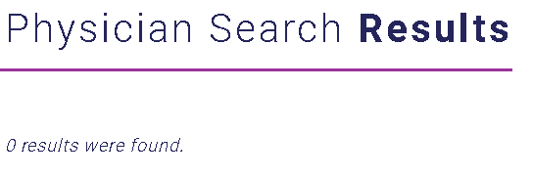
DR. MANUEL MONTEZ IS NOT BOARD CERTIFIED
NO RESULTS FOUND

Slide 5
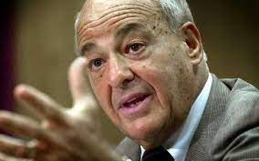
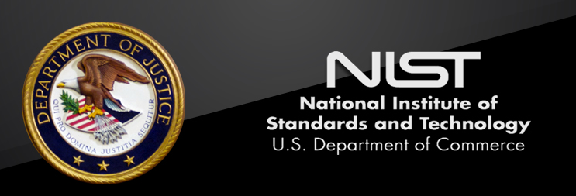
CYRIL WECHT, M.D., J.D. BOARD-CERTIFIED FORENSIC PATHOLOGIST
As of March 2020, there were just over one million professionally active physicians in the United States.
There are approximately 500 full-time, board-certified forensic pathologists in the U.S., according to the National Commission on Forensic Science.

Slide 6
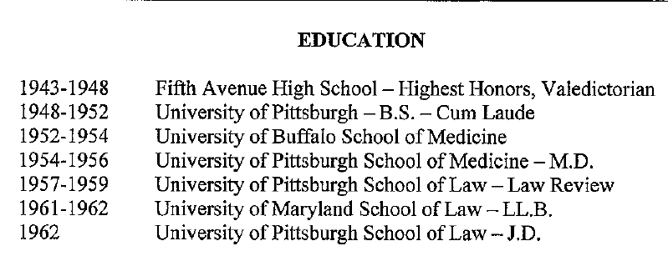
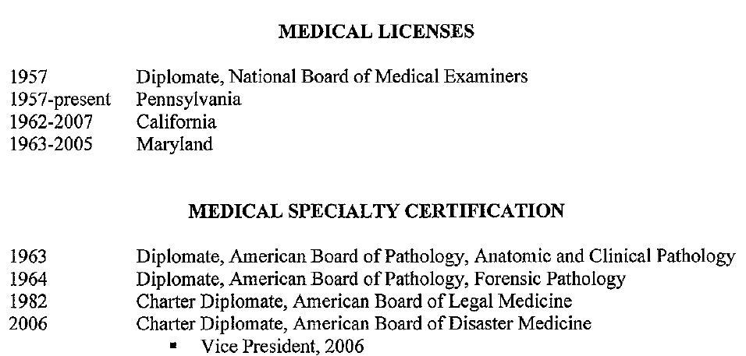
DR. WECHT’S EDUCATION
MEDICAL & LAW LICENSES

Slide 7
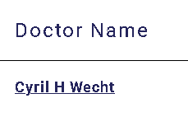
DR. WECHT IS BOARD CERTIFIED IN ANATOMIC PATHOLOGY & CLINICAL PATHOLOGY AND FORENSIC PATHOLOGY

Slide 8
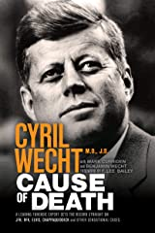
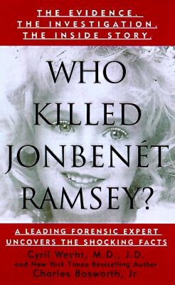
A SNAPSHOT OF DR. WECHT’S EXPERIENCE
AUTOPSIES
Has performed more than 21,000 autopsies
Has participated or reviewed 42,000 autopsies
WRITING CAREER
Has 640 published articles
Has authored or co authored 640 articles
Has authored or coauthored 48 books
Has been involved in researching commenting and writing about the deaths of:
President John F. Kennedy
Senator Robert Kennedy
Reverend Martin Luther King
Jon Benet Ramsey
O.J. Simpson
Phil Spector

Slide 9
PROFESSIONAL CONSULTANT POSITIONS
Consultant Los Angeles County Medical Examiner
1967- Robert Kennedy Assassination
1969- Sharon Tate/LaBianca murder-Charles Manson
1974- Symbionese Liberation Army Deaths (Patty Hearts case)
ABC- “20/20”
1975- Expert on segment re John F. Kennedy assassination
1979- Expert on segment re Elvis Presley death
‘‘JFK”
1991-Technical Advisor to Oliver Stone on the movie “JFK.”
NBC News and ABC News
1996 Consultant/commentator on O.J. Simpson trial

Slide 10
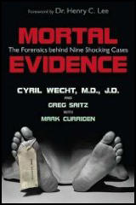
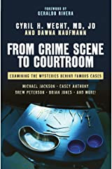
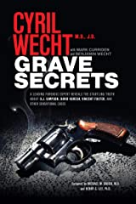
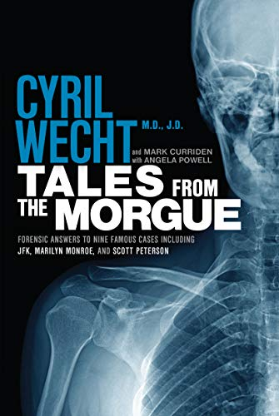
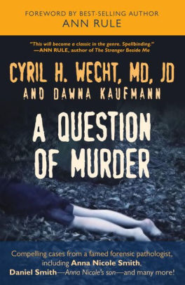
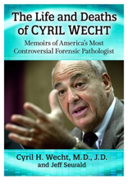
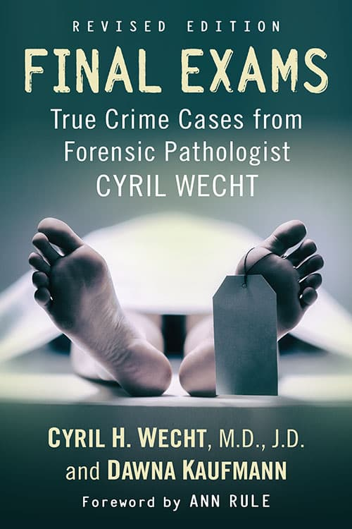
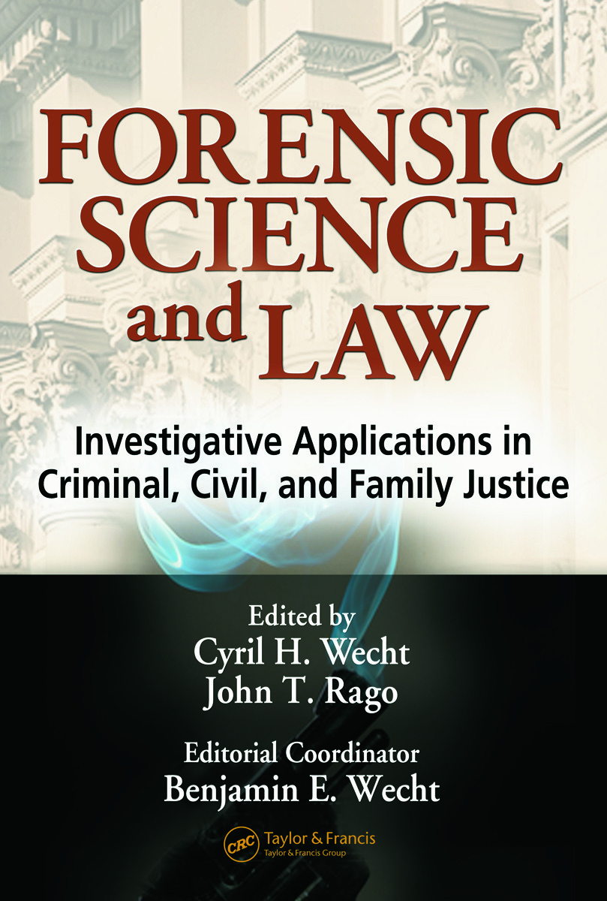
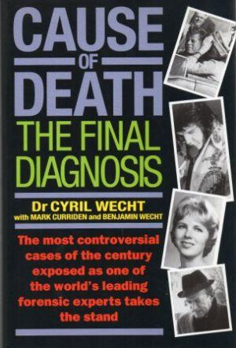

Slide 11
DR. WECHT HAS PRESENTED BEFORE THE NATIONAL ASSOCIATION OF MEDICAL EXAMINERS
Unraveling a Triple Homicide Dismemberment Jennifer L. Hammers, DO, Cyril H. Wecht & Pathology Associates, Pittsburgh, Pennsylvania, United States of America
NAME is the premier professional organization for medical examiners, forensic pathologists, and medicolegal affiliates and administrators.

