Slide 1




Kennesaw State University
BETA ALPHA PSI
Iota Tau Chapter
Visit Our Website
ksubap.com

Slide 2



BAP Financial Literacy Workshop
Today’s Meeting Agenda:
Upcoming Events
Important Reminders
Presentations and Q&A
Moore Colson and Henssler
Overview: Representatives will present on essential financial literacy topics to help students build money management skills.

Slide 3
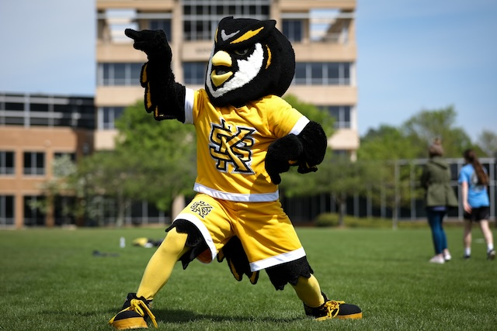



Upcoming Events
MAcc/CPA Info Session
Date: Thursday, September 18th
Time: 12:00 PM - 1:00 PM
Location: Virtual
MAcc/CPA Info Session
Date: Tuesday, September 23rd
Time: 2:00 PM - 3:00 PM
Location: Kennesaw Campus Burruss 269
President’s Award of Distinction
Applications now open for Fall 2025
Requirements: Essay, recommendation letters, resume (academic, research, leadership, etc.)
Deadline: Friday , September 26th @ 8:00 PM
Upcoming Events

Slide 4


HLB
Date: Wednesday, September 17th
Time: 4:00 PM - 6:00 PM
Location: Horned Owl
Two-Year Bridge Symposium
Date: Friday, November 14th
Time: All Day (Panel commitment required)
Location: Deloitte, EY, KPMG, and PwC offices nationwide
Upcoming Events
Firm Socials and Other Opportunities
Upcoming Events

Slide 5

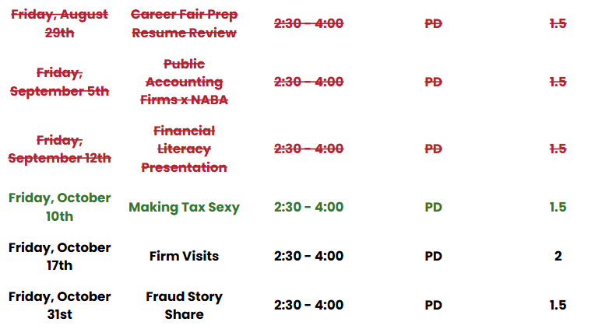
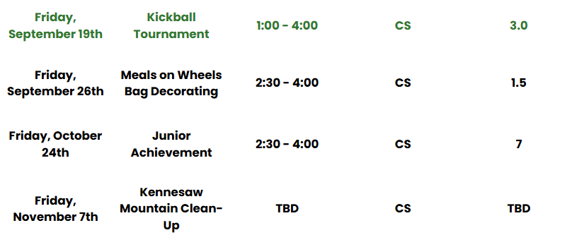
BAP Tentative Fall 2025 Schedule
Community Service
Professional Development
Upcoming Events

Slide 6
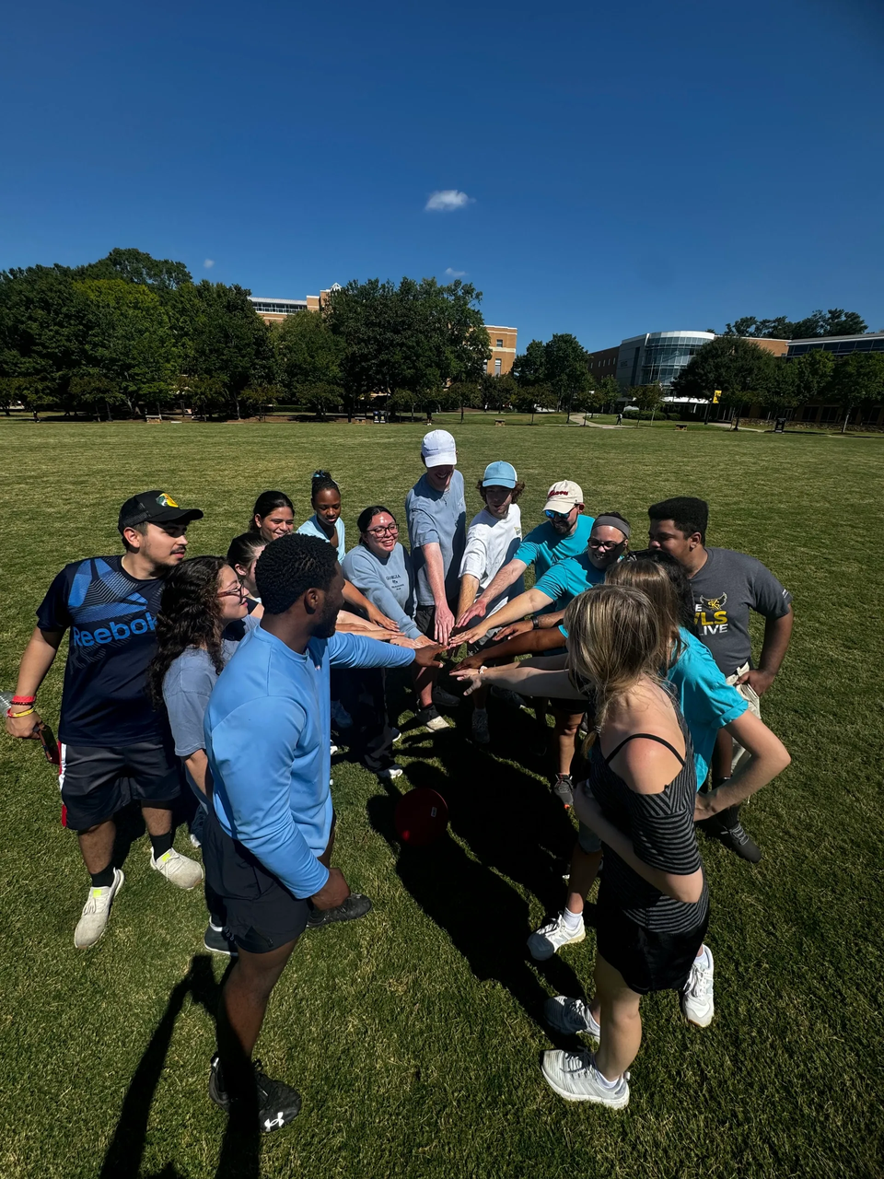
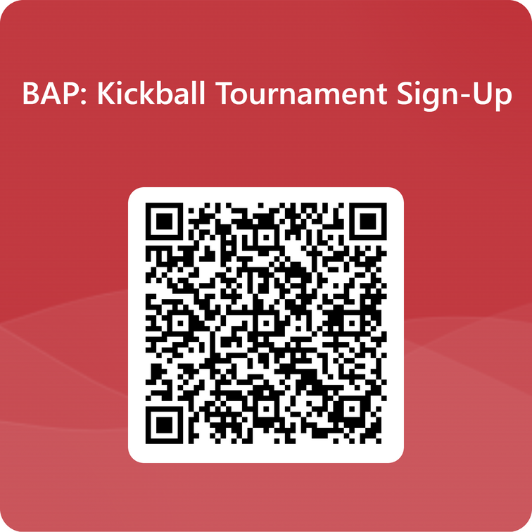
BAP Kickball Tournament
Overview: Join us on the Campus Green for a Kickball Tournament with our firm sponsors, an afternoon of competition, and networking
KSU, BAP Attire or Team Color (assigned next week)
Research visiting companies:
All Sponsors Invited
Upcoming Events

Slide 7


BAP Community Service: MUST Ministries
Bring Items during Kickball Event
We are collecting new and unopened toiletries and feminine hygiene products to support MUST Ministries and their mission of serving individuals and families in need.
Acceptable Items:
Soap
Shampoo & Conditioner
Toothpaste & Toothbrushes
Deodorant
Feminine Hygiene Products
Must be Unopened and New
Upcoming Events

Slide 8

BAP: Meals On Wheels
Overview: Volunteers decorate lunch bags with creative themes, adding a personal touch for seniors and individuals with disabilities, to promote community engagement
Volunteers are needed to deliver bags:
For questions, contact:
Kelsey Barton:
E: kbarto19@students.kennesaw.edu
Research visiting companies:
Aprio, Novogradac, and Nichols Cauley
Business Casual Attire
Upcoming Events

Slide 9

Non BAP PD and CS Hours
Non BAP PD and CS Hours
What if I can’t attend enough BAP meetings?
Members and Candidates may earn up to 2 PD hours and 2 CS hours outside of BAP:
All hours must be submitted using the Non-BAP CS and PD Hours Form at ksubap.com/resources.
Request must be submitted 2 days before the event it is supposed to occur
Form must be submitted within 1 week from completion of event
Important Reminders

Slide 10
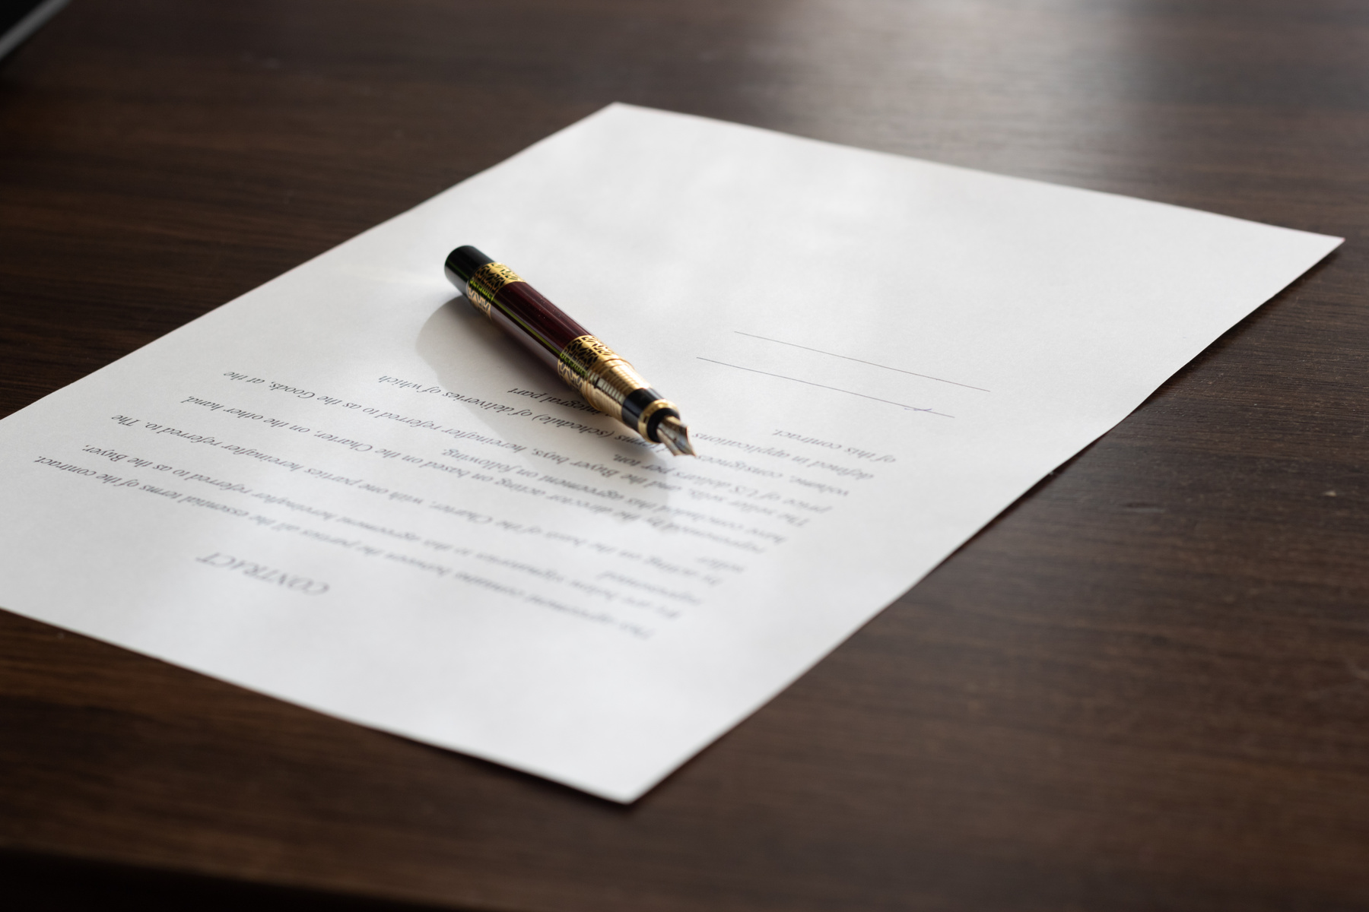
BAP Chapter Contracts
Chapter Contracts Reminder
How do I make it official?
BAP Iota Tau Chapter requires a physical contract to be signed that details requirements and expectations​
Only Members and Candidates must sign and return the contract; FBIS should still review the BAP Code of Ethics.​
Signed contracts deadline: TODAY, September 12th
Important Reminders

Slide 11

BAP Pie Awards
Beta Alpha Psi Pie Awards
How do I stand out?
BAP Iota Tau Chapter recognizes students who show outstanding participation at scheduled events
Awards:​
Professional Development Award​
Community Service Award
Prize:​
Pie, recognition, and a surprise
Important Reminders

Slide 12


Financial Literacy
Featuring Our Visiting Firms
Ask about money management tips and financial advice
Presentations and Q&A

Slide 13
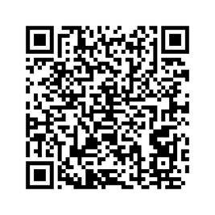
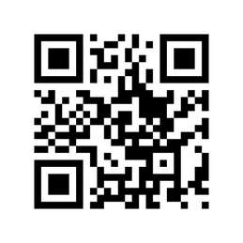
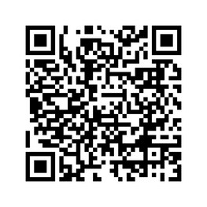
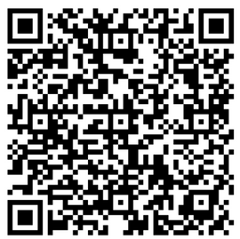
Follow Us
Instagram
Website
LinkedIn
Survey

Slide 14


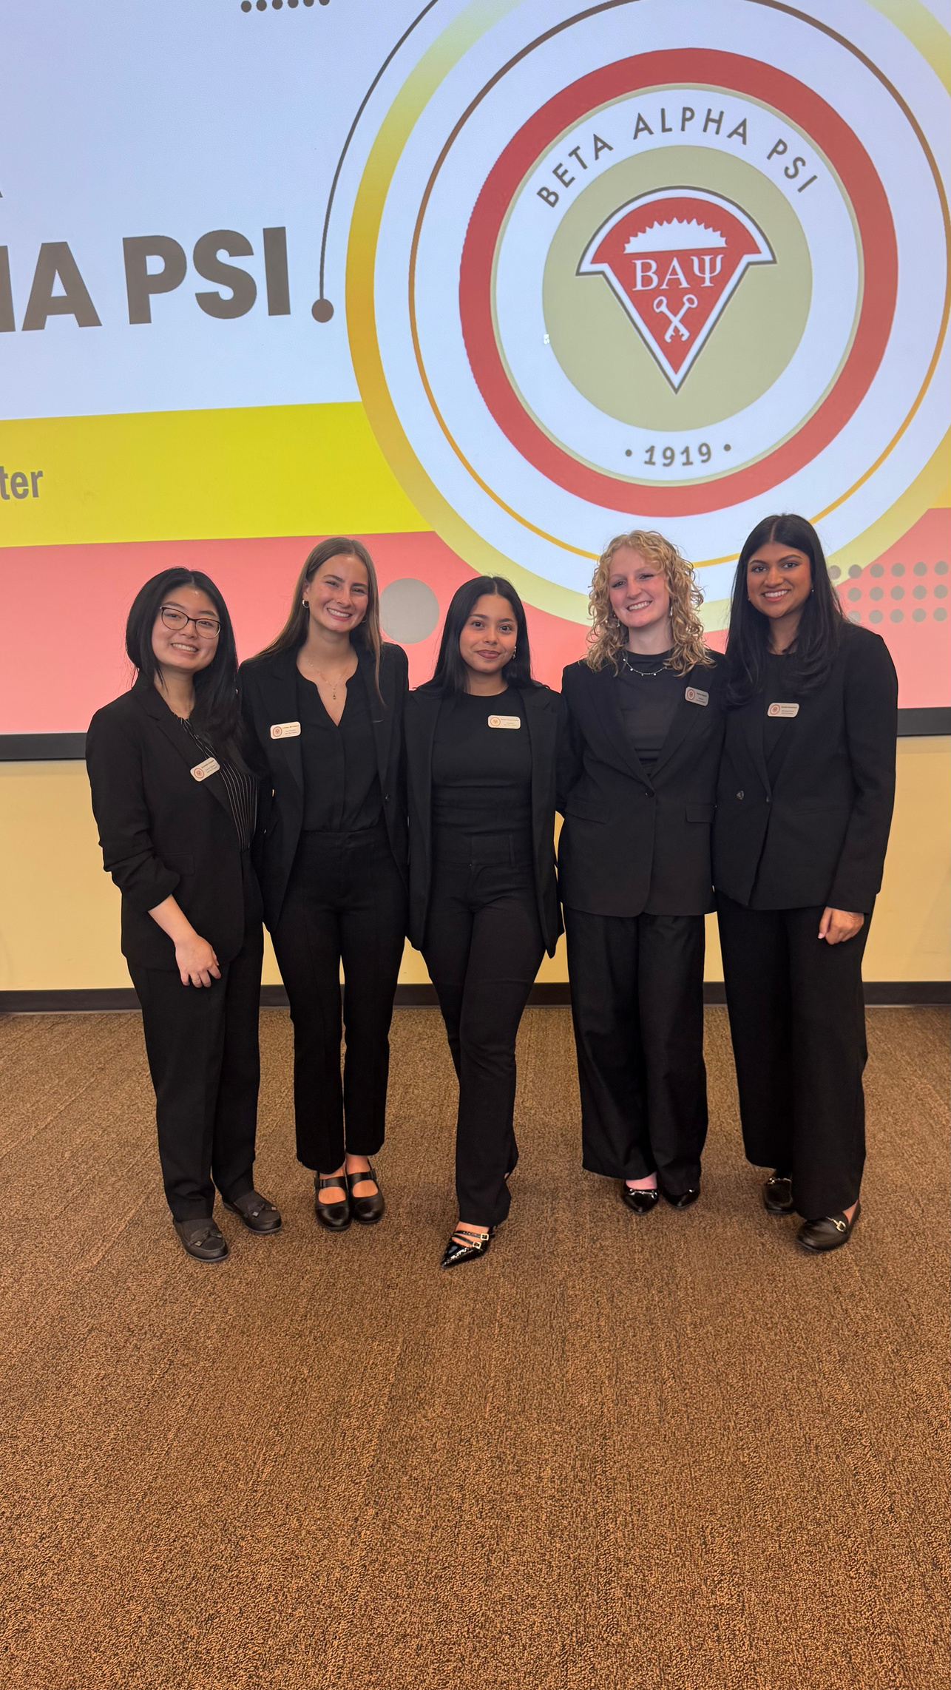
Contact Us
BETA ALPHA PSI - Iota Tau Chapter
Contact EC for any specific questions:
Karen Flores-Padilla, President
E: kfloresp@students.kennesaw.edu
Lindsey Mcclelland, Vice President
E: lmccle10@students.kennesaw.edu
Kelsey Barton, Reporter
E: kbarto19@students.kennesaw.edu
Anchiella Angelle, Events Director
E: aangell2@students.kennesaw.edu
Zainab Choudhary, Marketing Director
E: zchoudh1@students.kennesaw.edu
Contacts for other questions:
Shannon Shumate:
E: shumat2@kennesaw.edu
Amanda York:
E: ayork23@kennesaw.edu

Slide 15
Kennesaw State University
Thank You!
Iota Tau Chapter
Visit Our Website
ksubap.com

