Slide 1




Kennesaw State University
BETA ALPHA PSI
Iota Tau Chapter
Visit Our Website
ksubap.com

Slide 2



Beta Alpha Psi Initiation
Overview: Members will attend the Initiation Ceremony to celebrate new candidates becoming official BAP members and to recognize graduating seniors for their achievements and contributions.
Today’s Agenda:
  Welcome
  Refreshments
  New Member Initiation
  Graduation Recognition
  New Executive Committee Introduction
  Beta Alpha Pie Awards
  Fall Board Recognition
  Conclusion

Slide 3
Refreshments
Wait for instruction
We will dismiss by table, please grab ONE item of each to ensure everyone gets a fair amount.
Refreshments

Slide 4
Initiation
Wait for instruction
We will dismiss by table, please grab ONE item of each to ensure everyone gets a fair amount.
New Member Initiation

Slide 5
Graduation Recognition
We want to take a moment to recognize our graduating Fall seniors.
Graduation Recognition

Slide 6
New Executive Committee
Wait for instruction
We will dismiss by table, please grab ONE item of each to ensure everyone gets a fair amount.
New EC Introductions

Slide 7
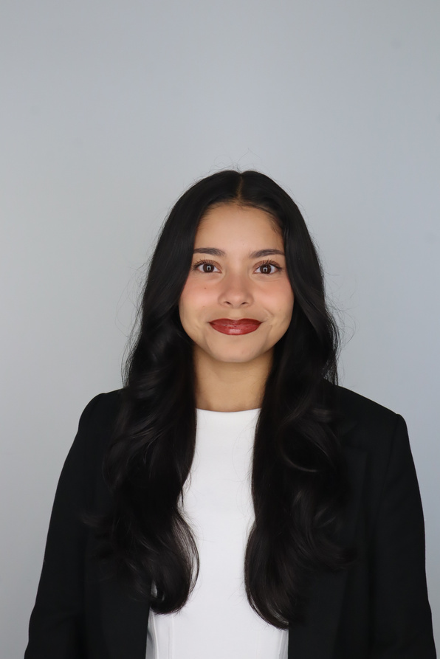
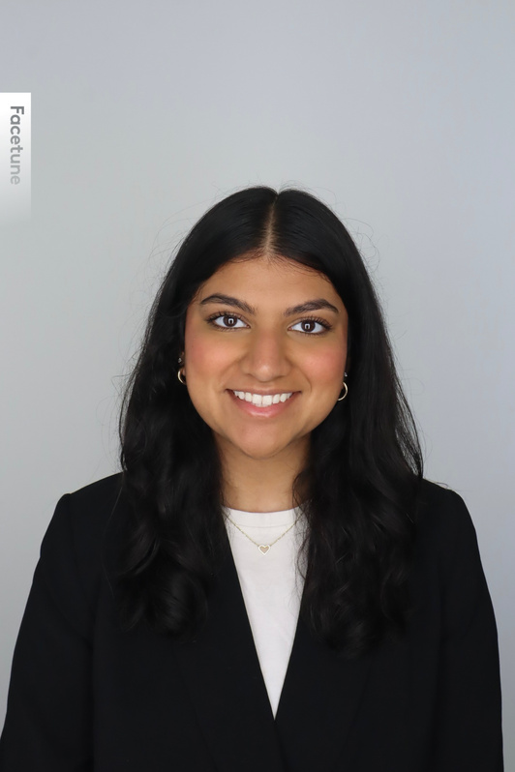
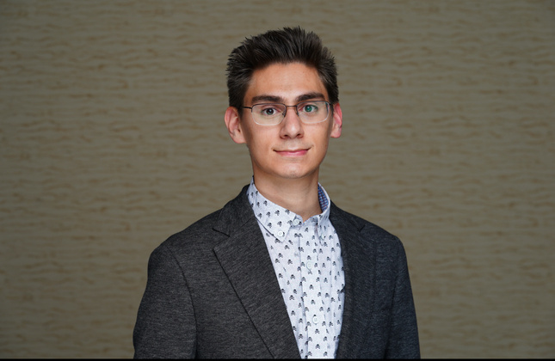
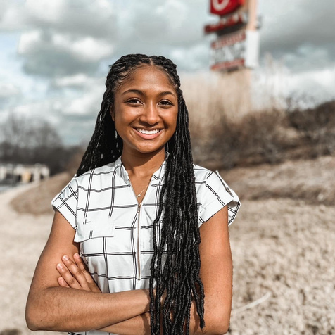
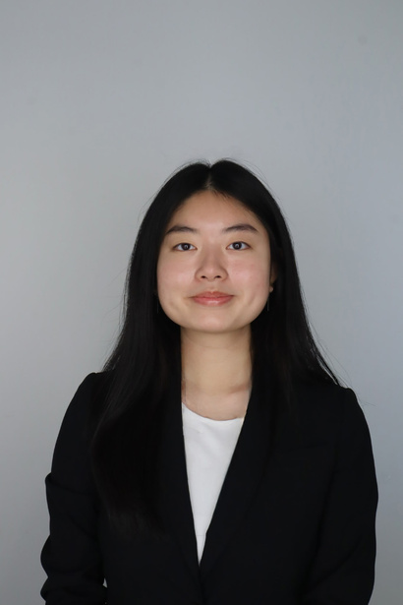
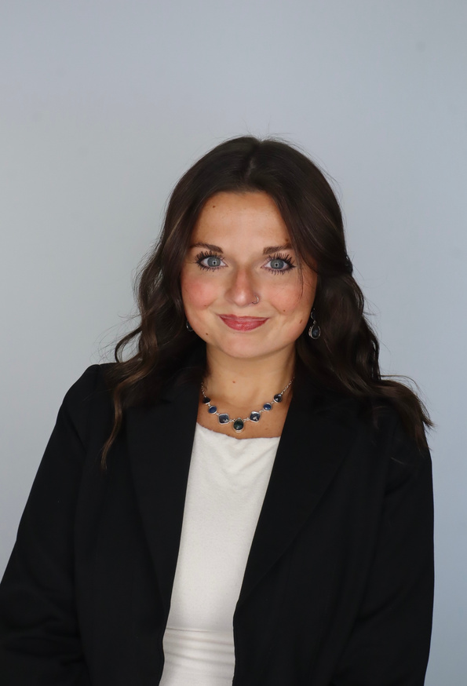
Meet the Executive Committee
Karen Flores-Padilla
Zainab Choudhary
Eric Super
President
Vice President
Treasurer
Beta Alpha Psi
Beta Alpha Psi
Beta Alpha Psi
Mya Bacchus
Hailey Young
New EC Introductions
Reporter
Beta Alpha Psi
Marketing Director
Beta Alpha Psi

Slide 8
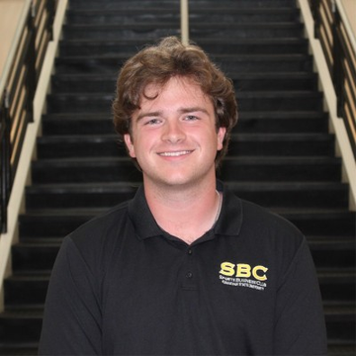
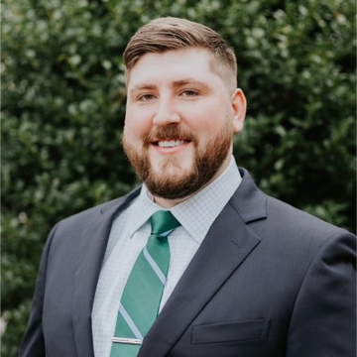
Beta Alpha Pie Awards
Featuring Our Winners
Daniel Crouse
Jared Key
Beta Alpha Psi Professional Development Award
Beta Alpha Psi Community Service Award
Introducing the students who showed outstanding participation at scheduled events!
Beta Alpha Pie Awards

Slide 9
Fall Board Recognition
Fall Board Recognition

Slide 10
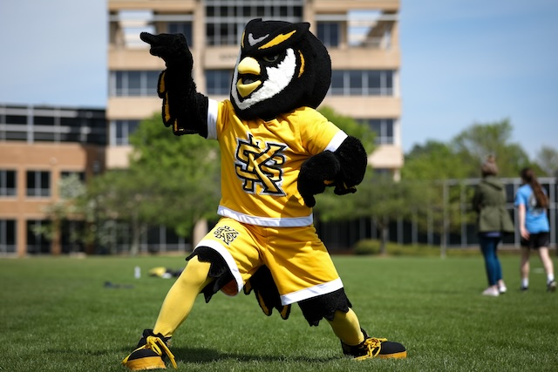


Upcoming Reminders
BAP Finals Study Session
Date: Wednesday, December 3rd
Time: 11:00 AM - 3:00 PM
Location: ALC 5104
Attire: Casual
GSCPA Scholarship
GSCPA Scholarships open
Scholarship Information
Scholarship Universe opened: November 1st
School of Accountancy scholarships due: February 1st
  No late submissions will be accepted
All Other Scholarships Deadline: Sunday , March 1st
Conclusion

Slide 11
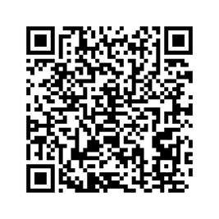
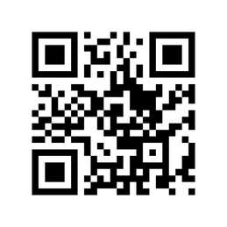
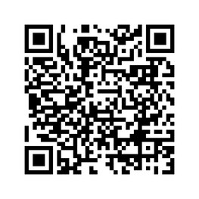
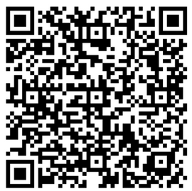
Follow Us
Instagram
Website
LinkedIn
Survey

Slide 12


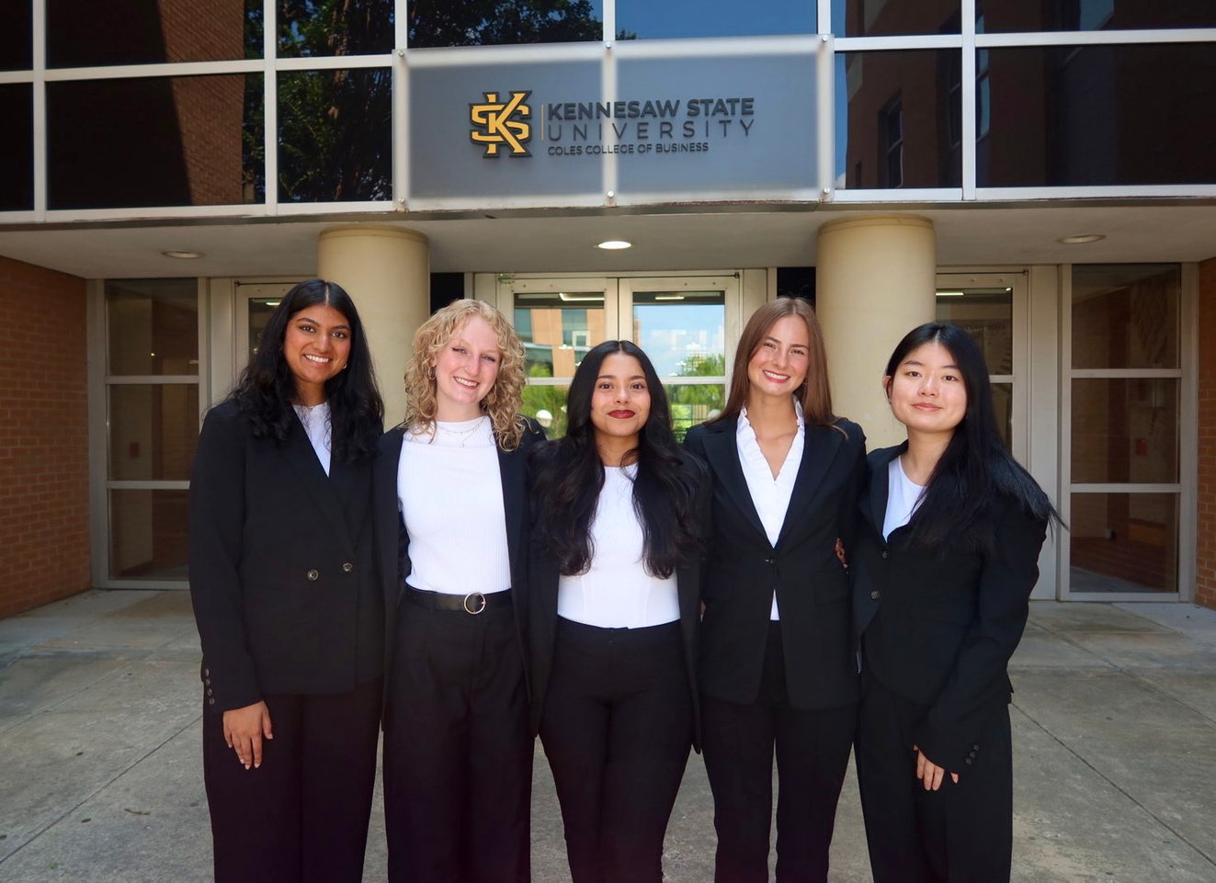
Contact Us
BETA ALPHA PSI - Iota Tau Chapter
Contact EC for any specific questions:
Karen Flores-Padilla, President
  E: kfloresp@students.kennesaw.edu
Lindsey Mcclelland, Vice President
  E: lmccle10@students.kennesaw.edu
Kelsey Barton, Reporter
  E: kbarto19@students.kennesaw.edu
Anchiella Angelle, Events Director
  E: aangell2@students.kennesaw.edu
Zainab Choudhary, Marketing Director
  E: zchoudh1@students.kennesaw.edu
Contacts for other questions:
Shannon Shumate:
  E: shumat2@kennesaw.edu
Amanda York:
  E: ayork23@kennesaw.edu

Slide 13
Kennesaw State University
Thank You!
Iota Tau Chapter
Visit Our Website
ksubap.com

