Slide 1





Kennesaw State University
BETA ALPHA PSI
Iota Tau Chapter
Visit Our Website
ksubap.com

Slide 2
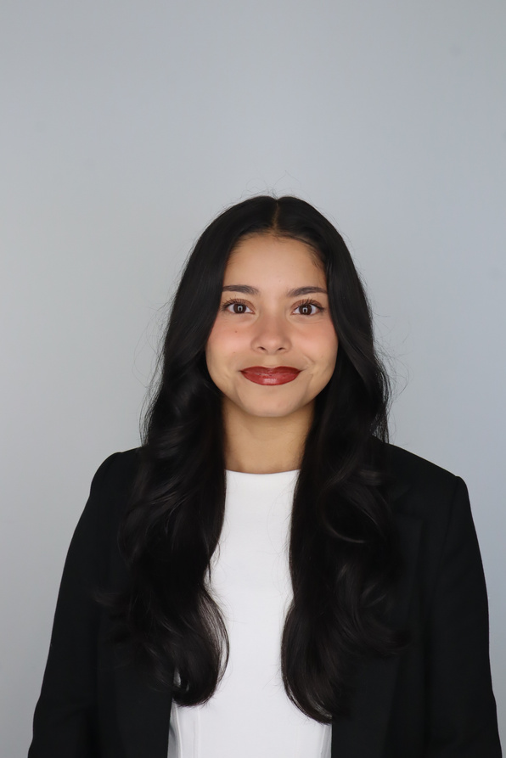
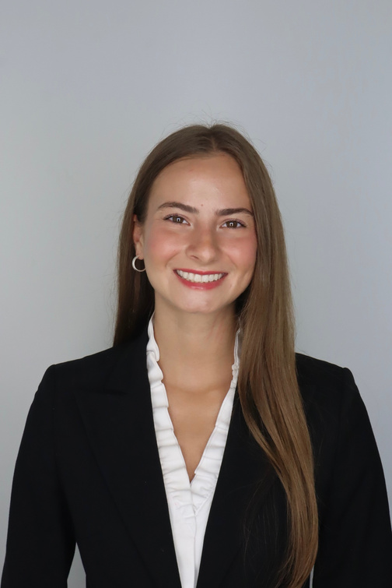
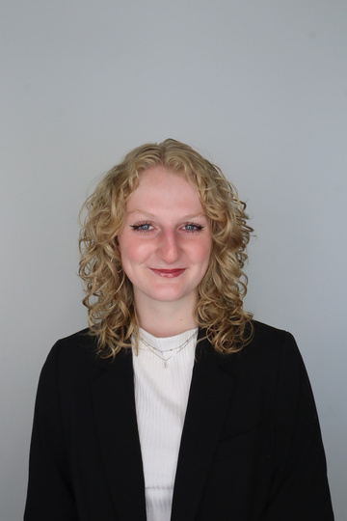
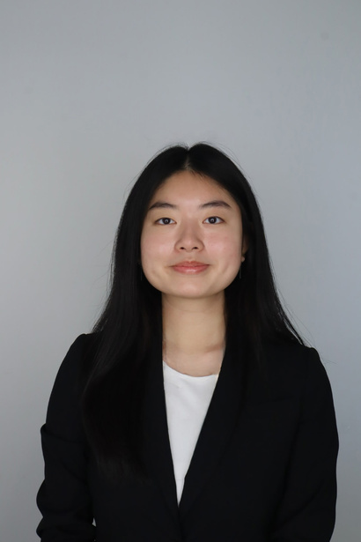
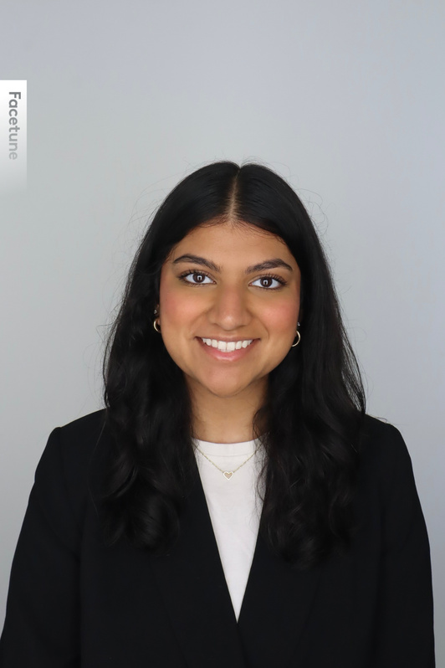
Meet The Executive Committee
Karen Flores-Padilla
Lindsey Mcclelland
Kelsey Barton
President
Vice President
Reporter
Anchiella Angelle
Zainab Choudhary
Meet the Board
Events Director
Marketing Director

Slide 3
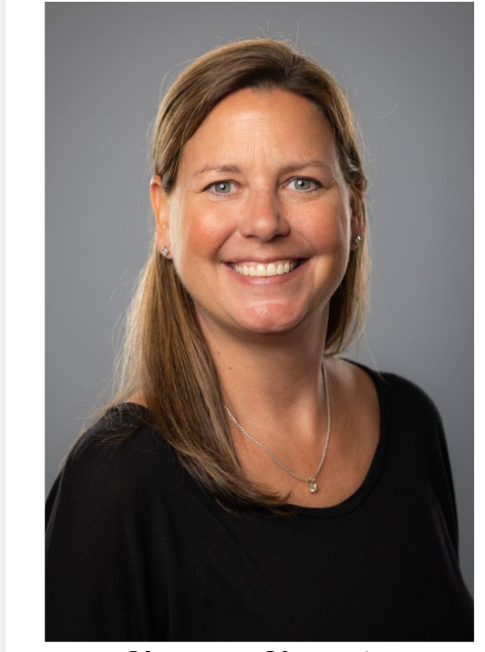
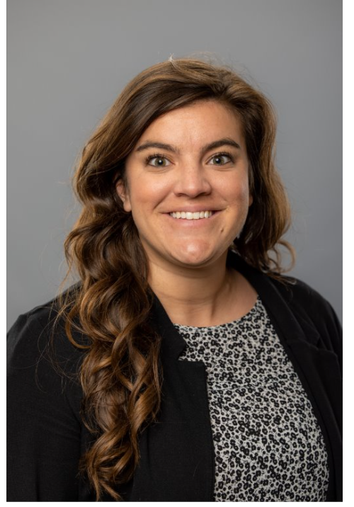
Meet Our Advisors
Shannon Shumate
Amanda York
Principal Lecturer
Associate Director, Strategic Partnerships
The Advisors

Slide 4
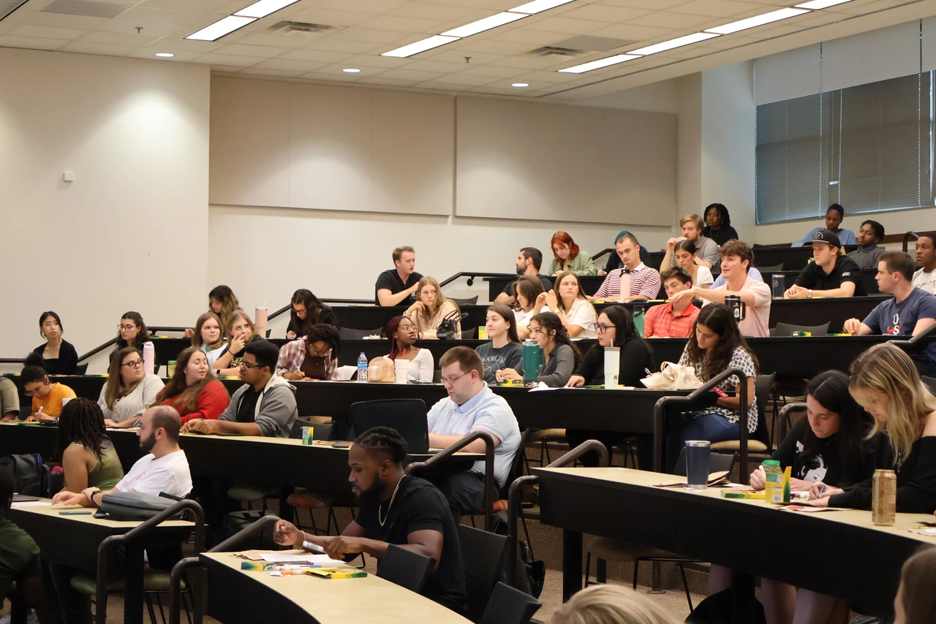





Reminder: Meeting Expectations
Put cellphones on silent during company visits
Network and engage with your peers
Business Professional attire for company visits
Be mindful when snacking
Enter quietly if you arrive late
Expectations

Slide 5


Career Fair Prep Resume Review
Today’s Meeting Agenda:
  Reminders & Important Dates
  Resume Q&A Panel
  Panel discussion on resume best practices
  3. Resume Review with Firms
  Mauldin & Jenkins, HLB Gross Collins, Carr Riggs & Ingram, CliftonLarsonAllen, and Nichols Cauley
How to put BAP on a resume:
Member of Beta Alpha Psi – Iota Tau Chapter​
Candidate for Membership of Beta Alpha Psi – Iota Tau Chapter
Member of FBIS – an Affiliate of Beta Alpha Psi​ - Iota Tau Chapter
Today’s Meeting

Slide 6
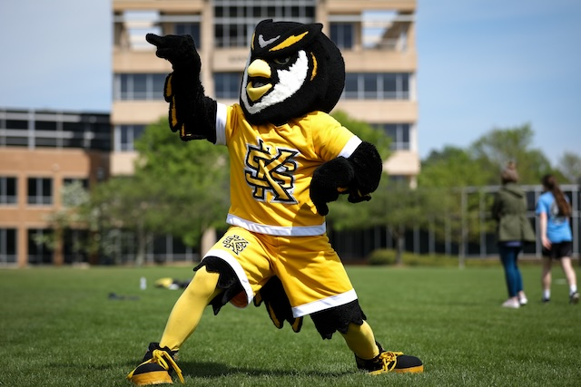



Upcoming Events
SOA Career Fair
Date: Thursday, September 4th
Time: 12:00 PM - 3:00 PM
Location: KSU Center Atrium
MAcc/CPA Info Session
Date: Thursday, September 18th
Time: 12:00 PM - 1:00 PM
Location: Virtual
President’s Award of Distinction
Applications now open for Fall 2025
Requirements: Essay, recommendation letters, resume (academic, research, leadership, etc.)
Deadline: Friday , September 26th @ 8:00 PM
Reminders & Important Dates

Slide 7
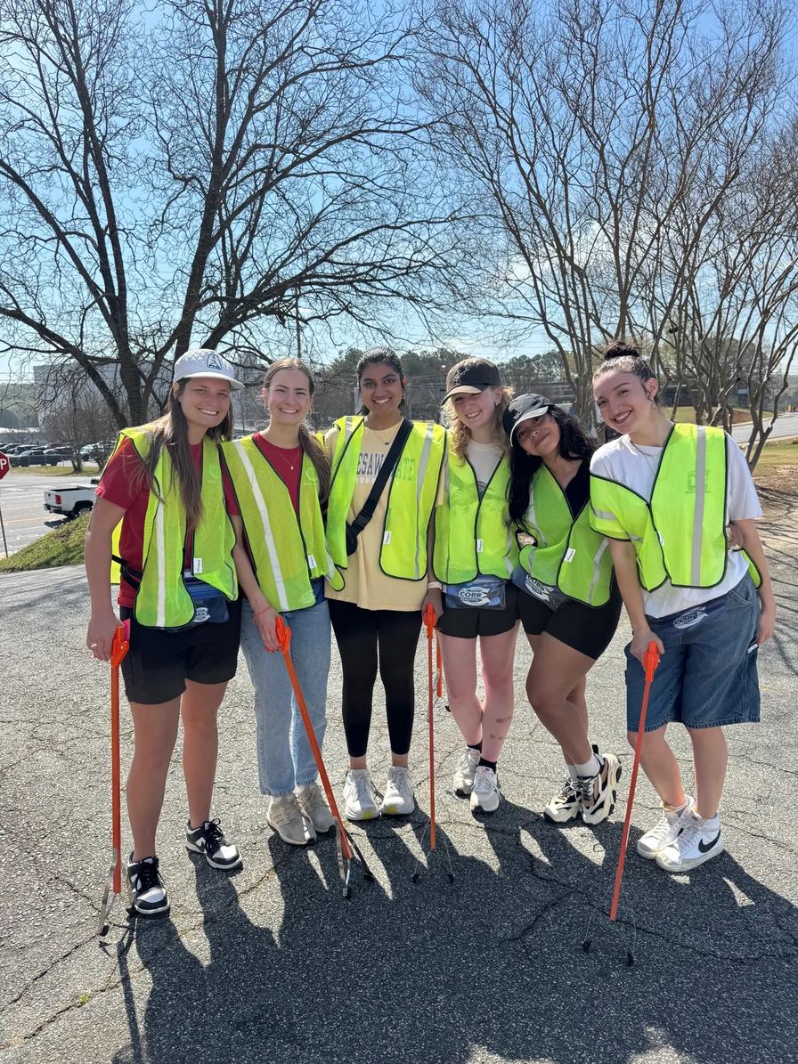
Community Service: Books for Africa
Want to earn additional community service hours?
Volunteers are needed to pack and transport books
  Community service hours will vary based on the time required to transport items
For questions, contact:
Kelsey Barton:
  E: kbarto19@students.kennesaw.edu
Reminders & Important Dates

Slide 8
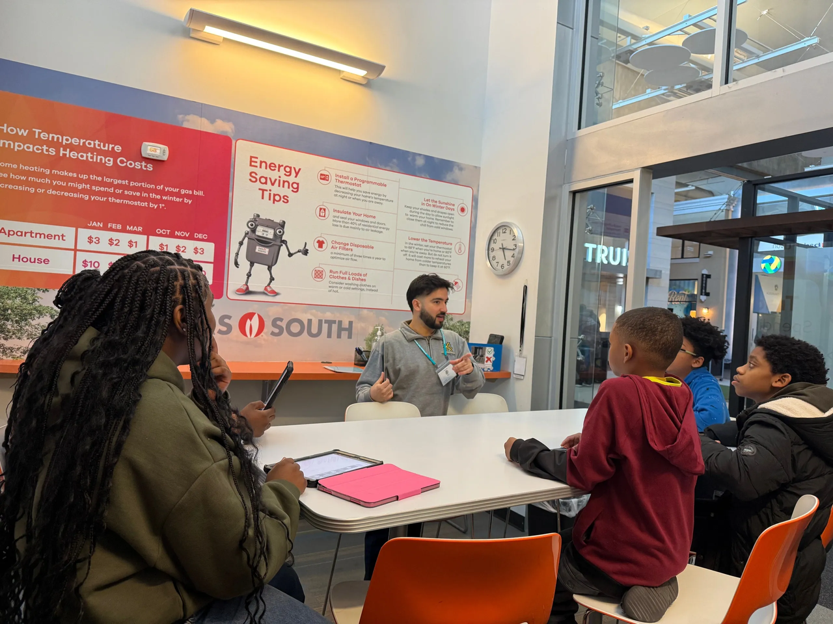
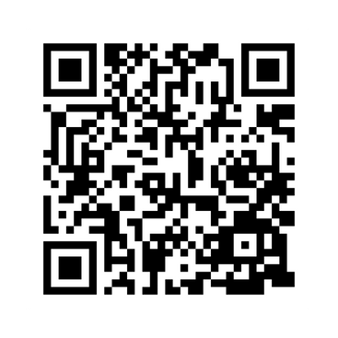
Community Service: SOA Career Fair
Want to earn additional community service hours?
Volunteer opportunities for 09/04/2025 include:
  Runner/Information Table – assist employers, direct attendees, replenish materials
  Clean-Up – help close out the event
Location: KSU Center Atrium
Scan the QR Code to Sign Up!
Reminders & Important Dates

Slide 9

BAP Chapter Contracts
Chapter Contracts Reminder
How do I make it official?
BAP Iota Tau Chapter requires a physical contract to be signed that details requirements and expectations​
  Only Members and Candidates must sign and return the contract; FBIS should still review the BAP Code of Ethics.​
  Signed contracts deadline: Friday, September 12th @ 11:59 PM
Reminders & Important Dates

Slide 10

BAP Resume Book
Chapter Contracts Reminder
How do I make it official?
BAP Compiles student resumes for employers to view. ​
  Send To: ksubapreporter@gmail.com as a PDF
  Resume deadline: Monday, September 1st @ 11:59 PM
  Label: Last Name_First Name_Resume
Reminders & Important Dates

Slide 11




Reminder: Registration Deadline & Degree Works Transcript
01
02
03
04
Go into Degree Works
Press CTRL + P (do NOT use printer icon)
Destination: Save as PDF
Layout: Lanscape then SAVE
  Final registration and payment deadline : Thursday, September 11th @11:59 pm​
  Only Candidates and Members must email a copy of their Degree Works transcript
  Degree Works transcripts should be submitted to Professor Shannon Shumate at sshumat2@kennesaw.edu.
Reminders & Important Dates

Slide 12

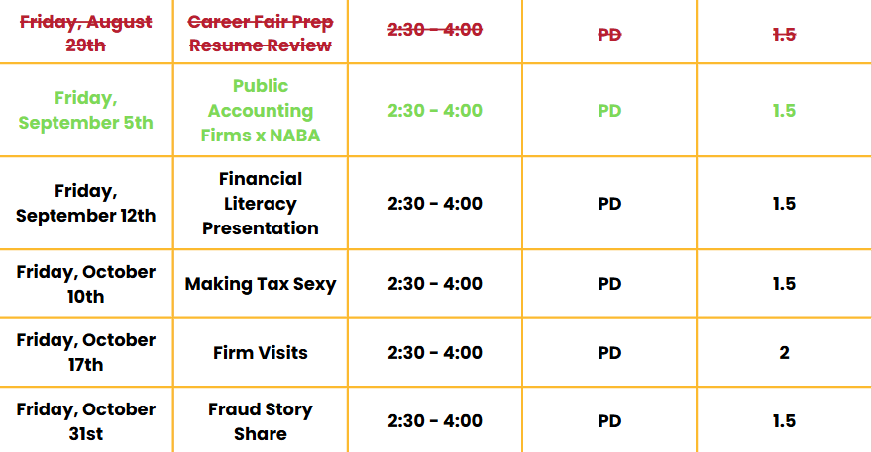
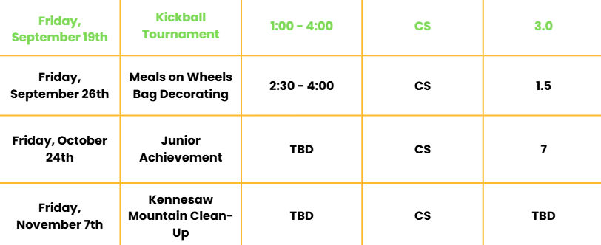
Tentative Fall 2025 Schedule
Community Service
Professional Development
Reminders & Important Dates

Slide 13

BAP x NABA:
Public Accounting Firms
Overview: Representatives from the firms will speak on topics such as public accounting early careers advice and successful networking:
  Learn about NABA INC.
  Business Professional Attire
Research and bring questions for visiting companies:
  Moore Colson, Deloitte, CohnReznick, Forvis Mazars, and Cherry Bekaert
Reminders & Important Dates

Slide 14


Panel Questions
Featuring Our Visiting Firms
Ask about resumes, career paths and interview tips
Resume Q&A

Slide 15


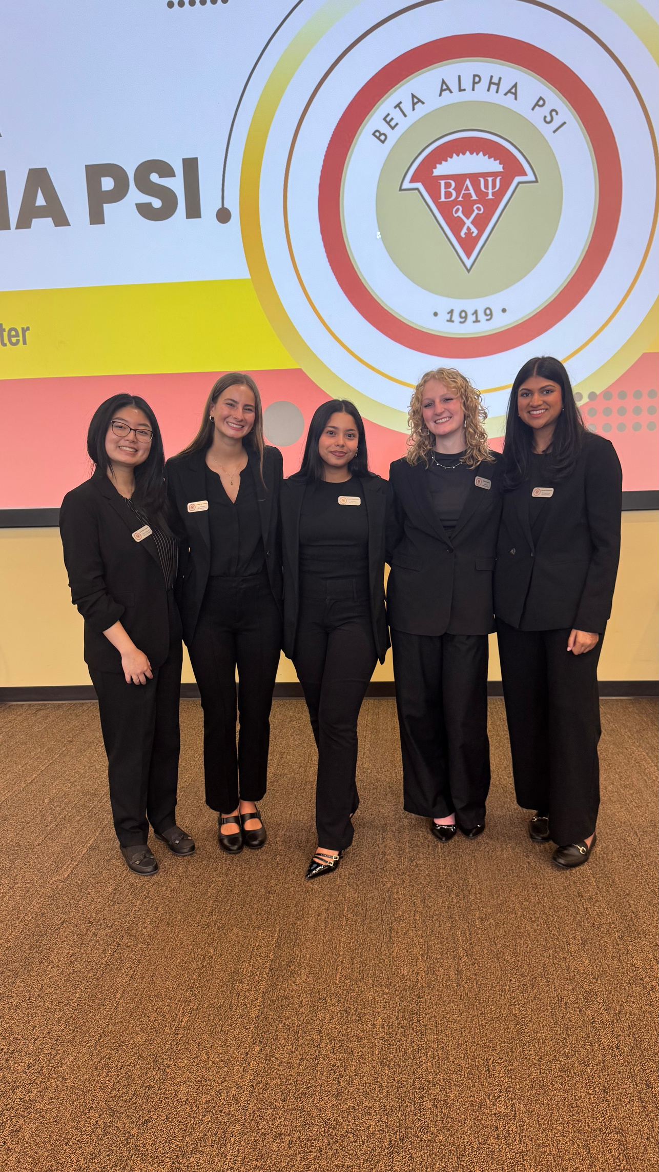
Contact Us
BETA ALPHA PSI - Iota Tau Chapter
Contact EC for any specific questions:
Karen Flores-Padilla, President
  E: kfloresp@students.kennesaw.edu
Lindsey Mcclelland, Vice President
  E: lmccle10@students.kennesaw.edu
Kelsey Barton, Reporter
  E: kbarto19@students.kennesaw.edu
Anchiella Angelle, Events Director
  E: aangell2@students.kennesaw.edu
Zainab Choudhary, Marketing Director
  E: zchoudh1@students.kennesaw.edu
Contacts for other questions:
Shannon Shumate:
  E: shumat2@kennesaw.edu
Amanda York:
  E: ayork23@kennesaw.edu
Contact Us

Slide 16
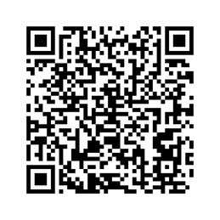
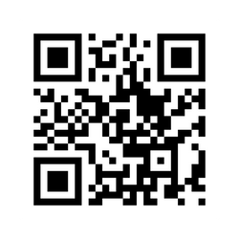
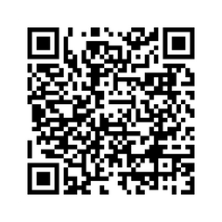
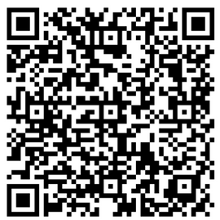
Follow Us
Instagram
Website
LinkedIn
Follow Us
Survey
BUSA

Slide 17

Kennesaw State University
Thank You!
Complete Attendance Check In
Visit Our Website
ksubap.com
Attendance

