Slide 1





Kennesaw State University
BETA ALPHA PSI
Iota Tau Chapter
Visit Our Website
ksubap.com

Slide 2

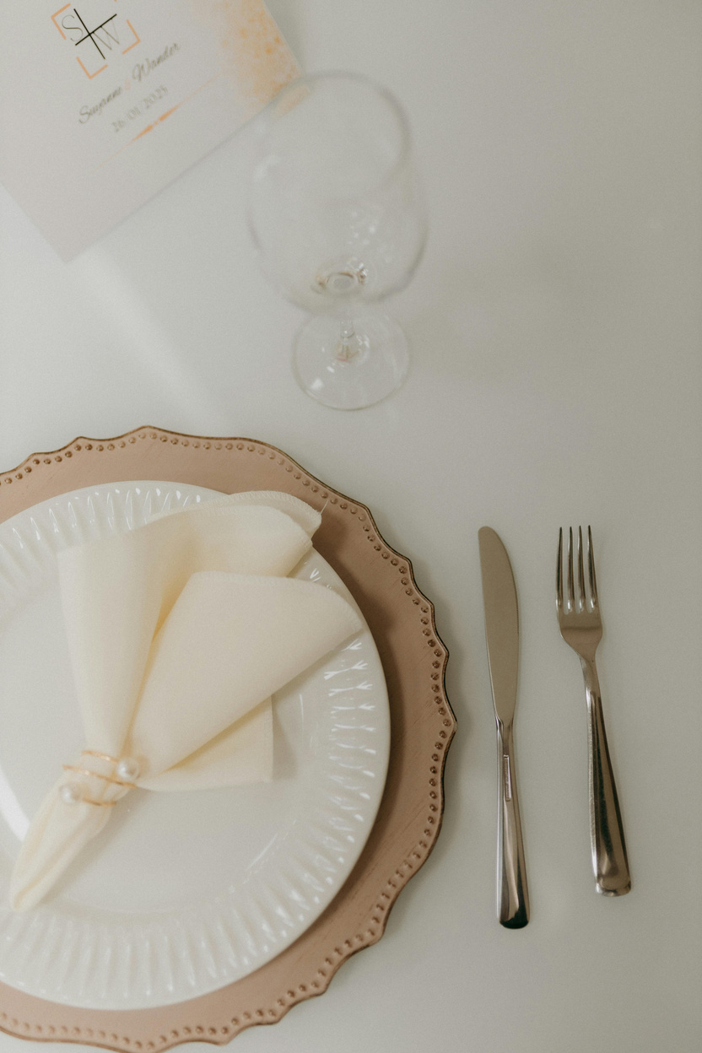
Today’s Meeting: BAP Silverware Rolling
Overview: Students and visiting professionals will assemble silverware for Meals on Wheels, combining community service with teamwork and engagement.
Meeting Agenda:
  Upcoming Events & Reminders
  BAP Announcements
  BAP Silverware Rolling with Firms: BDO, CohnReznick, HLB Gross Collins, and Koch Industries

Slide 3
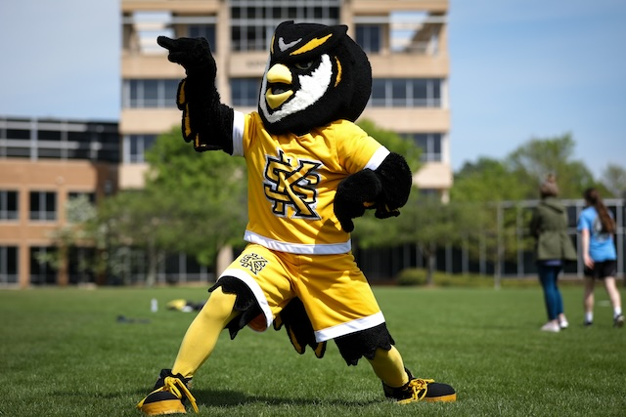
Upcoming Events
Feb 03
Tetley Talk with Joylon Bulley
2:00 - 3:00
Feb 12
MAcc Information Session
12:00 - 1:00
Feb 12
Meet the Firms
12:00 - 3:00
Feb 17
The Georgia Society of CPAs Wine & Work @ Vino Venue
5:00 - 7:00
Feb 18
Coles Fest Spring 2026
11:00 - 2:00

Slide 4
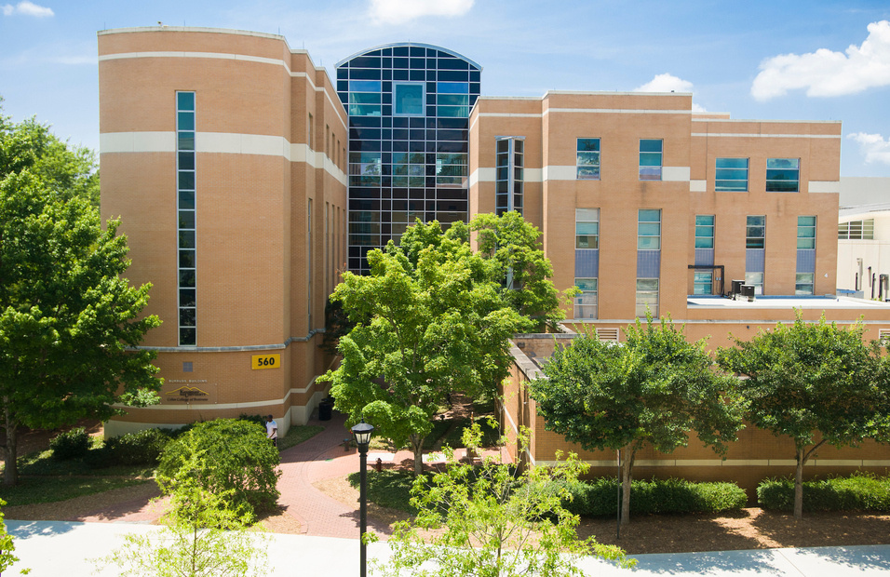
Important Reminders
Feb 01
GSCPA Scholarship Applications
Mar 01
Kennesaw State University Scholarships
Mar 15
AICPA Foundation Legacy Scholarships
N/A
Beta Alpha Psi Scholarships
N/A
Accounting Summer Leadership Programs 2026

Slide 5
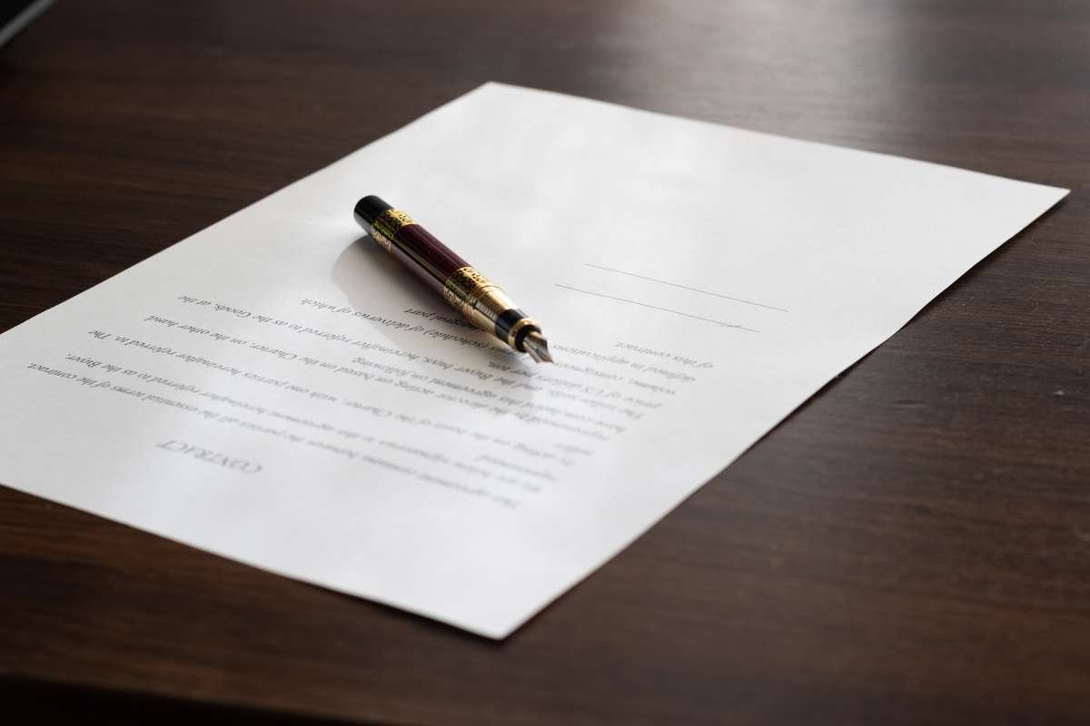

BAP Chapter Contracts
Overview: Beta Alpha Psi Iota Tau Chapter requires a physical contract to be signed that details requirements and expectations​.
  Only Members and Candidates must sign and return the contract; FBIS should still review the BAP Code of Ethics
  Signed contracts will must be given to Shannon Shumate
Signed contracts deadline: Friday, February 6th

Slide 6

Tentative Spring 2026 Schedule
Professional Development
Community
Service
DATE | MEETING | TIME | TYPE | ATTIRE
1/16/2026 | INFORMATION SESSION | 2:30 - 4:00 | - | BUSINESS CASUAL
1/23/2026 | BAP JEOPARDY | 2:30 - 4:00 | PD | BUSINESS PROFESSIONAL
2/6/2026 | RESUME REVIEW | 2:30 - 4:00 | PD | BUSINESS PROFESSIONAL
2/13/2026 | AI, IA, and IAP | 2:30 - 4:00 | PD | BUSINESS PROFESSIONAL
3/27/2026 | PREPARING FOR GRADUATE EDUCATION | 2:30 - 4:00 | PD | BUSINESS PROFESSIONAL
4/3/2026 | BE AUDIT YOU CAN BE | 2:30 - 4:00 | PD | BUSINESS PROFESSIONAL
DATE | MEETING | TIME | TYPE | ATTIRE
1/30/2026 | SILVERWARE ROLLING | 2:30 - 4:00 | CS | BUSINESS CASUAL
2/26/2026 | BOOKS FOR AFRICA | 1:00 - 3:00 | CS | KSU OR BAP ATTIRE
3/6/2026 | JUNIOR ACHIEVEMENT | 8:00 - 3:00 | CS | KSU OR BAP ATTIRE
- | - | - | - | -
- | - | - | - | -
- | - | - | - | -

Slide 7
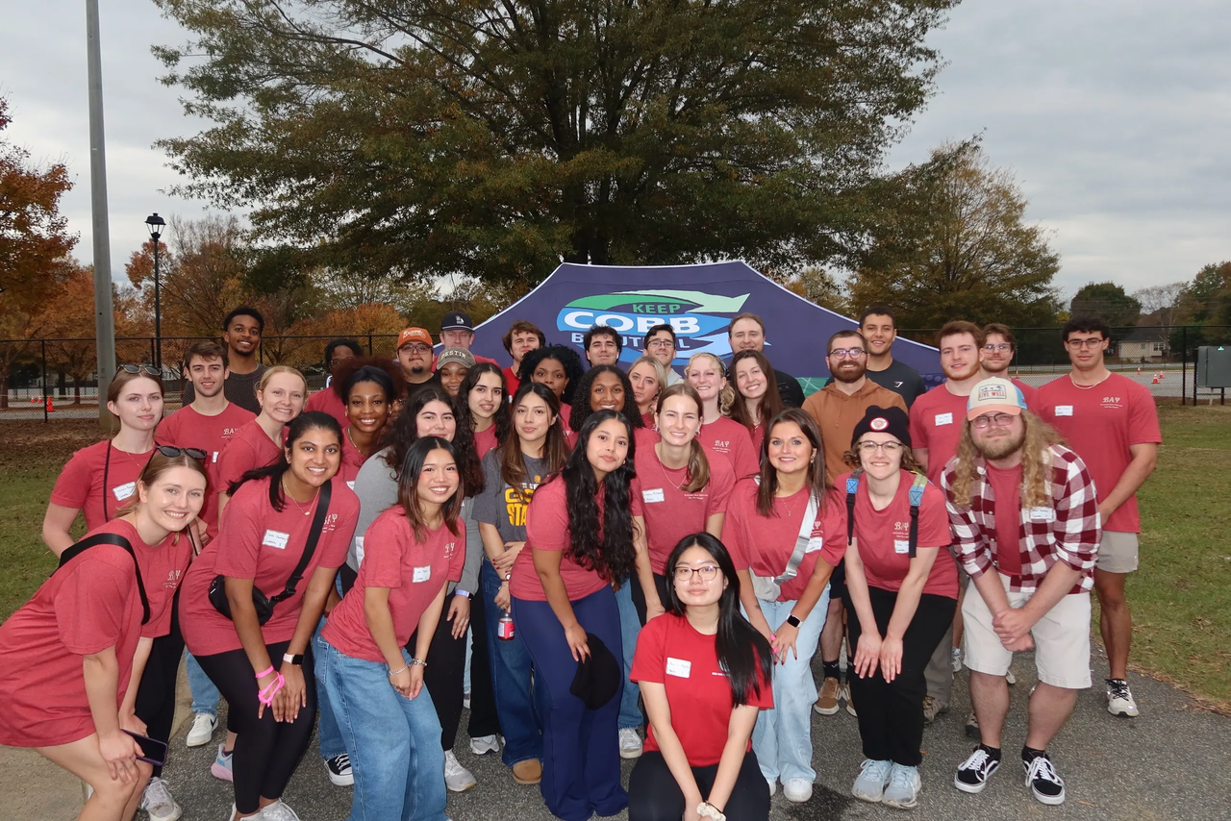
Non-BAP Community Service & Professional Development
What if i can’t attend enough meetings?
Members and Candidates may earn up to 2 PD hours and 1 CS hour outside of BAP. All hours must be submitted using the Non-BAP CS and PD Hours Form at ksubap.com/resources.
  Request must be submitted to our BAP reporter 2 days before the event it is supposed to occur
  Form must be submitted within 1 week from completion of event

Slide 8

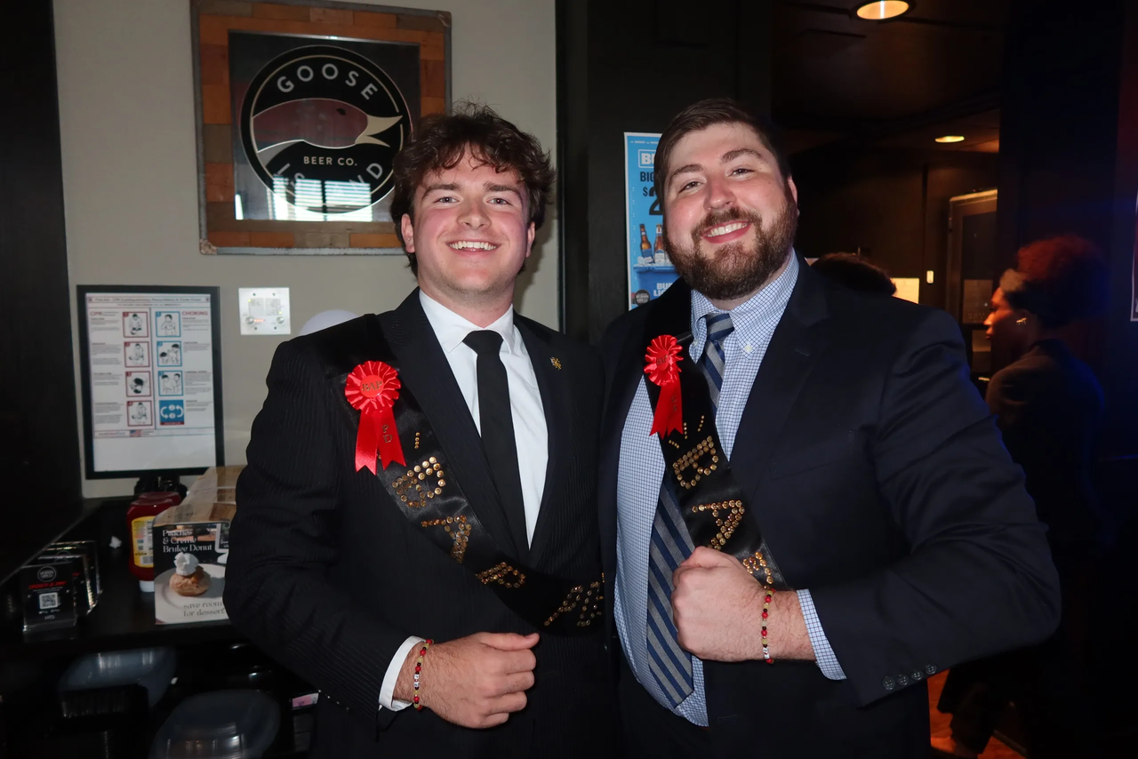
BAP Pie Awards
Overview: BAP Iota Tau Chapter recognizes students who show outstanding participation at scheduled events
Awards:​
  Most Professional Development Award​
  Most Community Service Award
Prize:​
  Pie, recognition, and a surprise

Slide 9


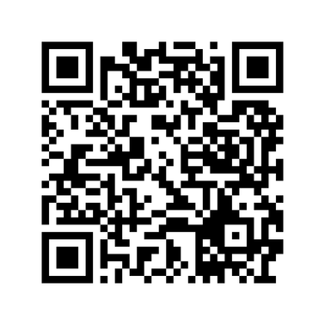
Meet The Firms Volunteers
Overview: This event provides students with the opportunity to connect directly with accounting firms, practice professional networking, and learn more about internship and full-time opportunities.
  Date: Thursday, February 12, 2026
  Location: KSU Center
Sign-up now!!!

Slide 10

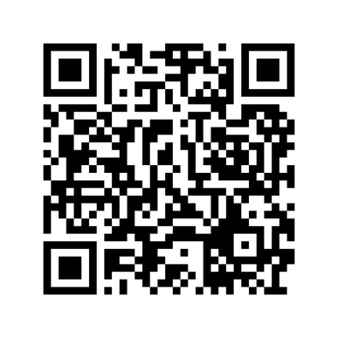
Books For Africa Community Service
Overview: Student volunteers will assist with packing donated books into boxes for Books For Africa. Volunteers will help sort, organize, and prepare materials for shipment, supporting global access to education and literacy initiatives.
  Date: Friday, February 27th
  Location: 1491 Cobb Industrial Drive, Bldg. B Marietta, GA 30066
  Credit: Counts toward 2 Community Service (CS) hours
Sign-up now!!!

Slide 11
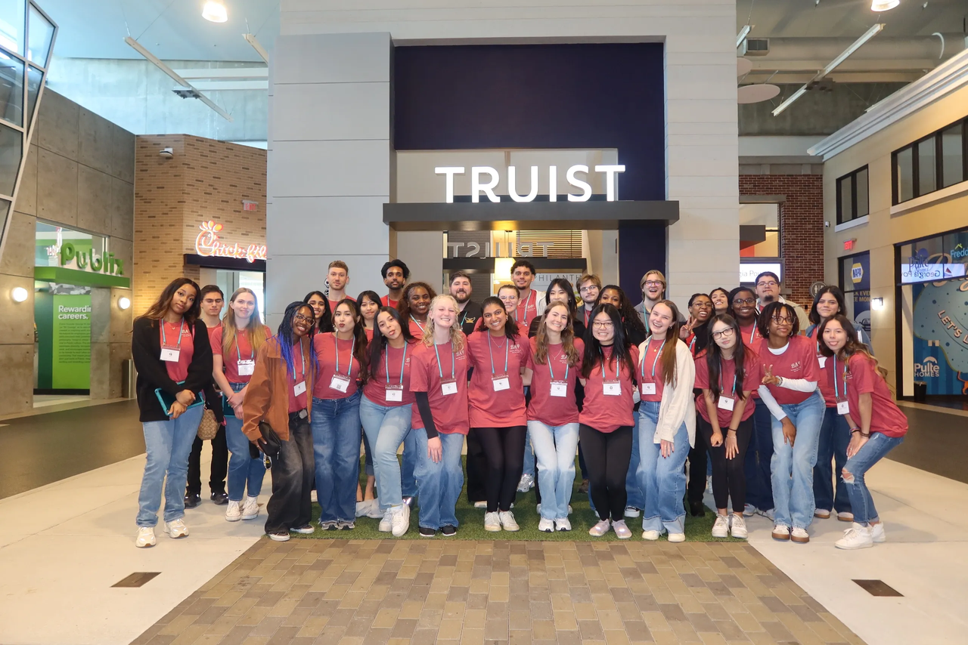
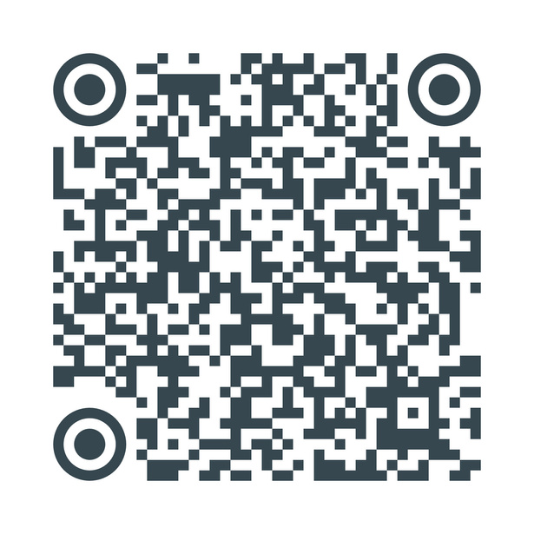
Volunteers for Mass Exams
Overview: Student volunteers are needed to serve as proctors for mass Accounting exams, assisting faculty to support academic integrity within the School of Accountancy.
  Dates: February 6, 7, and 14
  Role: Proctor support and exam logistics assistance
  Credit: Counts toward Community Service (CS) hours
Sign-up now!!!

Slide 12
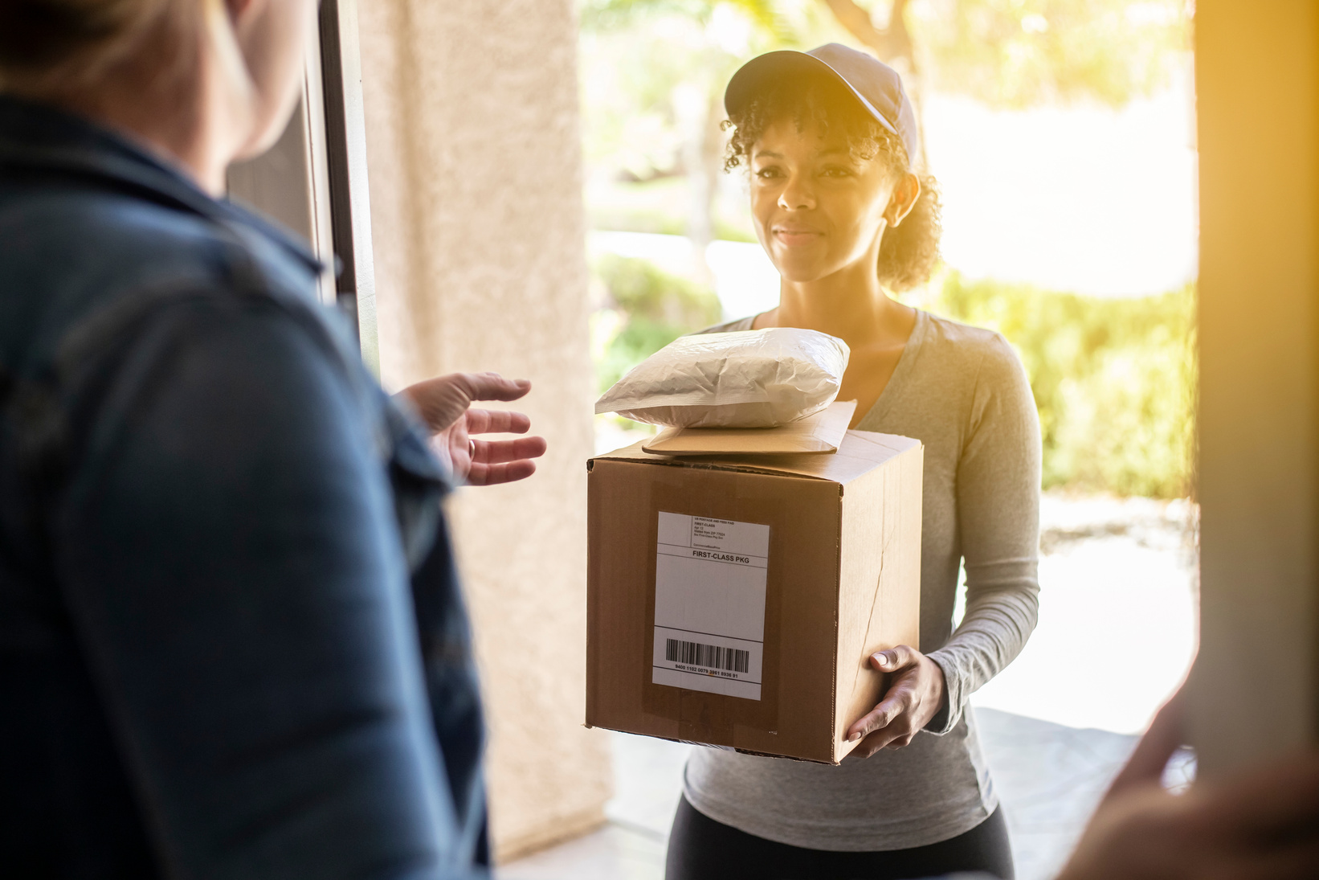
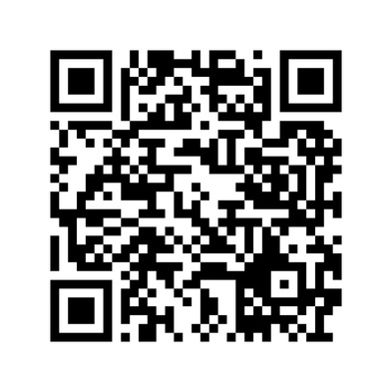
Volunteers for MUST Ministries
Overview: Two student volunteers are needed to deliver assembled silverware kits to MUST Ministries. Volunteers will assist with transporting the items and ensuring they are successfully dropped off.
  Date: Monday, February 2nd
  Location: 1407 Cobb Pkwy NMarietta, GA 30062
  Credit: Counts toward 1 Community Service (CS) hours
Sign-up now!!!

Slide 13



Silverware Rolling
Step One:
Step Two:
Step Three:
Assemble: Place one spoon and one fork neatly inside a napkin.
Secure: Roll the napkin tightly and fasten it with a rubber band.
Package: Place completed silverware sets into labeled boxes for delivery to MUST Ministries.

Slide 14


Next Meeting: Resume Review
Overview: This session includes a resume review and a short panel with visiting professionals to support student career readiness and professional development, focusing on resume best practices to create impactful resumes.
Visiting companies:
  CliftonLarsonAllen, Forvis Mazars, Mauldin & Jenkins, Moore Colson, and WBL
  Business Professional Attire

Slide 15

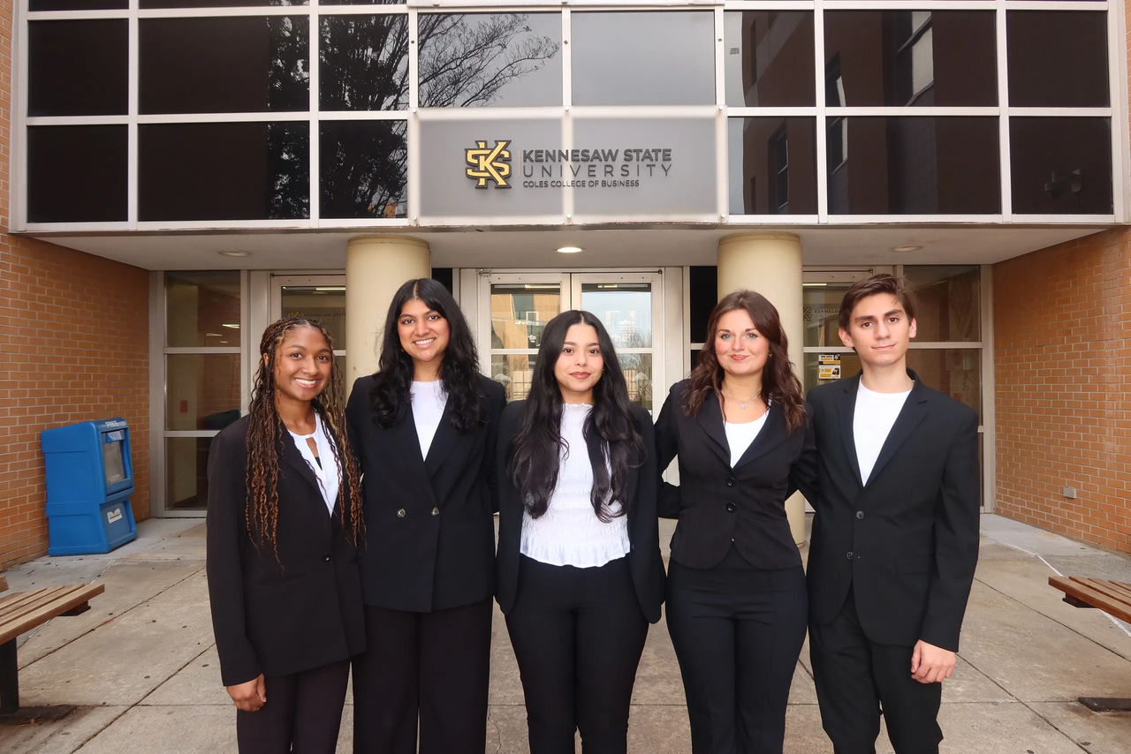
Contact Us
Beta Alpha Psi - Iota Tau Chapter
Contact EC for any specific questions:
Karen Flores-Padilla, President
  E: kfloresp@students.kennesaw.edu
Zainab Choudhary, Vice President
  E: zchoudh1@students.kennesaw.edu
Eric Super, Treasurer
  E: esuper@students.kennesaw.edu
Mya Bacchus , Reporter
  E: mbacchu2@students.kennesaw.edu
Hailey Young, Marketing Director
  E: hyoung32@students.kennesaw.edu
Contacts for other questions:
Shannon Shumate:
  E: sshumat2@kennesaw.edu
Amanda York:
  E: ayork23@kennesaw.edu

Slide 16

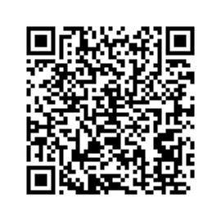
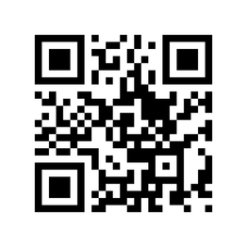
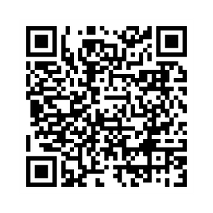
Follow US
Instagram
Website
LinkedIn

Slide 17
Kennesaw State University
Thank You!
Iota Tau Chapter
Visit Our Website
ksubap.com

