Slide 1



Kennesaw State University
BETA ALPHA PSI
Iota Tau Chapter
Visit Our Website
ksubap.com

Slide 2


Today’s Meeting: Preparing for Graduate Education
Overview: This session is designed to introduce students to their next steps after undergrad. Representatives from various graduate programs will share their experience and discuss opportunities.
Meeting Agenda:
Upcoming Events & Reminders
BAP Announcements
Preparing for Graduate Education

Slide 3
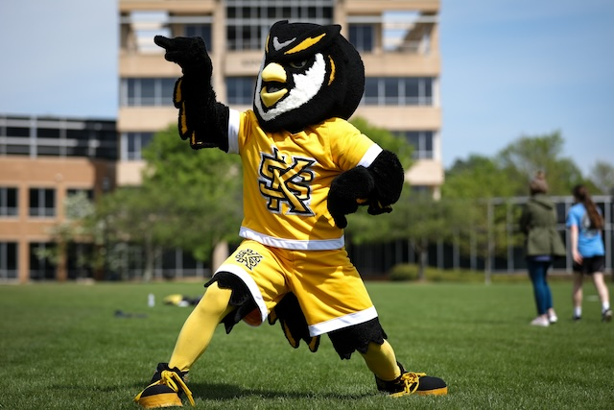
Upcoming Events
Mar 31
Speaker Series: What is Consulting?
2:00 - 3:15
Apr 2
Industry Voices: The Business of You
11:00 - 12:00
Apr 24
MAcc Information Session
11:30 - 12:30

Slide 4
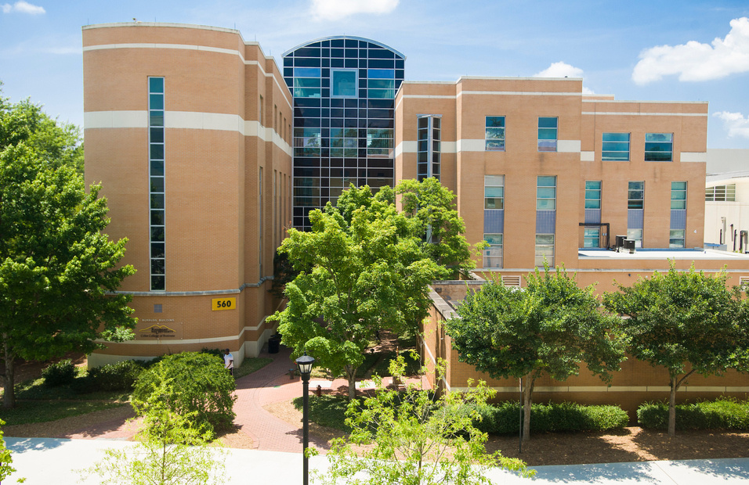
Important Reminders
Apr 30
DeKalb Chapter Scholarship
N/A
Beta Alpha Psi Scholarships
N/A
Accounting Summer Leadership Programs 2026

Slide 5
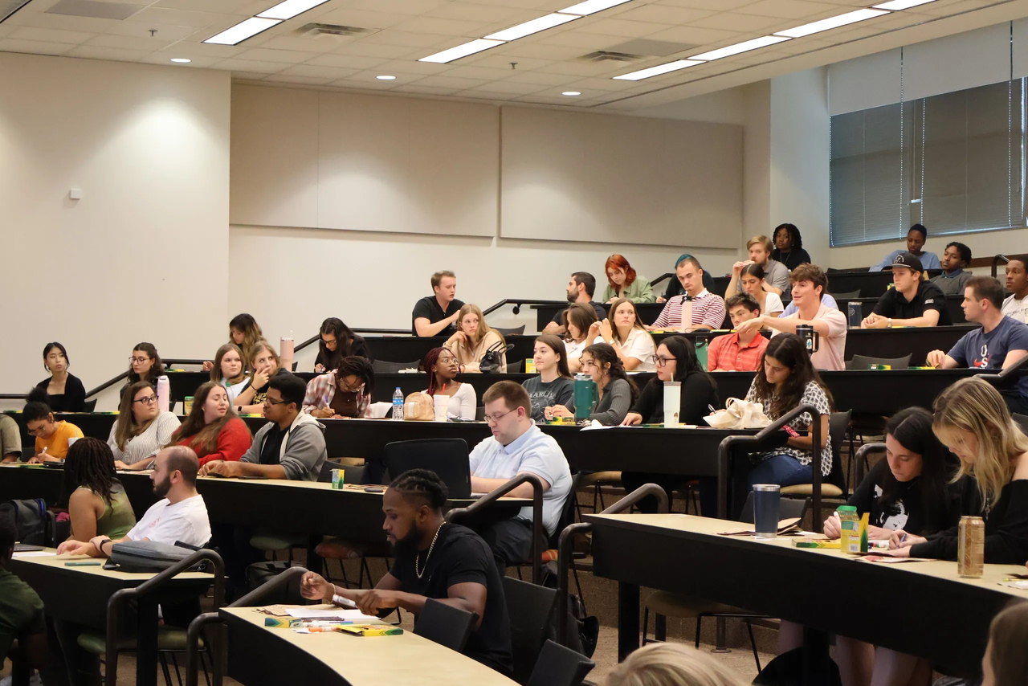
KNACK Tutors Fall Semester (ACCT 2102)
How can I help other students?
This opportunity is to lead exam prep sessions using instructor provided materials. Great for students looking to practice theyre accoutning knowledge.
Lead sessions for 15 - 20 students
Flexible Scheduling
Paid: $16/hour
Virtual or In-Person
Contact for questions? Harriett Pyburn
E: hpyburn@kennesaw.edu

Slide 6
Tentative Spring 2026 Schedule
Professional Development
Community
Service
DATE | MEETING | TIME | TYPE | ATTIRE
1/16/2026 | INFORMATION SESSION | 2:30 - 4:00 | - | BUSINESS CASUAL
1/23/2026 | BAP JEOPARDY | 2:30 - 4:00 | PD | BUSINESS PROFESSIONAL
2/6/2026 | RESUME REVIEW | 2:30 - 4:00 | PD | BUSINESS PROFESSIONAL
2/13/2026 | INTERNAL AUDIT PANEL | 2:30 - 4:00 | PD | BUSINESS PROFESSIONAL
3/27/2026 | PREPARING FOR GRADUATE EDUCATION | 2:30 - 4:00 | PD | BUSINESS PROFESSIONAL
4/3/2026 | BE AUDIT YOU CAN BE | 2:30 - 4:00 | PD | BUSINESS PROFESSIONAL
DATE | MEETING | TIME | TYPE | ATTIRE
1/30/2026 | SILVERWARE ROLLING | 2:30 - 4:00 | CS | BUSINESS CASUAL
2/26/2026 | BOOKS FOR AFRICA | 1:00 - 3:00 | CS | KSU OR BAP ATTIRE
3/6/2026 | JUNIOR ACHIEVEMENT | 8:00 - 3:00 | CS | KSU OR BAP ATTIRE
- | - | - | - | -
- | - | - | - | -
- | - | - | - | -

Slide 7
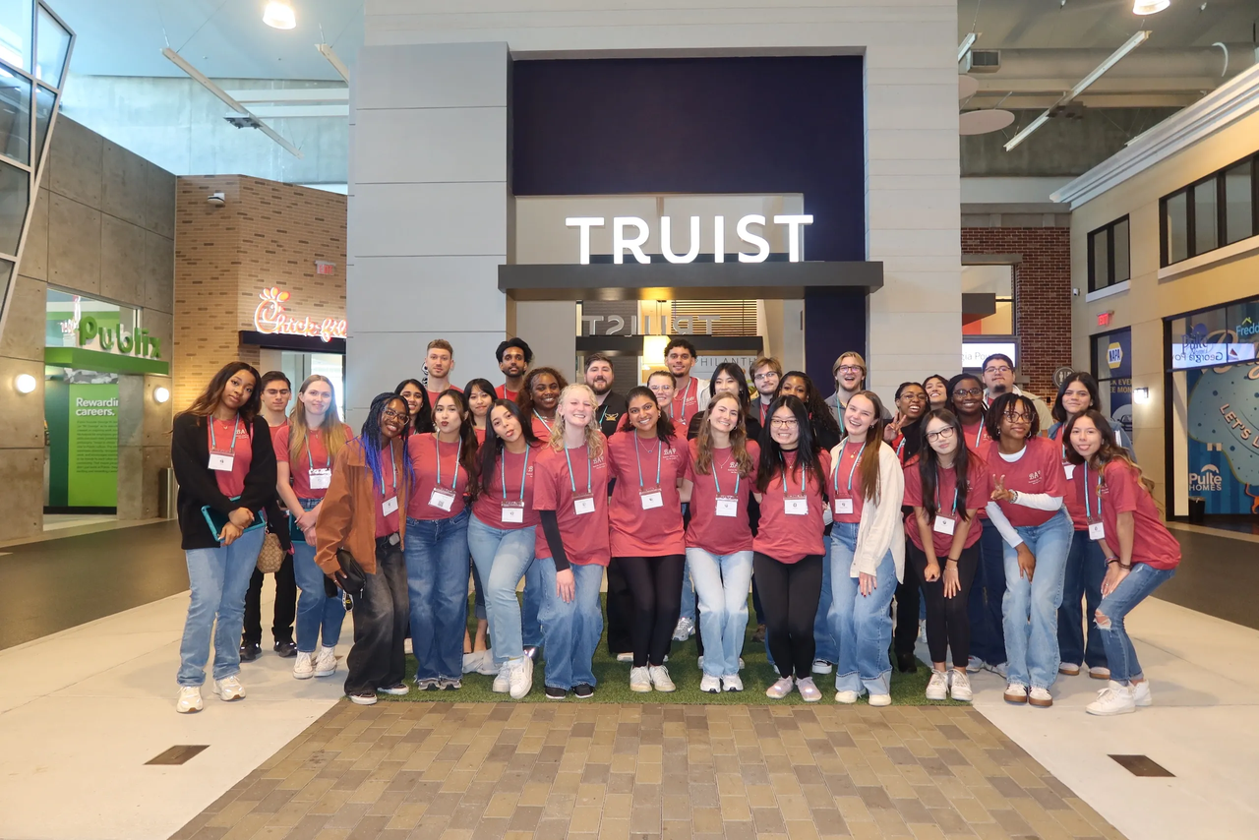
Non-BAP Community Service & Professional Development
What if i can’t attend enough meetings?
Members and Candidates may earn up to 2 PD hours and 1 CS hour outside of BAP. All hours must be submitted using the Non-BAP CS and PD Hours Form at ksubap.com/resources.
Request must be submitted to our BAP reporter 2 days before the event it is supposed to occur
Form must be submitted within 1 week from completion of event

Slide 8

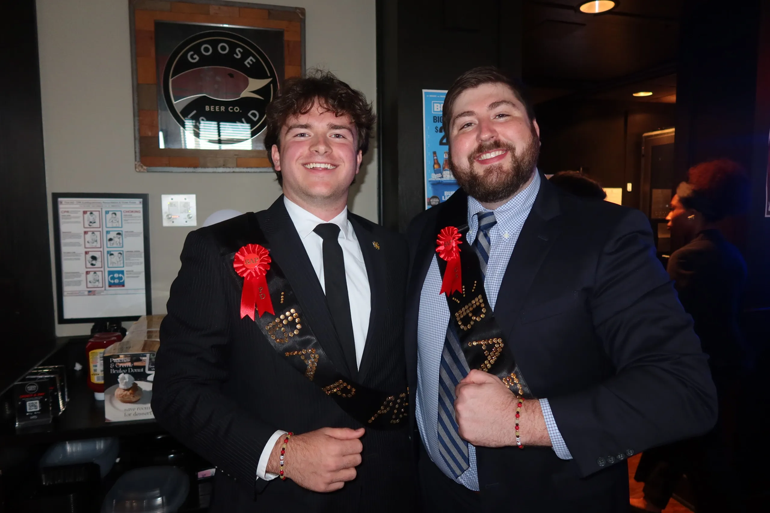
BAP Pie Awards
Overview: BAP Iota Tau Chapter recognizes students who show outstanding participation at scheduled events
Awards:​
Most Professional Development Award​
Most Community Service Award
Prize:​
Pie and recognition

Slide 9

Beta Alpha Psi Initiation
Overview: Members will attend the Initiation Ceremony to celebrate new candidates becoming official BAP members and to recognize graduating seniors for their achievements and contributions.
Location: KSU Center, Room 300 (Off the Atrium)
Time: 12:00 PM - 2:00 PM
Additional Details:
Business professional attire required
ONLY for candidates and members
Attendance is mandatory

Slide 10
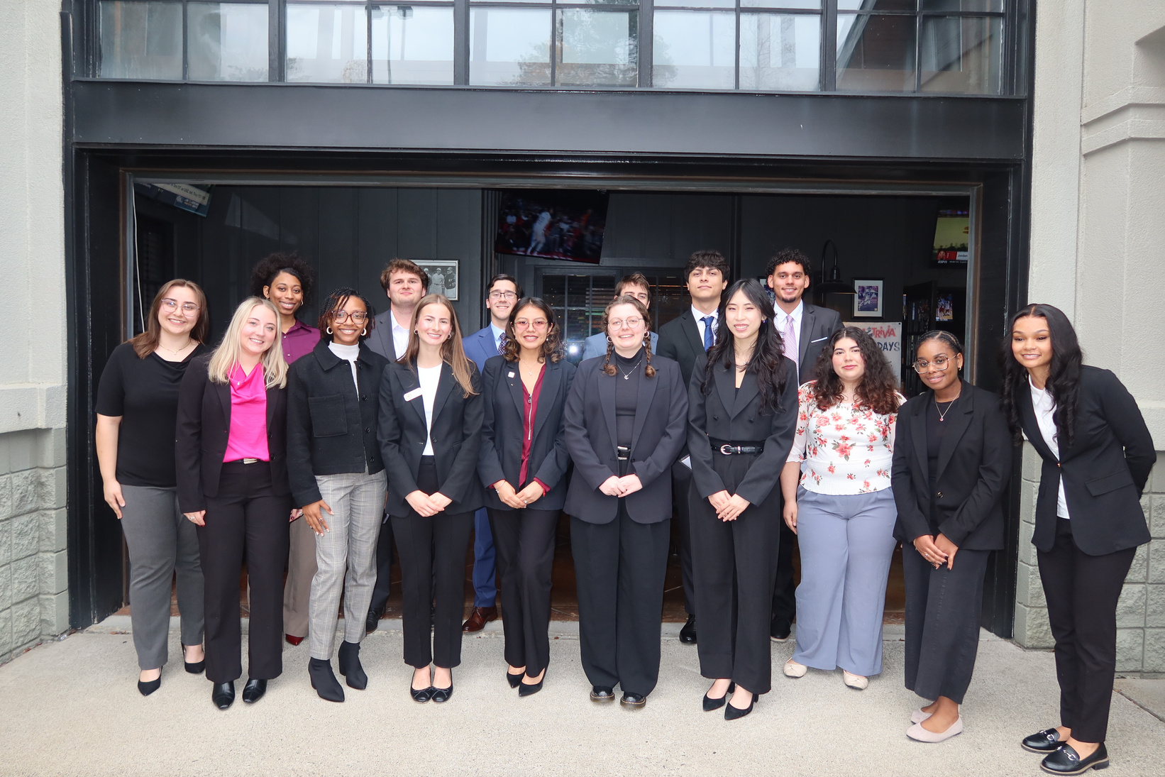
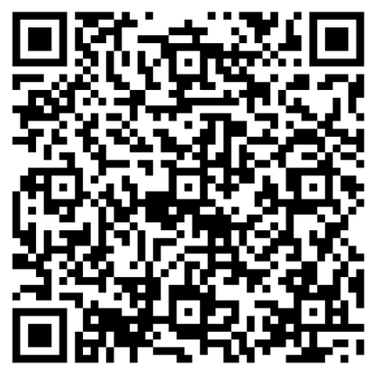
Senior Spotlight: Then vs Now
Overview: As part of initiation, we will be recognizing our graduating members through a Senior Spotlight. Each spotlight will feature a baby photo alongside a current photo to celebrate how far you have come.
What to Submit:
One baby or childhood photo
One current or professional photo
Name pronunciation (phonetic spelling)
Deadline: 04/07/2026 @Midnight
Complete the form now!!!

Slide 11

Next Meeting: Be Audit You Can Be
Overview: This session will feature a panel of professionals across different audit paths sharing insights into their roles, career journeys, and how students can prepare for recruiting.
Credit: Counts toward 1.5 Professional Development (PS) hours
Business Professional Attire
What to Expect:
Learn about different audit career paths and industries
Understand key skills and what firms look for in candidates

Slide 12
Preparing Graduate Education
Hear from graduate programs & firms
Engage with firms & representatives
Continue the conversation
Learn what programs offer, what to expect, and future plans.
Ask questions and learn how to prepare for your future.
Connect with professionals and start building relationships.

Slide 13
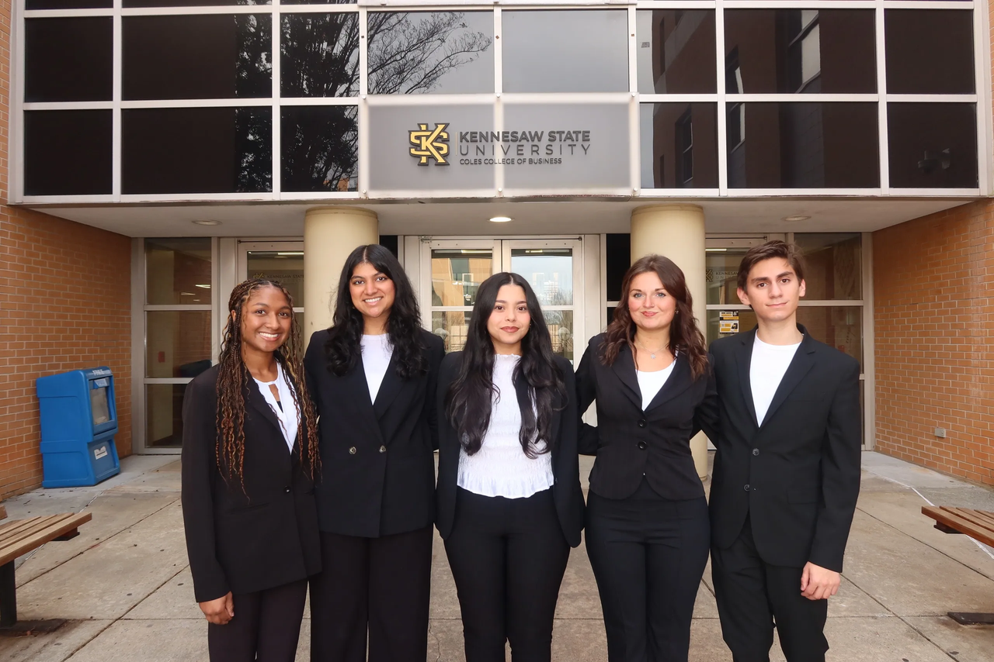
Contact Us
Beta Alpha Psi - Iota Tau Chapter
Contact EC for any specific questions:
Karen Flores-Padilla, President
E: kfloresp@students.kennesaw.edu
Zainab Choudhary, Vice President
E: zchoudh1@students.kennesaw.edu
Eric Super, Treasurer
E: esuper@students.kennesaw.edu
Mya Bacchus , Reporter
E: mbacchu2@students.kennesaw.edu
Hailey Young, Marketing Director
E: hyoung32@students.kennesaw.edu
Contacts for other questions:
Shannon Shumate:
E: sshumat2@kennesaw.edu
Amanda York:
E: ayork23@kennesaw.edu

Slide 14


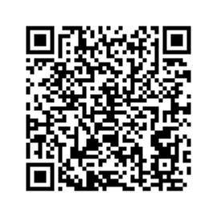
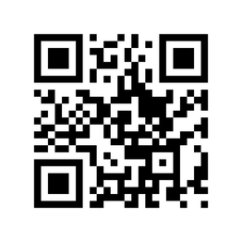
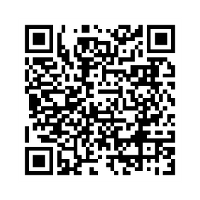
Follow US
Instagram
Website
LinkedIn

Slide 15
Kennesaw State University
Thank You!
Iota Tau Chapter
Visit Our Website
ksubap.com

