Slide 1





Kennesaw State University
BETA ALPHA PSI
Iota Tau Chapter
Visit Our Website
ksubap.com

Slide 2


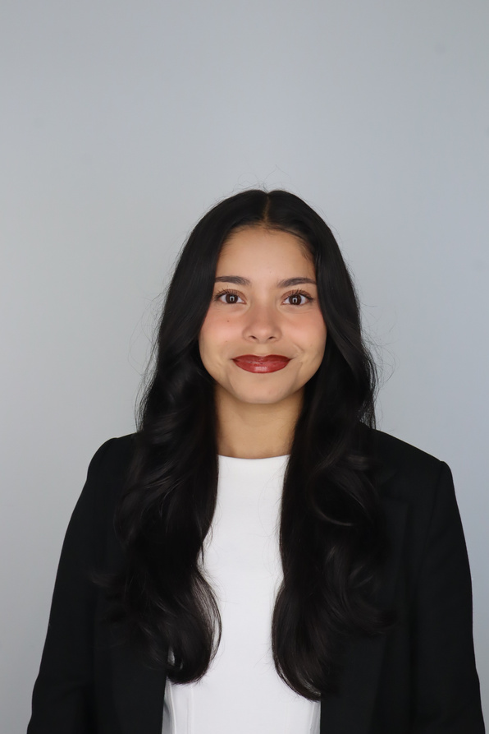
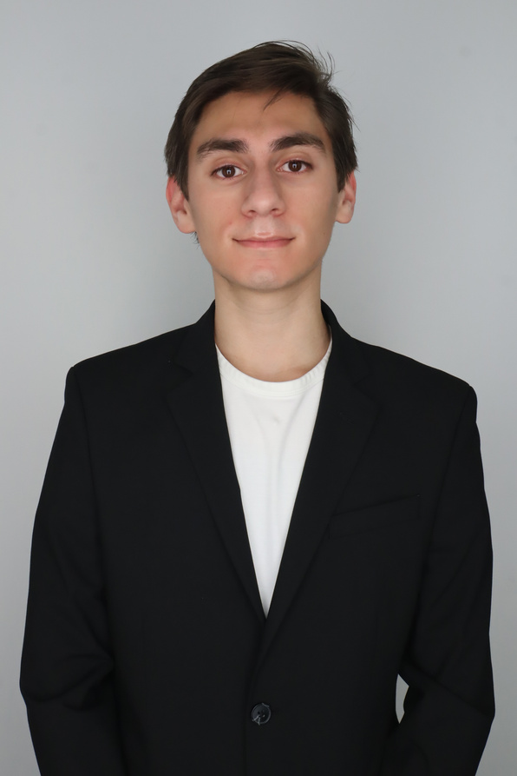
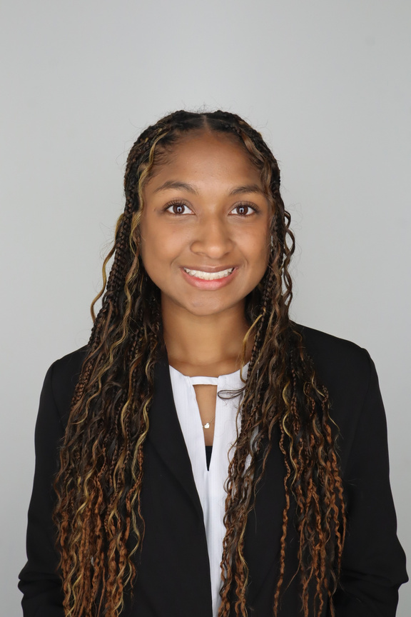
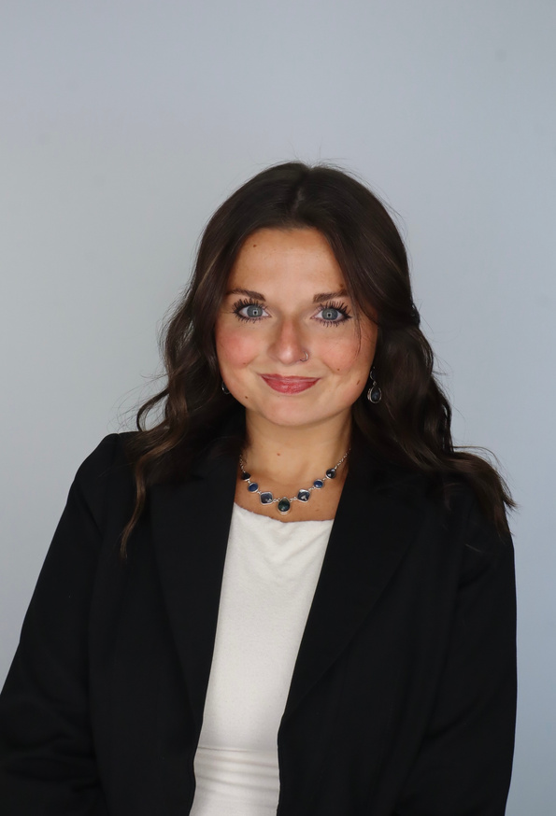
Meet The Executive Committee
Karen Flores-Padilla
Zainab Choudhary
Eric Super
President
Vice President
Treasurer
Mya Bacchus
Hailey Young
Reporter
Marketing Director

Slide 3

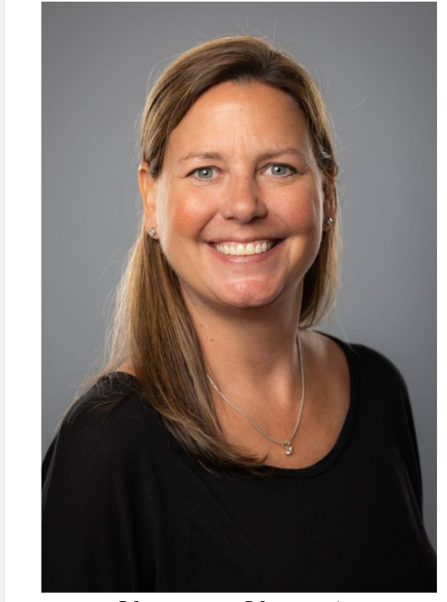
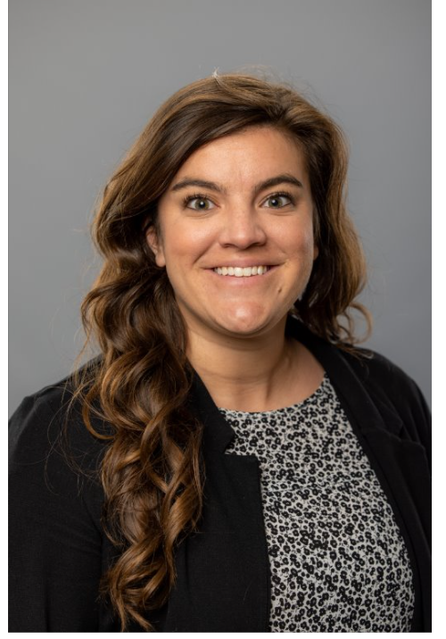
Meet The Advisors
Shannon Shumate
Amanda York
Principal Lecturer
Associate Director, Strategic Partnerships

Slide 4


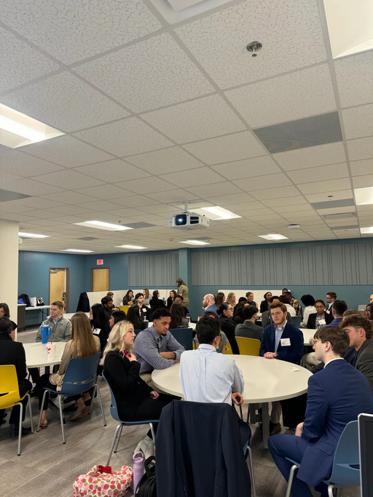



Meeting Expectations
When attending a meeting please ensure be remain respectful to speakers.
Electronics Silent
Networking
Cellphones should be put on silent for company visits
01
02
Network and engage with your peers
04
03
Professional Attire
Food & Drinks
Business Professional attire for company visits
Be mindful of snacking
05
Timeliness
Enter quietly if you arrive late between transitions

Slide 5
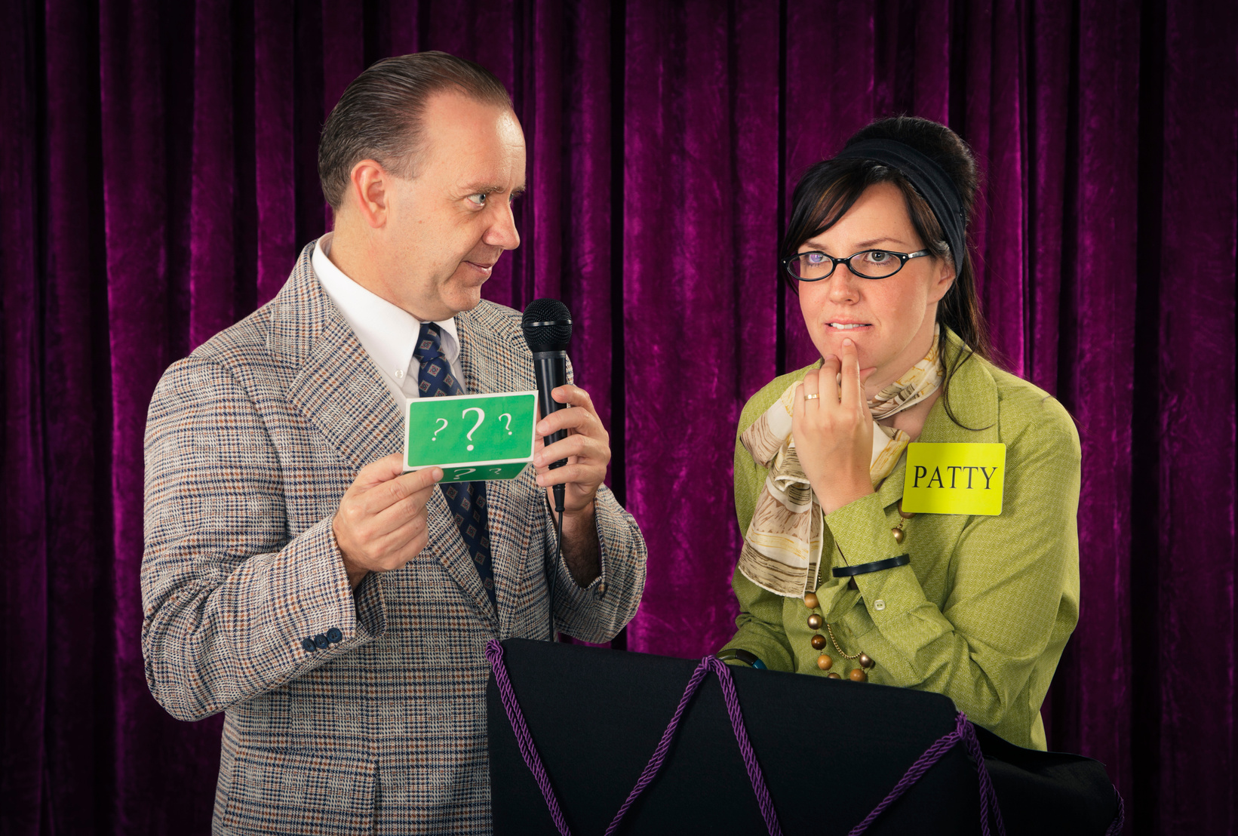
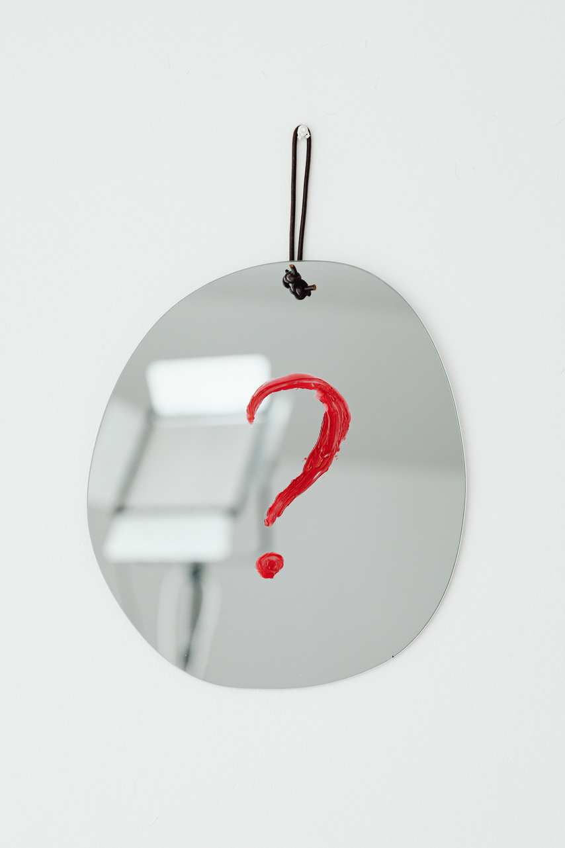
Today’s Meeting: BAP Jeopardy
Overview: This session will divide students into four teams paired with visiting firms to compete in a Jeopardy-style game focused on accounting knowledge, collaboration, and networking.
Meeting Agenda:
Upcoming Events & Reminders
BAP Announcements
BAP Jeopardy with Firms: Aprio, Bennett Thrasher, Carr Riggs & Ingram, CliftonLarsonAllen, CohnReznick, HLB Gross Collins, and Nichols Cauley

Slide 6
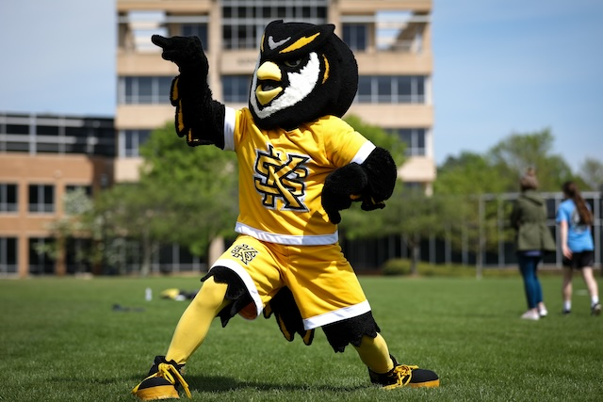
Upcoming Events
Jan 26
Coles Fest Spring 2026
11:00 - 2:00
Feb 02
Tetley Talk with Joylon Bulley
2:00 - 3:00
Feb 12
MAcc Information Session
12:00 - 1:00
Feb 12
Meet the Firms
12:00 - 3:00
Feb 17
The Georgia Society of CPAs Wine & Work @ Vino Venue
5:00 - 7:00

Slide 7
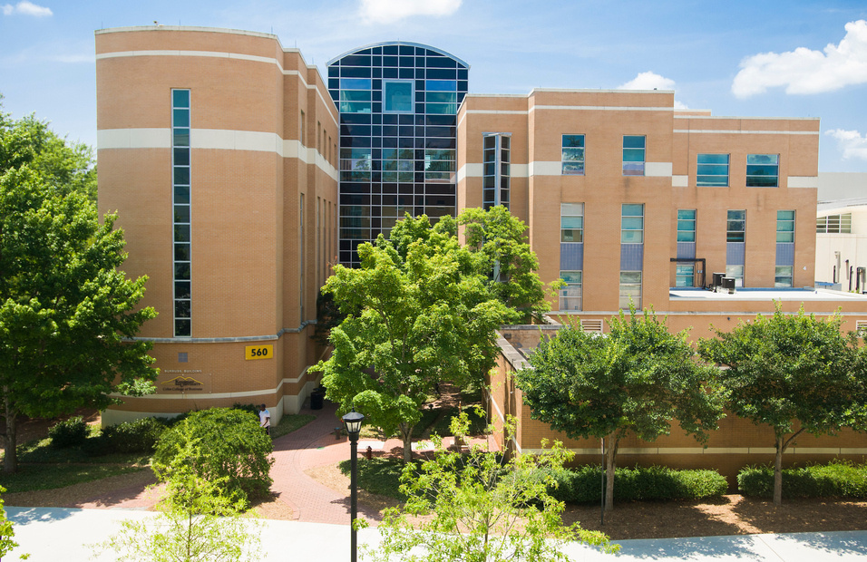
Important Reminders
Feb 01
GSCPA Scholarship Applications
Mar 01
Kennesaw State University Scholarships
Mar 15
AICPA Foundation Legacy Scholarships
N/A
Beta Alpha Psi Scholarships
N/A
Accounting Summer Leadership Programs 2026

Slide 8
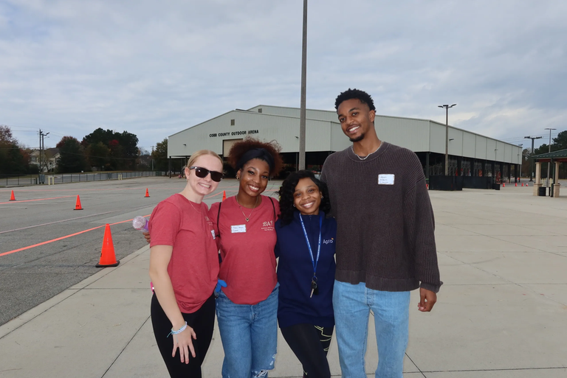
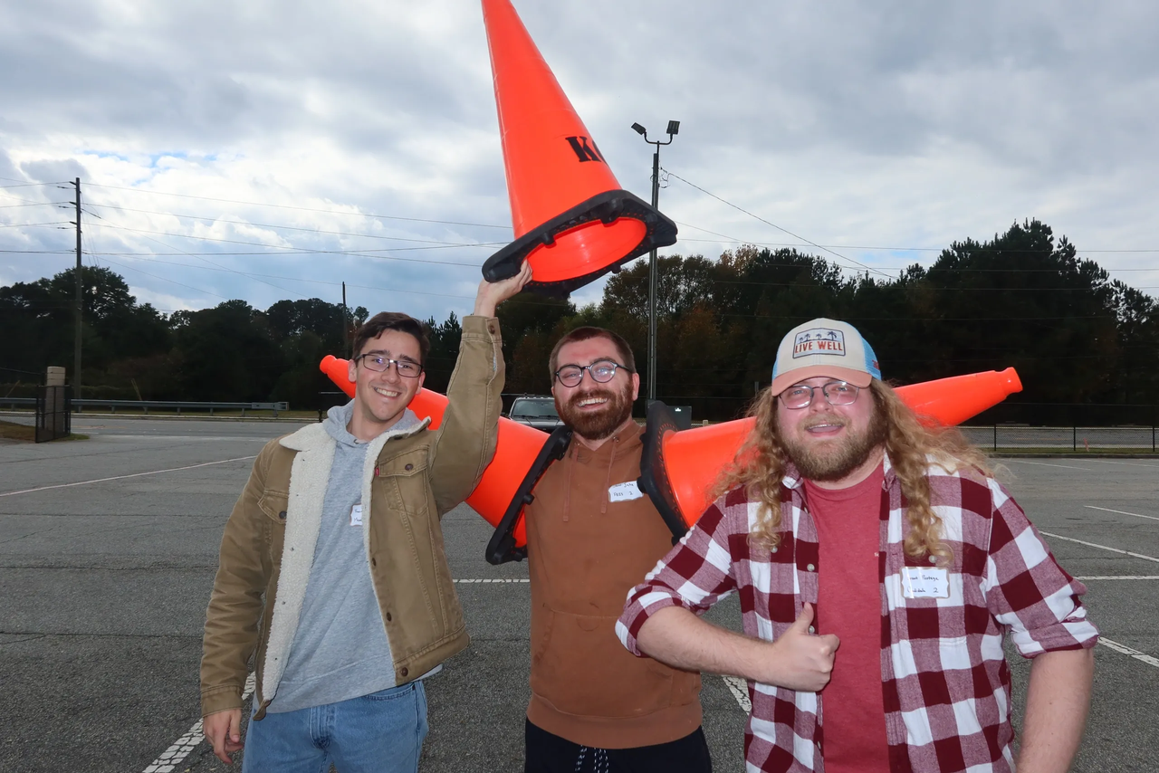
Not Eligible? Join as FBIS!
Overview: FBIS is the feeder program into becoming a Beta Alpha Psi Candidate. If you don't yet meet the 3100 requirement to become a Candidate​ join FBIS!
$32 per semester​
No participation requirements
Access to most events
No GPA requirement

Slide 9
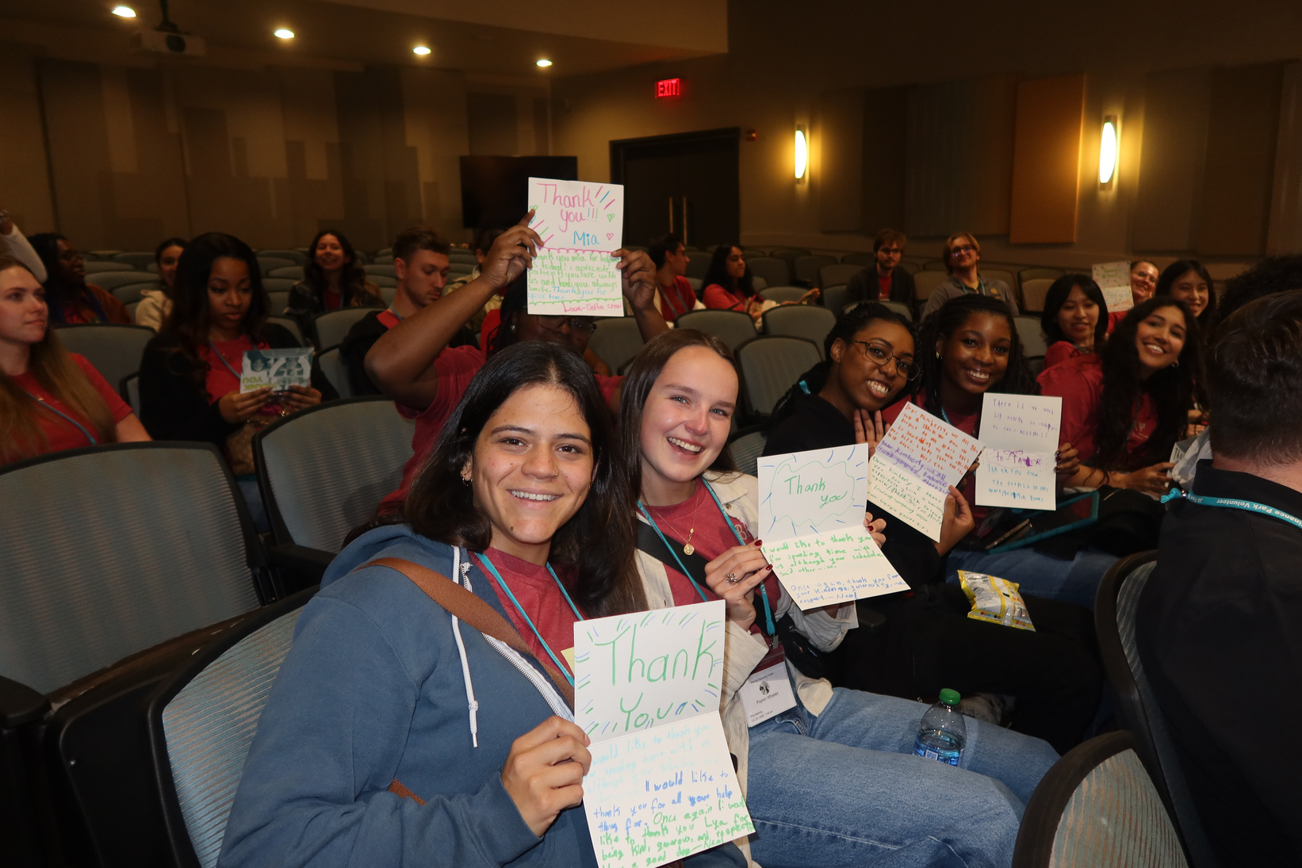
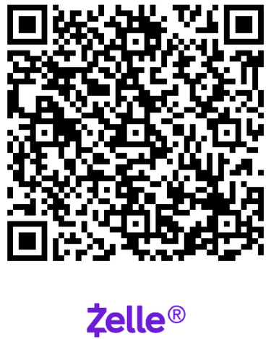
Candidate & Member Requirements
How to Join?
Must commit to 1 semester as Candidate & 1 semester as Member:
3 hours of community service​ (CS)
6 hours of professional development​ (PD)
1st Semester - $115 – Candidate​
2nd Semester - $52 – Member​
Final registration and payment
deadline : Wednesday, January 28th
@11:59 pm​
Pay Dues with Zelle

Slide 10


BAP Chapter Contracts
Overview: Beta Alpha Psi Iota Tau Chapter requires a physical contract to be signed that details requirements and expectations​.
Only Members and Candidates must sign and return the contract; FBIS should still review the BAP Code of Ethics
Contracts will be distributed in-person at the next meeting
Signed contracts will must be given to Shannon Shumate
Signed contracts deadline: Friday, Feburary 6th

Slide 11
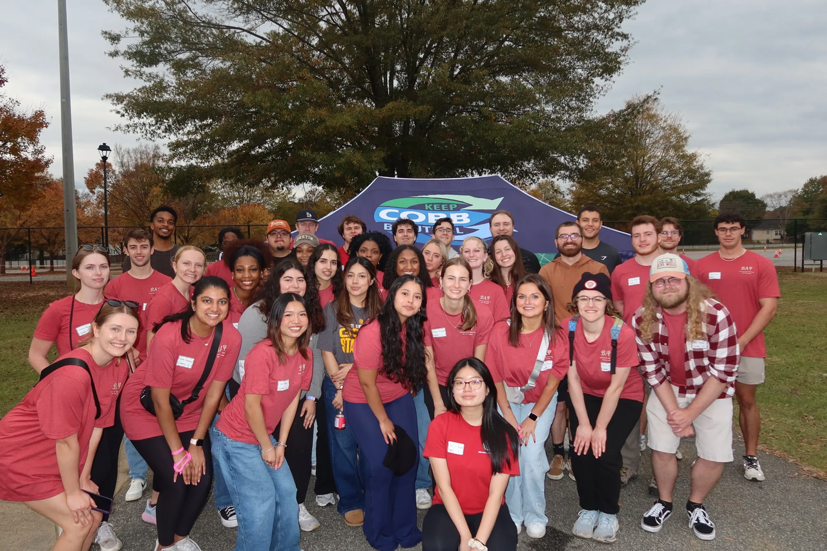
Non-BAP Community Service & Professional Development
What if i can’t attend enough meetings?
Members and Candidates may earn up to 2 PD hours and 1 CS hour outside of BAP. All hours must be submitted using the Non-BAP CS and PD Hours Form at ksubap.com/resources.
Request must be submitted to our BAP reporter 2 days before the event it is supposed to occur
Form must be submitted within 1 week from completion of event

Slide 12

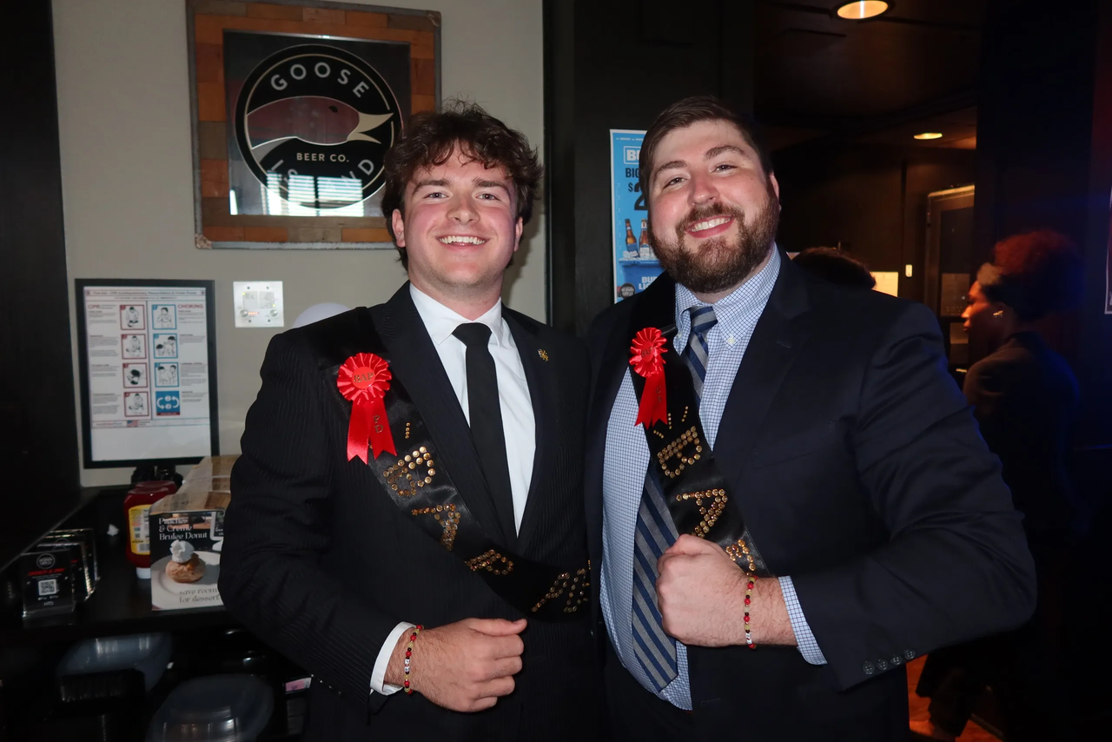
BAP Pie Awards
Overview: BAP Iota Tau Chapter recognizes students who show outstanding participation at scheduled events
Awards:​
Most Professional Development Award​
Most Community Service Award
Prize:​
Pie, recognition, and a surprise

Slide 13
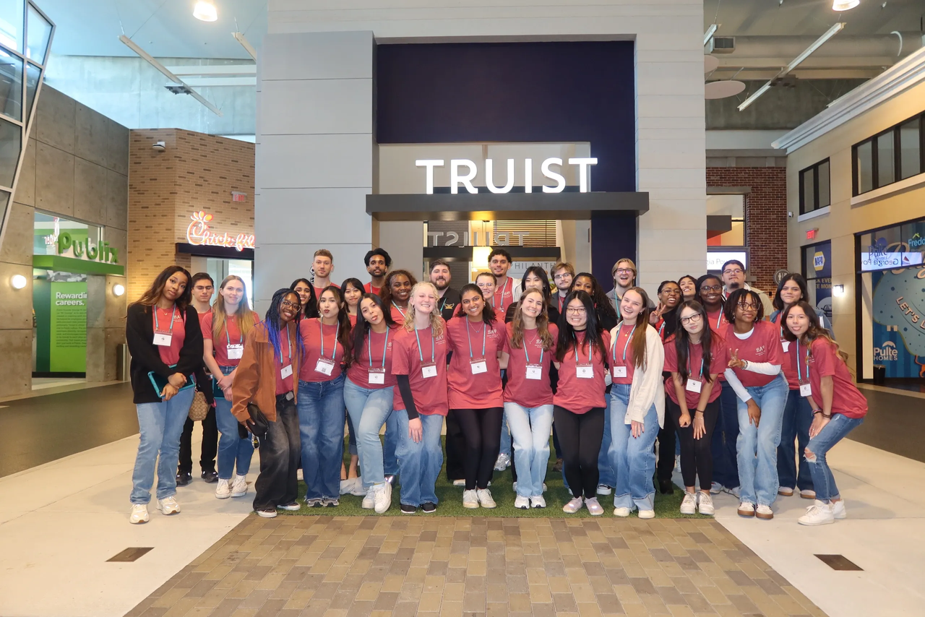
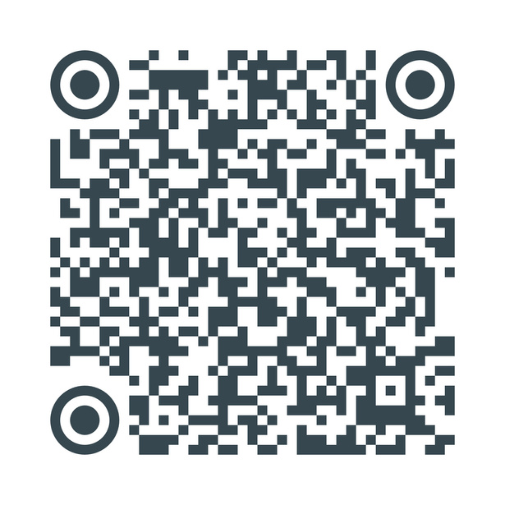
Volunteers for Mass Exams
Overview: Student volunteers are needed to serve as proctors for mass Accounting exams, assisting faculty to support academic integrity within the School of Accountancy.
Dates: February 6, 7, and 14
Role: Proctor support and exam logistics assistance
Credit: Counts toward Community Service (CS) hours
Sign-up now!!!

Slide 14






Registration Deadline & Degree Works Transcript
01
02
03
04
Go into Degree Works
Press CTRL + P (do NOT use printer icon)
Destination: Save as PDF
Layout: Landscape then SAVE
Final registration and payment deadline : Wednesday, January 28th @11:59 pm​
ONLY Candidates, Members, and On-Leave must email a copy of their transcript
Degree Works Transcripts must be submitted to Professor Shannon Shumate at sshumat2@kennesaw.edu.

Slide 15

Tentative Spring 2026 Schedule
Professional Development
Community
Service
DATE | MEETING | TIME | TYPE | ATTIRE
1/16/2026 | INFORMATION SESSION | 2:30 - 4:00 | PD | BUSINESS CASUAL
1/23/2026 | BAP JEOPARDY | 2:30 - 4:00 | PD | BUSINESS PROFESSIONAL
2/6/2026 | RESUME REVIEW | 2:30 - 4:00 | PD | BUSINESS PROFESSIONAL
2/13/2026 | AI IN THE BUSINESS WORLD | 2:30 - 4:00 | PD | BUSINESS PROFESSIONAL
3/27/2026 | PREPARING FOR GRADUATE EDUCATION | 2:30 - 4:00 | PD | BUSINESS PROFESSIONAL
4/3/2026 | BE AUDIT YOU CAN BE | 2:30 - 4:00 | PD | BUSINESS PROFESSIONAL
DATE | MEETING | TIME | TYPE | ATTIRE
1/30/2026 | SILVERWARE ROLLING | 2:30 - 4:00 | CS | BUSINESS CASUAL
2/26/2026 | BOOKS FOR AFRICA | 1:00 - 3:00 | CS | KSU OR BAP ATTIRE
3/6/2026 | JUNIOR ACHIEVEMENT | 8:00 - 3:00 | CS | KSU OR BAP ATTIRE
- | - | - | - | -
- | - | - | - | -
- | - | - | - | -

Slide 16



Jeopardy
Jeopardy Link
Step One:
Step Two:
Step Three:
Lock In
Play
Win

Slide 17


Next Meeting: Silverware Rolling
Overview: Students and visiting professionals will assemble silverware for Meals on Wheels, combining community service with teamwork and engagement.
Visiting companies:
BDO, CohnReznick, HLB Gross Collins, and Koch Industries.
Business Casual Attire

Slide 18

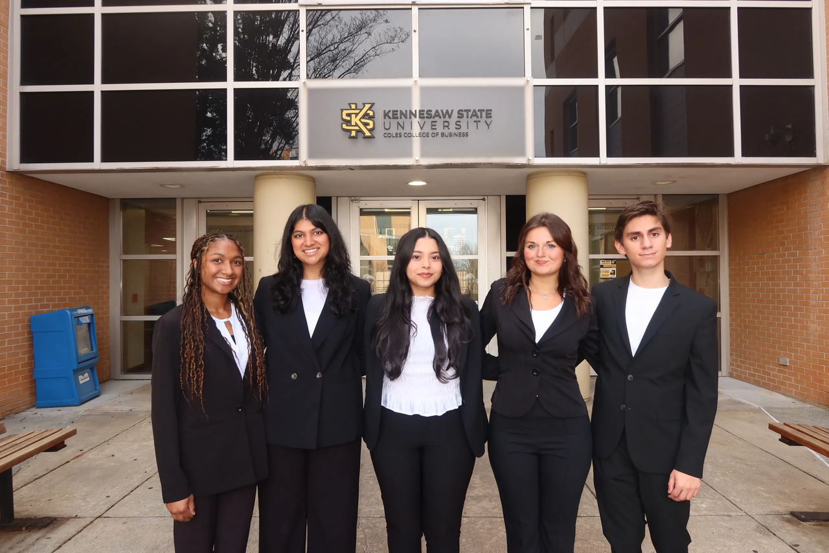
Contact Us
Beta Alpha Psi - Iota Tau Chapter
Contact EC for any specific questions:
Karen Flores-Padilla, President
E: kfloresp@students.kennesaw.edu
Zainab Choudhary, Vice President
E: zchoudh1@students.kennesaw.edu
Eric Super, Treasurer
E: esuper@students.kennesaw.edu
Mya Bacchus , Reporter
E: mbacchu2@students.kennesaw.edu
Hailey Young, Marketing Director
E: hyoung32@students.kennesaw.edu
Contacts for other questions:
Shannon Shumate:
E: sshumat2@kennesaw.edu
Amanda York:
E: ayork23@kennesaw.edu

Slide 19
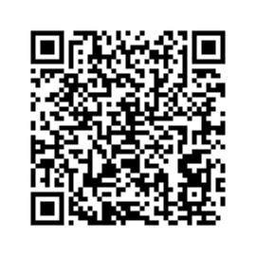
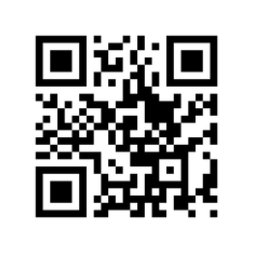
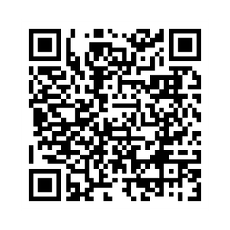
Follow US
Instagram
Website
LinkedIn

Slide 20
Kennesaw State University
Thank You!
Iota Tau Chapter
Visit Our Website
ksubap.com

