Slide 1





Kennesaw State University
BETA ALPHA PSI
Iota Tau Chapter
Visit Our Website
ksubap.com

Slide 2
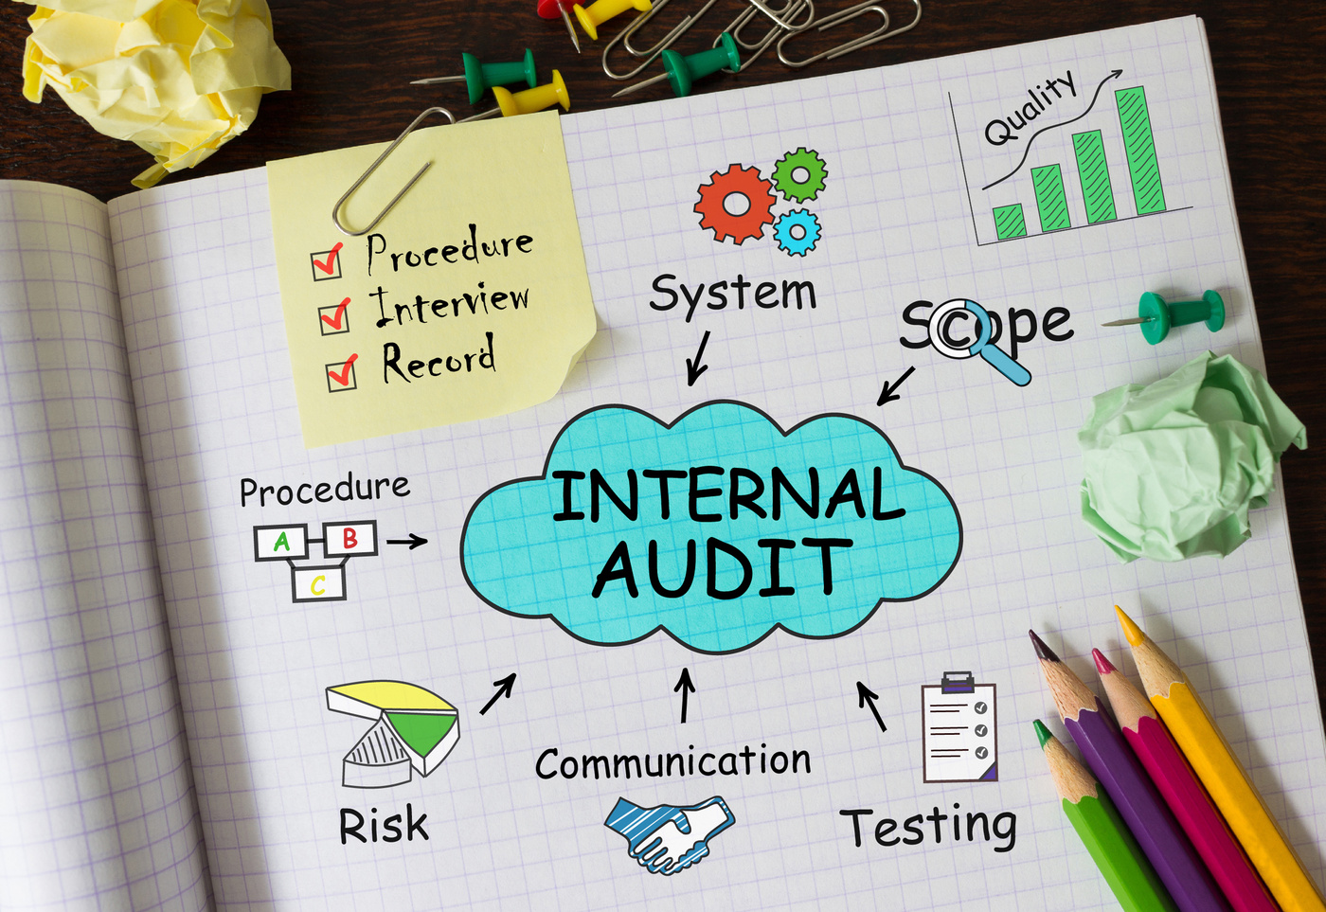

Today’s Meeting: Internal Audit Panel
Overview: This panel will cover the role of Internal Audit, the use of GenAI and technology in audit, and the professional pathway from Internal Audit Practitioner to Certified Internal Auditor, highlighting how audit adds value across organizations and career development opportunities for students.
Meeting Agenda:
Upcoming Events & Reminders
BAP Announcements
Internal Audit Panel with Firms: Axis Capital, Brambles, Cobb County Government, and UPS

Slide 3
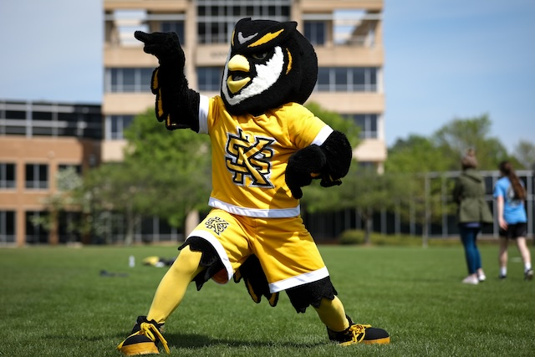
Upcoming Events
Feb 16
Coles Leadership Scholars Information Session
4:00 - 4:45
Feb 17
Aprio Social @Tin Lizzy’s RSVP: To Ellie McAlpin at ellie.mcalpin@aprio.com
5:00 - 7:00
Feb 18
Coles Fest Spring 2026
11:00 - 2:00
Feb 25
Industry Voices Sarah Branch
1:00 - 2:00

Slide 4
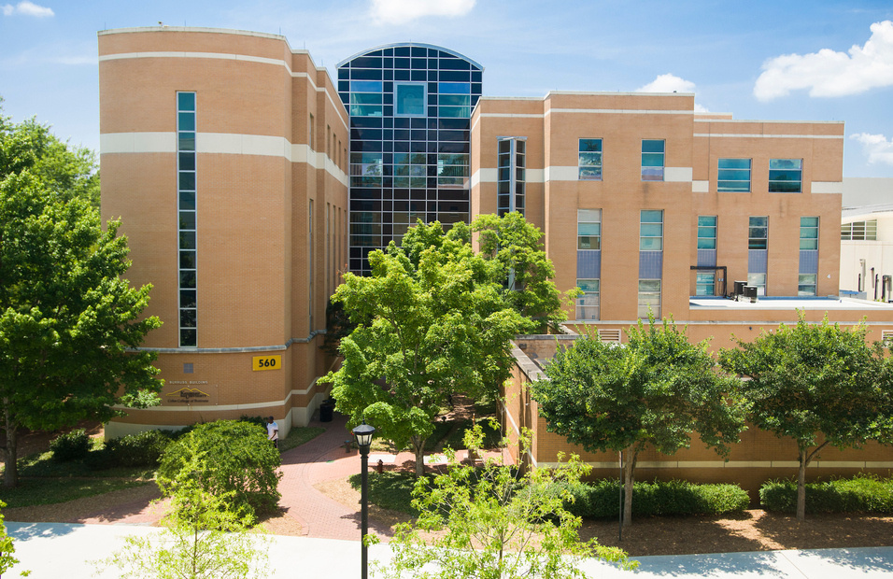
Important Reminders
Mar 01
KSU Foundation & School of Accountancy Scholarships
Mar 10
Newt D. Becker Scholarship
Mar 15
AICPA Foundation Legacy Scholarships
Apr 30
DeKalb Chapter Scholarship
N/A
Beta Alpha Psi Scholarships
N/A
Accounting Summer Leadership Programs 2026

Slide 5

Tentative Spring 2026 Schedule
Professional Development
Community
Service
DATE | MEETING | TIME | TYPE | ATTIRE
1/16/2026 | INFORMATION SESSION | 2:30 - 4:00 | - | BUSINESS CASUAL
1/23/2026 | BAP JEOPARDY | 2:30 - 4:00 | PD | BUSINESS PROFESSIONAL
2/6/2026 | RESUME REVIEW | 2:30 - 4:00 | PD | BUSINESS PROFESSIONAL
2/13/2026 | INTERNAL AUDIT PANEL | 2:30 - 4:00 | PD | BUSINESS PROFESSIONAL
3/27/2026 | PREPARING FOR GRADUATE EDUCATION | 2:30 - 4:00 | PD | BUSINESS PROFESSIONAL
4/3/2026 | BE AUDIT YOU CAN BE | 2:30 - 4:00 | PD | BUSINESS PROFESSIONAL
DATE | MEETING | TIME | TYPE | ATTIRE
1/30/2026 | SILVERWARE ROLLING | 2:30 - 4:00 | CS | BUSINESS CASUAL
2/27/2026 | BOOKS FOR AFRICA | 1:00 - 3:00 | CS | KSU OR BAP ATTIRE
3/6/2026 | JUNIOR ACHIEVEMENT | 8:00 - 3:00 | CS | KSU OR BAP ATTIRE
- | - | - | - | -
- | - | - | - | -
- | - | - | - | -

Slide 6
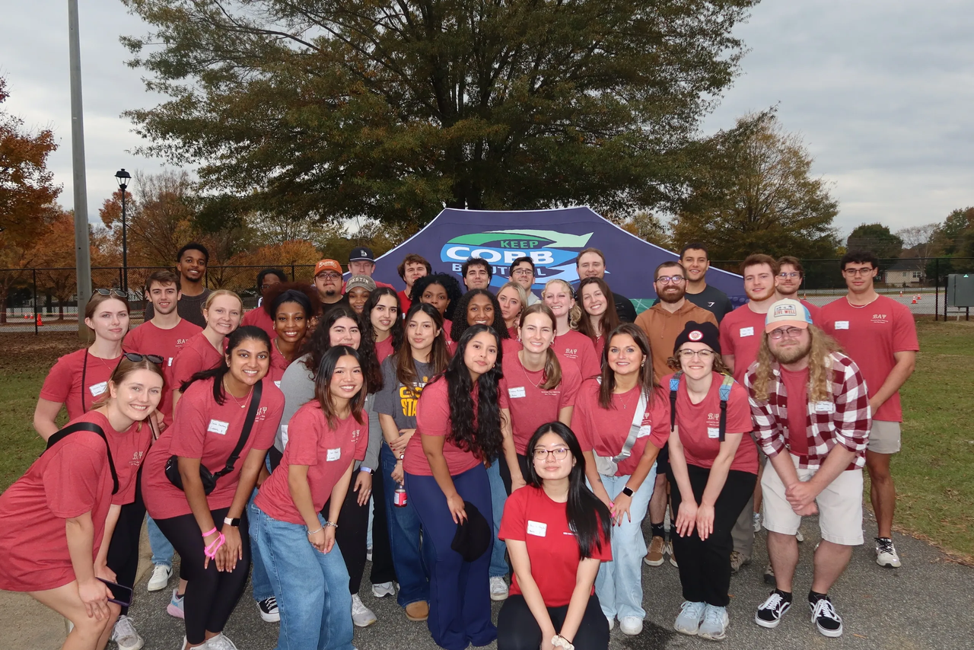
Non-BAP Community Service & Professional Development
What if i can’t attend enough meetings?
Members and Candidates may earn up to 2 PD hours and 1 CS hour outside of BAP. All hours must be submitted using the Non-BAP CS and PD Hours Form at ksubap.com/resources.
Request must be submitted to our BAP reporter 2 days before the event it is supposed to occur
Form must be submitted within 1 week from completion of event

Slide 7
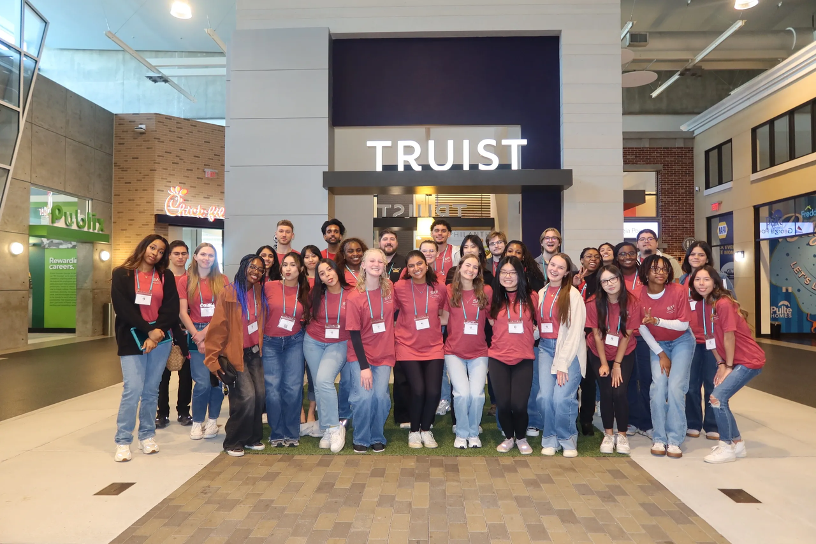
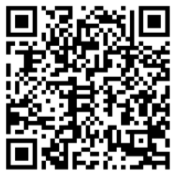
Junior Achievement CS
Overview: Students will work with kids to engage in interactive simulations, gaining insight into business, finance, and career pathways.
Date: Friday, March 6th
Time: 8:00 AM - 3:00 PM
Location: JA Chick-Fil-A Discovery Center
KSU or BAP Attire
ONLY for Candidates and Members
Worth 7.0 CS Hours
Parking, Coffee, Training, and Lunch provided
Sign-up now!!!

Slide 8

Next Meeting: Books For Africa CS
Overview: Student volunteers will assist with packing donated books into boxes for Books For Africa. Volunteers will help sort, organize, and prepare materials for shipment, supporting global access to education and literacy initiatives.
Date: Friday, February 27th
Location: 1491 Cobb Industrial Drive, Bldg. B Marietta, GA 30066
Credit: Counts toward 2 Community Service (CS) hours
Email with directions and reminders will be sent to students 02/23/2026

Slide 9



Internal Audit Panel Outline
Hear from professionals
Engage with firms & auditors
Continue the conversation
Explore career paths, industries, and what auditors do.
Ask questions and learn how to prepare for recruiting.
Meet representatives and expand your network.

Slide 10

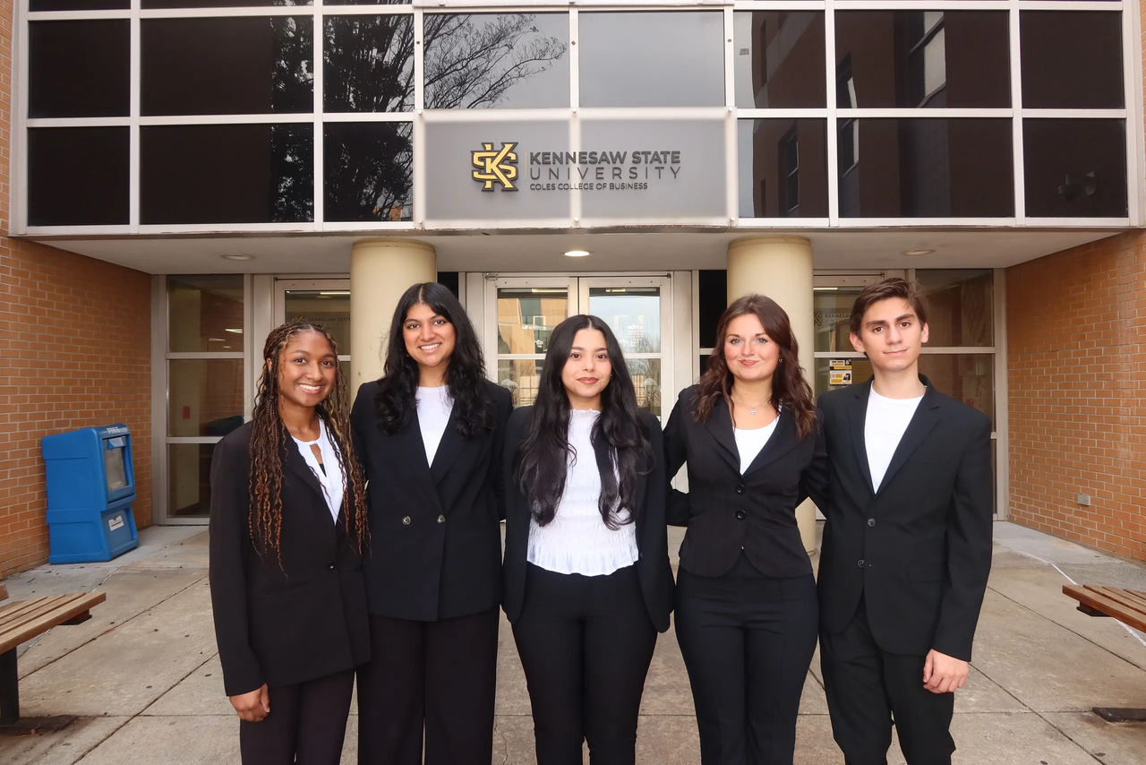
Contact Us
Beta Alpha Psi - Iota Tau Chapter
Contact EC for any specific questions:
Karen Flores-Padilla, President
E: kfloresp@students.kennesaw.edu
Zainab Choudhary, Vice President
E: zchoudh1@students.kennesaw.edu
Eric Super, Treasurer
E: esuper@students.kennesaw.edu
Mya Bacchus , Reporter
E: mbacchu2@students.kennesaw.edu
Hailey Young, Marketing Director
E: hyoung32@students.kennesaw.edu
Contacts for other questions:
Shannon Shumate:
E: sshumat2@kennesaw.edu
Amanda York:
E: ayork23@kennesaw.edu

Slide 11


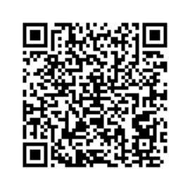
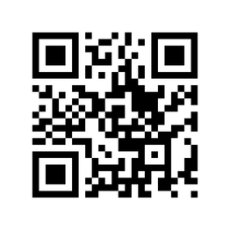
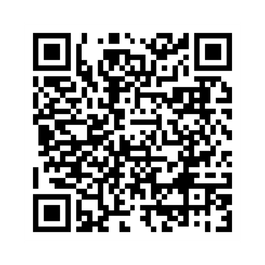
Follow US
Instagram
Website
LinkedIn

Slide 12
Kennesaw State University
Thank You!
Iota Tau Chapter
Visit Our Website
ksubap.com

