Slide 1




Kennesaw State University
BETA ALPHA PSI X NABA INC
Iota Tau Chapter
Visit Our Websites
ksubap.com
nabakennesaw.com

Slide 2
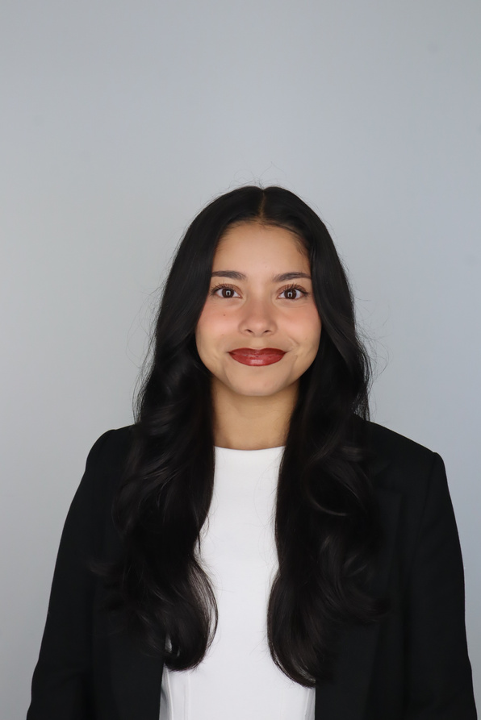
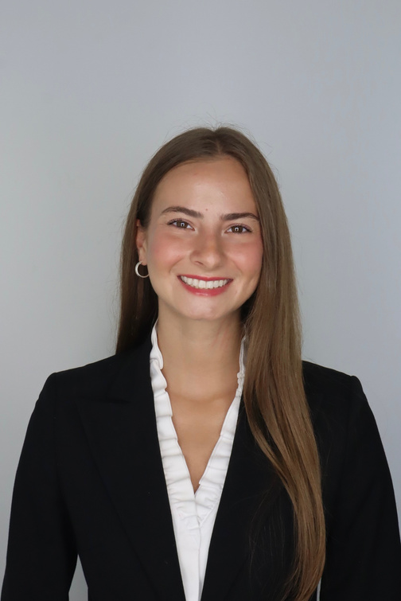
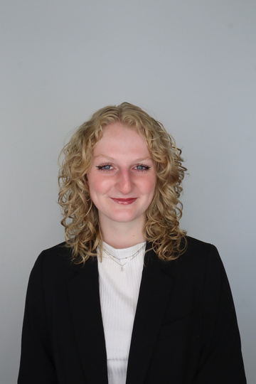

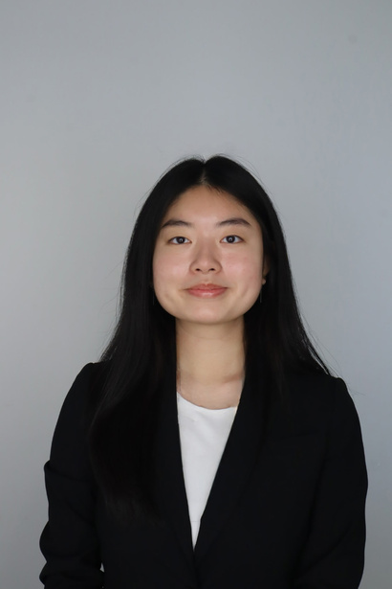
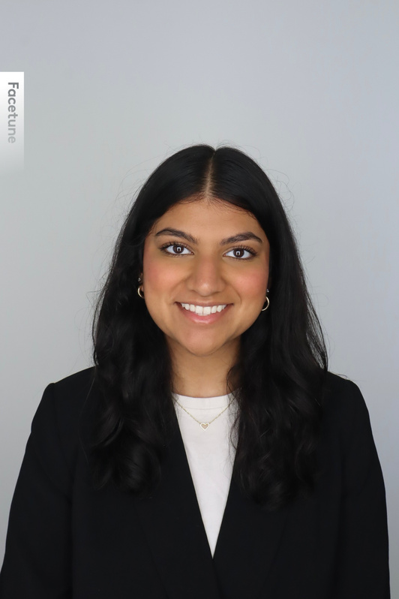
BAP Executive Committee
Karen Flores-Padilla
Lindsey Mcclelland
Kelsey Barton
President
Vice President
Reporter
Anchiella Angelle
Zainab Choudhary
Events Director
Marketing Director

Slide 3
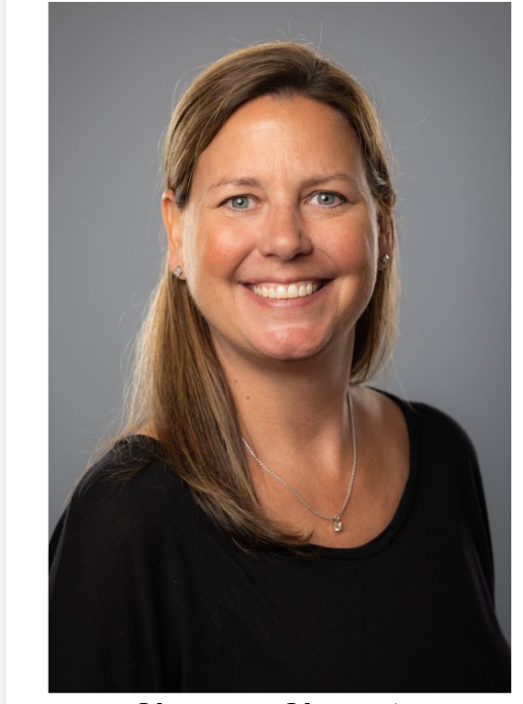
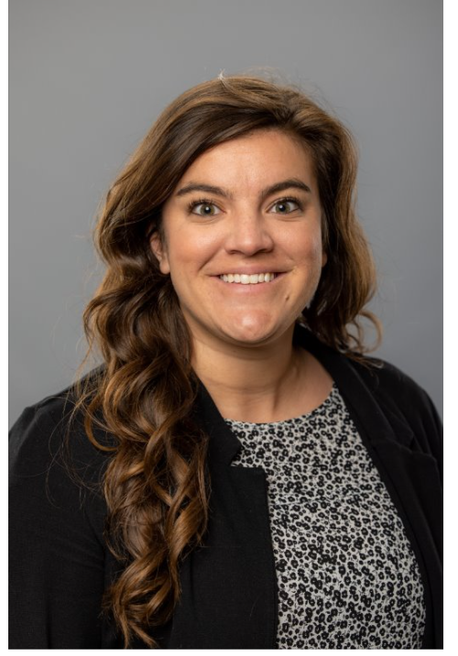
BAP Advisors
Shannon Shumate
Amanda York
Principal Lecturer
Associate Director, Strategic Partnerships

Slide 4
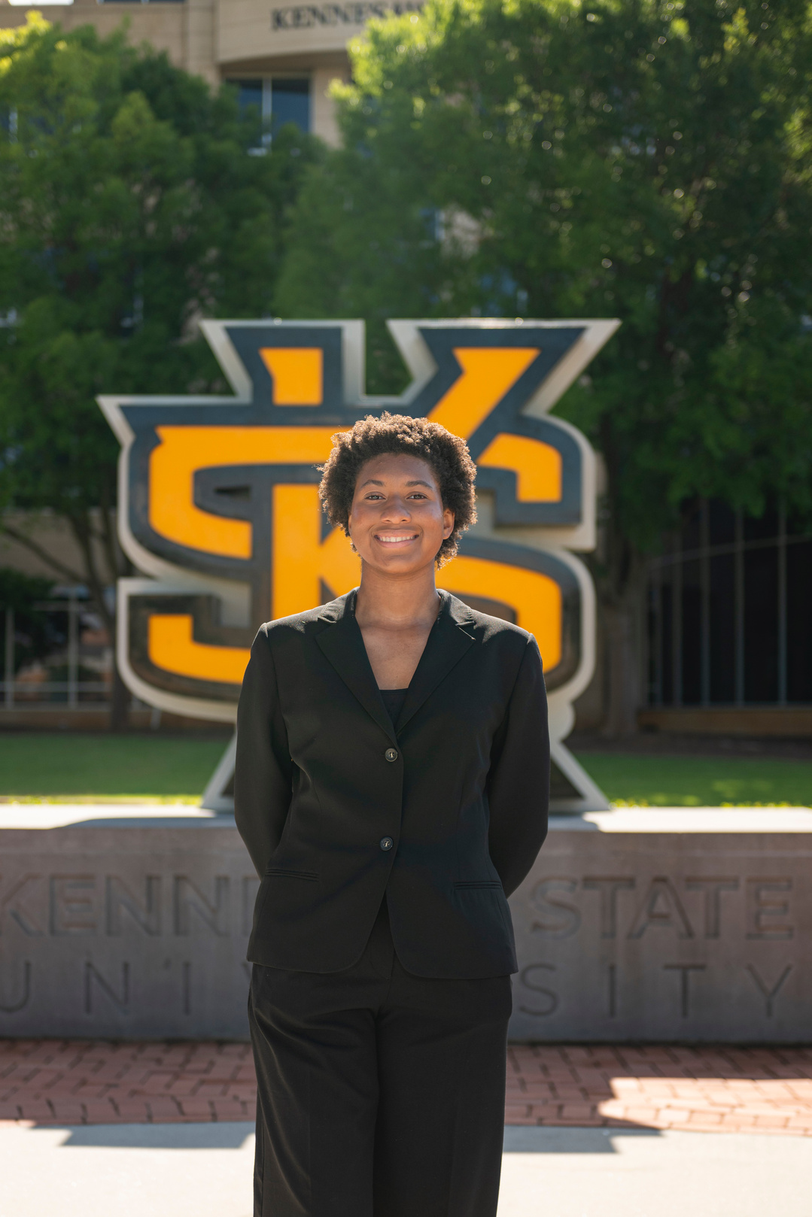
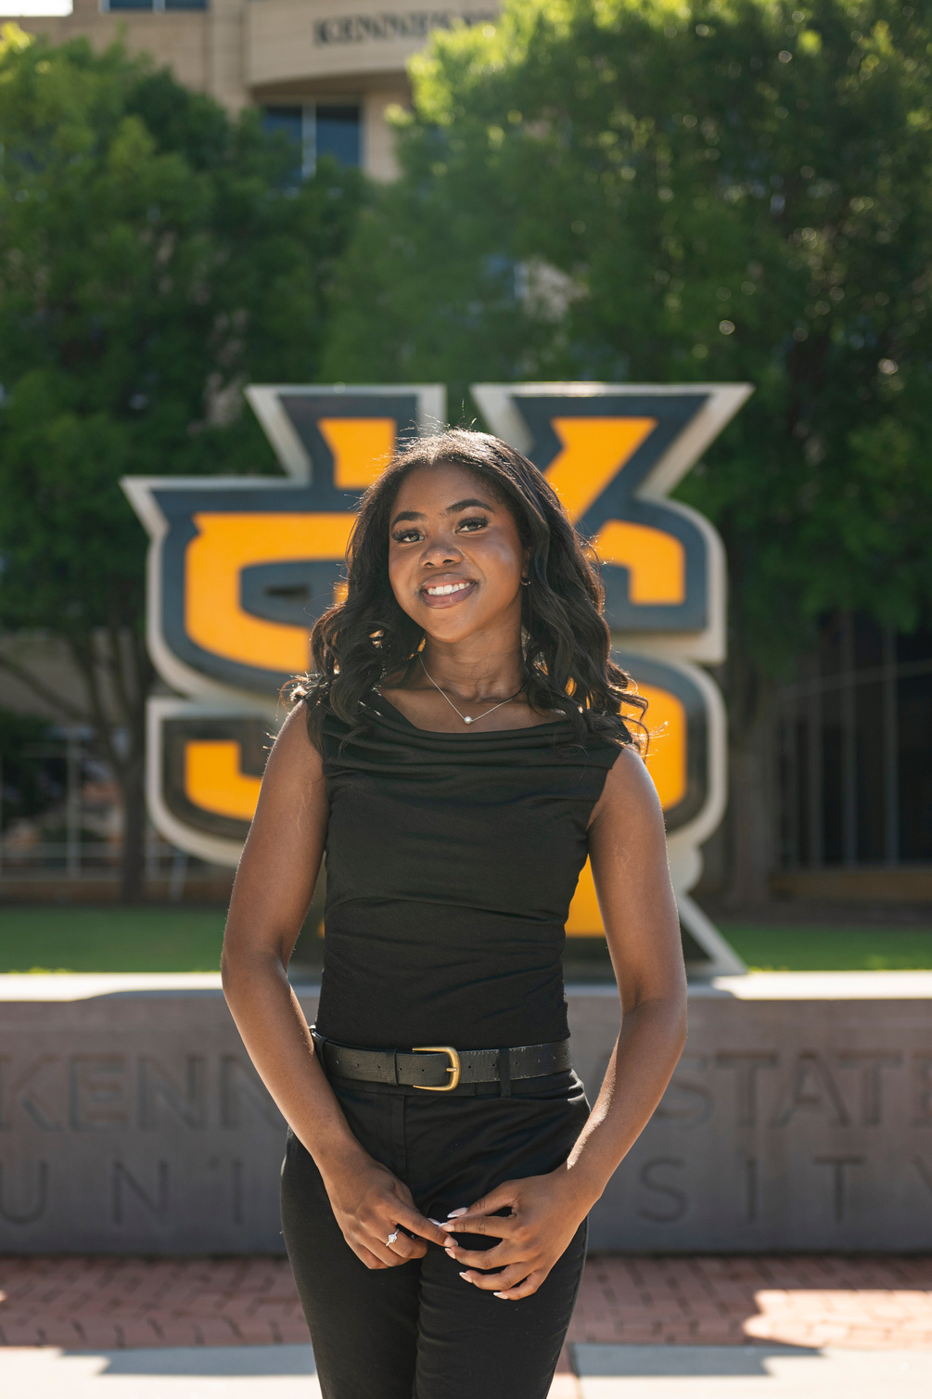
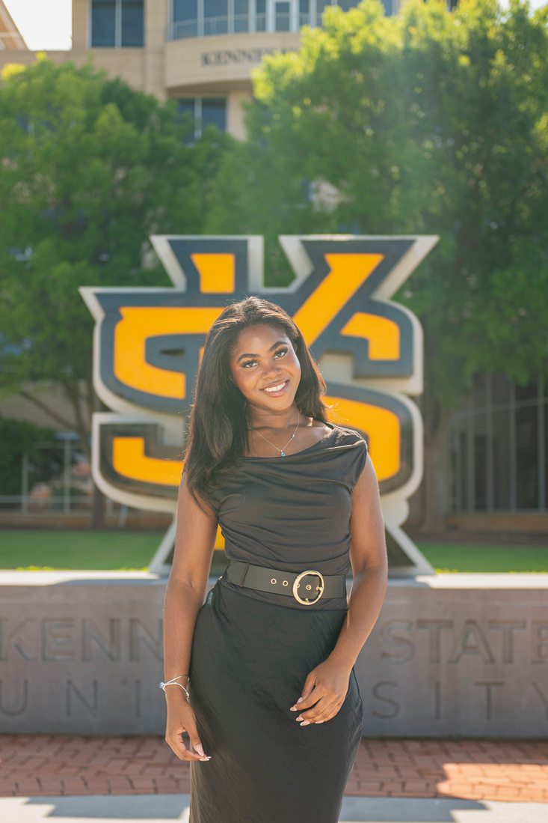
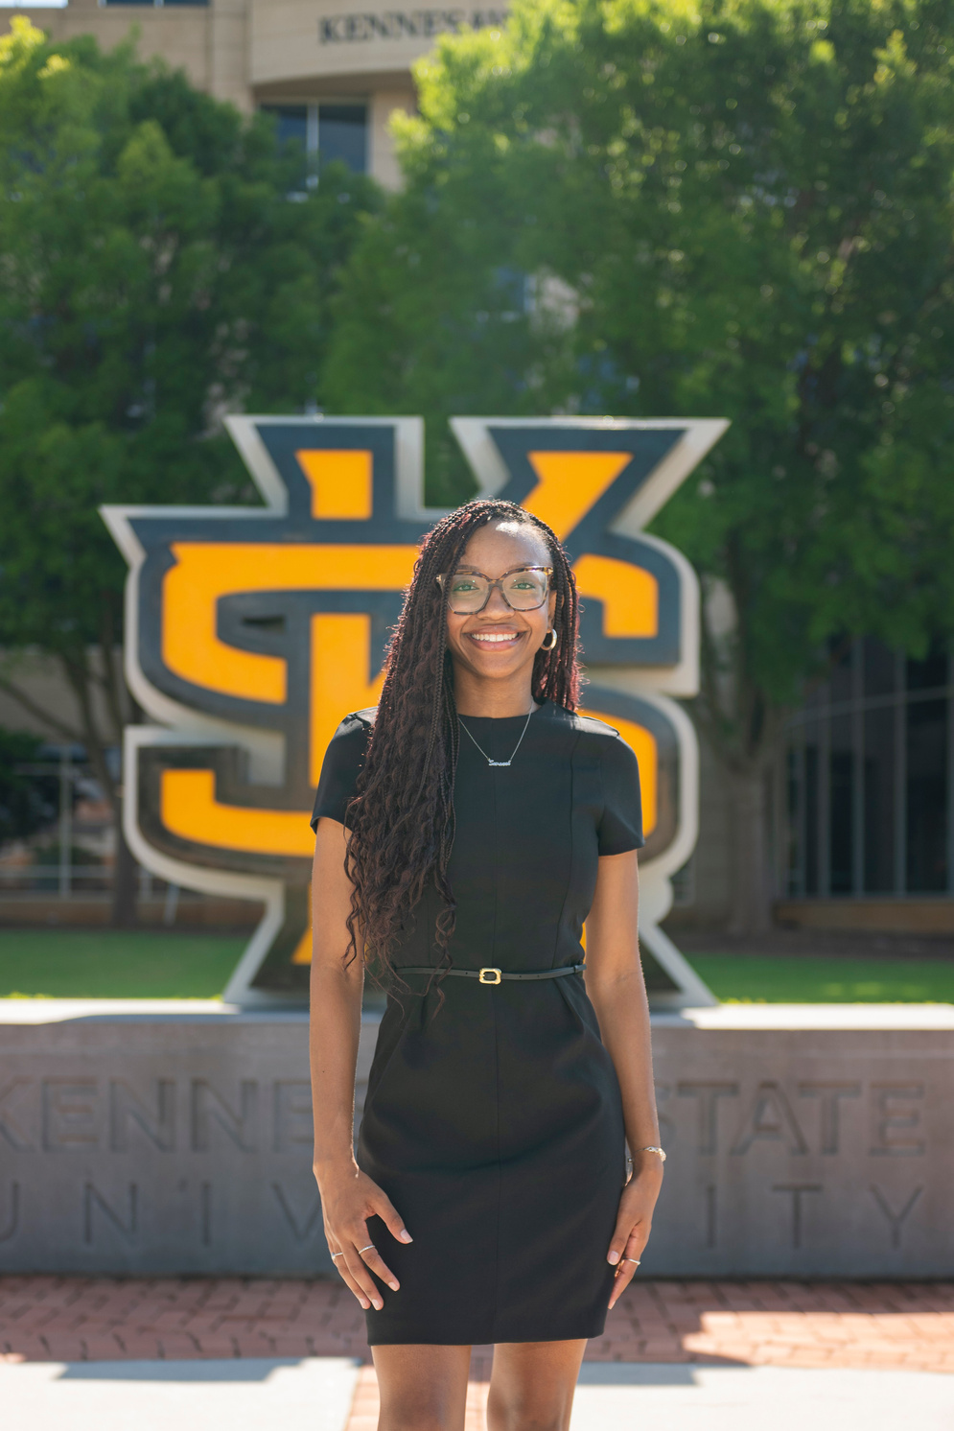
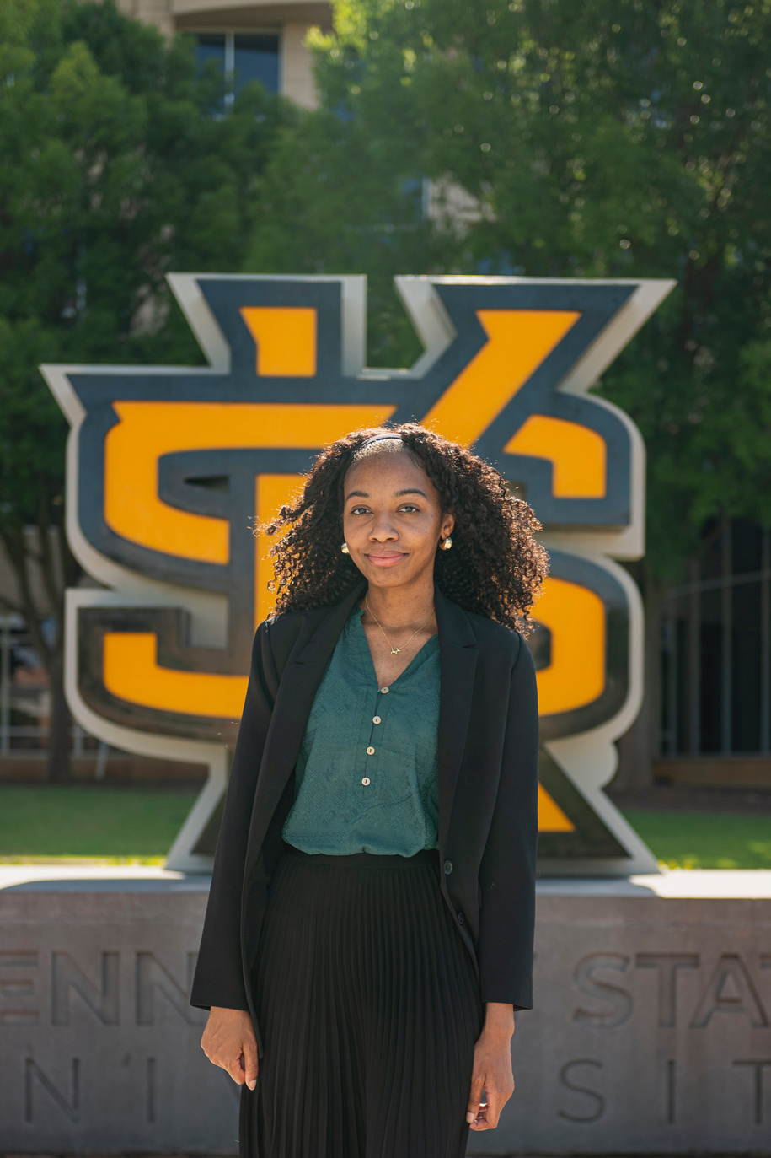
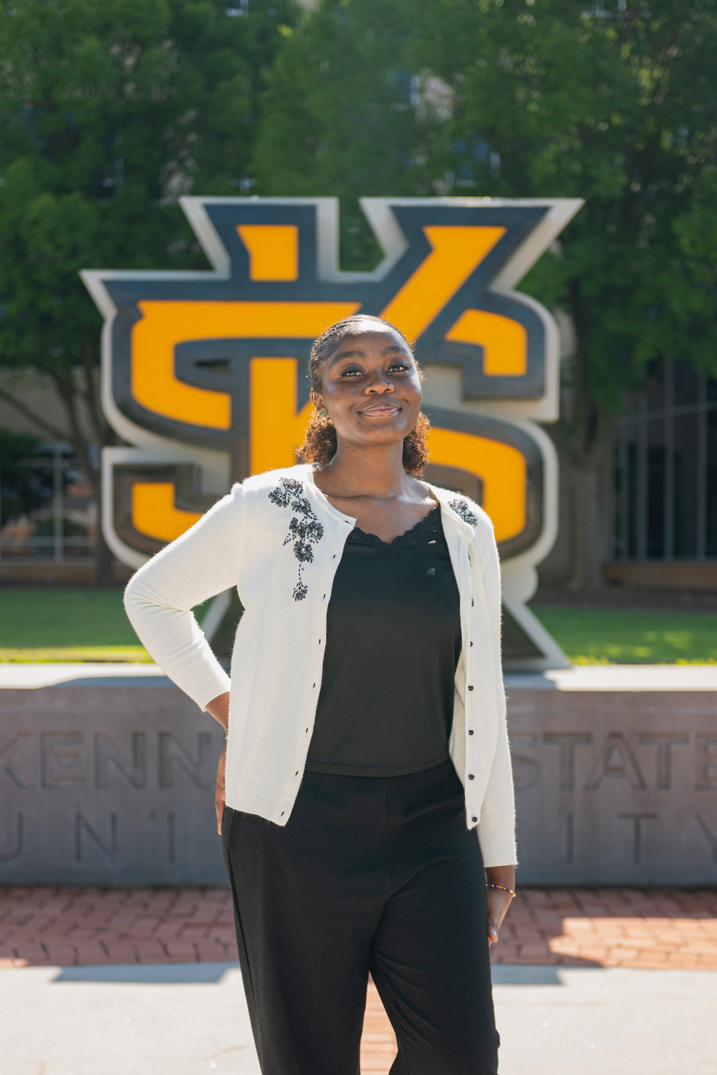
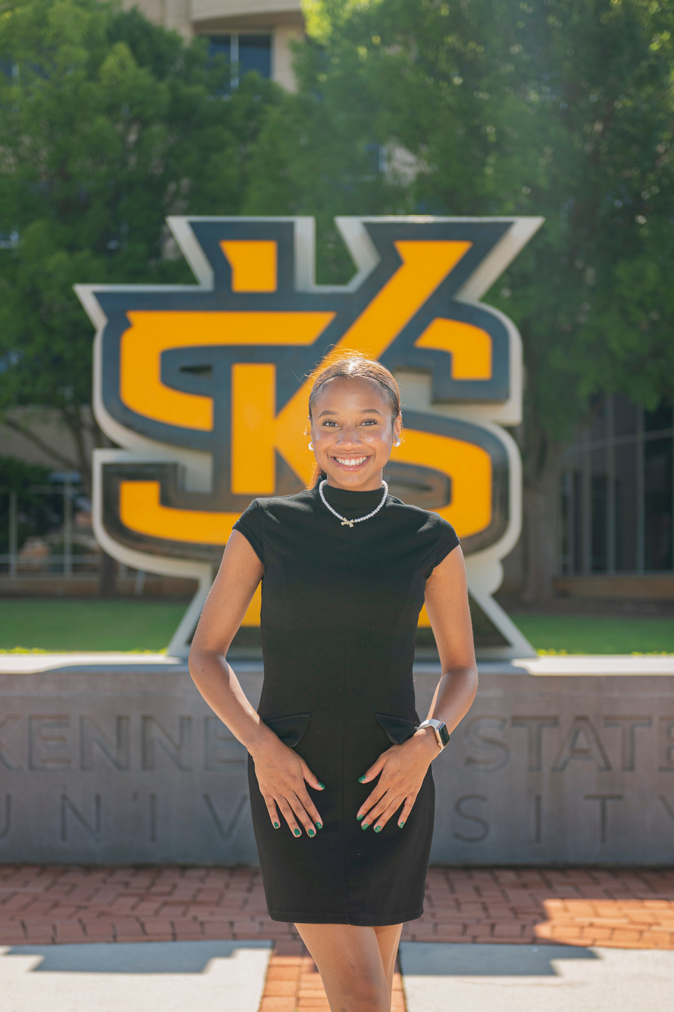
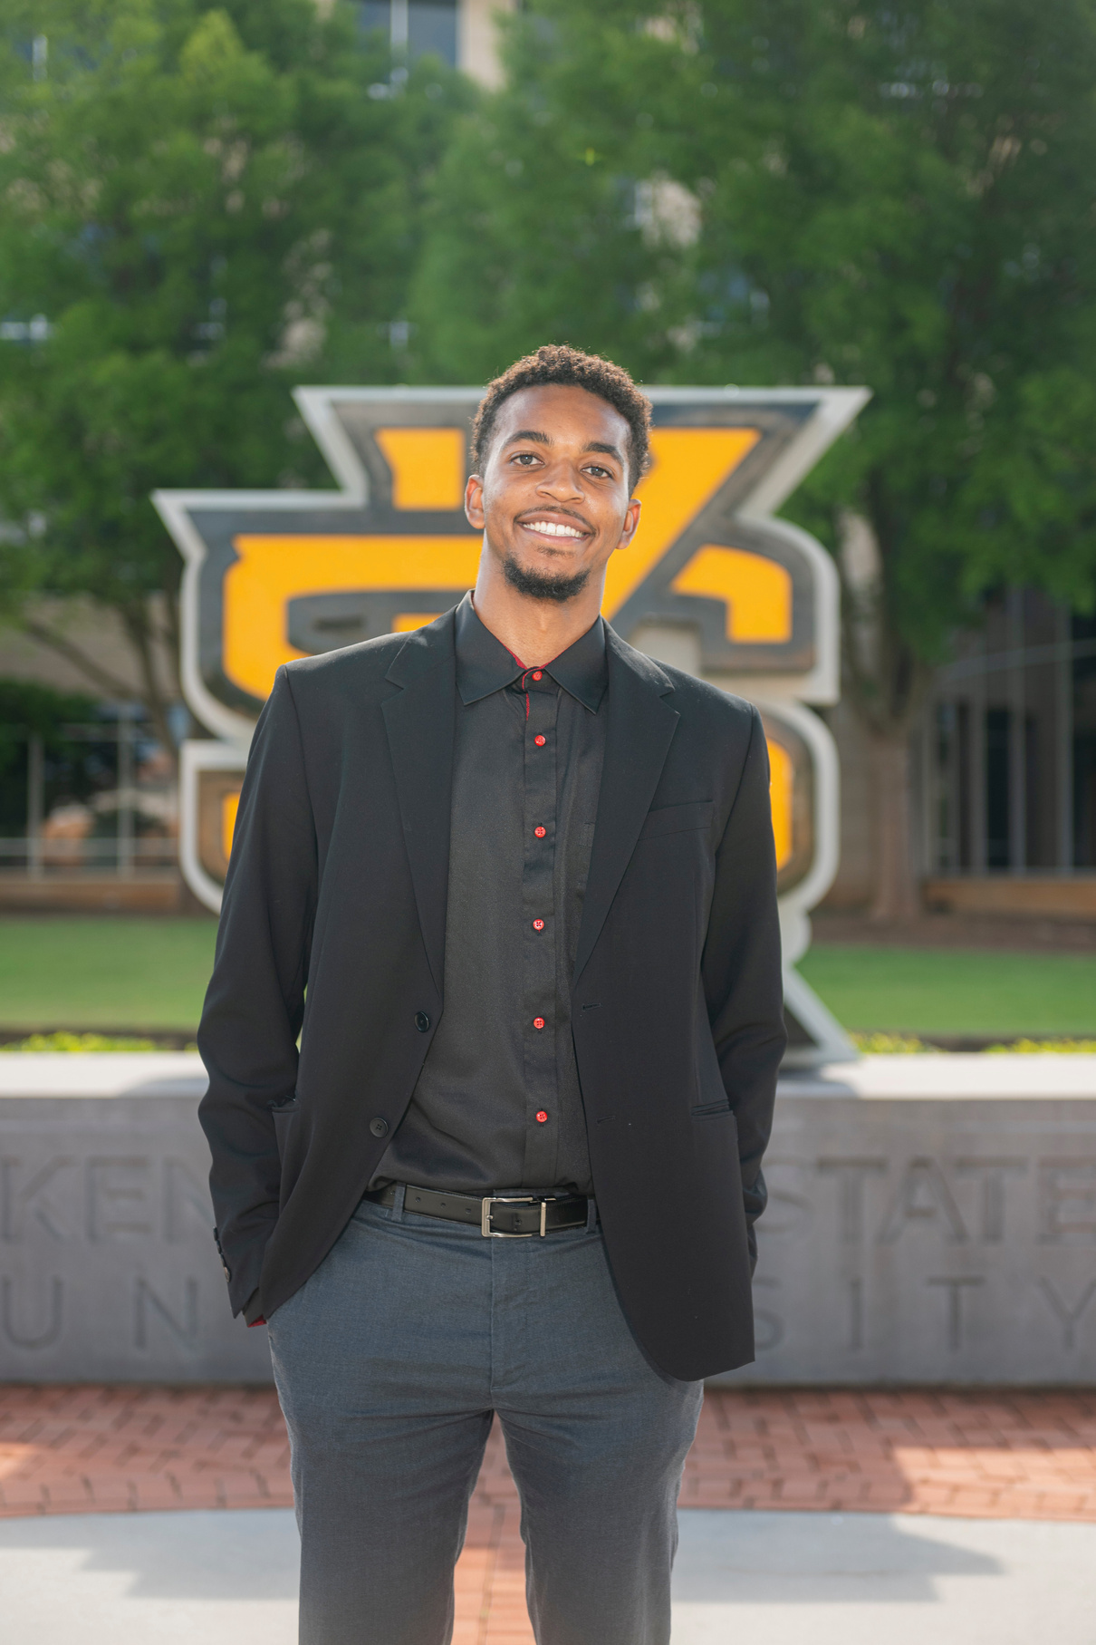
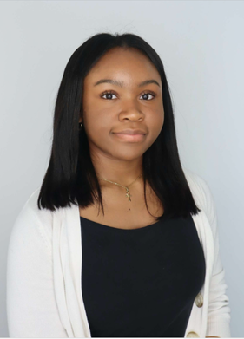
NABA Kennesaw Executive Board
Grace Laurenceau
Melleah Richards
Mellayne Richards
Savanna Hadley
Vice-President
Treasurer
Treasurer
Treasurer
Tameia Verdree
President
Cheyenne Parks
Saniah Middlebrooks
Jason Wilburn
Sanaa Deer-Fowlin
Event Coordinator
Event Coordinator
External Affairs
Internal Affairs

Slide 5
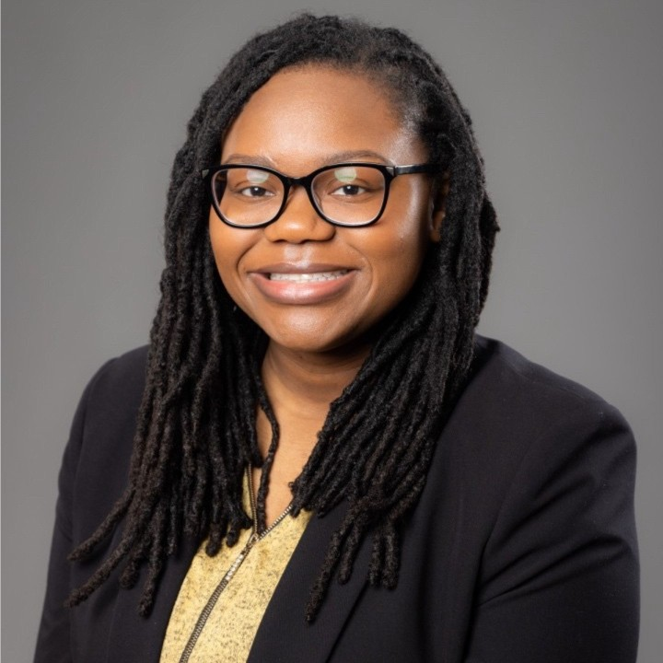
NABA Kennesaw Advisor
Cheree Copeland
Associate Director, Experiential Education

Slide 6
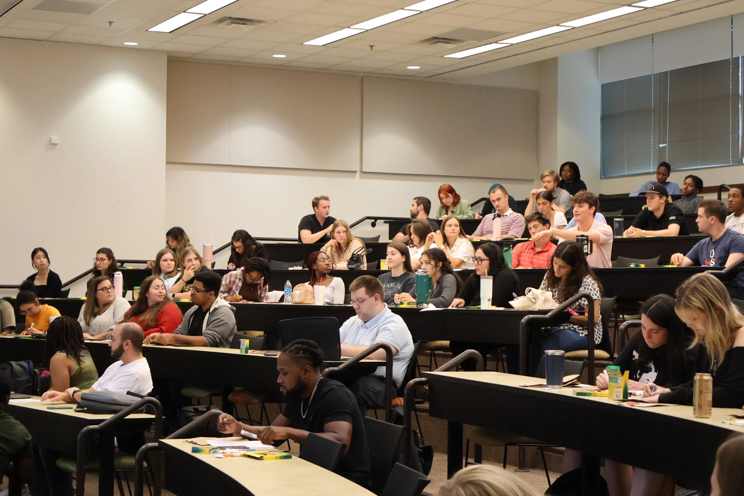





Reminder: Meeting Expectations
Put cellphones on silent during company visits
Network and engage with your peers
Business Professional attire for company visits
Be mindful when snacking
Enter quietly if you arrive late between transtions

Slide 7


BAP x NABA:
Public Accounting Firms
Today’s Meeting Agenda:
  Upcoming Events
  Important Reminders
  Q&A Panel with Firms
  Moore Colson, Deloitte, CohnReznick, Forvis Mazars, and Cherry Bekaert
Overview: Representatives from the firms will speak on topics such as public accounting early career advice and successful networking

Slide 8
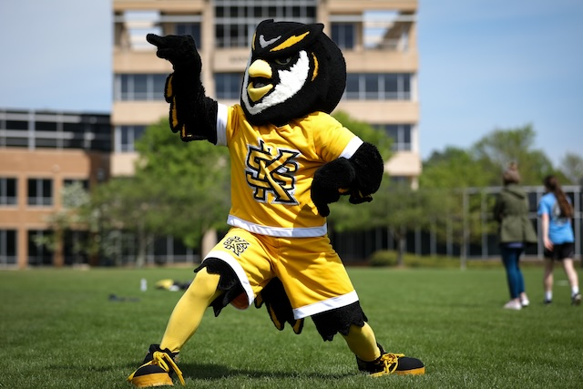



Upcoming Events
ColesFest
Date: Wednesday, September 10th
Time: 11:00 AM - 2:00 PM
Location: Student Center University Rooms
MAcc/CPA Info Session
Date: Tuesday, September 23rd
Time: 2:00 PM - 3:00 PM
Location: Kennesaw Campus Burruss 269
President’s Award of Distinction
Applications now open for Fall 2025
Requirements: Essay, recommendation letters, resume (academic, research, leadership, etc.)
Deadline: Friday , September 26th @ 8:00 PM
Upcoming Events

Slide 9


Upcoming Events
Firm Socials and Other Opportunities
Deloitte
Date: Thursday, September 9th
Time: 6:00 PM - 8:00 PM
Location: Tin Lizzy’s
Aprio
Date: Friday, September 10th
Time: 5:00 PM - 7:00 PM
Location: Tin Lizzy’s
HLB
Date: Wednesday, September 17th
Time: 4:00 PM - 6:00 PM
Location: Horned Owl
Two-Year Bridge Symposium
Date: Friday, November 14th
Time: All Day (Panel commitment required)
Location: Deloitte, EY, KPMG, and PwC offices nationwide
Upcoming Events

Slide 10

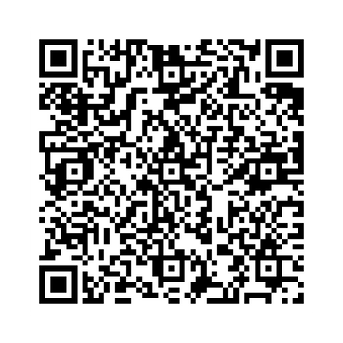
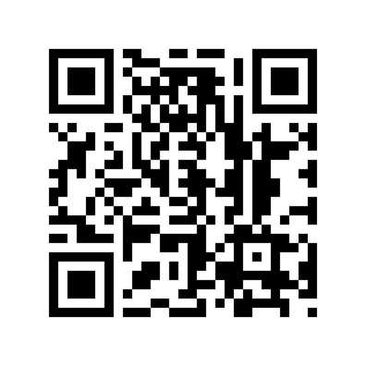


Upcoming Events NABA Kennesaw
9/8 Career Mapping Workshop
9/15 Meet KPMG: Sponsor Spotlight
Upcoming Events

Slide 11

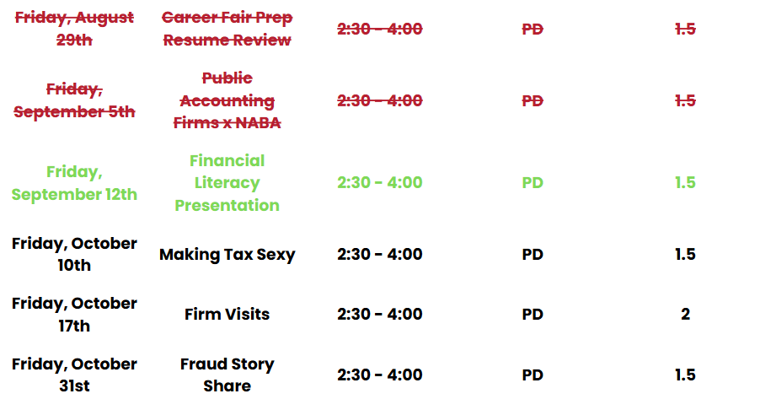
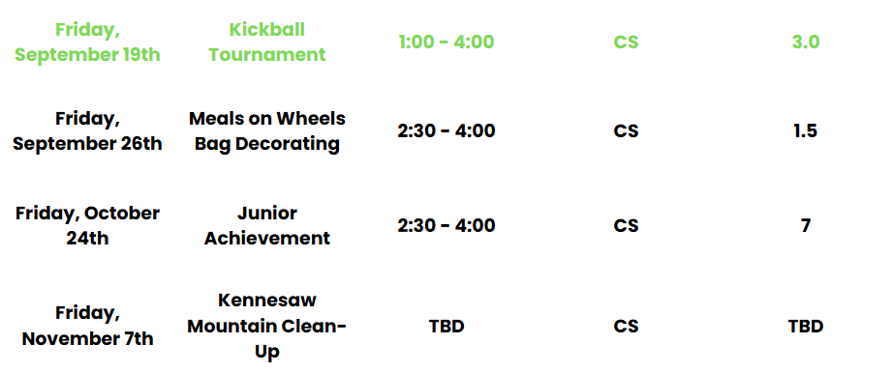
BAP Tentative Fall 2025 Schedule
Community Service
Professional Development
Upcoming Events

Slide 12
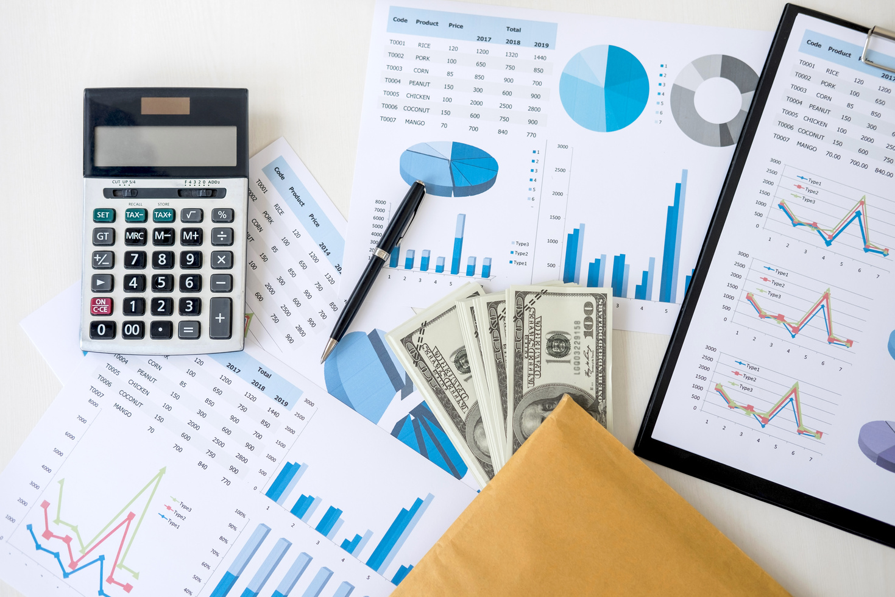
BAP: Financial Literacy Workshop
Overview: Representatives will present on essential financial literacy topics to help students build money management skills:
  Understanding Taxes
  Budgeting and High-Yield Savings Accounts
  Roth IRA
Business Professional Attire
Research and bring questions for visiting companies:
  Moore Colson, Deloitte, and Henssler
Upcoming Events

Slide 13

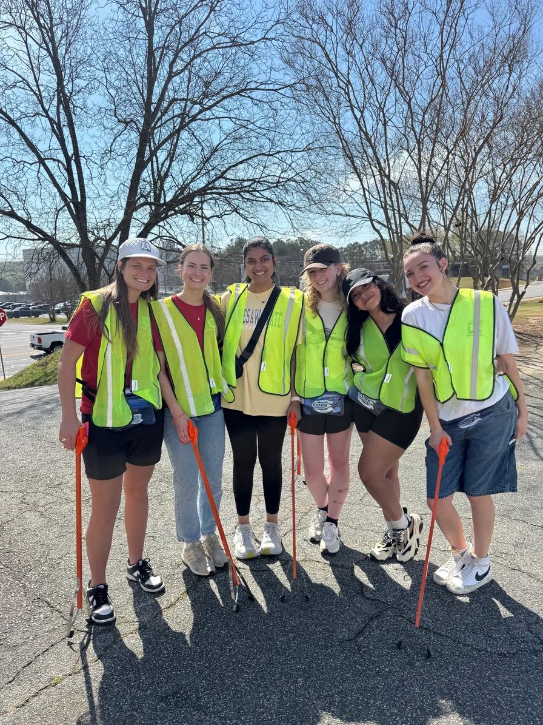
BAP Community Service: Books for Africa
Want to earn additional community service hours?
Volunteers are needed to pack and transport books
  Community service hours will vary based on the time required to transport items
For questions, contact:
Kelsey Barton:
  E: kbarto19@students.kennesaw.edu
Important Reminders

Slide 14
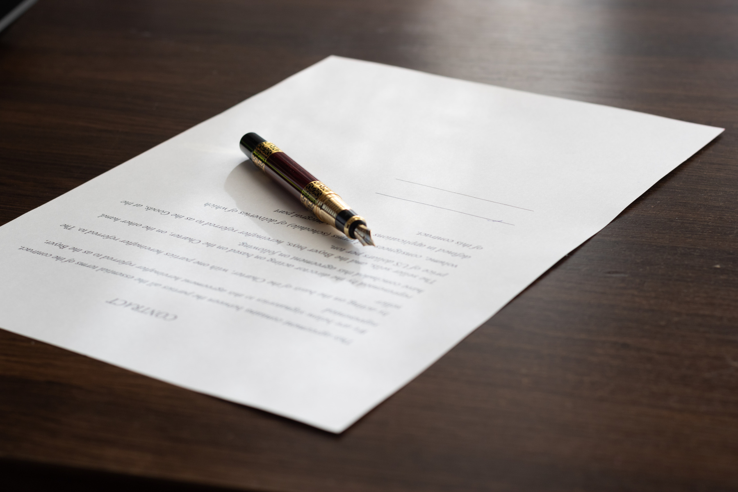
Non BAP PD and CS Hours
Non BAP PD and CS Hours
What if I can’t attend enough BAP meetings?
Members and Candidates may earn up to 2 PD hours and 2 CS hours outside of BAP:
  All hours must be submitted using the Non-BAP CS and PD Hours Form at ksubap.com/resources.
  Request must be submitted 2 days before the event it is supposed to occur
  Form must be submitted within 1 week from completion of event
Important Reminders

Slide 15
BAP Chapter Contracts
Chapter Contracts Reminder
How do I make it official?
BAP Iota Tau Chapter requires a physical contract to be signed that details requirements and expectations​
  Only Members and Candidates must sign and return the contract; FBIS should still review the BAP Code of Ethics.​
  Signed contracts deadline: Friday, September 12th @ 11:59 PM
Important Reminders

Slide 16




Reminder: Registration Deadline & Degree Works Transcript
01
02
03
04
Go into Degree Works
Press CTRL + P (do NOT use printer icon)
Destination: Save as PDF
Layout: Lanscape then SAVE
  Final registration and payment deadline : Thursday, September 11th @11:59 pm​
  Only Candidates and Members must email a copy of their Degree Works transcript
  Degree Works transcripts should be submitted to Professor Shannon Shumate at sshumat2@kennesaw.edu.
Important Reminders

Slide 17
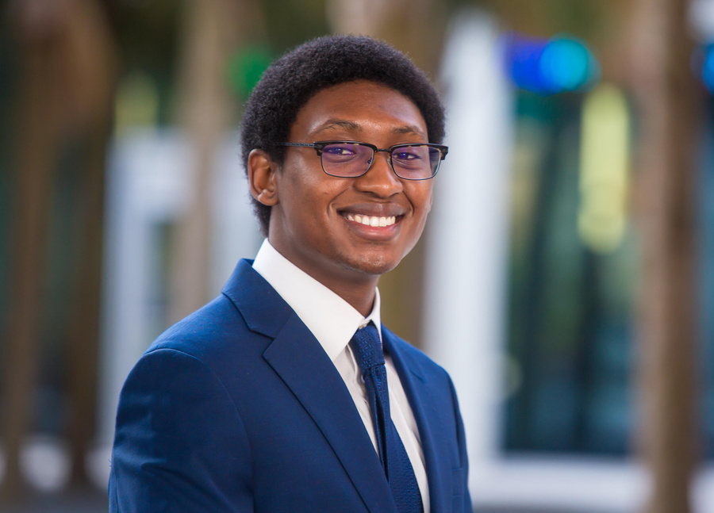
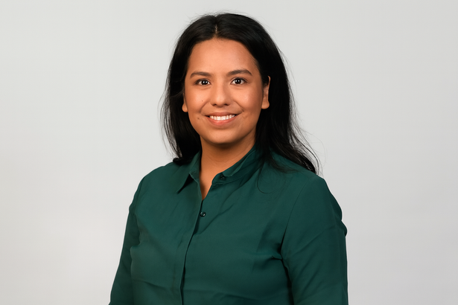
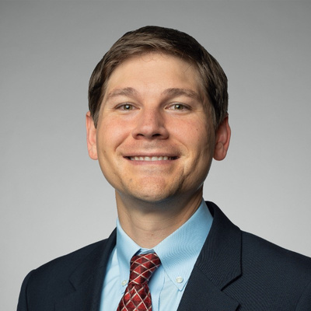
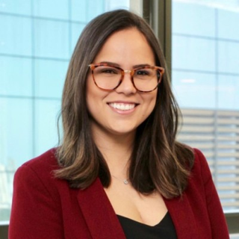
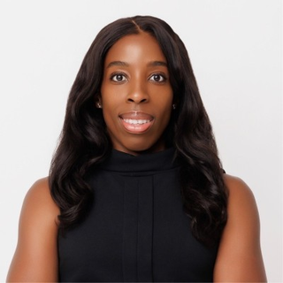
Meet the Panelists
Gabe Christian
Sandra Serrato
Phil Laminack
Audit Manager
Senior Assurance Associate
Tax Partner
Cherry Bekaert
CohnReznick
Forvis Mazar
Gisele Menezes
Didi Amajor
Q&A Panel with Firms
Tax Manager
Deloitte
Risk Advisory Senior Manager
Moore Colson

Slide 18





Panel Questions
Featuring Our Visiting Firms
Ask about career paths and interview tips in public accounting
Q&A Panel with Firms

Slide 19


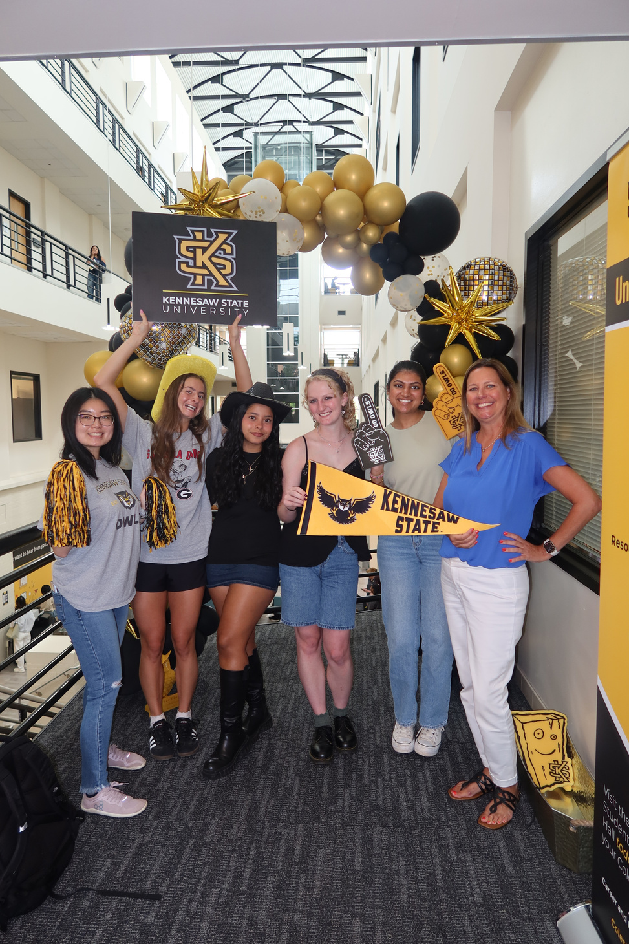
Contact Us
BETA ALPHA PSI - Iota Tau Chapter
Contact EC for any specific questions:
Karen Flores-Padilla, President
  E: kfloresp@students.kennesaw.edu
Lindsey Mcclelland, Vice President
  E: lmccle10@students.kennesaw.edu
Kelsey Barton, Reporter
  E: kbarto19@students.kennesaw.edu
Anchiella Angelle, Events Director
  E: aangell2@students.kennesaw.edu
Zainab Choudhary, Marketing Director
  E: zchoudh1@students.kennesaw.edu
Contacts for other questions:
Shannon Shumate:
  E: shumat2@kennesaw.edu
Amanda York:
  E: ayork23@kennesaw.edu

Slide 20
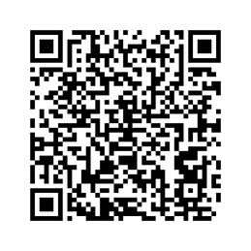
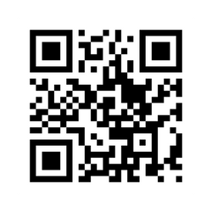
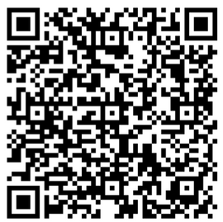
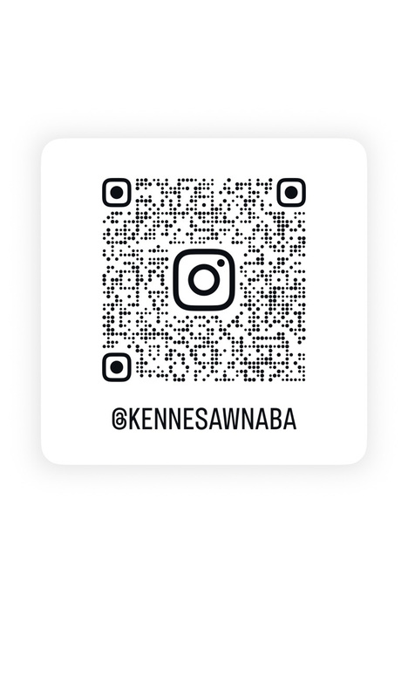
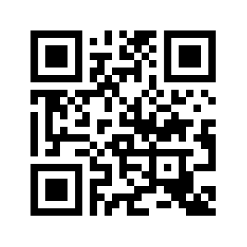
Follow Us
BAP Instagram
BAP Website
BAP Survey
NABA Instagram
NABA Website

Slide 21

Kennesaw State University
Thank You!
Iota Tau Chapter
Visit Our Websites
ksubap.com
nabakennesaw.com

