Slide 1





Kennesaw State University
BETA ALPHA PSI
Iota Tau Chapter
Visit Our Website
ksubap.com

Slide 2
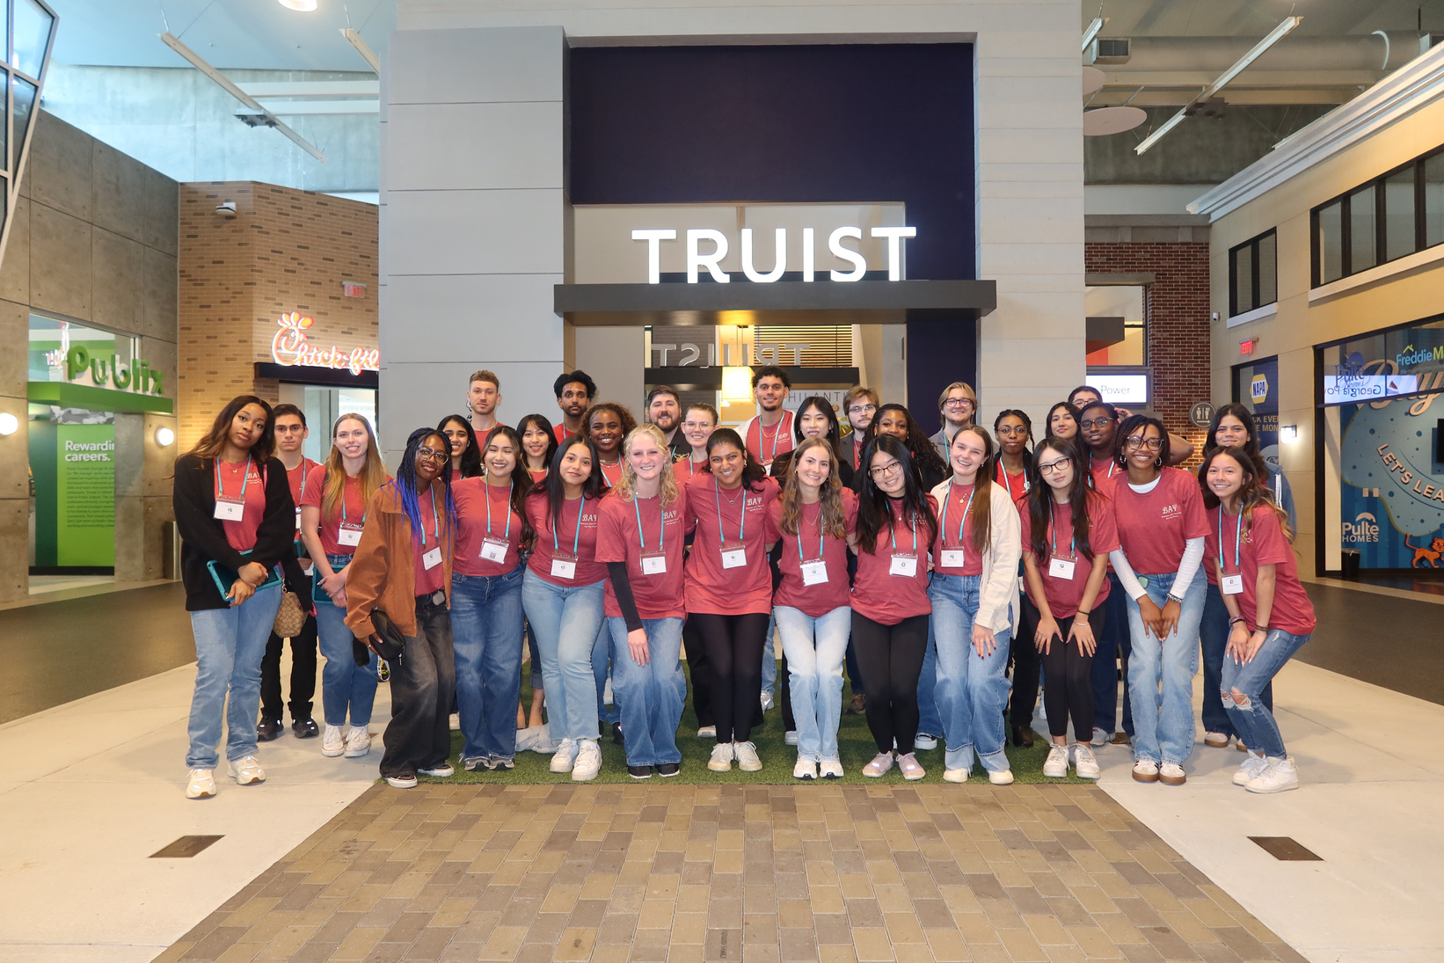
Why Join Beta Alpha
Psi?
Founded in 1919, Beta Alpha Psi is an international honor organization for financial information students and professionals.
  Professional Reputation & Networking
  Academic & Professional Development
  Ethics & Leadership

Slide 3


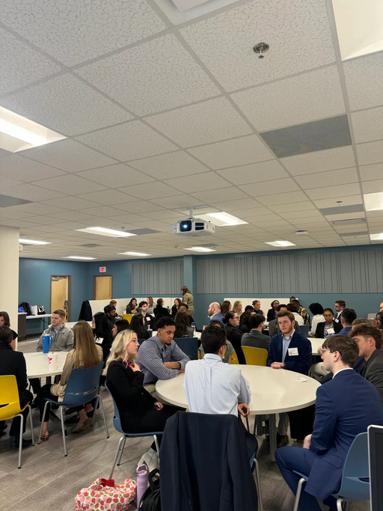



Meeting Expectations
When attending a meeting please ensure be remain respectful to speakers.
Electronics Silent
Networking
Cellphones should be put on silent for company visits
01
02
Network and engage with your peers
04
03
Professional Attire
Food & Drinks
Business Professional attire for company visits
Be mindful of snacking
05
Timeliness
Enter quietly if you arrive late between transitions

Slide 4


Chapter Vision & Mission
Vision
Mission
Beta Alpha Psi will shape the financial and business information professions by developing members into:
  Ethical
  Professional
  Confident leaders
To inspire and support excellence by:
  Encouraging the study and practice of accounting, finance, business technology, and analytics
  Providing opportunities for professional development, interaction among members, and financial professionals
  Fostering lifelong ethical, social, and public responsibilities

Slide 5

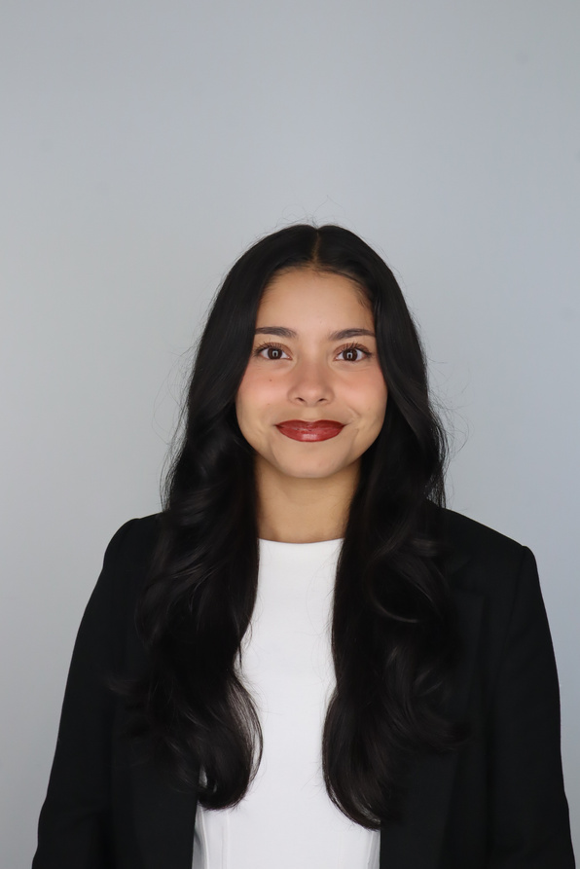
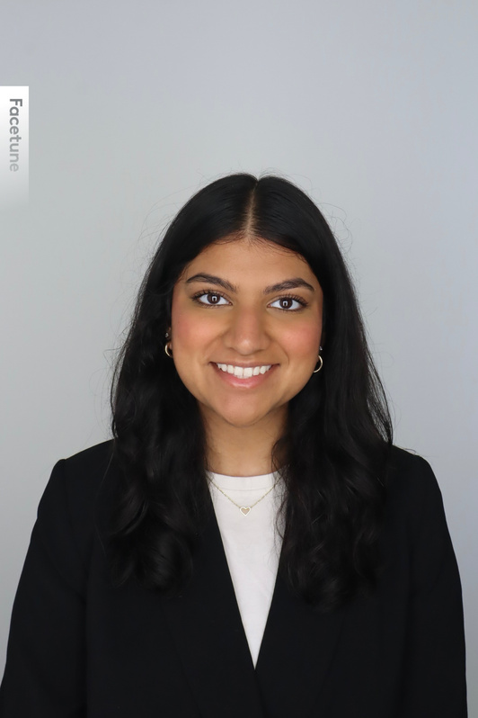
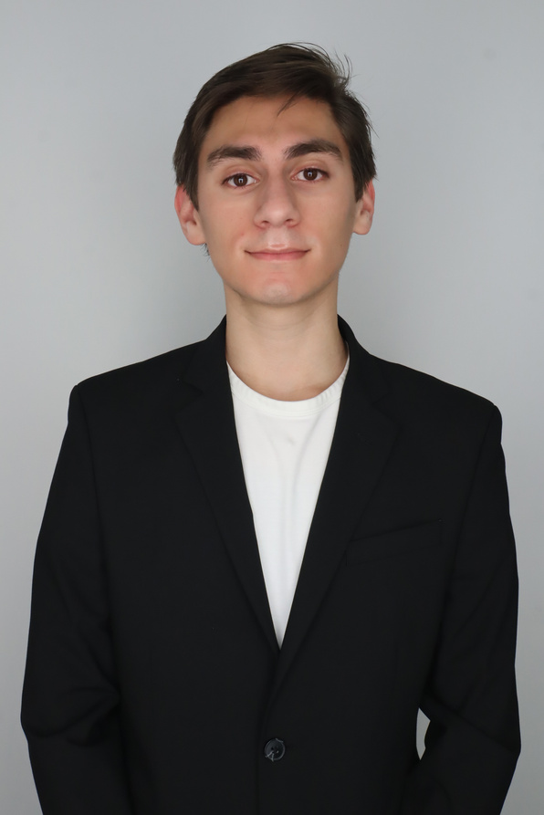
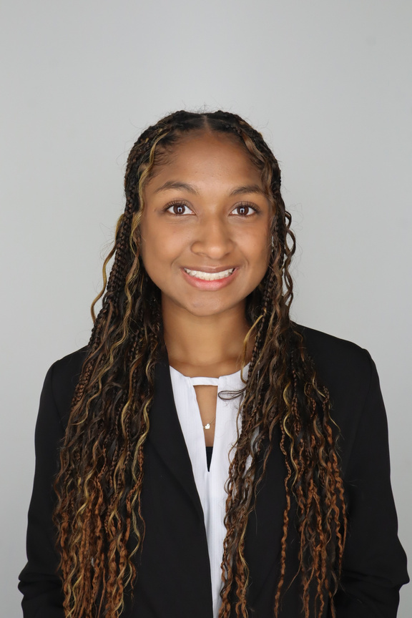
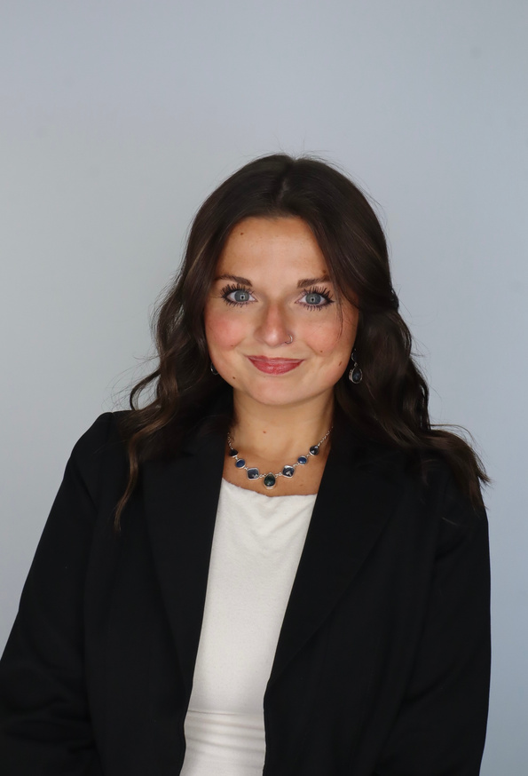
Meet The Executive Committee
Karen Flores-Padilla
Zainab Choudhary
Eric Super
President
Vice President
Treasurer
Mya Bacchus
Hailey Young
Reporter
Marketing Director

Slide 6

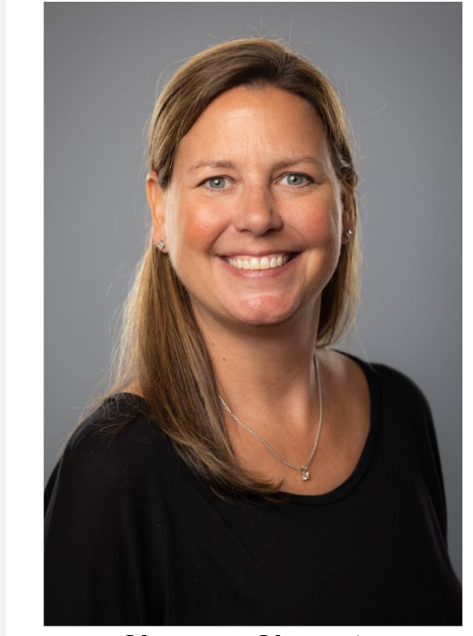
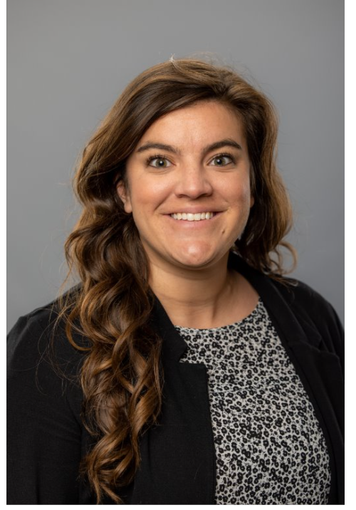
Meet The Advisors
Shannon Shumate
Amanda York
Principal Lecturer
Associate Director, Strategic Partnerships

Slide 7
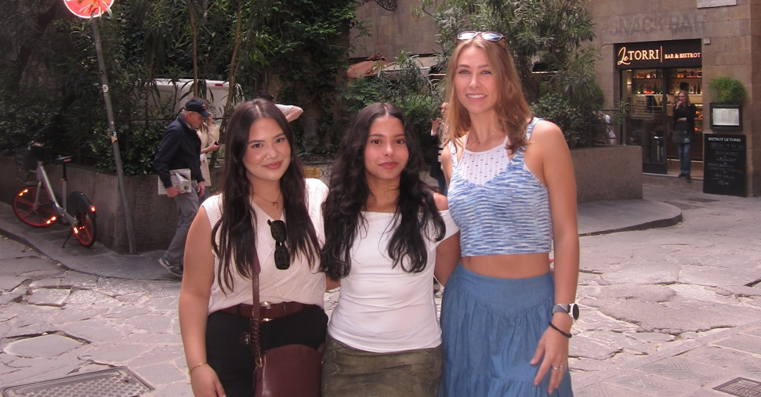


Karen Flores-Padilla
President
Internship: Bennett Thrasher Summer 2026
Fun Fact: I can’t swim & I can crack my thumbs
linkedin.com/in/karenflores-padilla
kfloresp@students.kennesaw.edu

Slide 8
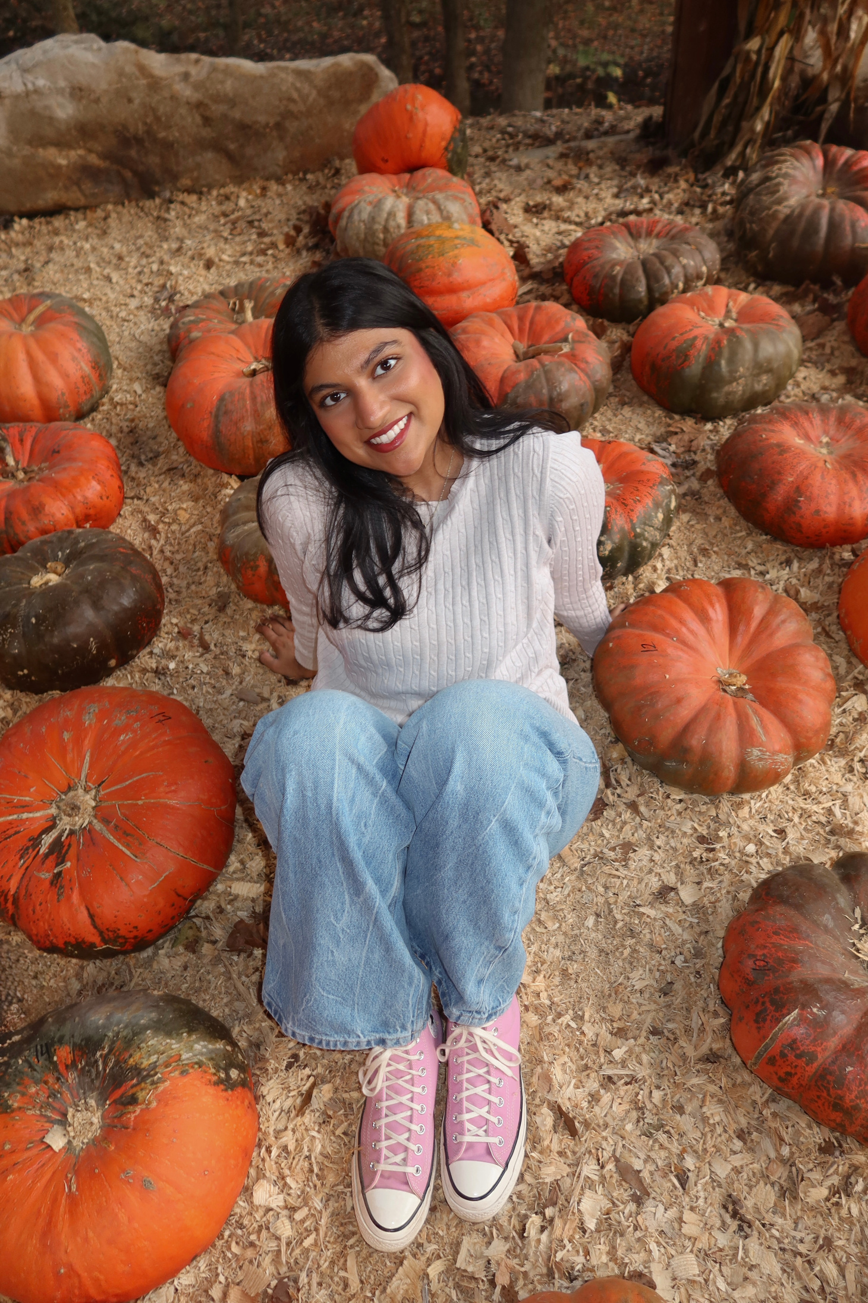
Zainab Choudhary
Vice President
Internship: KPMG Embark Summer 2026
Fun Fact: I was lost at sea for 20 minutes
linkedin.com/in/zainab-choudhary-
zchoudh1@students.kennesaw.edu

Slide 9
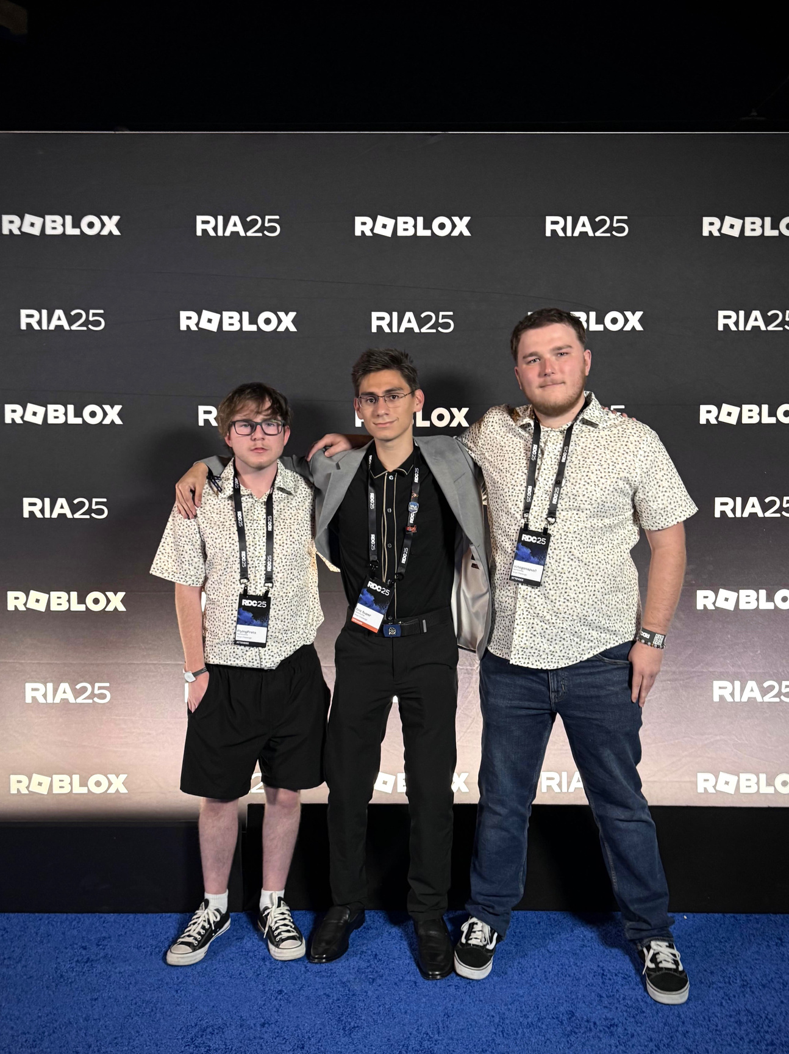
Eric Super
Treasurer
Internship: Deloitte Summer 2026
Fun Fact: I am a Roblox Game Developer
linkedin.com/in/eric-super
esuper@students.kennesaw.edu

Slide 10
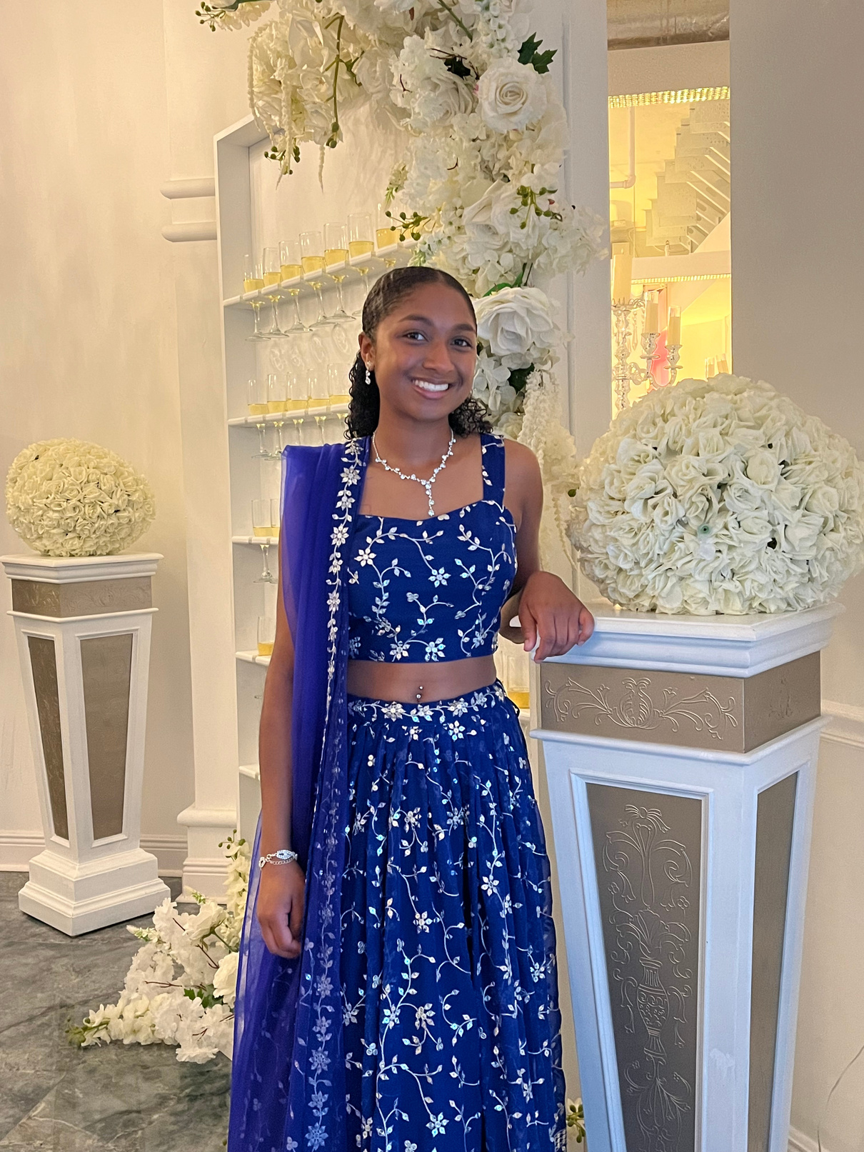
Mya Bacchus
Reporter
Internship: Moore Colson Spring 2025
Fun Fact: I enjoy playing tennis
linkedin.com/in/mya-bacchus
mbacchu2@students.kennesaw.edu

Slide 11
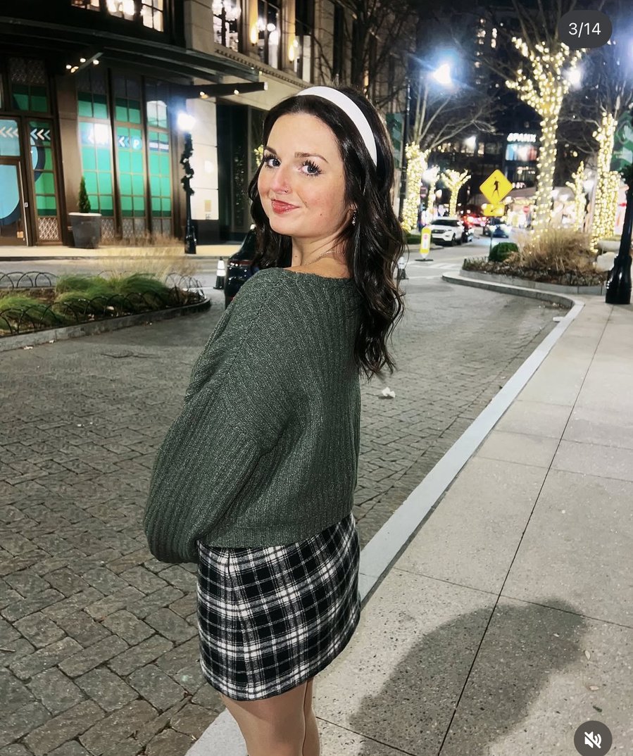
Hailey Young
Marketing Director
Expected Graduation Fall 2026
Fun Fact: I love to do arts and crafts
linkedin.com/in/hailey-young-3086a3346
hyoung32@students.kennesaw.edu

Slide 12
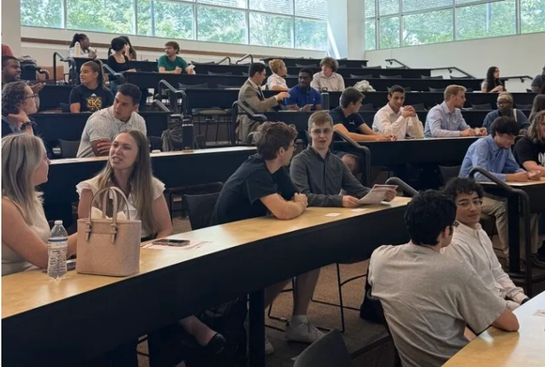
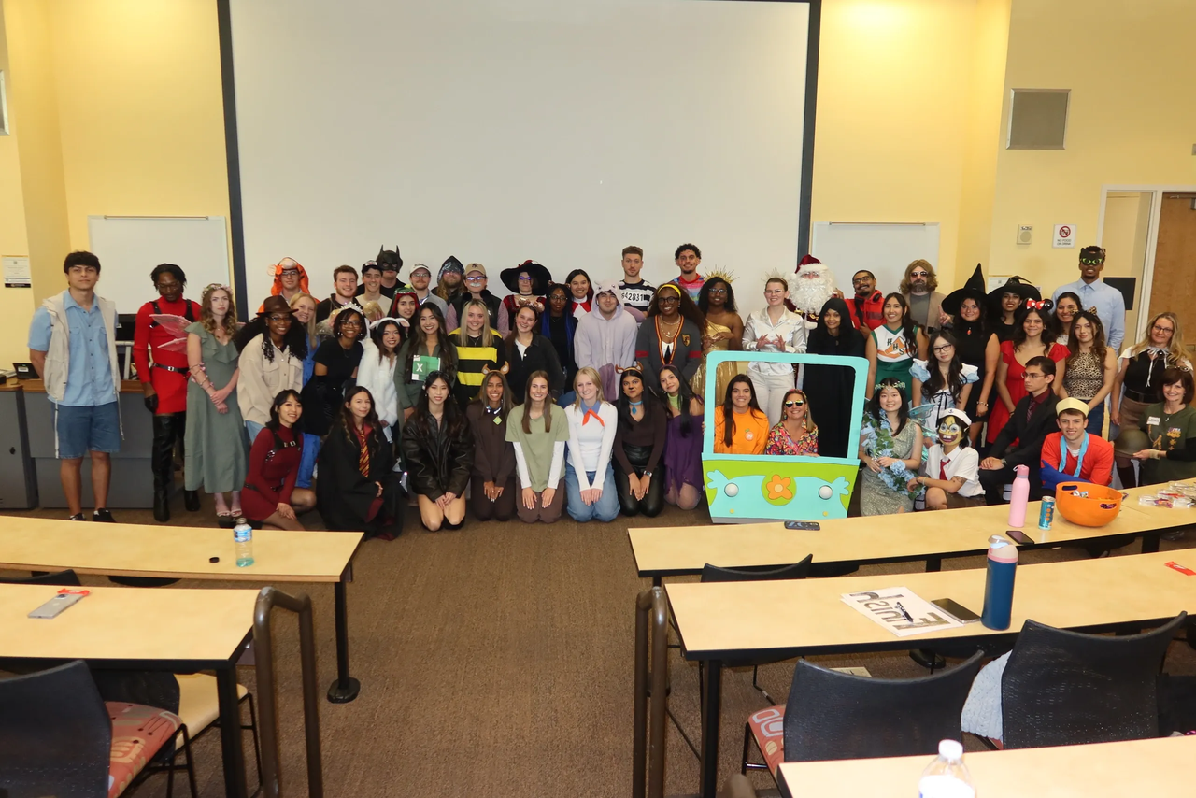
Am I Eligible?
Overview: Eligibility is determined by completion of all listed requirements and fulfillment of member responsibilities, including the semester contract, required hours, and adherence to professional conduct standards.
  Must have declared a major – Accounting, Finance, or Information Systems​
  Must complete ACCT 3100, FIN 3100, or IS 3100 (dependent on major) ​
  Major GPA (ACCT, FIN, IS) of 3.0 or higher beyond business core
  Institutional GPA of 3.3 or higher

Slide 13
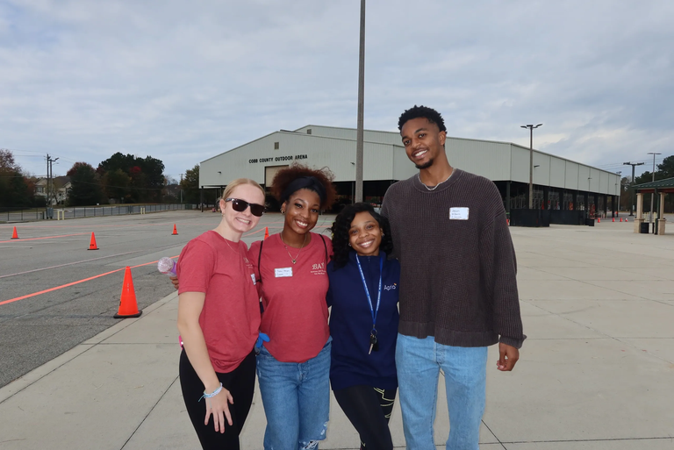
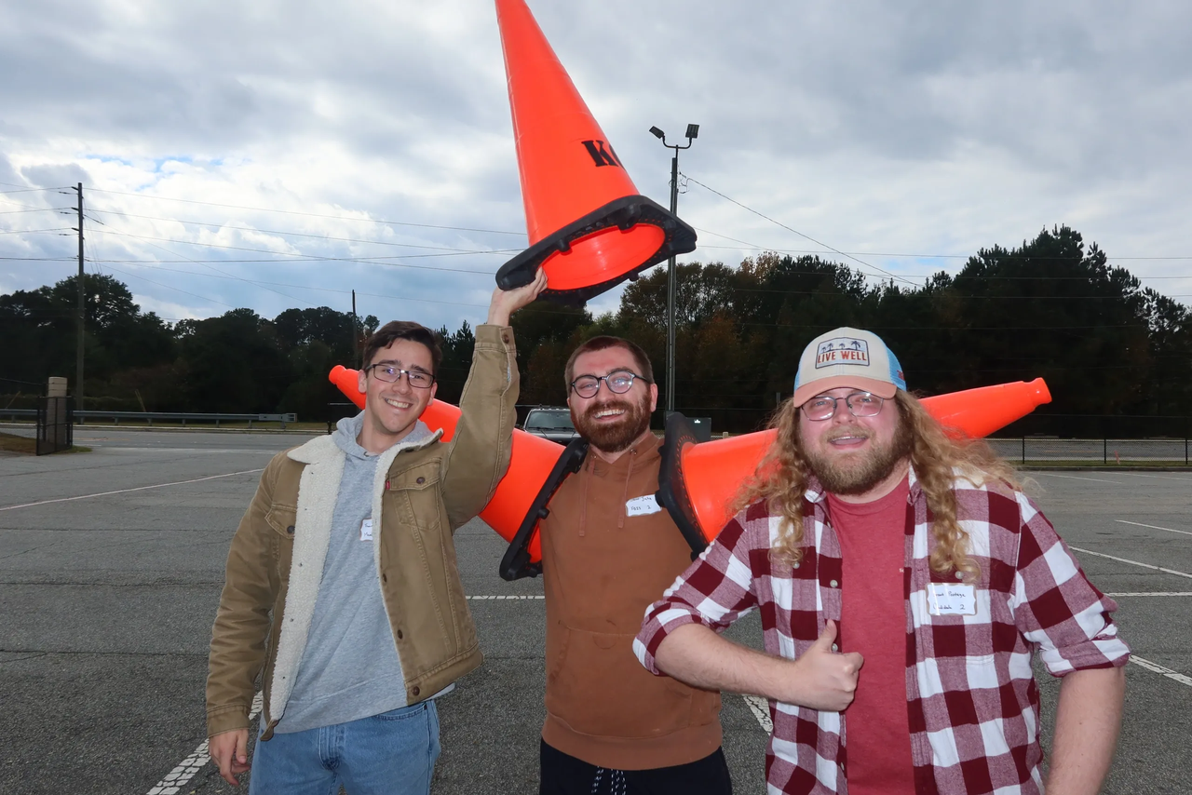
Not Eligible? Join as FBIS!
Overview: FBIS is the feeder program into becoming a Beta Alpha Psi Candidate. If you don't yet meet the 3100 requirement to become a Candidate​ join FBIS!
  $32 per semester​
  No participation requirements
  Access to most events
  No GPA requirement

Slide 14
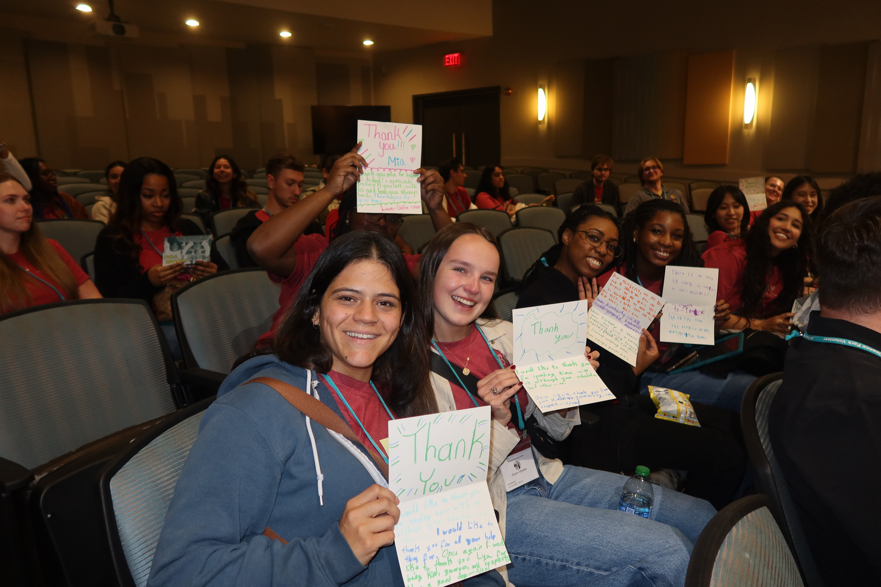
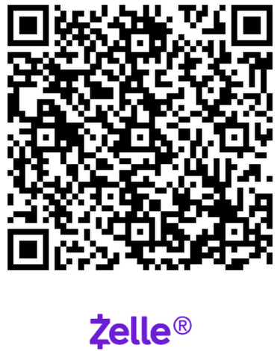
Candidate & Member Requirements
How to Join?
Must commit to 1 semester as Candidate & 1 semester as Member:
  3 hours of community service​ (CS)
  6 hours of professional development​ (PD)
  1st Semester - $115 – Candidate​
  2nd Semester - $52 – Member​
Final registration and payment
deadline : Wednesday, January 28th
@11:59 pm​
Pay Dues with Zelle

Slide 15






GPA Verification Steps
01
02
03
04
Go into Degree Works
Press CTRL + P (do NOT use printer icon)
Destination: Save as PDF
Layout: Landscape then SAVE
  ONLY Candidates and Members must email a copy of their transcript
  Degree Works Transcripts must be submitted to Professor Shannon Shumate at sshumat2@kennesaw.edu.

Slide 16

Tentative Spring 2026 Schedule
Professional Development
Community
Service
DATE | MEETING | TIME | TYPE | ATTIRE
1/16/2026 | INFORMATION SESSION | 2:30 - 4:00 | PD | BUSINESS CASUAL
1/23/2026 | BAP JEOPARDY | 2:30 - 4:00 | PD | BUSINESS PROFESSIONAL
2/6/2026 | RESUME REVIEW | 2:30 - 4:00 | PD | BUSINESS PROFESSIONAL
2/13/2026 | AI IN THE BUSINESS WORLD | 2:30 - 4:00 | PD | BUSINESS PROFESSIONAL
3/27/2026 | PREPARING FOR GRADUATE EDUCATION | 2:30 - 4:00 | PD | BUSINESS PROFESSIONAL
4/3/2026 | BE AUDIT YOU CAN BE | 2:30 - 4:00 | PD | BUSINESS PROFESSIONAL
DATE | MEETING | TIME | TYPE | ATTIRE
1/30/2026 | SILVERWARE ROLLING | 2:30 - 4:00 | CS | BUSINESS CASUAL
2/26/2026 | OFF CAMPUS CS EVENT | TBD | CS | KSU OR BAP ATTIRE
3/6/2026 | JUNIOR ACHIEVEMENT | 8:00 - 3:00 | CS | KSU OR BAP ATTIRE
- | - | - | - | -
- | - | - | - | -
- | - | - | - | -

Slide 17
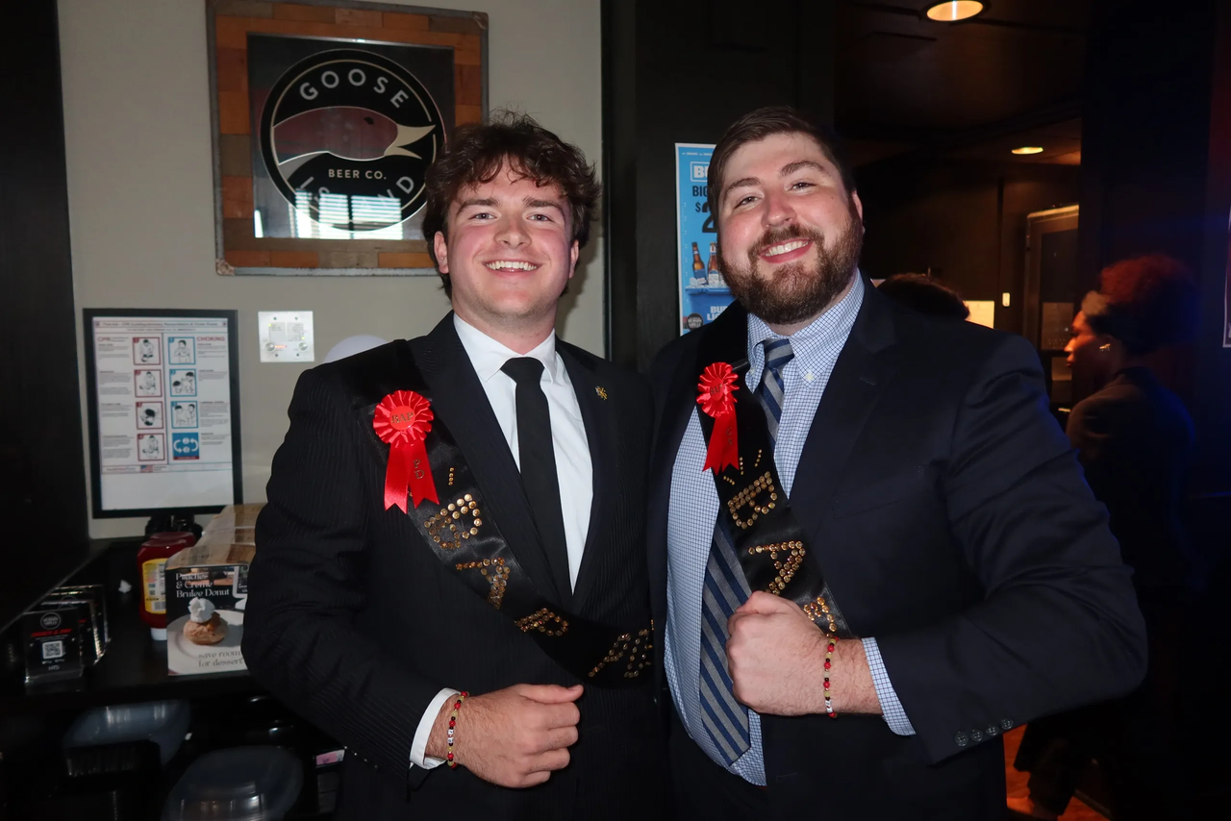
Non-BAP Community Service & Professional Development
What if i can’t attend enough meetings?
  Members and Candidates may earn up to 2 PD hours and 1 CS hours outside of BAP.
  All hours must be submitted using the Non-BAP CS and PD Hours Form at ksubap.com/resources.

Slide 18



Icebreaker Bingo
A timer will show how much time you have to get a BINGO before time runs out!
Step One:
Step Two:
Step Three:
Each square has something on it that might apply to someone else in the room. Your goal is to walk around, talk to people, and find someone who matches each square.
When you find someone who fits a square, write their name in it. Each person can only sign one square on your sheet, so don’t use the same person twice.
First person to get BINGO gets a prize!! And even if you don’t finish, that’s totally fine!!

Slide 19
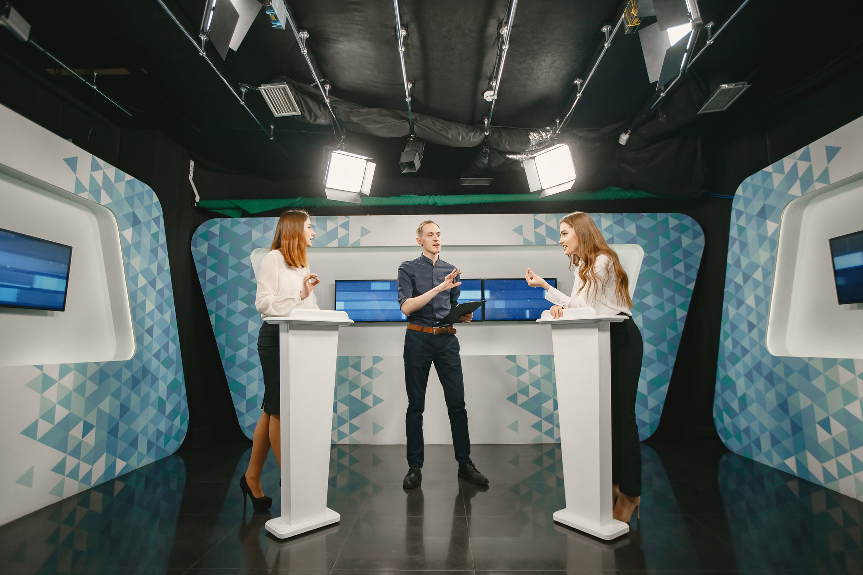

Next Meeting: BAP Jeopardy
Overview: Students are divided into four teams and paired with visiting firms to compete in a Jeopardy-style game that tests their accounting knowledge, while also reinforcing professional networking and collaboration.
Visiting companies:
  Aprio, Bennett Thrasher, Carr Riggs & Ingram, CliftonLarsonAllen, CohnReznick, HLB Gross Collins, and Nichols Cauley
  Business Professional Attire

Slide 20
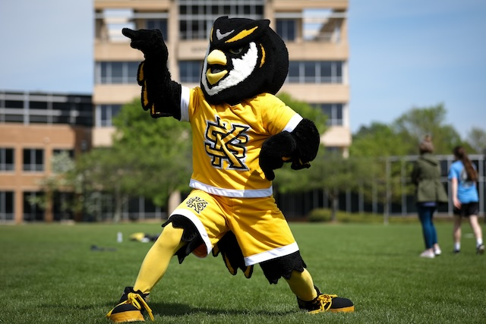
Upcoming Events
Jan 21
HLB Social @ Tin Lizzy’s
Email Lexie to RSVP: lquinton@grosscollins.com
4:00 - 6:00
Jan 26
Coles Fest Spring 2026
11:00 - 2:00
Feb 12
MAcc Information Session
12:00 - 1:00
Feb 12
Meet the Firms
12:00 - 3:00

Slide 21
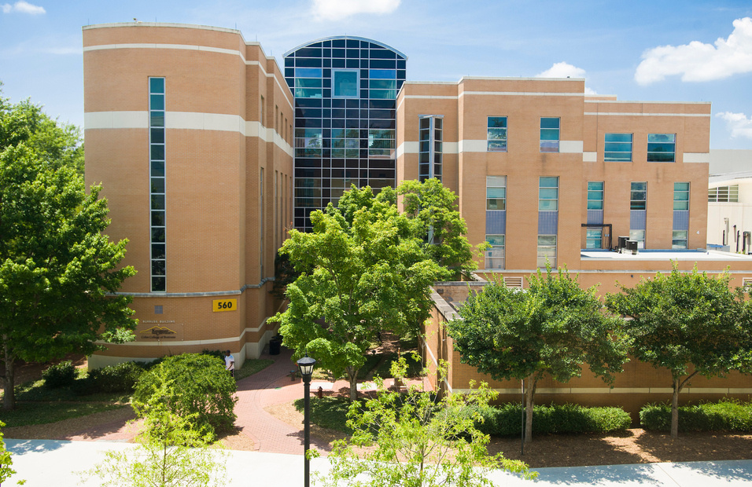
Important Reminders
N/A
Accounting Summer Leadership Programs 2026
Jan 23
Coca-Cola Corporate Audit Internship
Feb 01
GSCPA Scholarship Applications
Mar 01
Kennesaw State University Scholarships
N/A
Beta Alpha Psi Scholarships

Slide 22

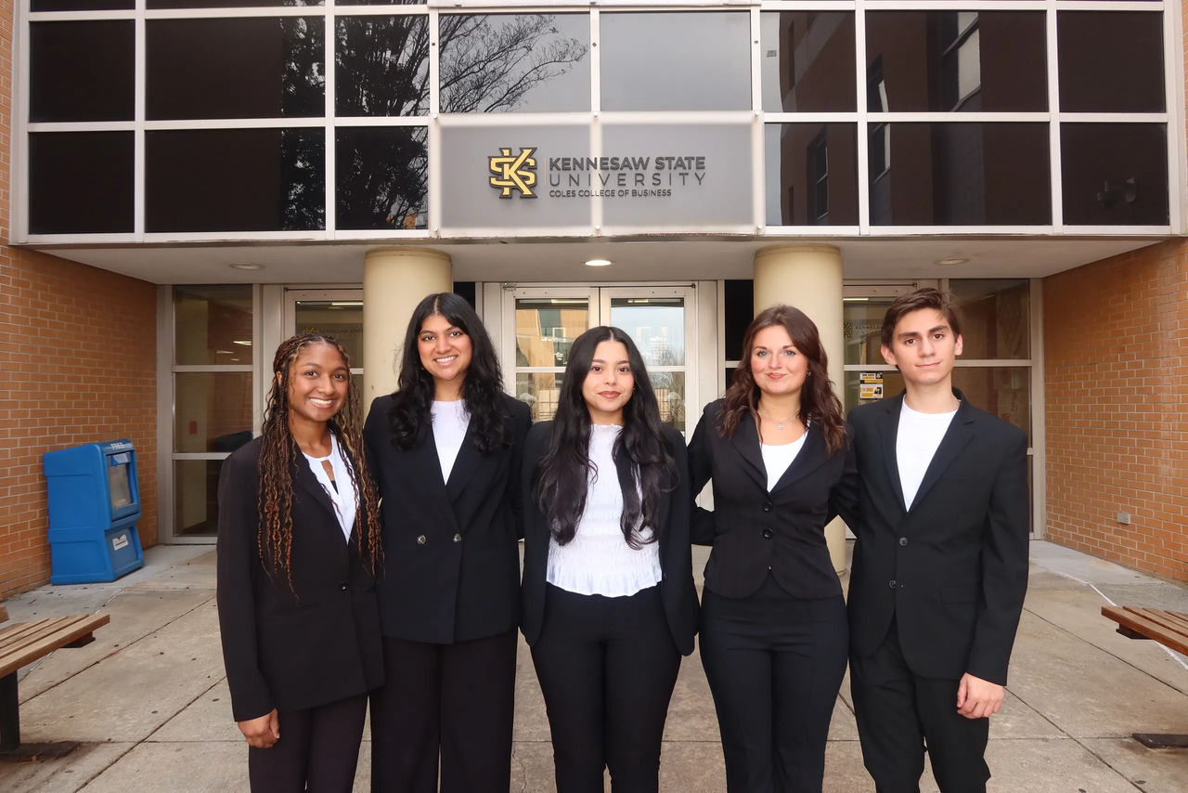
Contact Us
Beta Alpha Psi - Iota Tau Chapter
Contact EC for any specific questions:
Karen Flores-Padilla, President
  E: kfloresp@students.kennesaw.edu
Zainab Choudhary, Vice President
  E: zchoudh1@students.kennesaw.edu
Eric Super, Treasurer
  E: esuper@students.kennesaw.edu
Mya Bacchus , Reporter
  E: mbacchu2@students.kennesaw.edu
Hailey Young, Marketing Director
  E: hyoung32@students.kennesaw.edu
Contacts for other questions:
Shannon Shumate:
  E: sshumat2@kennesaw.edu
Amanda York:
  E: ayork23@kennesaw.edu

Slide 23
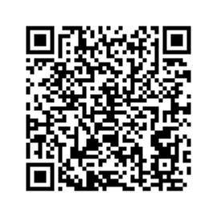
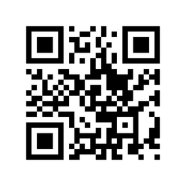
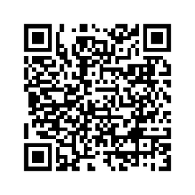
Follow US
Instagram
Website
LinkedIn

Slide 24
Kennesaw State University
Thank You!
Iota Tau Chapter
Visit Our Website
ksubap.com

