Slide 1





Kennesaw State University
BETA ALPHA PSI
Iota Tau Chapter
Visit Our Website
ksubap.com

Slide 2
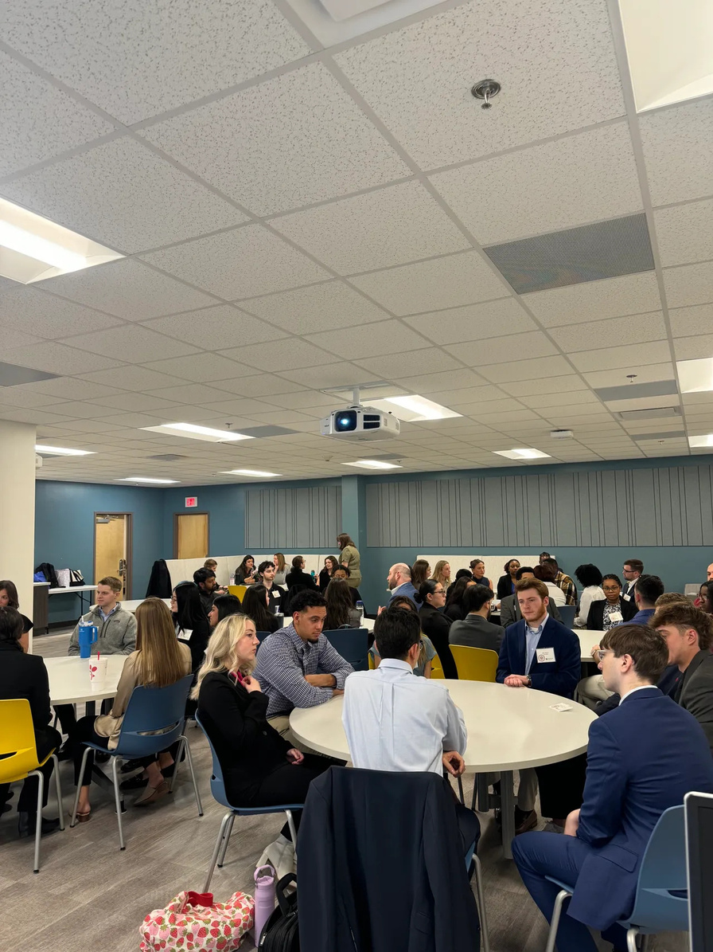
Why Join?
About BAP
Founded in 1919, Beta Alpha Psi is an international honor organization for financial information students and professionals.
Professional Reputation & Networking
  Gain recognition from employers and connect with top professionals in accounting, finance, analytics, and technology
Academic & Professional Development
  Build skills through mentoring, workplace readiness, credentialing, and recognition of academic excellence
Ethics & Leadership
  Foster responsible practices, advocacy, and community involvement through service
Introduction

Slide 3


Chapter Vision
Beta Alpha Psi will shape the financial and business information professions by developing members into ethical, professional, and confident leaders
Chapter Mission
To inspire and support excellence by:
  encouraging the study and practice of accounting, finance, business technology, and analytics
  providing opportunities for professional development, interaction among members, and financial professionals
  fostering lifelong ethical, social, and public responsibilities
Introduction

Slide 4
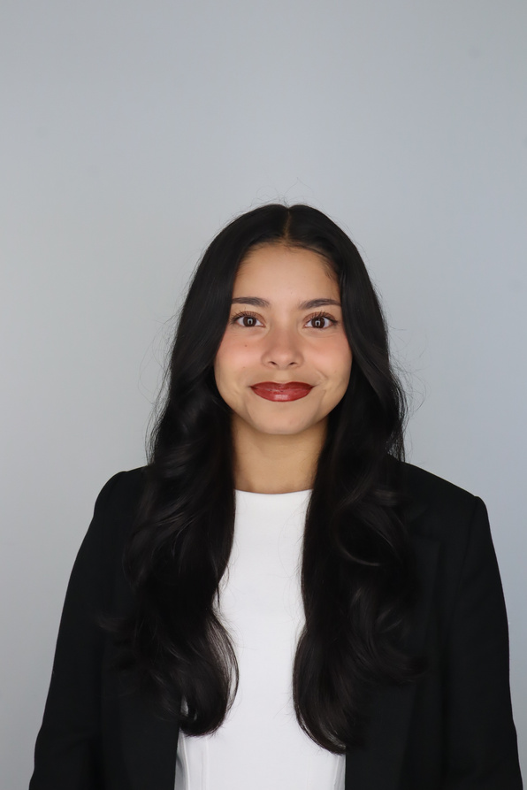
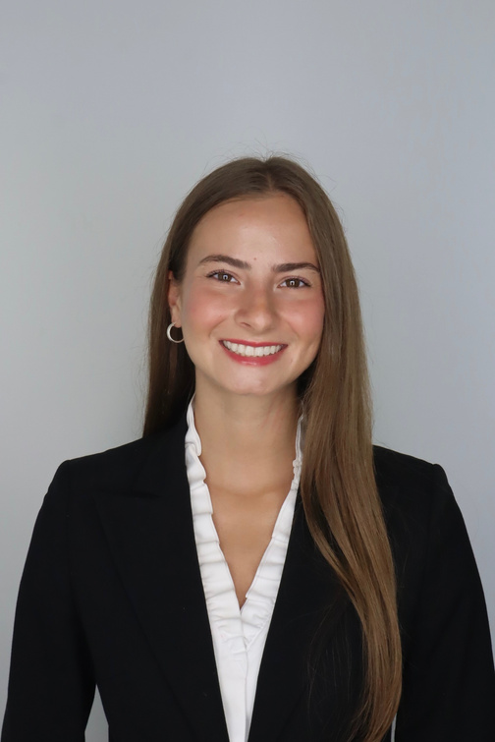
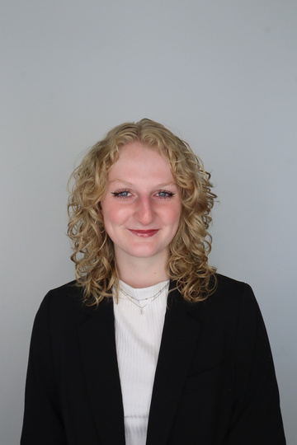
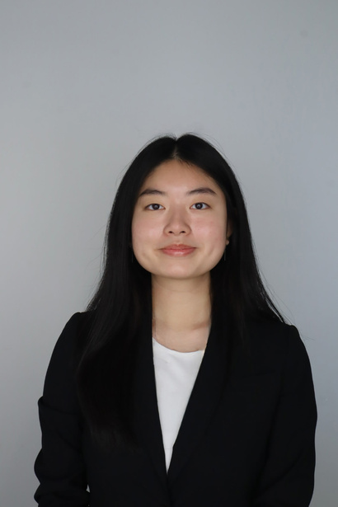
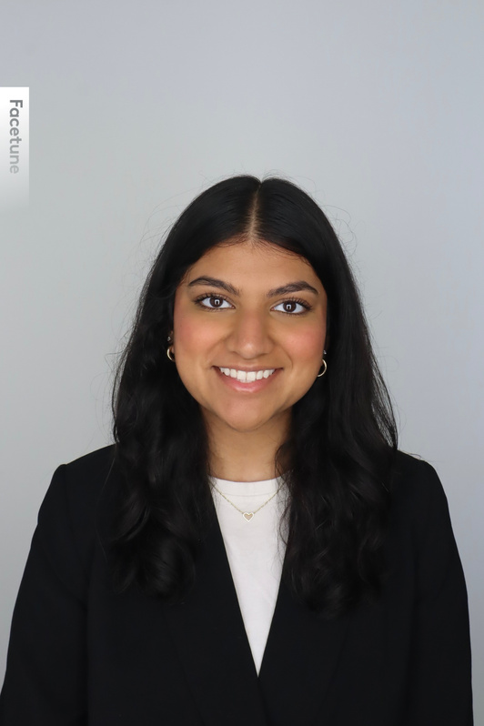
Meet The Executive Committee
Karen Flores-Padilla
Lindsey Mcclelland
Kelsey Barton
President
Vice President
Reporter
Anchiella Angelle
Zainab Choudhary
Meet the Board
Events Director
Marketing Director

Slide 5
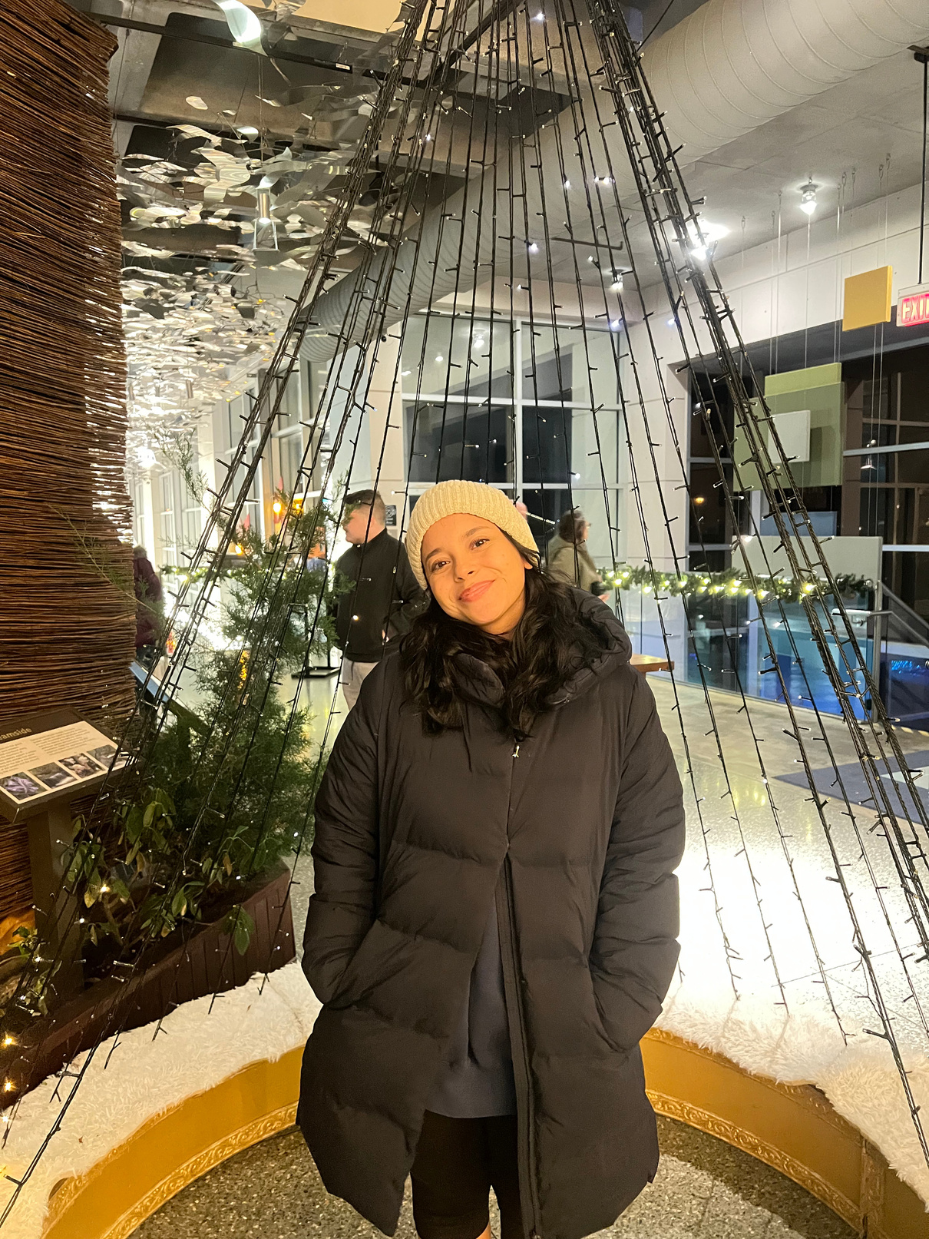
Karen Flores-Padilla
President
Major: Accounting
Minor: Coles Leadership Scholar
Hobbies: Hiking and Thrifting
Summer 2026 - Audit internship at Bennett Thrasher
Meet the Board

Slide 6
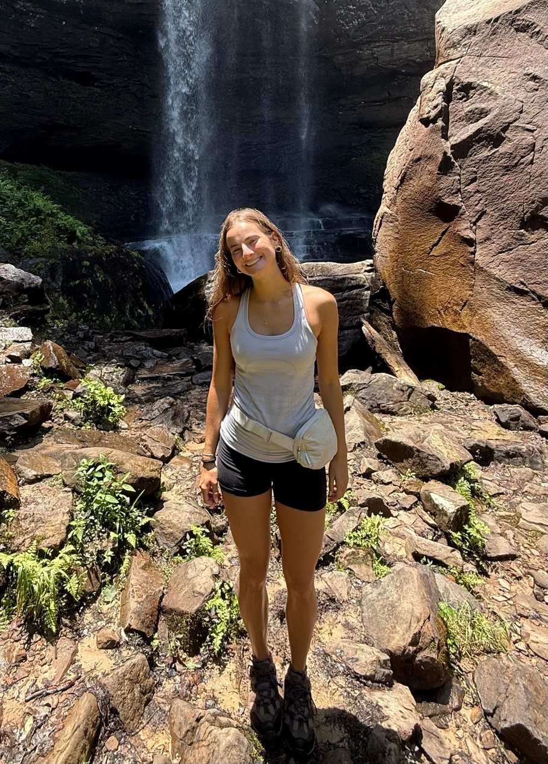
Lindsey Mcclelland
Vice President
Major: Accounting
Hobbies: Gym and Thrifiting
Spring 2026 - Tax internship at Warren Averett
Meet the Board

Slide 7
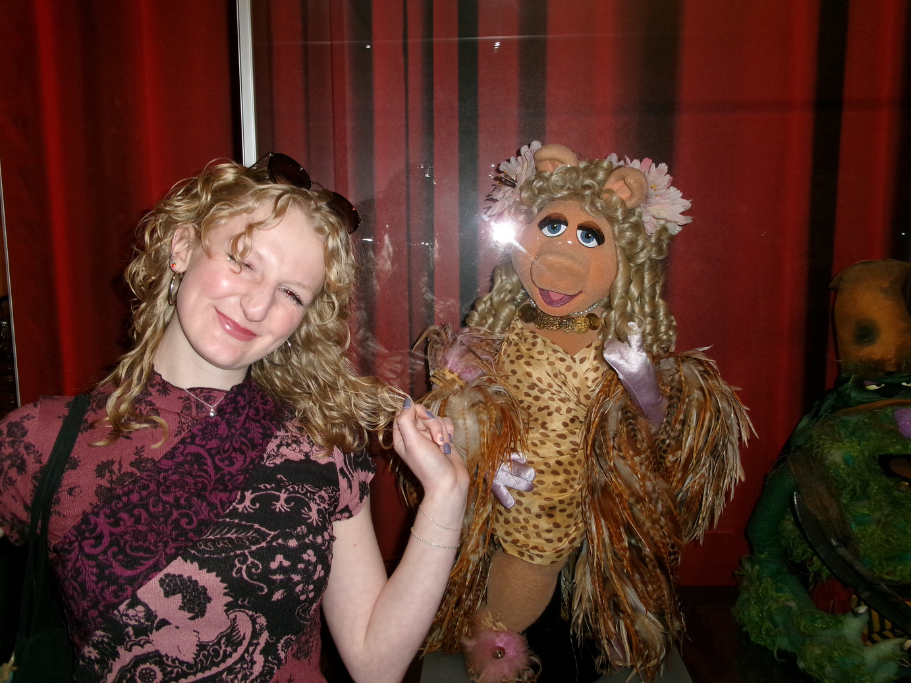
Kelsey Barton
Reporter
Major: Accounting
Hobbies: Reading and Camping
Spring 2026 - Tax internship at Cherry Bekaert
Meet the Board

Slide 8
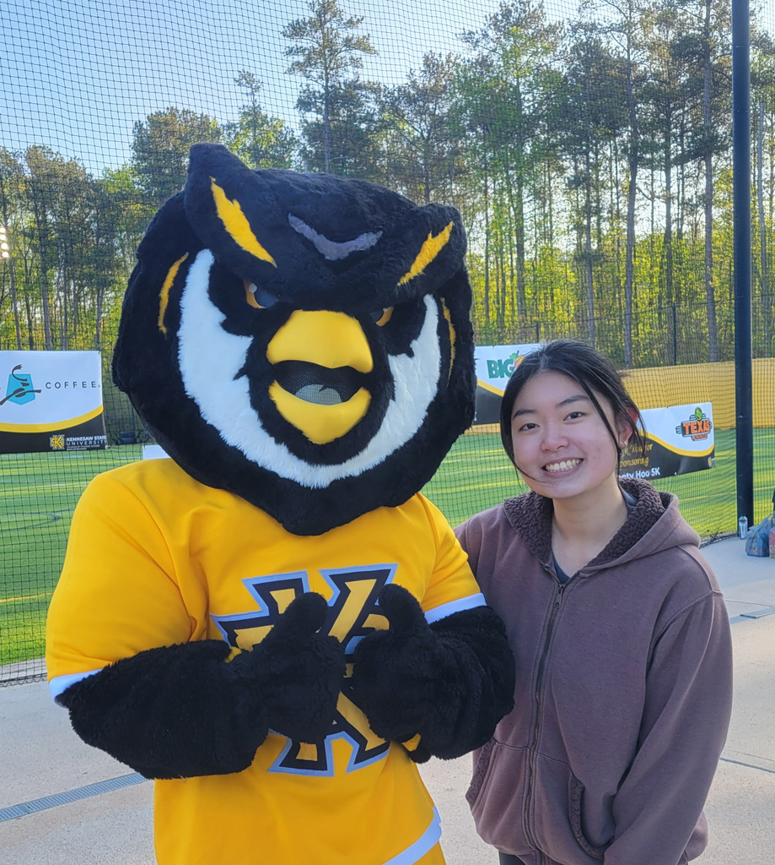
Anchiella Angelle
Events Director
Major: Accounting and Marketing
Hobbies: Volunteering
Spring 2026 - Tax internship at Aprio
Meet the Board

Slide 9
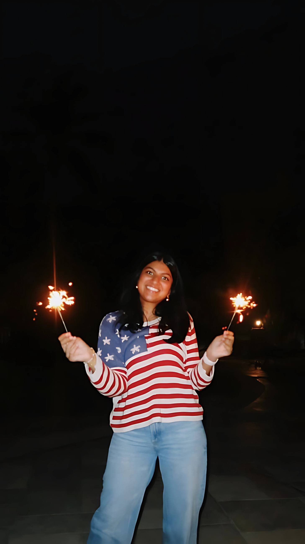
Zainab Choudhary
Marketing Director
Major: Accounting
Minor: Coles Leadership Scholar
Hobbies: Walking and Talking
Summer 2026 - Embark Scholar internship at KPMG
Meet the Board

Slide 10
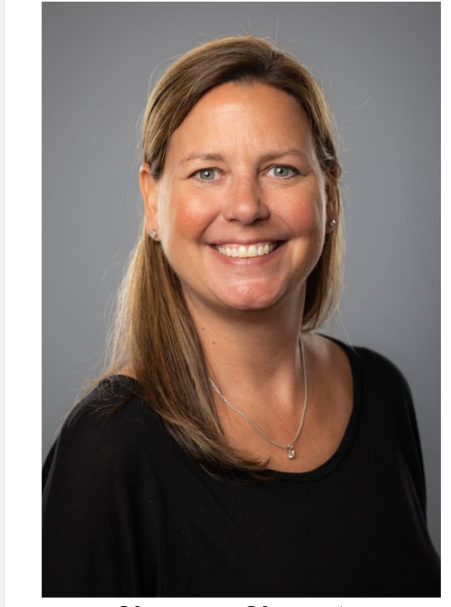
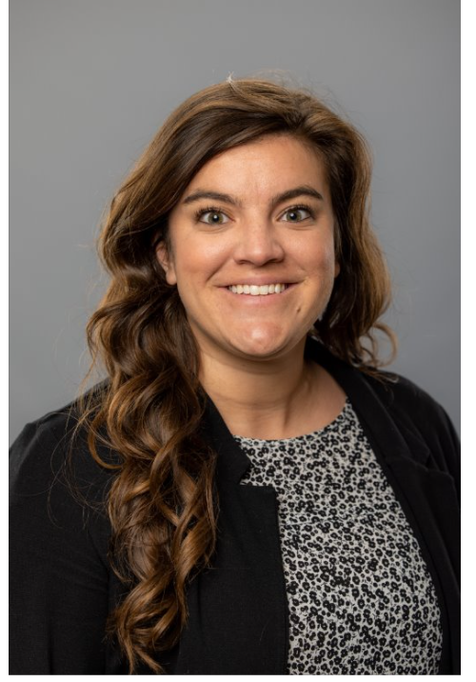
Meet Our Advisors
Shannon Shumate
Amanda York
Principal Lecturer
Associate Director, Strategic Partnerships
The Advisors

Slide 11
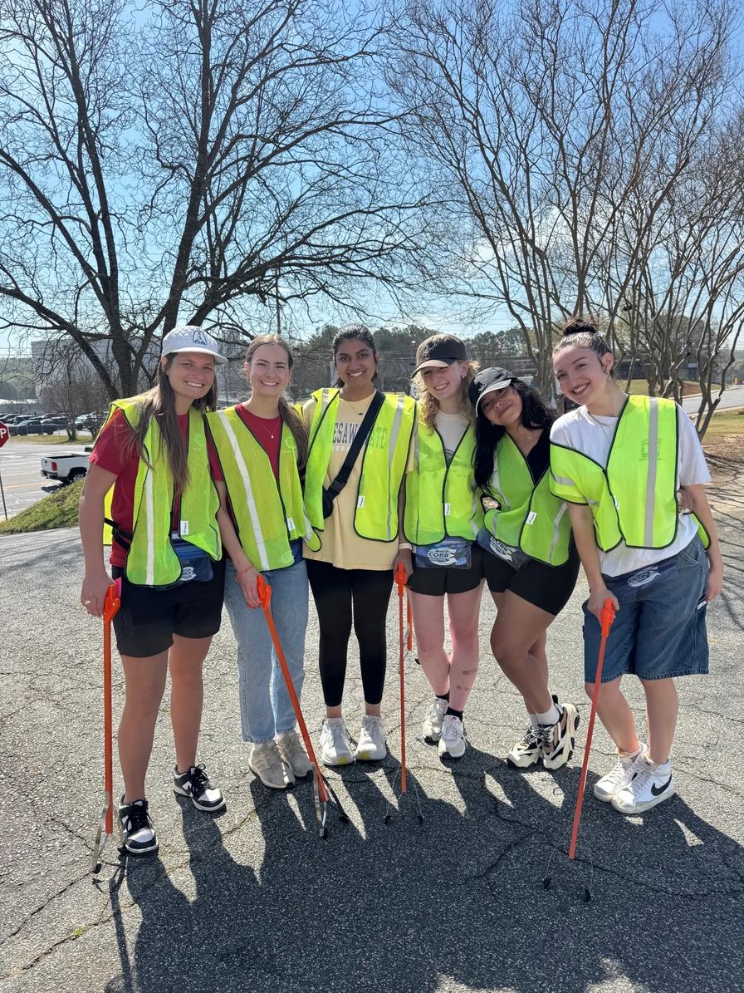
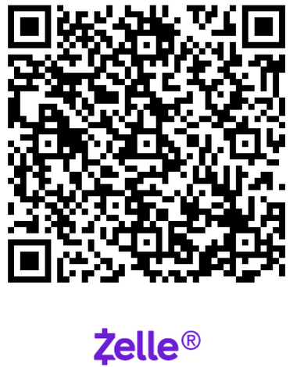
Candidate and Member Requirements
How to Join?
Must commit to two full semesters​ and complete first semester requirements to become a member​:
  6 hours of community service​ (CS)
  8 hours of professional development​ (PD)
  1st Semester - $110 – Candidate​
  2nd Semester - $50 – Member​
Final registration and payment
deadline : Thursday, September 11th
@11:59 pm​
Candidacy and Membership

Slide 12
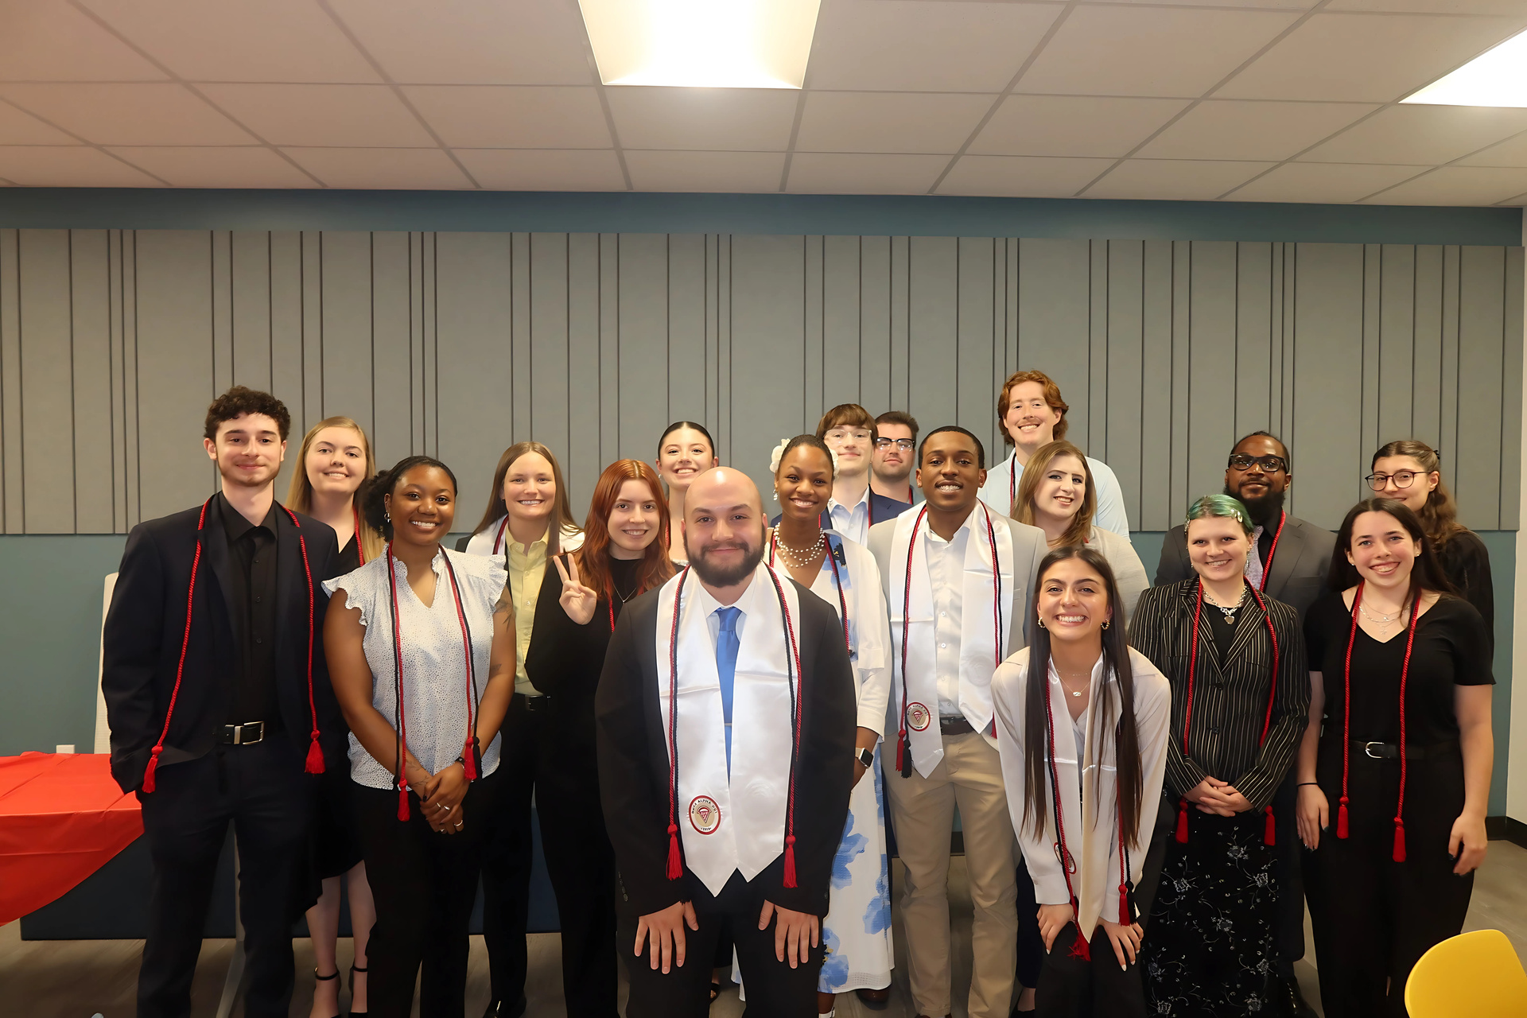
Eligibility Requirements
01
Am I Eligible?
  Must have declared a major – Accounting, Finance, or Information Systems​
  Must have completed major- 3100 course​
  Institutional and major GPA 3.0 beyond business core
Students who don't yet meet the 3100
requirement to become a candidate​ can join FBIS
Recommended minimum:​
  4 hours PD and 2 hours CS activities
  $30 per semester​
02
Join as FBIS!
Eligibility

Slide 13
Eligibility Requirements
Non BAP PD AND CS Hours
What if I can’t attend enough BAP meetings?
03
  Members and Candidates may earn up to 2 PD hours and 4 CS hours outside of BAP.
  All hours must be submitted using the Non-BAP CS and PD Hours Form at ksubap.com/resources.
Eligibility

Slide 14




GPA Verification Steps
01
02
03
04
Go into Degree Works
Press CTRL + P (do NOT use printer icon)
Destination: Save as PDF
Layout: Lanscape then SAVE
  Both Candidates and Members must email a copy of their transcript
  Degree Works transcripts should be submitted to Professor Shannon Shumate at sshumat2@kennesaw.edu.
GPA Verification

Slide 15

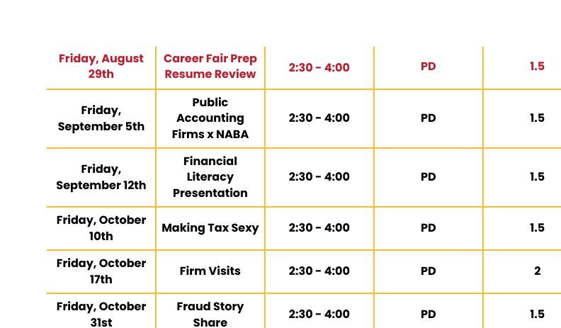
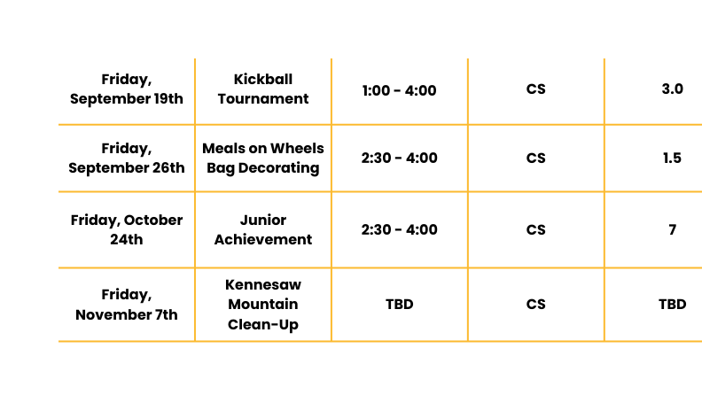
Tentative Fall 2025 Schedule
Community Service
Professional Development
Tentative Schedule

Slide 16
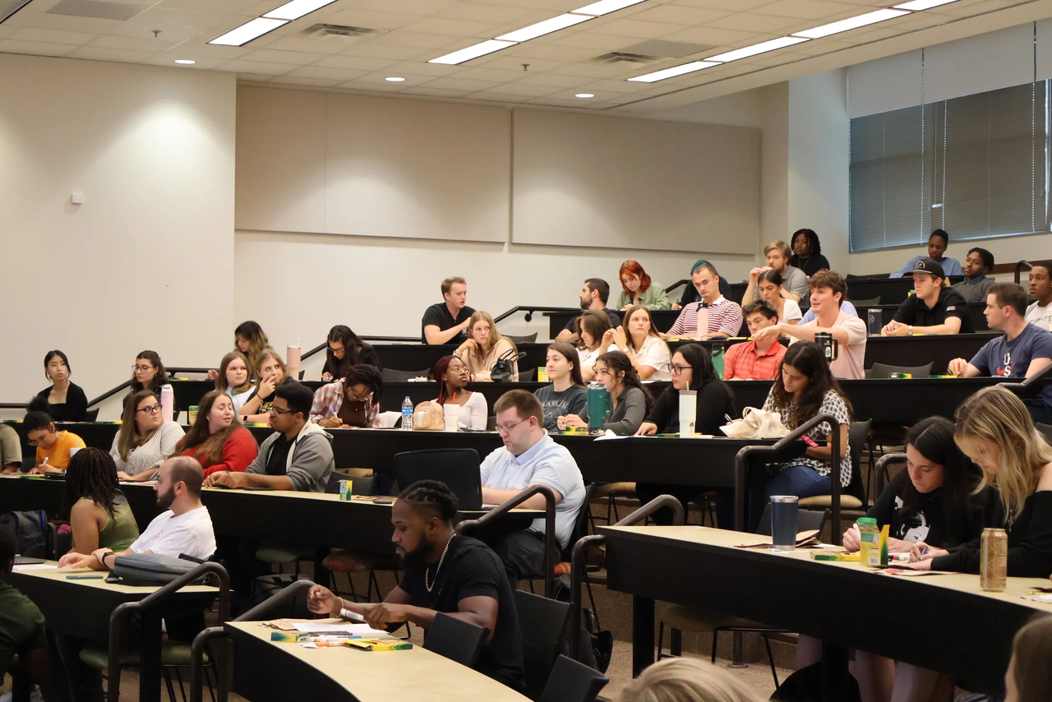




Meeting Expectations
Cellphone should be put on silent for company visits
Network and talk to your peers
Business Professional attire for company visits
Be mindful of snacking
Expectations

Slide 17



Ice Breaker Activity
Ask Your Pair a Question?
Share What You Learned!
Find Your Pair!
  Duo = blue and white
  Trio = blue, white, and pink
  No card? raise hand to receive one
  When you find your pair, sit down
Casual conversation, use questions below
Example questions:
  Name, Major, and Grade Level
  Memorable summer memory?
  Biggest challenge so far?
  At the end, pairs will talk to another pair nearby and share what they learned about each other
Ice Breaker

Slide 18


Career Fair Prep Resume Review
  Have a resume rough draft by next Friday’s meeting​
  Business Professional Attire
Bring questions for visiting companies:
  Mauldin & Jenkins, HLB Gross Collins, Carr Riggs & Ingram, CliftonLarsonAllen, and Nichols Cauley
Member of Beta Alpha Psi – Iota Tau Chapter​
Candidate for Membership of Beta Alpha Psi – Iota Tau Chapter
Member of FBIS – an Affiliate of Beta Alpha Psi​ - Iota Tau Chapter
Upcoming Meeting

Slide 19


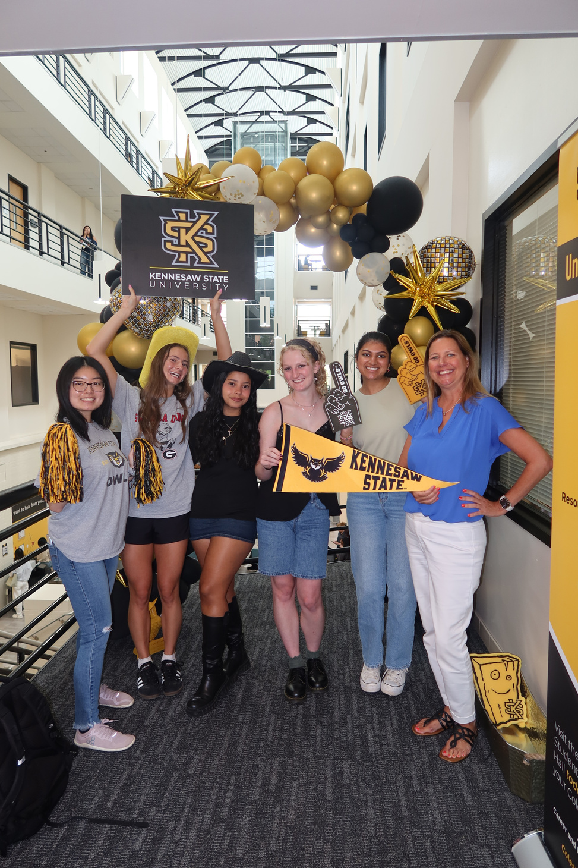
Contact Us
BETA ALPHA PSI - Iota Tau Chapter
Contact EC for any specific questions:
Karen Flores-Padilla, President
  E: kfloresp@students.kennesaw.edu
Lindsey Mcclelland, Vice President
  E: lmccle10@students.kennesaw.edu
Kelsey Barton, Reporter
  E: kbarto19@students.kennesaw.edu
Anchiella Angelle, Events Director
  E: aangell2@students.kennesaw.edu
Zainab Choudhary, Marketing Director
  E: zchoudh1@students.kennesaw.edu
Contacts for other questions:
Shannon Shumate:
  E: shumat2@kennesaw.edu
Amanda York:
  E: ayork23@kennesaw.edu
Contact Us

Slide 20
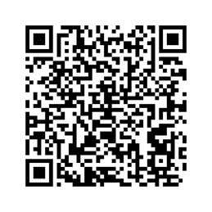
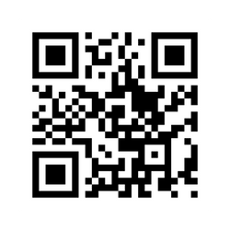
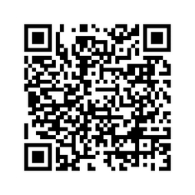
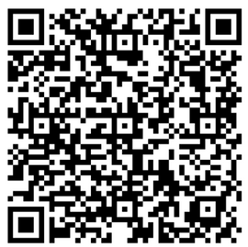
Follow Us
Instagram
Website
LinkedIn
Survey
BUSA
Follow Us

Slide 21

Kennesaw State University
Thank You!
Complete Attendance Check In
Visit Our Website
ksubap.com
Attendance

