Slide 1




Kennesaw State University
BETA ALPHA PSI
Iota Tau Chapter
Visit Our Website
ksubap.com

Slide 2






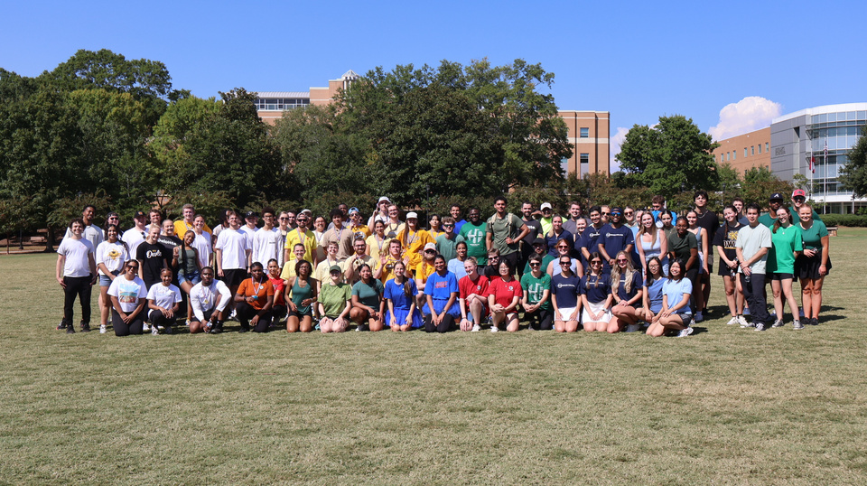

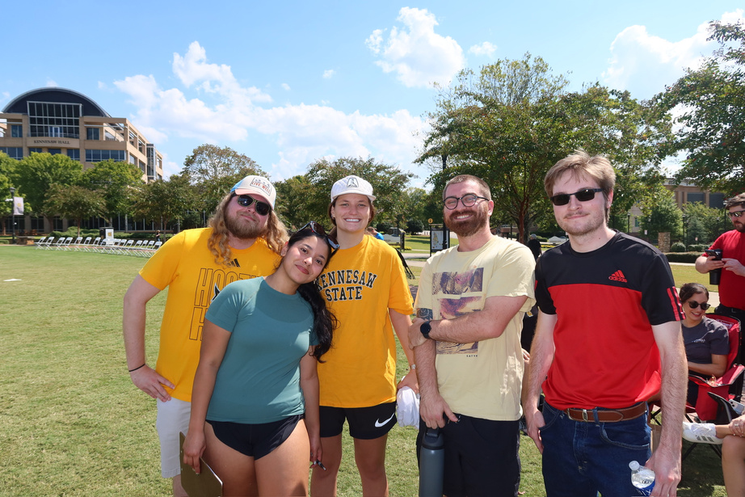





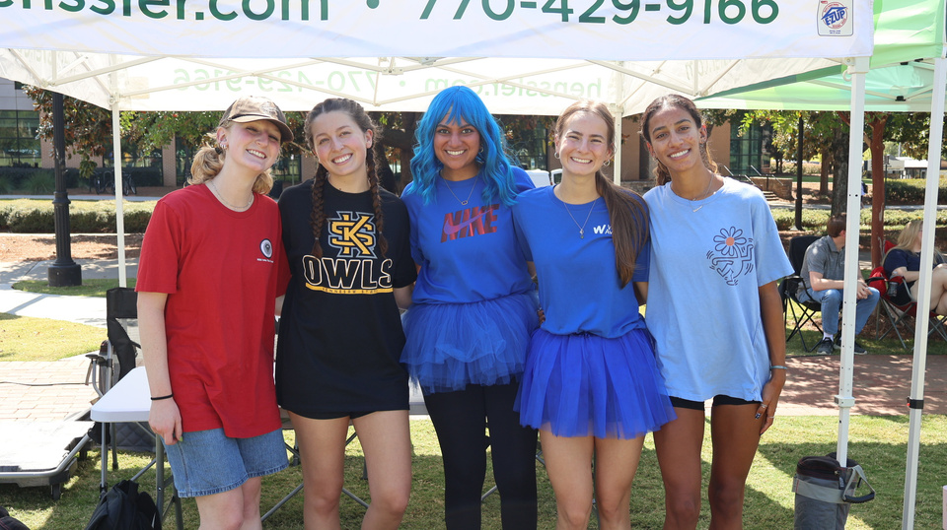
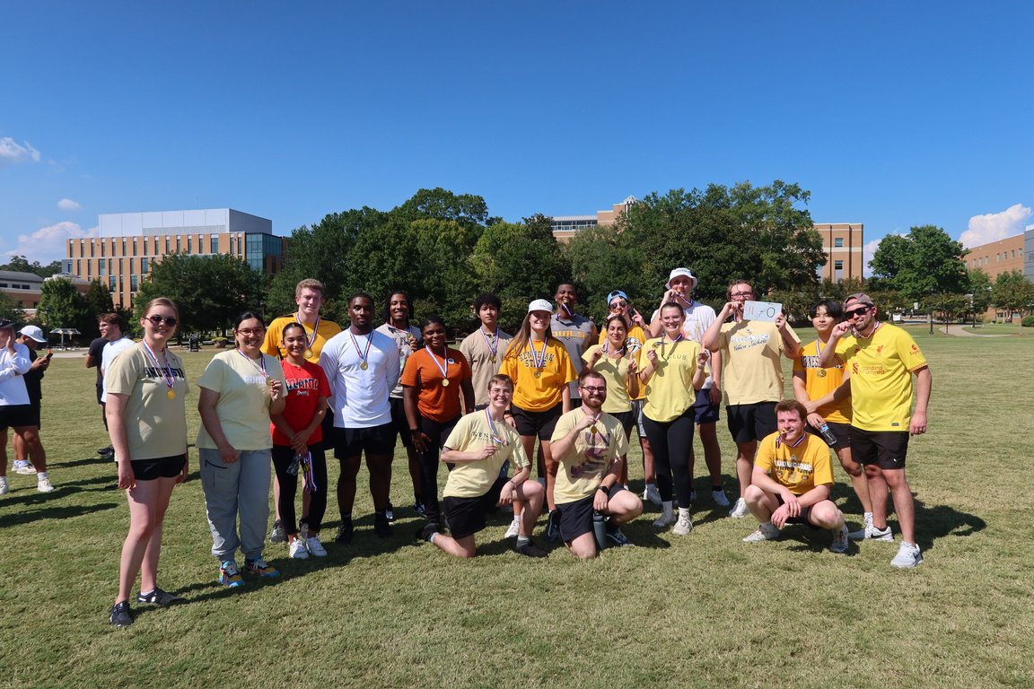





Kickball Tournament !

Slide 3



BAP: Meals On Wheels
Overview: Volunteers decorate bags with creative themes, adding a personal touch for seniors and individuals with disabilities, to promote community engagement
Today’s Meeting Agenda:
Upcoming Events
Important Reminders
Bag Decorating
Aprio, Novogradac, and Nichols Cauley

Slide 4
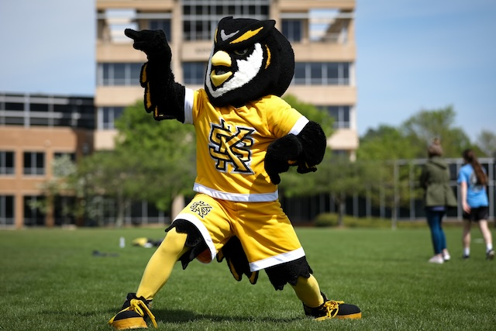



Upcoming Events
MAcc/CPA Info Session
Date: Friday, October 17th
Time: 11:30 AM
Location: Virtual
Internal Audit/Advisory Career Fair
Date: Friday, October 3rd
Time: 11:00 AM - 3:00 PM
Location: KSU Center
President’s Award of Distinction
Applications now open for Fall 2025
Requirements: Essay, recommendation letters, resume (academic, research, leadership, etc.)
Deadline: TODAY @8:00 PM
Upcoming Events

Slide 5
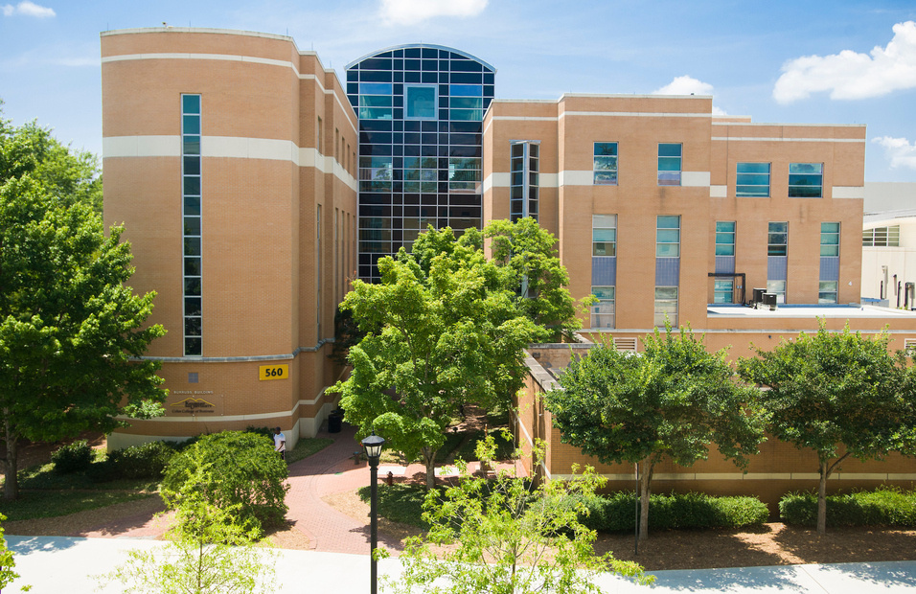



Upcoming Events
Other Opportunities
Industry Voices: TJ Bowling
Date: Tuesday, October 7th
Time: 6:00 PM - 7:00 PM
Location: Virtual
Your Path To Financial Freedom
Date: Wednesday, October 8th
Time: 1:25 PM - 2:15 PM
Location: ALC 1100
Tetley Leader Lecture Series
Date: Wednesday, October 15th
Time: 2:00 PM - 3:00 PM
Location: Student Center University Room
Upcoming Events

Slide 6

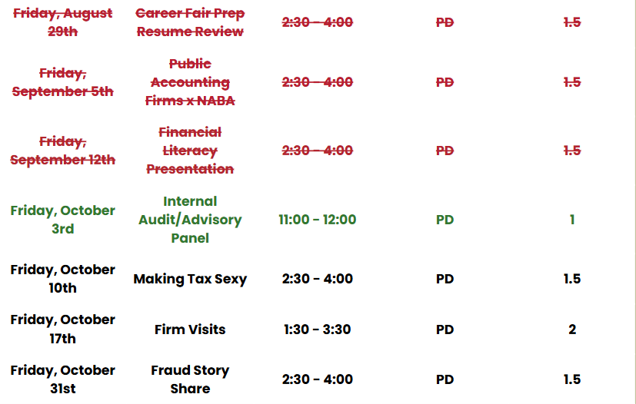
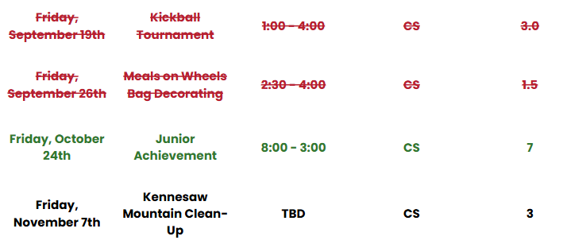
BAP Tentative Fall 2025 Schedule
Community Service
Professional Development
Upcoming Events

Slide 7

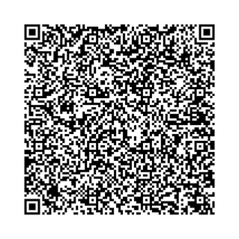
Firm Visits
Overview: Students will have the opportunity to participate in an on-site firm visit to gain firsthand exposure to professional environments.
Date: Friday, October 17th
Time: 1:30 PM - 3:30 PM
Firms: WBL, Nichols Cauley or Deloitte
Business Professional Attire
Only for Candidates and Members
Worth 2.0 PD Hours
Upcoming Events

Slide 8
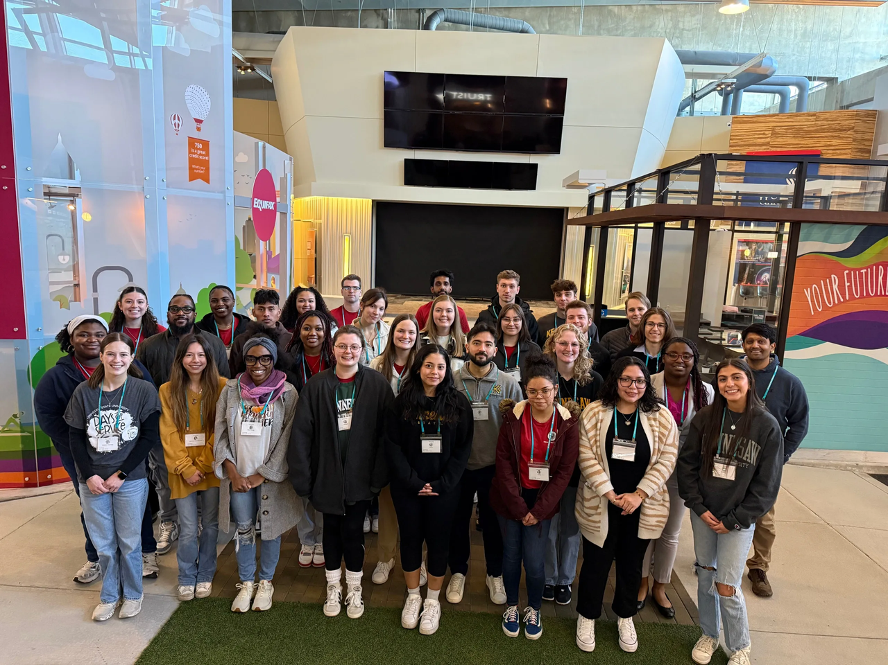
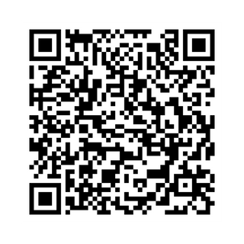
Junior Achievement
Overview: Students will work with kids to engage in interactive simulations, gaining insight into business, finance, and career pathways.
Date: Friday, October 24th
Time: 8:00 AM - 3:00 PM
Location: JA Chick-Fil-A Discovery Center
KSU or BAP Attire
Only for Candidates and Members
Worth 7.0 CS Hours
Parking, Coffee, Training, and Lunch provided
Upcoming Events

Slide 9

BAP Pie Awards
Beta Alpha Psi Pie Awards
How do I stand out?
BAP Iota Tau Chapter recognizes students who show outstanding participation at scheduled events
Awards:​
Professional Development Award​
Community Service Award
Prize:​
Pie, recognition, and a surprise
Important Reminders

Slide 10



Meals on Wheels
Featuring Our Visiting Firms
Decorate bags and network with firms
Bag Decorating

Slide 11
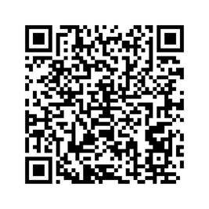
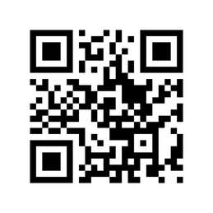
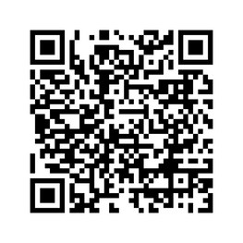
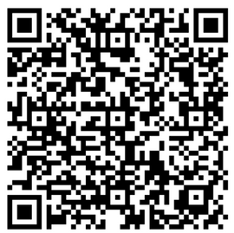
Follow Us
Instagram
Website
LinkedIn
Survey

Slide 12


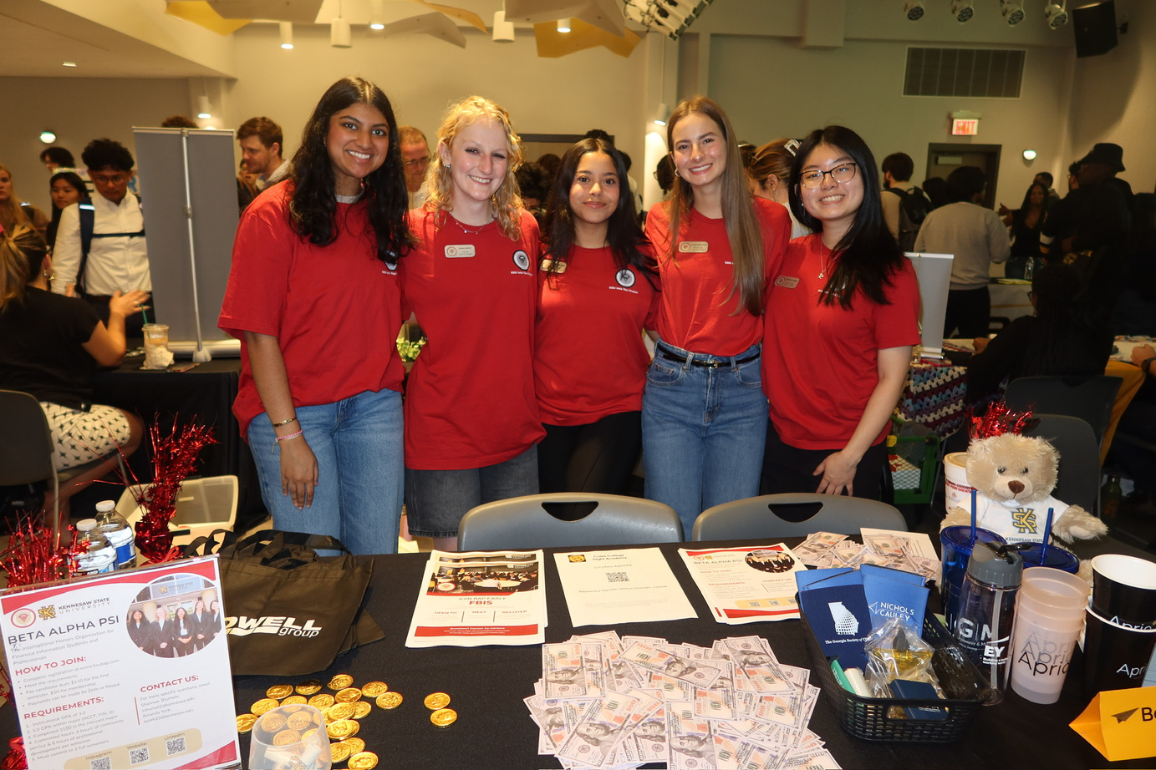
Contact Us
BETA ALPHA PSI - Iota Tau Chapter
Contact EC for any specific questions:
Karen Flores-Padilla, President
E: kfloresp@students.kennesaw.edu
Lindsey Mcclelland, Vice President
E: lmccle10@students.kennesaw.edu
Kelsey Barton, Reporter
E: kbarto19@students.kennesaw.edu
Anchiella Angelle, Events Director
E: aangell2@students.kennesaw.edu
Zainab Choudhary, Marketing Director
E: zchoudh1@students.kennesaw.edu
Contacts for other questions:
Shannon Shumate:
E: shumat2@kennesaw.edu
Amanda York:
E: ayork23@kennesaw.edu

Slide 13
Kennesaw State University
Thank You!
Iota Tau Chapter
Visit Our Website
ksubap.com

