Slide 1
Getting into the Flow
More on Actionable Agile Metrics
By Kevin Best
Material from Actionable Agile Metrics for Predictability by Daniel Vacanti

Slide 2
How did we get here?
Little’s Law through Operations Management lense
  Cycle Time = Work In Progress/Throughput
Where:
Cycle Time (CT) = the average amount of time it takes for an item to flow through the system.
Work In Progress (WIP) = the average total inventory in the system.
Throughput (TH) = the average Throughput of the system.
Notes:
Little’s Law locks the three measures together
in a unique and consistent way for any system in which
it applies. Little’s Law will not tell the managers how to
handle trade-offs or provide innovations to improve their
chosen measures, but it lays down a necessary relation.

Slide 3
How did we get here? - Continued
Another way to express Little’s Law algebraically is
TH = WIP/CT
Notes:
The upshot of Little’s Law is that, in general, the more
things that you work on at any given time (on average)
the longer it is going to take for each of those things
to finish (on average).

Slide 4
What does the OM version of Little’s Law give us?
A way to measure the throughput of our production process whether that is an engineering process, business deliverable process, or software creation.
Eventually one can use cumulative flow diagrams to generate Monte Carlo simulations for forecasting based on a stable and predictable process.
Cumulative Flow Diagrams help us understand if we have stability and predictability.
Notes:
Without getting to far ahead of myself, when one starts using cumulative flow diagrams keeping work in progress at minimal levels one can venture into trying to forecast when work can be delivered. There is a lot work to be done before this can happen. That is why there is emphasis on stable and predictable for that is where the work lies in getting a stable and predictable process. Most organizations do not have a stable and predictable process/system.

Slide 5
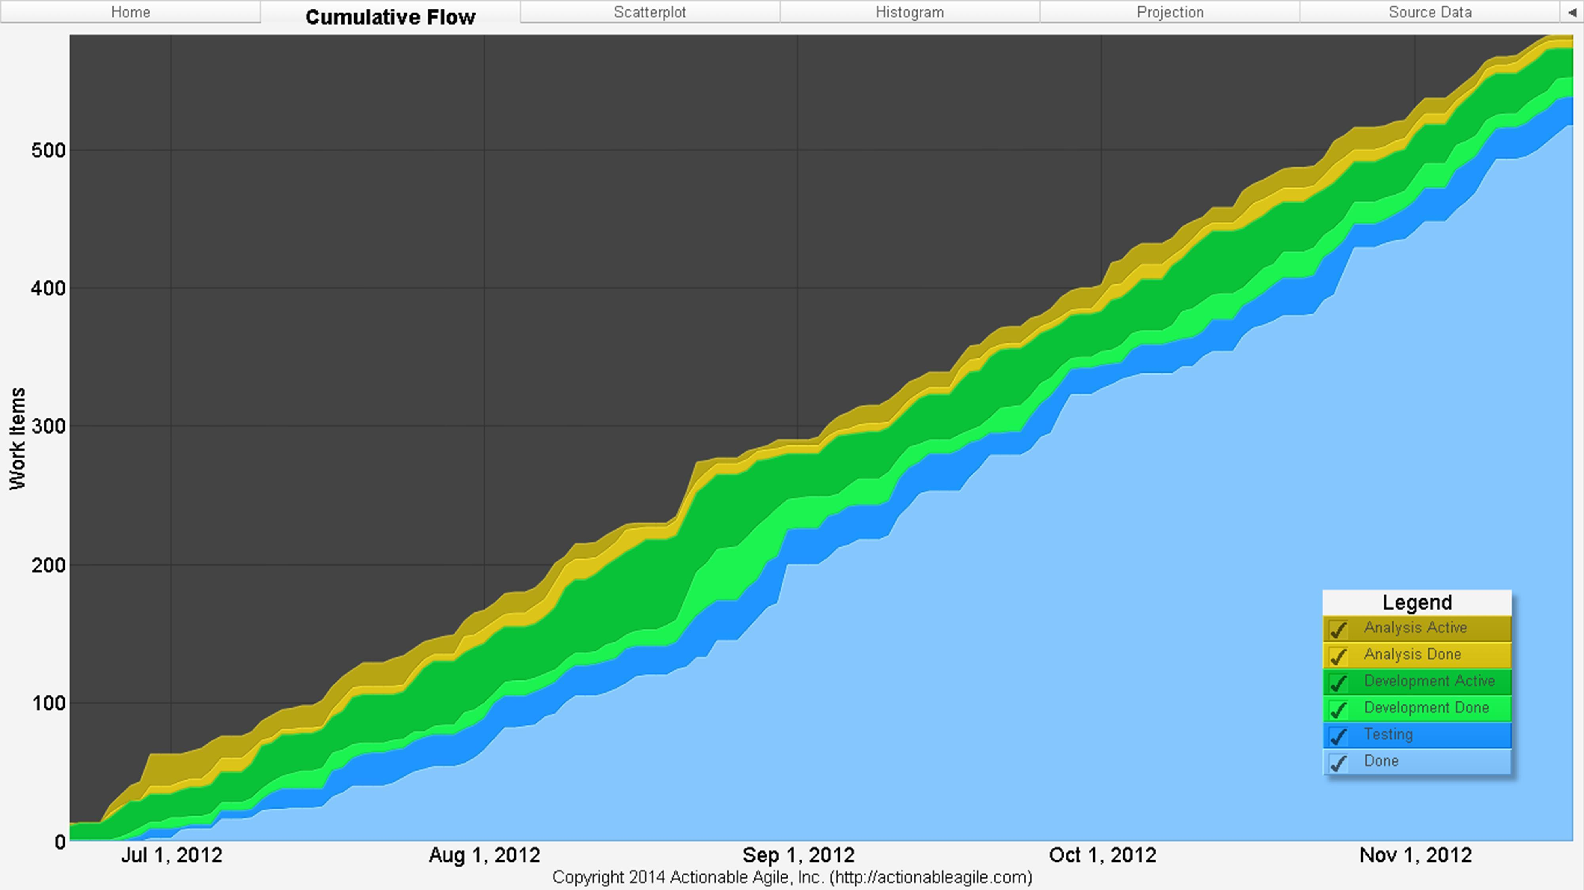
Cumulative Flow Diagram Introduction
Figure 4.1: A Basic CFD
Notes:
Without further ado let me introduce the subject of my presentation, the Cumulative Flow Diagram. Cumulative Flow Diagrams are all about arrivals and departures. The original name for this type of diagram is “Cumulative Arrival and Departures Diagram”.

Slide 6
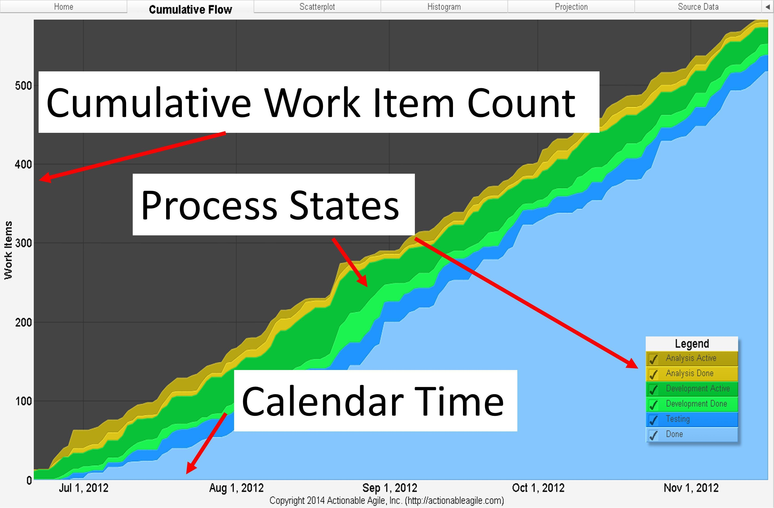
Anatomy of a Cumulative Flow Diagram
Figure 4.2: Anatomy of a CFD
Notes:
The above CFD presents time in calendar months. The X-Axis can be demarcated in two-week intervals, one-week interval, or in days. The Y-Axis presents the cumulative count of work items in the various arrival and departures. The bands in the above diagram are the different colored section on the graph. By “line” I mean the demarcation boundary of any band. Any band on a CFD is always going to be bounded by two lines: a top line and a bottom line. The bottom line of a given band will be the same as the top line of the succeeding—should such a subsequent band exist. There are 6 bands corresponding to each of the process states and it has seven lines that mark the boundaries.

Slide 7
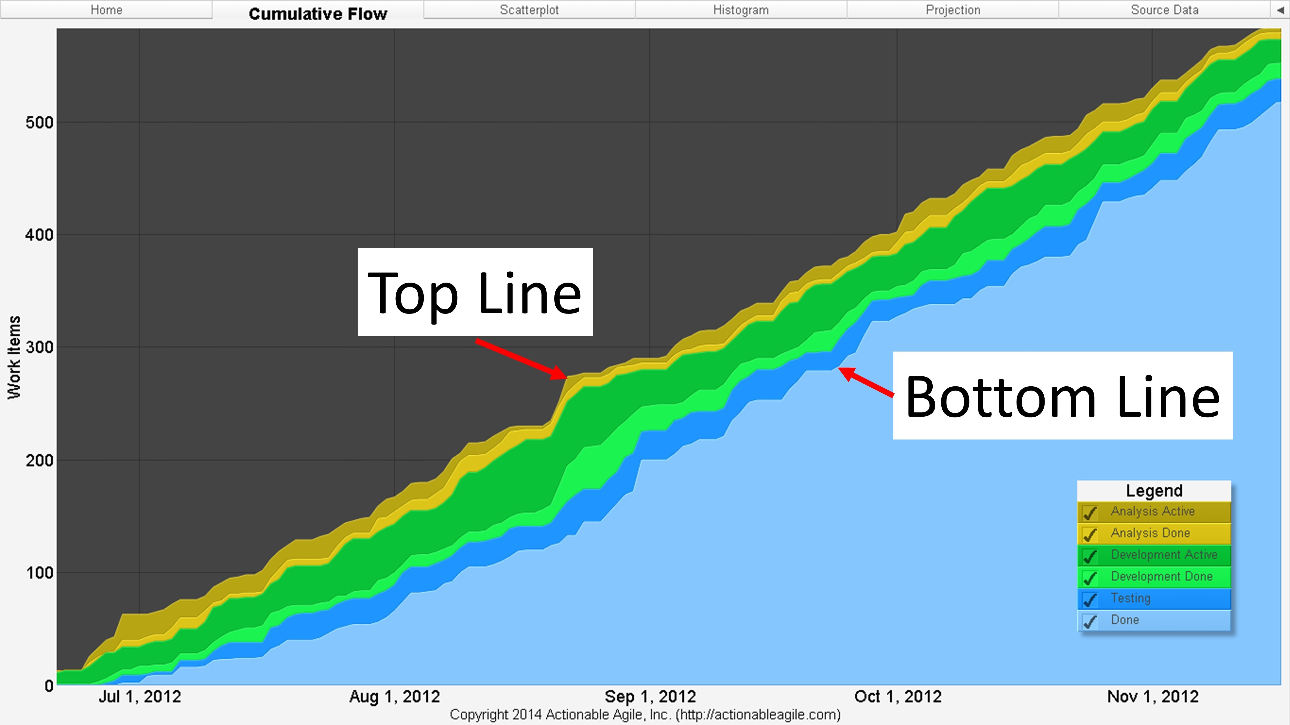
Anatomy of a Flow Diagram - Continued
Figure 4.3: The Top and Bottom Line on a CFD
Notes:
The most important thing to remember about CFDs is that they are fundamentally about the process arrivals and departures. Any chart that does not model or graph these arrivals and departures properly or any chart that includes extraneous information not considered an arrival or a departure cannot be properly called a Cumulative Flow Diagram.

Slide 8
Cumulative Flow Diagram Property #1
CFD Property #1: The top line of a Cumulative Flow Diagram always represents the cumulative arrivals to a process. The bottom line on a CFD always represents the cumulative departures from a process.
Notes:
Daniel Vacanti emphasizes that a chart that contains additional outside lines that do not represent process arrivals and departures is not a CFD. Any chart that does not account for cumulative arrivals and departures properly is not a CFD. The definition of the boundaries of your process is essentially up to you. However, once chosen, those boundaries will be represented by the lines on your graph as defined above.

Slide 9
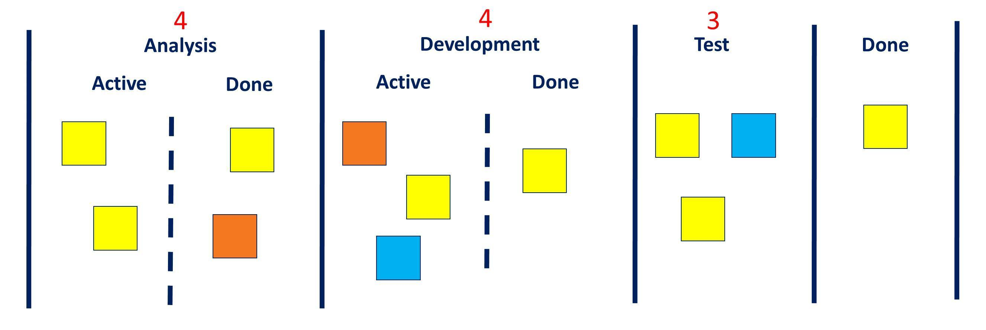
An Example Process - Kanban
Figure 4.4: Example Process
Notes:
Those familiar with Kanban may recognize this as a Kanban board, but the following discussion is equally applicable to a more Scrum or XP style of process that has columns as “To Do”, “Doing”, and “Done”.
In the example, arrivals to the process are denoted by the “Analysis Active” column, and departures from the processe are denoted by the “Done” column.

Slide 10
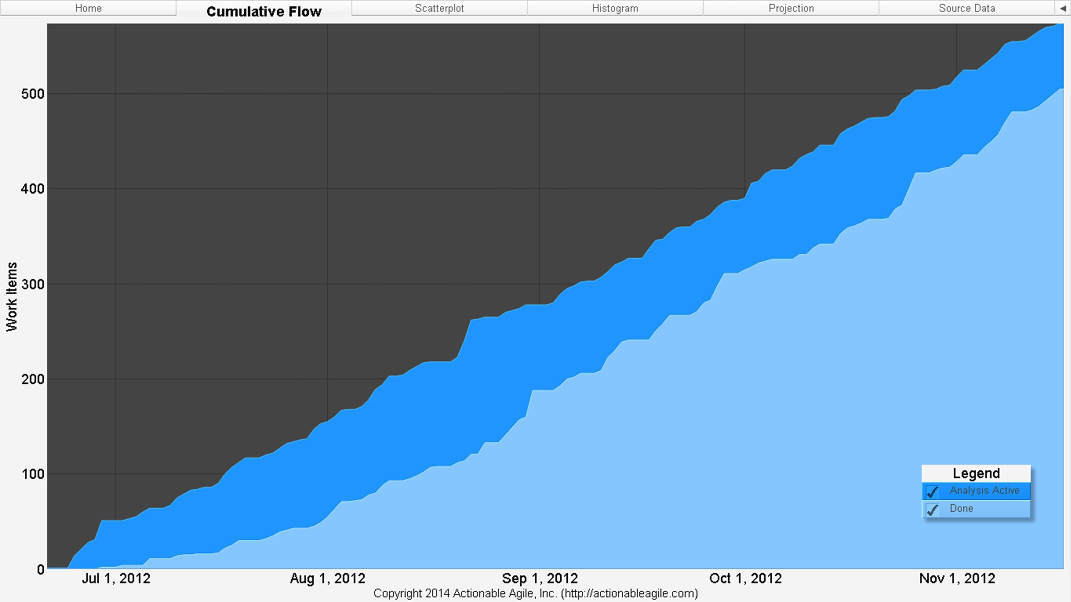
Total Process Arrivals and Departures
Figure 4.5: Total Process Arrivals and Departures Only on a CFD
Notes:
A simple CFD that models only the overall cumulative arrivals and departures in this process might look like:
There are only two bands on this diagram. As always, the top line of the band represents the cumulative arrivals to the “Analysis” column and the top line of the bottom band represents the cumulative departures to the “Done” column. Figure 4.5 is a perfectly valid CFD for the process shown in Figure 4.4. One question that you may want to keep in the back of your mind as you go through this discussion is: what do you think the advantages or disadvantages of visualizing your flow as only two lines and bands shown in Fugure 4.5?

Slide 11
Morphing into a Basic CFD
Figure 4.6 A Basic CFD
Notes:
By including the cumulative arrivals and departures for each intermediate workflow steps between “Analysis Active” and “Done” the CFD morphs into the diagram depicted in Figure 4.6. The several lines in Figure 4.6 now correspond to the cumulative arrivals and departures at each step in the workflow.

Slide 12
Final Thing to Know About CFDs
Cumulative Flow Diagrams (CFD) are intrinsically linked with Little’s Law.
Notes:
Dr. Little used CFDs in several of his publications when explaining his eponymous law. We spent a lot of time in the last presentation discussing Little’s Law’s assumptions because many time a violation will clearly show up on a CFD. That is the good news. The bad news is that many times an assumption violation will not clearly reveal itself on a CFD. This is why knowing the assumptions behind the law and be able to map them to the context in which the data was collected.

Slide 13
Constructing a CFD: Myths to Debunked
To create a CFD all you need to do is count all the work items in progress at each step of your process
Plot these counts on your chart are regular reporting intervals.
  “Dubious”
Notes:
Daniel Vacanti calls the above two step dance “building a chart based on counts”. Vacanti views building a chart just by counting items in progress as dubious.

Slide 14
The Supermarket Metaphor
Hours the store is open and hours the supermarket is closed.
Days of the week the supermarket the store is open and closed.
Various times throughout its operating hours it will have customers who enter and leave the market.
Some customers will make purchases
Other customers will leave empty-handed.
Notes:
Dr. Little used this metaphor in several publications. Continuing to have this image in mind let’s explore two very important facts about our market example:

Slide 15
Two Important Facts About the Market Example
Given its physical structure, it is very obvious to determine when customers have entered the market and when customers have left the market. Another way of saying this is that our shop has a very clear point at which customers are said to have arrived to the market, and there is a very clear point at which customers are said to have departed the market.
Every customer who enters the market ultimately departs the market. There are no customers who magically disappear. Even in the case of the continuously open market, customers must inevitably and eventually leave. This fact is true regardless of how long customers spend in the shop or regardless of whether they made a purchase or not.
Notes:
Let’s assume we are dealing with a shop that is continuously open and that we are tracking hourly arrivals and departures. How might we visualize the flow of customers on a CFD? A CFD is all about arrivals and departures, so first thing we need to ask ourselves: how do we determine if someone has arrived or departed our shop? One of the reasons we chose this particular example is because answering that question in this scenario is actually very easy.

Slide 16
We All Like Turnstiles, Right?
To calculate these arrivals and departures we could easily install turnstiles at all doors.
Count the number of people who enter and exit over time.
The turnstiles could increment an arrival count from the entrances.
Likewise the turnstiles could increment a departure count from the exits.
Notes:
These same turnstiles would not track how long each individual spent in the shop, nor would they be able to tell us if a departing individual made a purchase or not. Evey hour we could go and read those counts off the turnstiles and plot them on our graph. If we were tracking those counts in a spreadsheet, the data might look like figure 4.7.

Slide 17
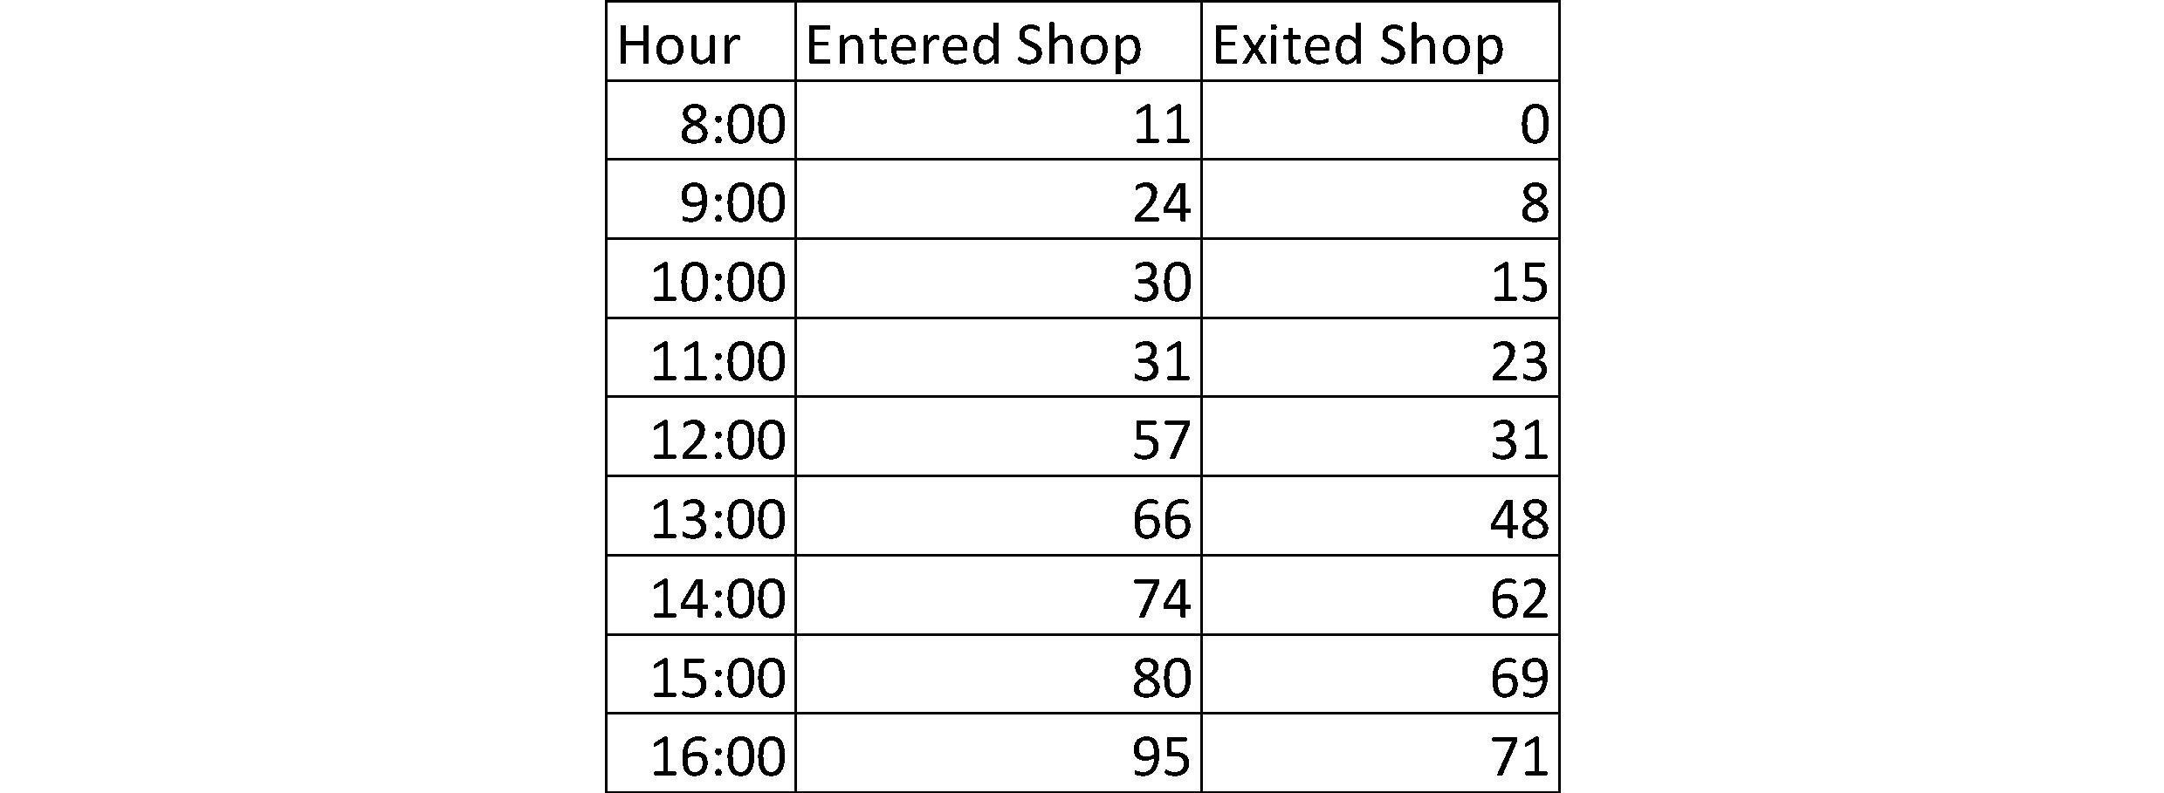
Spreadsheet for Arrivals and Departures
Figure 4.7: Cumulative Count of Arrivals and Departures for the Shop Example.
Notes:
Using a spreadsheet, this data could easily be converted into an Area Chart. The Area Chart, in this case, would be a CFD.

Slide 18
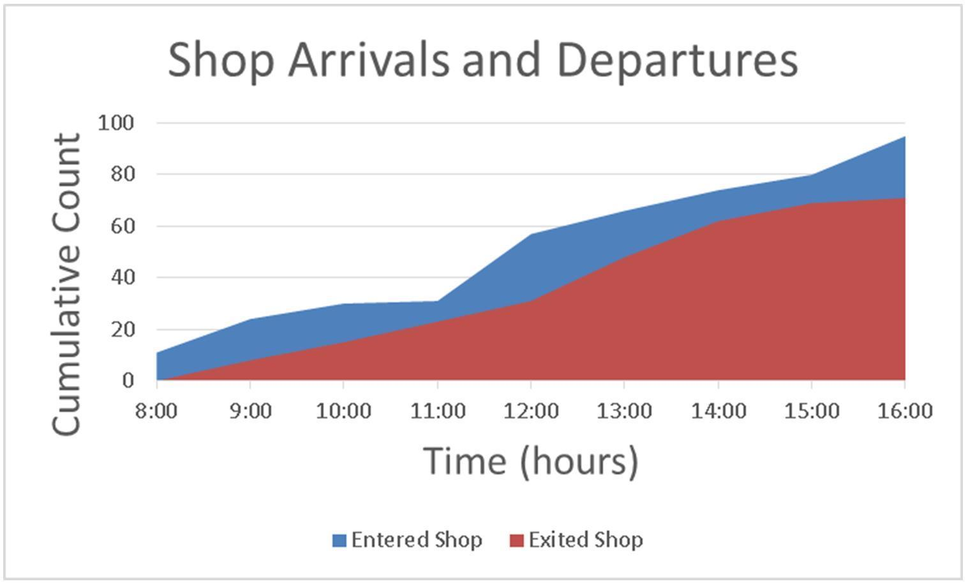
Shop Arrivals and Departures
Figure 4.8: Excel CFD for Shop Example
Notes:
Our cumulative flow diagram might look like this.

Slide 19
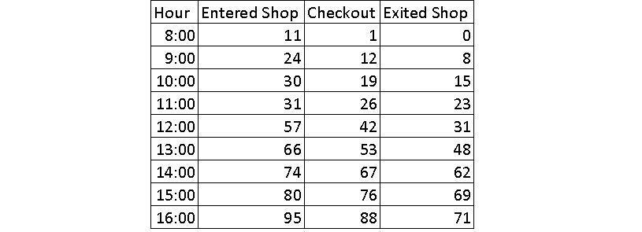
Adding Process Step – Things Get Interesting
Figure 4.9: Adding a Checkout Step to the Shop Example
Notes:
We add a process step called “checkout”. The shop has a single queue that feeds all cashiers. We install a turnstile that all customers who are purchasing items from the shop have to go through to get to a cashier. Additionally, all customers must exit the shop through the overall shop departures turnstile. Our data might look like the figure above.

Slide 20
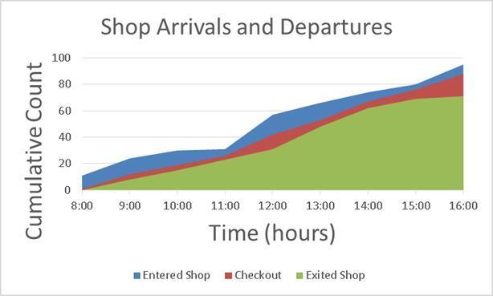
Adding Checkout Line to Shop CFD in Excel
Figure 4.10: Adding Checkout Line to Shop CFD in Excel
Notes:
This example is straightforward enough so far, but it gets very tricky when we start considering some special cases. For instance, how de account for those customers who enter the shop but the immediately turn around and leave for any number of reasons: maybe they forgot their shopping list, maybe they got a call and go outside to have better reception or privacy etc.? Do we count them as arrivals and departures from the shop? Maybe, Maybe not. Similarly, what about those customers who enter the checkout queue but leave immediately because they picked up the wrong items, or they forgot an item on the list, or they decide they don’t want to buy any of the items at all. Don we really want to count these customers as having “arrived” and “departed” the checkout queue?

Slide 21
Special Cases Causes Problems with Counts
If we decrement the arrival count for the special cases
  Our lines on our CFD will go down
Notes:
That is to say, if our reporting interval is every hour on the hour, and four customers arrive at 9:59 am (and we increment our arrival count), but they then leave at 10:01 am for one of the special cases above (and we decide to decrement our arrival count) then the data in our spreadsheet will look like the following

Slide 22

Non-Standard Departures
Figure 4.11: Data for Non-Standard Departures
Notes:
Changing our Cumulative Flow Diagram to look like:

Slide 23
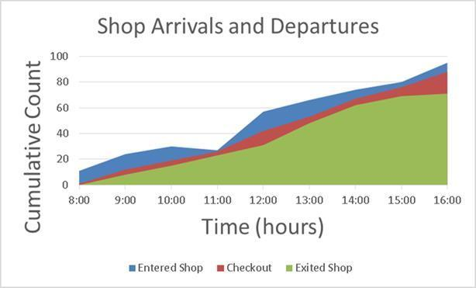
Non-Standard Departures
Figure 4.12: Excel CFD for Non-Standard Departures
Notes:
The difference between Figure 4.10 and Figure 4.12 is subtle but important. Note that the “Entered Shop” line Figure 4.12 actually goes down. You might be thinking “No problem. We have modeled exactly what happened.” But did we? I would argue that we did not. That customer physically arrived to our ship and then left. If we first increment then subsequently decrement our arrival count then we have a possibility of a negative arrival rate(which by the way, violates the whole principle of a Cumulative Flow Diagram). But in the real world it is not possible to have a negative arrival rate. Arrivals are binary: either something has arrived or it has not.

Slide 24
Handling the Case of a Non-Standard Departure
Two choices
  Count a customer as having arrived and then departed;
  Not count a customer as having arrived at all –i.e., it was a mistake to ever have incremented our arrival count in the first place.
Possible Solution
  Give each customer a timestamp for when they entered the market
  For when they enter the checkout queue
  For when they departed the market
Notes:
This is where building a CFD based on counts breaks down and why it is very difficult –and not at all recommended– to build a CFD just by counting items.

Slide 25
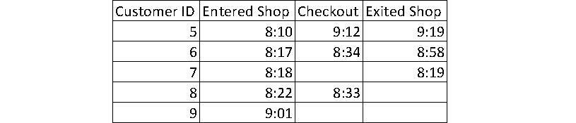
Timestamps for Customers
Figure 4.13: Timestamps for Customers
Notes:
Customer exits the shop for any reason other than a “normal” one then we could reflect that in our data in one or two ways.

Slide 26
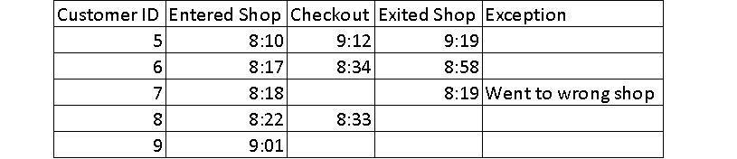
Timestamps for Customers “Tagging”
Figure 4.14: “Tagging” a customer with an Exception Reason

Slide 27
Dealing With Non-Standard Departures
First, we could choose to enter a departure timestamp and then “tag” that departure with a special reason.
Second, we could choose to simply delete the arrival timestamp as if the customer never entered the particular downstream queue.
Notes:
First strategy would give us an opportunity to filter out that “bad” data if we choose to do so when build our CFD. The second strategy would be an acknowledgement that it was a mistake to ever have
counted the arrival in the first place. This case might be a better solution for items that we expect to return to the queue at a later date (e.g., the situation where a customer leaves the checkout queue to go pick up additional
items but who will ultimately return to checkout).
Either of these approaches is valid. This brings us to the second fundamental principle of CFDs:

Slide 28
Second Fundamental Principle of CFDs
CFD Property #2: Due to its cumulative nature, no line on a CFD can ever decrease (go down).
Notes:
One can immediately spot that a CFD has not been constructed properly if you see lines on the chart that go down. A properly constructed CFD always has lines that are either increasing (going up) or are flat. This no-decreasing effect is precisely why these charts are called Cumulative Flow Diagrams.

Slide 29
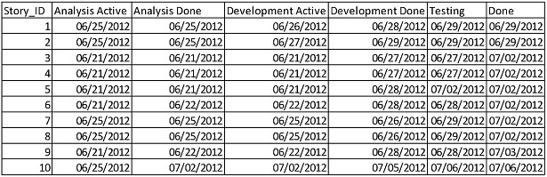
Requirements for Proper Creation of CFD
Track the date that an item enters each step of the workflow.
Track the time stamp that an item enters step of the workflow.
Figure 4.15: Example Data for building a CFD
Notes:
Work items in the real world move into the next phase of workflow sometimes must go back to the previous when there are indications that something is not working as expected or the requirements are not correct and need to be corrected and then the software product needs to be corrected to meet the new understanding of the requirements. Therefore we need to track date and sometimes the time of arrival for any item and not rely on counts for CFD.

Slide 30
In Summary
Cumulative Flow Diagrams (CFD) demonstrate arrivals and departures for work items
The visualization communications a lot of quantitative and qualitative information at a glance.
The anatomy of a CFD
Understanding correct way to construct a CFD is essential to knowing how to interpret it.
CFD Property #1
CFP Property #2
The best way to capture data for a CFD is to track the date when an item arrives at each step in the workflow.
Three ways to spot if a CFD has not been constructed properly
  If any Line slopes downward on any part of the graph
  If something that sounds like “backlog” has been graphed
  If some type of projection has been plotted.

Slide 31
Questions?

