Slide 1
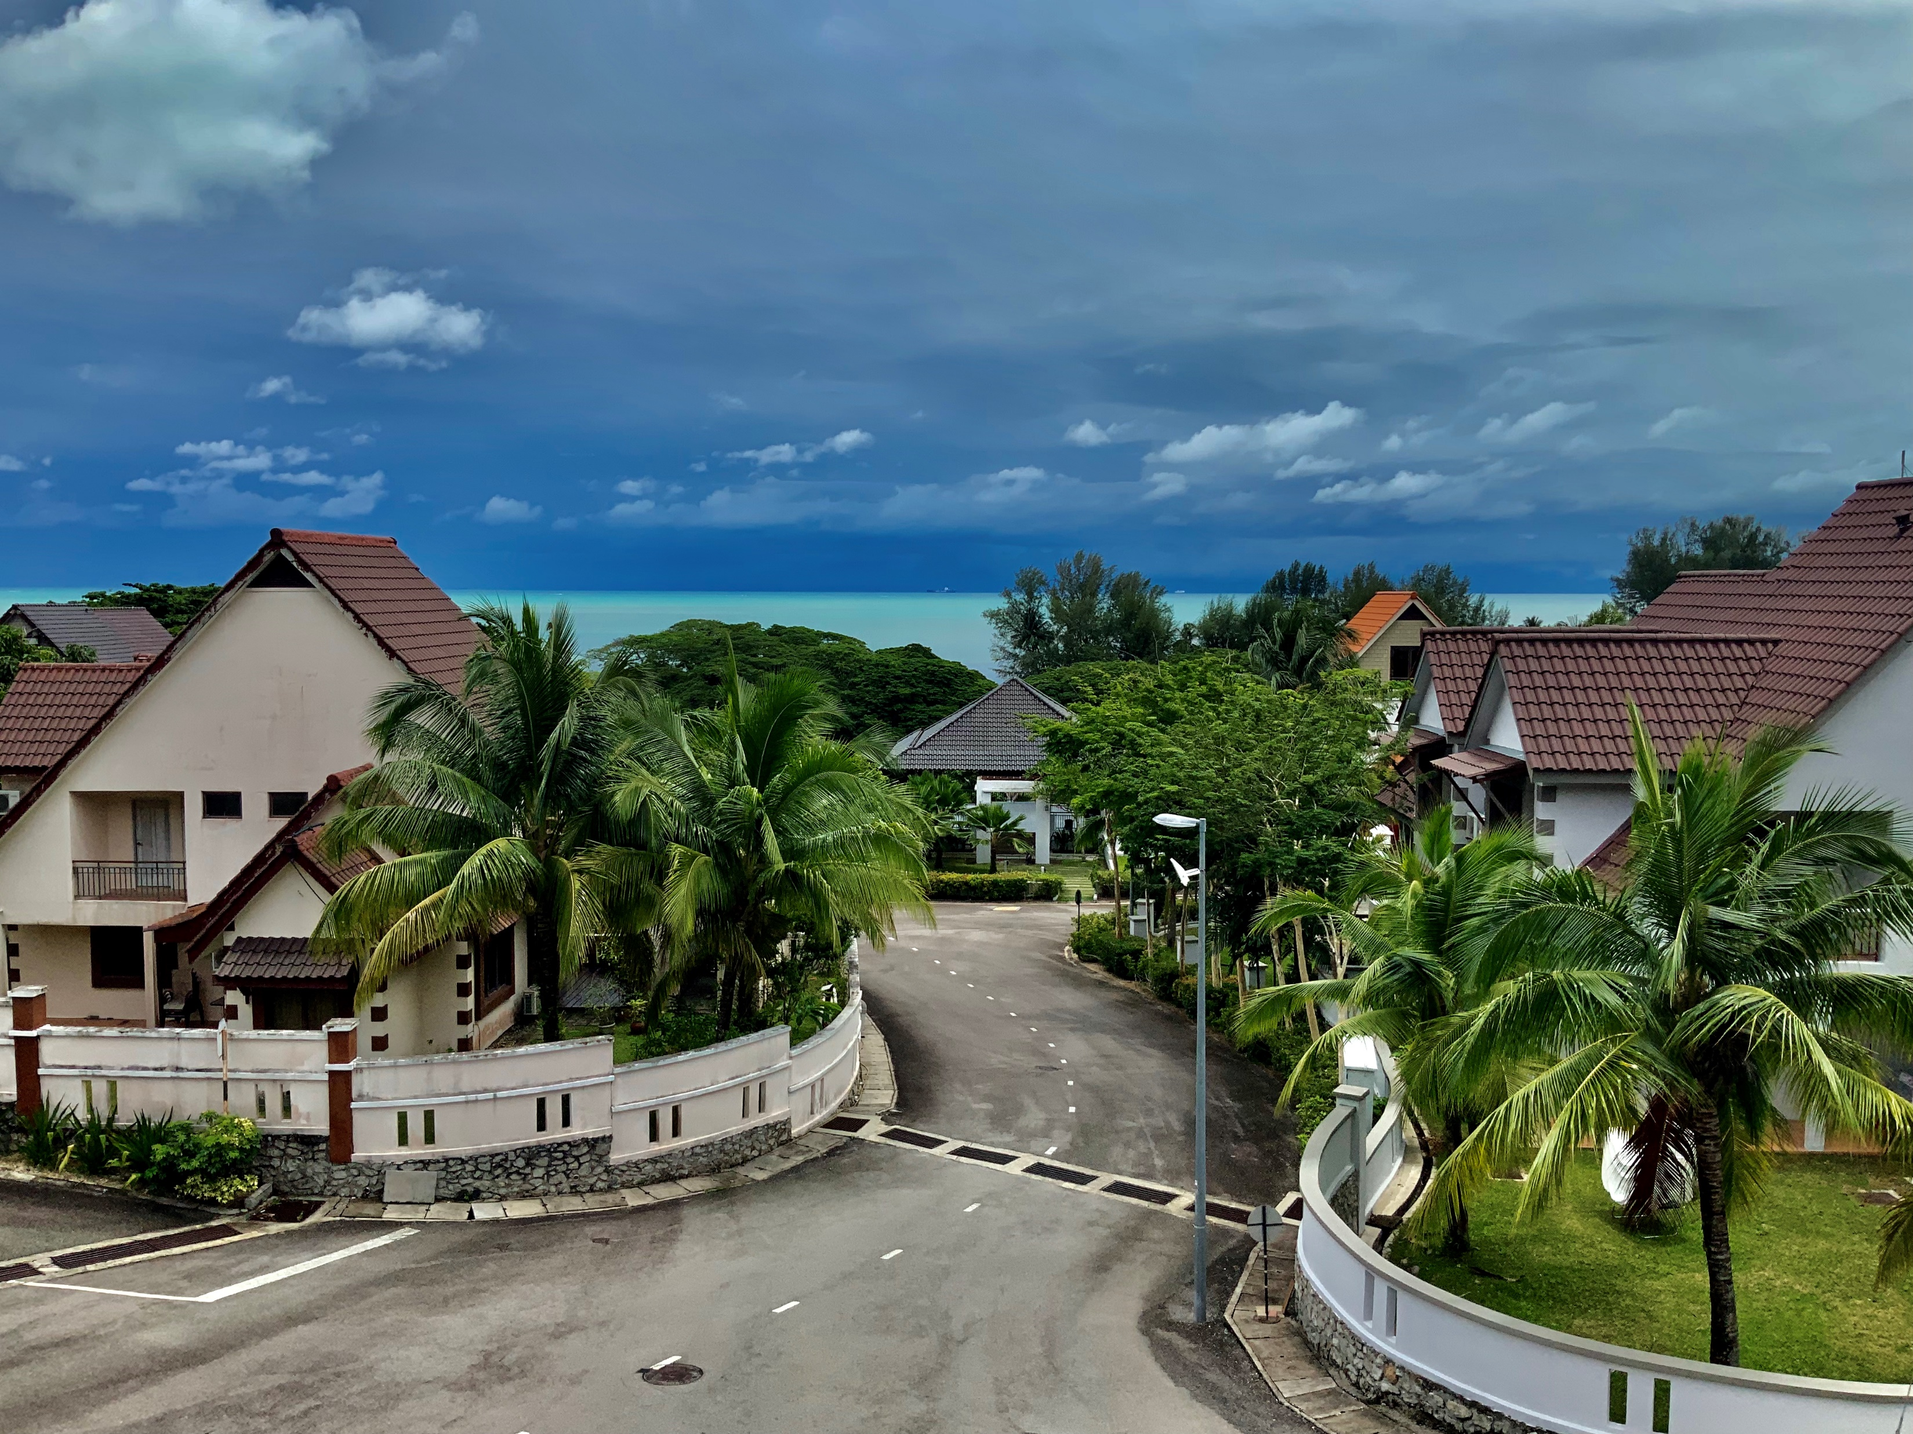
VILLA #46
Ferringhi Villas 46 Jalan Ferringhi Indah 5 11050 Batu Ferringhi Pilau Penang Malaysia

Slide 2
Basic Data
Location
Details
Key Data
200 meter from the beach
Located inside a gated community
Access to fitness centre, swimming pool and tennis court
Landed property with garden
Extreme quiet location
Close proximity to shops
Title: Strata – freehold
Build up area: 225 sqm / 2420 sqft
Roofed outside area: 137 sqm / 1475 sqft
Completely renovated: 2018 with full legal paperwork
Air Condition: 6 (13 kW)
Highly energy efficient
Sleeping Rooms: 4 (5)
Bathrooms: 3 (4)
Storage room: 1
Living room/Kitchen: 1
Outdoor Kitchen: 1
Laundry Room: 1
Office: 1
Fully high-end furnished

Slide 3
Western style and technology
The renovation what happened in 2018 was extensive and costed more than 1.5 million MYR. The front half of the house was demolished and new rebuild. New plumbing in stainless steel. New electric wiring using nearly 4000 meter electric cable and 800 meter internet cable. 86 electric outlets and 56 circuit breakers.

Slide 4
Balcony with sea view
Huge Terrace with high-end outdoor furniture. Fully roofed with a roofing imported from Switzerland what filters UV-rays as well as IR-rays, to keep the place cool.

Slide 5
Sleeping Rooms
Master 1
Master 2

Slide 6
Sleeping Rooms
Guest 1
Guest 2

Slide 7
Master Bathroom
Huge high end bathroom finished with marble with whirlpool and walk-in Grohe shower. Custom tailored double vanity.

Slide 8
Master Bathroom
The walk-in shower with a Grohe high-end rain shower has 3 sqm (33 sqft)

Slide 9
Additional guest bathrooms
Bathroom 2
Bathroom 3

Slide 10
Open Plan Living

Slide 11
modern Kitchen
Modern and spacy kitchen with high-end appliances. 2 x Bosch Steam Oven 1 x Bosch Dishwasher 4 x Domino Hobs (Grill, Gas and Induction) 1 x 120 cm Bosch cooking hood
1 x 788 litre Hitachi Fridge/Freezer

Slide 12
Bring Outdoors inside
Fully roofed terrace in front of living room and kitchen. Huge sliding door allows you to bring the outdoors to the livings space. Sliding window allows each serving the outdoor area.

Slide 13
Balcony with sea view
Beautiful and spacy terrace to enjoy your evenings. Extra full sized fridge and freezer in the office allows you have always chilled drinks ready for your guests.

Slide 14
Office Space
Generous airconditioned office space with massive luxury office furniture. As every room in our villa also the office has plenty of electric and internet sockets.

Slide 15
Staircases
Staircases got a custom build hand rail which servers during a power outage as emergency lighting. The color of the hand rail can be changed using a free APP.

Slide 16
Worth to mention
The house was completely renovated and basically to 2-thirds completely new build and all work was done with construction permit. And with that it is the only house in Ferringhi Villas what really was renovated fully legally. The design of the house was done focusing of optimal use of the existing space. There are nearly no dead-area/landings in the house.
Materials used: - All windows imported from Germany. High-end double glass windows with thermo bridges and high sound insulation. - Front door and inside doors imported from Germany. Soft closing. - Rail-free Aluminum Auto-gate - Facades painted with thermo-shield (Australia) what reduce the thermal effects of the sun for more than 40%. - Outside roofing constructed with double sandwich PE material what filters UV rays as well as IR rays. Imported from Switzerland. - 3rd floor roof insulted with aluminum fitted rockwool to further enhance the thermo insulation. - Electric outlets and switches from France - ACs as well as all other inbuild appliances are based on inverter technology and all install lights are LED based in order to reduce electric consumption.
- The complete plumbing was changed and only stainless steel pipes were used. - The complete house was rewired with high grade 3 x 0.75mm single wires what reduces the transmission losses in the house. - Electric & internet: Every single room of the house is equipped with plenty electric outlets (in the whole house 86 outlets are installed. - Every sleeping room, the living room, the office and the terrace are equipped with internet outlets. - The front garden has an additional supply of 12 V DC used for the water feature pump and in addition you will have also a interconnection at the water feature in case you want to implement an IOT solution. - The house is prepared for use of solar energy. A high-power cable is preinstalled and the service room has a high power switch installed. - The electric distribution box contains 56 live circuit breakers and 2 fault current protection switches. The house is supplied with a 100 A line. - Airconditioning: Living room and office: Panasonic ceiling cassettes - 2.5 KW Sleeping rooms: Panasonic wall units: 2 KW All outdoor units are installed in a channel on the east side of the house.

Slide 17
Worth to mention
When we designed the house the main factors for our design decisions were: 1) Space efficiency: In nearly all existing buildings you see a lot of space wasted what can not be used as a practical living space. In our house there is one small landing of about 45 sqft (4 sqm) what has no practical use. All other space is dedicated. 2) Energy efficiency: We lived before in houses here in Penang and our electricity bill was above 1000 MYR per month. Due to the technology used in our house our electricity bill dropped to 300-400 MYR.
3) Flexibility: When designing the rooms we had in mind that future owners would like to have more sleeping rooms as well as more bathrooms. - The current office space of about 450 sqft can easily remodeled into a huge 5th sleeping room and the currently existing bath room can be remodeled into a full bathroom. - The Laundry room in the second floor could be remodeled into an on-suit bathroom without major costs. Plumbing is prepared.

Slide 18
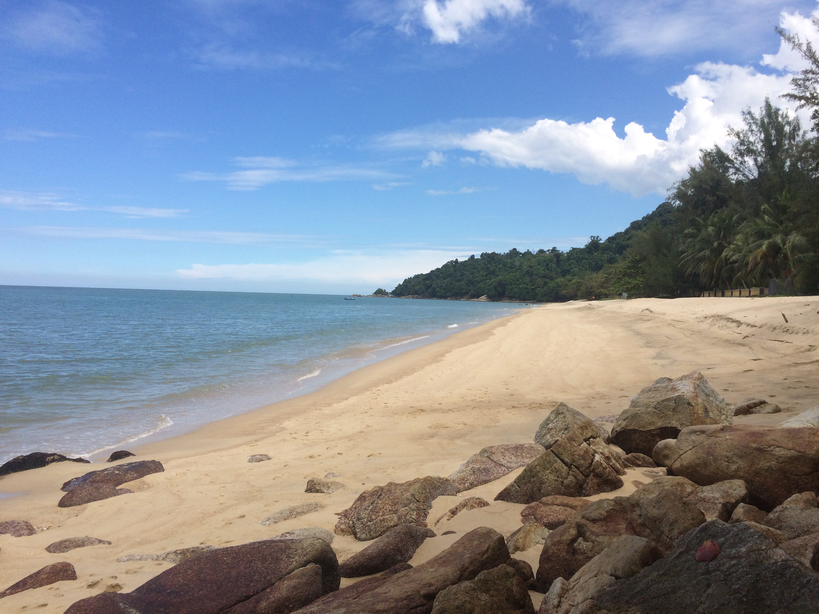
Enjoy morning or evening walks on Ferringhi beach – 200 meter from your door

