Slide 1


LAUNCHING THE GHANA STRATEGY REPORT:
GHANA ACTION PLAN 2018

Slide 2
GHANA ACTION PRINCIPLES
World Bank: currently 48% of youth aged 15-24 unemplyed
Increasing unemployment rate for graduates of advanced degrees
Estimate 90% unemployment within first year of graduation from univeristy
So-called “lost generation”
→no young generation must be considered “lost”
→ “lost” youth = lost future of society
→ seek to actively involve Ghanainan youth in the process of building not only solutions but a flourishing economy
→ non-partisan efforts: we serve no party but the people of Ghana towards universally shared goal!

Slide 3
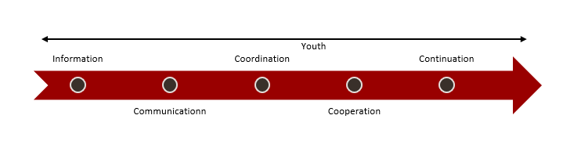
GHANA ACTION PRINCIPLES

Slide 4
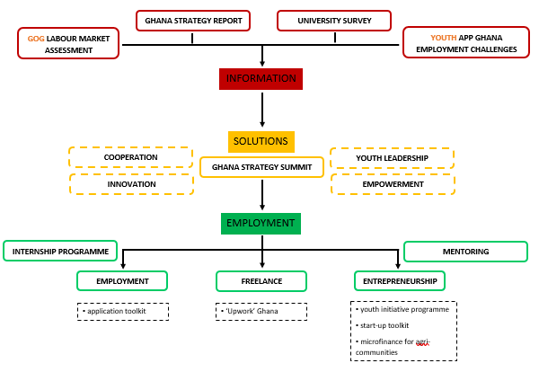
GHANA ACTION ROADMAP 2018

Slide 5
GHANA ACTION: INFORMATION
Together with GOG and Ghana Statistical Service as well as in cooperation with Dutch artificial intelligence company, provide and publish in-depth analysis of Ghana labour market, especially concerning the informal sector
Publish Ghana Strategy Report 2019 with greater insight and prepare establishment of Africa Centre for Strategic Policy
Develop and conduct national University survey
Discuss feasibility of analysis of youth employment challenges

Slide 6
GHANA ACTION: SOLUTIONS
Seek cooperation with local business environment and internationally inside and outside of Africa
Promote Ghana Innovation hubs
Foster youth leadership through youth summits
Local youth empowerment campaign

Slide 7
GHANA ACTION: EMPLOYMENT
(Inter-)National apprenticeship exchange programme
Online application and job market toolkit in cooperation with German networking and job search expert Michael T. Wurster
Development of online freelance platform
Local entrepreneurship incubator programme
Support of agrobusiness and produce export
Mentoring Initiative

Slide 8
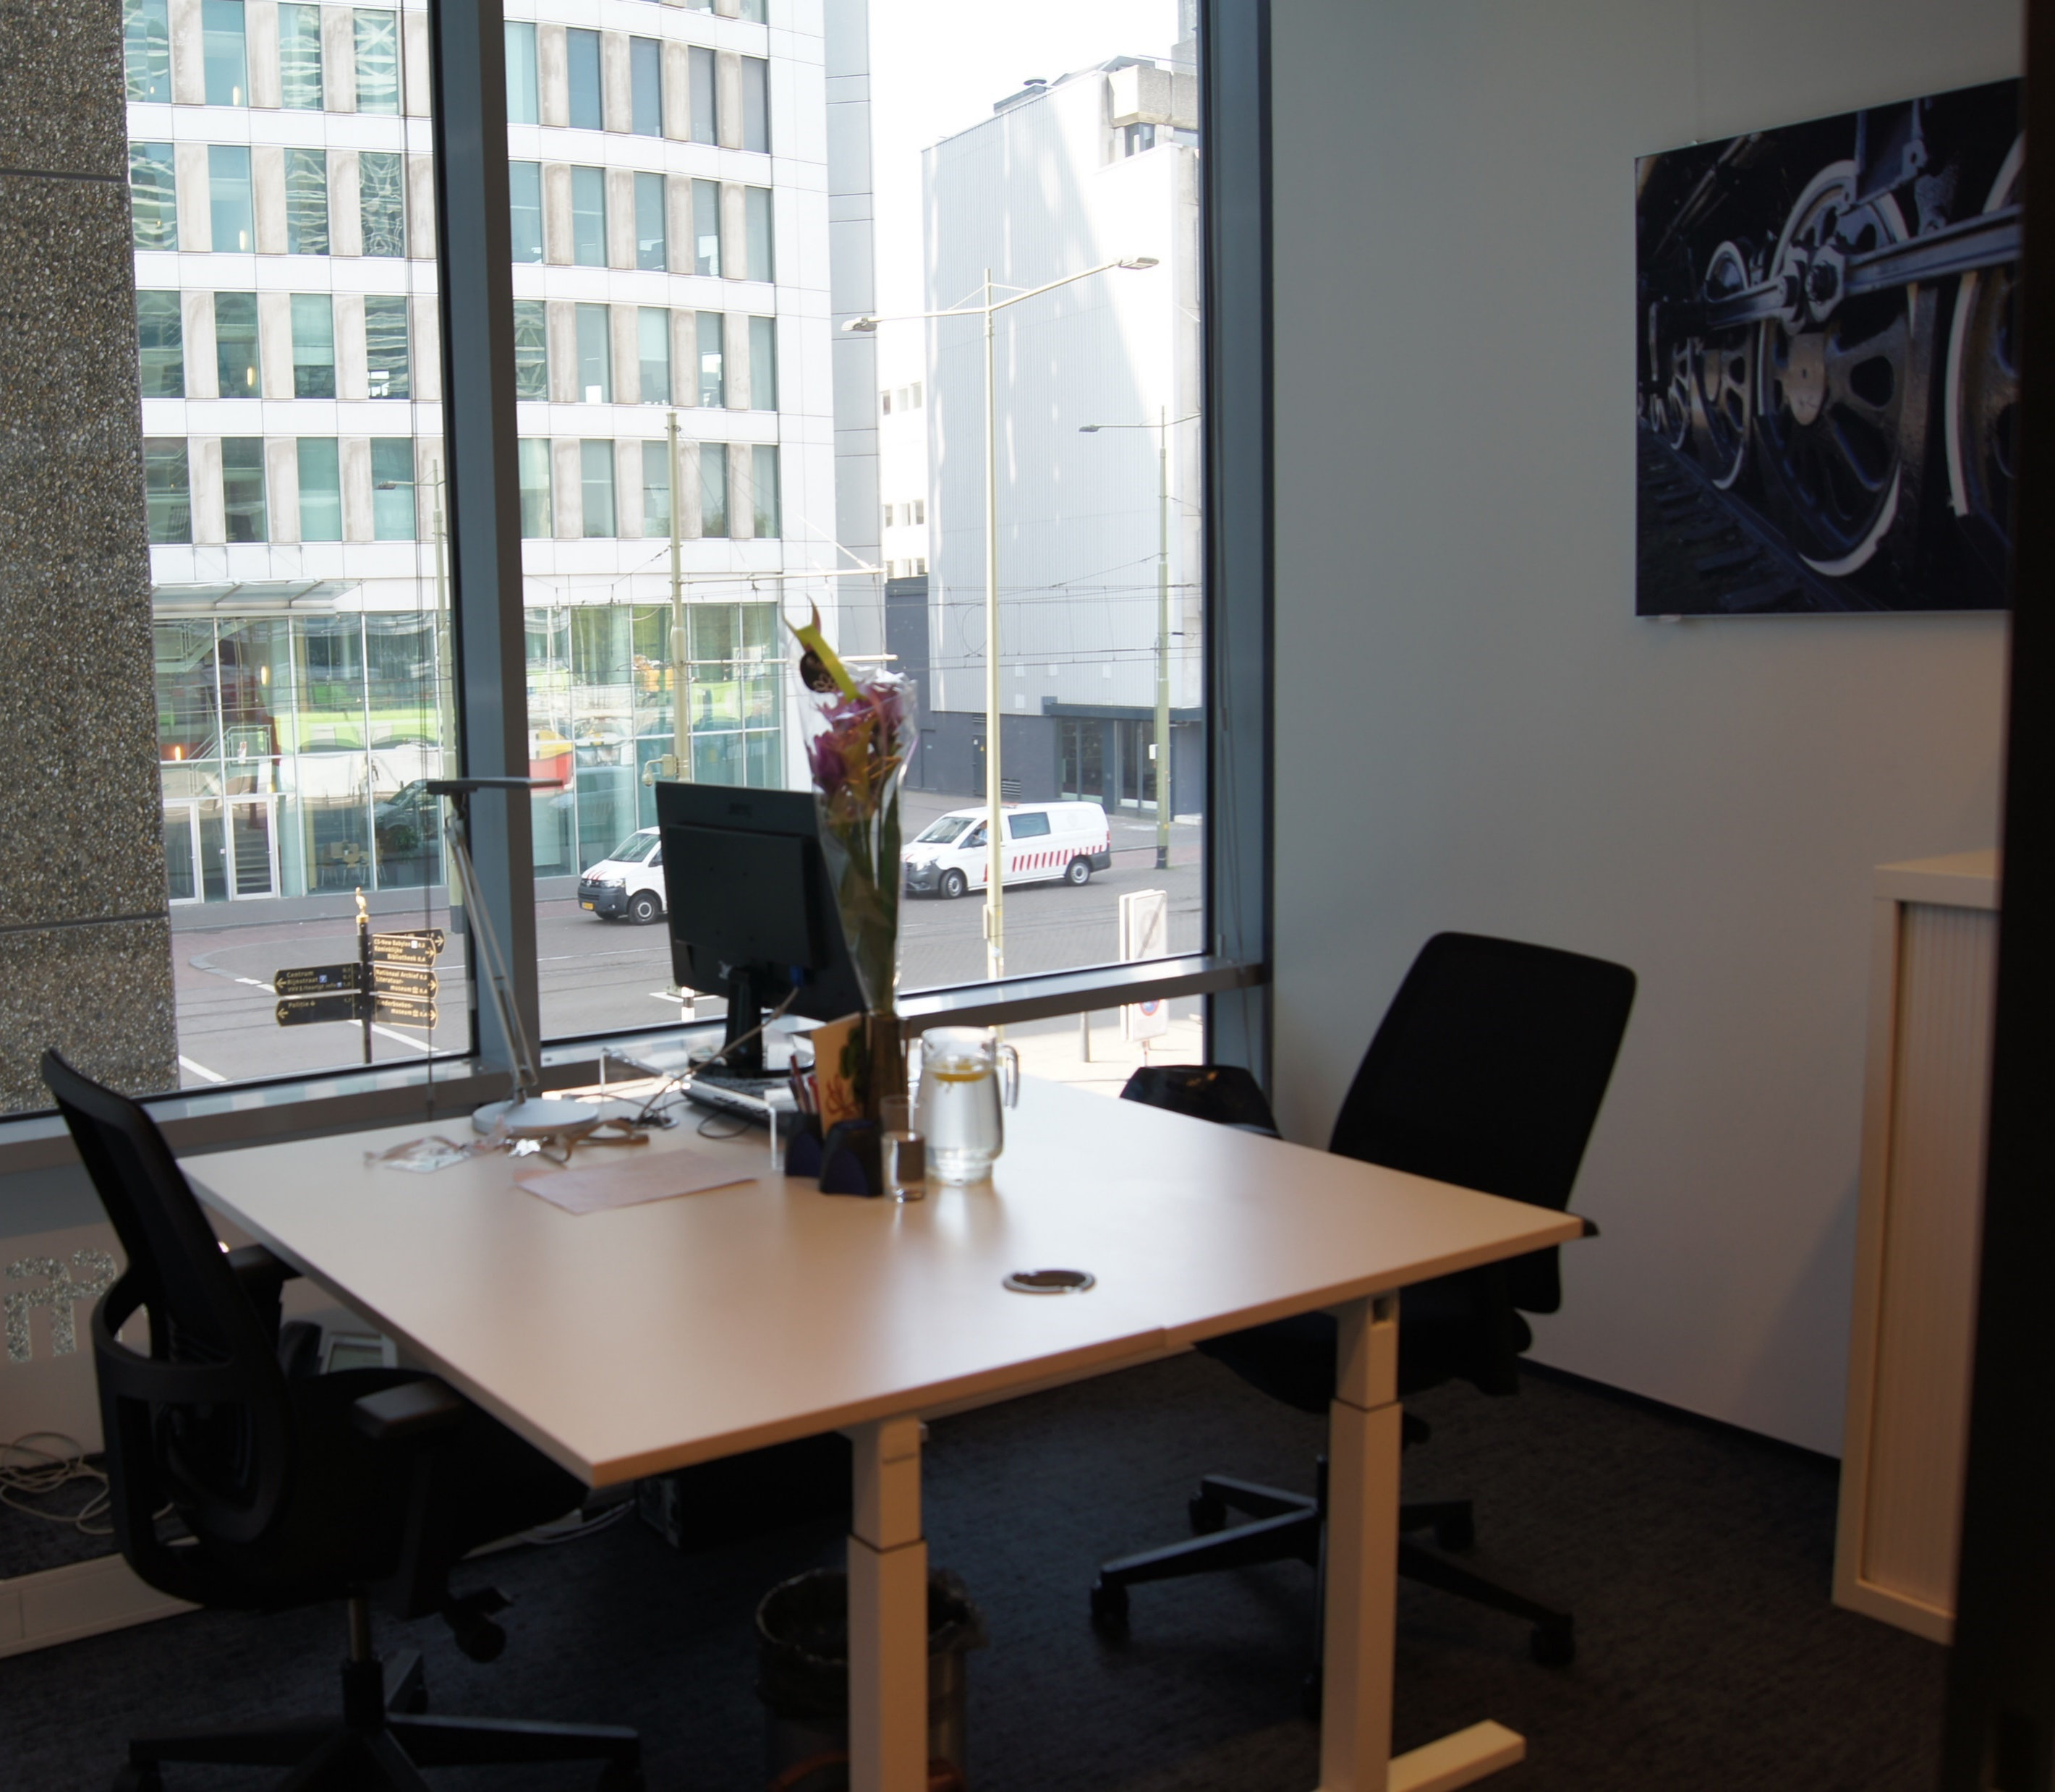
PROJECT OFFICES
Accra, Ghana
Washington DC, US
The Hague, Netherlands

Slide 9
ACKNOWLEDGEMENTS
The authors would like to express their gratitude to all the members of the National Election Early Warning and Response Group (NEEWARG), China Europe International Business School, the Election Situation Room 2016, National Peace Council, Kofi Annan Peace Keeping and Training Center, USAID, Legon Center for Diplomacy, West Africa Network for Peace Building and all political parties and dignitaries in Ghana, especially: H.E. John Agyekum Kufour, Hon. Lawyer Samson Kwaku Boafo, Hon. Elvis Ankrah, Mr. Patrick Acheampong, Dr. Francis Ashong Katai, Prof. Mathew Tsamenyi, Mr. Richard Ofori Atta and Dr. Kwame Kyei Baffour and the Enthamoty Youth team.

Slide 10
ACKNOWLEDGEMENTS
Mrs. ANA MANDULEY ATARODIAN is the Co-Founder and Head of Strategies at the UAE-Africa Mentoring Development Consortium (UAMDC); Head of Consultative Executives Forum and Research Writer.
Dr. FRANCIS ASHONG KATAI is the Head of investment t NADA, GHANA.
Mr. Boy Frank – Managing Director of Simpolicy, External Lecturer Diplomacy and Protocol at Leiden University, Campus The Hague, Ex Diplomat Foreign Service
Mrs. Mireille Toulekima – Director Business Development, MT Energy Resources; Member of Board of Directors and Partner, GlobalWEP; Chairman, Board of Directors & Global Executive Mentor, UAE-Africa Mentoring Development Consortium (UAMDC)
Mr. Wayne Francis – Director and Founder, Exponential Group; Co-Chairman of Board of Directors and Global Executive Mentor, UAE-Africa Mentoring Development Consortium (UAMDC)
Ms. Regina Huber – CEO, Founder and Transformational Leadership Coach, Transform Your Performance; Secretary General of Board of Directors and Global Executive Mentor, UAE-Africa Mentoring Development Consortium (UAMDC)
Mr. Frank Akwei- Research officer, Transform Ghana Peace Project
Mrs. Beatrice Somuah – Patron, Transform Ghana Peace Project
Dr. Stephen Nyarko – Data Collection Team Member, Transform Peace Project
H.E. Rev. Dr. Princess Asie Ocansey – Award-Winning Engineer; Activist for the Citizens without a Voice; Philanthropist and Founder, Jobs 4 Women Summit
Mr. Maweuna Washington – Volunteer, Transform Peace Project
Ms. Donna Kwabea Addo – Secretary, UAE-Africa Mentoring Development Consortium (UAMDC)
Dr. Christian Nyarko – Volunteer, Research Transform Ghana Peace Campaign
Dr. Kofi B. Meriku – Head of Partnerships, Transform Ghana Peace Campaign
Mr. Nirai Tomass – Consultant, Research Ghana Strategy Report
Mr. Rico Dagø Skaarup – Student, BSc. International Business at Copenhagen Business School

